Slide 1
Lighthouse
Building an agent-guided mobile robot from an empty Gazebo world
SLAM · Nav2 · frontier exploration · natural-language control · preemption
Dan · 2026-10-26

Slide 2
THE GOAL
One sentence, and everything else serves it
「带我去厨房看看冰箱」 — "take me to the kitchen and look at the fridge"
• Resolve the words to a place and an object
• Drive there without hitting furniture
• Stop at a pose from which the camera can actually see the object
• Answer what it saw — or refuse honestly if the place does not exist
• Abandon the trip cleanly if the operator changes their mind
Design driver: every failure must be diagnosable, not merely observed.

Slide 3
ARCHITECTURE
Five layers, one authority rule
5 · Interaction
owns concurrency: one task per utterance
4 · Agent
owns intent: which goal, in words
3 · Semantic map
owns naming: a database, read-only
2 · ROS 2 navigation
owns motion: goals in, velocities out
1 · Simulation
owns physics and sensors
Decisions flow down as goals; measurements flow up as observations. The model never touches /cmd_vel.

Slide 4
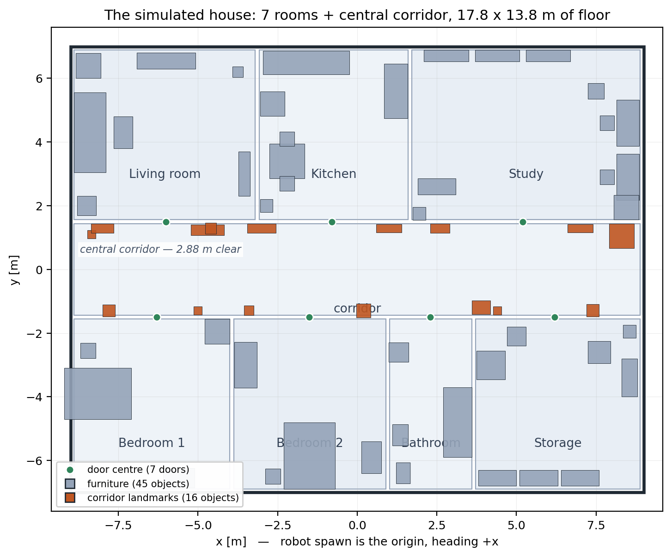
THE WORLD
A generated house, not a hand-drawn one
• build_world.py (898 lines) is the only source of world truth
• It also generates semantics.json and the 32-waypoint route
• 2D world raises low furniture so a single-line lidar can see it
• 3D world keeps real heights
• Hand-editing a .world file is forbidden by rule
Fig. 7 rooms + central corridor, 17.8 × 13.8 m. 61 objects, 16 of them deliberately standing in the corridor.

Slide 5
SENSORS
Two lidar heads, one camera without depth
Sensor | Rate | Good for | Must not be used for
/scan (LaserScan) | 8.4–8.5 Hz | SLAM, costmaps, passability, frontiers | seeing above the slice
/scan/points (64-line) | 8.4 Hz | future 3D costmap, offline analysis | anything today — nothing subscribes
/camera/image_raw | 7.1 Hz, 320×240 | VLM identity check, passability veto | geometry, scale, depth
/imu | 100 Hz | EKF experiments | accepted navigation
/odom | 50 Hz | truth-pose navigation, TF | real-robot localisation
The camera is a semantic instrument. It has no depth channel at all.

Slide 6
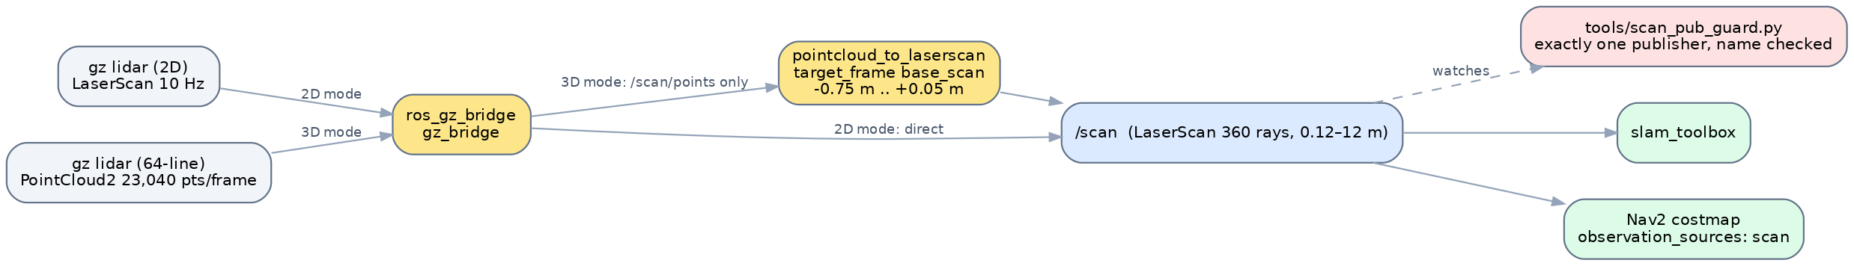
THE CONTRACT
One message type is the spine of the stack
• 360 rays, 0.12–12.0 m, frame base_scan
• A guard asserts exactly one publisher AND the right node name
• ≥ 2 publishers fails immediately: never transient
• A rogue publisher started later is caught within 30 s
• Cost of the contract: the costmap cannot see overhangs
Fig. In 3D mode the gz LaserScan is never bridged — only the point cloud, projected to a single 2D slice.

Slide 7
SLAM
The map everything else trusts
Property | Value | How it is known
size | 359 × 278 cells @ 5 cm | PGM header
extent | 17.95 × 13.90 m | cells × resolution
tilt | −0.1° | fitted in the single map decoder
interior unknown | 13.5 m² | inside the house footprint only
live map (3D) | dan_house_lighthouse3d.yaml → _explore4.pgm | config/maps
localisation | loc:=truth for every acceptance run | the honest gap: loc:=amcl unverified
One decoder (tools/map_quality.py) defines free / occupied / unknown. A second decoder once reported "done" with 180 m² never seen.

Slide 8
NAVIGATION
The door was innocent; the goal point was guilty
• A 1.30 m door with inflation 0.45 m leaves 0.02 m per side — feasible
• Widest-path probe: every door is 0.50–0.55 m half-width → cost 0
Failed goals measured 0.35–0.40 m clearance — inside the inflation band
• Inside that band the cost is 132–177 per cell; DWB must cross all of it
• It often prefers to rotate in place instead of entering
Stall diagnosis: 419/419 trajectories valid, vx=0.000 scored 63.40 vs 72.70
→ The robot was not stuck — standing still was simply cheaper
"No valid trajectories = 0" is not a health metric.

Slide 9
MAPPING
Two ways to build a map, kept for two reasons
 | Tour (frozen) | Frontier exploration
Driver | tour_node.py, 521 lines, plain Twist | frontier_explore.py, 943 lines
Input | 32 waypoints from route.json | live SLAM map, no input
Time | ~7 min of simulation | 20–45 min, budget-capped
Best result | 359 × 278 map, −0.1° tilt | 15.8 m² interior unknown
Role | phase-1 acceptance artefact | the experiment platform
The exploration node is valuable for its cancellation machinery, not its frontier scoring.

Slide 10
METHOD
One run per arm is not an experiment
• 15 goals: SmacPlanner2D wins by 21 m²
40 goals, same code: NavFn wins by 18 m²
Short runs measure variance, not effect
• ≥ 3 repetitions, ≥ 40 goals, compare medians
• Always print the within-arm range next to the between-arm shift
• Isolation: fresh DDS domain + Gazebo partition + map prefix per run
• Budget by the knee of the curve (~48 goals), not by round numbers
A driver that cannot invalidate its own runs will happily produce confident nonsense.

Slide 11
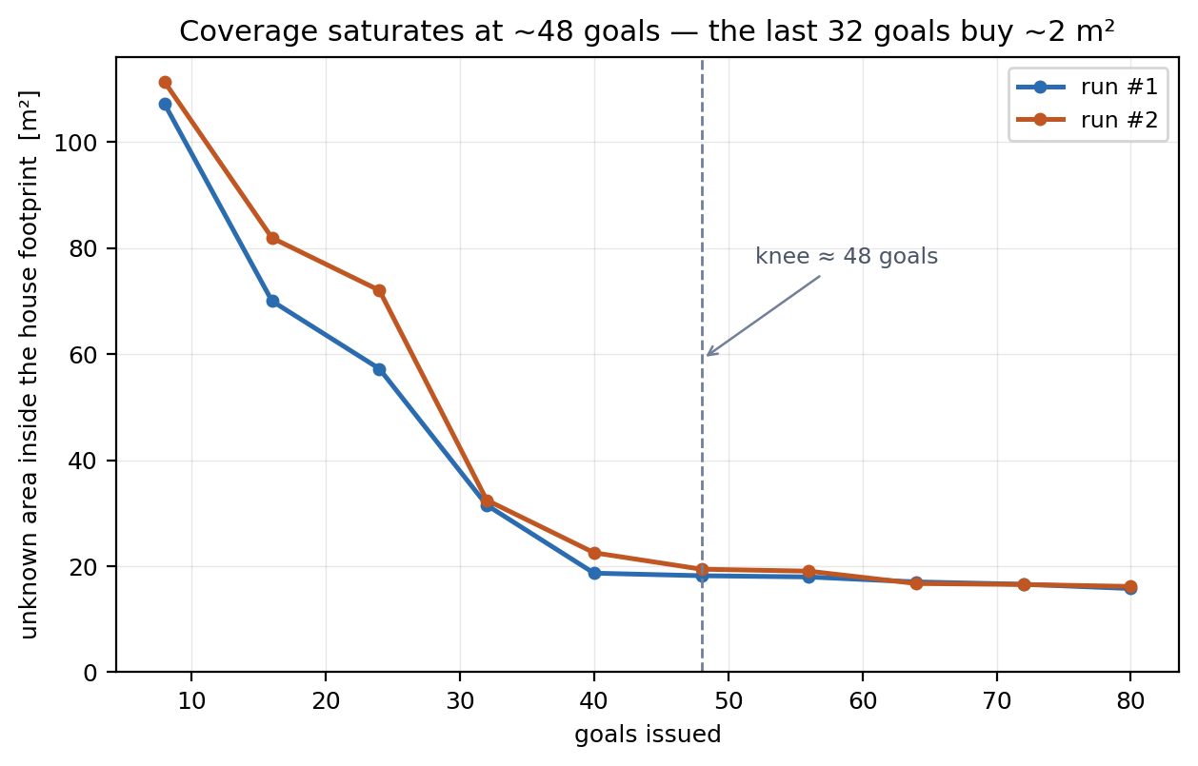
RESULTS
More budget does not buy more map
• 80 goals: 63/80 and 57/80 reached, both capped by goal count
• Stalls triple towards the cap
• Residue is shadow pockets behind furniture
• No configuration beat the 13.5 m² test map
• Recorded as a ceiling, not a target
Fig. Recomputed from the checkpoint maps of both 80-goal runs. Knee at ~48 goals; the last 32 goals buy 2.2–2.9 m² in 41 minutes of simulation.

Slide 12
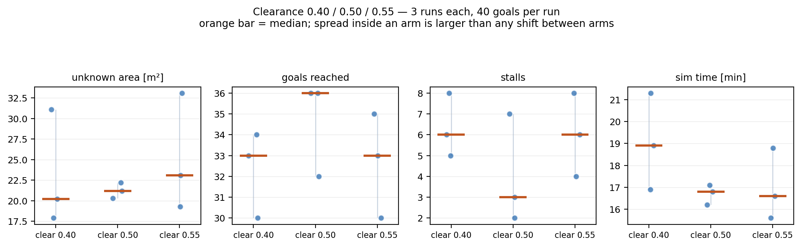
RESULTS
A parameter that turned out not to matter
• 0.40 / 0.50 / 0.55 clearance
• Reached 33 / 36 / 33, stalls 6 / 3 / 6
• Every between-arm difference < the noise inside an arm
• Verdict: clearance is a safety floor, not a coverage knob
• One invalid run was retried on a new domain — and recorded
Fig. 3 runs per arm, 40 goals each. Between-arm median shift 2.9 m² vs within-arm range 13.8 m².

Slide 13
THE AGENT
Language in, motion out — with authority kept apart
• Four processes: launch · rosbridge · agent_bridge · venv agent
Iron rule: anything importing rclpy runs on the system interpreter
• Status topic is latched, or a late subscriber waits forever
• Every goal carries a sequence number; stale results are dropped
• Agent model qwen3-vl:8b · reporter model qwen2.5:7b (1.9 s vs 31.7 s)
→ Seven tools: list_rooms, find_place, where_am_i, go_to, go_to_room, look_at, check_path
Asked to 「带我去沙发看看」, the model called find_place, answered, and never moved. tool_choice="required" was ignored by the compat layer. Hence: code moves the robot.

Slide 14
SEMANTICS
Authored truth, not perception
8
rooms (7 + corridor)
61
objects in the map
33
object classes
0
lines of perception code
• Monocular camera: no depth, no scale → no map write-back
• Millimetre coordinates, because it comes from the same table as physics
• Standoff: 16 directions, clearance = Nav2 inflation radius (0.45 m)
• Observation pose: object radius + 1.40 m, camera height 0.70 m
• At 0.55 m the VLM calls a fridge "a door" — a geometric fix, not a model fix
The camera confirms identity at query time. It never builds the map.

Slide 15
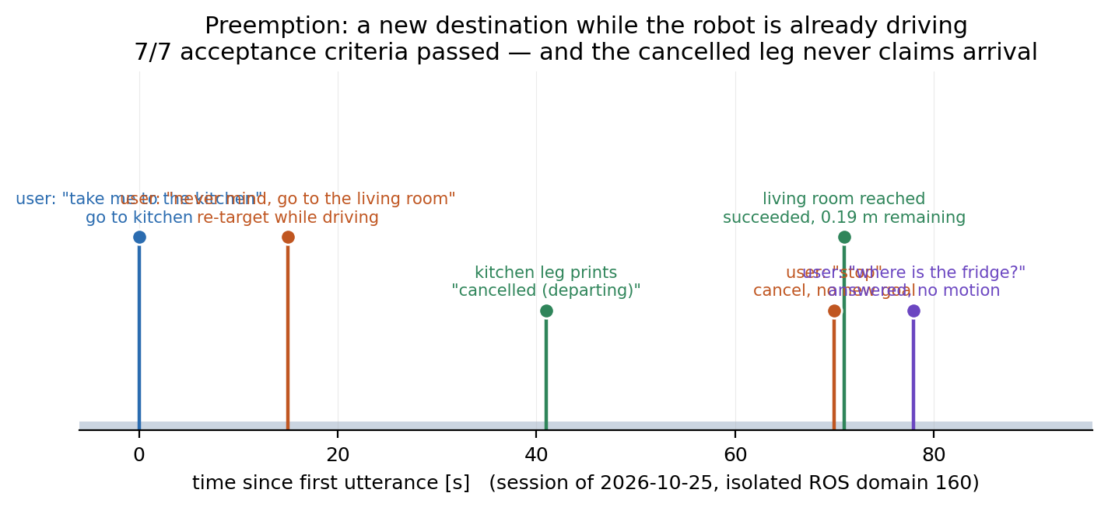
INTERACTION
Changing its mind mid-drive
• Judgment order: new destination > question > cancel
• Three pieces: to_thread · one task per utterance · code-side table
• Heartbeat 0 vs 25 per 0.5 s proves why to_thread is required
• Four bugs only a live run could find (stale seq, stuck thread, merged input, cancel parsed as a place)
• Guardrails: source-level assertions in the offline suite
Fig. Isolated domain 160. The cancelled leg prints "cancelled (departing)" and never claims arrival. 7/7 criteria passed.

Slide 16
ACCEPTANCE
Eleven measurements, not eleven opinions
Gate | What it proves | Result (2026-10-26)
G1 / G1b | link + localisation | 24 pose frames · 0.00 m / 0.0°
G2 | hard-coded goal | succeeded 13.3 s · 0.19 m · 0 recoveries
G3 | object → standoff → Nav2 | succeeded 63.0 s · 0.15 m off plan
G4 | mode D vision | 1.79 m · VLM 13.1 s · 4/4 checks
G5 / G6 | passability / question | laser 1.12 m + vision agree · 41.1 s
G7 / G8 | refusal / compound | 0.0 s · two segments succeeded
offline | 11 checks + 6 guard cases | 11/11 · 6/6
A cancelled leg may never report arrival — that single sentence summarises half of the preemption work.

Slide 17
HONEST GAPS
What this project deliberately does not do
Gap | Status | Why it matters
loc:=amcl | never re-verified | every number here assumes truth poses
EKF fusion drift | 7.1 m / −37°, unsolved | blocks wheel-odometry-only running
3D obstacles in costmap | not implemented | overhangs and table tops are invisible
semantic map from perception | not attempted | monocular camera has no depth
coverage > 13.5 m² | measured ceiling | frontier exploration plateaus
voice / wake word | not implemented | the REPL is the only input
real hardware | never run | this is a simulation project throughout
Each row is a decision with a reason, not an oversight.

Slide 18
OUTLOOK
From a house to a warehouse: 4–6 days, three real changes
Change | Nature | Work
scale 18×14 m → 60×40 m | re-measure | range, loop closure, costmap size, budget
3D obstacles | architectural | voxel layer from /scan/points; overhangs become visible
slot-address semantics | architectural | A-12-03-2 → pose; new resolver, reuse standoff
world + parameters | data | new generator, lexicon, route, maps
everything else | unchanged | ~3,900 lines: robot, launch, agent, tools, gates
Recommendation: add a world module in this repo (world:= switch, new branch), not a fork. Postponed on 2026-10-26 by decision.

Slide 19
Three things worth carrying away
1. Keep authority apart.
Code moves the robot and refuses what cannot exist; the model resolves ambiguity and talks.
2. Measure, then decide — and write down the retraction.
Clearance was a superstition until 3×3 said so. One published conclusion here was withdrawn.
3. Make failures loud at the edges.
A second publisher on /scan, a stale goal result, a cancelled leg claiming arrival — each is silent by nature, so each got a mechanism.

