Slide 1
Weekly report: Optimization of the lesion localization
01
Previously on last work
02
Optimization
Draw boxes
Lesion localization on lung region
03
Advantages and explanation

Slide 2
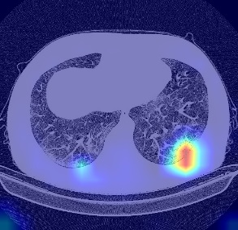
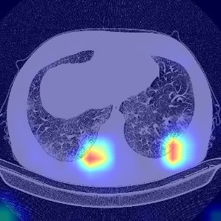
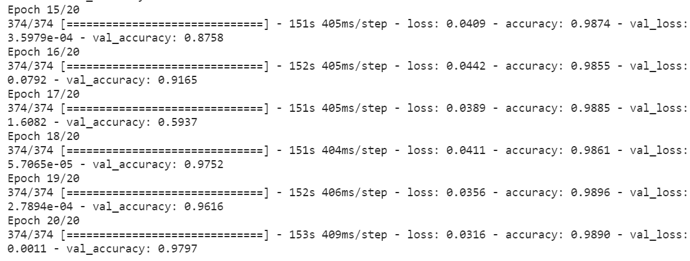
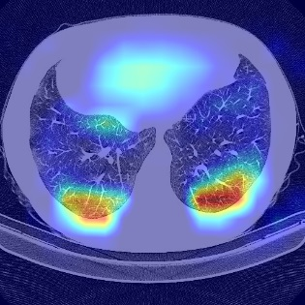
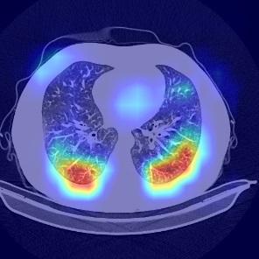
Last work
Differential diagnosis :
Target: Help clinicians making diagnosis with deep learning method
Method: Resnet + FPN + feature engineering method
Result: Binary classification with probability.
eg : [[0.99617696 0.00382302]]
Lesion localization :
Target: Mark the infection area of diagnosed CT image.
Method: Grad-cam : Gradient Class Activation Map. Depends on proposed network.
Result: Infection region is highlighted on different feature map.
*The brighter the color,
The more important
the region.
Fig 1. Training log in terms of
differential diagnosis
Fig 2. Samples of lesion localization.

Slide 3
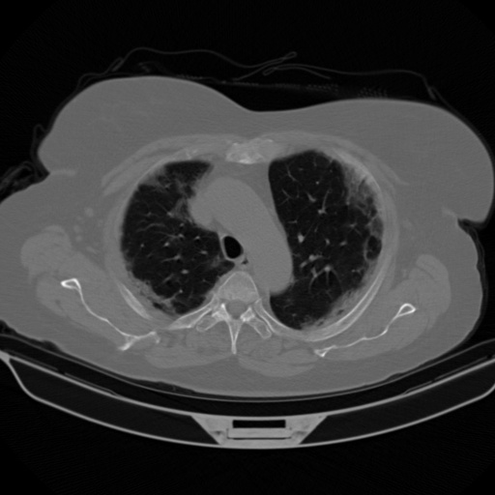
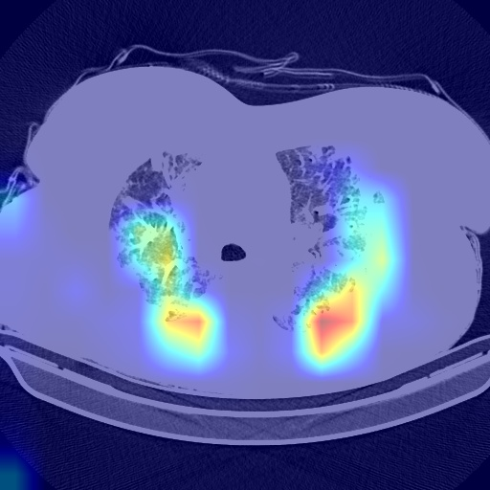
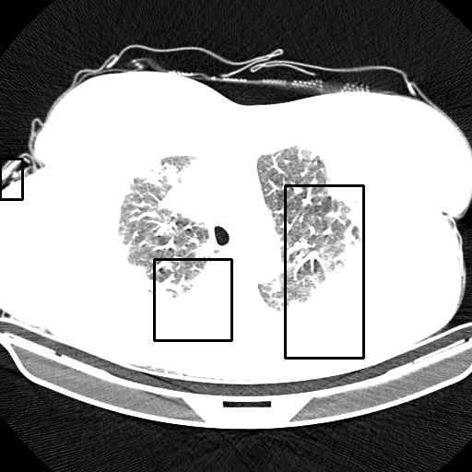
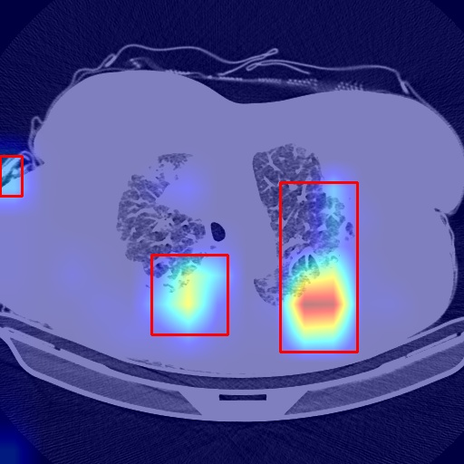
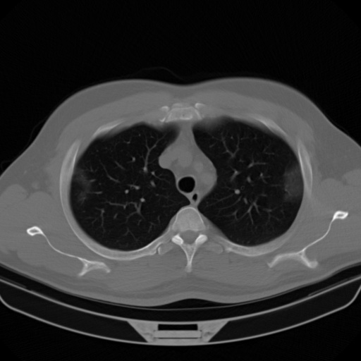
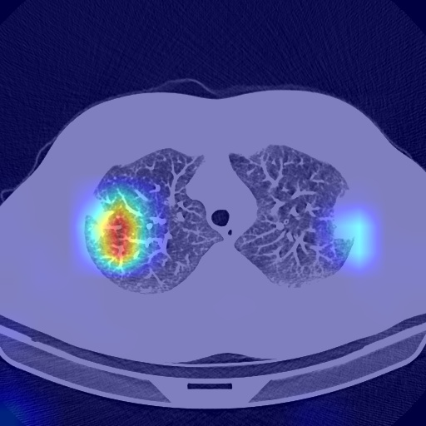
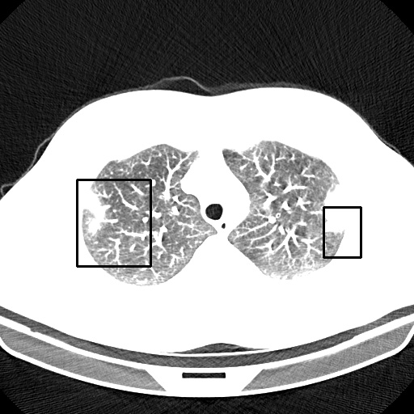
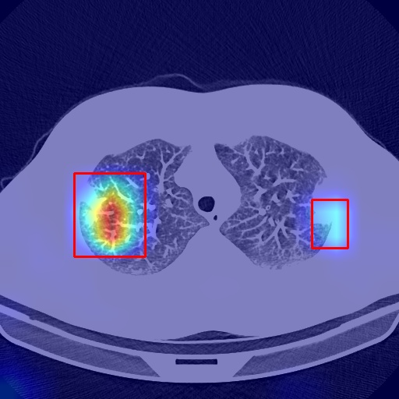
Optimization
1. Draw boxes:
Input
CAM image
Gray image
Draw box
1. Generate the gray image of CAM image.
Problem:
The size of boxes largely depends on
hypo-parameter
2. Obtain the histogram of Gray image and then adaptively select
the threshold→ size/num of box.
Useless but only for showing
The bed will be considered which is
not reasonable
3. Generate the coordinates of the box.

Slide 4
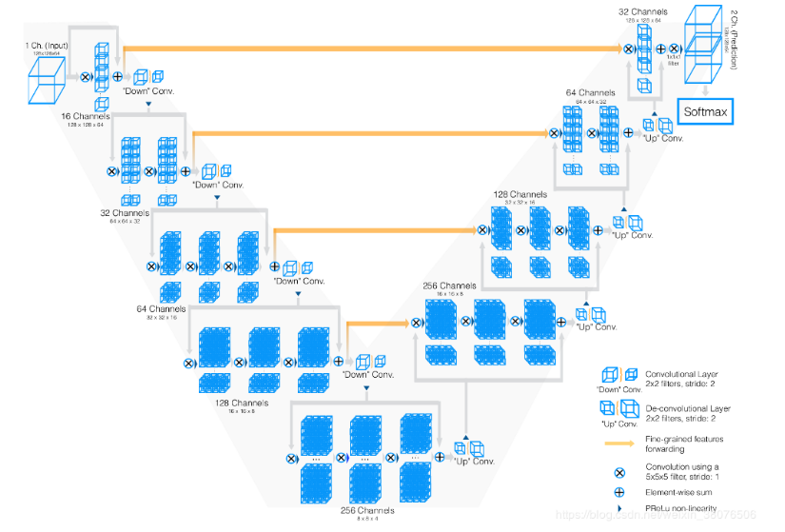
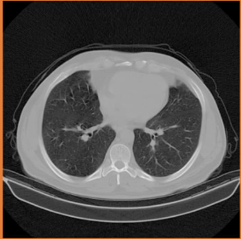
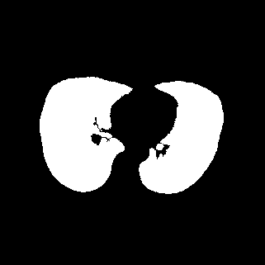
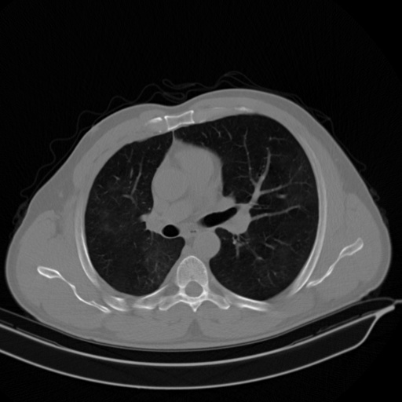

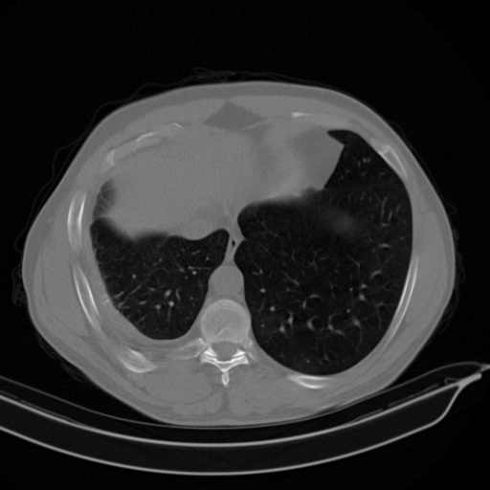
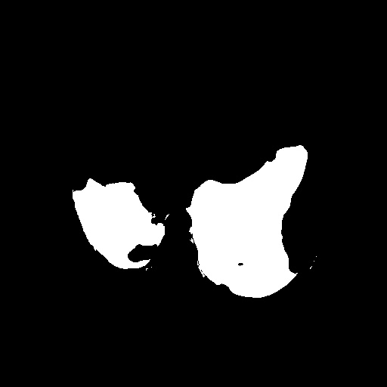
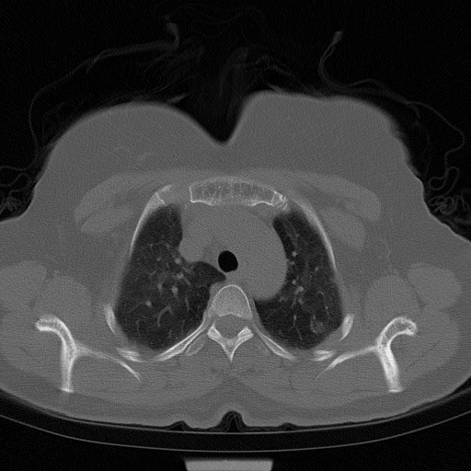
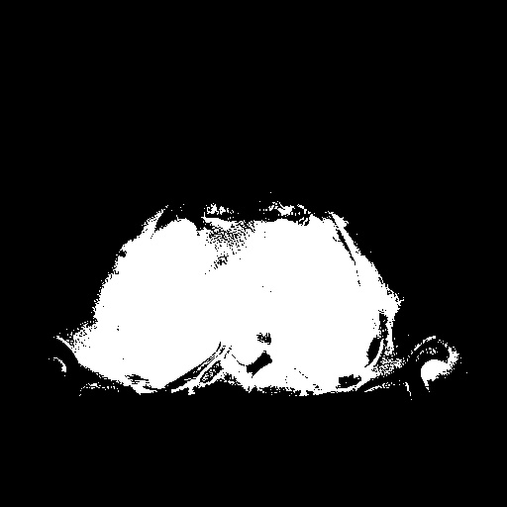
2. Lesion localization on lung region
Target: Mark the infection area of lung region instead of whole CT image.
Input: Lung region of CT image.
Method: Network: Resnet + FPN + feature engineering method
Localization： weakly-supervised method -- Grad-cam
Result: Infection region is highlighted on lung region.
Challenge : How to get Lung region of CT image
fed in
[I 200602 14:26:39 train:155] VALIDATION | E [280] |
CE: 0.19156 | ValmIOU: 0.899
[I 200602 14:59:31 train:155] VALIDATION | E [290] |
CE: 0.14557 | ValmIOU: 0.901
Unet
Fig 3. Results of segmentation.

Slide 5
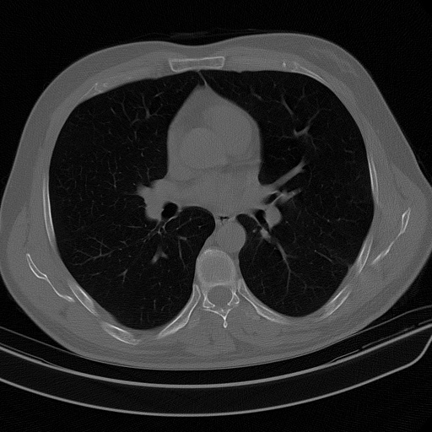
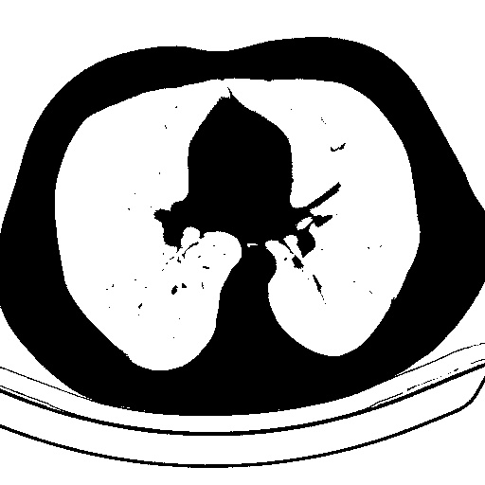

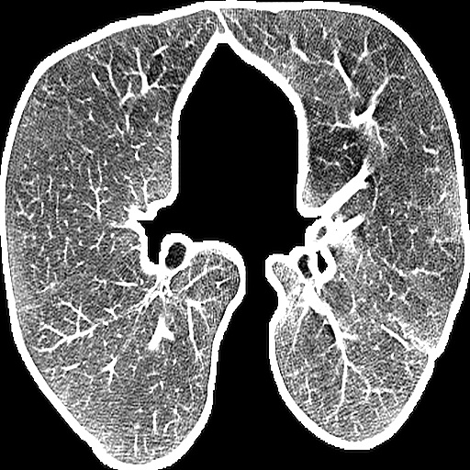
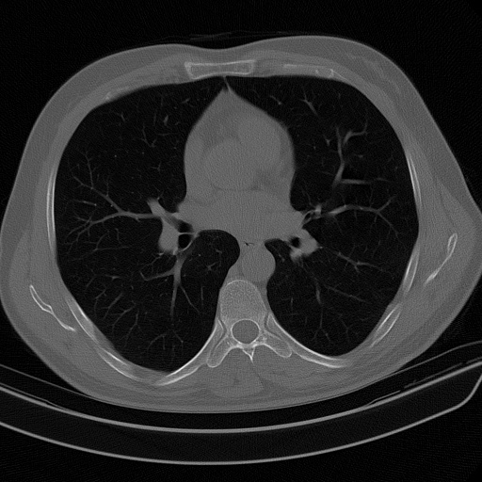
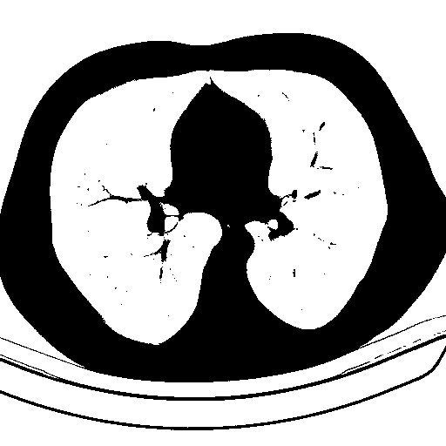

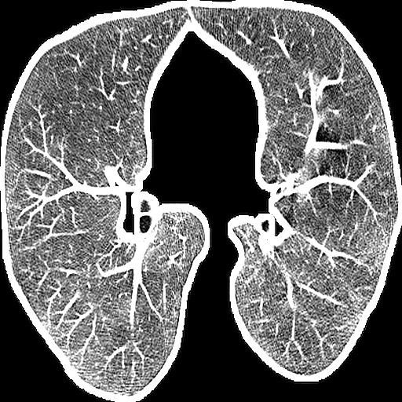
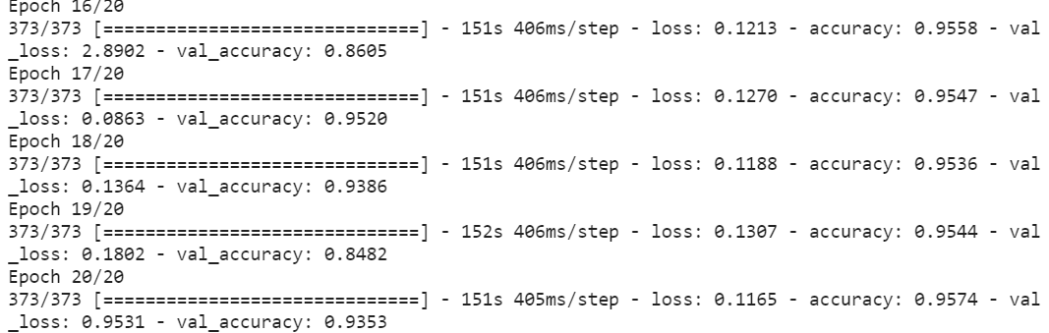
Solution 1
Input
Morphological operation
Background
Combine and resize
Result:
Fig 4. Training log in

Slide 6
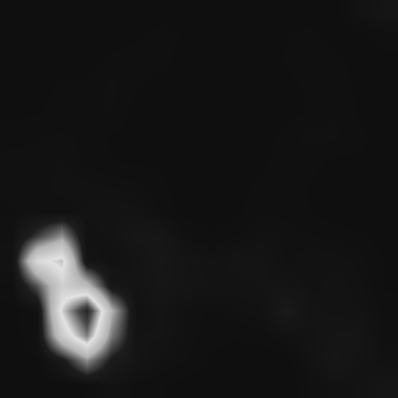
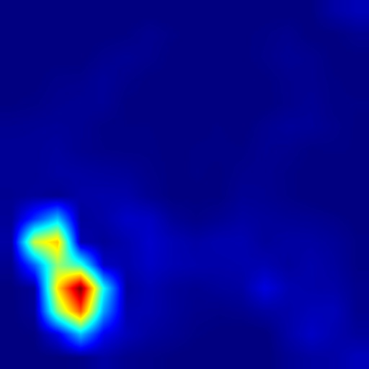
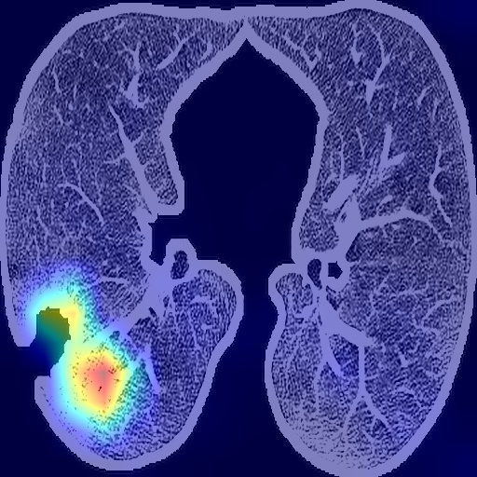
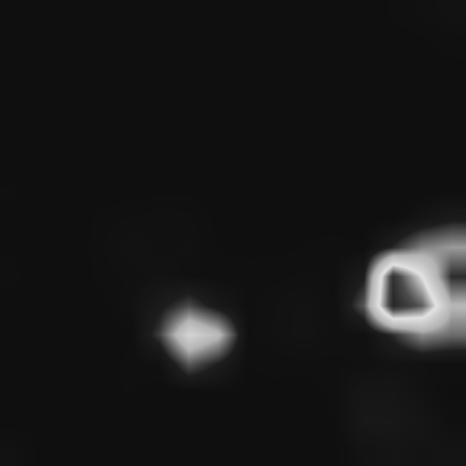
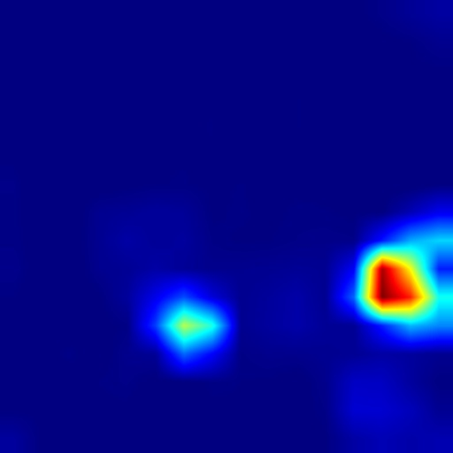
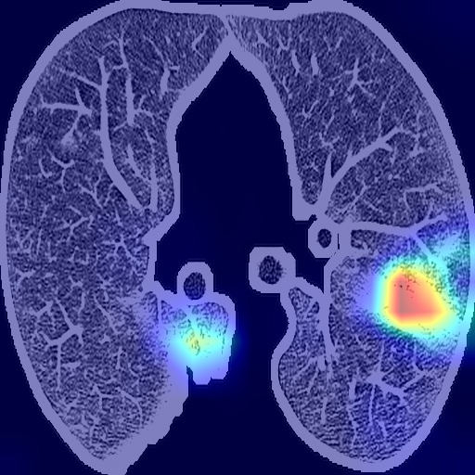
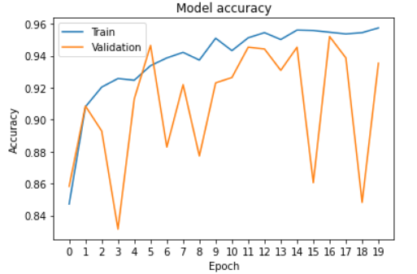
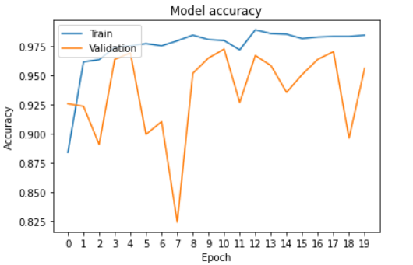
Gray map
Color map
Lesion
COVID
[[0.99617696 0.00382302]]
Normal
[[0.01332043 0.9866796 ]]
With lung region
With CT image
Fig 5. Accuracy comparison of two mode.

Slide 7
Advantages and explanation
Advantages:
keeping high precision while with relatively high precision.
With less time consumption.
Post-processing was removed
Explanation:
Why the predicted COVID and normal image are both highlighted in similar
pattern but with good probability?
It should be so. The highlighted region is the evidence that network classifies the images.
The network is trained to learn the different patterns between the COVID and normal image. Imaging that Why the network can classify the two types of images correctly, that’s because compare with the normal cases, the COVID cases have the GGO, crazing-paving pattern etc., and these manifestations are usually located at lower lobes with both sides ( these may relate to dataset ). If the network takes the similarly region as the evidence of classification, but has totally different prediction, It can just show that it is the different feature behind these highlighted region cause the difference. On the contrary, this finding can prove that the Interpretability of our model.

