Slide 1

WHAT IS MOTIVATION FOR SDN？

Slide 2


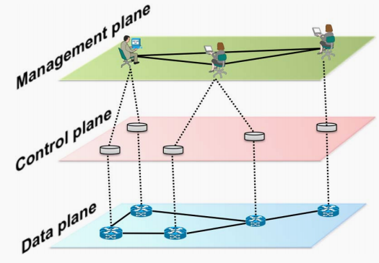
WHAT IS MOTIVATION FOR SDN？
Traditional Network
the data plane corresponds to the networking devices, which are responsible for forwarding data
the control plane represents the protocols used to populate the forwarding tables of the data plane elements
the management plane includes the software services used to remotely monitor and configure the control functionality
Network policy is defined in the management plane, the control plane enforces the policy, and the data plane executes it by forwarding data accordingly.

Slide 3
WHAT IS MOTIVATION FOR SDN？
Motivation for SDN
It is both difficult to configure the network according to predefined policies, and to reconfigure it to respond to faults, load, and changes.
The traditional networks are vertically integrated: the control and data planes are bundled together.
SDN is an emerging paradigm that promises to change this state of affairs, by breaking vertical integration, separating the network’s control logic from the underlying routers and switches, promoting logical centralization of network control, and introducing the ability to program the network.

Slide 4
WHAT IS SOFTWARE-DEFINED
NETWORKING？

Slide 5
WHAT IS SOFTWARE-DEFINED NETWORKING？
SDN refers to a network architecture where the forwarding state in the data plane is managed by a remotely controlled plane de coupled from the former.
the control and data planes are decoupled
forwarding decisions are flow based, instead of destination based
control logic is moved to an external entity, the so-called SDN controller or NOS
the network is programmable through software applications running on top of the NOS that in teracts with the underlying data plane devices

Slide 6
SDN ARCHITECTURE:
BOTTOM-UP

Slide 7
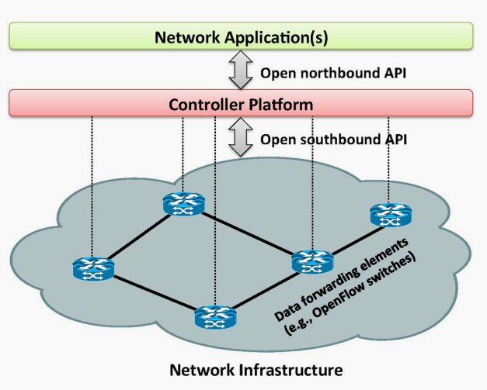
SDN ARCHITECTURE:BOTTOM-UP
SDN Architecture
Layer I: Infrastructure
An SDN infrastructure, similarly to a traditional network, is composed of a set of networking equipment. The main difference resides in the fact that those traditional physical devices are now simple forwarding elements without embedded control or software to take autonomous decisions

Slide 8
SDN ARCHITECTURE:BOTTOM-UP
SDN Architecture
Layer II: Southbound Interfaces
Southbound APIs are the connecting bridges between control and forwarding elements, thus being the crucial instrument for clearly separating control and data plane functionality.

Slide 9
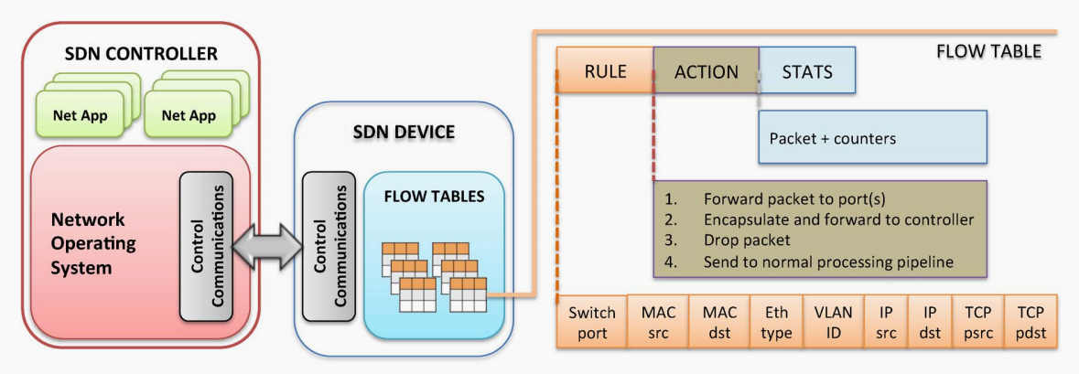
SDN ARCHITECTURE:BOTTOM-UP
OpenFlow
Inside an OpenFlow device, a path through a sequence of flow tables defines how packets should be handled. When a new packet arrives, the lookup process starts in the first table and ends either with a match in one of the tables of the pipeline or with a miss when no rule is found for that packet.

Slide 10
SDN ARCHITECTURE:BOTTOM-UP
OpenFlow
OpenFlow provides a common specification to implement OpenFlow-enabled forwarding devices, and for the communication channel between data and control plane devices.

Slide 11
SDN ARCHITECTURE:BOTTOM-UP
SDN Architecture
Layer III:Network Operating Systems/Controllers
The crucial value of a NOS is to provide abstractions, essential services, and common APIs to deve-lopers.Generic functionality as network state and network topology information, device discovery, and distribution of network configuration can be provided as services of the NOS.

Slide 12
SDN ARCHITECTURE:BOTTOM-UP
NOS
A NOS is a critical element in an SDN architecture as it is the key supporting piece for the control logic to generate the network configuration based on the policies defined by the network operator.
Distributed NOS
A distributed NOS can be a centralized cluster of nodes or a physically distributed set of elements. The common property of distributed controllers is fault tolerance. When one node fails, another neighbor node should take over the duties and devices of the failed node.

Slide 13
SDN ARCHITECTURE:BOTTOM-UP
SDN Architecture
Layer IV:Northbound Interfaces
Open and standard northbound interfaces are crucial to promote application portability and interoperability among the different control platforms. It would allow network applications not to depend on specific implementations. The northbound interface is mostly a software ecosystem, not a hardware one.
A common northbound interface is still an open issue.

Slide 14
SDN ARCHITECTURE:BOTTOM-UP
SDN Architecture
Layer V:Network Applications
Network applications can be seen as the ‘‘network brains’’. They implement the control logic that will be translated into commands to be installed in the data plane. Existing network applications perform traditional functionality such as routing, load balancing, and security policy enforcement, but also explore novel approaches, such as reducing power consumption.

