Slide 1
Tutorial
JDT fundamentals – Become a JDT tool smith
Martin Aeschlimann
IBM Research, Switzerland
martin_aeschlimann@ch.ibm.com

Slide 2
Outline
A guided tour through services offered by JDT core and JDT UI
  JavaTM Model
  Search Engine and Type Hierarchy
  Abstract Syntax Tree (AST)
  J2SE 5.0
Each part is associated with more detailed information, possibly with code example, targeted for Java tool developers

Slide 3
Target Audience
Plug-in implementers that want to use the Java infrastructure
  Code metrics plug-ins
  Code audit plug-ins
  Refactoring / quick fixes
  Research, commercial or JDT open-source contributors
Implementers of plug-ins for a new language
  Study JDT as an example on how to structure the core infrastructure
  Problems and solutions regarding memory and runtime performance
General knowledge about Eclipse plug-ins, core resources and in-dept knowledge of Java is expected.

Slide 4
Overview – The 3 Pillars
Java Model – Lightweight model for views
  OK to keep references to it
  Contains unresolved information
  From project to declarations (types, methods..)
Search Engine
  Indexes of declarations, references and type hierarchy relationships
AST – Precise, fully resolved compiler parse tree
  No references to it must be kept: Clients have to make sure only a limited number of ASTs is loaded at the same time
  Fully resolved information
  From a Java file (‘Compilation Unit’) to identifier tokens

Slide 5
The 3 Pillars – First Pillar: Java Model
Java Model – Lightweight model for views
  Java model and its elements
  Classpath elements
  Java project settings
  Creating a Java element
  Change notification
  Type hierarchy
  Code resolve
Search Engine
AST – Precise, fully resolved compiler parse tree

Slide 6
The Java Model - Design Motivation
Requirements for a element to show in viewers:
Light weight: Quickly created, small memory footprint
  Must scale and work for big workspaces (10’000 types and more). Cannot hold on resources, Eclipse is not just a Java IDE
Fault tolerant: Provide structure for files while editing
  Some source does not (yet) compile, missing brackets, semicolons. Tooling should be as helpful as possible
  Viewers like the outline want to show the structure while typing. Structure should stay as stable as possible
Chosen solution:
Lazily populated model
Quick creation: single parse, no resolving, no dependency on build state
Underlying buffer can be released and recreated any time

Slide 7
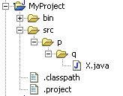
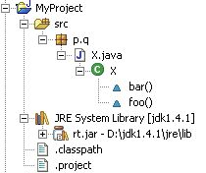
Java Elements API
IJavaElement form a hierarchy that renders the entire workspace from Java angle
Separated hierarchy from resources:
Important to note:
Not all Java elements must have an underlying resource (elements inside a JAR, external JAR files)
A Java package doesn’t have the same children as a folder (no concept of subfolder)
JavaCore.create(resource)
IProject
IJavaProject
IFolder
IPackageFragmentRoot
IPackageFragment
IFile
ICompilationUnit / IClassFile
IType
element.getParent()
IMethod
IField
element.getChildren()
IInitialzier
javaElement.getResource()

Slide 8
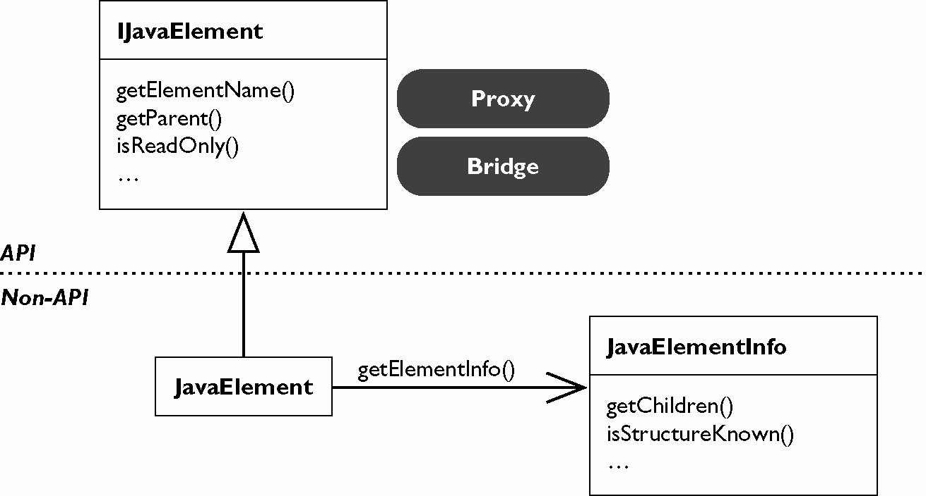
Java Element Handles
Handle/Info design
  IJavaElement objects are lightweight: Ok to keep references
  Underlying buffer (‘element info’) created on demand
  Element doesn’t need to exist or be on the build path (anymore). Use IJavaElement#exists() to test
  Handle representation stable between workspace instances
String handleId= javaElement.getHandleIdentifier();
IJavaElement elem= JavaCore.create(handleId);

Slide 9
Using the Java Model
Setting up a Java project
  A Java project is a project with the Java nature set
  Java nature enables the Java builder
  Java builder needs a Java class path
IWorkspaceRoot root= ResourcesPlugin.getWorkspace().getRoot();
IProject project= root.getProject(projectName);
project.create(null);
project.open(null);
Create a project
IProjectDescription description = project.getDescription();
description.setNatureIds(new String[] { JavaCore.NATURE_ID });
project.setDescription(description, null);
Set the Java nature
IJavaProject javaProject= JavaCore.create(project);
javaProject.setRawClasspath(classPath, defaultOutputLocation, null);
Set the Java build path

Slide 10
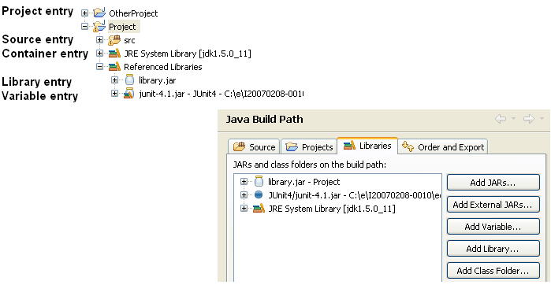
Java Classpath
The Java element hierarchy is defined by the Java classpath:
Classpath entries define the roots of package fragments.

Slide 11
Classpath – Source and Library Entries
Source entry: Java source files to be built by the compiler
  Folder inside the project or the project itself
  Possibility to define inclusion and exclusion filters
  Compiled files go to either a specific or the projects default output location
IPath srcPath= javaProject.getPath().append("src");
IPath[] excluded= new IPath[] { new Path("doc") };
IClasspathEntry srcEntry= JavaCore.newSourceEntry(srcPath, excluded);
Library entry: Class folder or archive
  Class files in folders, archive in workspace or external
  Source attachment specifies location of libraries source
  New in 3.4: External class folders

Slide 12
Java Classpath: Container Entries
Container entry: Multiple entries through an indirection
  Path denotes name and arguments for a ‘classpath container’
entry= JavaCore.newContainerEntry(new Path("containerId/containerArguments"));
  Classpath containers are contributed by extension point
  Classpath containers can compute classpath entries at call time
  Build-in containers: JRE, User library, PDE dependencies
jreCPEntry= JavaCore.newContainerEntry(new Path(JavaRuntime.JRE_CONTAINER));
Extension point ‘org.eclipse.jdt.core.classpathContainerInitializer’
  Initializes and manages containers (using JavaCore.setClasspathContainer(..))
Extension point ‘org.eclipse.jdt.ui.classpathContainerPage’
  Contributes a classpath container configuration page

Slide 13
Creating Java Elements
IJavaProject javaProject= JavaCore.create(project);
IClasspathEntry[] buildPath= {
JavaCore.newSourceEntry(project.getFullPath().append("src")),
JavaRuntime.getDefaultJREContainerEntry()
};
javaProject.setRawClasspath(buildPath, project.getFullPath().append("bin"), null);
IFolder folder= project.getFolder("src");
folder.create(true, true, null);
IPackageFragmentRoot srcFolder= javaProject.getPackageFragmentRoot(folder);
Assert.assertTrue(srcFolder.exists()); // resource exists and is on build path
IPackageFragment fragment= srcFolder.createPackageFragment("x.y", true, null);
String str=
"package x.y;" + "\n" +
"public class E {" + "\n" +
" String first;" + "\n" +
"}";
ICompilationUnit cu= fragment.createCompilationUnit("E.java", str, false, null);
IType type= cu.getType("E");
type.createField("String name;", null, true, null);
Set the build path
Create the source folder
Create the package fragment
Create the compilation unit, including a type
Create a field

Slide 14
Java Project Settings
Configure compiler settings on the project
  Compiler compliance, class file compatibility, source compatibility
  Compiler problems severities (Ignore/Warning/Error)
javaProject.setOption(JavaCore.COMPILER_COMPLIANCE, JavaCore.VERSION_1_5);
If not set on the project, taken from the workspace settings
  Project settings persisted (project/.settings/org.eclipse.jdt.core.prefs). Shared in a team
  More project specific settings: Formatter, code templates…
See Platform preferences story
  Platform.getPreferencesService()

Slide 15
Working Copies
A compilation unit in a buffered state is a working copy
Primary working copy: shared buffer shown by all editors
  based on the eclipse.platforms buffer manager (plug-in org.eclipse.core.filebuffers)
  becomeWorkingCopy(...): Increment count, internally create buffer, if first
  commitWorkingCopy(): Apply buffer to underlying resource
  discardWorkingCopy(): Decrement count, discard buffer, if last
  Element stays the same, only state change
Private working copy: Build a virtual Java model layered on top of the current content
  ICompilationUnit.getWorkingCopy(workingCopyOwner) returns a new element with a new buffer (managed by the workingCopyOwner) based on the underlying element
  commitWorkingCopy(): Apply changes to the underlying element
  Refactoring uses this to first try all changes in a sandbox to only apply them if compilable
Working copy owner: Connects working copies so that they reference each other

Slide 16
Java Element Change Notifications
Change Listeners:
  Java element delta information for all changes: class path changes, added/removed elements, changed source, change to buffered state (working copy)
  Changes triggered by resource change notifications (resource deltas), call to ‘reconcile()’
JavaCore.addElementChangedListener(IElementChangedListener)
IJavaElementDelta: Description of changes of an element or its children
Delta kind | Descriptions and additional flags
ADDED | Element has been added
REMOVED | Element has been removed
CHANGED | F_CONTENT | Content has changed. If F_FINE_GRAINED is set: Analysis of structural changed has been performed
 | F_MODIFIERS | Changed modifiers
 | F_CHILDREN | Deltas in children
 | F_ADDED_TO_CLASSPATH, F_SOURCEATTACHED, F_REORDER, F_PRIMARY_WORKING_COP,…
IJavaElementDelta[] getAffectedChildren()

Slide 17
JavaElementListener – an Example
Find out if types were added or removed
fJavaListener= new IElementChangedListener() {
public void elementChanged(ElementChangedEvent event) {
boolean res= hasTypeAddedOrRemoved(event.getDelta());
}
private boolean hasTypeAddedOrRemoved(IJavaElementDelta delta) {
IJavaElement elem= delta.getElement();
boolean isAddedOrRemoved= (delta.getKind() != IJavaElementDelta.CHANGED);
switch (elem.getElementType()) {
case IJavaElement.JAVA_MODEL: case IJavaElement.JAVA_PROJECT:
case IJavaElement.PACKAGE_FRAGMENT_ROOT: case IJavaElement.PACKAGE_FRAGMENT:
if (isAddedOrRemoved) return true;
return processChildrenDelta(delta.getAffectedChildren());
case IJavaElement.COMPILATION_UNIT:
ICompilationUnit cu= (ICompilationUnit) elem;
if (!cu.getPrimary().equals(cu))
return false;
if (isAddedOrRemoved || isPossibleStructuralChange(delta.getFlags()))
return true;
return processChildrenDelta(delta.getAffectedChildren());
case IJavaElement.TYPE:
if (isAddedOrRemoved) return true;
return processChildrenDelta(delta.getAffectedChildren()); // inner types
default: // fields, methods, imports...
return false;
}
}
}
Parent constructs:
Recursively go down the delta tree
Be aware of
private working copies

Slide 18
JavaElementListener – cont’d
private static boolean isPossibleStructuralChange(int flags) {
return hasSet(flags, IJavaElementDelta.F_CONTENT)
&& !hasSet(flags , IJavaElementDelta.F_FINE_GRAINED));
}
private boolean processChildrenDelta(IJavaElementDelta[] children) {
for (int i= 0; i < children.length; i++) {
if (hasTypeAddedOrRemoved(children[i]))
return true;
}
return false;
}
‘Fine Grained’ set means that children deltas have been computed. If not, it is a unknown change (potentially full change)
Visit delta children recursively

Slide 19
Type Hierarchy - Design Motivation
Subtype hierarchies are expensive to create and maintain.
Why not having an API IType.getSubtypes()?
Requires to index and resolve all compilation unit in a project and project dependants. Takes minutes for a normal-sized workspace
Why not keep a constantly updated hierarchy in memory?
Does not scale for big workspaces. Eclipse is not just a Java IDE (can not hold on 10 MB of structure)
Expensive updating. Every class path change would require types to recheck if they still resolve to the same type
Chosen solution:
Instantiated hierarchy object
  Defined life cycle
  Well known creation costs (sub type relationship is stored in index files)

Slide 20
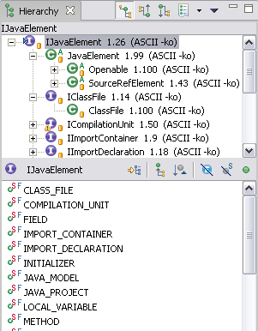
Type Hierarchy
Connect ITypes in a sub/super type relationship
Used in Hierarchy view

Slide 21
Type Hierarchy
Create – on a type or on a region (= set of Java Elements)
typeHierarchy= type.newTypeHierarchy(progressMonitor);
typeHierarchy= project.newTypeHierarchy(region, progressMonitor);
Supertype hierarchy – faster!
typeHierarchy= type.newSupertypeHierarchy(progressMonitor);
Get super and subtypes, interfaces and classes
typeHierarchy.getSubtypes(type)
Change listener – when changed, refresh is required
typeHierarchy.addTypeHierarchyChangedListener(..);
typeHierarchy.refresh(progressMonitor);

Slide 22
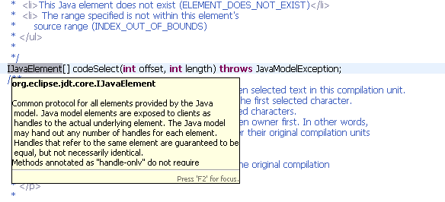
Code Resolve
Resolve the element at the given offset and length in the source
Used for Navigate > Open (F3) and tool tips
javaElements= compilationUnit.codeResolve(50, 10);

Slide 23
Code Resolve – an Example
Set up a compilation unit
Resolving the reference to “String” in a compilation unit
String content =
"public class X {" + "\n" +
" String field;" + "\n" +
"}";
ICompilationUnit cu=
fragment.createCompilationUnit(“X.java", content, false, null);
int start = content.indexOf("String");
int length = "String".length();
IJavaElement[] declarations = cu.codeSelect(start, length);
Contains a single IType: ‘java.lang.String’

Slide 24
The Java Model Offering
Navigation – resolve a name or source reference
IType type= javaProject.findType(“java.util.Vector”);
elements= compilationUnit.codeSelect(offset, length);
Code assist – evaluate completions for a given offset
compilationUnit.codeComplete(offset, resultRequestor);
Code formatting
ToolFactory.createCodeFormatter(options)
.format(kind, string, offset, length, indentationLevel, lineSeparator);

Slide 25
API in JDT.UI
Labels, images, structure, order for IJavaElements:
  JavaElementLabelProvider
  StandardJavaElementContentProvider
  JavaElementComparator
Selection and configuration dialogs, wizards
  JavaUI.createPackageDialog(..), JavaUI.createTypeDialog(..)
  BuildPathDialogAccess
  NewClassWizardPage, NewInterfaceWizardPage…
  New in 3.4: JavadocExportWizardPage,
  NewJavaProjectWizardPageOne / Two
Java Actions to add to context menus
  package org.eclipse.jdt.ui.actions

Slide 26
Second Pillar: Search Engine
Java Model – Lightweight model for views
Search Engine
  Design motivation
  Using the search engine
  Code example
AST – Precise, fully resolved compiler parse tree

Slide 27
Search Engine – Design Motivation
Need quick access to all references or declaration of a Java element
  Searching for all references of type “A”
  Call graphs
  All types in workspace
Trade-off between search and update performance
Chosen solution:
  Index based search engine
  Index is “word” based. It doesn’t contain resolve information (e.g. class U references method foo(), not method A#foo()).
  Special resolve step needed to narrow down matches reported from index (e.g. searching for B#foo() must not report U).

Slide 28
Search Engine
Indexed search for declarations and references
  packages, types, fields, methods and constructors
  using wildcards (including camel-case) or from a Java element
Scoped search
  scope = set of Java elements
  predefined workspace and hierarchy scopes
Precise and non-precise matches
  Code with errors, incomplete class paths
New in 3.4: Limit the match locations
  in casts, in catch clases, only return types…

Slide 29
Search Engine – Using the APIs
Creating a search pattern
Creating a search scope
Collecting results
  Subclass SearchRequestor
  Results are reported as SearchMatch
SearchPattern.createPattern("foo*",
IJavaSearchConstants.FIELD, IJavaSearchConstants.REFERENCES,
SearchPattern.R_PATTERN_MATCH | SearchPattern.R_CASE_SENSITIVE);
SearchEngine.createWorkspaceScope();
SearchEngine.createJavaSearchScope(new IJavaElement[] { project });
SearchEngine.createHierarchyScope(type);

Slide 30
Search Engine – an Example
Searching for all declarations of methods “foo” that return an int
Search pattern
SearchPattern pattern = SearchPattern.createPattern(
"foo(*) int",
IJavaSearchConstants.METHOD,
IJavaSearchConstants.DECLARATIONS,
SearchPattern.R_PATTERN_MATCH);
IJavaSearchScope scope = SearchEngine.createWorkspaceScope();
SearchRequestor requestor = new SearchRequestor() {
public void acceptSearchMatch(SearchMatch match) {
System.out.println(match.getElement());
}
};
SearchEngine searchEngine = new SearchEngine();
searchEngine.search(
pattern,
new SearchParticipant[] { SearchEngine.getDefaultSearchParticipant()},
scope,
requestor,
null /*progress monitor*/);
Search scope
Result collector
Start search

Slide 31
The 3 Pillars – Third Pillar: AST
Java Model – Lightweight model for views
Search Engine
AST – Precise, fully resolved compiler parse tree
  Overall design
  Creating an AST
  AST node details
  Bindings
  AST rewrite
  Refactoring toolkit

Slide 32
Abstract Syntax Tree - Design Motivation
Java Model and type hierarchy are on demand, fault-tolerant and optimized to present model elements in a viewer.
Refactorings and code manipulation features need fully resolved information down to statement level to perform exact code analysis.
Need way to manipulate source code on a higher abstraction than characters
Chosen solution:
Instantiated abstract syntax tree with all resolved bindings
  Defined life cycle
  Well known creation costs
Abstract syntax tree rewriter to manipulate code on language element level

Slide 33

Abstract Syntax Tree
Source Code
ASTParser#createAST(...)
AST
ReturnStatement
InfixExpression
MethodInvocation SimpleName
expression
leftOperand
rightOperand
IMethodBinding
resolveBinding

Slide 34
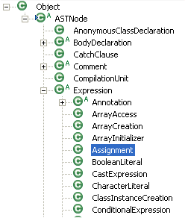
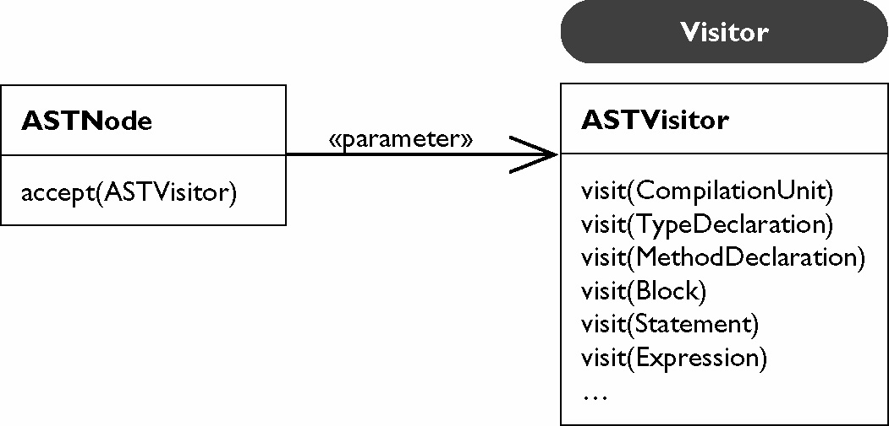
Abstract Syntax Tree cond’t
A Java type for each syntactic construct
  Assignment, CastExpression, ConditionalExpression…
Bindings for type information
  Can resolve all references through bindings
Visitors and node properties for analysis
ASTRewriter to manipulate an AST

Slide 35
Creating an AST
Build AST from element or source
  AST factory: ASTParser
  Either from Java model elements: ICompilationUnit, IClassFile (ITypeRoot)
  Or source string, file name and IJavaProject as context
Bindings or no bindings
  Bindings contain resolve information. Fully available on syntax errors free code, best effort when there are errors.
Full AST or partial AST
  For a given source position: All other method have empty bodies
  AST for an element: Only method, statement or expression

Slide 36
Creating an AST
Recovered node or no recovered node (new in 3.2)
  No recovery: When detecting syntax error: Skip method body
  With recovery: Skip tokens, or introduce artificial tokens to create statements.
  Recovered node are flagged with ASTNode#RECOVERED
Recovered bindings or no recovered bindings (new in 3.3 and 3.4)
  No recovery: No bindings if element can not be found (for example is not on the class path)
  With recovery: Introduce recovered bindings, only name is correct, no package or members. Bindings marked with binding.isRecovered()
Create multiple AST using same Binding environment, much faster

Slide 37
Creating an AST
ASTParser parser= ASTParser.newParser(AST.JLS3);
parser.setSource(cu);
parser.setResolveBindings(true);
parser.setStatementsRecovery(true);
ASTNode node= parser.createAST(null);
Create AST on an element
ASTParser parser= ASTParser.newParser(AST.JLS3);
parser.setSource("System.out.println();".toCharArray());
parser.setProject(javaProject);
parser.setKind(ASTParser.K_STATEMENTS);
parser.setStatementsRecovery(false);
ASTNode node= parser.createAST(null);
Create AST on source string

Slide 38
AST Browsing
Typed access to the node children:
  ConditionalExpression:
    getExpression()
    getThenExpression()
    getElseExpression()
Homogenous access using node properties:
List allProperties= node.structuralPropertiesForType();
expression=
node.getStructuralProperty(ConditionalExpression.EXPRESSION_PROPERTY);
Will contain 3 elements of type ‘StructuralPropertyDescriptor’:
ConditionalExpression.EXPRESSION_PROPERTY, ConditionalExpression.THEN_EXPRESSION_PROPERTY,
ConditionalExpression.ELSE_EXPRESSION_PROPERTY,

Slide 39
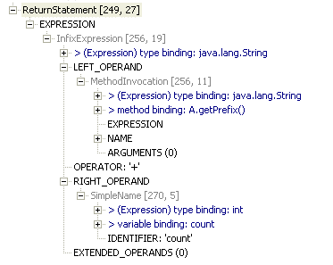
AST View Demo

Slide 40
AST View
private void print(ASTNode node) {
List properties= node.structuralPropertiesForType();
for (Iterator iterator= properties.iterator(); iterator.hasNext();) {
Object desciptor= iterator.next();
if (desciptor instanceof SimplePropertyDescriptor) {
SimplePropertyDescriptor simple= (SimplePropertyDescriptor)desciptor;
Object value= node.getStructuralProperty(simple);
System.out.println(simple.getId() + " (" + value.toString() + ")");
} else if (desciptor instanceof ChildPropertyDescriptor) {
ChildPropertyDescriptor child= (ChildPropertyDescriptor)desciptor;
ASTNode childNode= (ASTNode)node.getStructuralProperty(child);
if (childNode != null) {
System.out.println("Child (" + child.getId() + ") {");
print(childNode);
System.out.println("}");
}
} else {
ChildListPropertyDescriptor list= (ChildListPropertyDescriptor)desciptor;
System.out.println("List (" + list.getId() + "){");
print((List)node.getStructuralProperty(list));
System.out.println("}");
}
}
}
private void print(List nodes) {
for (Iterator iterator= nodes.iterator(); iterator.hasNext();) {
ASTNode node= (ASTNode)iterator.next();
print(node);
}
}

Slide 41
Bindings
Bindings are fully connected
  ITypeBinding has binding of super type, interfaces, all members
  IMethodBinding has binding of parameter types, exceptions, return type
  IVariableBinding has binding of variable type
Bindings are very expensive:
  Do not hold on bindings
  Do not hold on ASTNodes that contain bindings
Within an AST:
  Binding identity (can use ‘==‘ to compare bindings)
Bindings from different ASTs:
  Compare binding.getKey()
  Or isEqualTo(…)

Slide 42
Bindings
From a binding to its declaration ASTNode:
  astRoot.findDeclaringNode(binding) (on CompilationUnit)
From a binding to a IJavaElement:
  binding.getJavaElement()

Slide 43
AST Visitor
ASTParser parser= ASTParser.newParser(AST.JLS3);
parser.setSource(cu);
parser.setResolveBindings(true);
ASTNode root= parser.createAST(null);
root.accept(new ASTVisitor() {
public boolean visit(CastExpression node) {
fCastCount++;
return true;
}
public boolean visit(SimpleName node) {
IBinding binding= node.resolveBinding();
if (binding instanceof IVariableBinding) {
IVariableBinding varBinding= (IVariableBinding) binding;
ITypeBinding declaringType= varBinding.getDeclaringClass();
if (varBinding.isField() &&
"java.lang.System".equals(declaringType.getQualifiedName())) {
fAccessesToSystemFields++;
}
}
return true;
}
Count the number of casts
Count the number of references to a field of ‘java.lang.System’
(‘System.out’, ‘System.err’)

Slide 44
AST Rewriting
Instead of manipulating the source code change the AST and write changes back to source
Descriptive approach
  describe changes without actually modifying the AST
  allow reuse of the AST over several operations
  support generation of a preview
Modifying approach
  directly manipulates the AST
  API is more intuitive
  implemented using the descriptive rewriter
Rewriter characteristics
  preserve user formatting and markers
  generate an edit script

Slide 45
AST Rewriting
Implementation of descriptive rewrite is currently more powerful:
  String placeholders: Use a node that is a placeholder for an arbitrary string of code or comments
  Track node positions: Get the new source ranges after the rewrite
  Copy a range of nodes
  Modify the comment mapping heuristic used by the rewriter
  (comments are associated with nodes. Operation on nodes also include the associated comments)

Slide 46
AST Rewrite
Example of the descriptive AST rewrite:
public void modify(MethodDeclaration decl) {
AST ast= decl.getAST();
ASTRewrite astRewrite= ASTRewrite.create(ast);
SimpleName newName= ast.newSimpleName("newName");
astRewrite.set(decl, MethodDeclaration.NAME_PROPERTY, newName, null);
ListRewrite paramRewrite=
astRewrite.getListRewrite(decl, MethodDeclaration.PARAMETERS_PROPERTY);
SingleVariableDeclaration newParam= ast.newSingleVariableDeclaration();
newParam.setType(ast.newPrimitiveType(PrimitiveType.INT));
newParam.setName(ast.newSimpleName("p1"));
paramRewrite.insertFirst(newParam, null);
TextEdit edit= astRewrite.rewriteAST(document, null);
edit.apply(document);
}
Create the rewriter
Change the method name
Insert a new parameter as first parameter
Create resulting edit script
Apply edit script to source buffer

Slide 47
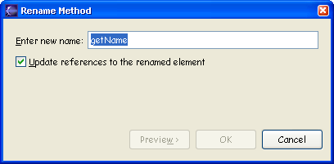
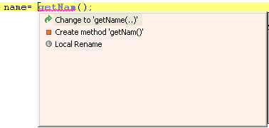
Code Manipulation Toolkits
Refactoring – org.eclipse.ltk.refactoring
  refactorings - org.eclipse.ltk.core.refactoring.Refactoring
    responsible for precondition checking
    create code changes
  code changes - org.eclipse.ltk.core.refactoring.Change
    provide Undo/Redo support
    support non-textual changes (e.g. renaming a file)
    support textual changes based on text edit support
  user interface is dialog based
Quick fix & Quick Assist – org.eclipse.jdt.ui.text.java
  AST based
  processors - org.eclipse.jdt.ui.text.java.IQuickFixProcessor
    check availability based on problem identifier
    generate a list of fixes
  user interface is provided by editor

Slide 48
New API in 3.4
New in 3.4: API to get the AST used in the active editor
  SharedASTProvider.getAST(…) (in JDT UI)
  JDT UI builds AST in the reconciler thread after modifications: Used for semantic highlighting, mark occurrences, quick fix,…
  When accessing the AST, clients can choose to wait for the AST or not.
  Don’t keep references to the AST nor its bindings!
New in 3.4: Apply edits on the compilation units
  ICompilationUnit.applyTextEdit(TextEdit edit)
  Text edits are the result of the AST rewriter, the import rewriter and code format
  Before: Create a IDocument first, or –recommended!- get the buffered IDocument from org.eclipse.resource.filebuffers. textEdit.apply(document)

Slide 49
What’s new in 3.4
For more information come to the short talk
What’s New in JDT
Thursday, 11:10 a.m., Room 203-204

Slide 50
Summary
JDT delivers powerful program manipulation services
  Java Model, Search engine and DOM AST
  Add your own tool to the Eclipse Java IDE
  but also in headless mode (can be used programmatically)
    Visual Editor, EMF, metric tools, …
  Full J2SE 5.0/6.0 support
Community feedback is essential
  bug reports: http://bugs.eclipse.org/bugs
  mailing lists: http://www.eclipse.org/mail/index.html
  newsgroups: news://news.eclipse.org/eclipse.tools.jdt

Slide 51
Legal Notice
Copyright © IBM Corp., 2007-2008. All rights reserved. Source code in this presentation is made available under the EPL, v1.0, remainder of the presentation is licensed under Creative Commons Att. Nc Nd 2.5 license.
Java and all Java-based trademarks are trademarks of Sun Microsystems, Inc. in the United States, other countries, or both.
Eclipse and the Eclipse logo are trademarks of Eclipse Foundation, Inc.
Other company, product, or service names may be trademarks or service marks of others.
THE INFORMATION DISCUSSED IN THIS PRESENTATION IS PROVIDED FOR INFORMATIONAL PURPOSES ONLY. WHILE EFFORTS WERE MADE TO VERIFY THE COMPLETENESS AND ACCURACY OF THE INFORMATION, IT IS PROVIDED "AS IS" WITHOUT WARRANTY OF ANY KIND, EXPRESS OR IMPLIED, AND IBM SHALL NOT BE RESPONSIBLE FOR ANY DAMAGES ARISING OUT OF THE USE OF, OR OTHERWISE RELATED TO, SUCH INFORMATION. ANY INFORMATION CONCERNING IBM'S PRODUCT PLANS OR STRATEGY IS SUBJECT TO CHANGE BY IBM WITHOUT NOTICE

Slide 52
The JDT Team
Philippe Mulet
Jérôme Lanneluc
Olivier Thomann
David Audel
Kent Johnson
Maxime Daniel
Frédéric Fusier
Jim des Rivières
Martin Aeschlimann
Daniel Megert
Markus Keller
Eric Jodet
Benno Baumgartner

