Slide 1
CS344: Introduction to Artificial Intelligence
Lecture: 22-23
Herbrand’s Theorem
Proving satisfiability of logic formulae using semantic trees
(from Symbolic logic and mechanical theorem proving)
By
Raunak Pilani
Under the guidance of Prof. P. Bhattacharyya

Slide 2
Basic Definitions
Interpretation: Assignment of meaning to the symbols of a language
Interpretations of Predicate logic requires defining:
  Domain Of Discourse (D), which is a set of individuals that the quantifiers will range over
  Mappings for every constant, n-ary function and n-ary predicate to elements, n-ary functions (D^{n}→D) and n-ary relations on D, respectively

Slide 3
Basic Definitions (contd.)
Satisfiability (Consistency)
  A formula G is satisfiable iff there exists an interpretation I such that G is evaluated to “T” (True) in I
  I is then called a model of G and is said to satisfy G
Unsatisfiability (Inconsistency)
  G is inconsistent iff there exists no interpretation that satisfies G

Slide 4
Need for the theorem
Proving satisfiability of a formula is better achieved by proving the unsatisfiability of its negation
Proving unsatisfiability over a large set of interpretations is resource intensive
Herbrands Theorem reduces the number of interpretations that need to be checked
Plays a fundamental role in Automated Theorem Proving

Slide 5
Skolem Standard Form
Logic formulae need to first be converted to the Skolem Standard Form, which leaves the formula in the form of a set of clauses
This is done in three steps
  Convert to Prenex Form
  Convert to CNF (Conjunctive Normal Form)
  Eliminate existential Quanitifiers using Skolem functions

Slide 6
Step 1: Converting to Prenex Form
Involves bringing all quantifiers to the beginning of the formula
  (Q_{i} x_{i}) (M), i=1, 2..., n
  Where,
  - Q_{i} is either V (Universal Quantifier) or Ǝ (Existential Quanitifier) and is called the prefix
  - M contains no Quantifiers and is called the matrix

Slide 7
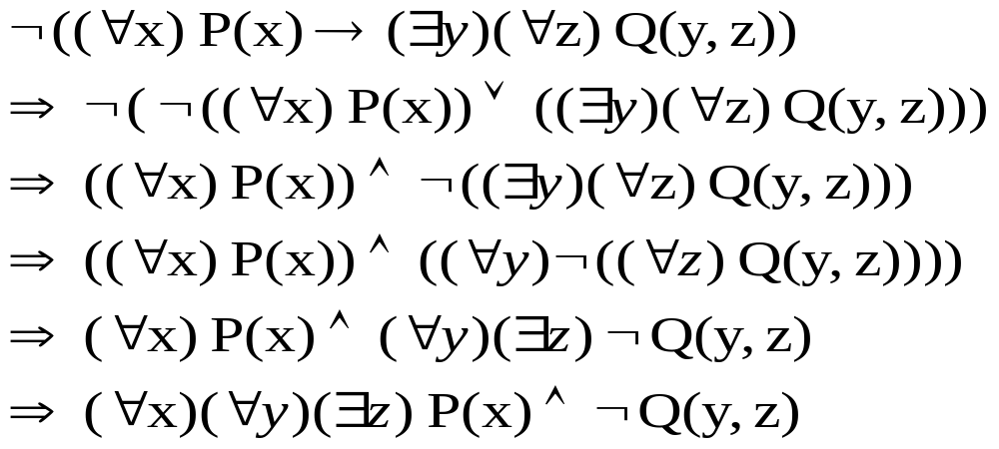
Example

Slide 8
Step 2: Converting to CNF
Remove and
Apply De Morgan’s laws
Apply Distributive laws
Apply Commutative as well as Associative laws

Slide 9
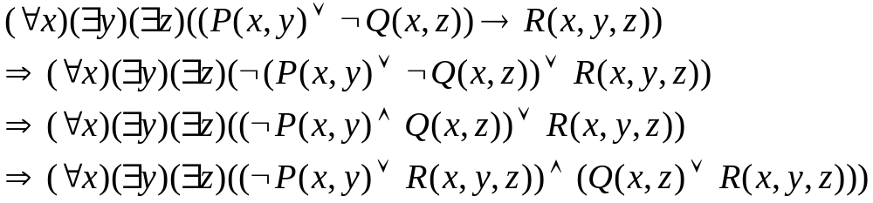
Example

Slide 10
Step 3: Skolemization
Consider the formula, (Q₁ x₁)… (Q_{n} x_{n})M
If an existential quantifier, Q_{r} is not preceded by any universal quantifier, then
  x_{r} in M can be replaced by any constant c and Q_{r} can be removed
Otherwise, if there are ‘m’ universal quantifiers before Q_{r} , then
  An m-place function f(p₁ , p₂ ,… , p_{m}) can replace x_{r} where p₁ , p₂ ,… , p_{m} are the variables that have been universally quantified
Here, c is a skolem variable while f is a skolem function

Slide 11
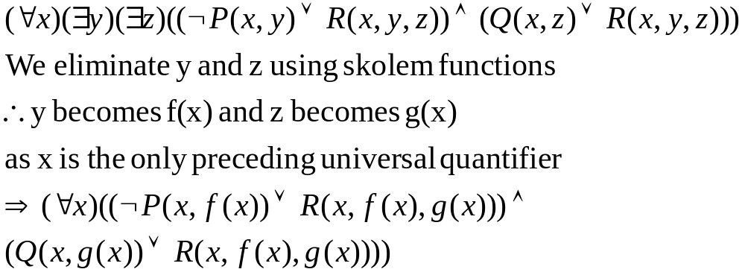
Example

Slide 12
Herbrand Universe
It is infeasible to consider all interpretations over all domains in order to prove unsatisfiability
Instead, we try to fix a special domain (called a Herbrand universe) such that the formula, S, is unsatisfiable iff it is false under all the interpretations over this domain

Slide 13
Herbrand Universe (contd.)
H₀ is the set of all constants in a set of clauses, S
If there are no constants in S, then H₀ will have a single constant, say H₀ = {a}
For i=1,2,3,…, let H_{i+1} be the union of H_{i} and set of all terms of the form f^{n}(t₁,…, t_{n}) for all n-place functions f in S, where t_{j} where j=1,…,n are members of the set H
H∞ is called the Herbrand universe of S

Slide 14
Herbrand Universe (contd.)
Atom Set: Set of the ground atoms of the form P^{n}(t₁,…, t_{n}) for all n-place predicates P^{n} occuring in S, where t₁,…, t_{n} are elements of the Herbrand Universe of S
  Also called the Herbrand Base
A ground instance of a clause C of a set of clauses is a clause obtained by replacing variables in C by members of the Herbrand Universe of S

Slide 15
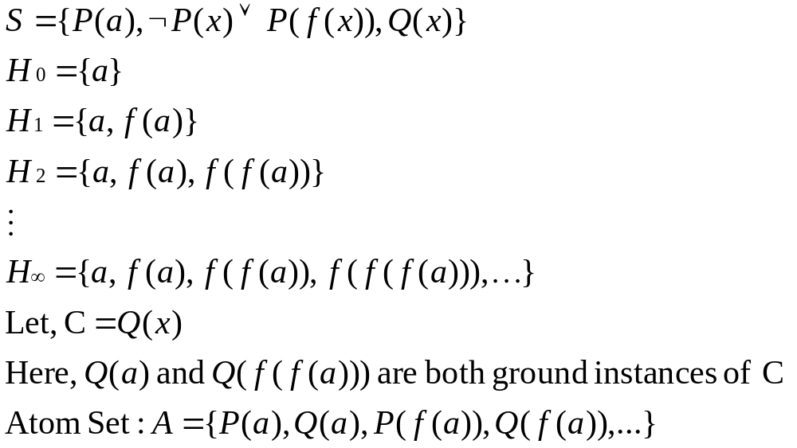
Example

Slide 16
H-Interpretations
For a set of clauses S with its Herbrand universe H, we define I as an H-Interpretation if:
  I maps all constants in S to themselves
  An n-place function f is assigned a function that maps (h₁ ,…, h_{n}) (an element in H^{n}) to f (h₁ ,…, h_{n}) (an element in H) where h₁ ,…, h_{n} are elements in H
Or simply stated as I={m₁, m₂, …, m_{n}, …}
where m_{j} = A_{j} or ~A_{j} (i.e. A_{j} is set to true or false) and A = {A₁, A₂, …, A_{n}, …}

Slide 17
H-Interpretations (contd.)
Not all interpretations are H-Interpretations
Given an interpretation I over a domain D, an H-Interpretation I* corresponding to I is an H-Interpretation that:
  Has each element from the Herbrand Universe mapped to some element of D
  Truth value of P(h₁ ,…, h_{n}) in I* must be same as that of P(d₁ ,…, d_{n}) in I

Slide 18
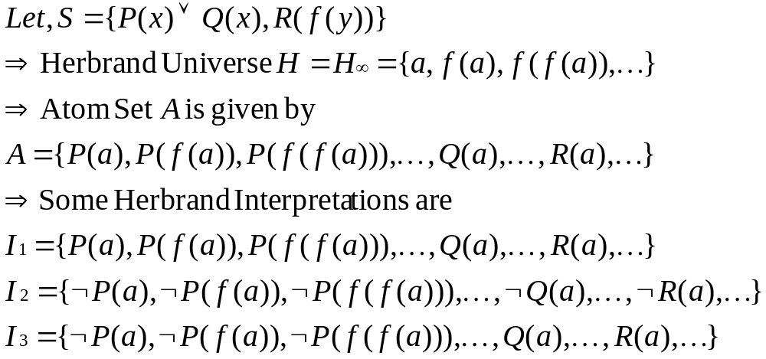
Example

Slide 19
Use of H-Interpretations
If an interpretation I satisfies a set of clauses S, over some domain D, then any one of the H-Interpretations I* corresponding to I will also satisfy H
A set of clauses S is unsatisfiable iff S is false under all H-Interpretations of S

Slide 20
Semantic Trees
Finding a proof for a set of clauses is equivalent to generating a semantic tree
A semantic tree is a tree where each link is attached with a finite set of atoms or their negations, such that:
  Each node has only a finite set of immediate links
  For each node N, the union of sets connected to links of the branch down to N does not contain a complementary pair
If N is an inner node, then its outgoing links are marked with complementary literals

Slide 21
Semantic Trees (Contd.)
Every path to a node N does not contain complementary literals in I(N), where I(N) is the set of literals along the edges of the path
A Complete Semantic Tree is one in which every path contains every literal in Herbrand base either +ve or –ve, but not both
A failure node N is one which falsifies I_{N} but not I_{N’}, where N’ is predecessor of N
A semantic tree is closed if every path contains a failure node

Slide 22
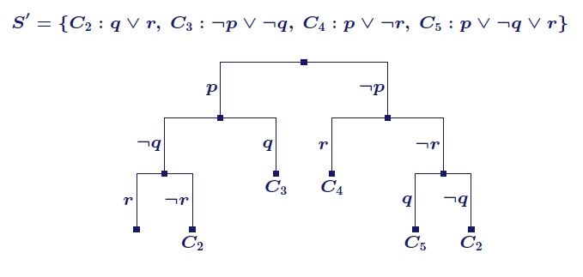
Example
Image courtesy: http://www.computational-logic.org/iccl/master/lectures/summer07/sat/slides/semantictrees.pdf
S’ is satisfiable because it has at least one branch without a failure node

Slide 23
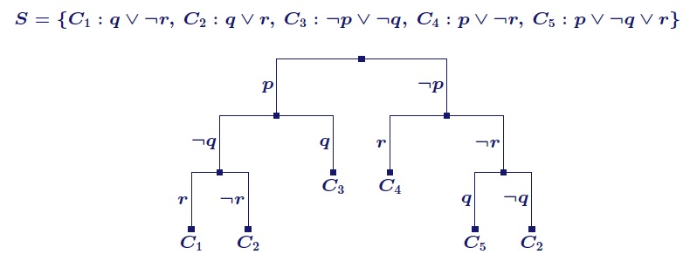
Example
Image courtesy: http://www.computational-logic.org/iccl/master/lectures/summer07/sat/slides/semantictrees.pdf
S is unsatisfiable as the tree is closed

Slide 24
Herbrand’s Theorem (Ver. 1)
Theorem:
A set S of clauses is unsatisfiable iff corresponding to every complete semantic tree of S, there is a finite closed semantic tree
Proof:
Part 1: Assume S is unsatisfiable
- Let T be the complete semantic tree for S
- For every branch B of T, we let I_{B} be the set of all literals attached to the links in B

Slide 25
Version 1 Proof (contd.)
- I_{B} is an interpretation of S (by definition)
- As S is unsatisfiable, I_{B} must falsify a ground instance of a clause C in S, let’s call it C’
- T is complete, so, C’ must be finite and there must exist a failure node N_{B} (a finite distance from root) on branch B
- Every branch of T has a failure node, so we find a closed semantic tree T’ for S
- T’ has a finite no. of nodes (Konig’s Lemma)
Hence, first half of thm. is proved

Slide 26
Version 1 Proof (contd.)
Part 2: If there is a finite closed semantic tree for every complete semantic tree of S
- Then every branch contains a failure node
- i.e. every interpretation falsifies S
- Hence, S is unsatisfiable
Thus, both halves of the theorem are proved

Slide 27
Herbrand’s Theorem (Ver. 2)
Theorem:
A set S of clauses is unsatisfiable iff there is a finite unsatisfiable set S’ of ground instances of clauses of S
Proof:
Part 1: Assume S is unsatisfiable
- Let T be a complete semantic tree of S
- By ver. 1 of Herbrand Thm., there is a finite closed semantic tree T’ corresponding to T

Slide 28
Version 2 Proof (contd.)
- Let S’ be a set of all the ground instances of clauses that are falsified at all failure nodes of T’
- S’ is finite since T’ contains a finite no. of failure nodes
- Since S’ is false in every interpretation of S’, S’ is also unsatisfiable
Hence first half of thm. is proved

Slide 29
Version 2 Proof (contd.)
Part 2: Suppose S’ is a finite unsatisfiable set of gr. instances of clauses in S
- Every interpretation I of S contains an interpretation I’ of S’
- So, if I’ falsifies S’, then I must also falsify S’
- Since S’ is falsified by every interpretation I’, it must also be falsified by every interpretation I of S
- i.e. S is falsified by every interpretation of S
- Hence S is unsatisfiable
Thus, both halves of the thm. are proved

Slide 30
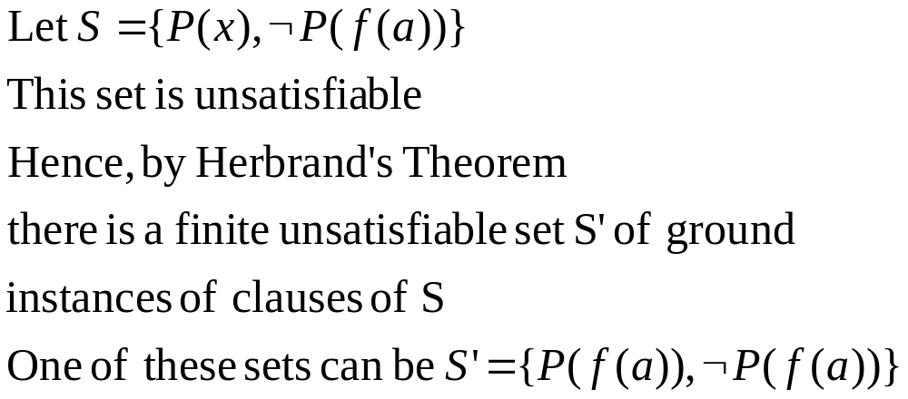
Example

Slide 31
References
Chang, Chin-Liang and Lee, Richard Char-Tung
Symbolic Logic and Mechanical Theorem Proving
Academic Press, New York, NY, 1973

