Slide 1
Non-Null Reference by default in Java: Alleviating the
Nullity Annotation Burden
Patrice Chalin, Perry James (Concordia University)
Presented by He Xiao

Slide 2
Motivation
Null pointer exceptions: one of the most common failures in OO languages.
Many Analysis tools exist, but require annotations
Non-null annotations require huge efforts

Slide 3
Main Contribution
In Java programs, at least 2/3 of declarations(other than local variables) that are of reference types are meant to be non-null, based on design intent

Slide 4
Second Contribution
Proposal for non-null by default in Java
  backward compatibility
  code migration

Slide 5
Empirical Study -- Subjects
Five open source Java projects : SoenEA, JML checker, ESC/Java2, the tallying subsystem of Koa and JDT core
  representative
  non-trivial size
  documentation
  familiar with code base

Slide 6
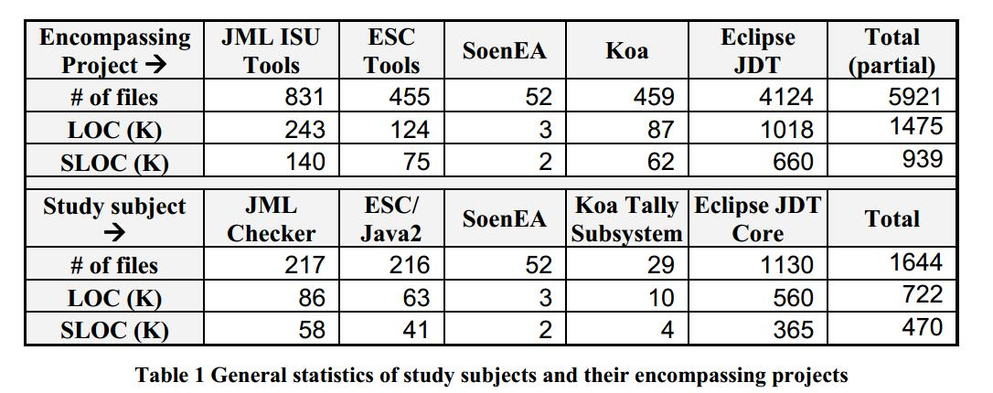
Empirical Study -- Sampling

Slide 7
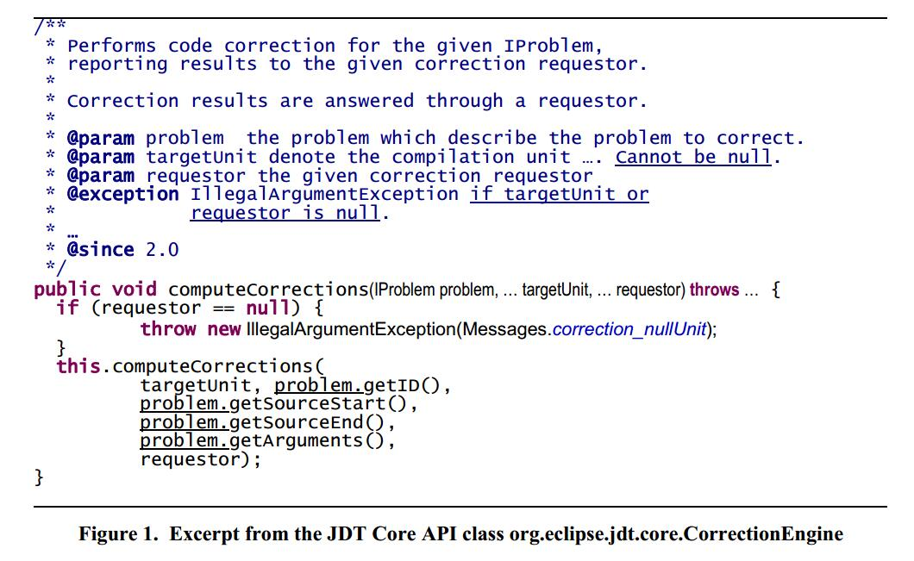
Empirical Study -- Annotating

Slide 8
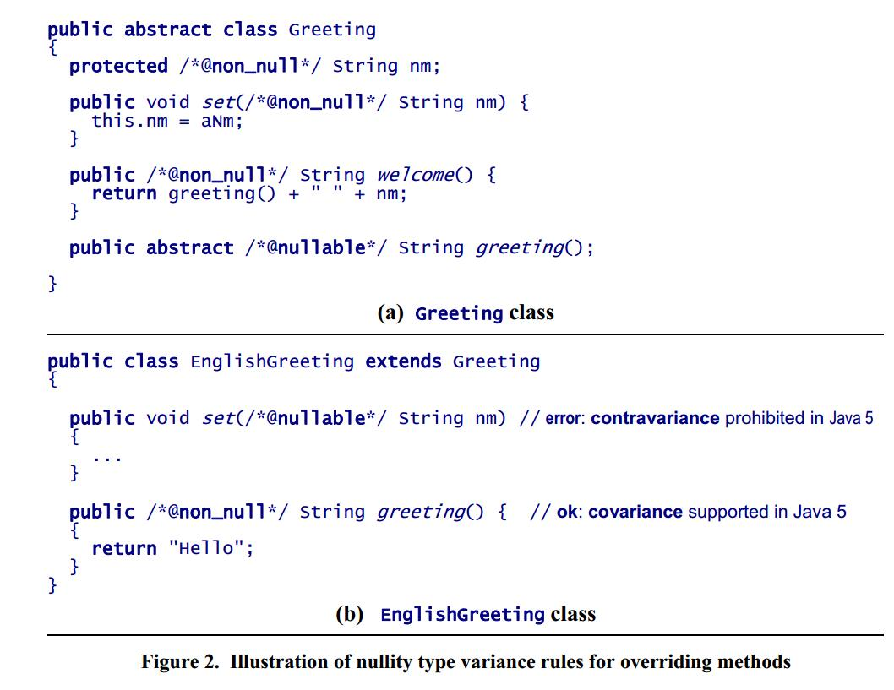
Handling of overriding methods

Slide 9
Empirical Study -- Metrics
d : No. of reference type declarations
m : No. of non-null reference type declaration
x : m/d

Slide 10
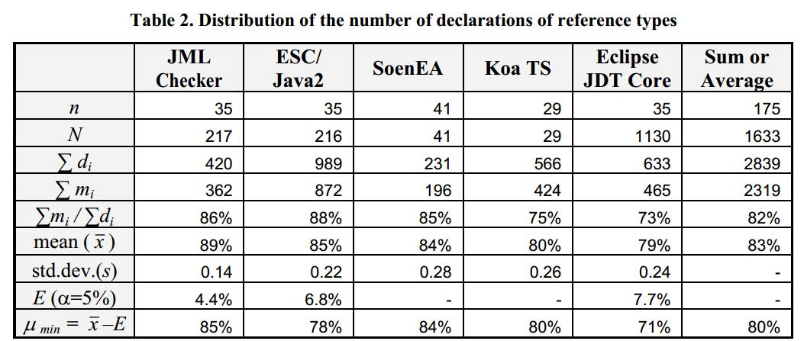
Empirical Study -- Results

Slide 11
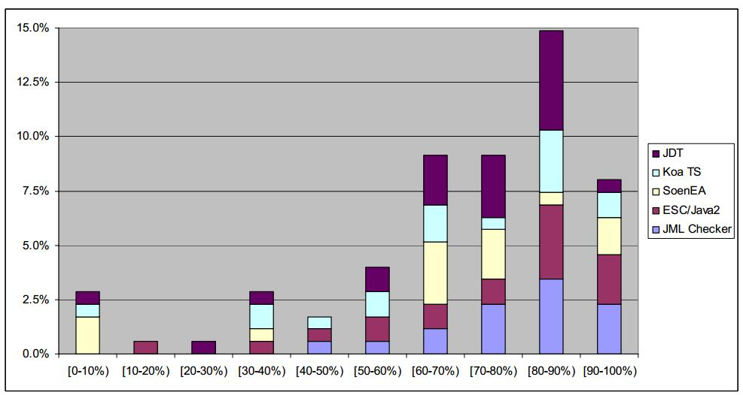
Results Cont.

Slide 12
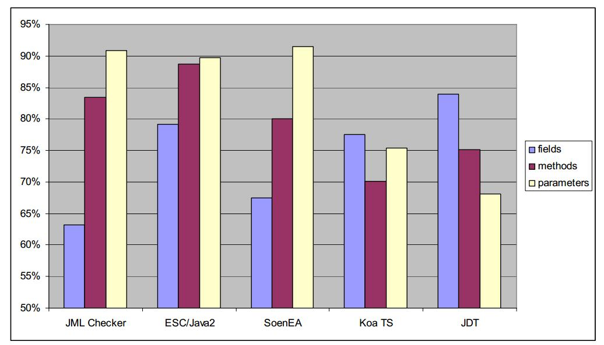
Results Cont.

Slide 13
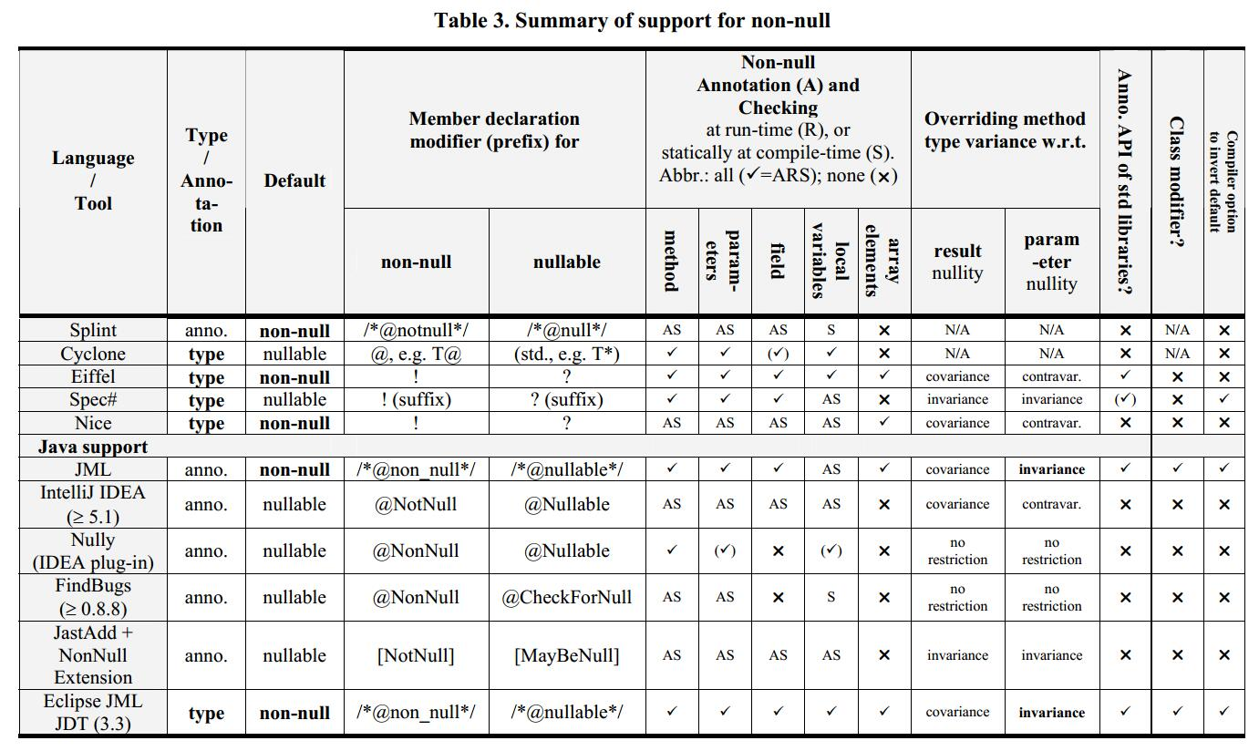
Summary of Non-null Support

Slide 14
Implementation of Non-Null by Default: Eclipse JML JDT
JML-like annotations
Script that help the migration of legacy code to new default

Slide 15
Conclusion
74%of reference type declarations are expected to be non-null by design in Java
Switch nullity defaults in Java is feasible

Slide 16
Q & A
Question: What if the not-null object have the null value by accident, does the tool return an error or just discard the value?

Slide 17
More Question?

