Slide 1
MintHint: Automated Synthesis of Repair Hints

Slide 2
Why Semi automated Repair?
Semi automated debugging tool that generates repair hints instead of fixes
The results from automatic program repair tools need to be manually inspected for correctness. Not all repairs generated are high quality.
Unlike existing automatic repair tools, MintHint does not rely on a specification
MintHint does not need to evaluate entire repair space to find correct snippets
MintHint helps find potential fixes even if the fix is not in the repair space

Slide 3
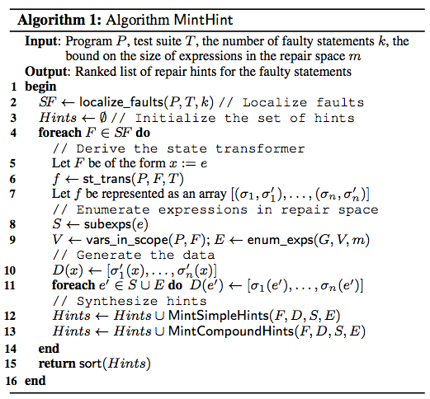
Algorithm
Identify suspicious lines
State transformer: Function that produces desired state (using Dynamic Symbolic Execution)
Repair space: List of possible expressions used in repair
Sorted based on statistical correlation
Synthesize hints
Insertion
Replacement
Removal
Retention
Compounding

Slide 4
Fault Localization
Uses spectrum based fault localization, Zoltar, to find suspicious locations.
Dynamically collects spectra (basic block hits, function hits, def-use pairs) from execution
Uses statistical formulas to evaluate risk
Obtains list of suspicious lines and runs independently for each one
Fault Localization tools may incorrectly flag lines as suspicious
MintHint generates “retain” hints and in the experiments filtered 40% of these

Slide 5
State transformers
Given an input state (set of all variable values) produces a set of output states that pass all of the tests
We make the left hand side of the expression symbolic
if (s[∗i] == ENDSTR) → branch0 = s[*i] == ENDSTR
Use DSE to find values of branch0 that produce the expected output
Execute program with corrected value to generate output state
int f()
{
int x = 100;
if(x > 10)
x--;
return x;
}
AssertEquals(100, f())

Slide 6
Repair Space
A list of possible repairs to choose from
Generated by enumerating valid combinations of variables and function calls
The repair space will always be incomplete since we must have a maximum number of variables/function calls
High_Confidence || Two_of_Three_Reports_Valid
High_Confidence || upward_preferred Two_of_Three_Reports_Valid || High_Confidence
! Two_of_Three_Reports_Valid High_Confidence && ! upward_preferred
Two_of_Three_Reports_Valid && ! High_Confidence
Climb_Inhibit
ALIM()
Positive_RA_Alt_Thresh[Alt_Layer_Value]
Inhibit_Biased_Climb()
ALIM() + NOZCROSS
Positive_RA_Alt_Thresh[Alt_Layer_Value] <= Inhibit_Biased_Climb()
Inhibit_Biased_Climb() != MAXALTDIFF
Positive_RA_Alt_Thresh[Alt_Layer_Value] / Inhibit_Biased_Climb()
MAXALTDIFF - Climb_Inhibit

Slide 7
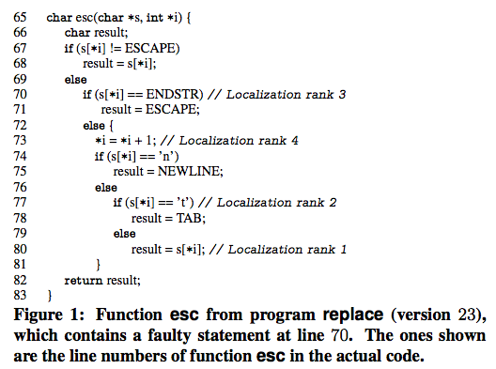
Example

Slide 8
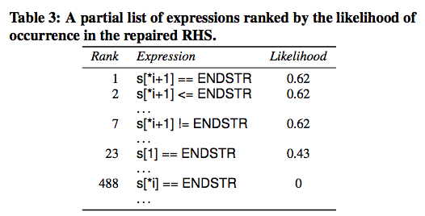
Ranking expressions
Expressions are ranked based on statistical correlation between expected values and output values
branch0 = s[*i] == ENDSTR
Input state |  | Output State | Values of repair space over input state
s | *i | branch0 | s[*i] == s[*i + 1] | s[*i] == ENDSTR | s[*i + 1] == ENDSTR
“@%&a” | 0 | false | false | false | false
“@n@” | 0 | false | false | false | false
“@n@” | 2 | true | false | false | true
“%@@” | 1 | false | true | false | false
“V@” | 1 | true | false | false | true

Slide 9
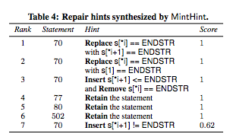
Hint Generation
Suspicious statement is discarded if symbolic execution fails or times out
If unsat for all failing tests, the statement cannot affect the output so a “retain the statement” hint is added
Simple hints
Involves a single program transformation so repairs must have low correlation among themselves
Looks at repairs that are above a given threshold of likelyness (function of correlation)

Slide 10
Pattern Matching
Then checks edit distance which is the minimum number of changes to transform to repaired statement
For example, the edit distance between “Kitten” and “Sitting” is 3
Kitten → Sitten → Sittin → Sitting
Fixes with smaller edit distances are more likely to be replacement
Afterwards, generate remove hints for lines that don’t have a Retain hint
if (edit_distance == 0)
Retain hint (statement already exists and is unlikely to be faulty)
else if (edit_distance <= 2)
Replacement hint (Incorrect operator, constant, variable, etc)
else if(edit_distance > 2)
Insertion hint

Slide 11
Compound Hints
Compound hints are sets of program transformations
Like in simple hints, expressions must all be likely enough
The expressions within each compound hint must be likely to occur together
Uses Spearman Partial coefficient

Slide 12
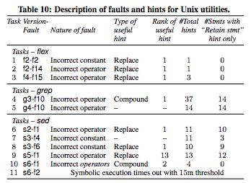
Experimental Setup
Tested on flex, grep, sed which range from 10-14k lines of code
Tasks 4,6,8,9 led to repair of fault
Task 10 was a partial repair
Task 7 failed due to too much noise
Task 5 timed out for actual faulty statement. Task 11 timed out for all potentially faulty statements

Slide 13
User Study
Used programs from Siemens suite sorted by number of faults
Only debugged top 5 suspicous statements from Zoltar for consistency and time
Studied 10 users each with at least 1 year of experience in C
8 working professionals
2 graduate students
Programs given to participants were chosen at random
Control Phase
Given results from localization tool and test suite
Experimental Phase
Also given generated repair hints

Slide 14
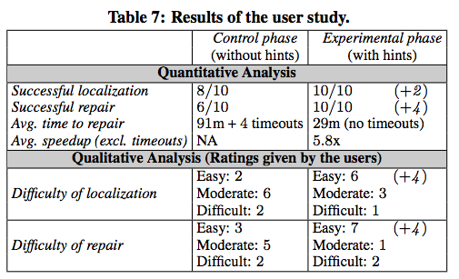
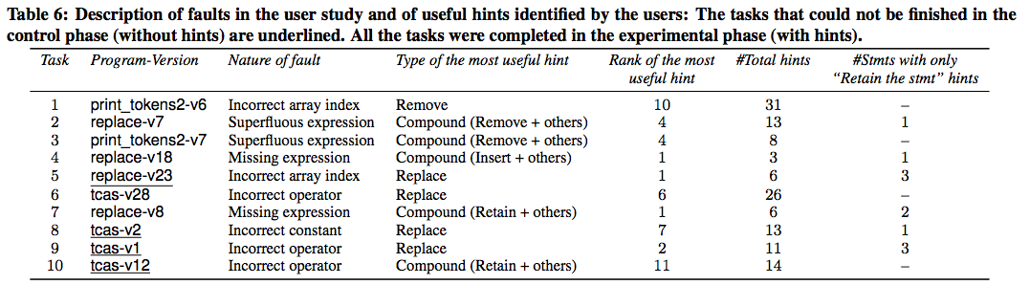
Most useful hint in top 11
Program was easier to repair
The programs were easier to localize and repair

Slide 15
Weaknesses
User Study had a small sample size
Sample size only contained experienced programmers
Although sample size is small, the user study does provide substantial evidence that to tool is helpful
Results are not compared with related tools that don’t rely on specification
The state transformer relies on DSE
Performance issue, DSE is the main bottleneck and times out after 15 mins
Issues with exploding paths
Does not support all data types
State transformers are noisy
The output of the DSE may not be in the repair space
Like most program repair tools, it depends on the quality of tests

