Slide 1
DySy: Dynamic Symbolic Execution for Invariant Inference
Christoph Csallner (Georgia Tech) , Nikolai Tillman (Microsoft Research) , Yannis Smragdakis (University of Oregon)
Presented by Angello Astorga

Slide 2
Automatic generation: method preconditions, postconditions and object state invariants. (e.g invariants)
Notes:
Invariant generation is a well studied problem in part because of its benefits.
Practical motivation
preconditions and post conditions are useful in program verification(properties), software testing and debugging( assertions).

Slide 3
Motivation
Current Dynamic Invariant Inference Systems
Highly dependent on test suites
Invariants reflect the assumptions and expectations
Large test suite needed
Spurious Invariants
Invariants can be irrelevant or false (.i.e., hold accidently)
Notes:
Technical motivation
Assumptions, we only want to test for a particular assertion

Slide 4
Dysy Goals
Improve quality of inferred invariants (.i.e., the percentage of relevant invariants)
Improve the ease of obtaining invariants. (i.e., the number of test cases required to disqualify invariants)
Notes:
Bulllet 1
So we propose the following contributions
Bullet 2
improve quality of inferred invariants or ease of obtaining them.
Over previous tools such as daikon whose invariants generated capture the assumptions and expectations of the test suite. (overly specific)
Dysy proposes a dynamic symbolic execution technique.

Slide 5
Dynamic Symbolic Execution
Choose next path
Code to generate inputs for:
Solve
Execute&Monitor
void CoverMe(int[] a)
{
if (a == null) return;
if (a.Length > 0)
if (a[0] == 1234567890)
throw new Exception("bug");
}
Constraints to solve
a!=null
a!=null &&
a.Length>0
a!=null &&
a.Length>0 &&
a[0]==1234567890
Data
null
{}
{0}
{123…}
Path Condition: pc
a==null
a!=null &&
!(a.Length>0)
a!=null &&
a.Length>0 &&
a[0]!=1234567890
a!=null &&
a.Length>0 &&
a[0]==1234567890
Negated condition
a==null
F
T
a.Length>0
F
T
Done: There is no path left.
a[0]==123…
F
T
- Slide from “Parameterized Unit Testing: Principles, Techniques, and Application in Practice”
Notes:
Given n path conditions
The intuition behind collecting only the last branch is because in some cases the exception failure is dependent on the last branch taken.
So following is an example the last branch negation

Slide 6
Pex (symbolic)
test runs
Seed Input
Input 2 = Solve(pc’)
… input n
Method under test
Method under test
Symbolic interpreter
Symbolic interpreter
pc
pc 2

Slide 7
Symbolic Interpreter
Constructs and Reasons through Pex’s representation of a symbolic state.
Symbolic State:
Path condition
Assignments of terms to locations(.i.e., static fields, instance fields, method arguments)
Supports:
Primitives (integers , floats, …)
Struct types
Instance and static fields of classes
Elements of arrays
… (see “Pex-White Box Test Generation for .NET” )
Notes:
Symbolic state is the path condition and

Slide 8
Dysy Algorithm
Quadruple (Method, path condition, result, final state)
Characterizes a path execution
Symbolically monitors execution of code under test
Collects a set of quadruples for each method call.
Applies symbolic reasoning on set of Quad
Outputs method preconditions and postconditons
Notes:
This technique overcomes the problem introduced by control dependencies and Eliminates likely irrelevant constraints.
But when quantified precondition are required this techniques is ineffective so we introduce a generalization of the path conditions

Slide 9
Step 1: PC and Final State Discovery
For each test run
Initialize symbolic state
Interpreter evolves symbolic state
Collecting Quadruples for each method call(nested)
Notes:
The main advantages of this technique is that is both simple and inexpensive to conduct.
But when control dependencies are introduced, this technique fails. so we introduce the second heuristic.

Slide 10
Step 2: Class Invariant Detection
Set of candidates
All conjuncts in path conditions with “this” as the only argument for all methods.
Likely invariants( final invariants)
If a candidate invariant implied by all path conditions -> include in class invariants.
Re-executes test suite to confirm.

Slide 11
Step 3: Pre- and post conditions
Simplifies path conditions with class invariants
Method preconditions: disjunction of all path conditions
Method postconditions: conjunction of path specific post conditions (results and assignments in symbolic state).

Slide 12
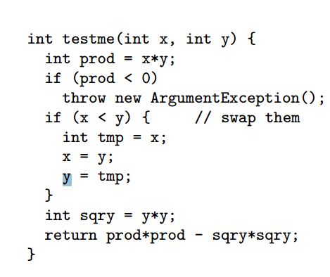
Example
Method Precondition:
x*y >= 0
Method Postcondition:
(x < y) -> (x*y*x*y – x*x*x*x )
(x >= y) -> (x*y*x*y – y*y*y*y )
Path Conditions:
x*y > = 0 && x < y
x*y > = 0 && x >= y

Slide 13
Problems
Does not handle loops (does not generate loop invariants)
Conditions in loops collapsed per-program-point( latest value remembered)
Ignore loop’s exit condition.
Will not generate interesting Invariants
implicit invariants such as ordering (.i.e., of array elements)

Slide 14
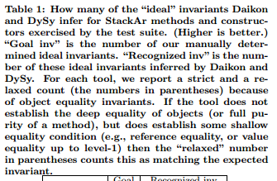
Research Question

Slide 15
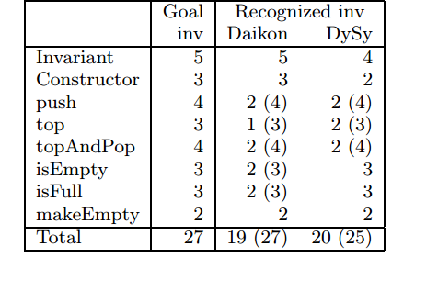

Slide 16
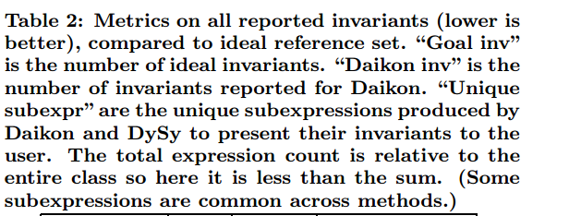
Research Question

Slide 17
