Slide 1
Commutativity Race Detection
Dimitar Dimitrov, Veselin Raychev, Martin Vechev, Eric Koskinen
--presented by He Xiao

Slide 2
Data Races in Concurrent Programs
Race condition
  two or more threads are accessing the same memory location concurrently
  at least one is performing a write operation
Possible solutions
  Synchronization
  Use thread-safe operations

Slide 3
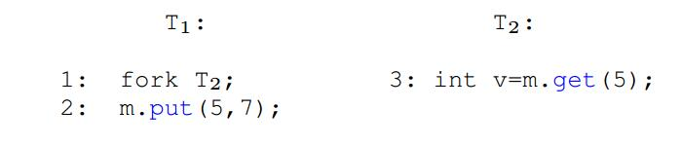
Are thread-safe operations really safe?
Typically, they only provide intra-procedural safety
There might still be races at method invocation level
  consider the example below:

Slide 4
Commutativity Races
Generalization of low-level data races.
Concentrate on the high-level interactions.
  Assuming the methods are atomic.

Slide 5
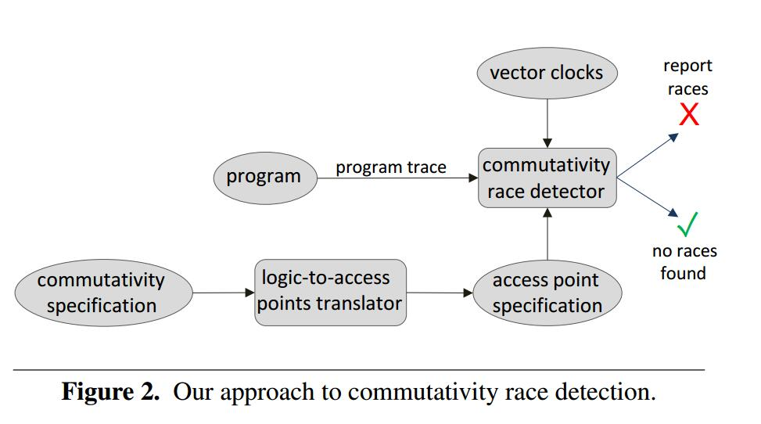
Achitecture of the Comutativity Race Detection

Slide 6
Traces recognized by the race detector

Slide 7
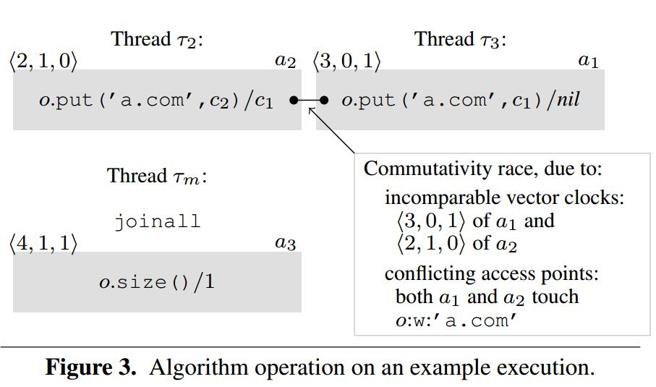
A bigger example

Slide 8
Three major steps of race detection
Step 1: obtain a commutativity specification.
  A spec for two put operations put(k₁, v₁)/p₁ and put(k₂, v₂)/p₂:
    k₁ ≠ k₂ ˅ (v₁ = p₁ ˄ v₂ = p₂)
Step 2: obtain an access point representation.
Step 3: commutativity race detection.

