Slide 1
Commutativity Race Detection
Dimitar Dimitrov, Veselin Raychev, Martin Vechev, Eric Koskinen
--presented by He Xiao

Slide 2
Data Races in Concurrent Programs
Race condition
two or more threads are accessing the same memory location concurrently
at least one is performing a write operation
Possible solutions
Synchronization
Use thread-safe operations
Notes:
Concurrent pgms are powerful but also problematic if not used appropriately.
Data races may occur which make the execution of the pgm unpredicable.
Programmers may use various ways to alleviate the problem;
Synchronization is hard for complex program, and improper sync may cause deadlocks.
Use thread-safe op may help but does not completely solve the problem.

Slide 3
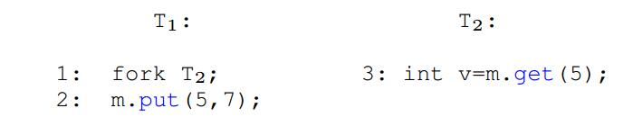
Are thread-safe operations really safe?
Typically, they only provide intra-procedural safety
There might still be races at method invocation level
consider the example below:
Notes:
But the

Slide 4
Commutativity Races
Generalization of low-level data races.
Concentrate on the high-level interactions.
Assuming the methods are atomic.
Notes:
In traditional race detection algorithm, reasoning can only be performed at the basic memory read/write level.
using their work, the reasoning of data races can be performed at the libray methods level, which might be quite appealing to programmers because they can directly deal with
the API that they are familiar with.
The assumption can be satisfied easily if we use thread-safe operations for the basic operations.
Then we will not be distracted by the races within the methods, and can therefore concentrate on the races at the lib methods level.

Slide 5
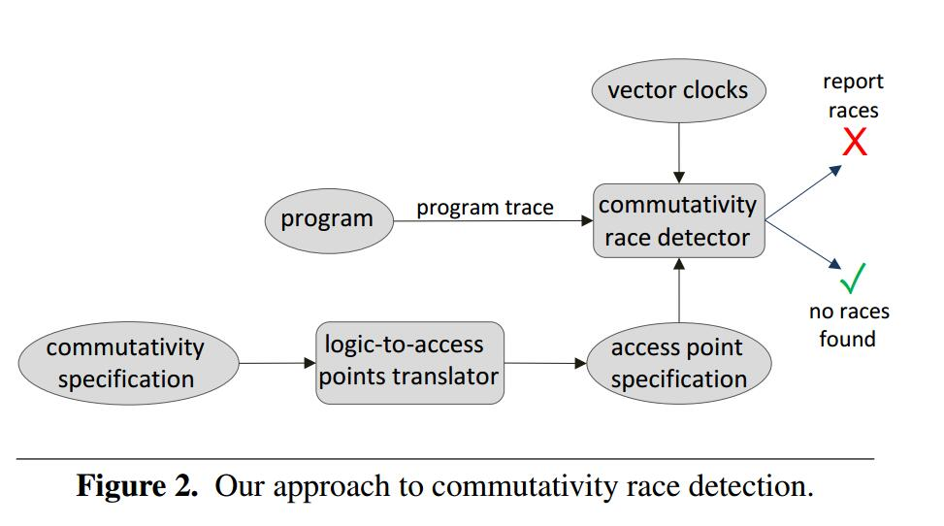
Achitecture of the Comutativity Race Detection

Slide 6
Traces recognized by the race detector
Notes:
The outtermost set is the set of all the traces.
The middle one is the set of all the traces that do not contain any commutativity races.
The innermost set is the set of all the traces that are accpeted by the comm. race detector.
Therefore, the race detector is sound in the sense that the trace that is reported safe is really safe.
It is not complete in the sense that there might be false alarms: it can not recognize some really safe trace.

Slide 7
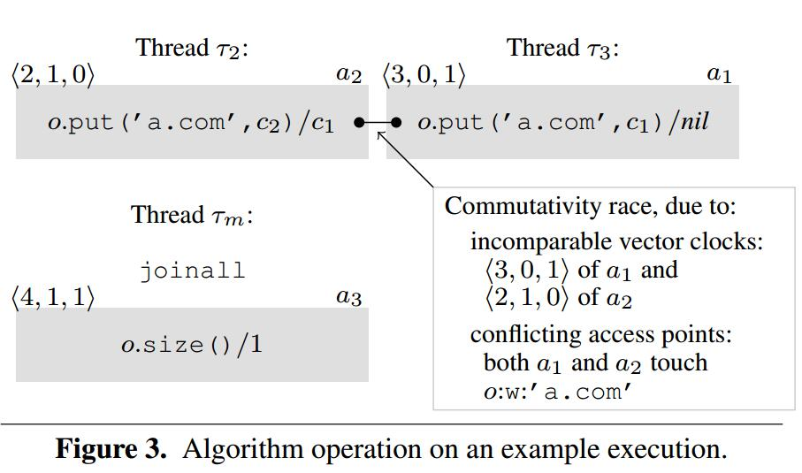
A bigger example

Slide 8
Three major steps of race detection
Step 1: obtain a commutativity specification.
Step 2: obtain an access point representation.
Step 3: commutativity race detection.

