Slide 1
RV: A Runtime Verification Framework for Monitoring, Prediction and Mining
Patrick Meredith
Grigore Rosu
University of Illinois at Urbana-Champaign (UIUC)
Runtime Verification, Inc.
(joint work with Dongyun Jin and Choonghwan Lee at UIUC)

Slide 2
Assurances for Self-Adaptive Systems
Self-adaptive systems come with new challenges
Increased complexity
Reasoning in the presence of uncertainty
System analysis pushed to a whole new dimension
Concerned not only with functional correctness of the system, but also with how system changes/adapts
…
This talk focuses on a very limited related aspect
How to specify a subset of essentially dynamic properties and how to efficiently runtime verify and validate them

Slide 3
Runtime Verification (RV)
Observe the system while it executes, possibly after appropriate instrumentation
Check the observed behavior against desirable explicit or implicit properties
React to detected violations
Report error , if used before deployment
Recover (when possible), during deployment

Slide 4
RV Workshop/Conference
Runtime verification had a hard time initially
Not testing, not verification; what it is?
Started in 2001 as workshop, about 20 people
ENTCS proceedings
Selected papers in journal (FMSD)
Turned into a conference in 2010
LNCS proceedings
FMSD special issue
80 participants
RV’11 had ~80 submissions

Slide 5
Current Limitations of Runtime Verification
Runtime and memory overhead: system observation and monitoring may add significant runtime and memory overhead
Limited coverage: if done naively, runtime verification guarantees lack of bugs only in the observed path, but not in other paths
Specifications: the difficulty of producing property specifications is underestimated. Developers do not want to write them.

Slide 6
Overview
The RV system
Highlights and goals
Parametric properties
What they are, semantics and slicing
Underlying technologies of RV
Monitoring
Prediction
Mining
Conclusion

Slide 7
The RV System
Developed by Runtime Verification, Inc., a startup company in Urbana, in collaboration with the Formal Systems Lab (FSL) at UIUC
Aims at overcoming the current limitations of runtime verification and, implicitly, at becoming the best runtime verification system
Builds upon technologies developed during the last 7 years within the FSL@UIUC

Slide 8
How RV System Overcomes Current Limitations of Runtime Verification
Low runtime and memory overhead: efficient instrumentation; delay monitor creation; garbage collect monitors
Increase coverage: predictive runtime analysis used to analyze causal models instead of flat execution traces; causal models comprise many traces
Mine specifications: running and observing unit tests, it learns (1) the most likely interacting events, and (2) the most likely properties they obey

Slide 9
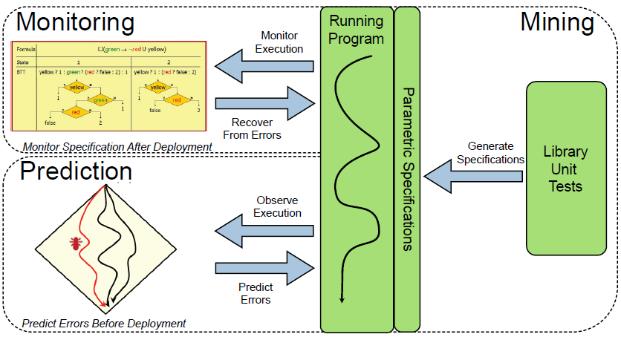
RV System Overview

Slide 10
RV Builds Upon UIUC Technologies
Efficient monitoring of parametric properties
JavaMOP
RV’03-10, TACAS’05, OOPSLA’07, ASE’08, ASE’09, PLDI’11
Predictive runtime analysis
jPredictor
FSE’03, TACAS’04, FMOODS’05, CAV’07, SAS’07, ICSE’08
Mining of parametric properties
jMiner
ICSE’11

Slide 11
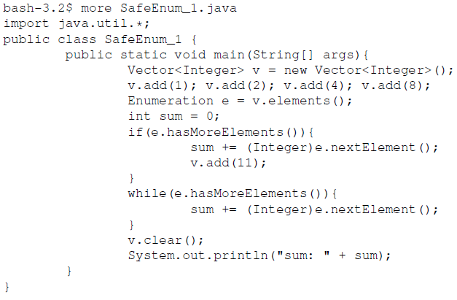
RV at Work: Monitoring I
Consider the following (wrong) Java program:
It modifies vector while enumerating it
Wrong!

Slide 12
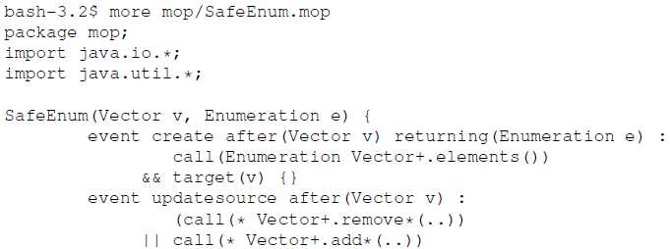

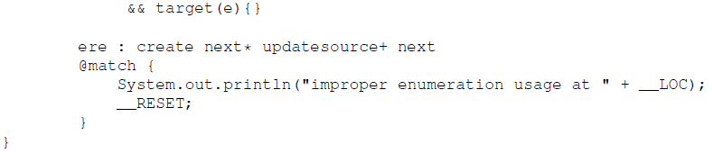
RV at Work: Monitoring II
Write parametric specifications under ./mop:
parameters
instrumentation
property
reaction

Slide 13
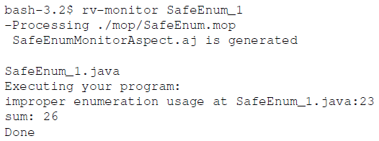
RV at Work: Monitoring III
Then call RV on the Java program to monitor:
RV compiles the program (with javac), generates monitors as aspects, then weaves them within the program binary (with ajc), then runs the resulting programs

Slide 14
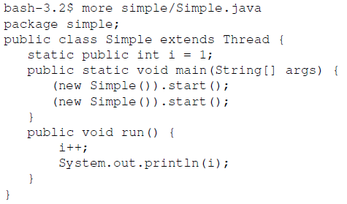
RV at Work: Prediction I
Consider the following (wrong) Java program:
Program has a race on the i and a race on output; these races will most likely not appear during testing; RV can predict them from one “successful” execution
Races
Races

Slide 15
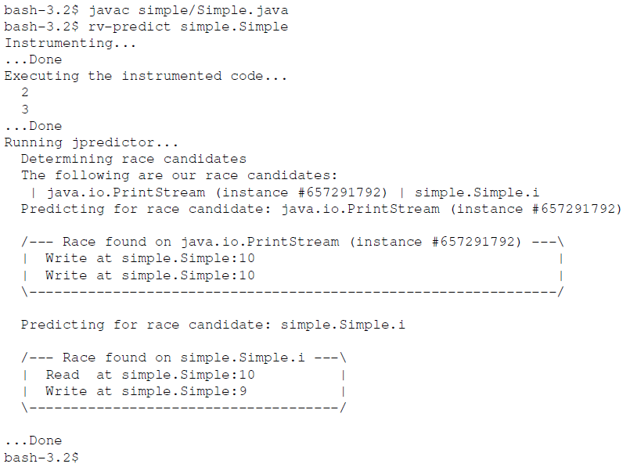
RV at Work: Prediction II
By default, RV prediction searches for races:

Slide 16
RV at Work: Prediction III
To predict violations of parametric properties, one needs to place them under ./mop, same like when monitoring them
A program may have races but those may not lead to violations of specifications
Though not a good idea to allow races anyway
Also, a program may run “successfully”, have no races predicted in it, but still violate behavioral specifications

Slide 17
RV at Work: Mining
The RV miner is less obvious to use
It works in two stages:
First, it observes executions of (small and tricky) unit tests to learn groups of parameters and corresponding events that interact
Then it observes (large and likely correct) programs making use of the learned events and
It slices the observed (large) parametric traces into (typically lots of small) non-parametric traces
It learns non-parametric properties that best explain the computed slices
Then adds the learned parameters to them

Slide 18
Parametric Properties
At the core of RV: all requirements are specified as parametric properties
These are properties over parametric events
Comprise a potentially unbounded number of property instances, one for each parameter
The main challenge is how to efficiently and correctly keep track of all property instances

Slide 19
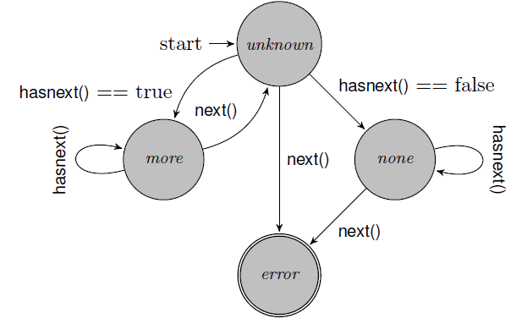
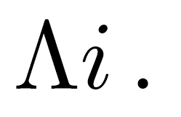
Examples of Parametric Properties I
Typestates are particular, one-parameter properties
For example, “hasnext() must be called and hold before each next() is called”, can be defined as follows:

Slide 20

Examples of Parametric Properties II
Same “hasnext() must be called and hold before each next() is called” typestate property, but specified using different parametric variants:
As a parametric regular expression:
As a parametric linear temporal logic formula:

Slide 21
Examples of Parametric Properties III
Colections are not allowed to change while accessed through iterators:
To avoid clutter, we drop the understood event parameters, i.e., we write the above as

Slide 22

Examples of Parametric Properties IV
Authenticate each key before use:
Each function should release each lock as many times as it acquires it (this is a parametric context-free property):

Slide 23
Parametric Trace Slicing I
RV is all about monitoring, predicting violations of, and mining parametric properties
All the above work with parametric traces
Traces formed with parametric events
Therefore, all face the problem of trace slicing
How to identify the sub-traces of events corresponding to each parameter instance?

Slide 24
Parametric Trace Slicing II
v1, e1
v1, e2
v2, e1
v2, e2
update(v1)
updatesource
updatesource
updatesource(v1)
create (v1,e1)
create
create (v1,e1)
updatesource(v2)
CHALLENGE:
How to do it efficiently?
updatesource
trace slice
next(e1)
next
next
next(e1)
create(v1,e2)
create
updatesource(v1)
updatesource
updatesource(v1)
next(e1)
next
next
next(e1)
For given parameters (v, e)
Notes:
24

Slide 25
RV Monitoring
Sends each trace slice to one monitor instance
Problem: The number of slices can be huge (potentially unbounded)
Challenge: Manage monitors efficiently
Index them for efficient retrieval
Garbage collect them when become unnecessary

Slide 26
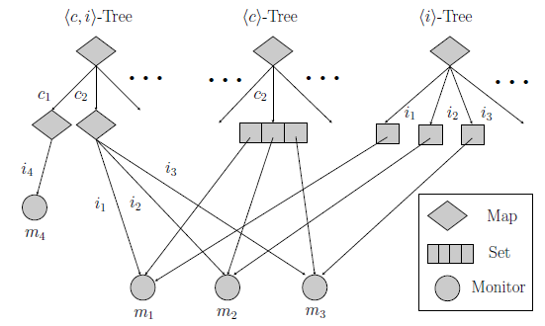
Monitor Indexing
Indexing trees using weak references
One tree per parameter combination in events
Monitors are collected when no events available

Slide 27
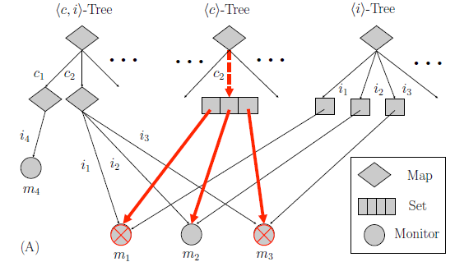
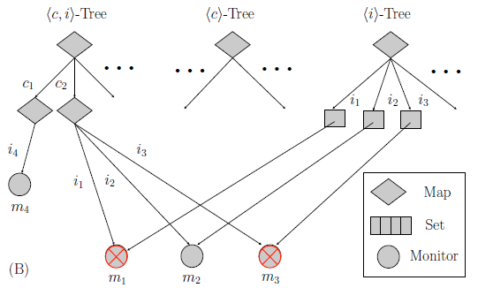
More Garbage Collection
Indexing trees alone not good enough
Pathological examples where unnecessary monitors stay alive forever
Solution: analyze the property statically; then collect monitors when they have no future

Slide 28
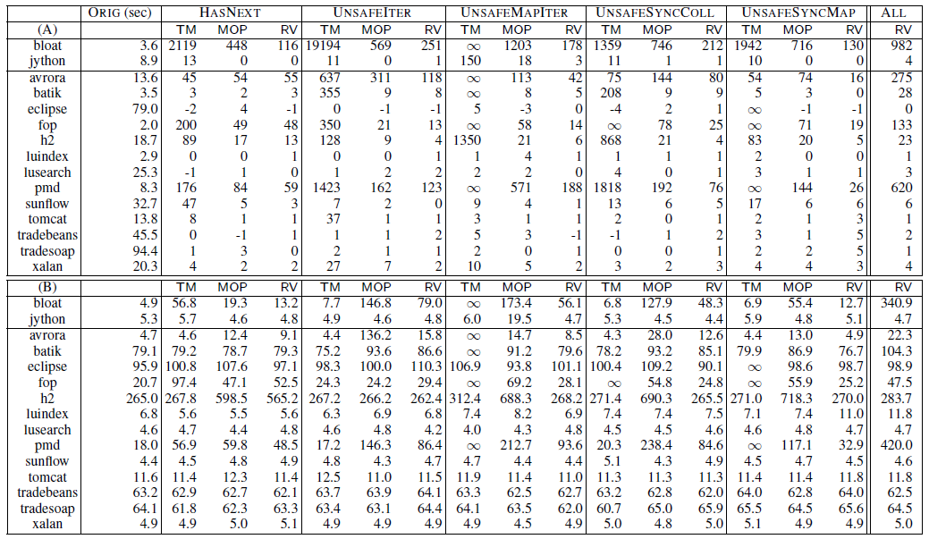
RV Monitoring Performance Evaluation
>2x faster than JavaMOP, >10x faster than Tracematches
(A) Runtime overhead in % (B) Memory overhead in MB

Slide 29
RV Prediction
Predicts errors in concurrent programs
Model checking: number of interleavings is prohibitively large
Testing: interleavings depend on environment
Combine dynamic and static methods to find bad behaviors near correct executions
29

Slide 30
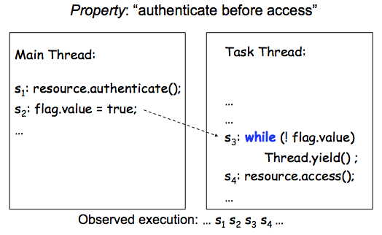
Prediction Example

Slide 31
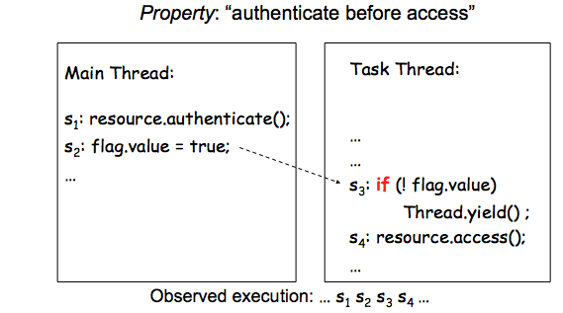
Prediction Example
Buggy S4 can be executed before S1
Low likelyhood to hit error in testing
31

Slide 32
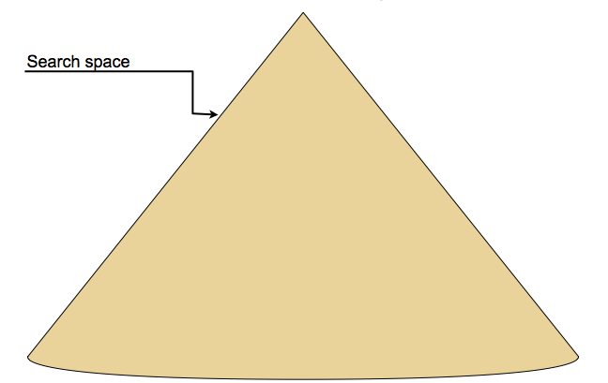
Predictive Runtime Analysis

Slide 33
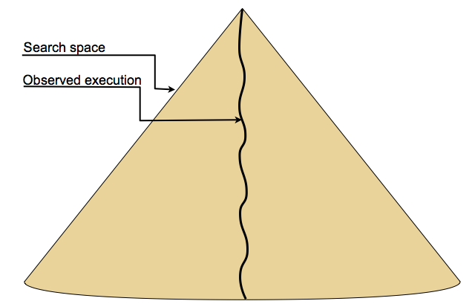
Predictive Runtime Analysis

Slide 34
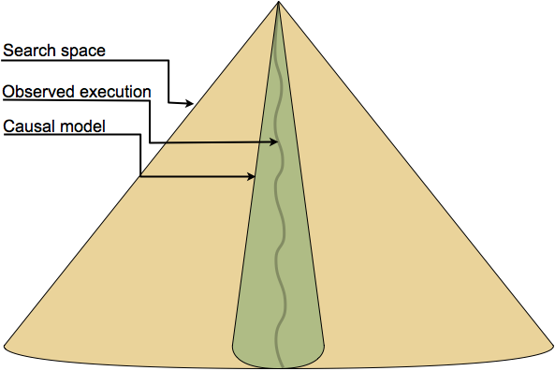
Predictive Runtime Analysis

Slide 35
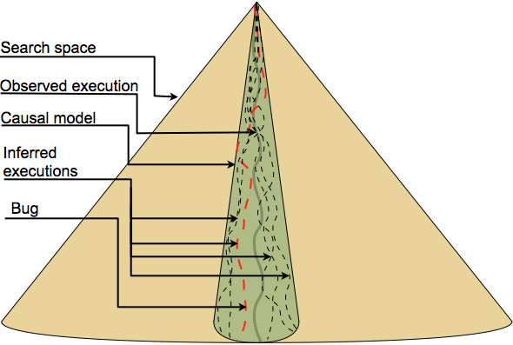
Predictive Runtime Analysis

Slide 36
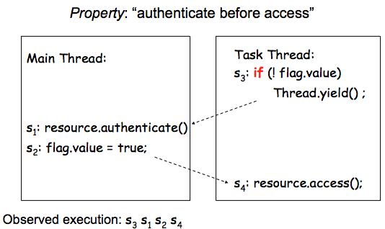
Happens-Before Works ... If Lucky

Slide 37
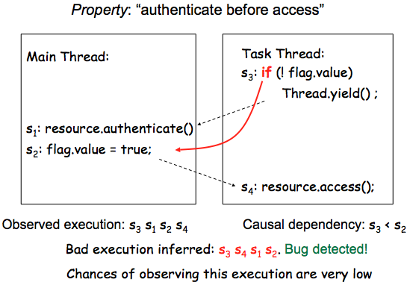
Happens-Before Works ... If Lucky

Slide 38
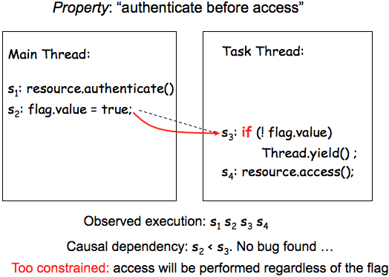
Happens-Before Limitations

Slide 39
RV Uses Sliced Causality
Relaxes the Happens-Before causal model
How? Focus on the property
Use static information about the program
Remove irrelevant events and causalities
Smaller and more relaxed causal model
(Exponentially) more inferred executions
Better predictive capability
39

Slide 40
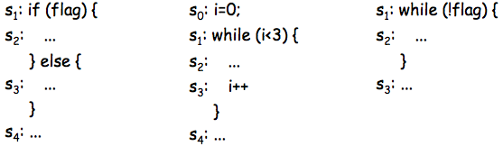
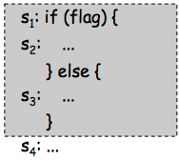
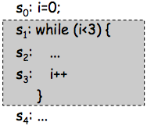
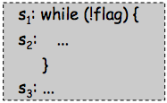
Static Information: Control Scope
S2 is in the control scope of S1 if its execution depends on a choice at S1
Extends to other control statements
break/continue, return, exceptions
40

Slide 41
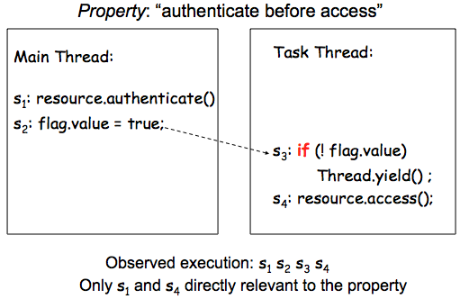
Sliced Causality Works!

Slide 42
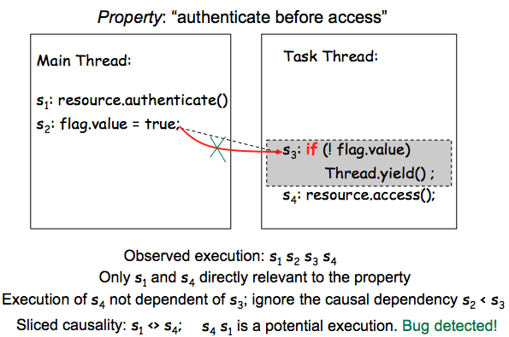
Slice Causality Works!

Slide 43
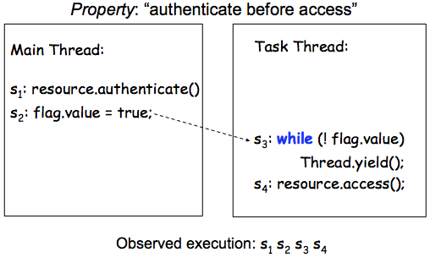
No False Alarms ☺

Slide 44
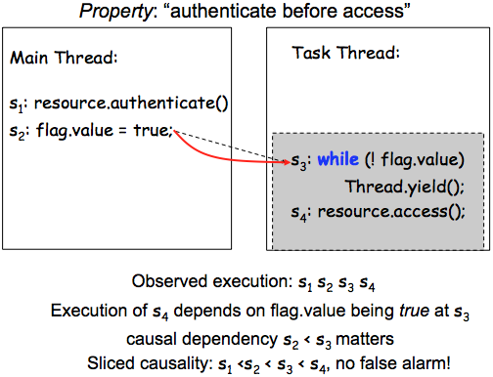
No False Alarms ☺

Slide 45
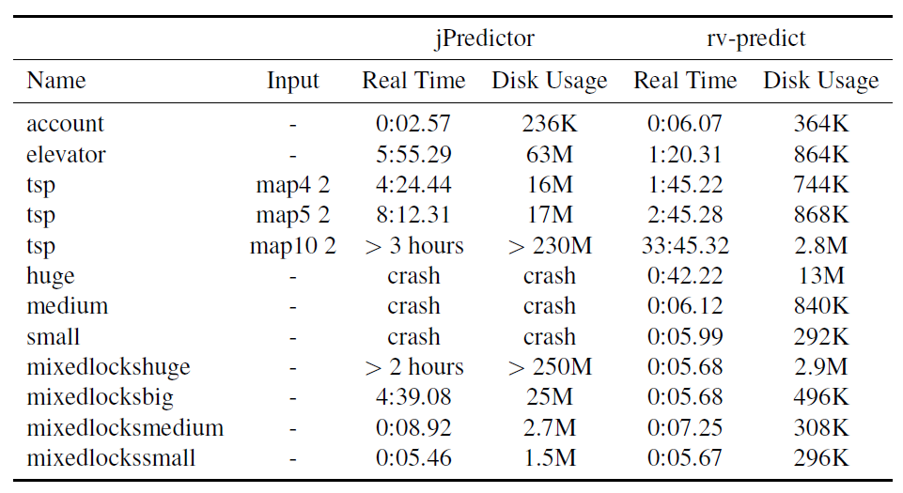
RV Prediction Performance

Slide 46
RV Mining
RV monitoring slices parametric traces and sends each slice to a monitor instance
RV miner is dual to RV monitor:
It uses (almost) the same trace slicer, but instead of sending the slices to monitors, uses them as input to a regular property learner (PFSA)
This way, we were able to mine most of the parametric specifications that we previously used for monitoring

Slide 47
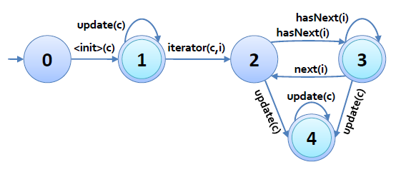
RV Mining Example I
Two properties in one:
the collection-iterator
the hasnext typestate

Slide 48
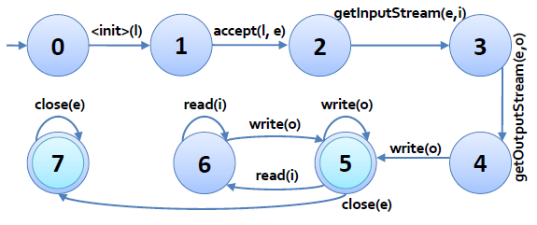
RV Mining Example
Server socket parametric specification:

Slide 49
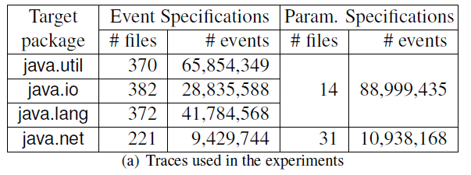
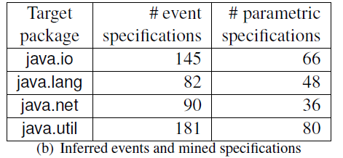
RV Mining Preliminary Evaluation I
Used several packages that come with unit tests

Slide 50
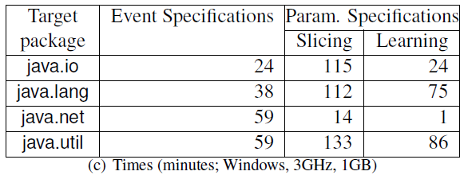
RV Mining Preliminary Evaluation II
Still relatively slow, though the mined specifications are very useful and general-purpose
Slicing is the most expensive

Slide 51
Conclusion
The RV system combines monitoring, prediction and specification mining
Uses at its core the notion of parametric specification, together with algorithms for parametric trace slicing used across any of the monitoring, prediction and mining capabilities
RV shows that the three apparently different technologies, namely monitoring, prediction and mining, in fact belong together

