Slide 1
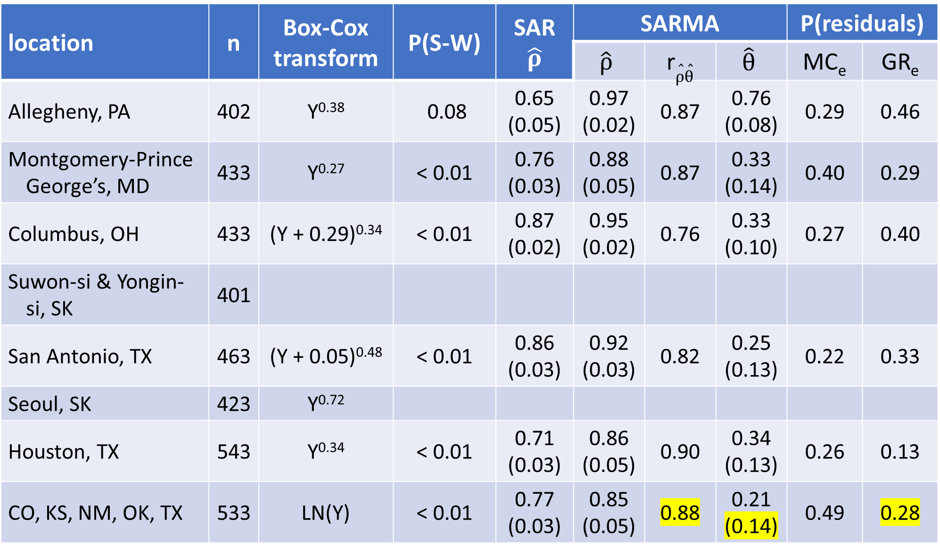
location | n | Box-Cox transform | P(S-W) | SAR $$\hat{ρ}$$ | SARMA |  |  | P(residuals)
 |  |  |  |  | $$\hat{ρ}$$ | r$\hat{ρ}\hat{θ}$ | $$\hat{θ}$$ | MC_{e} | GR_{e}
Allegheny, PA | 402 | Y^{0.38} | 0.08 | 0.65 (0.05) | 0.97 (0.02) | 0.87 | 0.76 (0.08) | 0.29 | 0.46
Montgomery-Prince George’s, MD | 433 | Y^{0.27} | < 0.01 | 0.76 (0.03) | 0.88 (0.05) | 0.87 | 0.33 (0.14) | 0.40 | 0.29
Columbus, OH | 433 | (Y + 0.29)^{0.34} | < 0.01 | 0.87 (0.02) | 0.95 (0.02) | 0.76 | 0.33 (0.10) | 0.27 | 0.40
Suwon-si & Yongin-si, SK | 401
San Antonio, TX | 463 | (Y + 0.05)^{0.48} | < 0.01 | 0.86 (0.03) | 0.92 (0.03) | 0.82 | 0.25 (0.13) | 0.22 | 0.33
Seoul, SK | 423 | Y^{0.72}
Houston, TX | 543 | Y^{0.34} | < 0.01 | 0.71 (0.03) | 0.86 (0.05) | 0.90 | 0.34 (0.13) | 0.26 | 0.13
CO, KS, NM, OK, TX | 533 | LN(Y) | < 0.01 | 0.77 (0.03) | 0.85 (0.05) | 0.88 | 0.21 (0.14) | 0.49 | 0.28

Slide 2
Feature | Alle-gheny, PA | Mont. & P-G’s, MD | Colum-bus, OH | Suwon-si & Yongin-si, SK | San Anton-io, Tx | Seoul, SK | Hous-ton, TX | CO, KS, NM, OK, TX
# PSA vectors | 41 | 53 | 53 |  | 55 |  | 64 | 61
# NSA vectors | 33 | 12 | 14 |  | 22 |  | 18 | 22
R² | 0.68 | 0.69 | 0.82 |  | 0.82 |  | 0.67 | 0.71
ESF_{PSA} R² | 0.53 | 0.65 | 0.78 |  | 0.77 |  | 0.61 | 0.65
ESF_{NSA} R² | 0.15 | 0.05 | 0.04 |  | 0.04 |  | 0.06 | 0.06
MC_{ESF} | 0.61 | 0.76 | 0.85 |  | 0.83 |  | 0.73 | 0.76
GR_{ESF} | 0.42 | 0.31 | 0.22 |  | 0.22 |  | 0.31 | 0.29
MC_{residuals} (p value) | −0.01 (0.05) | −0.03 (0.01) | −0.02 (0.01) |  | −0.00 (< 0.01) |  | 0.03 (< 0.01) | −0.02 (0.01)
GR_{residuals} | 1.01 | 0.90 | 1.00 |  | 0.95 |  | 0.87 | 0.96
P(S-W_{residuals}) | 0.14 | < 0.01 | 0.20 |  | 0.15 |  | < 0.01 | < 0.01

