Slide 1
CENTURY ECOSYSTEM
MODEL
Introduction to CENTURY

Slide 2
WHY CENTURY
Evaluate Effects of Environmental Change
Evaluate Changes in Management

Slide 3
What is CENTURY?
Simple Ecosystem Model
Soil Organic Matter
Plant Production
Hydrological
Nutrient Cycle

Slide 4
Why CENTURY was developed
From early experience (1970’s) of attempting to model everything (e.g. IBP) an understanding of the inherent problems of scaling processes and components within appropriate time and spatial scales for a specific set of questions or hypotheses

Slide 5
MODEL DEVELOPMENT
Development of CENTURY of biogeochemical cycles of C, N, P, and S for various ecosystem found globally was undertaken in order to provide adequate process-level representation of key transfers of material from critical ecosystem components.
Soil Organic Matter (SOM) was the focus of the model development because of the integration of ecosystem processes and environmental changes which is represented in SOM.
Environmental and land management factors can be easily incorporated into the simulations of SOM development.
Input parameters be meaningful in ecological terms and easily acquired from existing data bases or experimentally determined.

Slide 6
MODEL STRUCTURE
Structure based on turnover rates of SOM pools
THREE TYPES OF SOM POOLS
ACTIVE: Live microbes and their by- products
(2 to 5 year turnover)
SLOW: Physically and chemically protected
(20 to 50 years turnovers)
PASSIVE: Physically protected or chemically resistant SOM
(800 to 1200 year turnover)

Slide 7
MODEL CONTROLS
Monthly inputs of temperature and rainfall
Soil properties easily defined
Plant system controlled by T, H₂O, and nutrient availability
Land management practices modifies ecosystem processes
Hydrological input-output processes represented

Slide 8
WHY MODEL?
Provides a conceptual framework from which to pose hypotheses
Provides a mechanism to test a set of complex hypotheses
Provides insight into methods of field/lab testing model predictions

Slide 9
SUMMARY
CENTURY IS A TOOL FOR ANALYSIS OF CONTROLS ON SOIL ORGANIC MATTER AND PRODUCTIVITY
SIMULATION RESULTS DEMONSTRATE HOW INPROVED MANAGEMENT PRACTICES CAN ARREST ORGANCI MATTER LOSSES AND IMPROVE DEGRADED SOILS THROUGH:
    Higher yielding varieties
    Reduced soil disturbance
    Maintenance of crop residues
    Replacement of nutrient losses

Slide 10
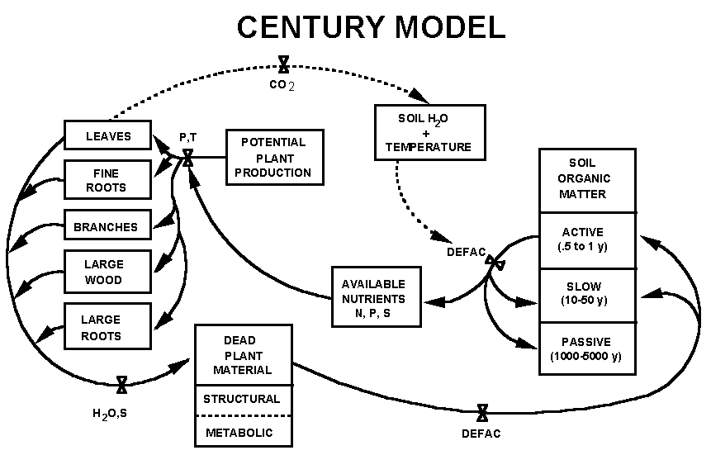
Overall flow diagram for the CENTURY model.
Notes:
Figure 1: Overall flow diagram for the CENTURY model.

Slide 11
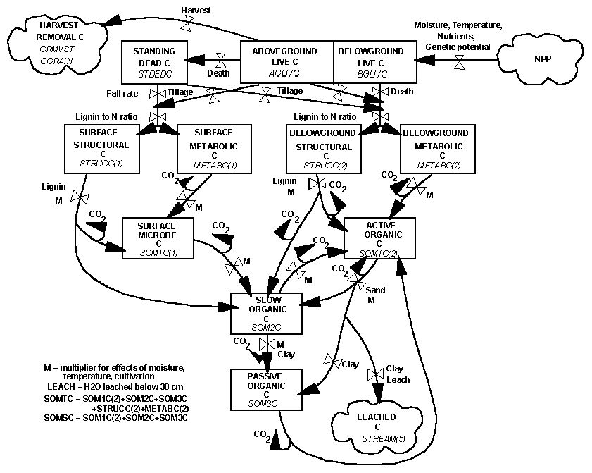
Flow diagram for the soil carbon submodel.
Notes:
Figure 2: Flow diagram for the soil carbon submodel.

Slide 12
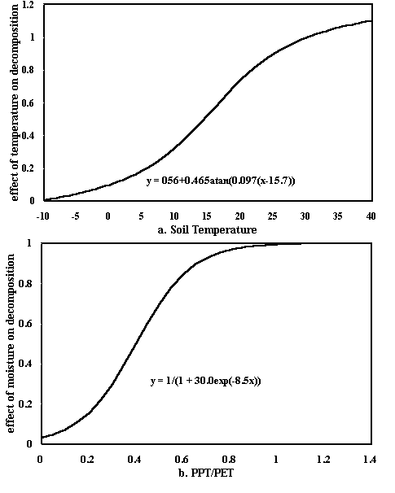
Impact of temperature and water on decomposition.
Notes:
Figure 3: Impact of temperature and water on decomposition.

Slide 13
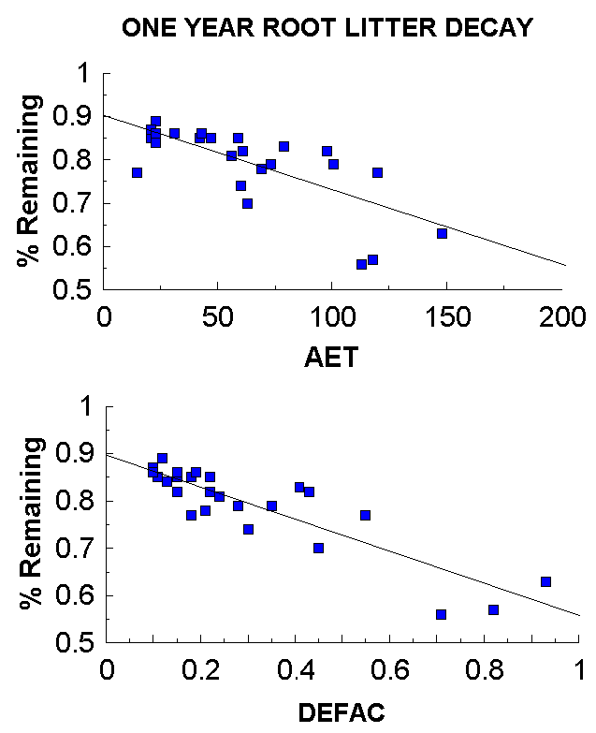
Impact of DEFAC and AET on decomposition.
Notes:
Figure 4 - Impact of DEFAC and AET on decomposition.

Slide 14
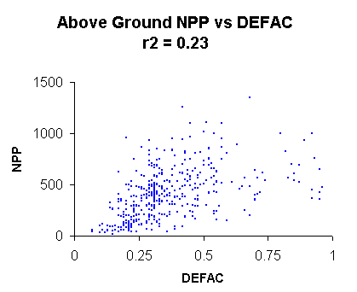
Observed above ground NPP for various global sites vs. CENTURY modeled abiotic decomposition factor (DEFAC).
Notes:
Figure 5: Observed above ground NPP for various global sites vs. CENTURY modeled abiotic decomposition factor (DEFAC).

Slide 15
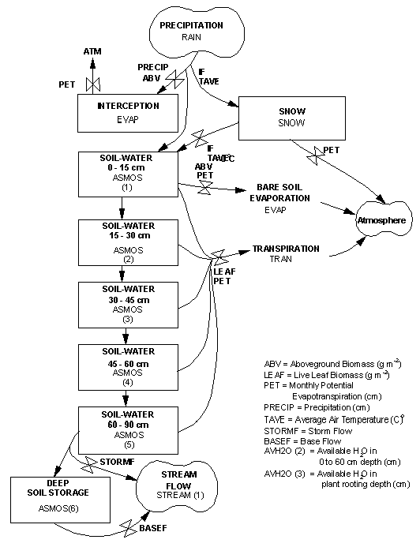
Flow diagram for the water flow submodel.
Notes:
Figure 6: Flow diagram for the water flow submodel.

Slide 16
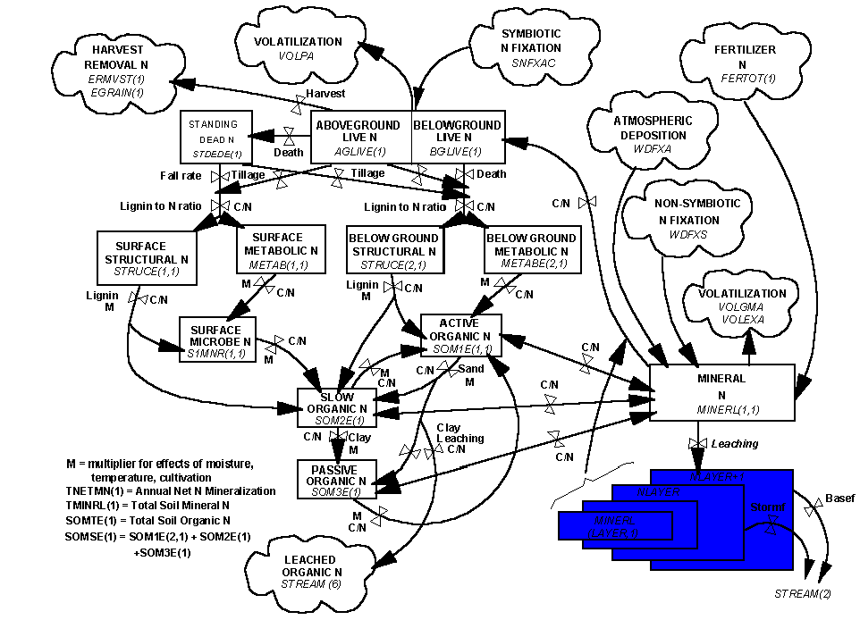
Flow diagram for the nitrogen submodel.
Notes:
Figure 7: Flow diagram for the nitrogen submodel.

Slide 17
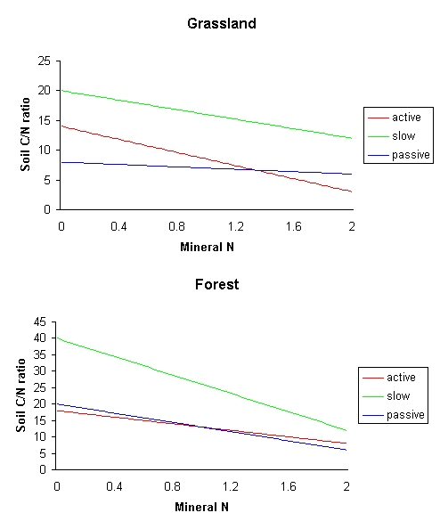
Impact of mineral N on soil C/N ratios for grasslands and forests.
Notes:
Figure 8: Impact of mineral N on soil C/N ratios for grasslands and forests

Slide 18
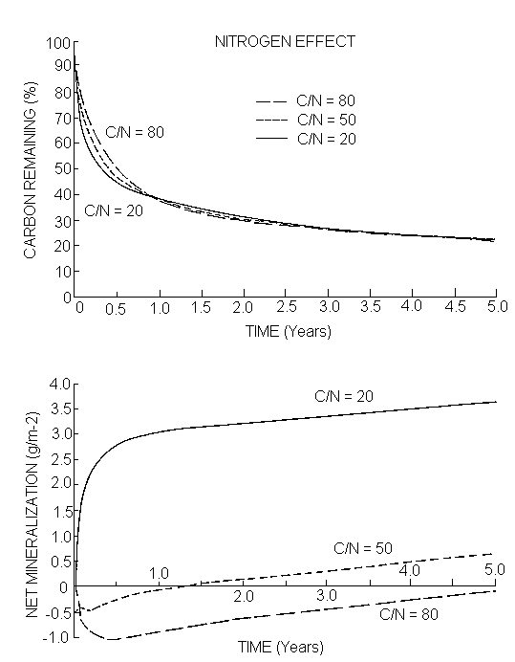
Effect of initial litter N content on litter carbon and N mineralization.
Notes:
Figure 9: Effect of initial litter N content on litter carbon and N mineralization

Slide 19
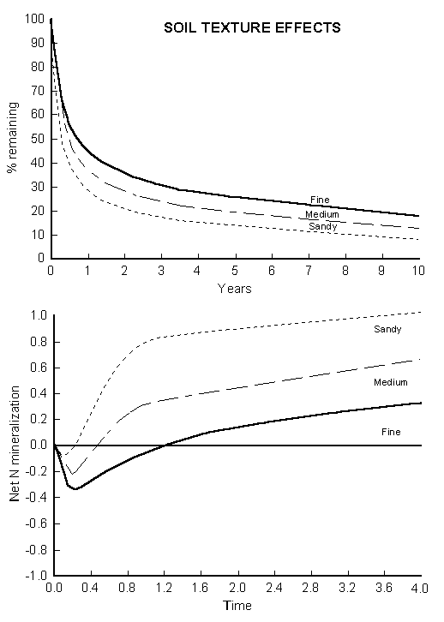
Effect of soil texture on litter C and N mineralization.
Notes:
Figure 10: Effect of soil texture on litter C and N mineralization

Slide 20
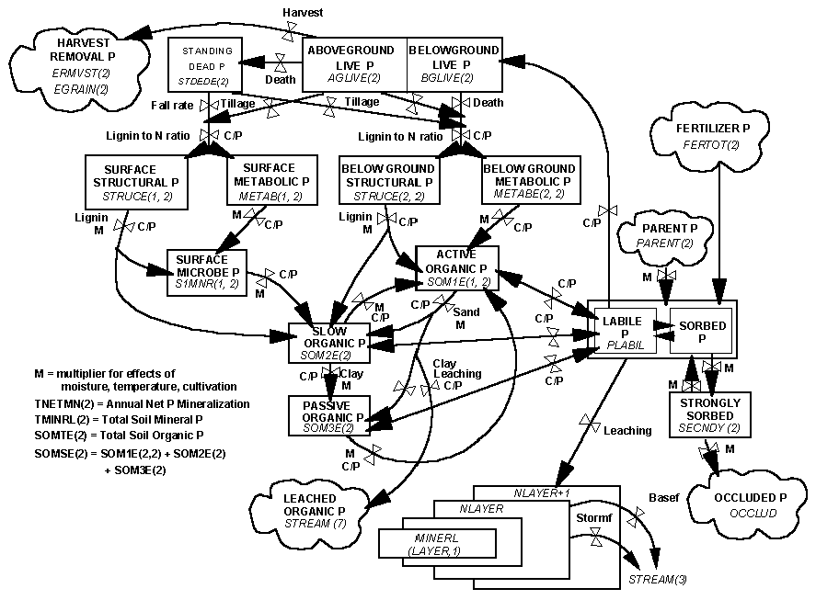
Flow diagram for the phosphorus submodel.
Notes:
Figure 11: Flow diagram for the phosphorus submodel

Slide 21
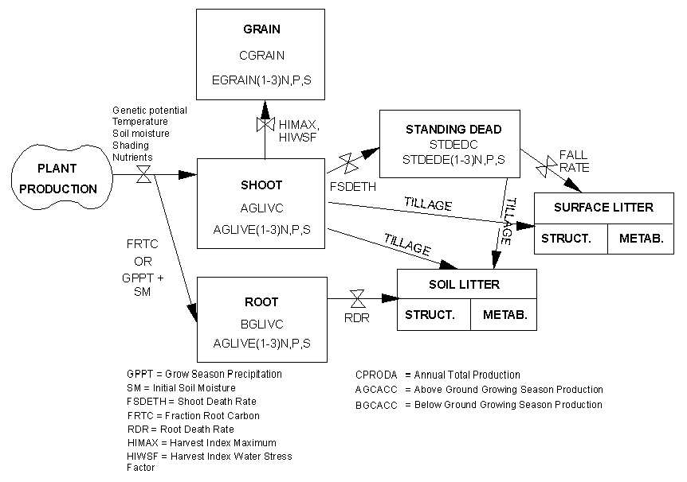
Flow diagram for the grass/crop submodel.
Notes:
Figure 12: Flow diagram for grass/crop submodel.

Slide 22
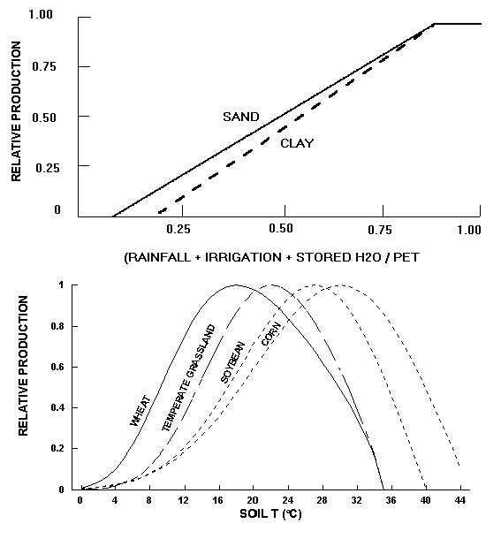
Impact of soil water and temperature on plant production.
Notes:
Figure 13: Impact of soil water and temperature on plant production.

Slide 23
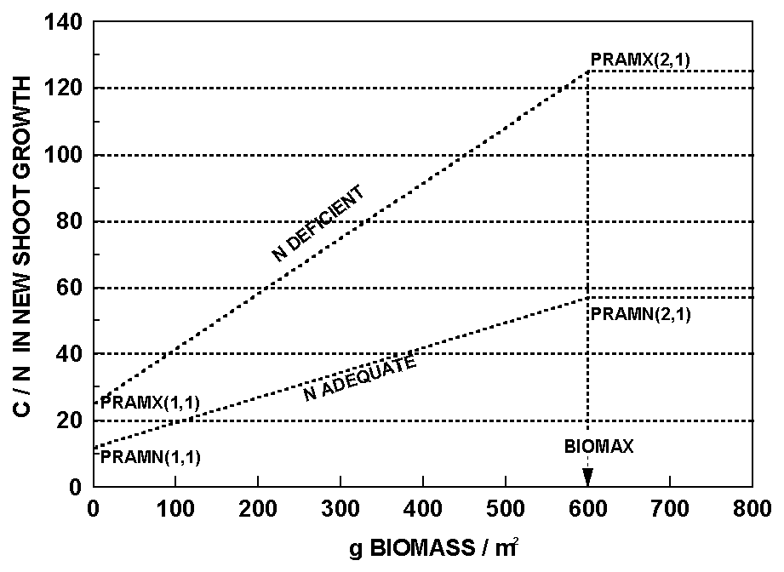
C/N of live shoots vs. biomass for grass/crop systems.
Notes:
Figure 14: C/N of live shoots vs. biomass for grass/crop systems.

Slide 24
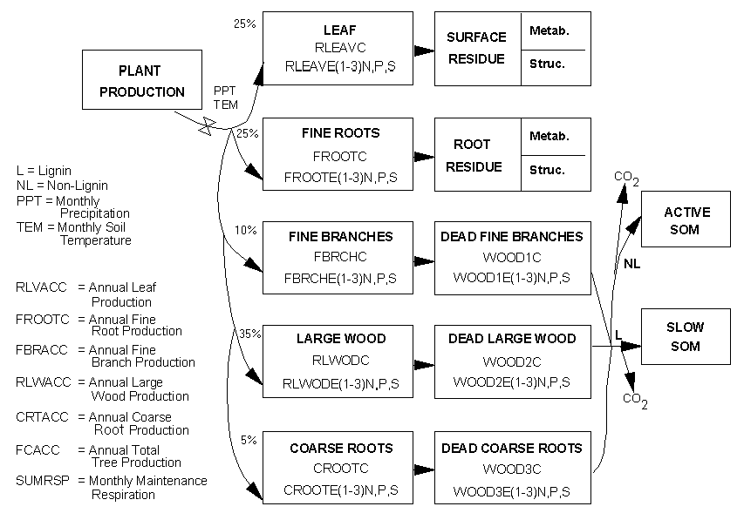
Flow diagram for forest submodel.
Notes:
Figure 15: Flow diagram for forest submodel.

Slide 25
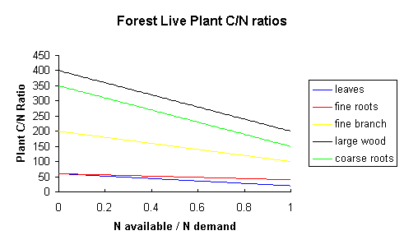
Live forest C/N ratio as a function of ratio of available plant N to potential plant N demand.
Notes:
Figure 16: Live forest C/N ratio as a function of ratio of available plant N to potential plant N demand.

Slide 26
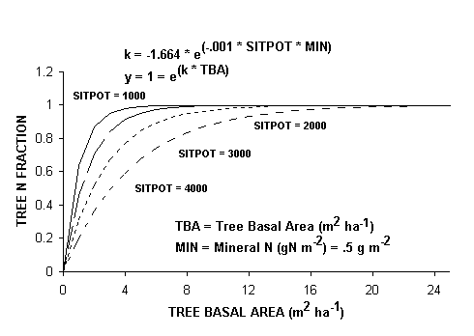
Allocation of N to trees vs. grass as a function of tree basal area and SITPOT.
Notes:
Figure 17: Allocation of N to trees vs. grass as a function of tree basal area and SITPOT.

Slide 27
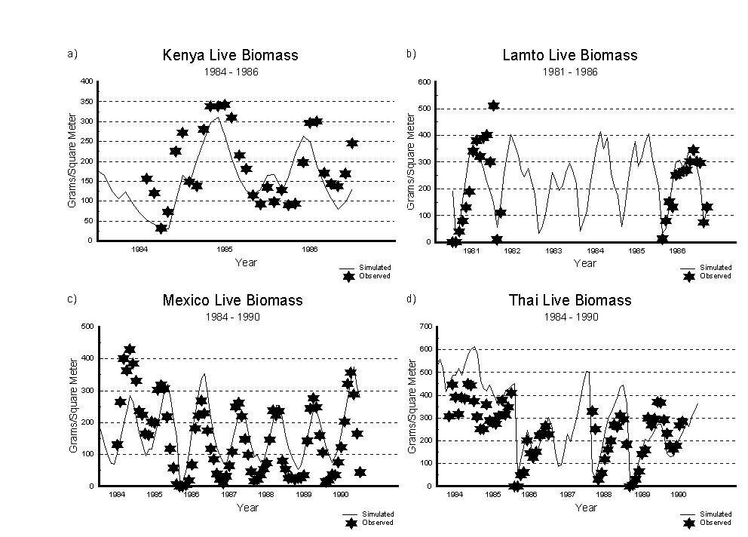
Comparison of simulated and observed live biomass for (a) Kenya, (b) Lamto, (c) Mexico, and (d) Thailand sites.
Notes:
Figure 18: Comparison of simulated and observed live biomass for (a) Kenya, (b) Lamto, (c) Mexico, and (d) Thailand sites.

Slide 28
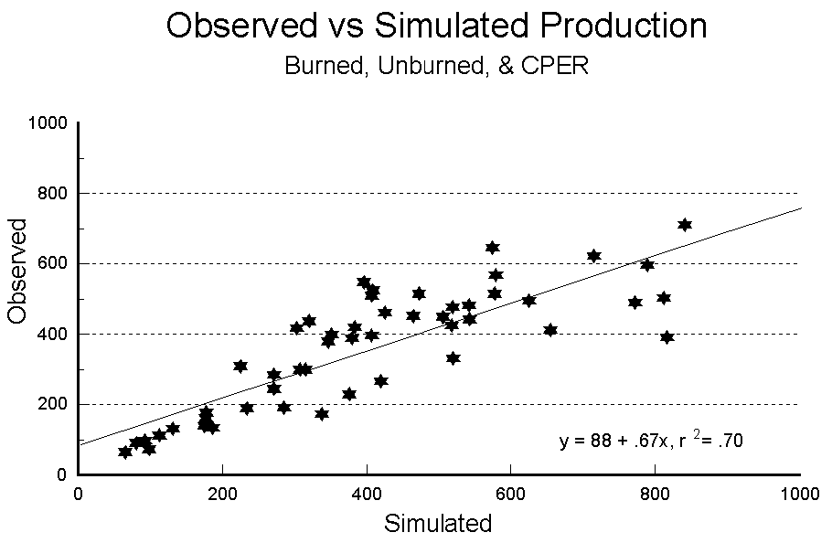
Comparison of observed and simulated aboveground plant production.
Notes:
Figure 19: Comparison of observed and simulated aboveground plant production.

Slide 29
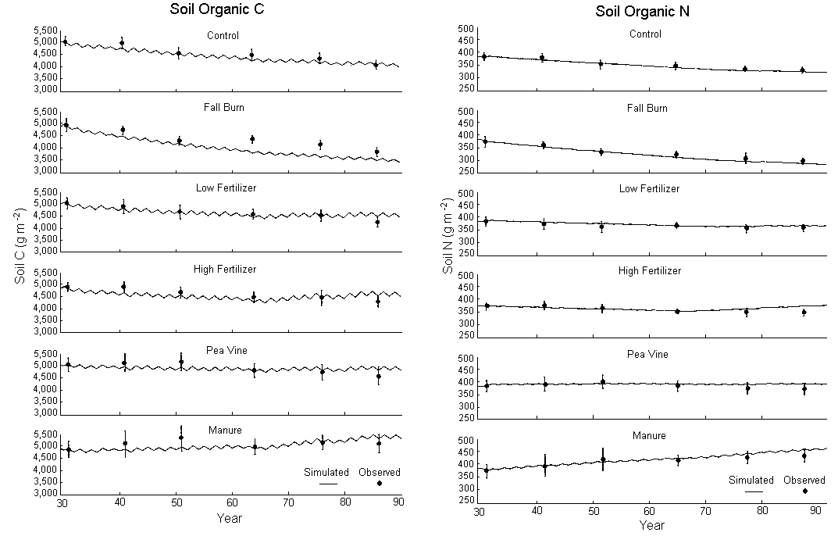
Comparison of observed and simulated soil C (0-30 cm) and soil N (0-30 cm).
Notes:
Figure 20: Comparison of observed and simulated soil C (0-30 cm) and soil N (0-30 cm).

Slide 30
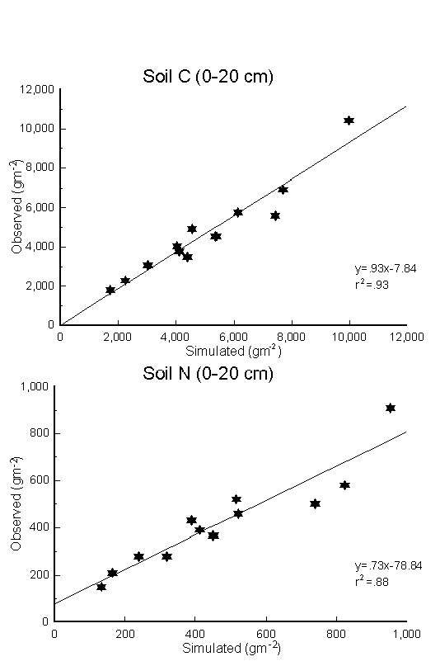
Comparison of simulated and observed soil (a) C and (b) N.
Notes:
Figure 21: Comparison of simulated and observed soil (a) C and (b) N.

Slide 31
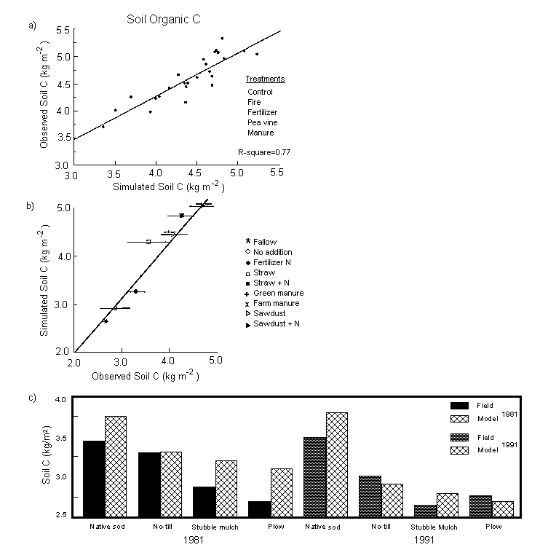
Observed vs. simulated soil C for different treatments.
Notes:
Figure 22: Observed vs. simulated soil C for different treatments.

Slide 32
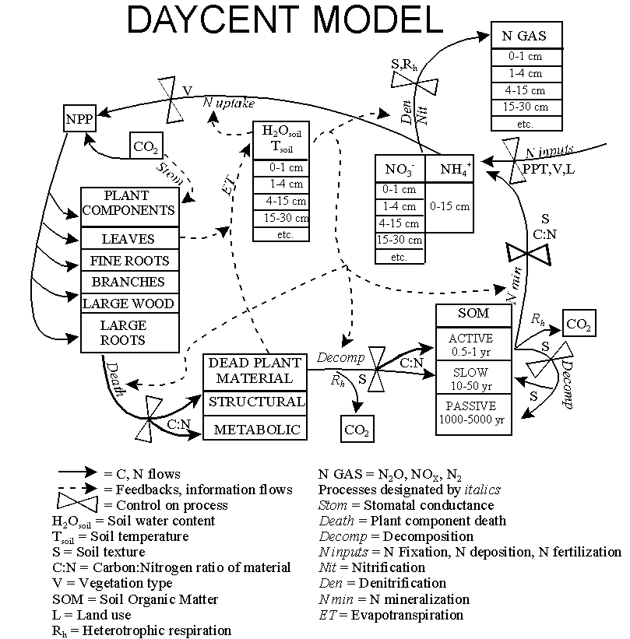
Flow diagram for DAYCENT.
Notes:
Figure 23: Flow diagram for DAYCENT.

Slide 33
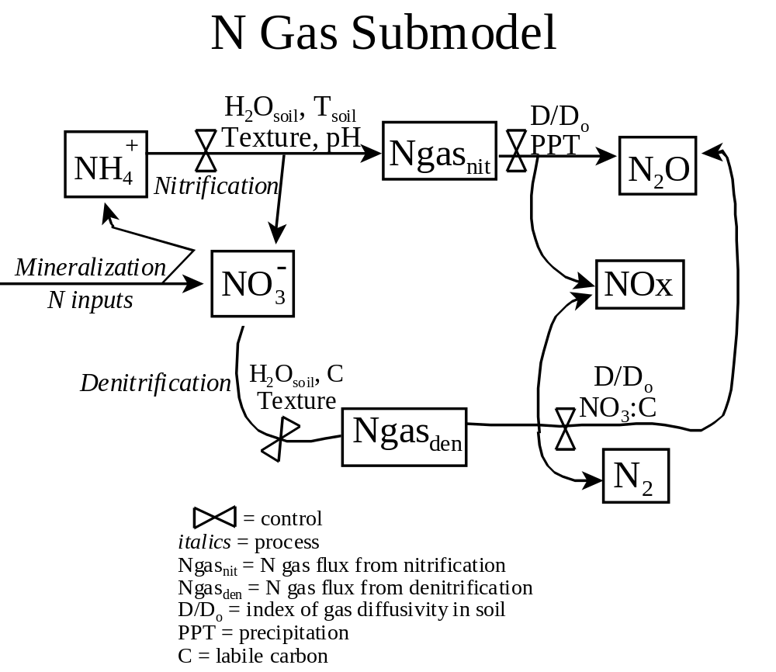
Nitrification and denitrification N gas flow diagram. (Del Grosso et al. 2001)
Notes:
Figure 24: Nitrification and denitrification N gas flow diagram.

Slide 34
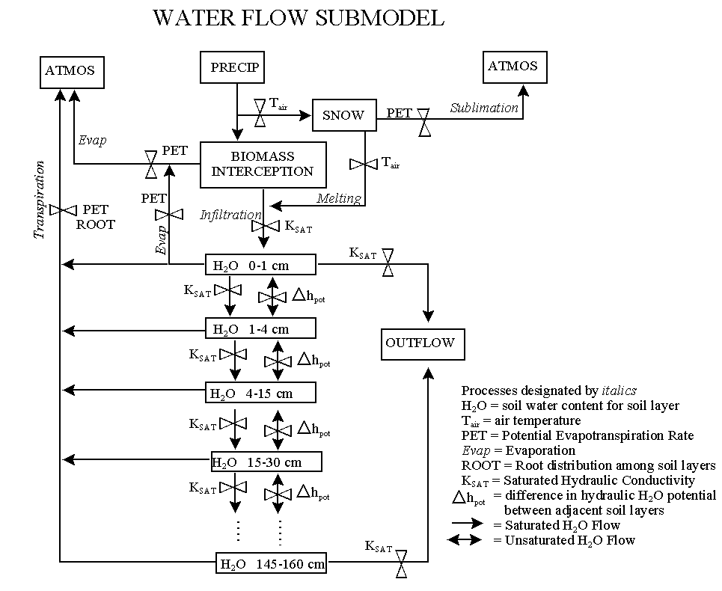
DAYCENT soil water flow diagram.
Notes:
Figure 25: DAYCENT soil water flow diagram

Slide 35
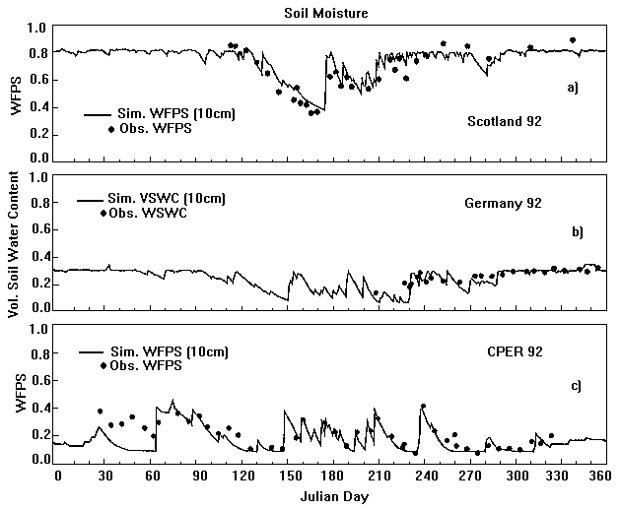
Comparison of observed vs. simulated WFPS.
Notes:
Figure 26: Comparison of observed vs. simulated WPFS.

Slide 36
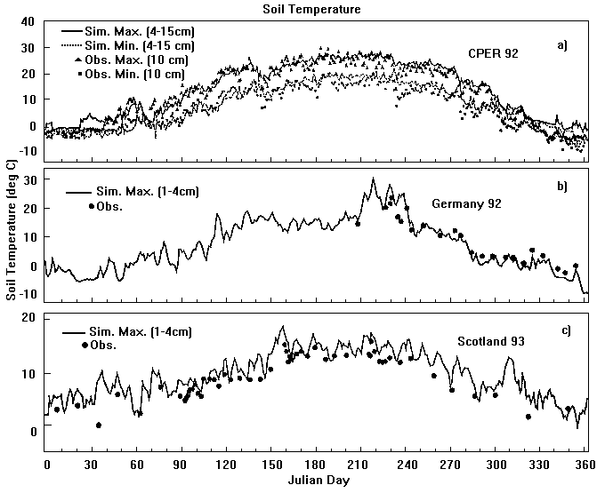
Comparison of observed vs. simulated soil temperature.
Notes:
Figure 27: Comparison of observed vs. simulated soil temperature.

Slide 37
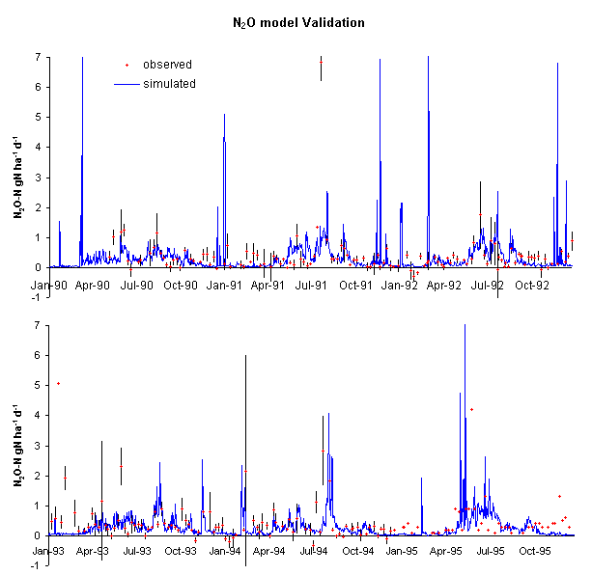
Comparison of observed vs. simulated N₂O flux.
Notes:
Figure 28 – Comparison of observed and simulated N20 flux.

Slide 38
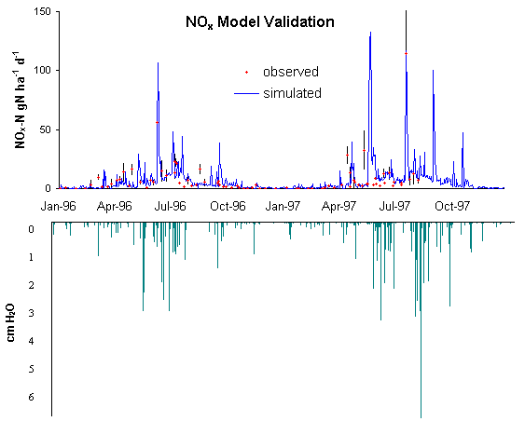
Comparison of observed and simulated NO_{x} flux.
Notes:
Figure 29: Comparison of observed and simulated Nox flux.

Slide 39
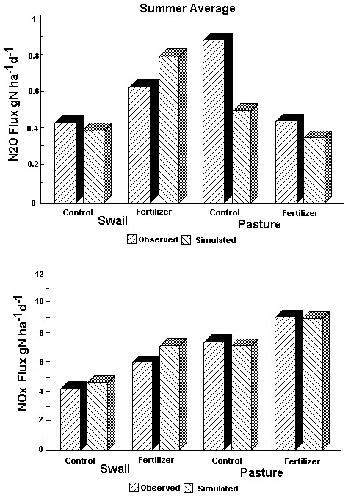
Comparison of observed and simulated H₂O and NO_{x} fluxes.
Notes:
Figure 30: Comparison of observed and simulated H2O and NOx fluxes.

Slide 40
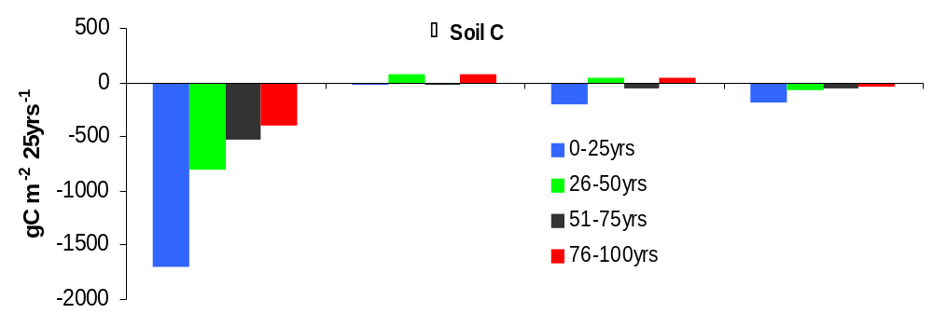
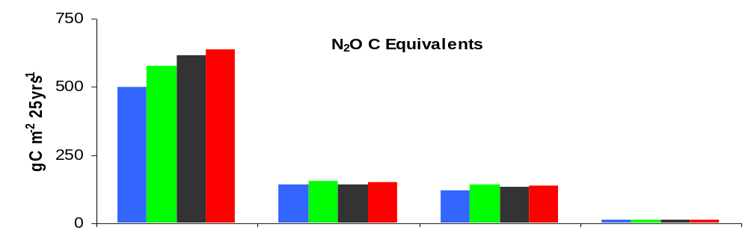
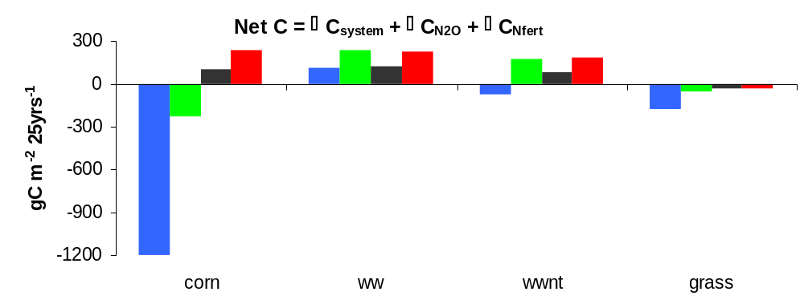
Comparison of simulated changes in soil C, integrated C equivalents of N₂O emissions and net C for a conventional tillage winter wheat/fallow system (ww), no till winter wheat fallow (wwnt), irrigated corn, and reversion to native grass for 25 year periods following 75 years of conventional till winter wheat/fallow land use. Negative values represent uptake of greenhouse gases by the soil. (From Del Grosso et al. 2001)
Δ
Σ
Σ
Δ
Σ
Σ
Σ
Notes:
Figure 31: Comparison of simulated changes in soil C, integrated C equivalents of N₂O emissions and net C for a conventional tillage winter wheat/fallow system (ww), no till winter wheat fallow (wwnt), irrigated corn, and reversion to native grass for 25 year periods following 75 years of conventional till winter wheat/fallow land use. Negative values represent uptake of greenhouse gases by the soil. (From Del Grosso et al. 2001)

Slide 41
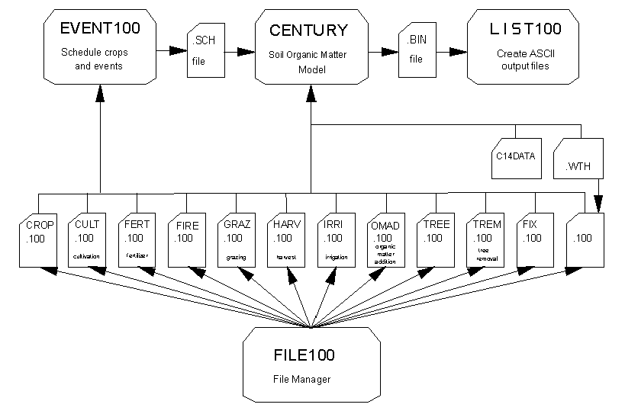
The CENTURY model environment showing the relationship between programs and the file structure.
Notes:
Figure 32: The CENTURY model environment showing the relationship between programs and the file structure.

