Slide 1
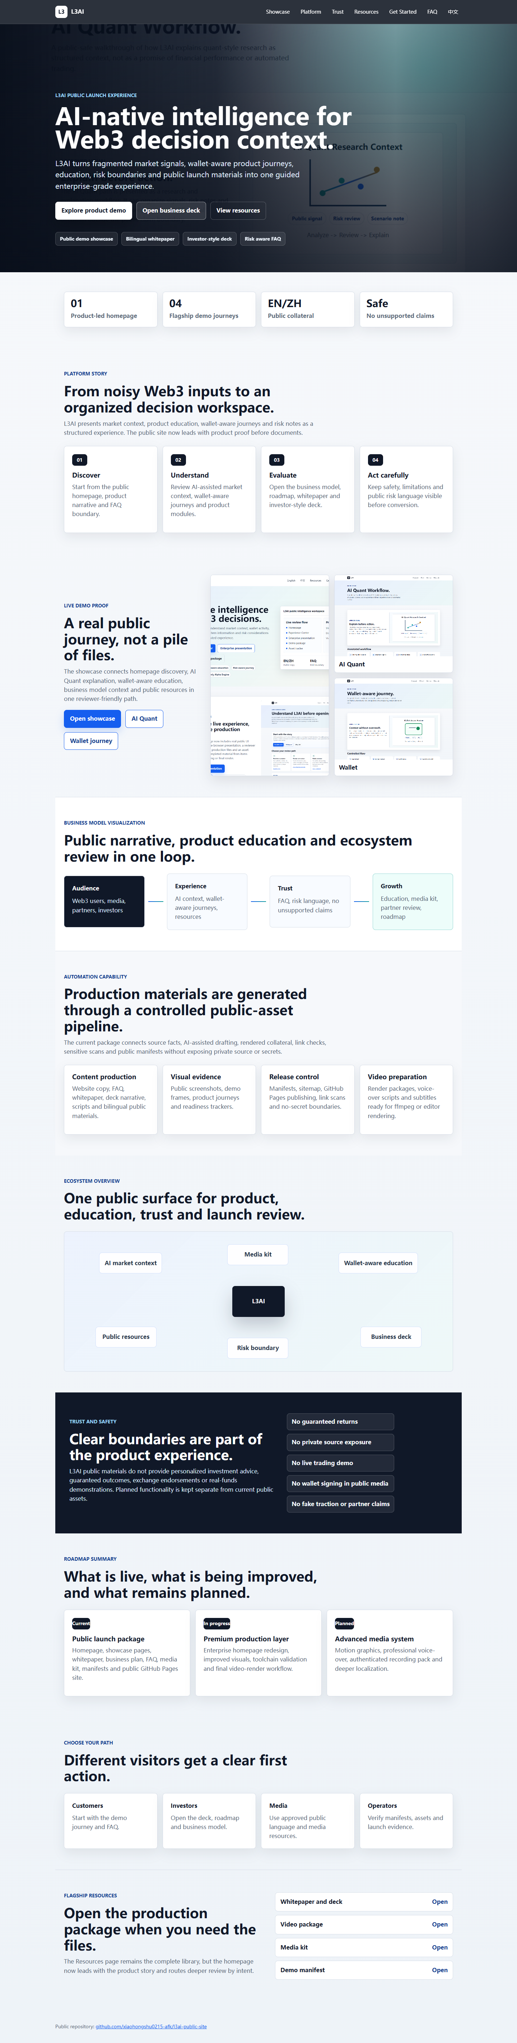
PUBLIC EXECUTIVE VIEW
L3AI organizes Web3 decisions before action.
A product-led public experience for market context, wallet-aware education, risk boundaries and launch-ready collateral.
Product-led
Review-gated
Public safe
L3AI Executive Deck v2 | PREMIUM-VIDEO-027 | 01

Slide 2
WHY IT MATTERS
Web3 users need context, not another file library.
The public experience must explain product journeys, business model and risk boundaries before asking users to act.
Problem
Stakes
Answer
Signals are fragmented
Trust is fragile
L3AI adds structure
Market data, wallet activity, product language and community claims rarely arrive in one clear path.
Public claims can outrun product, legal and security review if launch content is not controlled.
A guided intelligence layer makes product education and review more understandable.
L3AI Executive Deck v2 | PREMIUM-VIDEO-027 | 02

Slide 3
PUBLIC EXPERIENCE
The homepage now leads with product proof.
The premium homepage moves the story from downloads to demo-first proof, then routes deeper review by intent.
Demo
Deck
Resources
Homepage -> Showcase -> Business model -> Trust boundary -> Resources
L3AI Executive Deck v2 | PREMIUM-VIDEO-027 | 03
L3AI Executive Deck v2 | PREMIUM-VIDEO-027 | 03

Slide 4
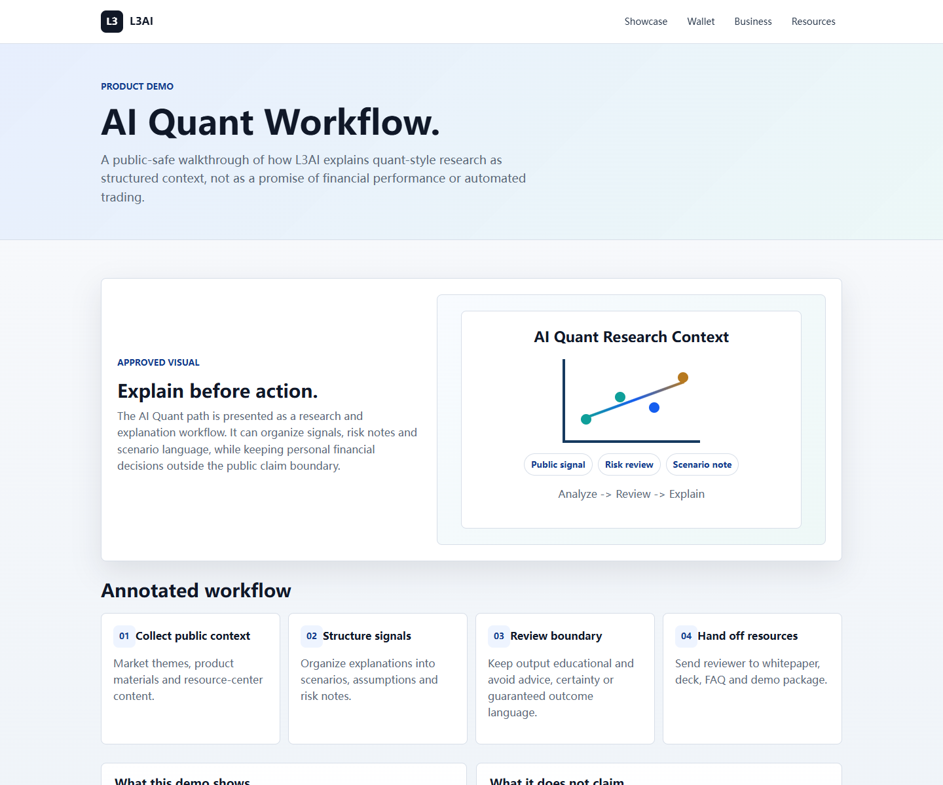
PRODUCT WORKFLOW
AI Quant is framed as research explanation.
The story stays ambitious while keeping personal financial decisions outside the public claim boundary.
Input
Role
Boundary
Public context
Explain
No certainty
Market themes and product materials are organized for review.
AI language helps compare, summarize and clarify assumptions.
The public story avoids performance promises and automated trading claims.
L3AI Executive Deck v2 | PREMIUM-VIDEO-027 | 04

Slide 5
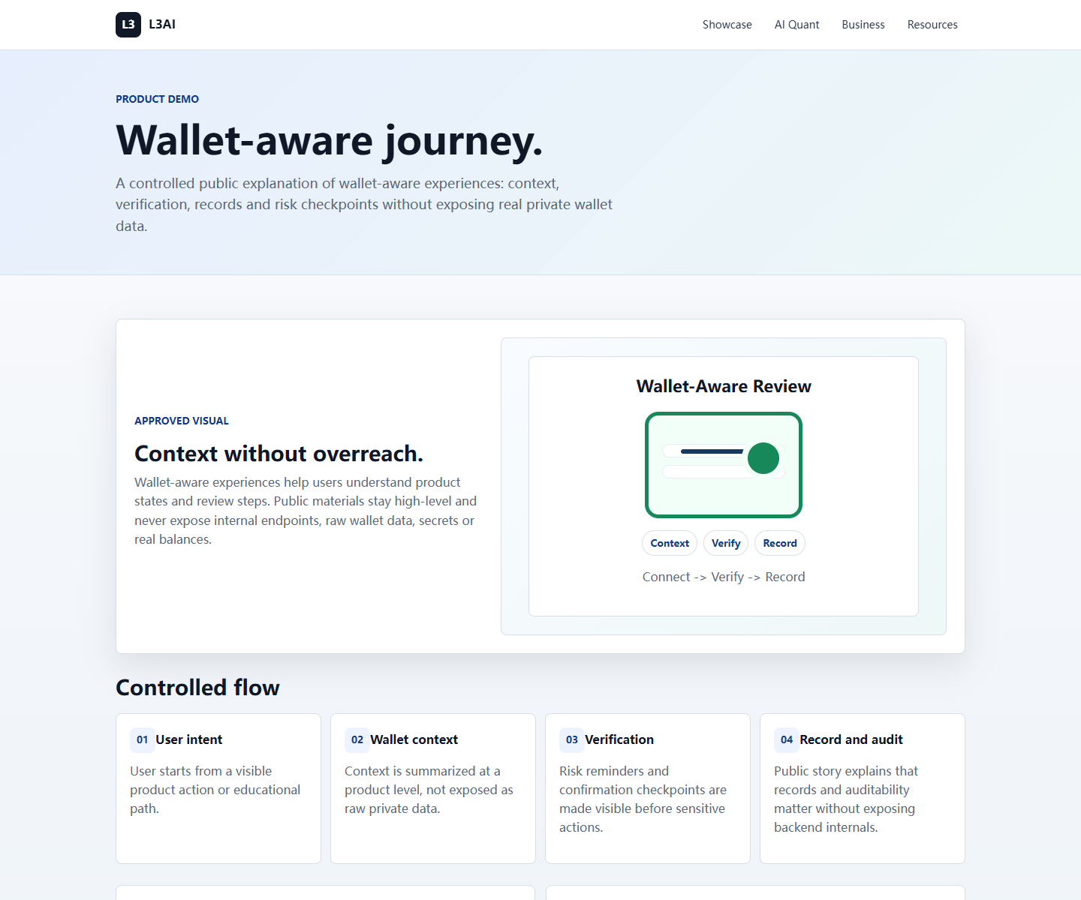
WALLET-AWARE JOURNEY
Wallet context is educational, not exposed.
The public wallet narrative shows verification and record concepts without displaying real private wallet data.
Context
Review
Record
Intent first
Checkpoints
Auditability
Users start from visible product or education paths.
Risk reminders appear before sensitive product actions.
Public wording stays high level and avoids backend internals.
L3AI Executive Deck v2 | PREMIUM-VIDEO-027 | 05

Slide 6
BUSINESS MODEL
The model is understandable without forecasts.
The public business story explains audience, experience, trust and growth without inventing revenue metrics.
Audience
Experience
Trust
Growth
Users, media, partners, investors
AI context, wallet-aware journeys
FAQ, risk language, public manifests
Education, media kit, partner review
L3AI Executive Deck v2 | PREMIUM-VIDEO-027 | 06
L3AI Executive Deck v2 | PREMIUM-VIDEO-027 | 06

Slide 7
TRUST LAYER
The safety boundary is visible by design.
No investment advice
No guaranteed outcomes
No real wallet data
The public story avoids advice, guaranteed outcomes, fake traction, private data and internal implementation details.
No fake traction
No private source exposure
L3AI Executive Deck v2 | PREMIUM-VIDEO-027 | 07

Slide 8
ECOSYSTEM
L3AI connects product, education and release governance.
Media kit
The system is strongest when public content, demo proof, resources, media and release evidence reinforce one another.
AI market context
Wallet-aware education
L3AI
Public resources
Business deck
Risk boundary
L3AI Executive Deck v2 | PREMIUM-VIDEO-027 | 08
L3AI Executive Deck v2 | PREMIUM-VIDEO-027 | 08

Slide 9
ROADMAP
Current, in progress and planned work stay separate.
This keeps public expectations clear while still showing the larger product direction.
Current
In progress
Planned
Launch package
Production media
Advanced recordings
Premium website, showcase pages, whitepaper, deck, FAQ, media kit and manifests.
Rendered promo video, executive deck v2, QA reports and upgraded public assets.
Authenticated product recording, voice-over, motion graphics and deeper localization.
L3AI Executive Deck v2 | PREMIUM-VIDEO-027 | 09

Slide 10
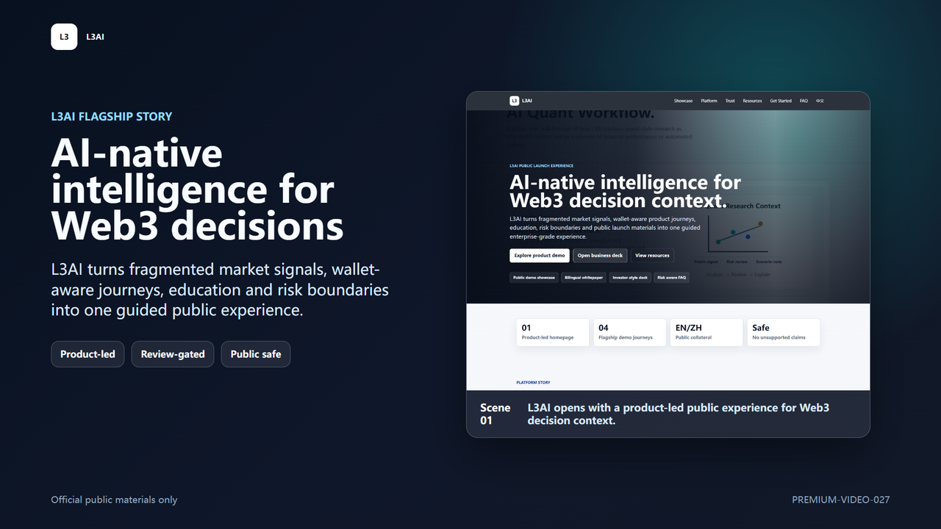
MEDIA SYSTEM
The video and website now reinforce each other.
A 3-minute flagship video directs viewers back to the live public demo, deck, resources and verification manifest.
MP4
Subtitles
Poster
Rendered locally with ffmpeg and public screenshots.
L3AI Executive Deck v2 | PREMIUM-VIDEO-027 | 10
L3AI Executive Deck v2 | PREMIUM-VIDEO-027 | 10

Slide 11
QUALITY GATE
Public collateral is scored by readiness, not optimism.
The quality report separates complete production assets from work that still requires human creative production.
Ready
Ready
Manual
Website and video
Executive deck
Creative extras
Homepage, showcase, rendered MP4, subtitles and thumbnails.
Editable PPTX with screenshots, diagrams and concise narrative.
Voice-over, authenticated recordings and motion graphics remain specialist production.
L3AI Executive Deck v2 | PREMIUM-VIDEO-027 | 11

Slide 12
NEXT ACTION
Use the official public package for controlled review.
Watch video
Open showcase
Start with the video, open the live demo, then use the executive deck and resources for deeper diligence.
Read whitepaper
Verify manifest
L3AI Executive Deck v2 | PREMIUM-VIDEO-027 | 12

