Slide 1
EDA Dataset & Model

Slide 2
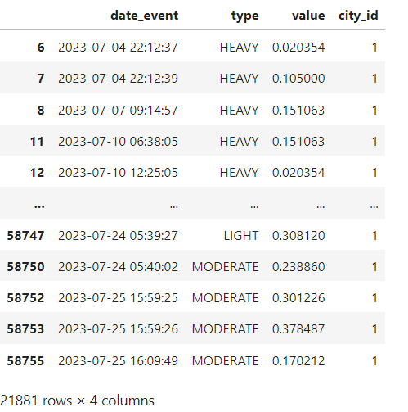
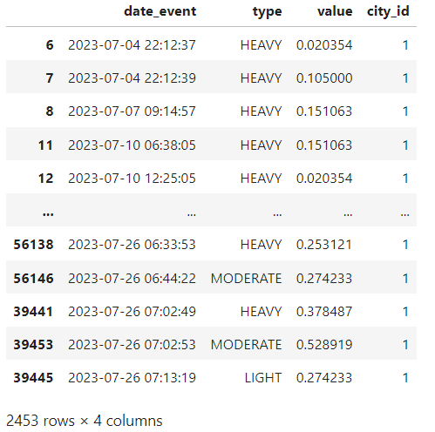
Raw Dataset
21881 rows
4 cols
Type : ['HEAVY' 'LIGHT' 'MODERATE’]
City : [1]
Processed Dataset v1 (drop duplicate)
2453 rows (- 88.8%)
4 cols
Type : ['HEAVY' 'LIGHT' 'MODERATE’]
City : [1]
Date : 7/4 – 7/26

Slide 3
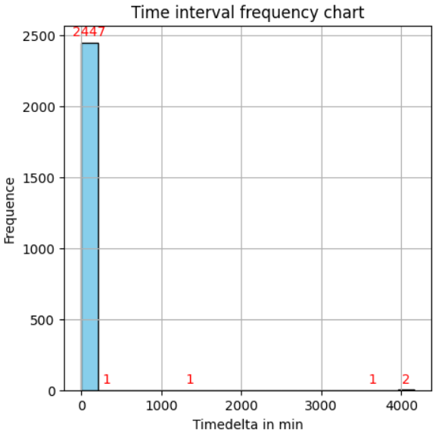
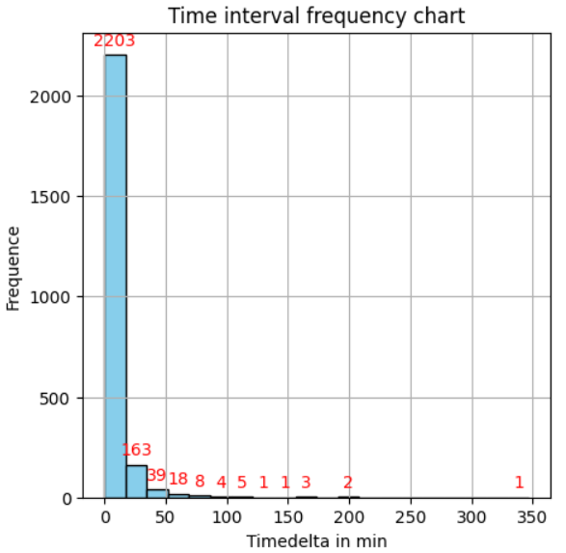
Time interval frequency chart (in min)
Processed Dataset v1 (Drop duplicates)
2453 rows
4 cols
Type : ['HEAVY' 'LIGHT' 'MODERATE’]
City : [1]
Processed Dataset v2 (Drop abnormal values )
2448 rows (- 8 rows)
4 cols
Type : ['HEAVY' 'LIGHT' 'MODERATE’]
City : [1]
Drop abnormal values delta>12*60 min
Abnormal values

Slide 4
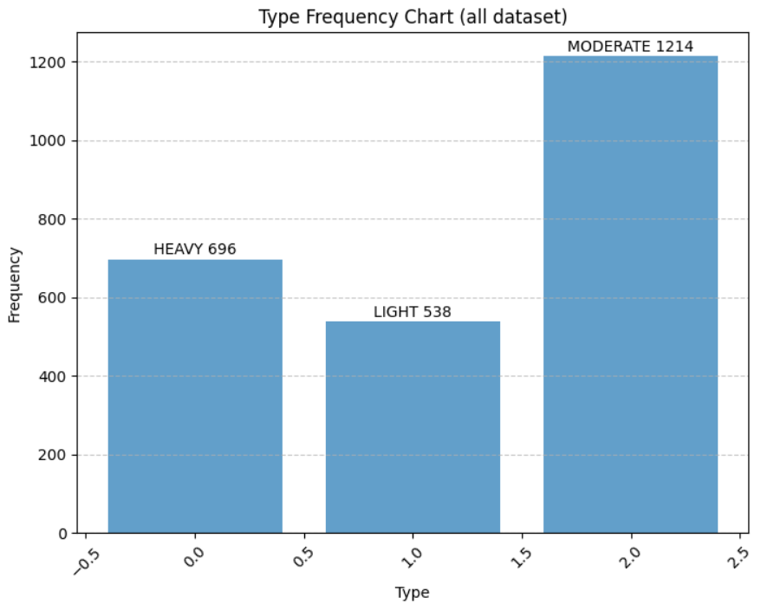
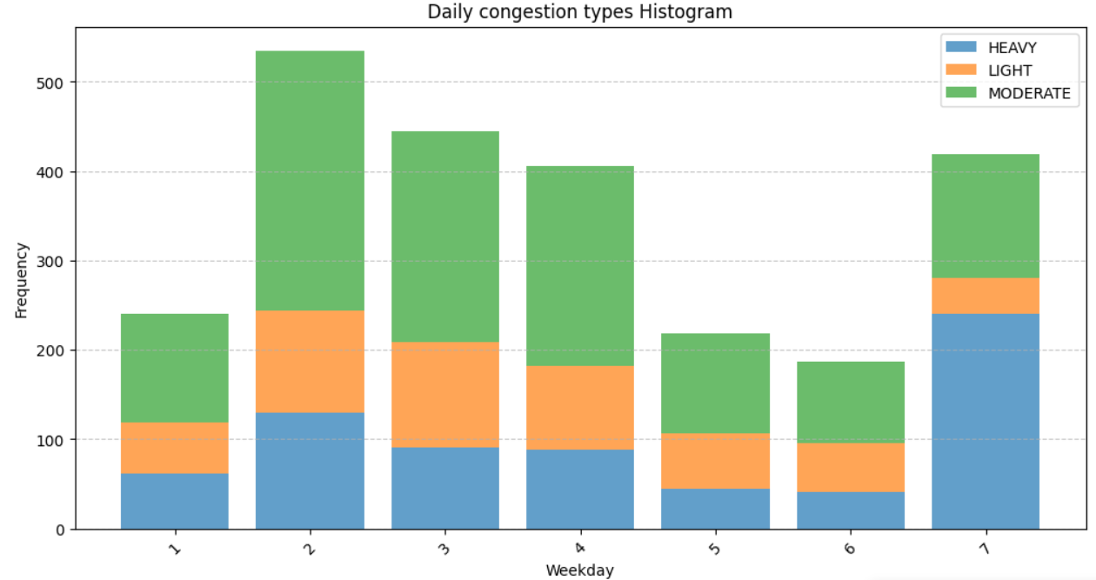
Type Frequency Chart

Slide 5
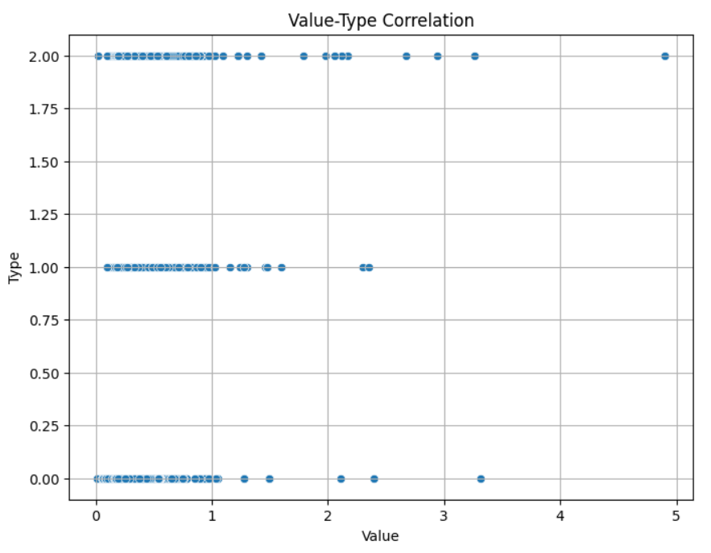
Value-type correlation

Slide 6
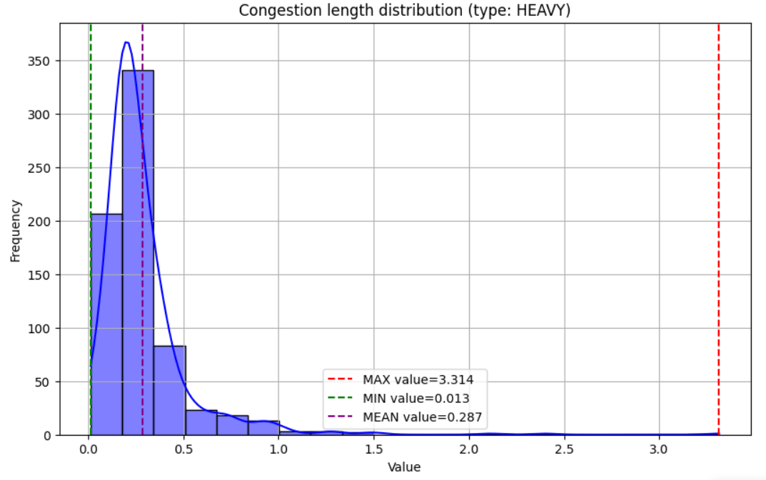
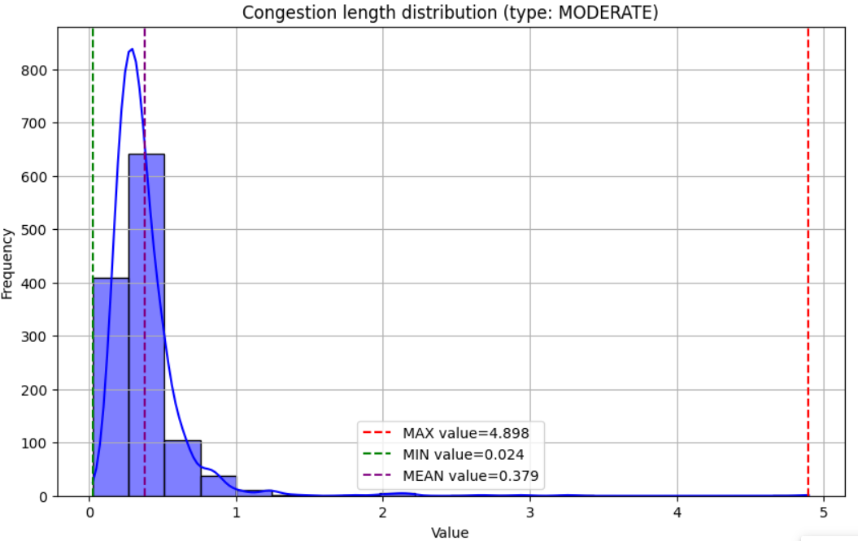
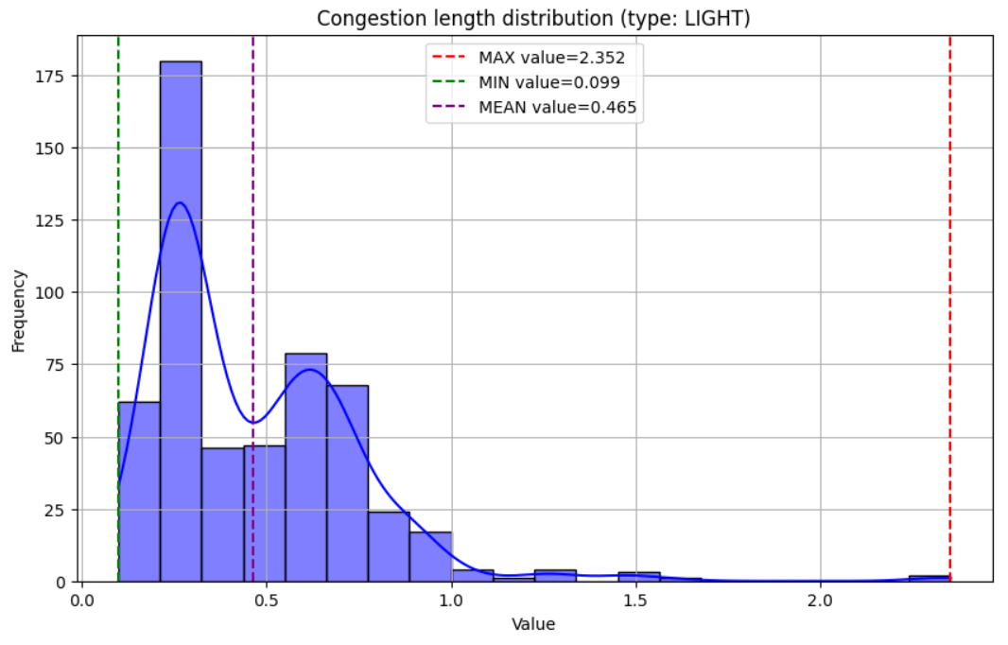
Congestion length distribution chart

Slide 7
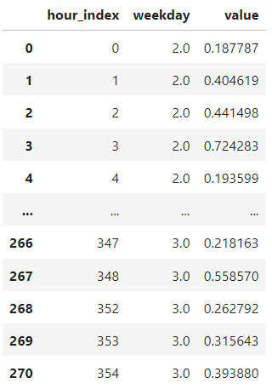
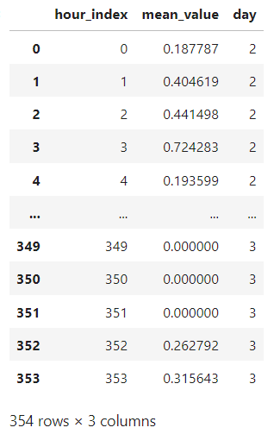
Dataset from 7/11 for city1
Time intervals are different → need a unified Time interval
hour index
Cumulated hour (ref : the first timestmp)
Calculate mean-value in one hour index
We have missing values → 270 rows but 354 hours
Padding missing values by 0
We have 354 rows and 354 hours

Slide 8
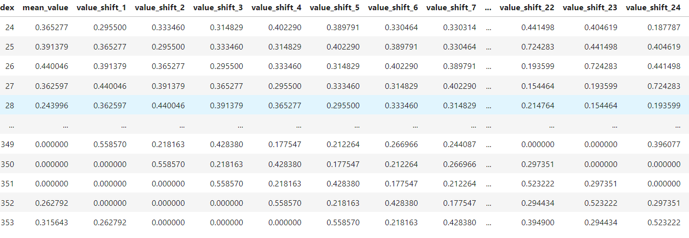
Dataset
y
X
AutoRegression
- Use last 24h data (mean value) to predict actual mean value

Slide 9
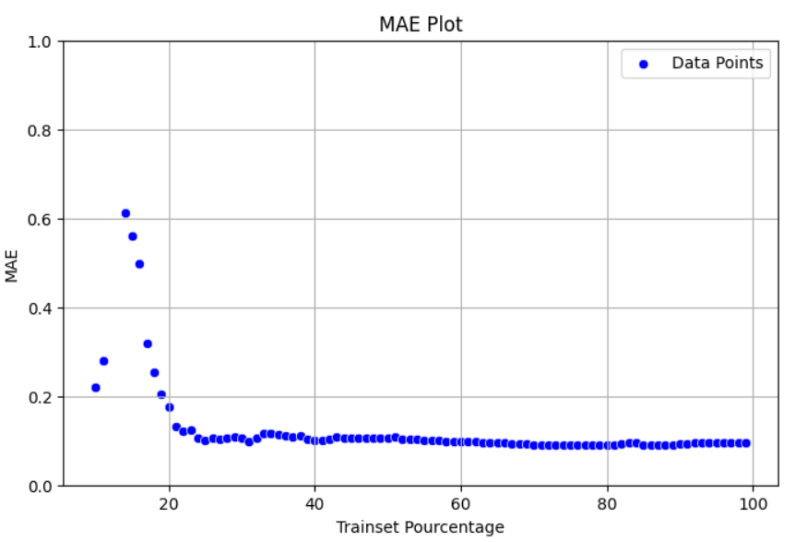
Linear Regression Model
X
AutoRegression
- Use last 24h data (mean value) to predict actual mean value

Slide 10
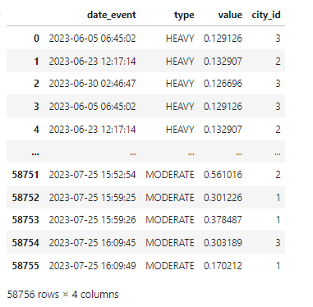
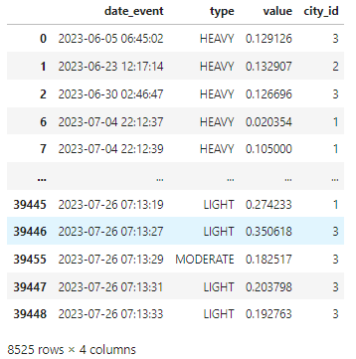
Raw Dataset
58756 rows
4 cols
Type : ['HEAVY' 'LIGHT' 'MODERATE’]
City : [1 2 3]
Processed Dataset v1 (drop duplicate)
8525 rows (- 85.5%)
4 cols
Type : ['HEAVY' 'LIGHT' 'MODERATE’]
City : [1 2 3]

Slide 11
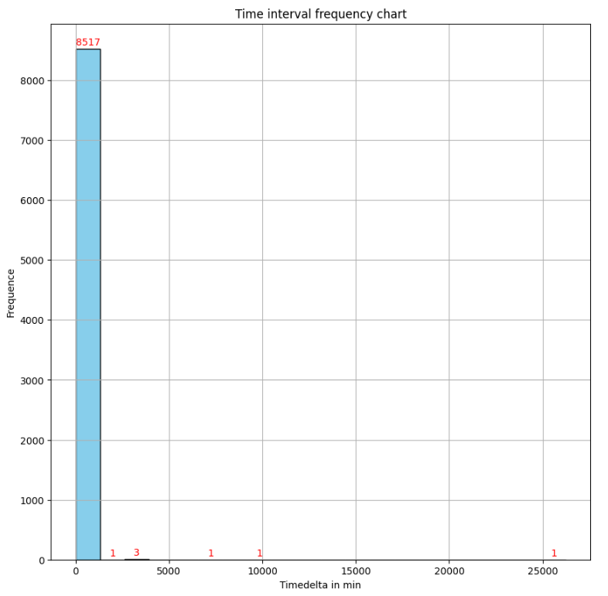
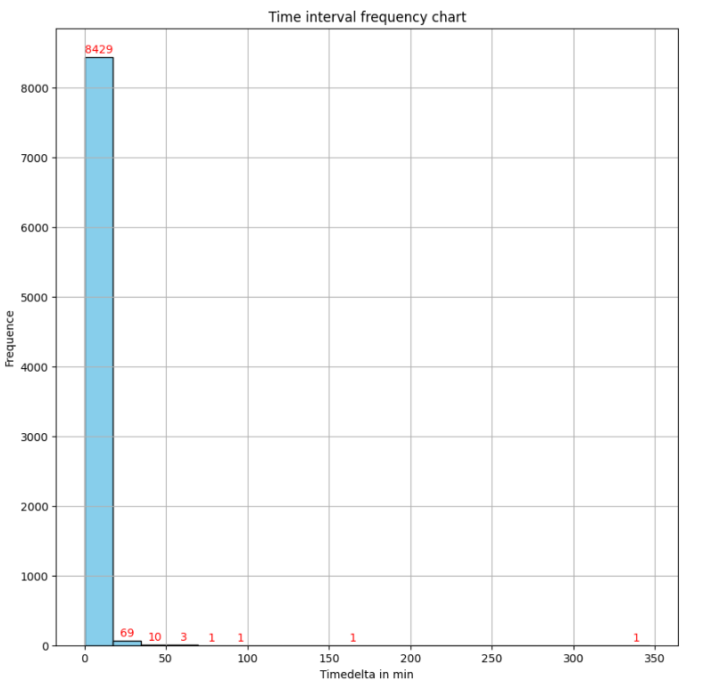
Time interval frequency chart (in min)
Processed Dataset v1 (Drop duplicates)
8525 rows
4 cols
Type : ['HEAVY' 'LIGHT' 'MODERATE’]
City : [1 2 3]
Processed Dataset v2 (Drop abnormal values )
8515 rows (- 15 rows)
4 cols
Type : ['HEAVY' 'LIGHT' 'MODERATE’]
City : [1 2 3]
Drop abnormal values delta>12*60 min
Abnormal values

Slide 12
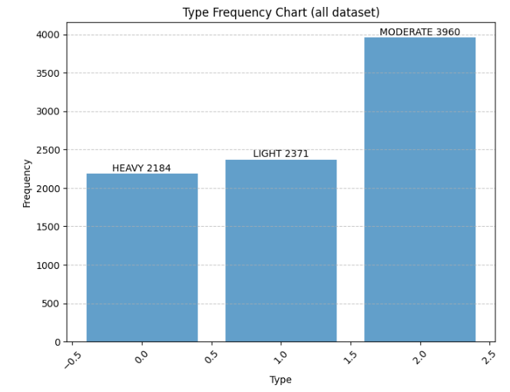
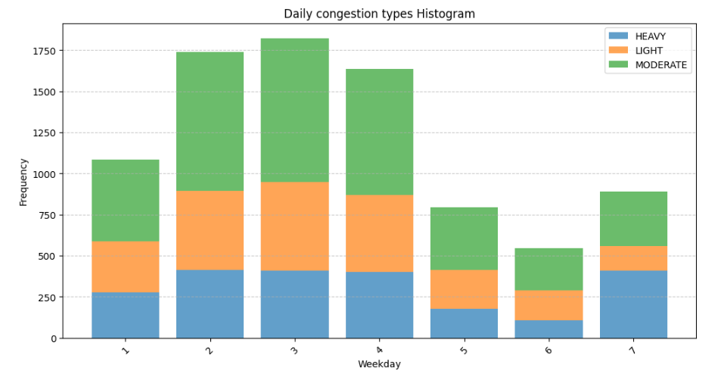
Type Frequency Chart

Slide 13
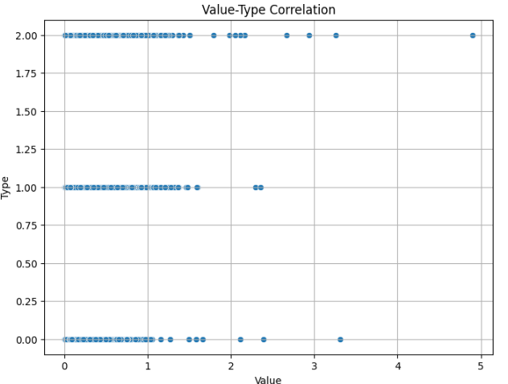
Value-type correlation

Slide 14
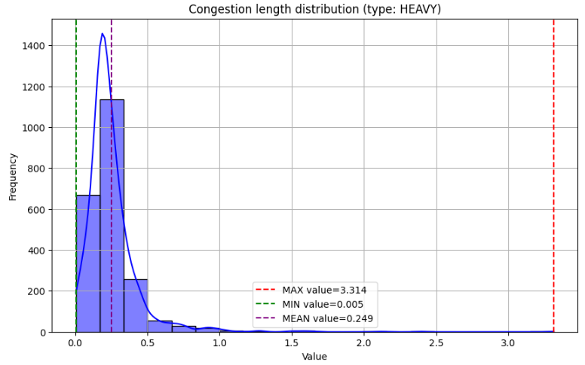
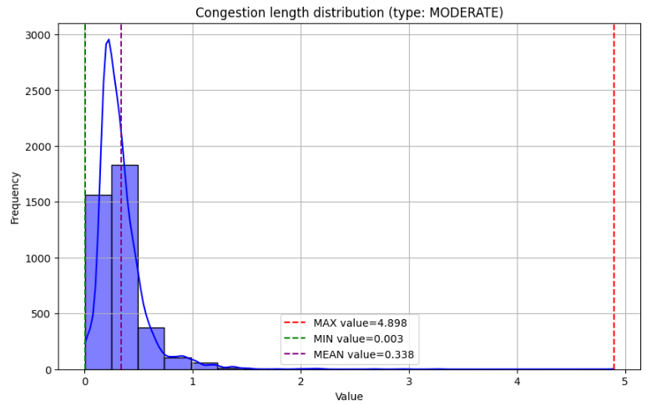
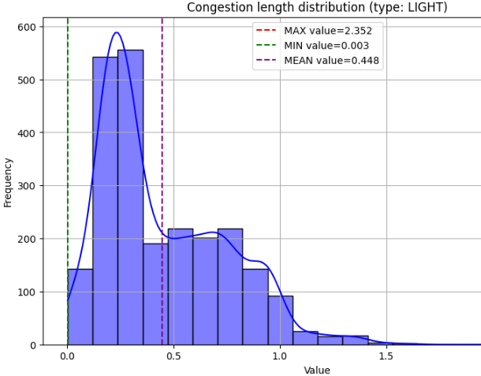
Congestion length distribution chart

