Slide 1
A Biterm Topic Model for Short Texts
Xiaohui Yan, Jiafeng Guo, Yanyan Lan, Xueqi Cheng
Institute of Computing Technology,
Chinese Academy of Sciences

Slide 2







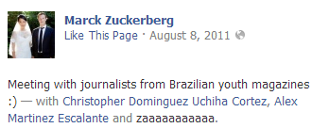



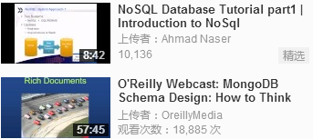
Short Texts Are Prevalent on Today's Web

Slide 3
Background
Understanding the topics of short texts is important for many tasks
  content recomendation
  user interest profiling
  content characterizing
  emerging topic detecting
  semantic analysis
  ...
This work originates from a browsing recomendation project

Slide 4
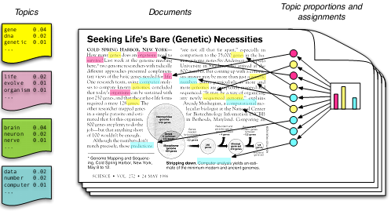
Topic Models
From Blei
Model the generation of documents with latent topic structure
  a topic ~ a distribution over words
  a document ~ a mixture of topics
  a word ~ a sample drawn from one topic
Previous studies mainly focus on normal texts

Slide 5
Problem on Short Texts: Data Sparsity
Word counts are not discriminative
  normal doc: topical words occur frequently
  short msg: most words only occur once
Not enougth contexts to identify the senses of ambiguous words
  normal doc: rich context, many relevant words
  short msg: limited context, few relevant words
The severe data sparsity makes conventional topic models less effective on short texts

Slide 6
Previous Approaches on Short Texts
Document aggregation
  e.g. aggregating the tweets published by the same users
  heuristic, not general
Mixture of unigrams
  each document has only one topic
  too strict assumption, peaked posteriors P(z|d)
Sparse topic models
  add sparse constraints on the distribution over topics in a document, e.g. Focused Topic Model
  too complex, easy to overfit

Slide 7
Key Idea
A Topic is basically a group of correlated words and the correlation is revealed by word co-occurrence patterns in documents
  why not directly model the word co-occurrences for topic learning?
Conventional Topic models suffer from the problem of severe sparse patterns in short documents
  why not use the rich global word co-occurrence patterns for better revealing topics instead?

Slide 8
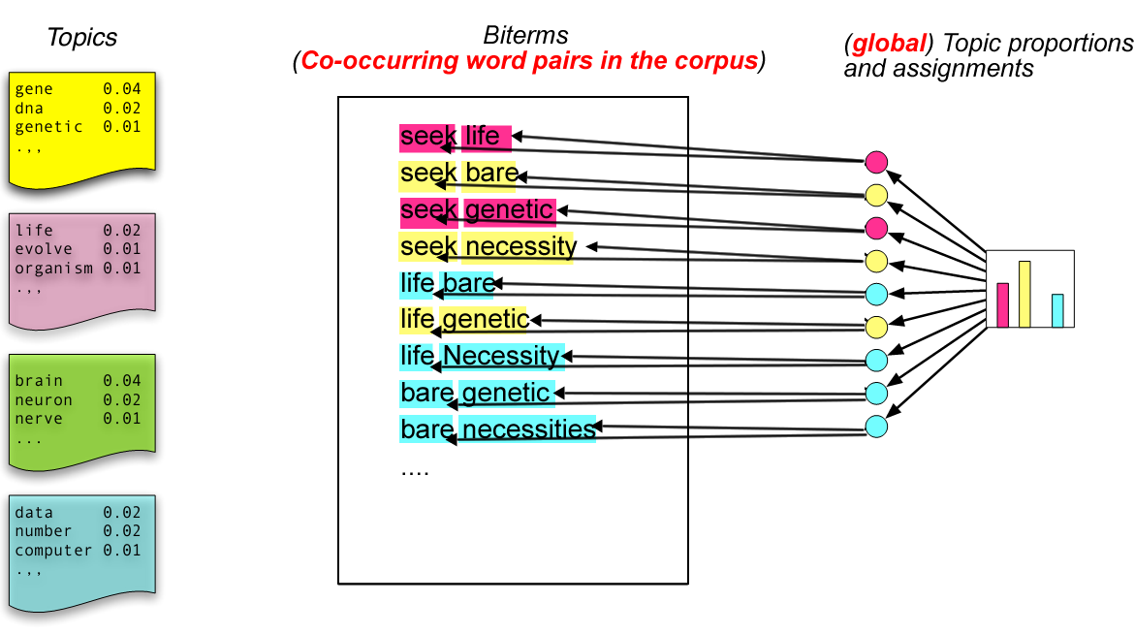
Biterm Topic Model (BTM)
Model the generation of biterms with latent topic structure
  a topic ~ a distribution over words
  a corpus ~ a mixture of topics
  a biterm ~ two words drawn from one topic

Slide 9
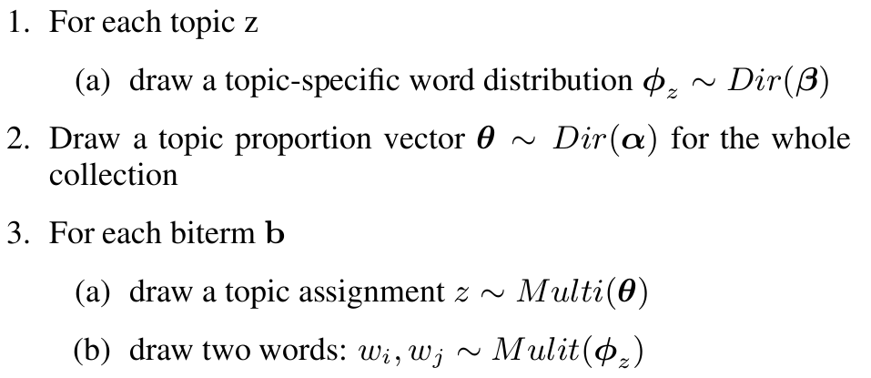
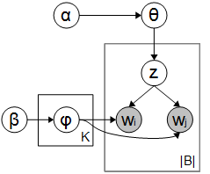
Generation Procedure of Biterms

Slide 10



Inferring Topics in a Document
Assumption
  the topic proportions of a document equals to the expectation of the topic proportions of biterms in it
where

Slide 11
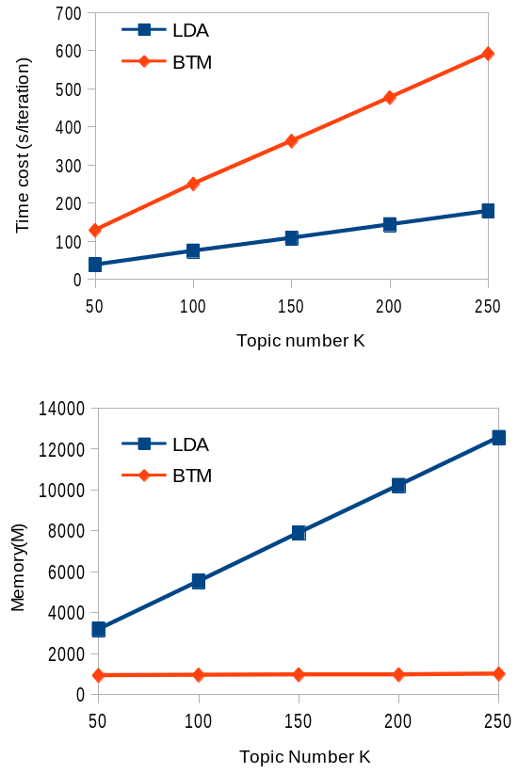

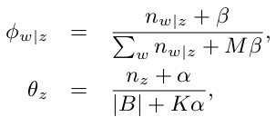
Parameters Inference
Gibbs Sampling
  sample topic for each biterm
  parameters estimate
BTM is more memory-efficient than LDA

Slide 12
Experiments: Datasets
 | Tweets2011 (short text) | Question (short text) | 20Newsgroup (normal text)
#documents | 4,230,578 | 189,080 | 18,828
#words | 98,857 | 26,565 | 42,697
#users | 2,039,877 | - | -
#categories | - | 35 | 20
avg doc length (after pre-processing) | 5.21 | 3.94 | 97.20

Slide 13
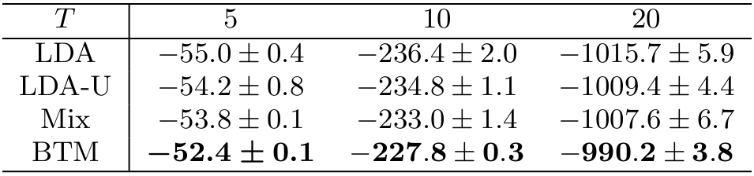
Experiments: Tweets2011 Collection
Topic quality
  Metric: average coherence score (Mimno'11) on the top T words
    A larger coherence score means the topics are more coherent
D. Mimno, H. Wallach, E. Talley, M. Leenders, and A. McCallum. Optimizing semantic oherence in topic models. EMNLP 2011

Slide 14

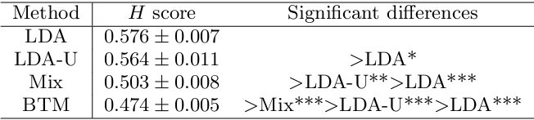
Experiments: Tweets2011 Collection
Quality of topic proportions of documents (i.e. P(z|d))
  select 50 frequent and meanful hashtags as class labels
  organize documents with the same hashtag into a cluster
  measure: H score
    smaller value indicates better agreement with human labeled classes

Slide 15
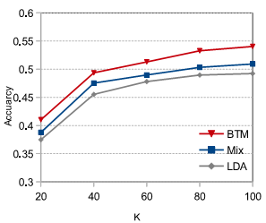
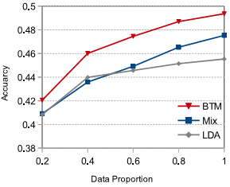
Experiments: Question Collection
Evaluated by document classification (linear SVM)

Slide 16
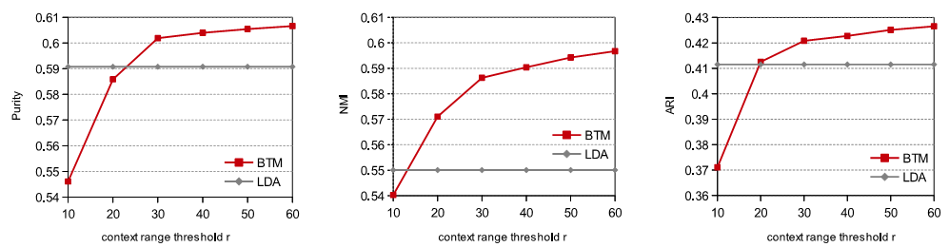
Experiments: 20Newsgroup Collection (Normal Texts)
Biterm extraction
  any two words co-occurring closely (with distance no larger than a threshold r )
Clustering result

Slide 17
Summary
A practical but not well-studied problem
  topic modeling on short texts
  conventional topic models suffer from the severe data sparsity when modeling the generation of short text messages
A generative model: Biterm Topic Model
  model word co-occurrences to uncover topics
  fully exploit the rich global word co-occurrens
  general and effective
Furture works
  better way to infer topic proportations for short text messages
  explore BTM in real-world applications

Slide 18
Thank You！
More Information:
Http://xiaohuiyan.com

