Slide 1
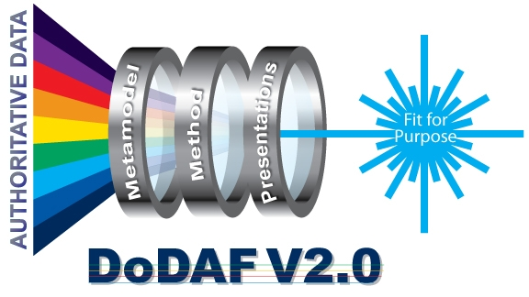
DoDAF V2.0 Community Update Overview
12 August 2010
MR. MICHAEL WAYSON
Architecture and Infrastructure Directorate
Office of the DoD Deputy Chief Information Officer
(703) 607-0482 Michael.Wayson@osd.mil

Slide 2
Plenary Agenda
8:30 – 8:45 Welcome & Introductions
8:45 – 9:30 DoDAF V2.0 Community Update
What’s New in DoDAF-DM2 Version 2.02
DoDAF Training
9:30 – 10:30 DoDAF V2.0 Implementation
  DoDAF V2.0 Architectural Views Examples
  AT&L Interoperability and Capability Development Framework (CDF)
10:30 – 10:45 Break
10:45 – 11:45 DoDAF V2.0 Implementation
JFCOM Joint Mission Thread (JMT) & DoDAF- DM2 Mapping
11:45 – 12:00 DoDAF V2.0 Governance
ASRG
12:00 – 12:30 UPDM Update
12:30 Wrap up & Closing Remarks
Notes:
The agenda this morning is straightforward. First we start with the focus of the new DoDAF.
We will then take you through a quick overview of the Models and architectural descriptions; how to select viewpoints that fit the purpose for which an architecture is being created, and the terms that we use. This section introduces you to the views and viewpoints (What we used to call products) that will be expanded on later in the morning by Charles Thornburg.
We will discuss, again briefly, the data in the new DoDAF meta-model, and we will end an introduction to the DoDAF six step development process.
There will be time at the end of the presentation for questions but, if, during the presentation you have a very brief question, please feel free to ask it.

Slide 3
Plenary Objectives
Provide DoDAF V2.0 Overview Update
Provide DoDAF V2.0 Implementation Insights & Examples
Provide DoDAF Meta Model Updates

Slide 4
DoDAF V2.0
Architectural Views Examples
Topics
DoDAF V2.0 Architecture Models-Views & Descriptions
Creation of DoDAF V2.0 Architectural Views
Reviewing DoDAF V2.0 Architectural Views
Lesson Learned
DoDAF V2.0 Work Group Road Map

Slide 5
Perspectives:
Viewpoints That Fit-the-Purpose
Capability Viewpoint
Articulate the capability requirement, delivery timing, and deployed capability
Operational Viewpoint
Articulate operational scenarios, processes, activities & requirements
Project Viewpoint
Describes the relationships between operational and capability requirements and the various projects being implemented; Details dependencies between capability management and the Defense Acquisition System process.
Standards Viewpoint
Articulate applicable Operational, Business, Technical, and Industry policy, standards, guidance, constraints, and forecasts
Data and Information Viewpoint
Articulate the data relationships and alignment structures in the architecture content
All Viewpoint
Overarching aspects of architecture context that relate to all models
Services Viewpoint
Articulate the performers, activities, services, and their exchanges providing for, or supporting, DoD functions
Systems Viewpoint
Articulate the legacy systems or independent systems, their composition, interconnectivity, and context providing for, or supporting, DoD functions
Architectural viewpoints are composed of data that has been organized to facilitate understanding.

Slide 6
DoDAF V2.0 Architecture Models-Views & Descriptions

Slide 7
Creation of DoDAF V2.0
Architectural Views
Step 1: Determined the intended purpose
Step 2: Determined scope and defined the boundaries
Step 3: Determined data required for architectural views
Step 4: Collected, organized, correlated, store
data in commercial tool
Step 5: Conducted analysis of the architectural views
Step 6: Summarized lessons learned

Slide 8
DoDAF V2.0
Architectural Views Examples
Reviewing DoDAF V2.0 Architectural Views
Notes:
The agenda this morning is straightforward. First we start with the focus of the new DoDAF.
We will then take you through a quick overview of the Models and architectural descriptions; how to select viewpoints that fit the purpose for which an architecture is being created, and the terms that we use. This section introduces you to the views and viewpoints (What we used to call products) that will be expanded on later in the morning by Charles Thornburg.
We will discuss, again briefly, the data in the new DoDAF meta-model, and we will end an introduction to the DoDAF six step development process.
There will be time at the end of the presentation for questions but, if, during the presentation you have a very brief question, please feel free to ask it.

Slide 9
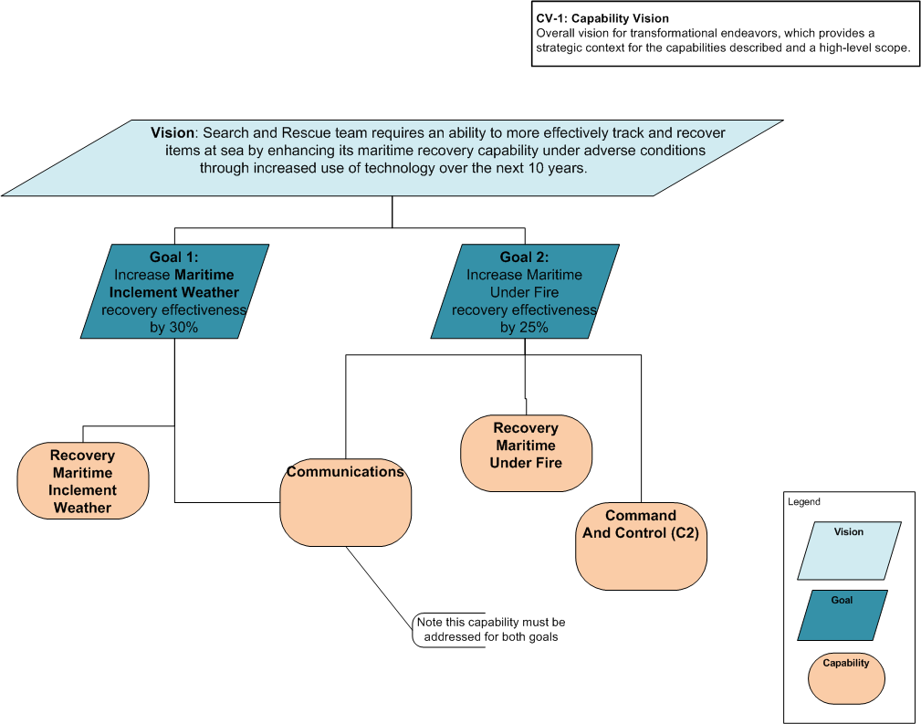
CV-1: Vision
The overall vision for transformational endeavors, which provides a strategic context for the capabilities described and a high-level scope.
The CV-1 addresses the enterprise concerns associated with the overall vision for transformational endeavors and thus defines the strategic context for a group of capabilities. The intended usage is communication of the strategic vision regarding capability development.
This diagram is meant to capture the relationship between the Vision, the Goals and the Capabilities. It is a decomposition type of a diagram. In this example there is one Vision, two Goals and four Capabilities

Slide 10
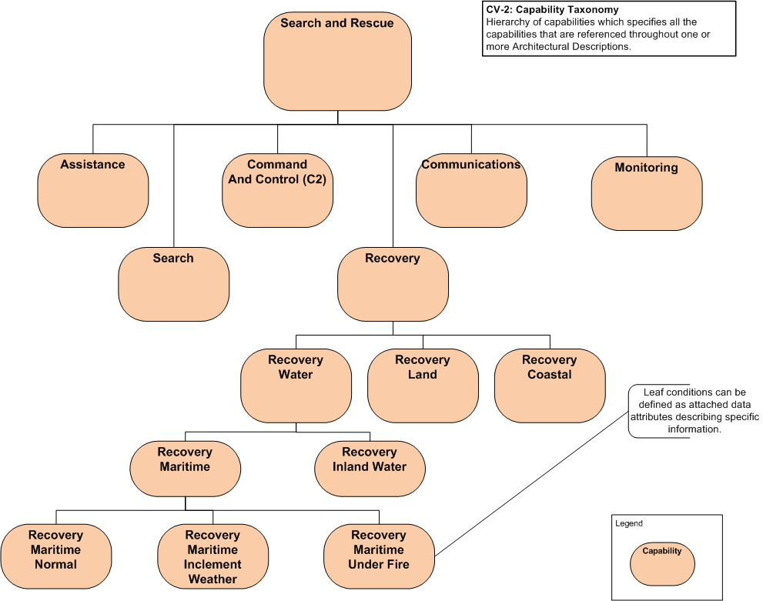
CV-2: Capability Taxonomy
A hierarchy of capabilities which specifies all the capabilities that are referenced throughout one or more Architectural Descriptions.
The CV-2 captures capability taxonomies. The model presents a hierarchy of capabilities.
This diagram is meant to capture this relationship. A Capability should be different that an activity.

Slide 11
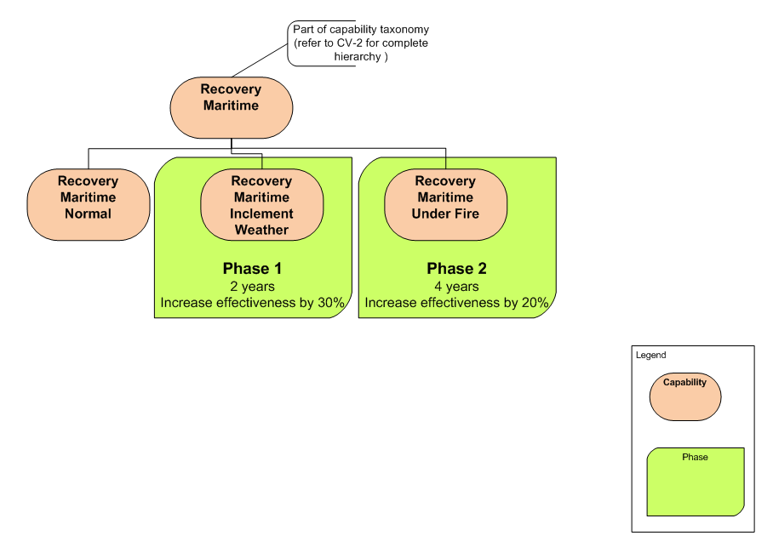
CV-3: Capability Phasing
The planned achievement of capability at different points in time or during specific periods of time. The CV-3 shows the capability phasing in terms of the activities, conditions, desired effects, rules complied with, resource consumption and production, and measures, without regard to the performer and location solutions.
The CV-3 provides a representation of the available capability at different points in time or during specific periods of time
This diagram is meant to capture the time phase of the second and third child capability through the green shape which carries the phase data. Other techniques may be used to capture the phase data as desired.

Slide 12
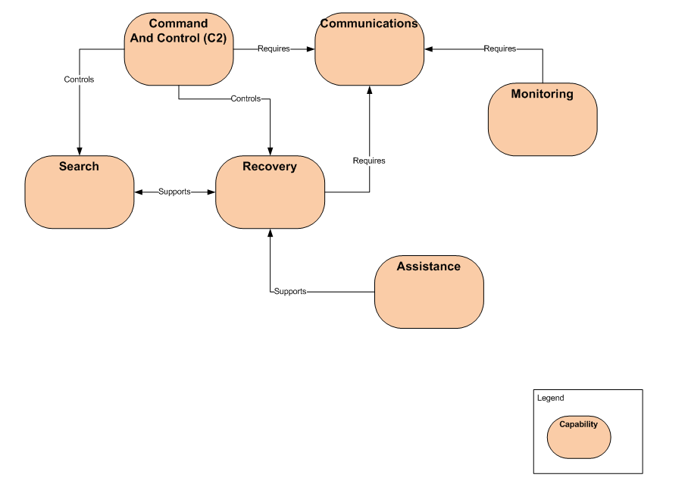
CV-4 Capability Dependencies
The dependencies between planned capabilities and the definition of logical groupings of capabilities.
The CV-4 describes the dependencies between planned capabilities.
This diagram shows relationships (including a relationship label) between six capabilities.

Slide 13
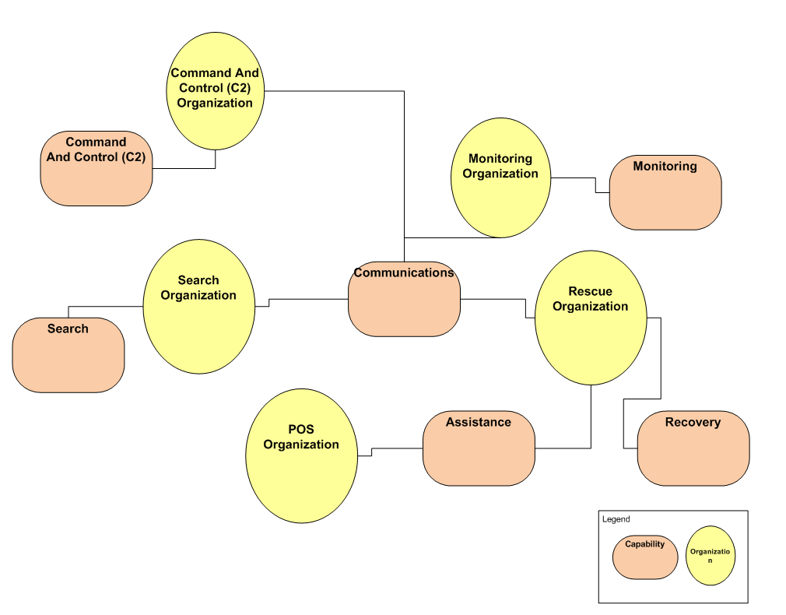
CV-5: Capability to Organizational Development Mapping
The fulfillment of capability requirements shows the planned capability deployment and interconnection for a particular Capability Phase. The CV-5 shows the planned solution for the phase in terms of performers and locations and their associated concepts.
The CV-5 shows deployment of Capabilities to specific organizations.
This diagram shows the relationship between Capability and Organizations

Slide 14
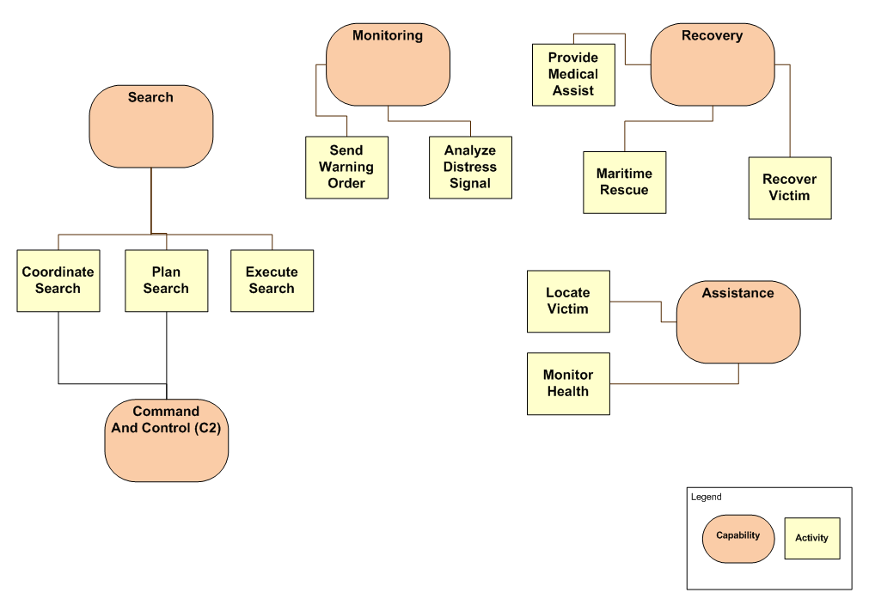
CV-6 Capability to Operational
Activities Mapping
A mapping between the capabilities required and the operational activities that those capabilities support.
A mapping between the capabilities required and the operational activities that those capabilities support.
This diagram shows the relationship between Capability and Activities. Either style of presentation is acceptable for this model, a graphical mapping or a matrix mapping.

Slide 15
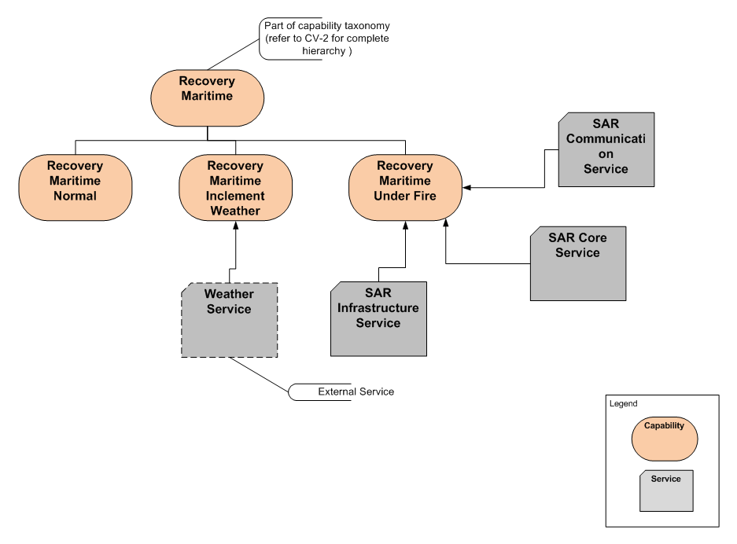
CV-7: Capability to Services
A mapping between the capabilities and the services that these capabilities enable.
The CV-7 describes the mapping between the capabilities required and the services that enable those capabilities.
This diagram shows the relationship between Capability and Activities. Either style of presentation is acceptable for this model, a graphical mapping or a matrix mapping.

Slide 16
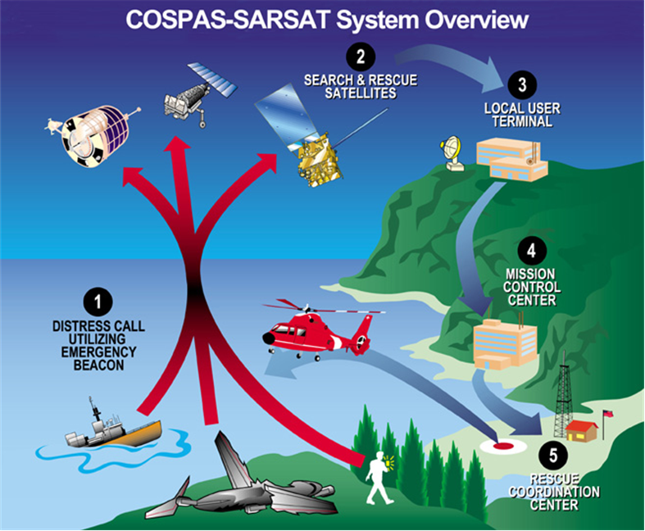
OV-1: High-Level Operational Concept Graphic
The high-level graphical/textual description of the operational concept
The OV-1 is the pictorial representation of the written content of the AV-1 Overview and Summary Information.
This diagram is meant to convey the general, high level, description of the systems that may perform in this mission, and that there may be some form of communication between them. This is a pictorial representation only.

Slide 17
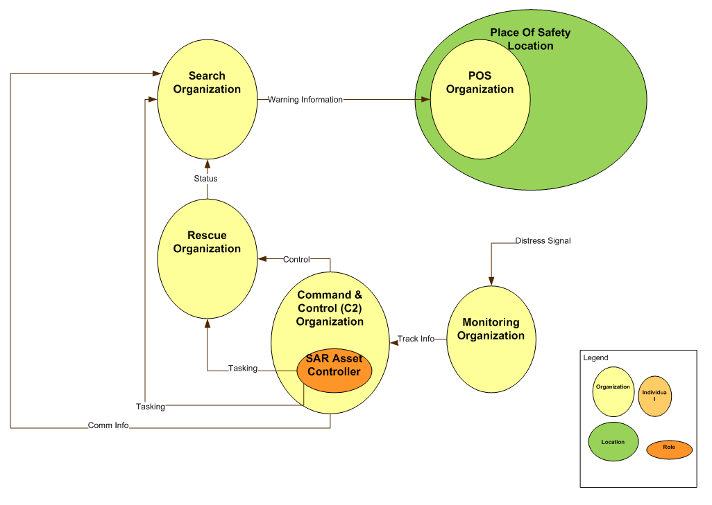
OV-2: Operational Resource Flow Description
A description of the Resource Flows exchanged between operational activities.
The OV-2 depicts Operational Needlines that indicate a need to exchange resources. The OV-2 is intended to track the need for Resource Flows between specific Operational Activities and Locations that play a key role in the Architectural Description
This diagram is meant to capture the needlines between the different Organizations [Locations] that are key to this sample architecture description.

Slide 18
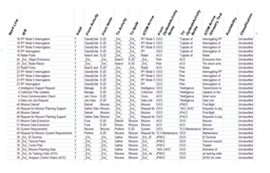
OV-3: Operational Resource Flow Matrix
A description of the resources exchanged and the relevant attributes of the exchanges.
The OV-3 identifies resource elements and relevant attributes of the Resource Flows and associates the exchange to the producing and consuming Operational Activities and locations and to the Needline that the Resource Flow satisfies.
This matrix is a list of Resource Flows and the key attributes of the associated Resources. One or more rows of this matrix are associated with a Needline in the OV-2: Operational Resource Flow Description

Slide 19
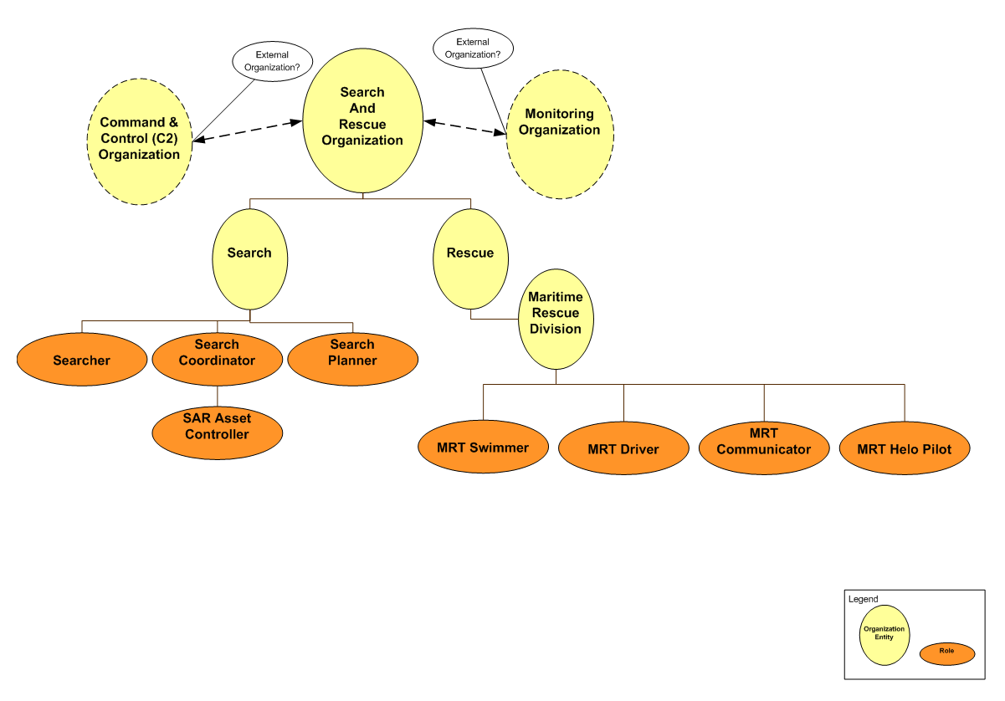
OV-4: Organizational Relations Chart
The organizational context, role or other relationships among organizations.
The OV-4 addresses the organizational aspects of an Architectural Description.
This diagram is meant to show the hierarchical relationships between the organizations involved in Search and Rescue.

Slide 20
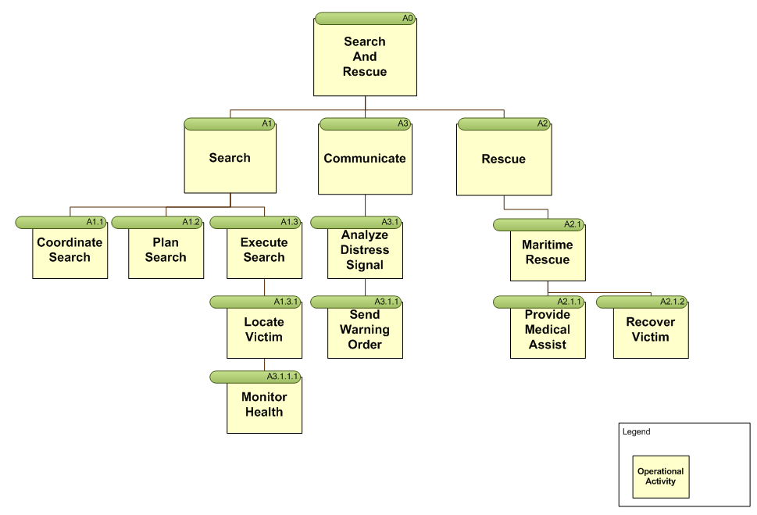
OV-5a: Operational Activity
Decomposition Tree
The capabilities and activities (operational activities) organized in a hierarchical structure.
The OV-5a helps provide an overall picture of the activities involved and a quick reference for navigating the OV-5b.
This diagram shows the hierarchical representation of the Search and Rescue activities. These will be used in the OV-5b Operational Activity Model

Slide 21
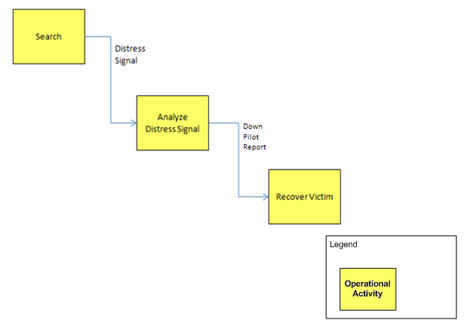
OV-5b: Operational Activity Model
The context of capabilities and activities (operational activities) and their relationships among activities, inputs, and outputs; Additional data can show cost, performers, or other pertinent information.
The Activity Model shows activities connected by Resource Flows; it supports development of an OV-3 Operational Resource Flow Matrix.
This diagram shows an example of Operational Activities that produce and consume Resource Flows. These Resource Flows and related Operational Activities are related to the Resource Flows identified in both the OV-2 Operational Resource Flow Description and the OV-3 Operational Resource Flow Matrix.

Slide 22
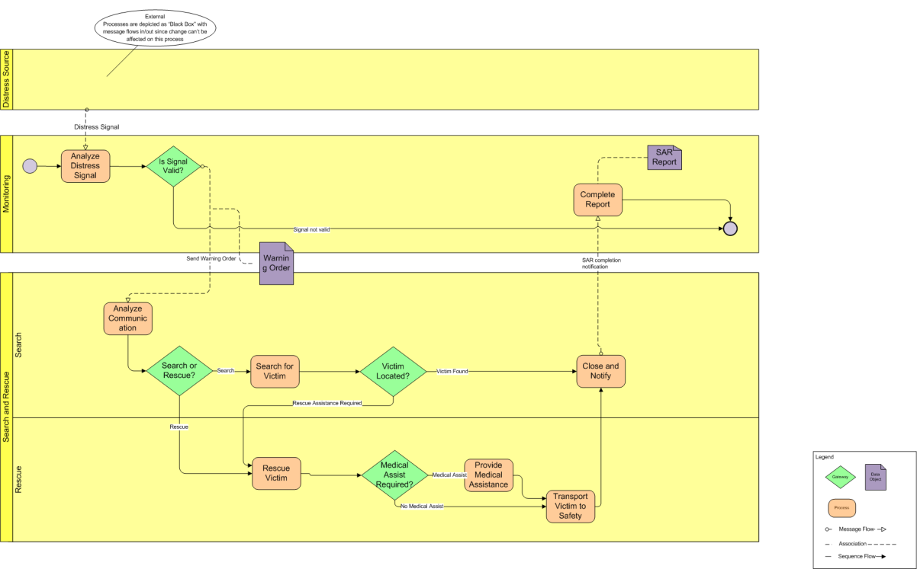
OV-6c: Event-Trace Description
One of three models used to describe activity (operational activity). It traces actions in a scenario or sequence of events.
The OV-6c provides a time-ordered examination of the Resource Flows as a result of a particular scenario.
This diagram is meant to show the sequence of activities and the data that flows between them. The lanes in this diagram are the Organizations that are used in the OV-2 Operational Resource Flow Diagram.

Slide 23
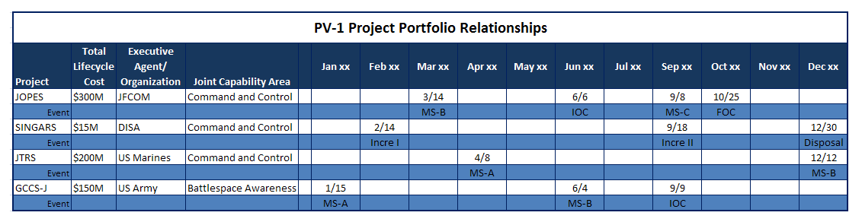
PV1: Project Portfolio Relationships
It describes the dependency relationships between the organizations and projects and the organizational structures needed to manage a portfolio of projects.
The PV-1 describes how acquisition projects are grouped in organizational terms as a coherent portfolio of acquisition programs or projects, or initiatives related to several portfolios.
This diagram is meant to show Programs and how they are organized by increment, JCAs and total cost.

Slide 24
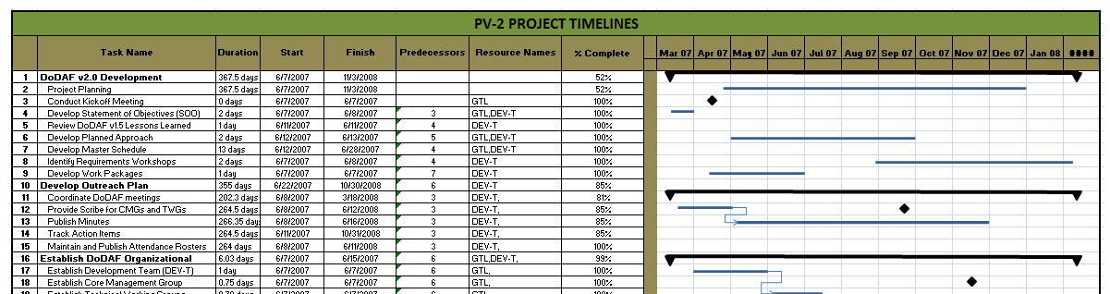
PV2: Project Timelines
A timeline perspective on programs or projects, with the key milestones and interdependencies.
The PV-2 provides an overview of a program or portfolio of individual projects, or initiatives, based on a timeline.
This diagram is meant to show Programs and how they are organized on a timeline.

Slide 25
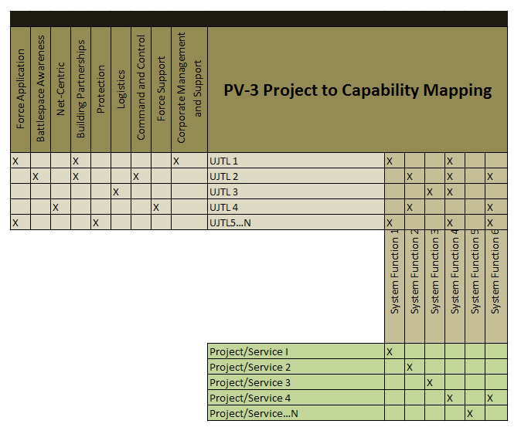
PV3: Project to Capability Mapping
The PV-3 maps programs, projects, portfolios, or initiatives to capabilities to show how the specific elements help to achieve a capability.
The PV-2 provides an overview of a program or portfolio of individual projects, or initiatives, based on a timeline.
This diagram is meant to the mapping of Projects to the Capability by tracing through the dependent relationship. This shows the relationship is not direct but dependent on other relationships.

Slide 26
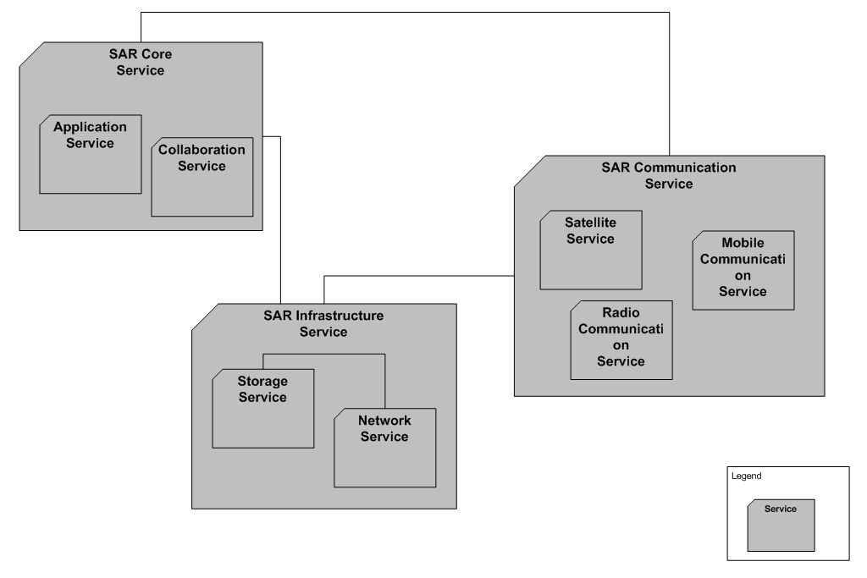
SvcV-1: Services Interface Description
The identification of services, service items, and their interconnections.
The SvcV-1 addresses the composition and interaction of Services. A SvcV-1 can be used simply to depict services and sub-services and identify the Resource Flows between them.
This diagram is meant to show the Resource Flow between the Services used in the Search and Rescue architecture description

Slide 27
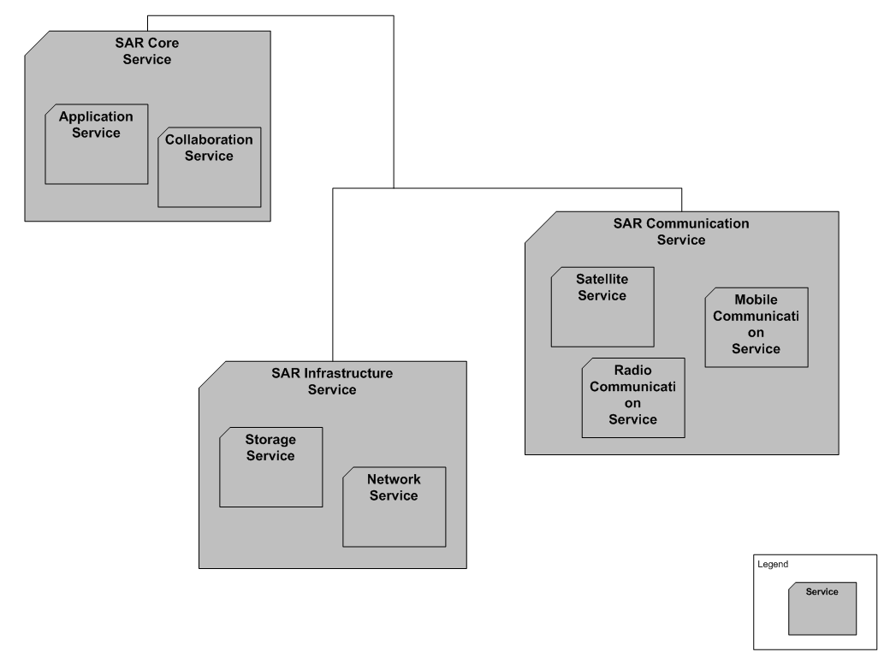
SvcV-2: Services Resource Flow Description
A description of Resource Flows exchanged between services.
A SvcV-2 DoDAF-described Model is used to give a precise specification of a connection between Services.
This diagram depicts the physical connectivity between the Services supporting the Resource Flows identified in the SvcV-1 diagram.

Slide 28
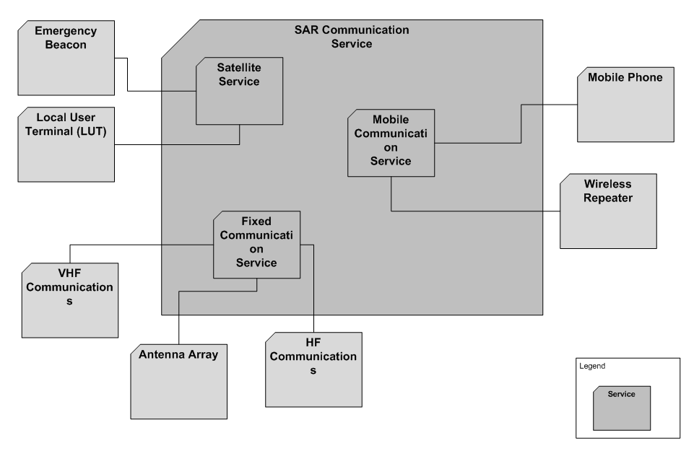
SvcV-3a Systems-Services Matrix
The relationships among or between systems and services in a given Architectural Description.
A SvcV-3a enables a quick overview of all the system-to-service resource interactions specified in one or more SvcV-1 Services Context Description models.
This diagram depicts the system to service dependencies

Slide 29
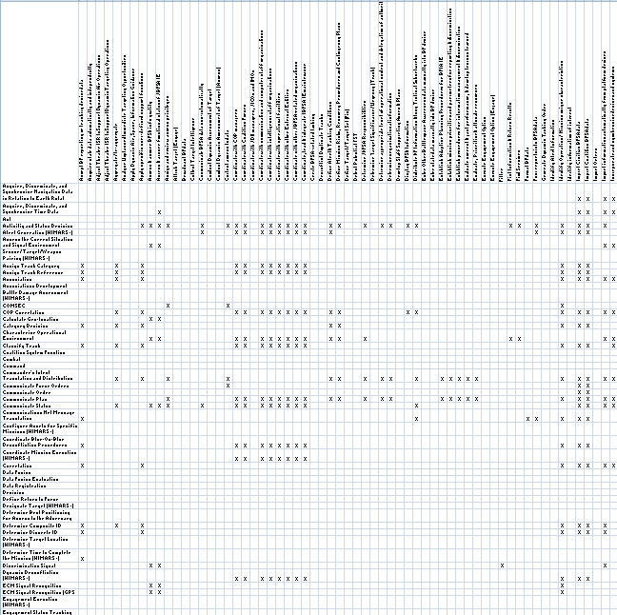
SvcV-3b: Services-Services Matrix
The relationships among services in a given Architectural Description.
The SvcV-3b provides a tabular summary of the services interactions specified in the SvcV-1 Services Context Description for the Architectural Description.
This diagram depicts the Service to Service interactions in a matrix format.

Slide 30
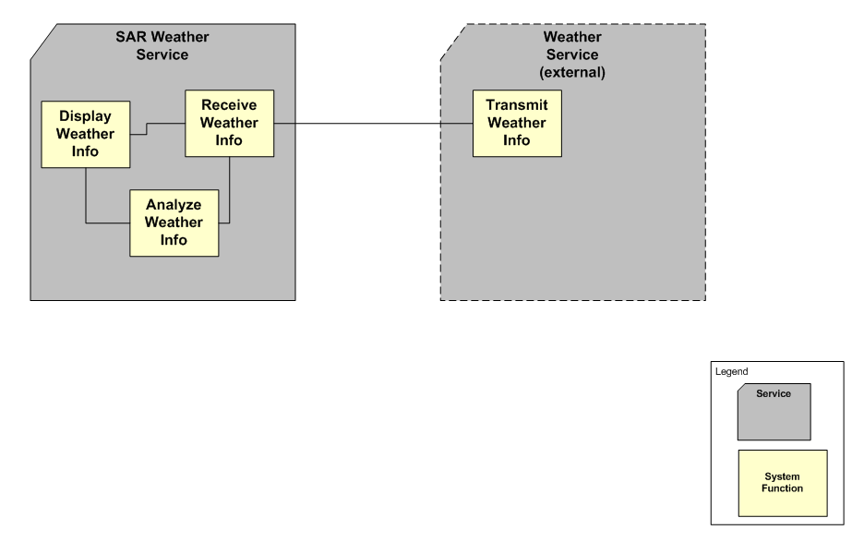
SvcV-4: Services Functionality Description
The functions performed by services and the service data flows among service functions (activities).
The primary purpose of SvcV-4 is to develop a clear description of the necessary data flows that are input (consumed) by and output (produced) by each resource.
This diagram depicts the data flows that flow between the services of the architecture.

Slide 31
SvcV-5: Operational Activity to Services Traceability Matrix
A mapping of services (activities) back to operational activities (activities).
The SvcV-5 depicts the mapping of service functions to operational activities and thus identifies the transformation of an operational need into a purposeful action performed by a service solution.
This matrix depicts the relationships between the set of Operational Activities and the set of Service Functions applicable to an Architectural Description.

Slide 32
SvcV-6: Services Resource Flow Matrix
A description of the resources exchanged and the relevant attributes of the exchanges.
The SvcV-6 specifies the characteristics of the Service Resource Flows exchanged between Services.
The SvcV-6 identifies resource elements and relevant attributes of the Resource Flows and associates the exchange to the producing and consuming Services
This matrix is a list of Resource Flows and the key attributes of the associated Resources.

Slide 33
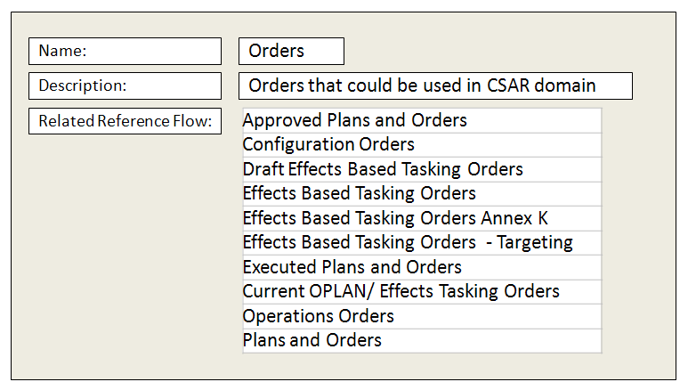
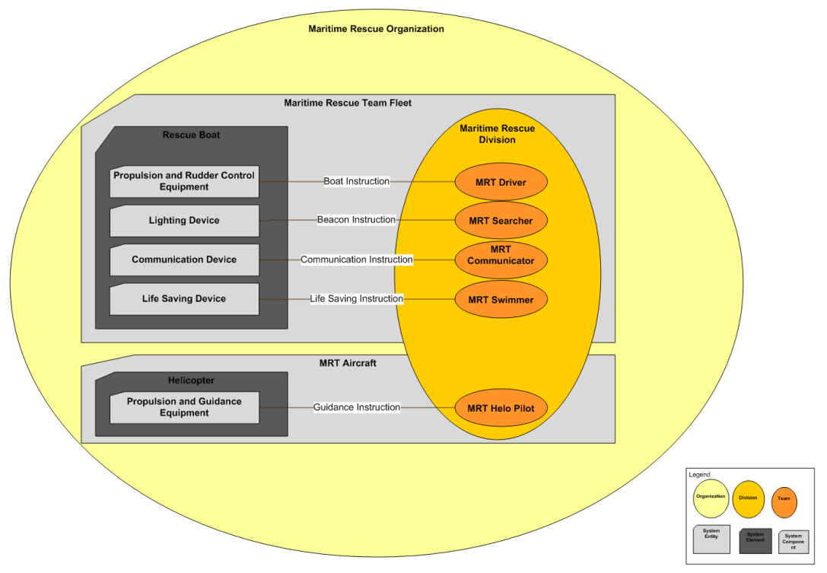
SV-1: Systems Interface Description
The identification of systems, system items, and their interconnections.
In addition to depicting Systems (Performers) and their structure, the SV-1 addresses Resource Flows. A Resource Flow, as depicted in SV-1, is an indicator that resources pass between one System and the other. The SV-1 depicts all System Resource Flows between Systems that are of interest.
This diagram is meant to show the Resource Flows between a Person Type and a System (both are types of Performer). The diagram also shows the grouping of Performer Types.

Slide 34
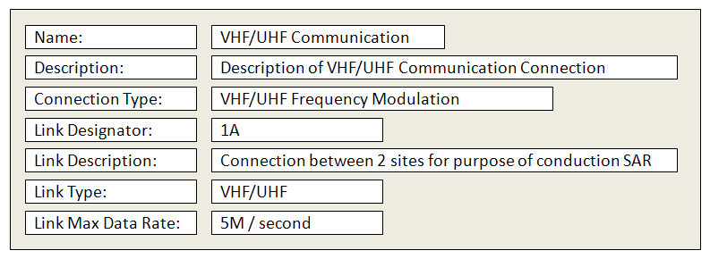
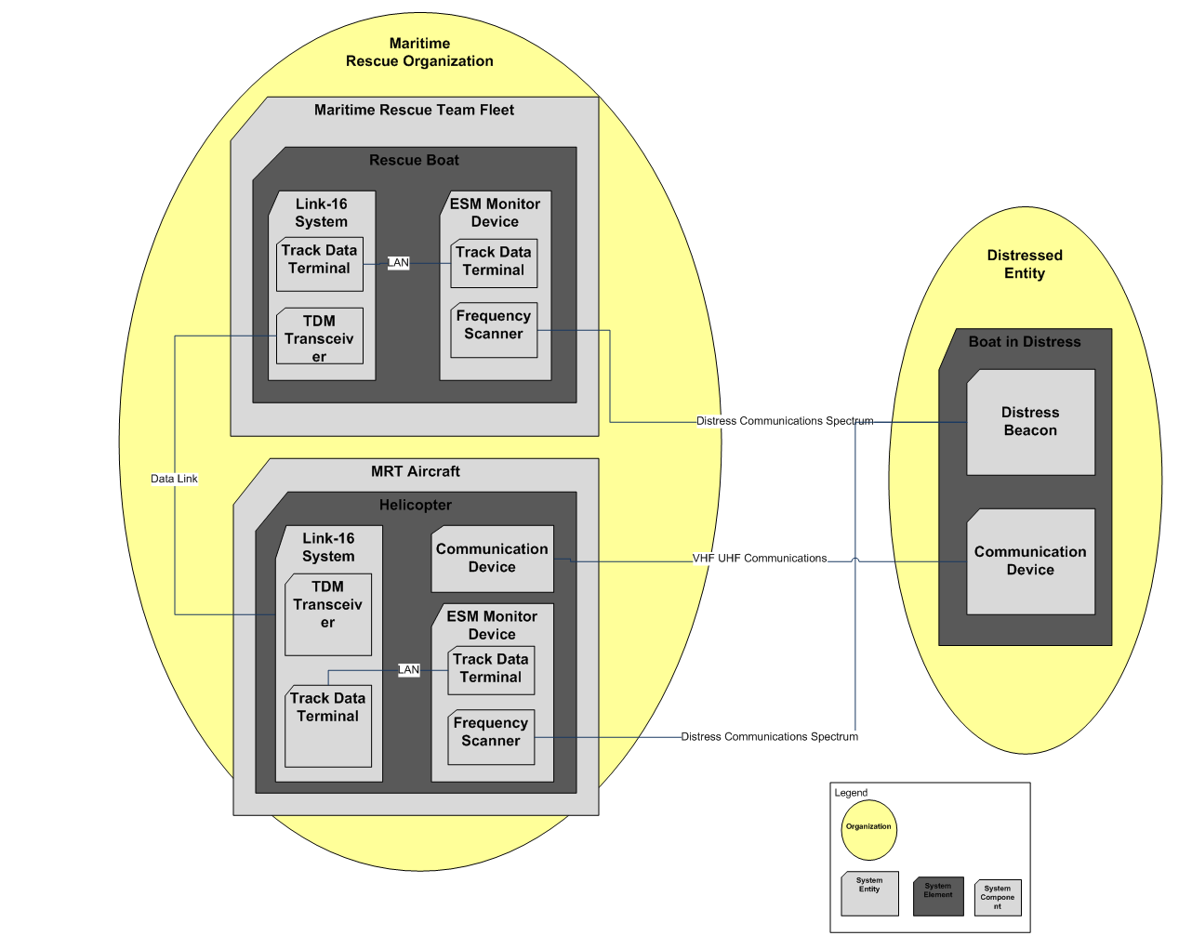
SV-2: Systems Resource Flow Description
A description of Resource Flows exchanged between systems.
A SV-2 DoDAF-described Model is used to give a precise specification of a connection between Systems. This may be an existing connection, or a specification for a connection that is to be made.
This diagram is meant to show a representation of the primary physical connection between the systems of interest.

Slide 35
SV-3: Systems-Systems Matrix
The relationships among systems in a given Architectural Description. It can be designed to show relationships of interest, (e.g., system-type interfaces, planned vs. existing interfaces).
The SV-3 provides a tabular summary of the system interactions specified in the SV-1 Systems Interface Description model for the Architectural Description.
This matrix is used to identify the association between Systems in context with the architecture’s purpose.

Slide 36
SV-5a: Operational Activity to Systems Function Traceability Matrix
A mapping of system functions (activities) back to operational activities (activities).
The SV-5a addresses the linkage between System Functions described in SV-4 Systems Functionality Description and Operational Activities specified in OV-5a Operational Activity Decomposition Tree or OV-5b Operational Activity Model.
This matrix is used to tie together the logical representation of the Operational Activities of the OV-5a with the System Functions of the SV-4 Systems Functionality Description.

Slide 37
SV-6: Systems Resource Flow Matrix
Provides details of system resource flow elements being exchanged between systems and the attributes of that exchange.
The SV-6 focuses on the specific aspects of the system Resource Flow and the system Resource Flow content in a tabular format.
The SV-6 identifies resource elements and relevant attributes of the Resource Flows and associates the exchange to the producing and consuming Systems
This matrix is a list of Resource Flows and the key attributes of the associated Resources.

Slide 38
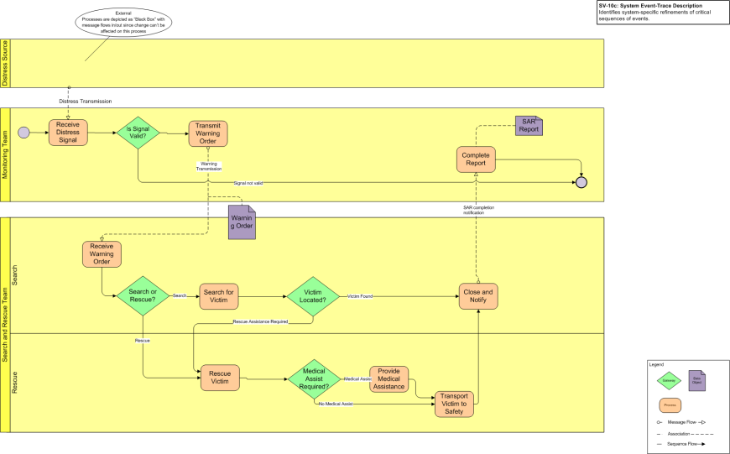
SV-10c: Event-Trace Description
One of three models used to describe system functionality. It identifies system-specific refinements of critical sequences of events described in the Operational Viewpoint.
The SV-10c provides a sequential examination of the interactions between functional resources.
This diagram is meant to show the sequence of System Functions and the data that flows between them. The lanes in this diagram are the Organizations that are used in the SV-1 Systems Interface Description
Monitoring System
SAR Weather System

Slide 39
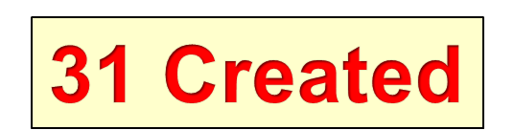
View summary
OV-1, OV-2, OV-3, OV-4, OV-5a , OV-5b, OV-6c
SV-1, SV-2, SV-3 , SV-5a , SV-6, SV-10c
CV-1, CV-2, CV-3, CV-4, CV-5, CV-6, CV-7
SvcV-1, SvcV-2, SvcV-3a, SvcV-3b, SvcV-4, SvcV-5 , SvcV-6, SvcV-10c
PV-1, PV-2 , PV-3

Slide 40
Architectural Views Examples
Lesson Learned
Six Step Process is a must when creating DoDAF V2.0 Architectural Views
All descriptive terms must be defined clearly
The architectural model descriptions need to be more consistent with the metamodel

Slide 41
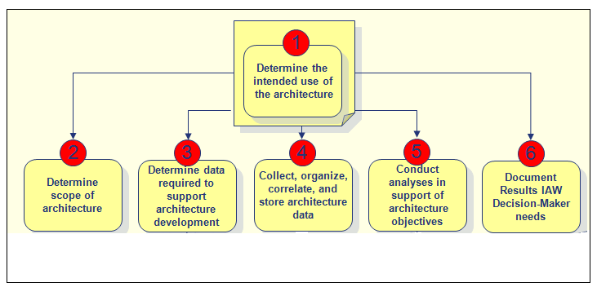
Methodology: DoDAF V2.0 Six-Step Architecture Development Process
Determine Use, Scope and Data Requirements of Architecture
Architect (build models), analyze and present (report)
Notes:
The DoDAF 2.0 method is a high-level approach to the development and use of architectural descriptions.
It begins with determining the use and scope of the architectural description.
It then involves the determination of data requirements necessary to meet the use and scope.
It then involves the capture, collection, organization, etc. of data – this is the “modeling” portion of the method. This is what we traditionally think of when we think of building DoDAF architectures. The creation of models. It is from this concept that we are going to launch into a conversation about the DoDAF 2.0 models.
The full lifecycle of the method is to perform analysis on the data collected through the context of building models and the presentation of views IAW “information consumers” needs.

Slide 42
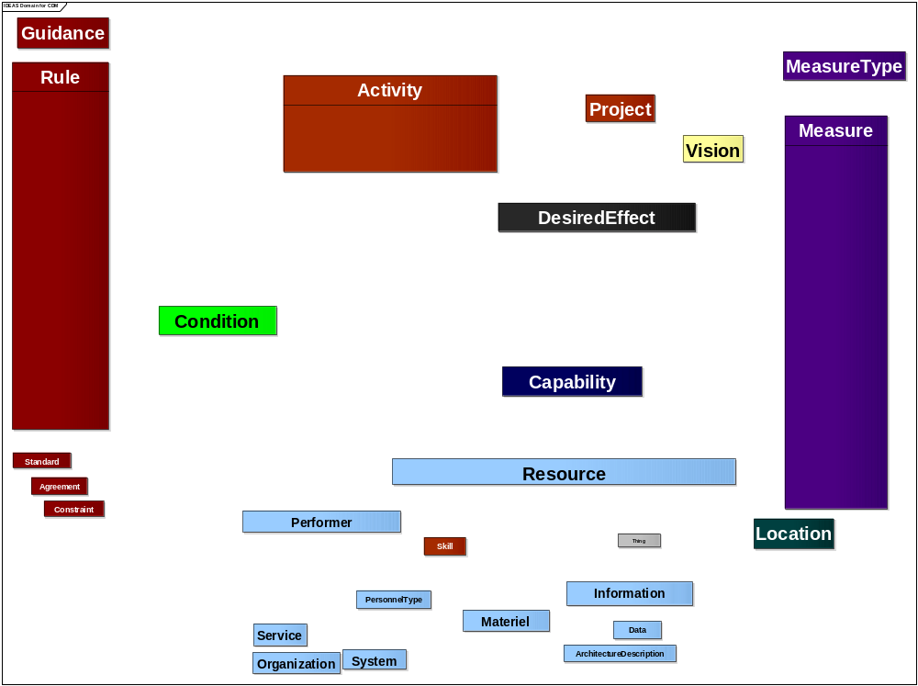
CDM (DIV-1) Graphic
1
3
2
4
6
5
8
7
9
11
10
12
13
20
14
16
17
19
18
21
22
26
15
23
24
25
27
28
29
31
(see “DM2 CDM Description document” for definitions)
30
23 (+ 24 &25)
20 (+ 21 & 22)
30
34
33
Green lines are super-subtype. Read in direction of arrow, “is a type of”
Blue lines are associations. See notes for key descriptions and examples. Read key in direction of arrow.
Crows feet are associations between the association at the foot and the arrow, read according to the key.
32
36
Person Type
35
37

Slide 43
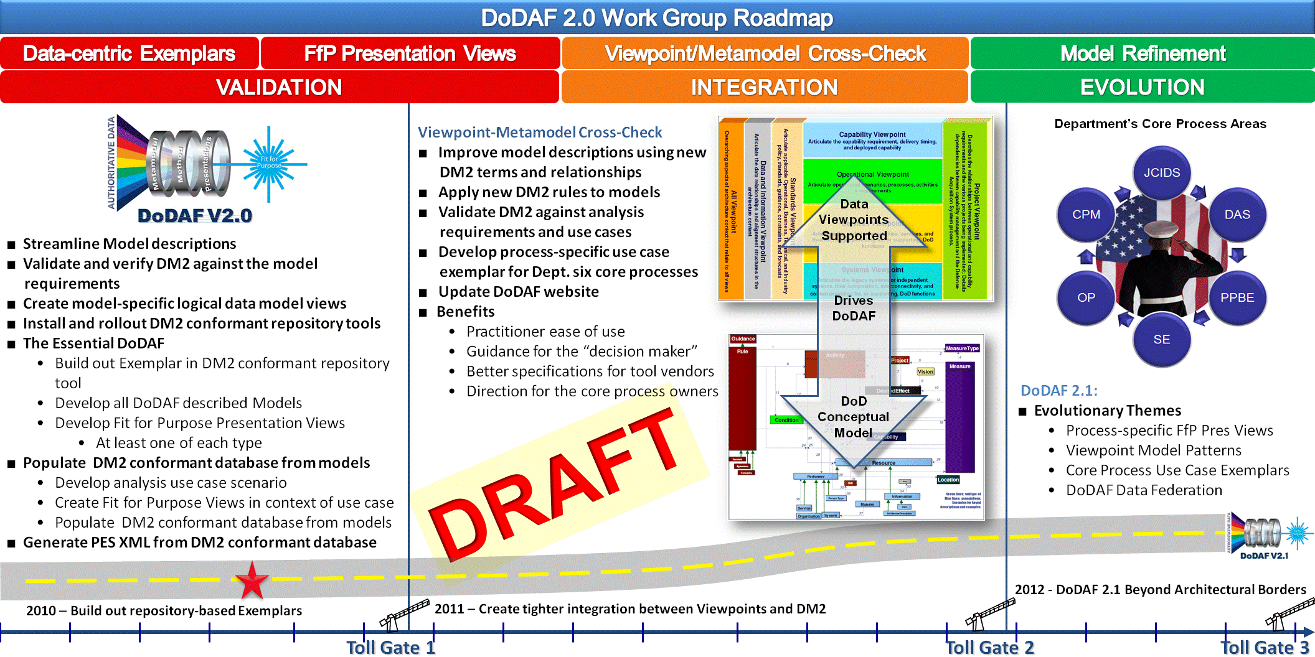
DoDAF V2.0 Roadmap

Slide 44
Wrap up & Closing Remarks
Data Dictionary is critical to architecture development
Training is basic to EA profession
Value of DoDAF Six Step Process
Clearly defined terms and common vocabulary
Critical interoperability questions
Enterprise Architecture to DM2 mapping
CIO Governance Oversight
DoDAF-DM2 Working Group – get involved
Notes:
The agenda this morning is straightforward. First we start with the focus of the new DoDAF.
We will then take you through a quick overview of the Models and architectural descriptions; how to select viewpoints that fit the purpose for which an architecture is being created, and the terms that we use. This section introduces you to the views and viewpoints (What we used to call products) that will be expanded on later in the morning by Charles Thornburg.
We will discuss, again briefly, the data in the new DoDAF meta-model, and we will end an introduction to the DoDAF six step development process.
There will be time at the end of the presentation for questions but, if, during the presentation you have a very brief question, please feel free to ask it.

Slide 45
Points of Contact
Michael Wayson
  Michael.Wayson@osd.mil (703) 607-0482
Shelton Lee
  Shelton.Lee@lmco.com (703) 916-7340
David McDaniel
  David.McDaniel@SilverBulletInc.com (703) 892-6062 x2
Notes:
It is important to note at the outset that utilizing this methodology for your architecture effort is NOT mandatory. It has been provided in DoDAF 2.0 as a means for organizations to adopt a generic, easy-to-use method for creating an architectural description, and for new teams with little experience.
If an organization prefers to use its own methods, then the generic methodology is there to compare to ensure that all the needed steps are contained in the methodology the organization prefers to use in its own efforts.
There are six steps is the DoDAF methodology:
1-Determine the intended use of the architecture
2- Determine the scope of the architecture
3- Determine data required to support architecture development
4- Collect, organize, correlate and store data
5- Conduct analysis in support of architecture objectives
6- Document results
Managers don’t do all of these steps. The first 2 (speak to) are the managers’ domain, as is Step 5. The rest are the domain of the architect and development team, with the manager acting as a subject-matter expert, where needed.

