Slide 1


Building the Future of Multi-agent Workforce
Wendong Fan
Core Member of CAMEL-AI
CAMEL-AI.org

Slide 2
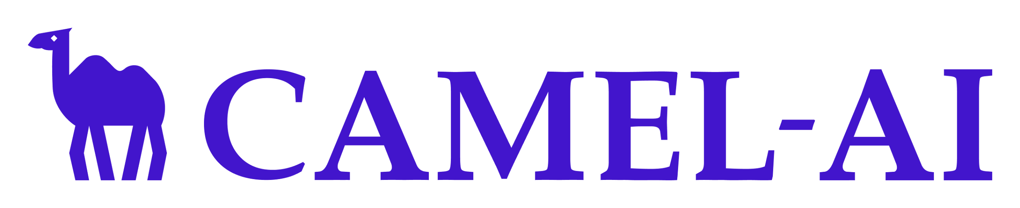
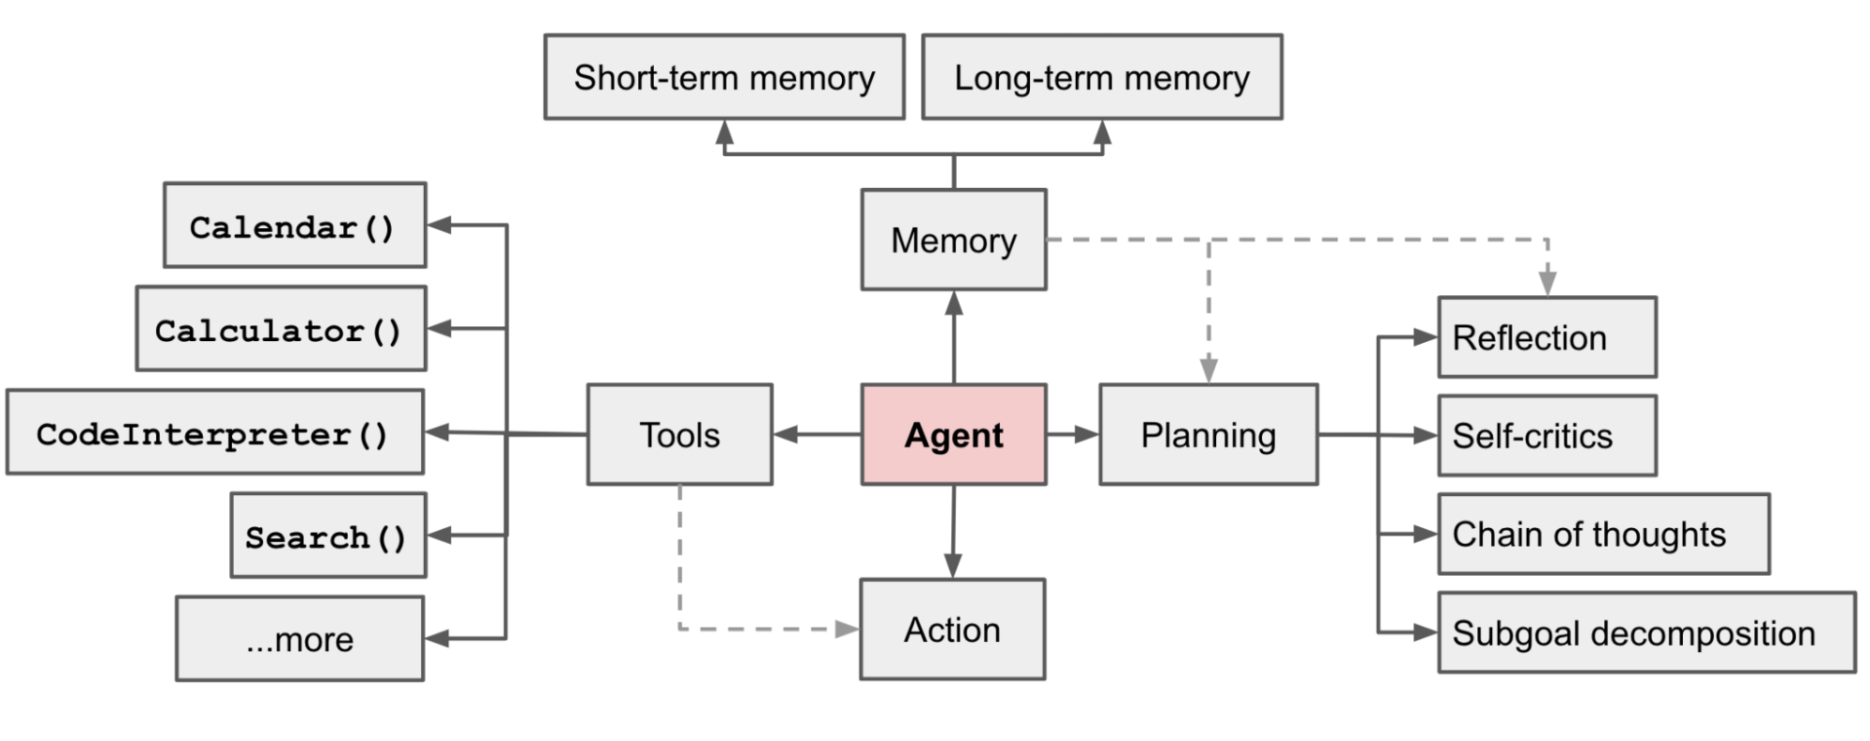
Language Models as Agents
Key differences:
Language as Input
Language as Output
State and Action are expressed as natural language
Generalizability
….
Lilian Weng: https://lilianweng.github.io/posts/2023-06-23-agent/
Notes:
One of the most popular definition of language model agents:

Slide 3
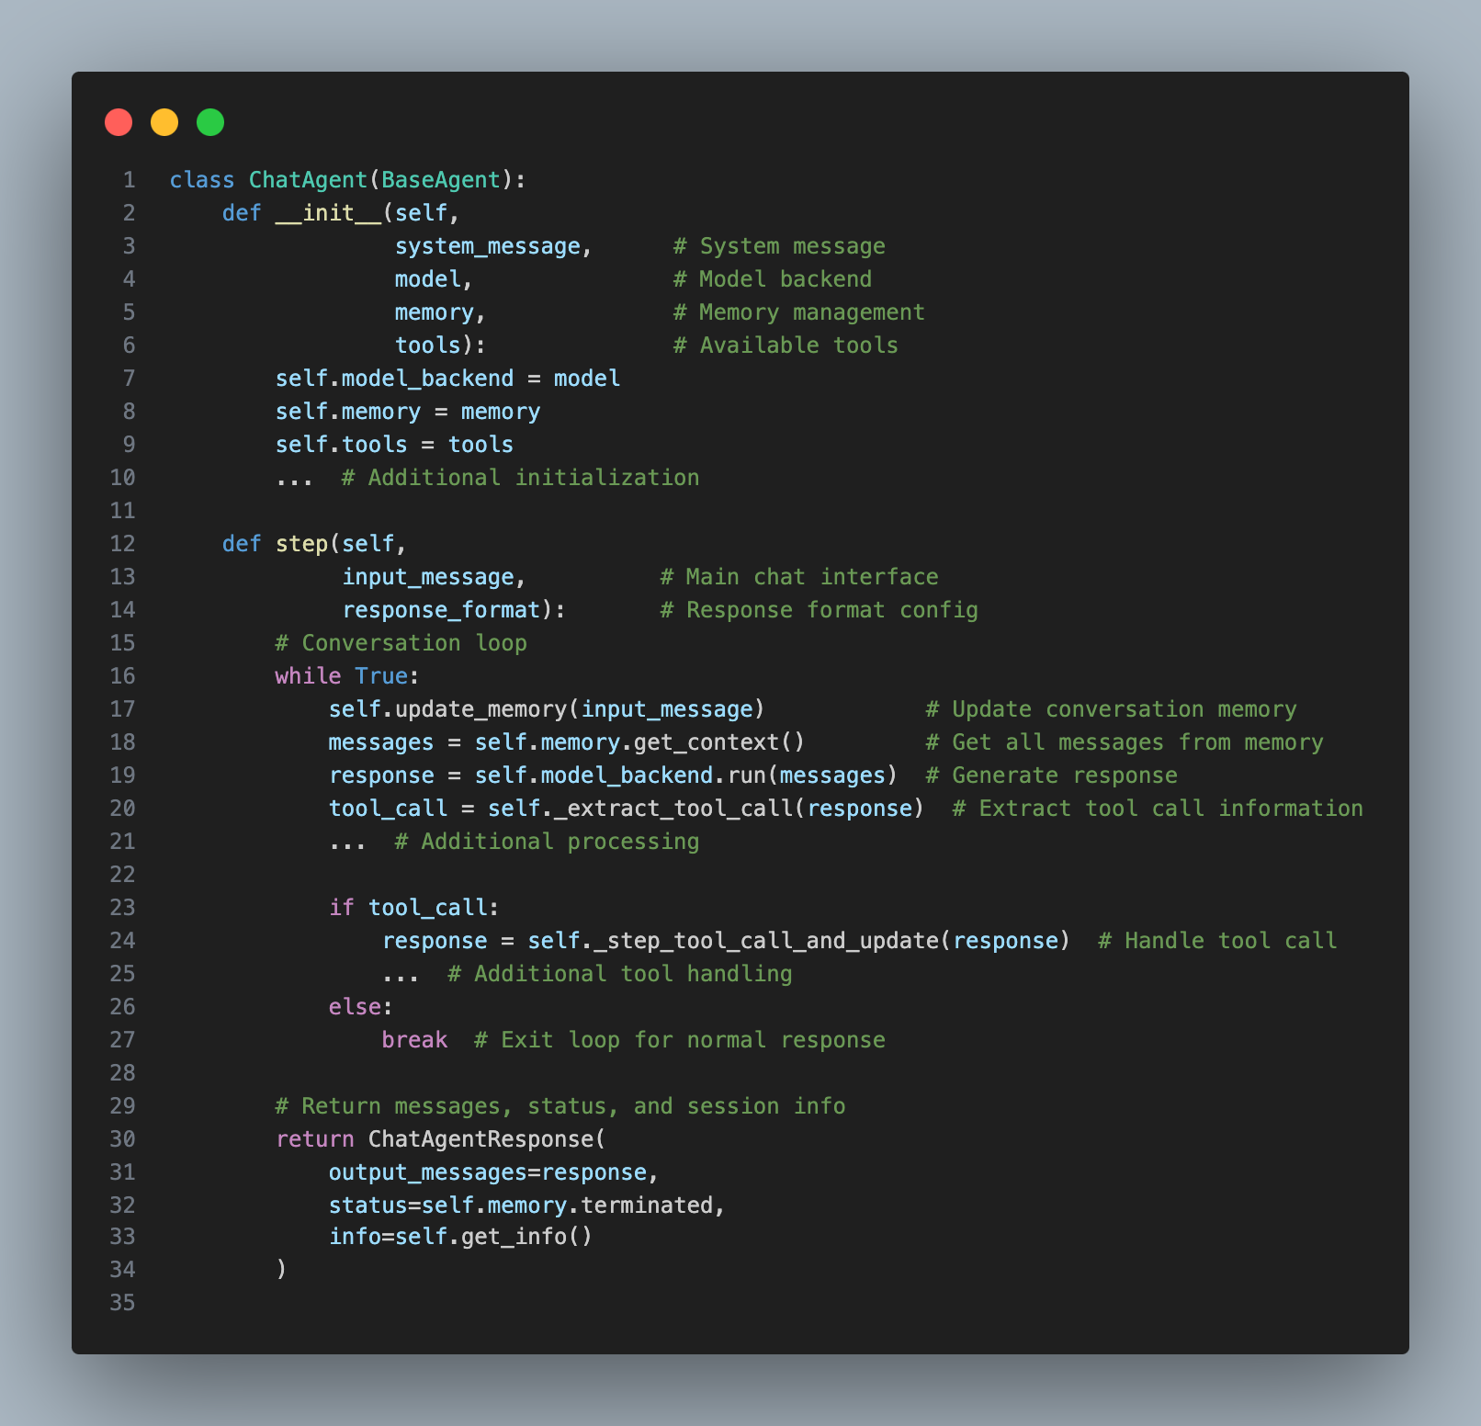
Language Models as Agents
Key Features:
- Memory: Manages chat history and context window
- Tools: Supports both internal and external function calls
- Step Loop: Handle task require multiple request with one step

Slide 4
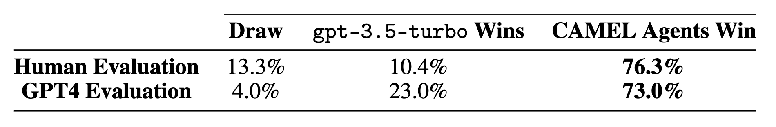
More Agents Between than one?
CAMEL agents are better one agent > 70% on 200 tasks
GPT-4 evaluation aligns with Human evaluation
Agent Evaluation Results
CAMEL (NeurIPS 2023): https://arxiv.org/abs/2303.17760

Slide 5
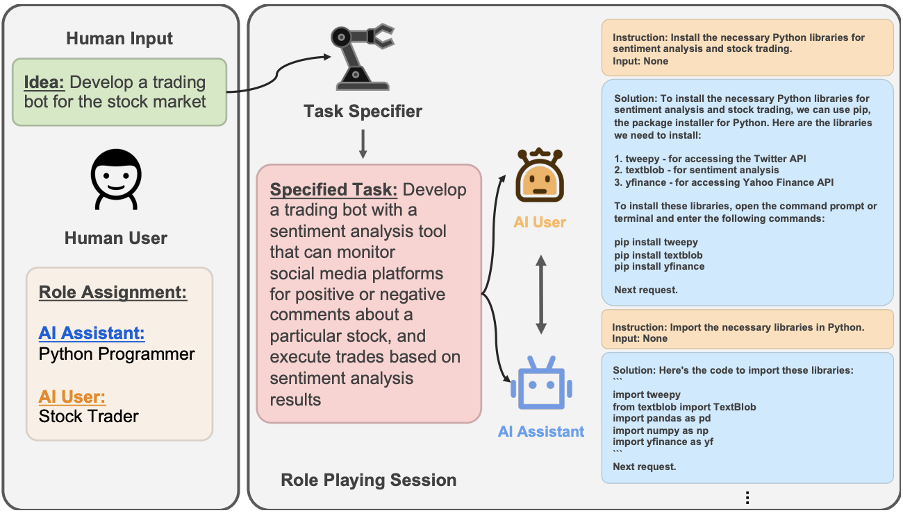
CAMEL
Idea
Role assignment
Task agents
Chat agents
Role-Playing Framework
CAMEL (NeurIPS 2023): https://arxiv.org/abs/2303.17760
Notes:
Here is an illustration of CAMEL framework:

Slide 6
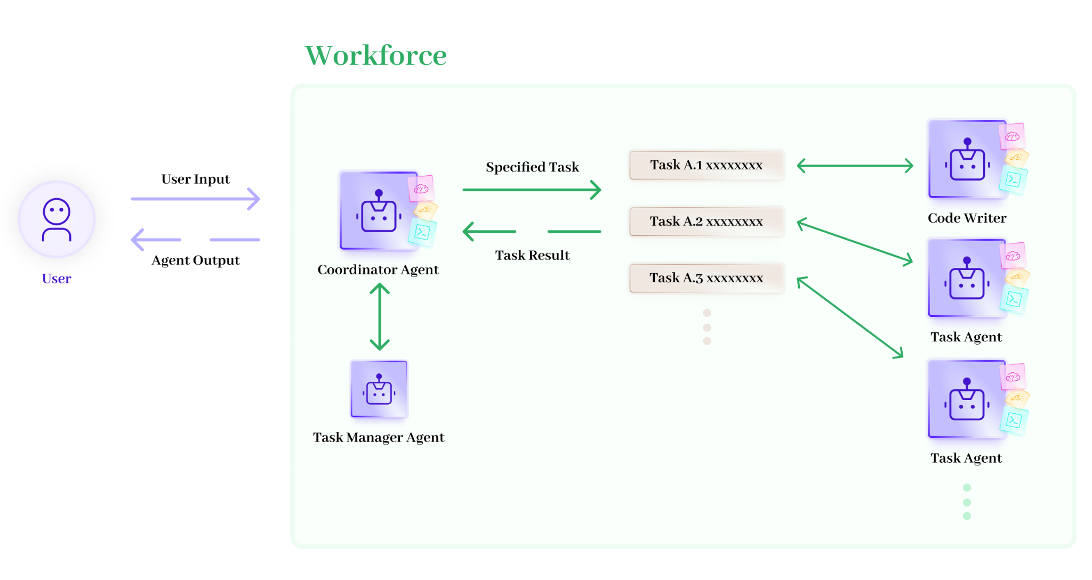
CAMEL
Workforce
Hierarchical Architecture
Task Planning and Decomposition
Task Channel Communication
Robust Failure Handling

