Slide 1


Assessing Outcome Disparity with Proxy for Unobserved Protected Class
Pitfalls and Lessons
Xiaojie Mao
Notes:
Add a question answer: why only including White-Hispanic and White-Black but not White-Asian

Slide 2

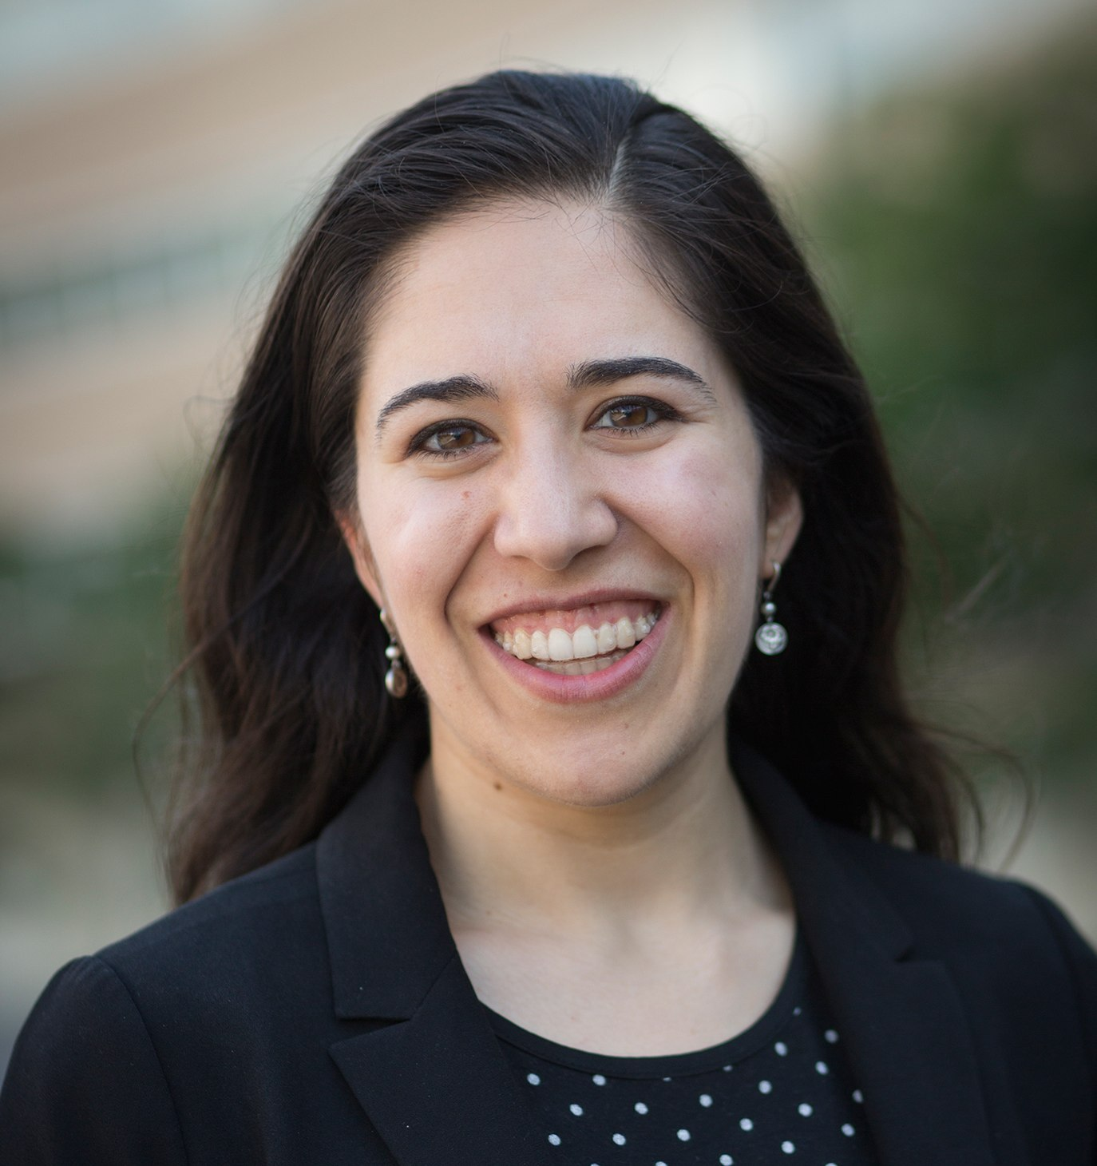


Joint Work with
Paper: Fairness under unawareness: assessing disparity when protected class is unobserved, 2019 ACM FAT* conference
Nathan Kallus
Madeleine Udell
Jiahao Chen
Geoff Svacha

Slide 3
Introduction

Slide 4
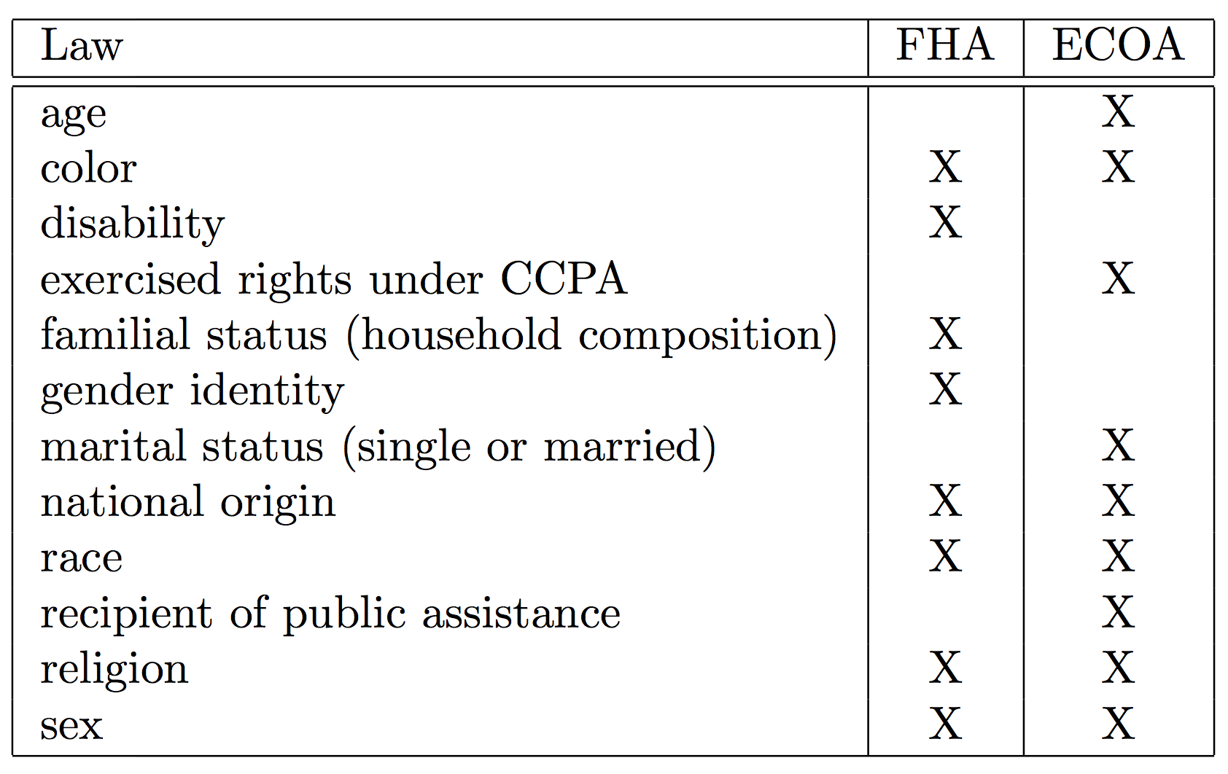
Fair Lending laws

Slide 5
Two doctrines of discrimination
Disparate Treatment
Explicitly consider class membership in treatment
E.g., redlining
Disparate Impact
Disproportionately excludes or burdens certain persons on a prohibited basis
E.g., four-fifths rule in employment

Slide 6
Disparate impact
Outcome disparity assessment
Business justification
Existence of Alternative treatments
Question: how to assess outcome disparity when the protected class is unobserved? E.g., race for non-mortgage customers.
Practice: CFPB use proxy models to impute the protected class.
Notes:
Change the fonts

Slide 7






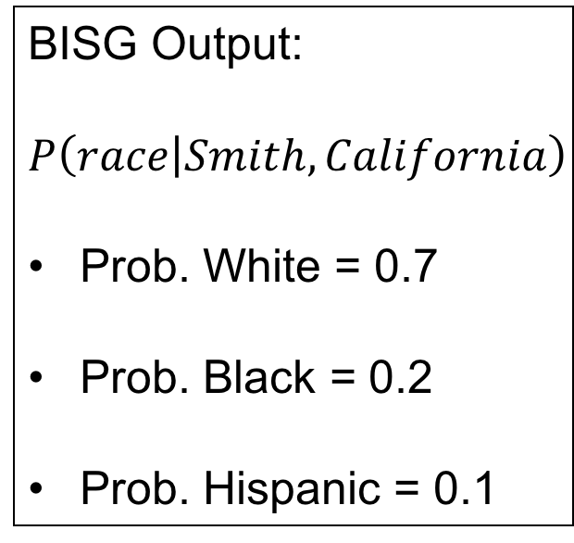
Bayesian Improved Surname Geocoding
Guess race based on surname and geolocation:
Mr./Ms. Smith living in California
BISG Output:
$$P\left(race | Smith, California\right)$$
Prob. White = 0.7
Prob. Black = 0.2
Prob. Hispanic = 0.1

Slide 8
Controversy about BISG proxy
CFPB’s analysis based on BISG led to $98 million fine against Ally Bank in 2013.
Baines and Courchane (2014) and Zhang (2016) found that using BISG race proxy overestimates the outcome disparity.
Research question: Why overestimation? Is underestimation possible?
We need to understand the tools we use!

Slide 9
Thresholded estimator

Slide 10

Threshold Rule
Classify as White
Mr./Ms. Smith living in California
Threshold = 0.65
What if we cannot classify the race …

Slide 11

Threshold Rule
Mr./Ms. Smith living in New York
Threshold = 0.65
High confidence
High threshold
High sample loss

Slide 12
Outcome disparity
Estimation Bias?
Demographic disparity:
Average loan acceptance rate for advantaged group
Average loan acceptance rate for disadvantaged group
Estimated disparity based on imputed protected class:
Average loan acceptance rate for imputed advantaged group
Average loan acceptance rate for imputed disadvantaged group

Slide 13


Inter-geolocation variation
Classified as advantaged group
Classified as disadvantaged group
dominated by
High income neighborhood
Acceptance rate
100%
Acceptance rate
100%
dominated by
Low income neighborhood
Acceptance rate
0%
Acceptance rate
0%

Slide 14
Inter-geolocation variation
True:
Average acceptance rate for
70%
Acceptance rate
100%
Acceptance rate
100%
Acceptance rate
0%
Acceptance rate
0%

Slide 15
Inter-geolocation variation
True:
Average acceptance rate for
70%
Estimated:
Acceptance rate
100%
Acceptance rate
100%
Average acceptance rate for
100%
Overstimated!
Acceptance rate
0%
Acceptance rate
0%

Slide 16
Inter-geolocation variation
True:
Average acceptance rate for
30%
Acceptance rate
100%
Acceptance rate
100%
Acceptance rate
0%
Acceptance rate
0%

Slide 17
Inter-geolocation variation
True:
Average acceptance rate for
30%
Estimated:
Acceptance rate
100%
Acceptance rate
100%
Average acceptance rate for
0%
Underestimated!
Acceptance rate
0%
Acceptance rate
0%

Slide 18
Inter-geolocation variation
True disparity:
Average acceptance rate for
Average acceptance rate for
Acceptance rate
100%
Acceptance rate
100%
40%
Estimated disparity:
Average acceptance rate for
Overestimated
Average acceptance rate for
Understimated
Acceptance rate
0%
Acceptance rate
0%
100%
Inter-geolocation variation causes overestimation bias!

Slide 19
Inter-geolocation variation
high acceptance rate → high socioeconomic status → more likely to be classified as the advantaged group
Low acceptance rate → low socioeconomic status → more likely to be classified as the disadvantaged group
Using geolocation in proxy model for disparity evaluation may be problematic too!

Slide 20
Inter-geolocation variation
True disparity:
Average acceptance rate for
Average acceptance rate for
40%
Acceptance rate
100%
Acceptance rate
100%
Estimated disparity:
Average acceptance rate for
Average acceptance rate for
Acceptance rate
0%
Acceptance rate
0%
100%

Slide 21
Intra-geolocation variation
True disparity:
Average acceptance rate for
Average acceptance rate for
30%
Acceptance rate
70%
Acceptance rate
40%
Estimated disparity:
Average acceptance rate for
Average acceptance rate for
Acceptance rate
70%
Acceptance rate
40%
12%

Slide 22
Intra-geolocation variation
Acceptance rate
70%
Acceptance rate
40%
Acceptance rate
70%
Acceptance rate
40%

Slide 23
Intra-geolocation variation
True:
Average acceptance rate for
70%
Acceptance rate
70%
Acceptance rate
40%
Acceptance rate
70%
Acceptance rate
40%

Slide 24
Intra-geolocation variation
True:
Average acceptance rate for
70%
Estimated:
Acceptance rate
70%
Acceptance rate
40%
Average acceptance rate for
61%
Underestimated!
Acceptance rate
70%
Acceptance rate
40%

Slide 25
Intra-geolocation variation
True:
Average acceptance rate for
40%
Acceptance rate
70%
Acceptance rate
40%
Acceptance rate
70%
Acceptance rate
40%

Slide 26
Intra-geolocation variation
True:
Average acceptance rate for
40%
Estimated:
Acceptance rate
70%
Acceptance rate
40%
Average acceptance rate for
49%
Overestimated!
Acceptance rate
70%
Acceptance rate
40%

Slide 27
Intra-geolocation variation
True disparity:
Average acceptance rate for
Average acceptance rate for
Acceptance rate
70%
Acceptance rate
40%
30%
Estimated disparity:
Average acceptance rate for
Underestimated
Average acceptance rate for
Overestimated
Acceptance rate
70%
Acceptance rate
40%
12%
Intra-geolocation variation causes underestimation bias!

Slide 28
Thresholded estimator bias
The bias depends on complex interplay of inter-geolocation variation and intra-geolocation variation;
Relative influence of inter-geolocation variation depends on
Actual fraction of a protected class
Imputed fraction of a protected class
which is very sensitive to the threshold;
Previous study usually uses high threshold:
inter-geolocation variation dominates
→ overestimation bias.

Slide 29
Weighted estimator

Slide 30


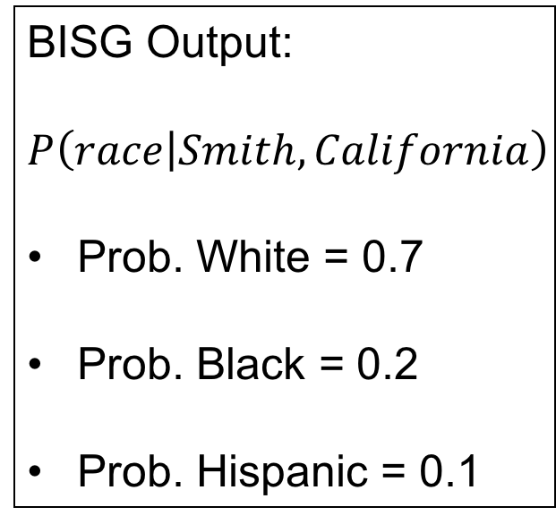
Weighted estimator
BISG Output:
$$P\left(race | Smith, California\right)$$
Prob. White = 0.7
Prob. Black = 0.2
Prob. Hispanic = 0.1
Weight = 0.7
Weight = 0.2
Weight = 0.1
Fractional Race Assignment

Slide 31
Inter-geolocation variation
True disparity:
Average acceptance rate for
Weight = 0.7
Weight = 0.3
Average acceptance rate for
Acceptance rate
100%
Acceptance rate
100%
40%
Estimated disparity:
Weight = 0.3
Average acceptance rate for
Weight = 0.7
Average acceptance rate for
Acceptance rate
0%
Acceptance rate
0%
Weighted estimator is robust to inter-geolocation variation!
40%

Slide 32
Intra-geolocation variation
True disparity:
Average acceptance rate for
Weight = 0.7
Average acceptance rate for
Weight = 0.3
Acceptance rate
70%
Acceptance rate
40%
30%
Estimated disparity:
Average acceptance rate for
Weight = 0.3
Weight = 0.7
Average acceptance rate for
Acceptance rate
70%
Acceptance rate
40%
4.8%
Intra-geolocation variation causes underestimation bias!

Slide 33


Weighted estimator bias
The bias depends only on intra-geolocation variation:
Underestimation of disparity if on most geolocations:
Overestimation of disparity if on most geolocations:
Acceptance rate
$$>$$
Acceptance rate
Acceptance rate
$$<$$
Acceptance rate
The formula for intra-geolocation variation is slightly different from the thresholded estimator (see paper for detail).

Slide 34
HMDA dataset

Slide 35
HMDA dataset
Estimation Bias
=
Estimated Disparity
-
True Disparity

Slide 36
HMDA dataset
Thresholded estimator overestimates disparity!
2. Lower threshold → small estimation bias due to delicate counterbalance of bias sources

Slide 37
HMDA dataset
Weighted estimator underestimates disparity

Slide 38
Conclusions

Slide 39
Conclusions
Thresholded estimator
its bias depends on the complex interplay of two opposing bias sources due to the geolocation disparity;
its bias tends to be very sensitive to the threshold.
Weighted estimator
is simpler to reason about the bias.
tends to underestimate the outcome disparity.
Evaluating outcome disparity without true protected class is very challenging!

Slide 40
Thank you!

Slide 41
Q & A

Slide 42
Why not control income in the examples?
Demographic disparity without controlling any factor is indeed the most susceptible to estimation bias.
The same results hold if there are other uncontrolled factors that correlates with misclassification error and outcome.
Baines and Courchane (2014) and Zhang (2017) still observed overestimation bias even after controlling many factors.

Slide 43
Why considering demographic disparity?
Easy to analyze, and sufficient for the main intuition;
Results regarding the thresholded estimator can be easily generalized to disparity accounting for legitimate factors;
Actually being used in practice:
80% rule in labor law;
Baines and Courchane (2014) suggested that CFPB might have used similar disparity measure.

Slide 44
How general the results are?
It applies for any probabilistic proxy model based on any low dimensional discrete variables.
It can easily generalize to the multi-class protected attribute.

Slide 45
What if we also add surname?
Inter-geolocation variation → inter-geolocation-surname variation;
Intra-geolocation variation → intra-geolocation-surname variation;
Adding surname additionally alleviates the bias but does not remove the two bias sources.

Slide 46
How to extend the result to multi-class protected attribute?
Multi-class protected attribute like race (White, Hispanic, Black, Asian, etc.) is more common;
Without loss of generality, we can define an advantaged group and disadvantaged group;
Our results can easily apply for pairwise outcome disparity.

Slide 47

BISG estimation error
We assumed perfect estimation of
$$P\left(race | surname, geolocation\right);$$
BISG assumption: living address is independent with surname given race;
Mismatch between the race composition of census population and loan applicants;
People married to other races, etc.

Slide 48
Maximum A Posterior estimator
Zhang (2017) proposed to impute the unobserved protected class by the most probable class;
This amounts to nonuniform low thresholds, which make the two bias sources comparable;
The observed bias decrease is the consequence of counterbalance of the two opposing biases.

Slide 49
Intuition for the weighted estimator bias
Robustness to inter-geolocation variation
Magic Math!
Intra-geolocation variation
The disadvantaged group with lower acceptance rate contributes to the average for the advantaged group.

