Slide 1

Fairness under Unawareness: Assessing Disparity when Protected Class is Unobserved
Presenter: Xiaojie Mao
Notes:
Add a question answer: why only including White-Hispanic and White-Black but not White-Asian

Slide 2

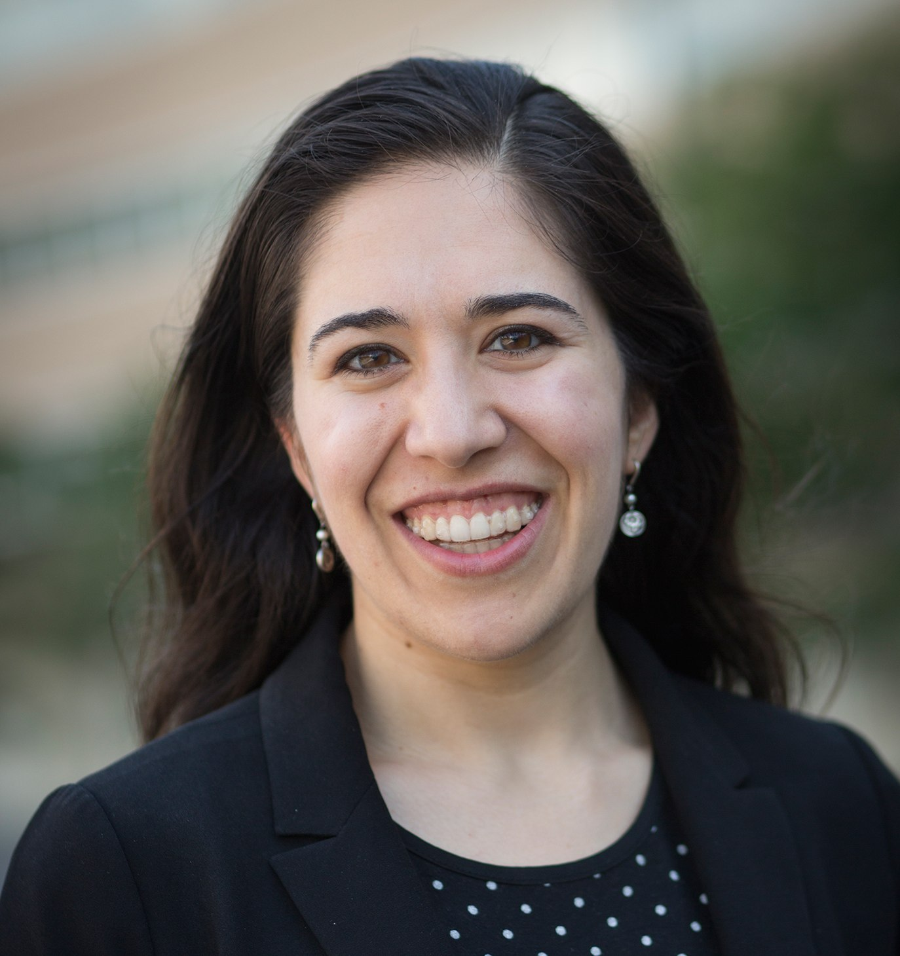


Joint Work with
Nathan Kallus
Madeleine Udell
Jiahao Chen
Geoff Svacha

Slide 3
Background

Slide 4
Fair Lending
Fair lending laws (e.g., FHA, ECOA, etc.) prohibit discrimination based on customers’ protected class;
Evaluating compliance requires assessing outcome disparity.
Challenge: how to assess outcome disparity when the protected class is unobserved? E.g., race for non-mortgage customers.
Practice: CFPB use a proxy model to impute the protected class.
Notes:
Change the fonts

Slide 5






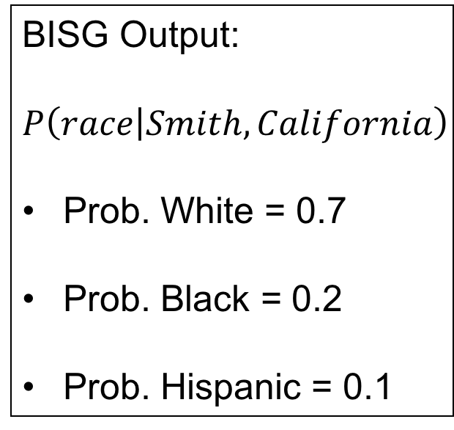
Bayesian Improved Surname Geocoding
Guess race based on surname and geolocation:
Mr./Ms. Smith living in California
BISG Output:
$$P\left(race | Smith, California\right)$$
Prob. White = 0.7
Prob. Black = 0.2
Prob. Hispanic = 0.1

Slide 6

Threshold Rule
Classify as White
Mr./Ms. Smith living in California
Threshold = 0.65
What if we cannot classify the race …

Slide 7

Threshold Rule
Mr./Ms. Smith living in New York
Threshold = 0.65
High confidence
High threshold
High sample loss

Slide 8
Controversy about BISG proxy
CFPB’s analysis based on BISG led to $98 million fine against Ally Bank in 2013.
Baines and Courchane (2014) and Zhang (2016) found that using BISG race proxy overestimates the outcome disparity.
Question: Why overestimation? Is underestimation possible?
We need to understand the tools we use!

Slide 9
Analysis

Slide 10
Outcome disparity
Problem: Estimation Bias?
Demographic disparity:
Average loan acceptance rate for advantaged group
Average loan acceptance rate for disadvantaged group
Estimated disparity based on imputed protected class:
Average loan acceptance rate for imputed advantaged group
Average loan acceptance rate for imputed disadvantaged group

Slide 11


Set-up
Classified as advantaged group
Classified as disadvantaged group
dominated by
Higher Acceptance Rate
High income neighborhood
dominated by
Low income neighborhood
Lower
Acceptance Rate

Slide 12
Thresholded Estimator

Slide 13
Inter-geolocation variation
Classified as advantaged group
Classified as disadvantaged group
High income neighborhood
Acceptance rate
100%
Acceptance rate
100%
Acceptance rate
varies across
different geolocations
Low income neighborhood
Acceptance rate
0%
Acceptance rate
0%

Slide 14
Inter-geolocation variation
True disparity:
Average acceptance rate for
70%
Average acceptance rate for
30%
Acceptance rate
100%
Acceptance rate
100%
40%
Estimated disparity:
100%
Average acceptance rate for
Overestimated
0%
Average acceptance rate for
Understimated
Acceptance rate
0%
Acceptance rate
0%
100%
Inter-geolocation variation causes overestimation bias!

Slide 15
Inter-geolocation variation
high acceptance rate → high socioeconomic status → more likely to be classified as the advantaged group
low acceptance rate → low socioeconomic status → more likely to be classified as the disadvantaged group
Using imputed race magnifies the outcome disparity because geolocations embed socio-economic bias!

Slide 16
Intra-geolocation variation
Classified as advantaged group
Classified as disadvantaged group
Acceptance rate
70%
Acceptance rate
40%
Acceptance rate
varies within
same geolocations
Acceptance rate
70%
Acceptance rate
40%

Slide 17
Intra-geolocation variation
True disparity:
Average acceptance rate for
70%
Average acceptance rate for
40%
Acceptance rate
70%
Acceptance rate
40%
30%
Estimated disparity:
61%
Average acceptance rate for
Underestimated
49%
Average acceptance rate for
Overstimated
Acceptance rate
70%
Acceptance rate
40%
12%
Intra-geolocation variation causes underestimation bias!

Slide 18
Thresholded estimator bias
The bias depends on complex interplay of inter-geolocation variation and intra-geolocation variation;
Relative influence of inter-geolocation variation depends on
Actual fraction of a protected class
Imputed fraction of a protected class
which is very sensitive to the threshold;
Previous study usually uses high threshold:
inter-geolocation variation dominates
→ overestimation bias.

Slide 19
Weighted estimator

Slide 20


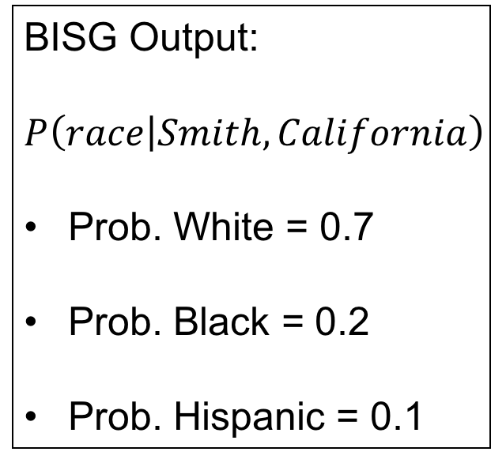
Weighted estimator
BISG Output:
$$P\left(race | Smith, California\right)$$
Prob. White = 0.7
Prob. Black = 0.2
Prob. Hispanic = 0.1
Weight = 0.7
Weight = 0.2
Weight = 0.1
Fractional Race Assignment

Slide 21


Property of Weighted Estimator
For Weighted estimator
inter-geolocation variation has no effect;
Intra-geolocation variation can cause bias.
Underestimation of disparity if on most geolocations:
Overestimation of disparity if on most geolocations:
Acceptance rate
$$>$$
Acceptance rate
Acceptance rate
$$<$$
Acceptance rate

Slide 22
Conclusions

Slide 23
Conclusions
Thresholded estimator depends on the complex interplay of two opposing bias sources;
it tends to overestimate disparity due to use of the geolocation and hard thresholding;
its bias is very sensitive to the threshold.
Weighted estimator is simpler to reason about the bias.
It tends to underestimate the outcome disparity.
Evaluating outcome disparity without true protected class is very challenging!

Slide 24
Thank you!

Slide 25
Q & A

Slide 26
Why not control income in the examples?
Demographic disparity without controlling any factor is indeed the most susceptible to estimation bias.
The same results hold if there are other uncontrolled factors that correlates with misclassification error and outcome.
Baines and Courchane (2014) and Zhang (2017) still observed overestimation bias even after controlling many factors.

Slide 27
Why considering demographic disparity?
Easy to analyze, and sufficient for the main intuition;
Results regarding the thresholded estimator can be easily generalized to disparity accounting for legitimate factors;
Actually being used in practice:
80% rule in labor law;
Baines and Courchane (2014) suggested that CFPB might have used similar disparity measure.

Slide 28
How general the results are?
It applies for any probabilistic proxy model based on any low dimensional discrete variables.
It can easily generalize to the multi-class protected attribute.

Slide 29
What if we also add surname?
Inter-geolocation variation → inter-geolocation-surname variation;
Intra-geolocation variation → intra-geolocation-surname variation;
Adding surname additionally alleviates the bias but does not remove the two bias sources.

Slide 30
How to extend the result to multi-class protected attribute?
Multi-class protected attribute like race (White, Hispanic, Black, Asian, etc.) is more common;
Without loss of generality, we can define an advantaged group and disadvantaged group;
Our results can easily apply for pairwise outcome disparity.

Slide 31

BISG estimation error
We assumed perfect estimation of
$$P\left(race | surname, geolocation\right);$$
BISG assumption: living address is independent with surname given race;
Mismatch between the race composition of census population and loan applicants;
People married to other races, etc.

Slide 32
Maximum A Posterior estimator
Zhang (2017) proposed to impute the unobserved protected class by the most probable class;
This amounts to nonuniform low thresholds, which make the two bias sources comparable;
The observed bias decrease is the consequence of counterbalance of the two opposing biases.

Slide 33
Intuition for the weighted estimator bias
Robustness to inter-geolocation variation
Magic Math!
Intra-geolocation variation
The disadvantaged group with lower acceptance rate contributes to the average for the advantaged group.

