Slide 1
Causal Inference with Noisy and Missing Covariates via Matrix Factorization
Xiaojie Mao
Department of Statistics and Data Science
Cornell University
Nathan Kallus, Xiaojie Mao, and Madeleine Udell. "Causal inference with noisy and missing covariates via matrix factorization." Advances in neural information processing systems. 2018.

Slide 2
Causal Inference under unmeasured confounders
Earning
Causal Effect?
College
Unobserved Confounder
outcome
Treatment/intervention
Intelligence

Slide 3
Earning
Causal Effect?
College
Unobserved Confounder
outcome
Treatment
Intelligence
IQ
GPA
Scholar-ship
Observed Proxies

Slide 4
Problem
Estimate causal effects using proxies for unobserved confounders.
Observed proxies may be messy:
Noisy;
Missing values;
Heterogeneous data types (e.g., continuous, categorical, count, etc).
Goal: accurately estimate causal effects using messy proxies with theoretical recovery guarantees.

Slide 5
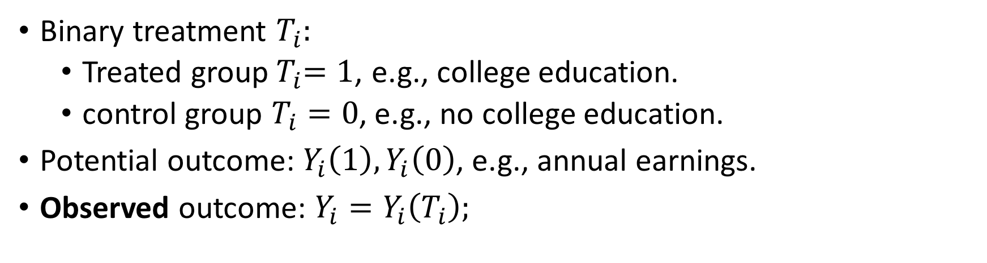
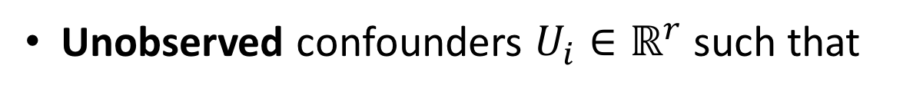
Notation
Binary treatment $T_{i}:$
Treated group${ T}_{i}=1$, e.g., college education.
control group $T_{i}=0$, e.g., no college education.
Potential outcome:${ Y}_{i}\left(1\right), Y_{i}\left(0\right)$, e.g., annual earnings.
Observed outcome: $Y_{i}=Y_{i}\left(T_{i}\right);$
Unobserved confounders $U_{i}∈ℝ^{r}$ such that
Observed proxy variables $X_{i}∈ℝ^{p}$ are noisy measurements of $U_{i}$.
Estimate average treatment effect (ATE) with i.i.d samples ${\left(X_{i}, T_{i}, Y_{i}\right)}_{i=1}^{N}$
Notes:
(Y_i(0), Y_i(1)) \perp T_i \mid U_i

Slide 6
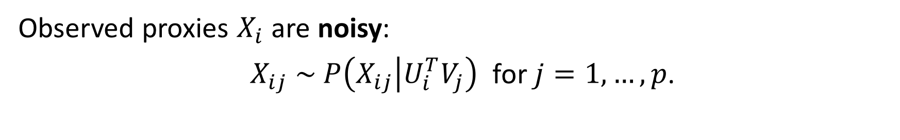
Noisy proxy variables
Observed proxies $X_{i}$ are noisy:
$X_{ij} \sim P\left(X_{ij} | U_{i}^{T}V_{j}\right)$ for $j=1, …, p$.
Noise can cause biased estimation.
Example:
Regressing $Y$ on $X, T$ gives biased least square estimator:
Notes:
Y_i \mid U_i, T_i &\sim \mathcal{N}( U_i^\top\alpha + \tau T_i, \sigma^2)
X_{ij} \mid U_i &\sim \mathcal{N}(U_i^\top V_j, \sigma'^{2})
i = 1, \dots, N, j = 1, \dots, p
\lim_{N \to \infty}| \hat{\tau}_{OLS} - \tau| \ne 0

Slide 7
What if we have many proxies?
Under mild regularity condition, if we further let $p→∞$ while fixing $r$,
Implication: using many noisy proxies can reduce bias!
Question: How to effectively use a large number of proxies while handling
High dimensionality
Missing value
Heterogeneous data types
Low Rank Matrix Factorization!
Notes:
\lim_{p \to \infty}\lim_{N \to \infty}| \hat{\tau}_{OLS} - \tau| = 0

Slide 8





Low rank matrix factorization
Noisy and missing proxy variables
$X_{ij} \sim P\left(X_{ij} | Φ_{ij}\right)$ with ${Φ_{ij}= U}_{i}^{T}V_{j}$ for $i∈\left\{1,…, N\right\},j∈\left\{1, …, p\right\}$.
observed entry index set $Ω ⊆ \left\{1,…, N\right\} × \left\{1, …, p\right\}$.
observation matrix
signal matrix
$$U$$
$$V^{T}$$
✘ | ✘ | … | ?
✘ | ? | … | ✘
? | ✘ | … | ✘
✘ | ? | … | ✘
✘ | ✘ | … | ✘
✘ | ✘ | … | ✘
✘ | ✘ | … | ✘
✘ | ✘ | … | ✘
✘ | ✘
✘ | ✘
✘ | ✘
✘ | ✘
✘ | ✘ | … | ✘
✘ | ✘ | … | ✘
$$Φ=$$
$$=$$
$$X=$$
noisy and missing
Low Rank

Slide 9







$$X$$
$$\hat{Φ}$$
IQ | GPA | ... | scholarship
110 | 3.7 | ... | 1
? | 3.0 | … | 0
108 | ? | … | ?
99 | 2.2 | … | ?
IQ | GPA | ... | scholarship
✘ | ✘ | ... | ✘
✘ | ✘ | … | ✘
✘ | ✘ | … | ✘
✘ | ✘ | … | ✘
Matrix Factorization
$$Y$$
$$T$$
Earning | College
5500 | 1
3000 | 0
5800 | 1
3300 | 0
Singular Value
Decomposition
Causal Inference: regression,
matching, weighting, etc.
ATE: $\hat{τ}$
✘ | ✘
✘ | ✘
✘ | ✘
✘ | ✘
✘ | ✘
✘ | ✘
✘ | ✘
✘ | ✘
… | ✘
… | ✘
$$\hat{U}$$

Slide 10
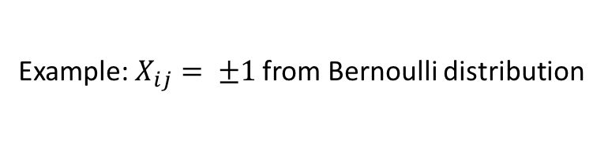
Low rank matrix factorization (LRMF)
Nuclear norm penalty encourages low rank solution:
Convex optimization problem under exponential family noise distribution (e.g., Gaussian, Bernoulli, Poisson, etc.)
Example:$X_{ij}= ±1$ from Bernoulli distribution
Extensive literature on recovery guarantee for low-rank $Φ:$
e.g.
(Candaaes, and Plan 2010,
Mazumder et. al. 2010,
Gunasekar et. al. 2014)
Notes:
\hat{\Phi} = \operatorname{argmin}\limits_{\Phi} \frac{Np}{|\Omega|}[\sum\limits_{(i, j)\in \Omega} - \log P(X_{ij}| \Phi_{ij})] + \lambda \|\Phi\|_{\star}
\|\Phi\|_{\star} = \sum_{k = 1}^{N \wedge p}\sigma_k(\Phi)
\frac{1}{Np}\|\hat{\Phi} - \Phi\|_{F} \overset{N, p \to \infty}{\longrightarrow} 0

Slide 11
Assumptions for low rank matrix factorization (LRMF)
✔✔️
Question: how to accurately estimate causal effects with messy proxies?
Low rank assumption $p≫r:$
Noisy?
Missing completely at random assumption:
Missingness?
Exponential family error distribution assumption.
Heterogeneous data?

Slide 12
Theoretical guarantee
Assume
Linear regression model ;
Low rank, missing completely at random, exponential family noise;
Exponential family matrix factorization is used with ;
$T_{i}$ is almost surely not linearly dependent with $U_{i}$;
Regularity condition on $U, V$ such that for $Φ=UV^{T}$
bounded away from 0 with high probability.
$\left|Ω\right|>crN\text{log}N$ and $p^{1+ δ}/N→$0 for positive constants $δ, c;$
Then
Notes:
\lambda = \mathcal{O}\bigg(\sqrt{\frac{rpN^2\log N}{|\Omega|}}\bigg)
{\sigma_{\min}(UV^\top)}/{\sigma_{\max}(UV^\top)}

Slide 13
Simulation

Slide 14
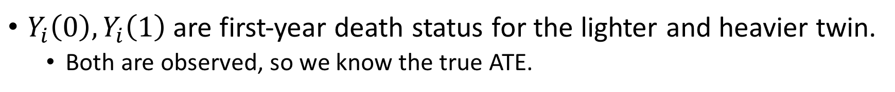
Data analysis: twins mortality
N = 11984 twin pairs born in U.S. during 1998-1991 and weighed less than 2kg (Louizos et. al. 2017).
covariates relating to parents, the pregnancy and birth for each pair of twins.
Goal: estimate ATE of being the heavier twin on first-year mortality.
$Y_{i}\left(0\right),Y_{i}\left(1\right)$are first-year death status for the lighter and heavier twin.
Both are observed, so we know the true ATE.
Number of gestation week (GESTAT10) is known to be highly correlated with the outcomes.
Categorical variable with value 0, 1, …, 9, indicating number of gestation weeks.

Slide 15




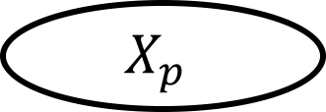
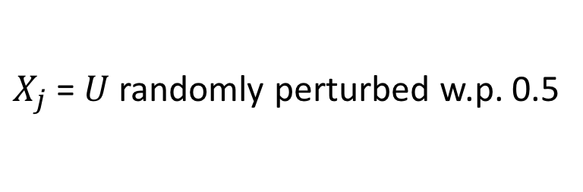

Twins mortality: simulate observational data
$$Y=Y\left(T\right)$$
$$T$$
Mortality
Heavier Twin?
$$U$$
GESTAT10
$$T|U \sim \text{Bernoulli}\left(\text{SoftMax}\left(5\left(U/10− 0.1\right)\right)\right)$$
$$X_{1}$$
$$X_{2}$$
$$X_{p}$$
$X_{j}$ = $U$randomly perturbed w.p. 0.5
Missingness w.p. 0.3

Slide 16
Twins mortality: result

Slide 17
Summary
Usual causal estimator is biased under unmeasured confounding.
Using a large number of proxies for a small number of unmeasured confounders can reduce bias.
Low rank matrix factorization is an effective way to use proxies: it
Effectively denoises the proxies;
adapts to missing values;
accommodates heterogeneous data types;
enhances many popular causal inference methods;
enjoys theoretical guarantee.

Slide 18
Kallus, Nathan, Xiaojie Mao, and Madeleine Udell. "Causal inference with noisy and missing covariates via matrix factorization." Advances in neural information processing systems. 2018.
Contact: xm77@cornell.edu Website: https://xiaojiemao.github.io/
Thank you!

