Slide 1
Interval Estimation of Individual-Level Causal Effects Under Unobserved Confounding
Xiaojie Mao
Department of Statistics and Data Science
Cornell University
Based on joint work with Nathan Kallus and Angela Zhou.

Slide 2
Causal inference under unmeasured confounding
Age
Individual-level treatment effect (ITE)
Blood pressure if HRT were applied
Blood pressure if HRT were not applied
Hormone Replacement
Therapy (HRT)
Blood Pressure

Slide 3
Causal inference under unmeasured confounding
Age
Health Consciousness
Individual-level treatment effect (ITE)
Blood pressure if HRT were applied
Blood pressure if HRT were not applied
Hormone Replacement
Therapy (HRT)
Blood Pressure

Slide 4
Unmeasured confounding can bias point estimates

Slide 5
Unmeasured confounding can bias point estimates
Causal effects are unidentifiable
under unmeasured confounding.

Slide 6
Partial Identification bound

Slide 7
Partial Identification bound

Slide 8
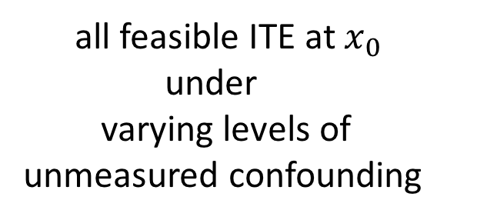
Partial Identification bound
all feasible ITE at $x_{0}$
under
varying levels of unmeasured confounding

Slide 9
Partial Identification bound
all feasible ITE at $x_{0}$
under
varying levels of unmeasured confounding
Previous literature:
mostly consider population-level average treatment effect (no personalization )

Slide 10
Interval estimators

Slide 11
Interval estimators
Thank You!

