Slide 1

Diffusion of “Following” Links in Microblogging Networks
Jing Zhang
Tsinghua University
Collaborate with
Wei Chen (MSRA)
Zhanpeng Fang and Jie Tang (THU)
Jing Zhang, ZhanpengFang, Wei Chen, and Jie Tang. Diffusion of “Following” Links in Microblogging Network. Accepted by TKDE.

Slide 2
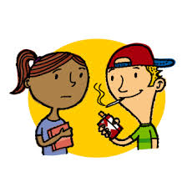


What is Social Influence?
Social influence occurs when one's opinions, emotions, or behaviors are affected by others, intentionally or unintentionally.^{[1]}
Peer Pressure
Opinion leadership
Group Influence
…
[1] http://en.wikipedia.org/wiki/Social_influence
Notes:
Social influence takes many forms and includes:
Peer pressure: is influence that a peer group, observers or individual exerts that encourages others to change their attitudes, values, or behaviors to conform the group norms.
Opinion leadership : comes from the theory of two-step flow of communication. Opinion leadership is leadership by an active media user who interprets the meaning of media messages or content for lower-end media users.
Conformity is the act of matching attitudes, beliefs, and behaviors to group norms.

Slide 3







“Love Obama”
I love Obama
I hate Obama, the worst president ever
Obama is fantastic
Obama is great!
No Obama in 2012!
He cannot be the next president!
Positive
Negative
Notes:
Obama has done just that. From social networking to his blog to his Fight the Smears campaign, Obama has made his Web 2.0 presence known. He has over 1.5 million friends on MySpace and Facebook, and he currently has over 45,000 followers on Twitter. This personal activity in social networks allows him to quickly get the word out across multiple platforms.

Slide 4


Influence Maximization
Initially targeting a few “influential” seeds, to trigger a maximal number of individuals to adopt the opinions/products through friend recommendation.
Probability of B influencing C
B
A
0.2
C
0.5
0.2
0.4
0.5
0.3
D
E
F
0.5

Slide 5




Following Influence on Twitter
Time 1
Time 2
Lady Gaga
Lady Gaga
Lei
Sen
Lei
Sen
Peng
Peng
When you follow a user in a social network, will the be-
havior influences your friends to also follow her?

Slide 6

Link Influence
v
Node Influence
Link Influence
Active node
Active link
v
Node to be influenced
Link to be influenced

Slide 7
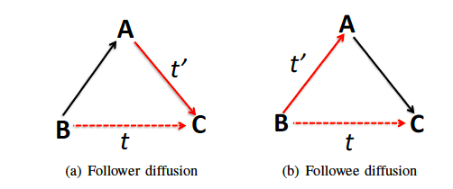
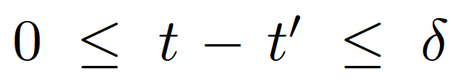
Two Categories of Link Influence
–>: pre-existing relationships
–>: a new link added at time t’
-->: a possible link added at time t

Slide 8
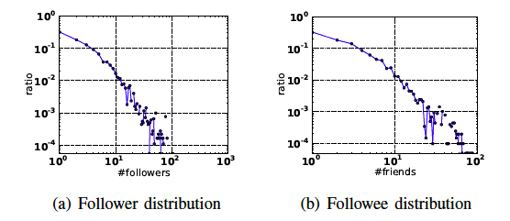
Twitter Data
Twitter data
“Lady Gaga” -> 10K followers -> millions of followers;
13,442,659 users and 56,893,234 following links.
A complete dynamic network
112,044 users and 468,238 follows
From 10/12/2010 to 12/23/2010, 13 timestamps by viewing every 4 days as a timestamp

Slide 9

Randomization Test
Randomization test is a model-free, computationally intensive statistical technique for hypothesis testing, the main steps are
Compute some test statistic using the set of original observations;
Carry out the random shuffle according to the null hypothesis a large number of times, and compute the test statistic for each random data;
By the law of large numbers, the permutation p-value is approximated by the proportion of randomly generated values that exceed or equal the observed value of the test statistic.
Null hypothesis: the formation of neighboring links is temporally independent of one another.
Test statistic:

Slide 10
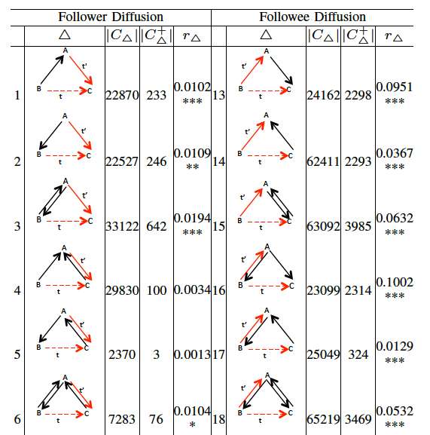

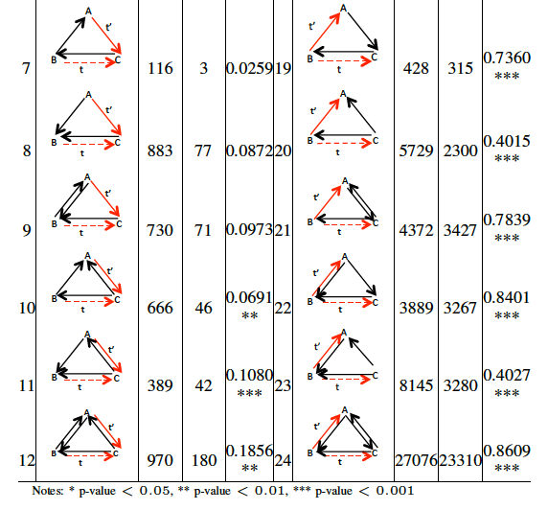
P-values on 24 Triads
The link e_{AC} is formed most probably due to the “following” behavior from ordinary user to celebrity user.
The most probable reason of B “following” C is C
“following” B before and B “following” back, rather than the influence from A “following” C .
The most probable reason why A follows C is “following” back, and thus C is more likely to be an ordinary user.
There are more two-way links in a triadic closure, which can strengthen the diffusion effect from e_{AC.}

Slide 11
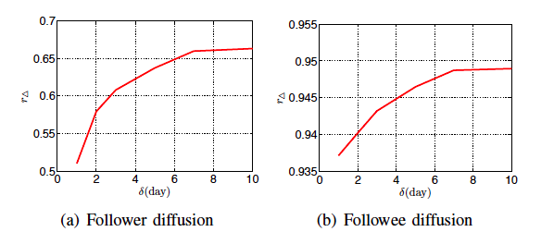
Diffusion Decay
The increasing rate becomes slower over time.
When δ is larger than 7 days, the rate almost stops increasing.
The formation of B following C in followee diffusion is easier than that in follower diffusion.

Slide 12
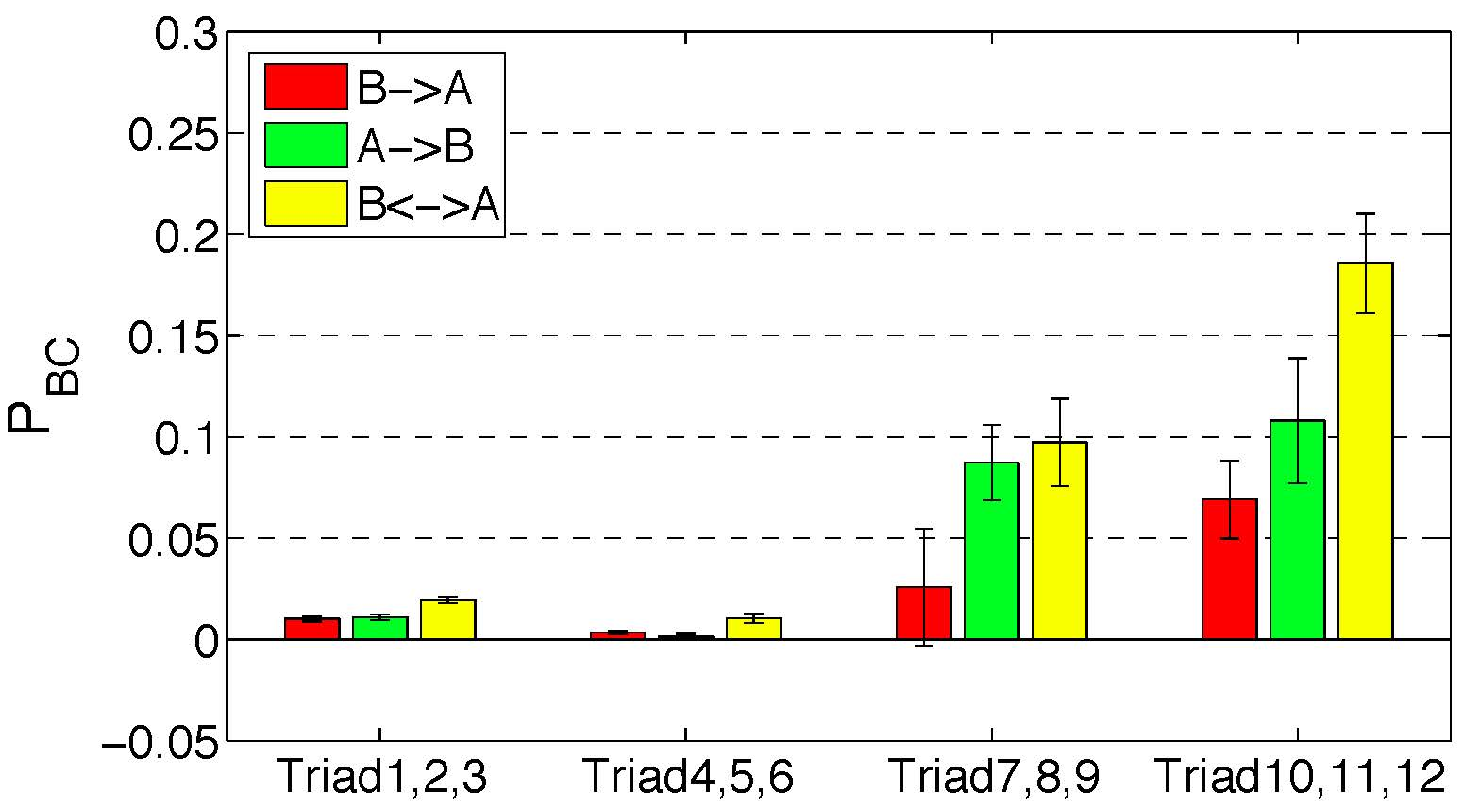
Follower Diffusion: Power of Reciprocity
A
A
A
t
t
<
t
B
C
B
C
B
C
t'
t'
t'
B ->A
A->B
B<->A
Observation: Reciprocal relationships are much more likely to be actual “social” relationships, rather than “celebrity following”, and thus have stronger social influence.

Slide 13
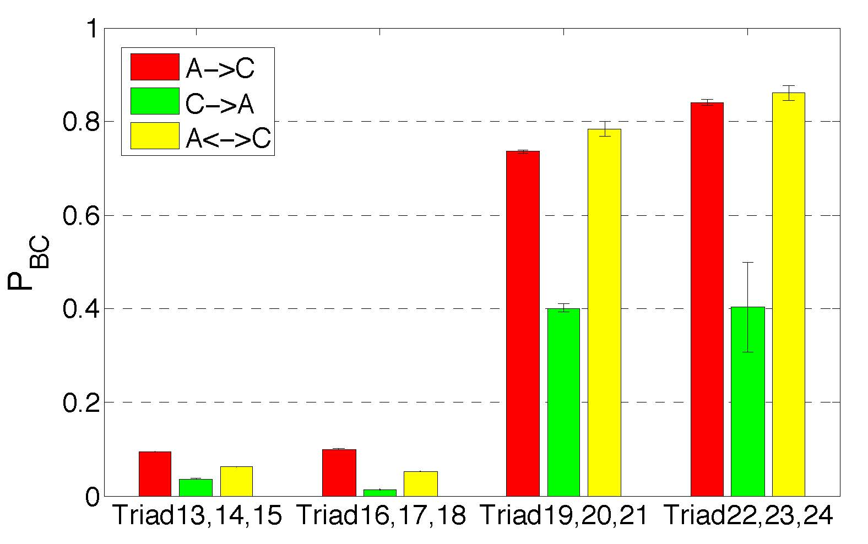
Followee Diffusion: Easy Discovery
A
A
A
t
t
>
t
B
C
B
C
B
C
t'
t'
t'
A ->C
A<->C
A<-C
Observation: When a user B follows another user A, who already follows user C, B is likely to discover C through browsing A’s retweets of C’s messages or directly checking A’s followee list, and A’s interest in C may indicates that B would also be interested in C.

Slide 14
“Following” Link Cascade Model
When a link e’ is added at time t’, at each time slot from time t’ to t’+δ:
The follower end point B of link e may discover the link e’ with discovery probability g_{e’e}.
Once discovered, e’ may trigger e to be formed with influence probability h_{e’e}.
If failed, e’ will have no chance to activate e again.
When multiple links activate e, e is activated at the time of the first successful attempt.
The time delay λ for discovery follows a geometric distribution with parameter g_{e’e} and after discovery there is one chance at time t’+λ that e’ could activate e.
e’
’
F
’
’
’
e
Notes:
Influence does not happen immediately after A follows C because it may take some time for B to discover A and C’s relationship, e.g. due to the login frequency of B.

Slide 15

Influence Estimation
The object is to estimate h_{e’e} and g_{e’e.}
The method is to maximize the likelihood of generating all the links and solve the parameters in the likelihood function.
1
2
We formalize the formation of each newly added link.
For each newly added link, we also formalize its effect on its unformed neighboring links.

Slide 16


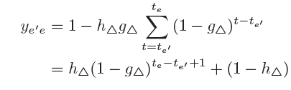

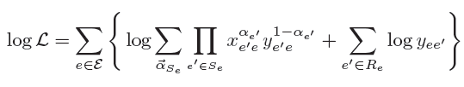
Log-likelihood
A link e is successfully added if at least one of its recently added neighboring links e’ ∈S_{e} successfully activated it.
Use a latent binary vector α_{Se} = {α_{e’}} _{e’ ∈Se} to represent the statuses of S_{e}.
α_{e’} =1: e’ tried to activate e and succeeded.
α_{e’} =0: e’ failed to activate e within [t_{e’} , t_{e}].
Assume p(α_{Se}) is uniformly distributed.
Assume e’ activates e independently
The probability of e’ not activating e within [t_{e’} , t_{e}]
The probability of e’ activating e at time t_{e} successfully.
The final log-likelihood:

Slide 17


EM Algorithm
Estimate the influence probabilities associated to 24 triads instead of link pairs.
Associate each link pair (e,e’) to a triad structure.
Aggregate different pairs with the same structure together.
Introduce a posterior distribution q(e|α_{Se}) of p(e|α_{Se}), and get a lower bound of the original log-likelihood function.
Differentiate the lower bound with respect to each parameter and set the partial differential to zero.

Slide 18
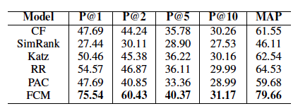
Ranking-based Link Prediction
CF，SimRank, and Katz
They only consider the static structure information and ignore the dynamic evolution of the network structure.
RR and PAC
They fit the distributions of some macroscopic properties such as clustering coefficient and closure ratio。
They also do not consider the temporal dependence between two links.

Slide 19
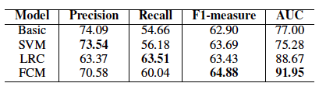
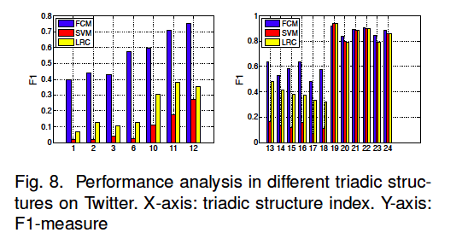
Classification-based Link Prediction
SVM and LRC perform poorer than FCM on the triads presenting relatively weak diffusion effects, especially on triads 1, 2, 3, and 6.
The performance of SVM and LRC may be dominated by the effects from the statistically significant triads.
FCM smooths the effects from different factors using a generative process.
Group3
Group4

Slide 20
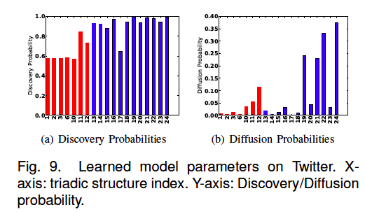
Learned Model Parameters
The discovery probabilities learned for followee diffusion patterns are generally higher than follower diffusion patterns, which indicate that the discoveries in followee diffusion are easier than those in follower diffusion.
The learned diffusion probabilities are consistent with the rates in Table 1, which suggests that the diffusion effects in followee diffusion are stronger than those in follower diffusion.

Slide 21



Application: Follower Maximization
Alice
John
Mary
Find a set S of k initial followers to follow user v such that the number of subsequent new followers to follow v is maximized.

Slide 22
Application: Friend Recommendation
Bob
Ada
Mike
Find a set S of k initial followees for user v such that the total number of subsequent new followees accepted by v is maximized.

Slide 23
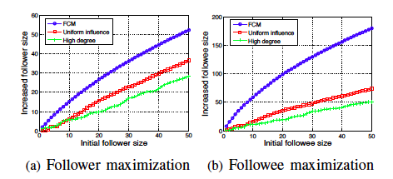
Application Performance
High degree
May select the users that do not have large influence during link diffusion process.
Greedy algorithm with uniform configured influence
Can not accurately describe the influence between links.
Greedy algorithm with learned influence by FCM
Distinguish the influence in different triad structures.

Slide 24
Conclusion
Observations
Conduct a randomization test to demonstrate the formation of two links in some triads is temporally dependent.
The diffusion effect between two links decays over time。
A two-way relationship between two users can trigger more links (+1%) than a one-way relationship。
A relationship directed from A to C improves the diffusion likelihood from A following C to B following C (+3-40%).
Propose a “following” link cascade model to depict the link diffusion process by considering the time delay and different diffusion patterns.
Learn the diffusion strength in different triadic structures by maximizing an objective function based on the proposed model.
Apply the model into two specific influence maximization applications, follower maximization and followee maximization.

Slide 25
Thank You Data&Codes: http://cs.aminer.org/followinf

