Slide 1
A Topic Modeling Approach and its Integration into the Random Walk Framework for Academic Search
¹Jie Tang, ²Ruoming Jin, and ¹Jing Zhang
¹Knowledge Engineering Group,
Dept. of Computer Science and Technology
Tsinghua University
²Department of Computer Science
Kent State University
Dec. 25th 2008

Slide 2

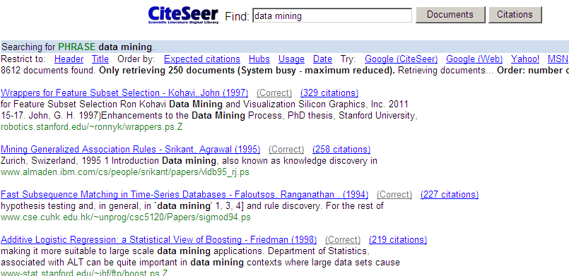

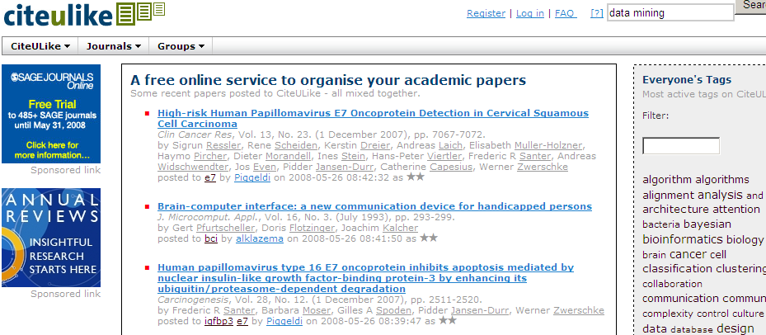
Motivation
“Academic search is treated as document search, but ignore semantics”
However, the results are still not satisfactory …

Slide 3
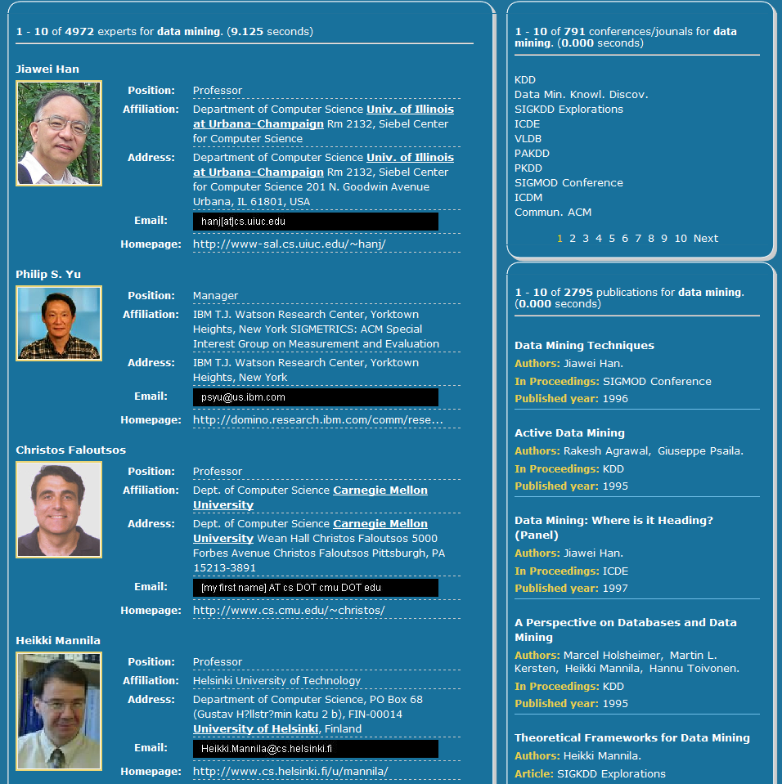
Examples – Expertise search
Data mining
Modeling using VSM
Principles of Data Mining.
DJ Hand - Drug Safety, 2007 - drugsafety.adisonline.com
Search with keyword
Return
Advances in Knowledge Discovery and Data Mining
UM Fayyad, G Piatetsky-Shapiro, P Smyth, R…
Data Mining: Concepts and Techniques
J Han, M Kamber - 2001…
Search with semantic modeling
Experts
Expertise conferences
Modeling using semantic topics
Topics
Data mining
0.4
Association Rules
Return
Expertise papers
Data mining
0.2
Database systems
0.15
0.1
Data management
0.05
0.02
Web databases
Information systems

Slide 4
Challenges
How to model the heterogeneous academic network?
How to capture the link information for ranking objects in the academic network?
Topic
Notes:
4
本文的主要工作，就是研究如何为学术社会网络统一建模，不但模型化各种异构数据的特点，还模型化他们之间的关系。我们采用话题模型的方法来实现。具体来说，本文的主要工作是：

Slide 5
Outline
Previous Work
Our Approach
Ranking with Topic Model and Random Walk
Experimental Results
Online System—ArnetMiner.org

Slide 6
Previous Work
Search with keyword
Language Model [Zhai, 01], VSM, etc.
Search with semantic topics
LSI [Berry,95], pLSI [Hofmann, 99], LDA [Blei,03] [Wei, 06], etc.
Ranking
PageRank [Page, 99], HITS [Kleinberg, 99], PopRank [Nie, 05], Link Fusion [Xi, 04], AuthorRank [Liu, 05], etc.
Combining links and contents
A Joint Probabilistic Model [Cohn and Hofmann, 01], Topical PageRank [Nie, 06], etc.

Slide 7
Outline
Previous Work
Our Approach
Ranking with Topic Model and Random Walk
Experimental Results
Online System—ArnetMiner.org

Slide 8
Modeling the Academic Network using
authors
words
Topic
ACT1
conference
ACT2
ACT3
Author-Conference-Topic Model [Tang et al., 08]

Slide 9
Generative Story of ACT1 Model
Paper
Latent Dirichlet Co-clustering
Shafiei and Milios
We present a generative model for clustering documents and terms. Our model is a four hierarchical bayesian model. We present efficient inference techniques based on Markow Chain Monte Carlo. We report results in document modeling, document and terms clustering …
NLP
P(c|z)
ICDM 0.23
KDD 0.19
….
IR
ICDM
NIPS
mining 0.23
clustering 0.19
classification 0.17
….
ML
P(w|z)
DM
clustering
Shafiei
NLP
inference
IR
P(c|z)
ICML 0.23
NIPS 0.19
….
DM
ML
model 0.23
learning 0.19
boost 0.17
….
P(w|z)
Milios
Generative process
Notes:
9

Slide 10
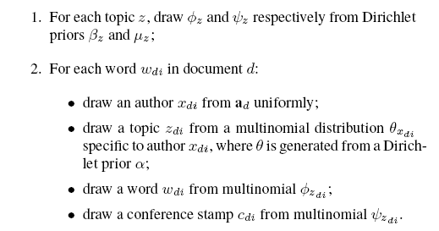
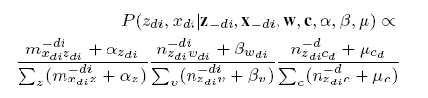
ACT Model 1
Generative process:
authors
words
Topic
ACT1
conference

Slide 11
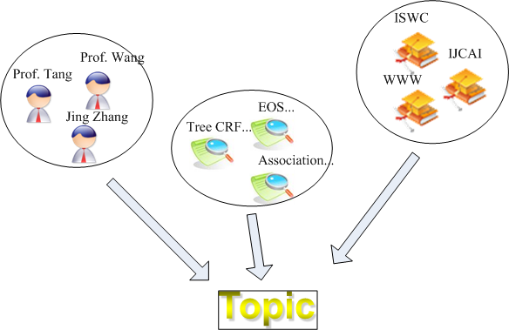
Integrating Topic Model into Random Walk
Modeling academic network with topics
Random walk over the academic network
+
=?

Slide 12


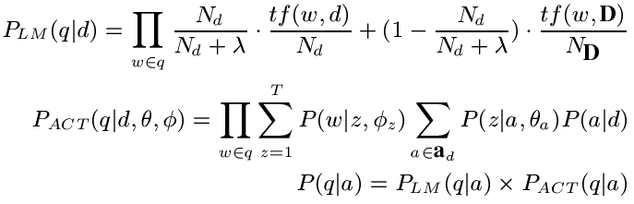
Combination Method 1
Stage 1:
Random walk
Ranking score
Combination by multiplication
Topic layer
Topic-based relevance score
Stage 2.
Topic-based relevance

Slide 13
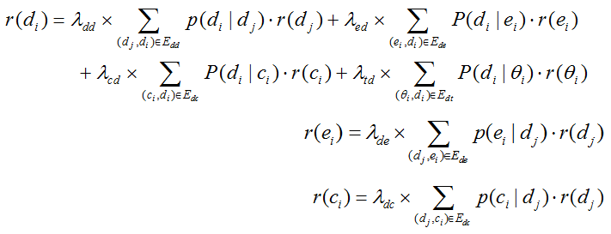
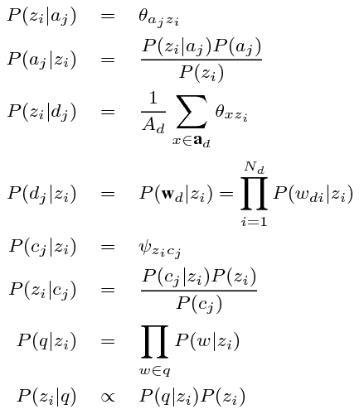
Combination Method 2
Ranking score
Transition probability

Slide 14
Outline
Previous Work
Our Approach
Ranking with Topic Model and Random Walk
Experimental Results
Online System—ArnetMiner.org

Slide 15
Experimental Setting
Arnetminer data: (http://arnetminer.org)
14,134 authors, 10,716 papers, 1,434 confs/journals
and relationships between them
Evaluation measures:
pooled relevance + human judgment
P@5, P@10, P@20, R-pre, MAP
Baselines:
Language Model (LM)
LDA
Author Topic (AT)
Notes:
We use the two language models, composite model and hybrid model as the baselines, we call them CM and HM. We also report the results obtained by Libra and Rexa
We implemented our mixture model in two stages, we call it MM.
In the first stage, we use PLSA to estimate the probabilities … Here, documents denote publications in Arnetminer, terms are extracted from the titles and conference names of publications after word segmentation, stop word filtering and stemming.
In the second stage, we rank experts using the following equation for each query.

Slide 16
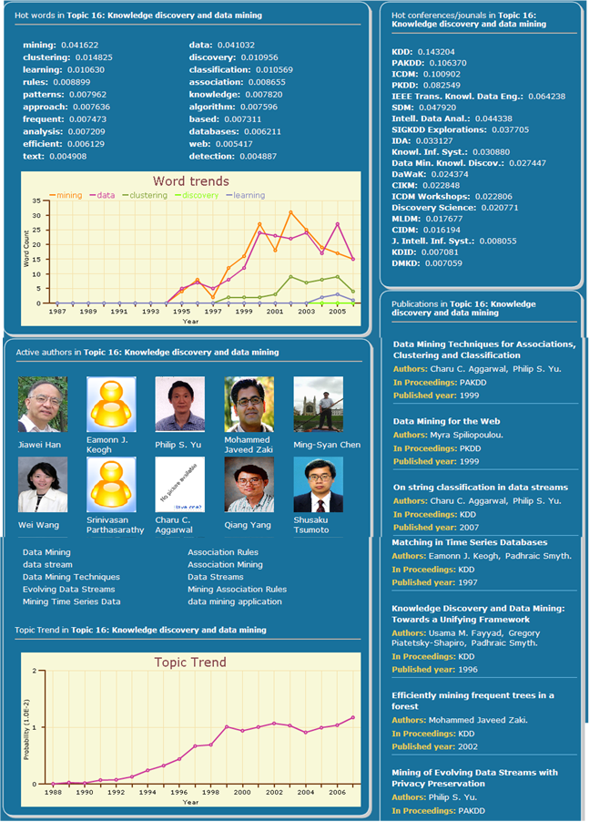
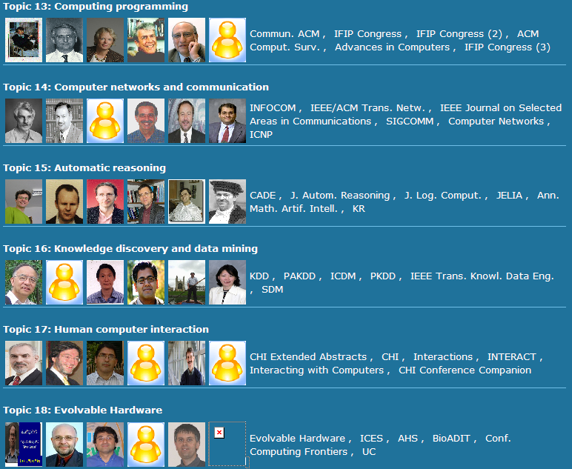
Discovered Topics
200 topics have been discovered automatically from the academic network

Slide 17
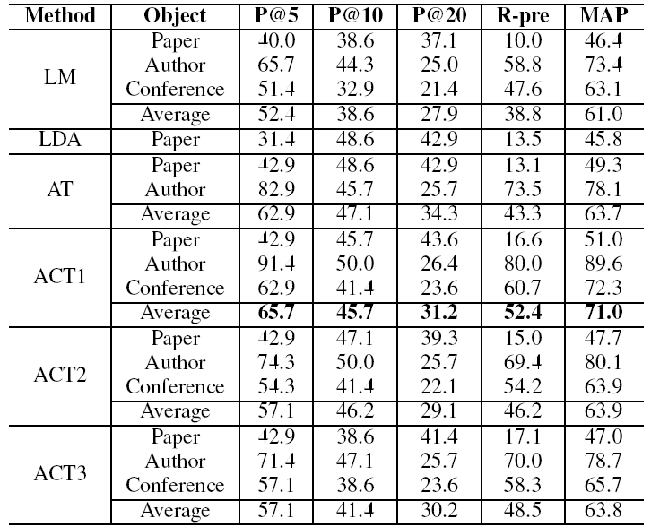
Expertise Search Results

Slide 18
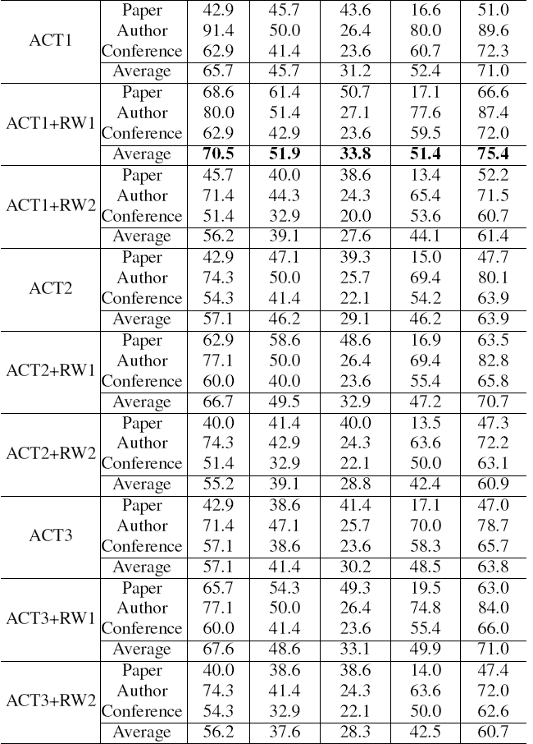
Expertise Search Results (cont.)

Slide 19
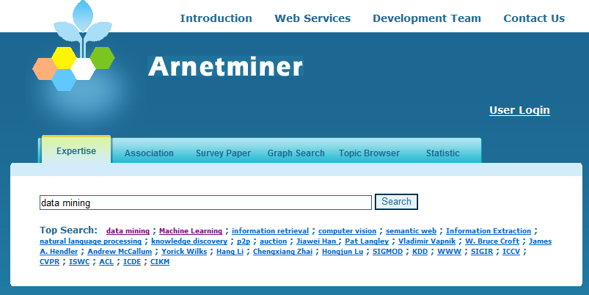
Online System—ArnetMiner (http://arnetminer.org)
Experts
Expertise conferences
Expertise papers

Slide 20
Outline
Previous Work
Our Approach
Ranking with Topic Model and Random Walk
Experimental Results
Conclusion & Future Work

Slide 21
Conclusion & Future Work
Investigate the problem of modeling heterogeneous academic network using a unified probabilistic model.
Propose two methods to combine topic models with the random walk framework for academic search.
Experimental results show that our approach can significantly improve the performance of academic search.
Our approach is general. Variations of the approach can be applied to many other applications such as social search and blog search.

Slide 22
Thanks!
Q&A & Demo
HP: http://keg.cs.tsinghua.edu.cn/persons/tj/
Online URL: http://arnetminer.org

