Slide 1
Topic Distributions over Links on Web
Jie Tang¹, Jing Zhang¹, Jeffrey Xu Yu², Zi Yang¹, Keke Cai³, Rui Ma³, Li Zhang³, and Zhong Su³
¹ Tsinghua University
² Chinese University of Hong Kong
³ IBM, China Research Lab
Dec. 7th 2009

Slide 2
Motivation
Web users create links with significantly different intentions
Understanding of the category and the influence of each link can benefit many applications, e.g.,
Expert finding
Collaborator finding
New friends recommendation
…
Notes:
Just read the text

Slide 3
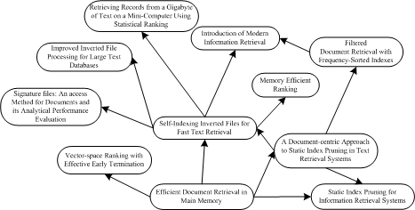
Examples – Topic distribution analysis over citations
Researcher A
an in-depth understanding of the research field?
?
VS.
Semantic citation network
Original citation network
Notes:
We use an example to demonstrate the importance of the problem we are dealing with.
This is a citation graph. When starting to work on a new research topic or brainstorming
for novel ideas, a researcher often wants to have an in-depth understanding of existing literatures in the field
Suppose we know the topic distribution of each paper and the link category and the influence of each citation, we can easily understand how a research field has been evolving in the past years, what are the
relationships between research papers or topics, and how a piece of research work influences on its follow-up work.
However, from the original citation network, which does not have the link semantic information, such an in-depth is highly infeasible. This leads us to think about the link semantic analysis problem.

Slide 4
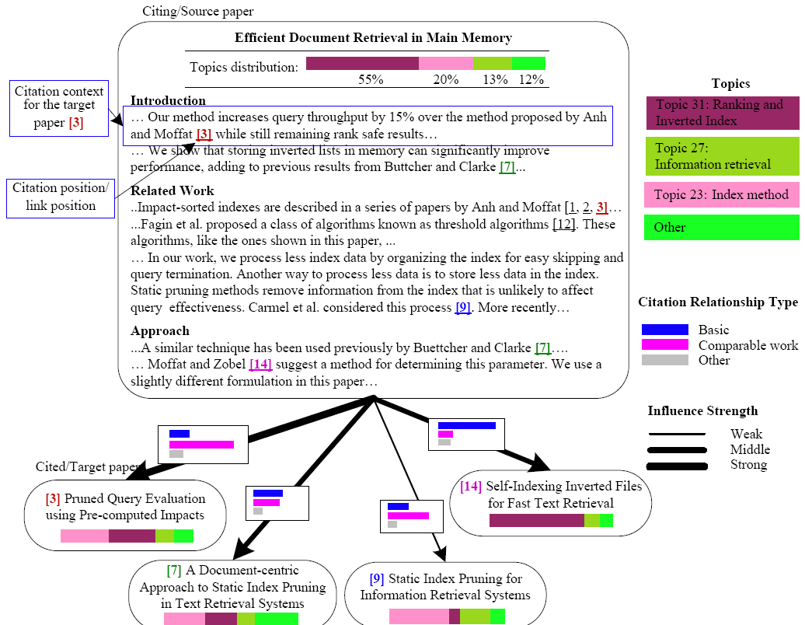
Problem: Link Semantic Analysis
Topic modeling over links
Citation context words
Link semantics
Notes:
Basically, the link semantic analysis problem can be defined as follows.
First, discover what topics a web page is about.
Second, we need consider how to analyze the citation context words, which usually contains hints for understanding the relationship between the current paper and the cited paper.
Third, the task is to identify the category distribution for each link and estimate the influential strength of the
Link.

Slide 5
Outline
Previous Work
Our Approach
Pairwise Restricted Boltzmann Machines (PRBMs)
Experimental Results
Conclusion & Future Work

Slide 6
Previous Work
Link influence analysis
Citation influence topic [Dietz, 07];
Social influence analysis [Crandall, 08; Tang, 09];
Social network analysis
Social network analysis [Wasserman, 94]
Web community discovery [Newman, 04]
‘Small world’ networks [Watts, 18]
Graphical model
Probabilistic LSI [Hofmann, 99],
Latent Dirichlet Allocation [Blei, 03],
Restricted Boltzmann machines [Welling, 01]
Notes:
Just read the text
There are three types of related work: link influence analysis, social network anlaysis, and graphical model.
For link influence analysis, citation influence topic model and several social influence methods have been proposed.
For

Slide 7
Outline
Previous Work
Our Approach
Pairwise Restricted Boltzmann Machines (PRBMs)
Experimental Results
Conclusion & Future Work

Slide 8
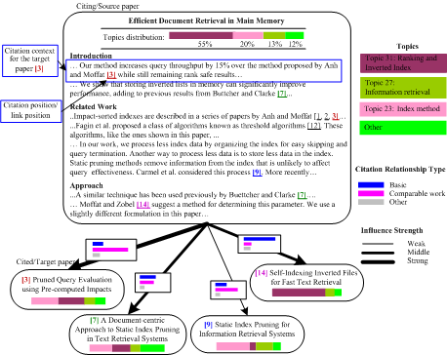
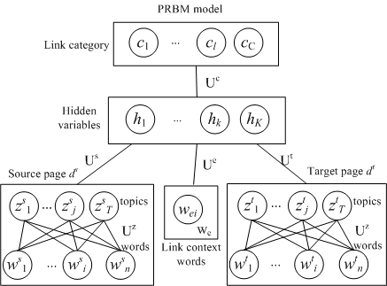
Pairwise Restricted Boltzmann Machines (PRBMs)
Link category
Latent variables defined over the link to bridge the two pages
Topic distribution
Link context words
Example
Pairwise Restricted Boltzmann Machines (PRBMs)
Notes:
The proposed model to deal with the link semantic analysis problem is pairwise restricted boltzmann machines.
In this model, we define the citation context words as a set of observation variables w and a layer of latent variables for modeling the topic distribution.
Then the link category is also modeled as a set of observation variables.
Based on citation context words for each link, and the topic distribution on both source page and the target page, we use a layer of latent variables to classify the category of the link.

Slide 9


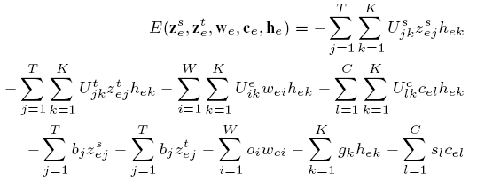
Formalization of PRBMs
Formalization
Obj. Func:
with
PRBMs
Notes:
The model can be formally formulated as follows.
The objective function is defined according to the negative loglikelihood of the observation variables, that is words and link category. The probability is defined by the property of Restrict Boltzmann Machine. Further the energy function E is defined like this, where U is the correlation matrix.

Slide 10


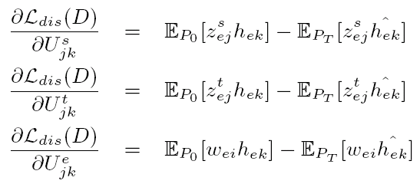

Model Learning
Generative learning
Expectation w.r.t. the data distribution
Expectation w.r.t. the distribution defined by the model
We use the Contrast Divergence to learn the model distribution P_{M}
Discriminative learning
Obj. Func:
Hybrid learning
Notes:
We can learn the PRBM model by minimizing the negative log-likelihood. Typically,
this can be done by estimating the gradient of the model parameters. The exact gradient, for any parameter theta
can be written as follows. We can calculate the gradient by
In some applications, we only want to correctly predict the link category based on topic distributions of the linked web pages. Thus we can explicitly emphasize that we want to infer one modality from other modalities, and perform discriminative learning of the PRBM model. The discriminative log-likelihood is defined like this. Accordingly, we can write the new gradient for each parameter as follows.
When the training data is sufficient, a discriminative learning usually results in a higher quality model than a counterpart generative model. However, when the data is limited, the discriminative learning may underperform the generative counterpart. In our case, it is difficult to obtain a large number of labeled links. Thus a better way is to adopt a hybrid discriminative/generative learning by combining the respective training criteria.

Slide 11



Link Semantic Analysis
Link category annotation
First we calculate
Then we estimate the probability p(c|e) by a mean field algorithm
Link influence estimation
Estimate influence by KL divergence
An alternative way is to generate the influence score by a Gaussian distribution, thus
Notes:
After learning the PRBM model, we can predict the category of each link. We use a two-step algorithm to solve
this problem. In the first step, we calculate the probability p(z|w) and in the second step we estimate the probability by a mean field algorithm.
For estimating the link influence, we consider two means. The first method is to estimate the influence by KL divergence and an alternative method is to generate the influence score in the PRBM model, for example, by a Gaussian distribution.

Slide 12
Outline
Previous Work
Our Approach
Pairwise Restricted Boltzmann Machines (PRBMs)
Experimental Results
Conclusion & Future Work
Notes:
We conducted experiments to evaluate the effectiveness of our proposed approach.

Slide 13
Experimental Setting
Data sets
Arnetminer data: 978,504 papers, 14M citations
Wikipedia: 14K “article” pages and 25 K links
Evaluation measures
Link categorization accuracy
Topical analysis
Baselines:
SVM+LDA
SVM+RBM
Notes:
We use two data sets: arnetminer and wikipedia. In arnetminer, we have 978,504 papers and 14 millions citations, 50 words surrounding each citation position are extracted as citation context words.
In wikipedia, 14,468 “article” pages and 25,817 links were collected from Wikipedia. Also, 50 words before and after each link position are extracted as link context words.
For evaluation, we manually annotate the link category and influence and evaluate the accuracy of the link categorization.
As for the baseline, we consider first apply a topic model e.g., latent dirichelet allocation or restricted boltzmann machines to discover the topic distribution, then use support vector machine to find the link category.

Slide 14
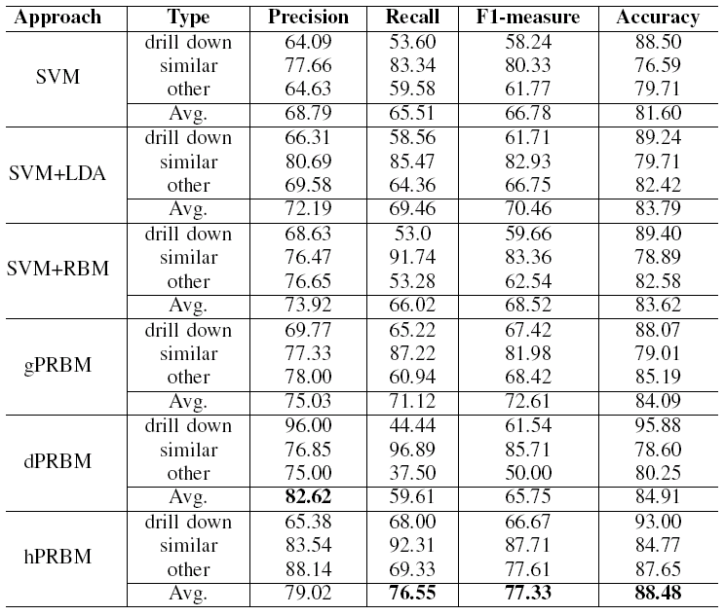
Accuracy of Link Categorization
gPRBM: our approach with generative learning
dPRBM: our approach with discriminative learning
hPRBM: our approach with hybrid learning
Notes:
The table lists the five-fold cross-validation results for link category annotation. The results indicate that our approach with the best performance (by hPRBM) significantly outperforms the baseline methods. We can also see that by combining the topic model (from LDA and RBM), the SVM based method also achieves an improvement.

Slide 15
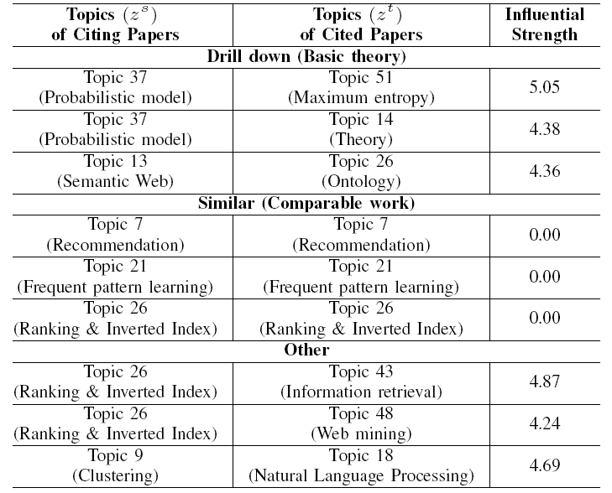
Category-Topic Mixture
Notes:
The table shows the correlation of topics and the citation relationship category. For each category, we show three hot topic-pairs. The last column lists the influential strength of the citing topic on the cited topic. The score was calculated using KL-divergence, thus a lower score indicates a stronger influence.
we can see that a strong dependency exists between the relationship category and the topic distribution.

Slide 16
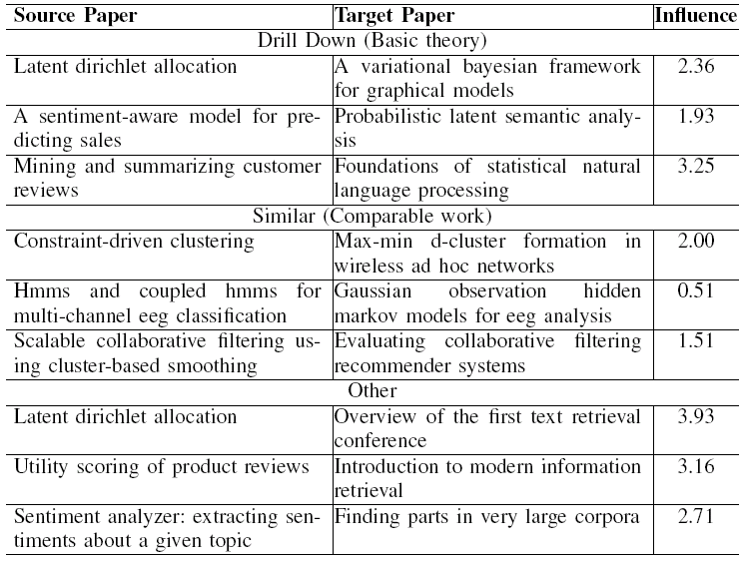
Example Analysis
Notes:
The Table lists several example links (citation relationships) associated with each category. The last column shows
the influence strength of the target paper on the source paper. Clearly we see, for the “similar” category, the influence of the target paper on the source paper is stronger (with a lower KL-divergence score) than the other two categories; while
the influence in the “drill down” is stronger than the “other” category.

Slide 17
Outline
Previous Work
Our Approach
Pairwise Restricted Boltzmann Machines (PRBMs)
Experimental Results
Conclusion & Future Work
Notes:
Finally, we conclude this paper.

Slide 18
Conclusion & Future Work
Concluding remarks
Investigate the problem of quantifying link semantics on the Web
Propose a Pairwise Restricted Boltzmann Machines to solve this problem
Future Work
Semantic analysis over social relationships
Correlation between the link semantics and the information propagation
Notes:
Read the text

Slide 19
Thanks!
Q&A
HP: http://keg.cs.tsinghua.edu.cn/persons/tj/

