Slide 1

A Mixture Model for Expert Finding
Jing Zhang, Jie Tang, Liu Liu, and Juanzi Li
Tsinghua University
2008-5-23
Notes:
Good afternoon, everyone, my name is Zhang Jing and I am a master student from Tsinghua University. In this presentation, I am going to give an introduction of our work on “A mixture model for expert finding”.
This is joint work with…

Slide 2

Outline
Motivation
Related Work
Our Approach
Experiments
Conclusion
Notes:
This is the outline of my presentation.
First, I will introduce the task and the motivation and then the related work.
Then, I will explain the models for expert finding, including traditional language models and our proposed mixture model;
After that, I will present the experimental results;
Finally, I will give a summary.

Slide 3
Introduction
Expert Finding aims at answering the question: “Who are experts on topic X?”
The task is very important, because we usually want to:
  find the important scientists on a research topic
  find the most appropriate collaborators for a project
  find an expertise consultant

Slide 4

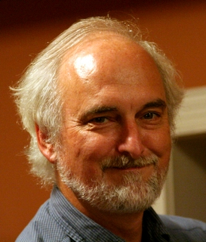
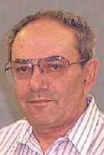

Motivation
Semantic web
Timothy W. Finin
Question:
1.How to discover the relationships of words in a semantic level?
2. How to use the relationships to improve the performance of expert finding?
Integrating ecoinformatics resources on the semantic web. In Proceedings of WWW'2006
A Semantic Web Services Architecture. IEEE Internet Computing, 2005
Language Model emphasizes the occurrence of query terms in the support documents.
Support vector machine
Natural language processing
Vladimir Vapnik
Language Model
Dan Roth
Language Model
A Support Vector Clustering Method. In Proceedings of ICPR'2000
Boosting and Other Machine Learning Algorithms. In Proceedings of ICML'1994
A Pipeline Framework for Dependency Parsing. In Proceedings of ACL'2006
Probabilistic Reasoning for Entity Relation Recognition. In Proceedings of COLING'2002
Notes:
Let us look at a scenario.
Suppose a user want to query the experts of “semantic web”, then we think the person “Timothy W. Finin” should be identified as the expert of “semantic web”. Look at his support documents, (here, in our scenario, the support documents are the persons’ publications), we can see that the two words “semantic” and “web” both appear in each of his support documents. In this way, previous language models can work well to retrieve this expert.
Then, let me see another example. Suppose a user want to query the experts of “support vector machine”, then as we know, “vapnik” should be the top expert of “support vector machine”. Look at his support documents, we can find the three words “support”, “vector”, and “machine” in his support documents. In this way, although the three words do not appear in the same document, we can still identify “vapnik” as the right expert using a modified language model.
So language models can work well for the both examples.
However, let us see an example again. Suppose the user want to query the experts of “natural language processing”, then as we know, “Dan Roth” should be the expert, however, look at his support documents, the three words “natural”, “language” and “processing” do not appear together in his support documents. In this way, language models can not work well, because language model is based on keyword matching. However, when analyzing his support documents, we notice that the words “dependency parsing” and “entity relation recognition” are both semantically related to “natural language processing”, although the words can not be matched with the query. So a question can be brought forward: ”How to do a semantic level expert search? ”

Slide 5
Outline
Motivation
Related Work
Our Approach
Experiments
Conclusion
Notes:
Now I want to simply introduce the related work

Slide 6
Related Work
Language Model for Expert Finding
  TREC 2005 and TREC 2006
    Find the associations between candidates and documents
    E.g. Cao (2005), Fu (2005), Balog (2006)
  Advanced model
    Study expert finding in a sparse data environment
    E.g. Balog(2007)
  An overview of most of the models
    Analyze and compare different models for expert finding
    Probabilistically equivalent and differences lie in independent assumptions
    E.g. Petkova, 2007
Notes:
Many efforts have been made on finding experts using language models.
For example,
Cao, 2005 has proposed a two-stage language model, in the first stage, they use a co-occurrence model to retrieve documents given a query, and in the second stage, they use a relevance model to find experts in those documents.
Balog, 2006 propose two language models. One models expert candidates using documents directly and another is similar to Cao, 2005.
Balog, 2007 studies the expert finding problems in a sparse data environments and proposes several advanced models based on their dataset.
Petkova, 2007 analyze and compare different language models for expert finding. They argue that all the models are probabilistically equivalent and the differences lie in independent assumptions.

Slide 7
Related Work
Probabilistic latent semantic analysis (PLSA)
  Discover latent semantic structure
  Assume hidden factors underlying the co-occurrences among two sets of objects
PLSA applications
  Information retrieval
    Hofmann 1999
  Text learning and mining
    Brants, 2002, Gaussier, 2002, Kim, 2003, Zhai, 2004
  Co-citation analysis
    Cohn, 2000, Cohn, 2001
  Social annotation analysis
    Wu, 2006
  Web usage mining
    Jin, 2004
  Personalize web search
    Lin, 2005
Notes:
We also survey the research of PLSA
The idea of using latent semantic structure in information retrieval can track back to latent semantic analysis (LSA). The main idea of LSA is to map data from a high-dimensional vector space to a reduced lower vector space.
Then Hofmann propose a new approach to discover latent variables. The difference between LSA and PLSA is that PLSA is the probabilistic model and have a more solid statistical foundation. The main idea of PLSA is assuming there exists a set of hidden factors which can underlie the co-occurrences among two sets of observed objects.
PLSA has many applications, for example, in information retrieval, text learning and mining, co-citation analysis, social annotation analysis, web usage mining and personalized web search.

Slide 8
Outline
Motivation
Related Work
Our Approach
Experiments
Conclusion
Notes:
In this paper, we present our approach for expert finding

Slide 9
Overview
Language model
Our approach
theme
term
doc
PLSA
term
doc
Notes:
We focus on the above problem and propose a mixture model based on probabilistic latent semantic analysis (PLSA) for expert finding. In this model, to avoid the limitation of language models, we do not model the relevance between a query and a document directly, instead, we use a hidden theme layer to model semantic relationships between query and support documents of experts. In this way, an expert whose support documents associated with the same themes as that of a query can be ranked higher, although they may not contain the query terms.

Slide 10
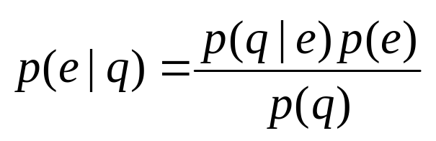
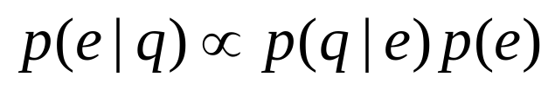
Problem Setting
What is the task of expert finding?
  Given e: an expert, q: a query
  Estimate p(e|q)
  Assuming p(q) is uniform:
Query-independent probability
We focus on: Query-dependent probability
Notes:
First, we formalize the task of expert finding?
We denote an expert as e, a query as q
A general process of expert finding is to estimate the probability of a person being an expert for a given query, namely, p(e
|q).
Using bayes’ formula, we can get the right equation.
Usually we assume p(q) is uniform, then the equation can be simplified into this one. In this equation, p(e) reflects the query-independent expertise of a person. There are many ways to compute p(e), for exmaple, we can simply use the number of one’s publications to represent it; or more complicated, we can calculate it by using the propagation scheme like pagerank. And some work assumes that it is uniform and only focus on the query-dependent probability, namely p(q|e), which is the most important component in the equation. And p(q|e) is usually estimated by language models. In this paper, we only focus on p(q|e)

Slide 11
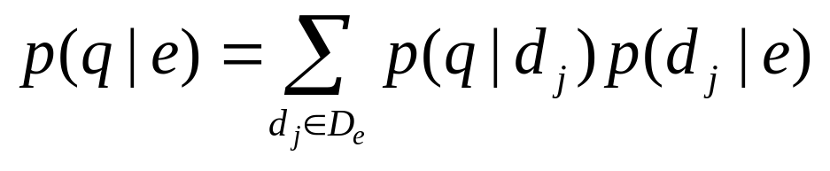
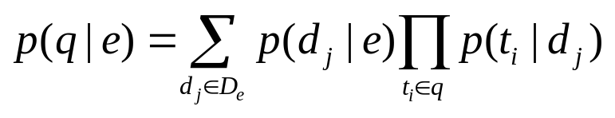
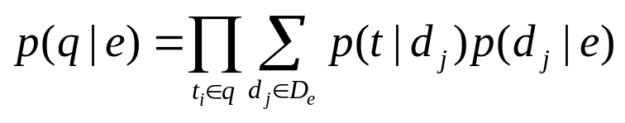
Language Models for Expert Finding
Expert finding target: estimate p(q|e)
  D_{e} ={d_{j}} : Support documents related to a candidate e
extend by two ways
1
2
1: e is the author of d_{j}
0: otherwise.
Composite model
Hybrid model
co-occurrence of all the query terms in the same document
co-occurrence of all the query terms in all the support document of an expert
Notes:
We first introduce how to use language models to do expert finding:
As I told before, the target of expert finding is to calculate the probability p(q|e).
For each expert, there exists a collection of support documents, we denote it as D_{e}
Here, each support document is viewed as a unit and the estimations of all the documents of a candidate expert are combined like this equation:
In this equation, p(d|e) indicates how a document can characterize the expert candidate. There are several ways to estimate the probability. However, in our setting, this probability is viewed as identical, we set it as 1, if e is the author of d, otherwise we set it as 0.
Then based on the foundation of language models, this equation can be extended by two ways.
In the first model, we first integrates the probability of document d_{j} generating each term t_{i,} then we combines the different document models together, we call this composite model. This model is based on the assumption that terms are independent in a document. So this model emphasize the co-occurrence of all the query terms in the same document.
In the second model, we collect all terms’ information from all documents associated with the given expert candidate and model the expert directly. It is based on the assumption that terms are independent in a candidate. Therefore, this model does not care much about the co-occurrence of query terms in the same support document, but emphasize the co-occurrence of all the query terms in all the support document of an expert.

Slide 12

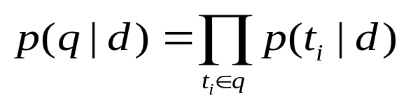
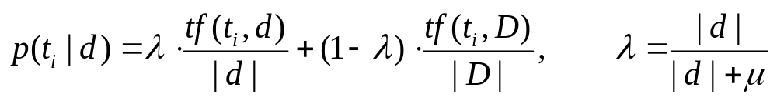
Language Model for Document Retrieval
Language model describes the relevance between a document d and a query q as the generating probability
Assume terms appear independently in the query:
P(t_{i}|d) is estimated by maximum likelihood estimation and Dirichlet smoothing:
Notes:
In the two models, we implement some basis theory of language model for document retrieval. I only want to explain that p(t|d) can be estimated by …
In document retrieval, language model describe the relevance between a document and a query as the following probability
Based on bayes’s formula, P(d|q) is proportional to P(q|d)*p(d)
For a query, we usually assume that terms appear independently in the query and we get the equation:
Then the probability of each term in the query given a document can be estimated by the maximum likelihood estimation and dirichlet smoothing, where tf(ti, d) is the term frequency of term ti in document d

Slide 13
A Mixture Model for Expert Finding
Language models need calculate p(t_{i}|d_{j})
We assume k hidden themes Θ={θ₁, θ₂, …, θ_{k} } between term t_{i} and document d_{j}
p(t|θ_{m})
p(θ_{m}|d)
t₁
θ₁
d₁
p(d)
t₂
θ₂
d₂
…
…
t_{n}
θ_{k}
d_{m}
Notes:
From the above introduction, we know that language models are limited to the keyword-matching. They need to calculate the probability p(ti|dj)
So how to avoid computing p(ti|dj)?
Based on the foundation of PLSA, we propose a mixture model for expert finding.
Originally, we have the terms and the documents, now we assume there are k hidden themes between terms and documents. Each hidden theme θm is semantically associated with multiple terms and support documents. Similarly, each support document or term is also associated with multiple themes, respectively. we use the hidden themes associated to terms and support document as the bridge to model the relevance, actually, the function of hidden themes is to smooth the traditional relevance results.
The generative processing of the dataset is like this.
First, we select a document d with probability p(d)
Second, we pick a latent theme @ with the probability p(@|d)
Finally, we generate a term with probability p(t|@)
As a result, we obtain an observed pair (t,d) without @.

Slide 14
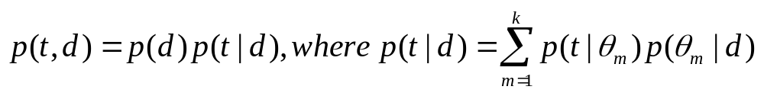
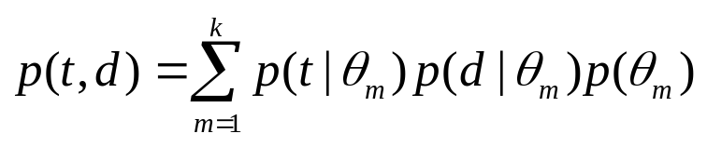
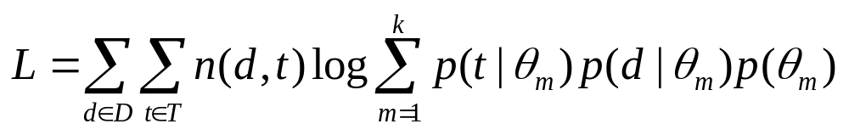
A Mixture Model for Expert Finding
Based on the generative process, we define a joint probability model:
With Bayes’ formula, we get:
In order to explain the observations (t, d), we need to maximize the log-likelihood function by the given parameters:
  where n(d, t) denotes the co-occurrence times of d and t.
Notes:
The generative process can be expressed as a joint probability equation:
In this equation, we sums over all possible choices of @.
Then we use bayes’ formula to transform the equation to get its symmetric version:
Our object is to estimate the three probabilities:
We can solve these parameters by maximizing the log-likelihood function:
Here n(d,t) is the co-occurrence times of d and t.
Now the problem is how to estimate the parameters so to optimize the log likihood

Slide 15
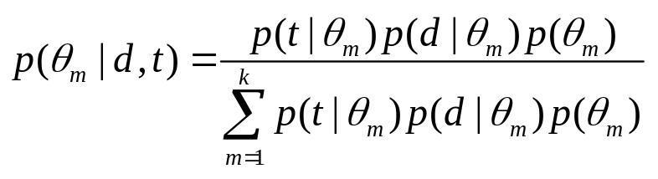
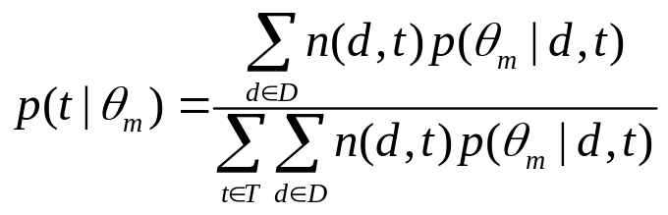
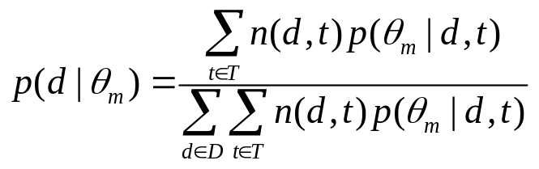
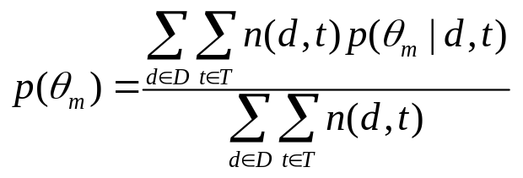
A Mixture Model for Expert Finding
We use EM to estimate the maximum likelihood.
  E-step: we aim to compute the posterior probability of latent theme θ_{m}, based on the current estimates of the parameters
  M-step: we aim to maximize the expectation of the log-likelihood of Equation
Notes:
We use Expectation-Maximization algorithm to optimize the maximum log-likelihood.
Following are the update formulas of e-step and m-step.
It runs iteratively until the log-likelihood function converges to a local maximum.
Finally, we can obtain the three parameters.

Slide 16
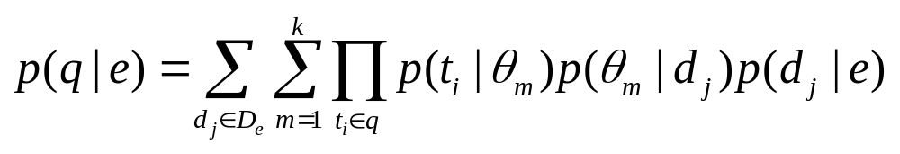
A Mixture Model for Expert Finding
We rank experts based on the estimated parameters:
p(t |θ_{m})
p(d |θ_{m})
p(θ_{m})
Notes:
Based on the three probabilities, we can extend the original language model to another equation, in this equation, we do not estimate the relevance between t and d directly, instead, we use hidden themes as bridge between them, therefore, semantically related experts can be retrieved, not limited to keyword matching.

Slide 17
Language Models for Expert Finding
Composite model works well for a support document containing all the query terms.
Hybrid model is more flexible, it works well for all the query terms are in all the support documents
The two models are based on keyword-matching, they can not work well for the support documents containing no query terms.
Timothy W. Finin
Integrating ecoinformatics resources on the semantic web. In Proceedings of WWW'2006
A Semantic Web Services Architecture. IEEE Internet Computing, 2005
Semantic
web
Vladimir Vapnik
Support
vector machine
A Support Vector Clustering Method. In Proceedings of ICPR'2000
Boosting and Other Machine Learning Algorithms. In Proceedings of ICML'1994
Dan Roth
Natural language processing
A Pipeline Framework for Dependency Parsing. In Proceedings of ACL'2006
Probabilistic Reasoning for Entity Relation Recognition. In Proceedings of COLING'2002
Notes:
However, the two language models have limitations.
In the previous examples, we can conclude that …

Slide 18
Outline
Motivation
Related Work
Our Approach
Experiments
Conclusion
Notes:
Next, I will present my experiments.

Slide 19
Data Preparation
We evaluate on Arnetminer(http://www.arnetminer.org)
  An academic research network
  448,289 researchers
  725,655 publications
A sampled dataset
    (421 researchers and 14,550 publications)
    Select 7 most frequent queries from the log of ArnetMiner,e.g. “information extraction”, “machine learning”, “semantic web”, and so on.
    For each query, pool the top 30 persons from Libra, Rexa, and ArnerMiner into a single list
    Collect all the publications of these persons from Arnetminer
Notes:
We evaluate our proposed model on Arnetminer
The PLSA will take a long time on the full data set, so we sample 421 persons with their about 14 thousand publications.

Slide 20
Evaluation
Ground truth: pooled relevance judgments together with human judgments
    One faculty and two graduates provide human judgments on the pooled results from Libra, Rexa, and Arnetminer
We evaluate using P@5, P@10, P@20, P@30, R-prec, MAP and P-R curve
Notes:
For evaluation, we construct the ground truth by using the pooled relevance judgments together with human judgments.
Particularly
First, we select 7 most frequent queries from the log of Arnetminer
Second, for each query, we pool the top 30 results from Libra, Rexa, and Arnetminer into a single list. Here, Libra and Rexa are both academic search engines on the web and they both contain the function of expert search.
Third, one faculty and two students provide human judgments. Assessments were carried out mainly in terms of how many publications he/she has published, how many publications are related to the given query, how many top conference papers he/she has published, what distinguished awards he/she has been awarded.
Finally, the judgment scores are averaged.
We evaluate all the search results by…

Slide 21
Experimental Setting
Baselines:
  Composite model (CM)
  Hybrid model (HM)
  Libra (http://libra.msra.cn)
  Rexa (http://rexa.info)
Our Approach
  One stage: Estimate p(t|θ_{m}), p(d|θ_{m}), and p(θ_{m}) using PLSA
  Second stage: Rank experts using
Notes:
We use the two language models, composite model and hybrid model as the baselines, we call them CM and HM. We also report the results obtained by Libra and Rexa
We implemented our mixture model in two stages, we call it MM.
In the first stage, we use PLSA to estimate the probabilities … Here, documents denote publications in Arnetminer, terms are extracted from the titles and conference names of publications after word segmentation, stop word filtering and stemming.
In the second stage, we rank experts using the following equation for each query.

Slide 22
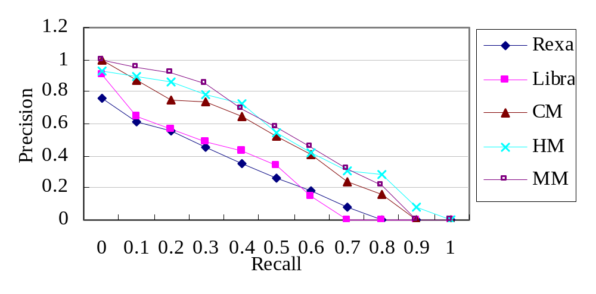
Experimental Results
Query | Approach | P@5 | P@10 | P@20 | P@30 | R-pre | MAP
AVE | Libra | 68.57 | 48.57 | 47.14 | 40.95 | 40.48 | 51.04
 | Rexa | 60.00 | 54.29 | 46.43 | 39.52 | 37.09 | 46.21
 | CM | 74.29 | 72.86 | 65.00 | 57.14 | 49.39 | 69.46
 | HM | 85.71 | 78.57 | 68.57 | 61.43 | 56.40 | 71.15
 | Our Approach | 94.29 | 88.57 | 69.29 | 57.62 | 54.76 | 75.41
Notes:
We report the average measure results (including precision and recall) of the 7 queries here for every measure items.
From the results, we can see that our proposed model outperforms the two
language models in terms of P@5, P@10,P@20 and MAP. From the PR curve, we can also
see that our model outperforms the language models in most of the 11 points, which
confirms the effectiveness of our approach

Slide 23
Experimental Results
Top 9 experts for query “natural language processing” by five expert finding approaches
Our approach | CM | HM | Libra | Rexa
Raymond J. Mooney | Rebecca F. Bruce | Janyce Wiebe | Eric Brill | W. Addison Woods
Dan Roth | Janyce Wiebe | Michael Collins | Christopher D. Manning | Klaus Netter
Michael Collins | Veronica Dahl | Aravind K. Joshi | Adam L. Berger | Yorick Wilks
Janyce Wiebe | Robert J. Gaizauskas | Raymond J. Mooney | Stephen Della Pietra | Kavi Mahesh
Aravind K. Joshi | Kevin Humphreys | Rebecca F. Bruce | Vincent J. Della Pietra | Robert H. Baud
Rebecca F. Bruce | Aravind K. Joshi | Veronica Dahl | David D. Lewis | Kevin Humphreys
Veronica Dahl | Philippe Blache | Robert J. Gaizauskas | Kenneth Ward Church | Philippe Blache
Claire Cardie | Eric Brill | Thomas Hofmann | Hinrich Schutze | Victor Raskin
Oren Etzioni | Raymond J. Mooney | Eric Brill | Lillian Jane Lee | Lorna Balkan
Raymond J. Mooney
Dan Roth
Raymond J. Mooney
Raymond J. Mooney
Notes:
Our mixture model ranks higher for “Raymond J. Mooney” than the language models. This is because many of Mooney’s papers do not exactly contain the query terms although they are related to “natural language processing”.
We rank higher for “Dan Roth” due to the similar reason. He has very few papers with title containing the words “natural” “language” and ”processing”. Our model can discover him in a semantically-level, However, language models can not work well.

Slide 24
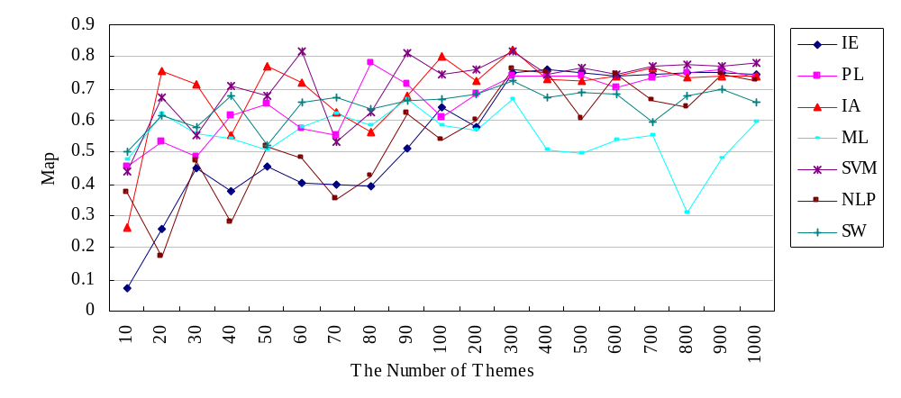
The number of themes
The effect of the number of themes
  The number of themes is small, the model prefers to very general queries
  With the number increasing, the model prefers to specific queries
  300 seems to be a best balance for the performance in our setting.
Notes:
The number of hidden themes is difficult to determine. In our experiment, we try to tune the parameter to get better performance.
This figure shows we evaluate different number of themes. We notice that when the number of themes is small, the model prefers to very general queries, like ML, SW, with the number increasing, the model prefers to specific queries, like IE, SVM. Finally we set the number as 300, because 300 seems to be a best balance for the performance in our setting

Slide 25
Example themes discovered
Top words associated with themes
#Themes = 10
Theme #12 | Theme #64
information | KDD
design | neural
framework | from
intelligent | text
ontology | selection
management | networks
based | Time
semantic | data
systems | mining
web | using
#Themes = 300
Theme #12 | Theme #64
spelling | zero
roadmap | variance
ebl | manifolds
correction | predictions
scoring | principal
question | transformation
Directions | ICPR
answering | matrix
ICGA | clustering
syntax | words
Notes:
We report representative words with some themes, here we list top words for each theme. We set the number of themes as 10 and 300, and select two themes for each of them. We discover that for number 10, the words are more generative, like “information”, “semantic”. And for the number 300, the words are more specific, like “spelling”, ”correction”

Slide 26
Error Analysis
For p@30 and R-prec, our model underperforms language models for some noises in stage one.
For example, if query “intelligent agents”:
A Multi-Objective Multi-Modal Optimization Approach for Mining Stable Spatio-Temporal Patterns. In Proc. of IJCAI’ 2005
has strong relationship with conference “Autonomous Agents and Multi-Agent Systems”
has close relationship with “Intelligent Agents”
Notes:
We also notice the disadvantages of our model. For p@30 and r-prec, our model underperforms language models. Because in the first stage of our model, when estimating the probabilities using PLSA, we may bring forward some noises.
For example,
In this support document, the word “multi” has strong relationship with conference “autonomous agents and multi-agent systems”, and the conference “IJCAI” has close relationships with the query “intelligent agents”, So it will be wrongly identified as the support document of the query “intelligent agents”.

Slide 27
Outline
Motivation
Related Work
Our Approach
Experiments
Conclusion
Notes:
Finally, I will make a summary

Slide 28
Conclusion
Propose a mixture model for expert finding.
  Assume a latent theme layer between terms and documents
  Employ the themes to help discover semantically related experts to a given query
  A EM based algorithm has been employed for parameter estimation
Notes:
In this paper, we have proposed a mixture model for expert finding. We assume that there is a latent theme layer between terms and documents and employ the themes to help discover semantically related experts to a given query. A EM algorithm has been employed for parameter estimation in the proposed model. Experimental results show that our proposed model can achieve better performances than the traditional language models.

Slide 29
Further Work
Automatically determine the number of hidden themes
Directly model the relationships between authors and terms. We plan to try Latent Dirichlet Allocation based model.
Find expertise papers, conferences, and authors together.

Slide 30
Thank You
Q & A

