Slide 1
A Discriminative Approach to Topic-Based Citation Recommendation
Jie Tang and Jing Zhang
Presented by
Pei Li
Knowledge Engineering Group,
Dept. of Computer Science and Technology
Tsinghua University
April, 2009
Notes:
Good morning everyone, my name is Jie Tang and I am from Tsinghua University.
In this presentation, I am going to talk about “A Discriminative Approach to Topic-Based Citation Recommendation”. This is a joint work with Jing Zhang.

Slide 2
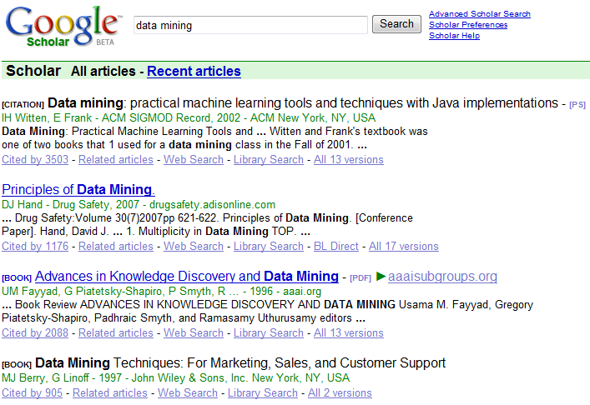
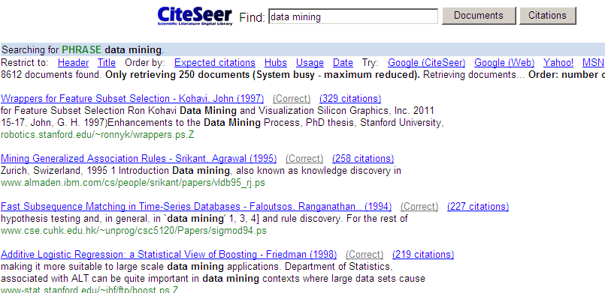

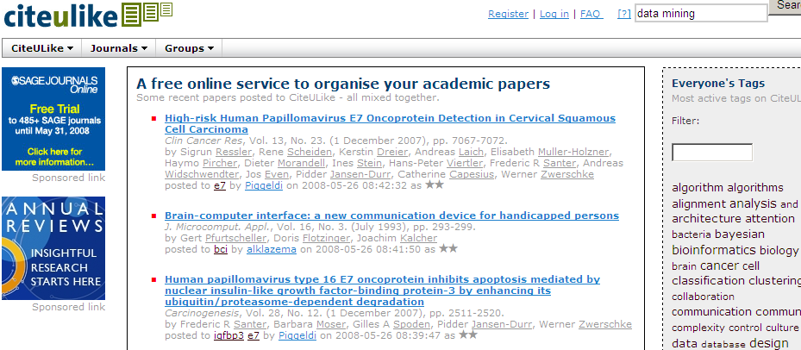
Motivation
“Academic search is insufficient in many practical applications”
However, we are surrounded
by the numerous academic data …

Slide 3
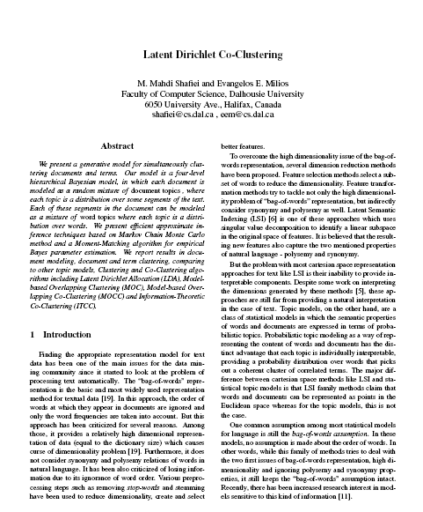

Examples – Citation Suggestion
Which papers should we refer to?
?
Researcher A

Slide 4
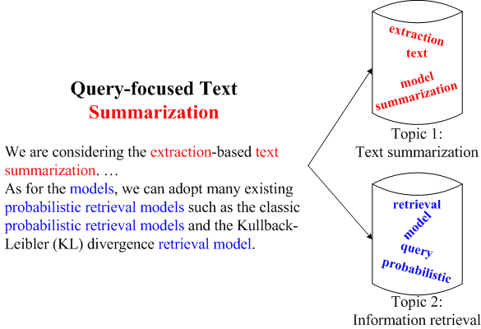

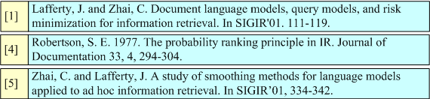
Problem Formulation

Slide 5
Problem Formulation
Two challenging questions:
How to identify the topics?
How to recommend citations based on the topics?

Slide 6
Outline
Prior Work
Our Approach
The RBM-CS model
Ranking and recommendation
Matching recommended papers with sentences
Experiments
Conclusions

Slide 7
Prior Work
Measuring the quality of journal/paper
Science Citation Index (Garfield, Science’72)
Bibliographical Coupling (BC)
(Kessler, American Documentation’63)
Paper recommendation
using a graphical framework (Strohman et al. SIGIR’07)
collaborative filtering (McNee et al. CSCW’02)
Restricted Boltzmann Machines (RBMs)
generative models based on latent variables to model an input distribution

Slide 8
Outline
Prior Work
Our Approach
The RBM-CS model
Ranking and recommendation
Matching recommended papers with sentences
Experiments
Conclusions

Slide 9
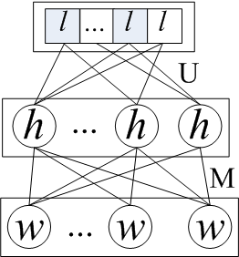
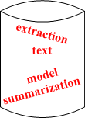
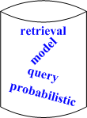
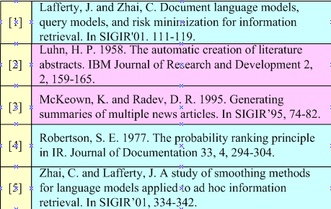
Approach Overview
RBM-CS
Topic analysis with RBM-CS
Discriminative model parameters Θ
Training data
…
+
U
a
1
M
e
b
Modeling
Topic 1
Topic 2
Test data: a new document
2
3
Citation set
Matching
2
Candidate selection

Slide 10
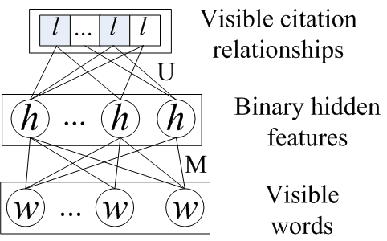
Modeling with RBM-CS model
Discriminative objective function:
Bias terms
Sigmoid func: σ(x) = 1/(1+exp(-x))
Bias terms

Slide 11
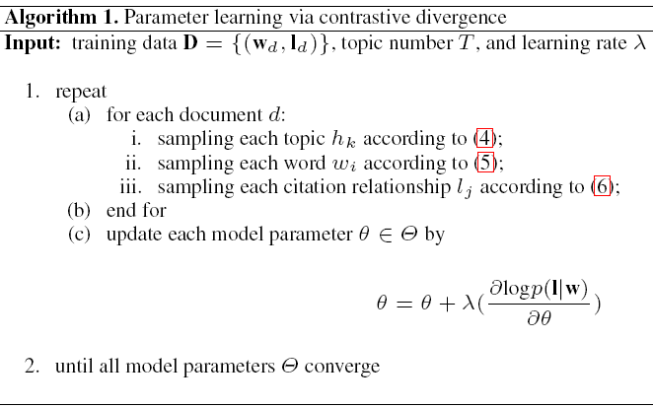




Parameter Estimation

Slide 12
Ranking and Recommendation
By applying the same modeling procedure to the citation context, we can obtain a topic representation {h_{c}} of the citation context c.
Therefore, we can calculate:
Finally, candidate papers are ranked according to p(l_{d}|h_{c}) and the topic ranked K papers are returned as the recommended papers.

Slide 13
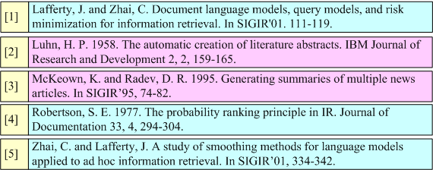
Matching Recommended Papers with Citation Sentences
The goal is to match
Probabilities obtained from RBM-CS
Use KL-divergence to measure the relevance between the recommended paper and the citation sentence:
the ith sentence in the citation context c

Slide 14
Outline
Prior Work
Our Approach
The RBM-CS model
Ranking and recommendation
Matching recommended papers with sentences
Experiments
Conclusions

Slide 15
Experimental Setting
Data Sets
NIPS: 1,605 papers and 10,472 citations
Citeseer: 3,335 papers and 32,558 citations
Baseline methods
Language model
Restricted Boltzmann Machines (RBMs)
Evaluation Measures
P@1, P@3, P@5, P@10, Rprec, Bpref, MRR
Parameter Setting
K=7 for NIPS and K=11 for Citeseer
Learning rate=0.01/batch-size, momentum=0.9, decay=0.001

Slide 16
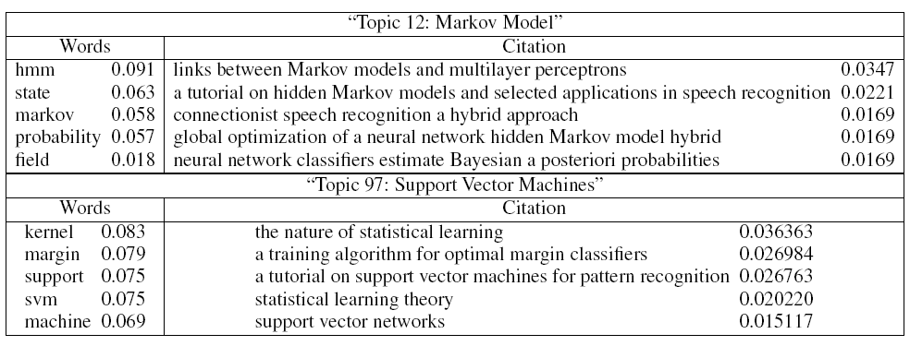
Discovered “Topics”

Slide 17
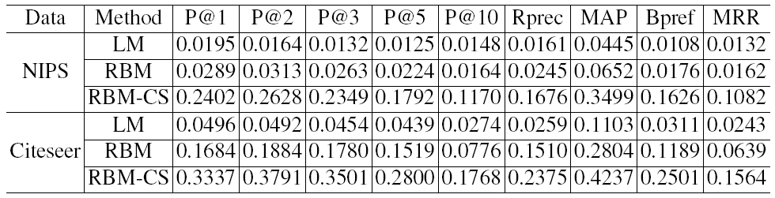
Recommendation Performance

Slide 18
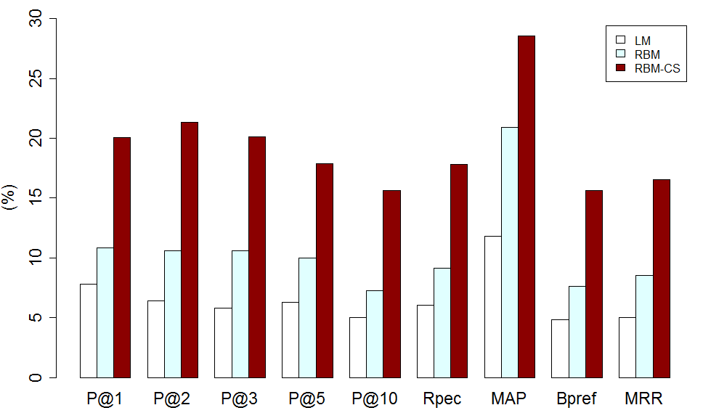
Sentence-level Performance
+7.65%
+9.24%

Slide 19
Outline
Prior Work
Our Approach
The RBM-CS model
Ranking and recommendation
Matching recommended papers with sentences
Experiments
Conclusions

Slide 20
Conclusion
Formalize the problems of topic-based citation recommendation
Propose a discriminative approach based on RBM-CS to solve this problem
Experimental results show that the proposed RBM-CS can effectively improve the recommendation performance
The citation recommendation is being integrated as a new feature into the our academic search system ArnetMiner (http://arnetminer.org).

Slide 21
Thanks!
Q&A
HP: http://keg.cs.tsinghua.edu.cn/persons/tj/

