Slide 1
Neural-Symbolic Reasoning on Knowledge Graphs
Jing Zhang
School of Information, Renmin University of China

Slide 2
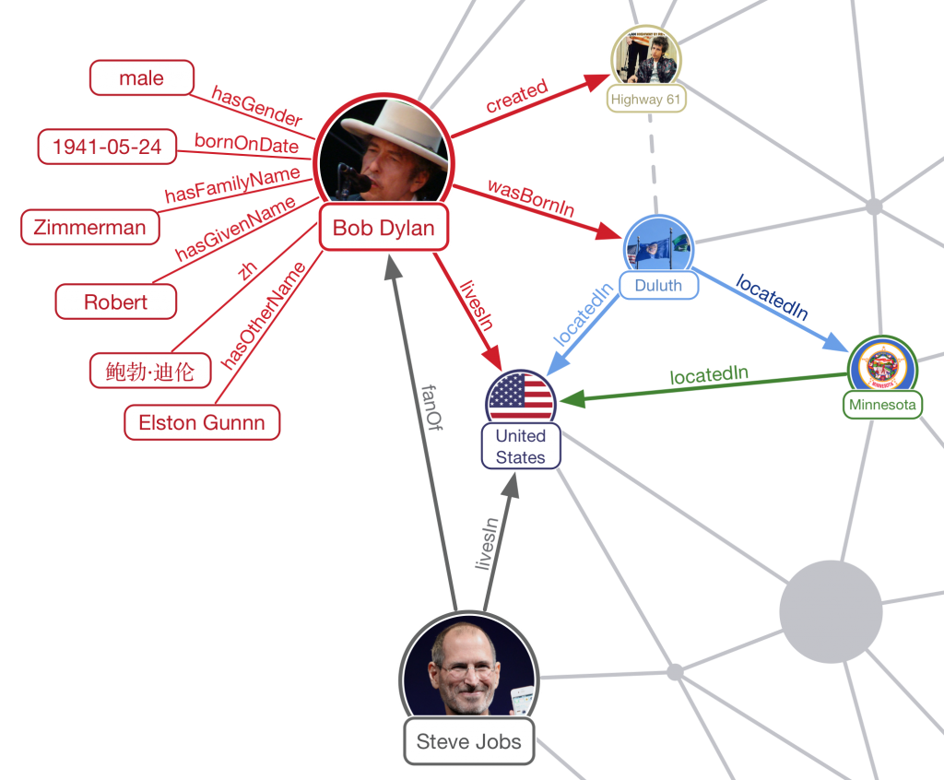
Knowledge Graph Reasoning
KGR
Deduce tails entities over KGs as the answers to the given query
A query can be
A head entity and a relation --- KGC
A natural language question --- KGQA
publish
work in
KDD
write
RUC
write
write
work in
THU
work in
write
SIGIR
publish
DBpedia
Open academic graph (OAG)

Slide 3
Knowledge Graph Completion
KGC
Neural Reasoning
Symbolic Reasoning
Neural-Symbolic Reasoning
Symbolic-driven Neural Reasoning
Symbolic-driven Probabilistic Reasoning
Neural-driven Symbolic Reasoning
Path-based
Graph-based
Matrix-based

Slide 4
Knowledge Graph Completion
KGC
Neural Reasoning
Symbolic Reasoning
Neural-Symbolic Reasoning
Symbolic-driven Neural Reasoning
Symbolic-driven Probabilistic Reasoning
Neural-driven Symbolic Reasoning
Path-based
Graph-based
Matrix-based

Slide 5


Neural Reasoning
Learn distributed embeddings for entities/relations
Translation-based models
TransE, TransR, TransP….
Multiplicative models
RESCAL, DisMult, ComplEx
Deep models
CNN:ConvE(h,r), ConvR(r-cnn), ConvKG(h,r,t)
RNN: RSN
GNN: R-GCN(r->W_{r}), CompGCN(r and W)
Good generalization, but ineffective for complex logic relations, lack interpretation

Slide 6
Knowledge Graph Completion
KGC
Neural Reasoning
Symbolic Reasoning
Neural-Symbolic Reasoning
Symbolic-driven Neural Reasoning
Symbolic-driven Probabilistic Reasoning
Neural-driven Symbolic Reasoning
Path-based
Graph-based
Matrix-based

Slide 7





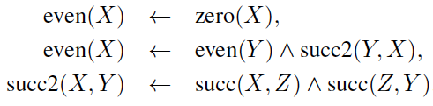
Symbolic Reasoning
Inductive logic programming (ILP)
Derive a set of if-the logic rules to describe the positive instances but not the negative instances
Rule:
Atom:
Ground atom: all the variables are instantiated by constants
A triplet (h, r, t) can be viewed as a ground atom r(h,t)
Example:
Predicate set:
Ground atoms:
Positive/negative instances:
Solution of rules for the even predicate:

Slide 8
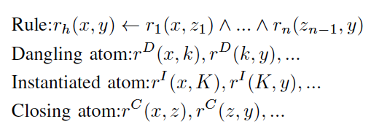
AMIE
Rule Extending
Generate candidate rules by adding three kinds of new atoms into existing rules iteratively
Rule Pruning
Recall:
If a rule r<- B can cover more triplets with r, the head coverage (hc) of the rule will be high
Precision:
If more triplets derived by a rule r<-B satisfy r, the confidence (conf) of the rule will be high
Good interpretation, but intolerant to the ambiguous and noisy data.

Slide 9
Knowledge Graph Completion
KGC
Neural Reasoning
Symbolic Reasoning
Neural-Symbolic Reasoning
Symbolic-driven Neural Reasoning
Symbolic-driven Probabilistic Reasoning
Neural-driven Symbolic Reasoning
Path-based
Graph-based
Matrix-based

Slide 10
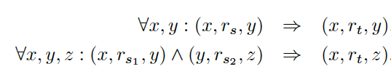

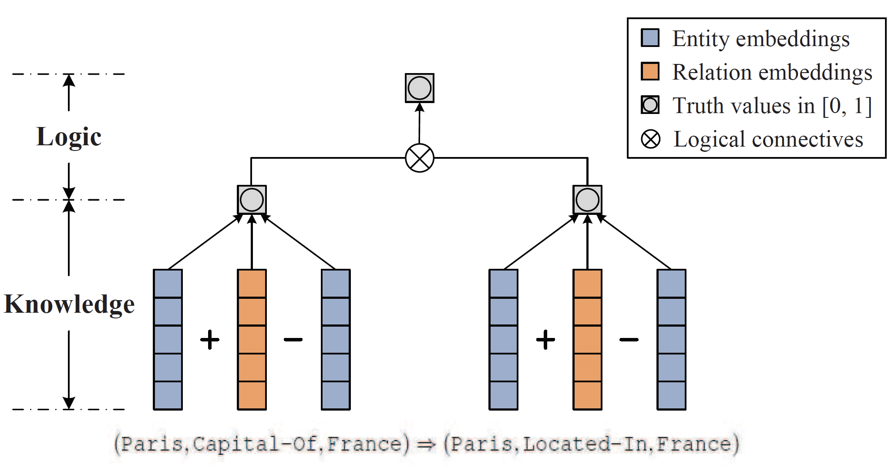
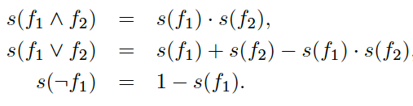

Symbolic-driven Neural Reasoning
Extend the training set for embeddings
KALE
Deal with two types of rules
Score a ground rule
Combine the triplets and the ground rules as the training set
Inference and transitivity rules:

Slide 11
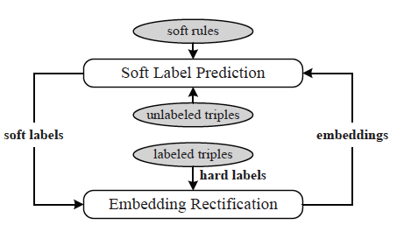
Symbolic-driven Neural Reasoning
RUGE
Inject the new triplets derived by some rules instead of the ground rules into the training set
Iteratively update entity/relation embeddings and label the new triplets derived by the rules

Slide 12
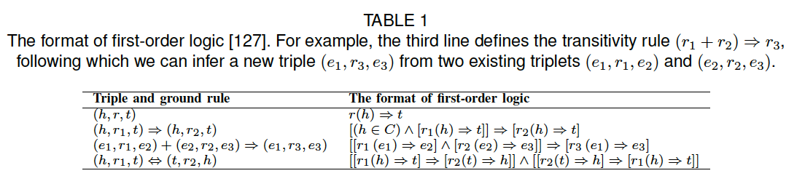
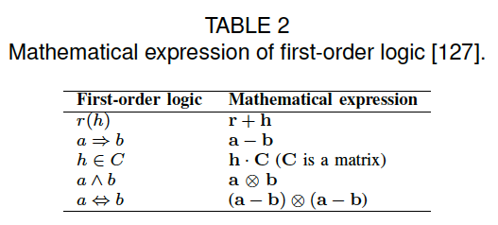
Symbolic-driven Neural Reasoning
Wang et al.
Avoid calculating the scores of triplets independently
First transform a ground rule into first-order logic, and then perform matrix operations
Lack interpretation

Slide 13
Knowledge Graph Completion
KGC
Neural Reasoning
Symbolic Reasoning
Neural-Symbolic Reasoning
Symbolic-driven Neural Reasoning
Symbolic-driven Probabilistic Reasoning
Neural-driven Symbolic Reasoning
Path-based
Graph-based
Matrix-based

Slide 14
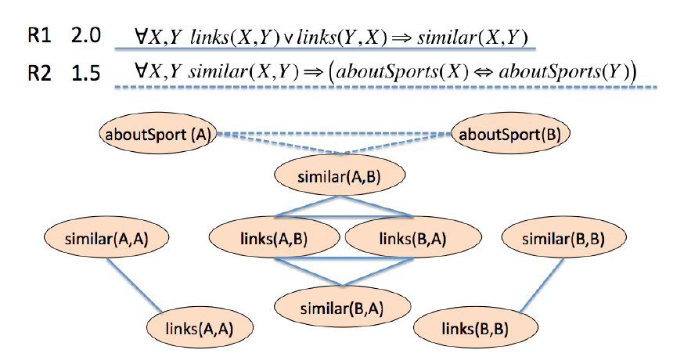
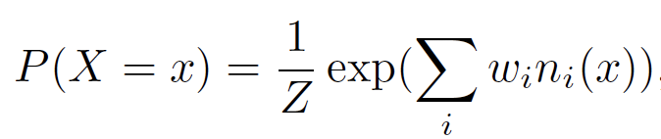
Probabilistic Reasoning
MLN:
A node is built for each grounding atom
An edge is built between two nodes if they are in the same rule
All the nodes in a ground rule form a clique
#true groundings of the i-th rule
Learn the corresponding weights
Infer the value of a ground atom

Slide 15
Symbolic-driven Probabilistic Reasoning
pLogicNet
Combine MLN and graph embeddings
Variational EM
E-step:
Infer the variational probability of unobserved triplets, parameterized by a KGE model
M-step:
Update the weights of logic rules by optimizing the pseudo-likelihood defined on both the observed triplets and those inferred by the KGE model.
The logic network is large, making the inference inefficient; can not learn new rules.

Slide 16
Neural-driven Symbolic Reasoning
To derive the logic rules
Extend multi-hop neighbors around the head entity, and then predict the answers in these neighbors
NN is to deal with the uncertainty and ambiguity, and also reduce the search space.

Slide 17
Knowledge Graph Completion
KGC
Neural Reasoning
Symbolic Reasoning
Neural-Symbolic Reasoning
Symbolic-driven Neural Reasoning
Symbolic-driven Probabilistic Reasoning
Neural-driven Symbolic Reasoning
Path-based
Graph-based
Matrix-based

Slide 18
Path-based Reasoning
Extend only one neighbor at each step
PRA (Pure Symbolic Reasoning)
Given a set of pre-defined meta-paths (r)
Given h and t, enumerate all the paths
Calculate S_{p}(h,t) of different paths as features to train a classifier for each relation
Poor generalization, cannot deal with unobserved relations

Slide 19
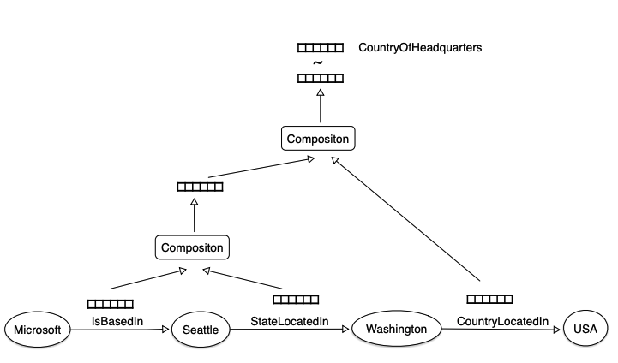
Path-based Reasoning (Cont.)
Neelakantan et al.
Use RNN to compose the semantics of relations in an arbitrary-length path
Compare the embeddings between a path and the query relation
Improve the generalization, can deal with unobserved relations
Paths are traversed heuristically without evaluation. Path space increases with the hops

Slide 20
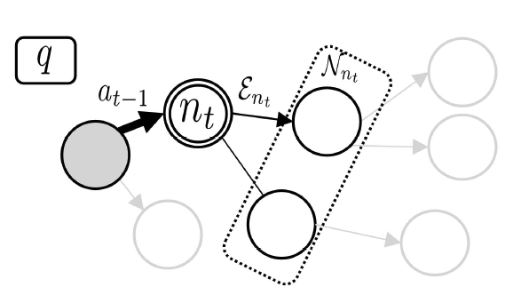
Path-based Reasoning (Cont.)
DeepPath
Reinforcement learning
To evaluate a path
MDP
Agent: sample a relation at each hop
State: current entity, target entityRL
Reward: accuracy, length and diversity
Rules can be abstracted from the sampled paths (AnyBRUL)
Tail entity should be given

Slide 21
Path-based Reasoning (Cont.)
MINERVA
Reinforcement learning
To find the answer
MDP
State: query relation, partial path
Reward: accuracy
Soft reward, dropout actions (Multi-Hop)
Value-based RL (M-walk)
Model path as hidden variables (DIVA)

Slide 22
Knowledge Graph Completion
KGC
Neural Reasoning
Symbolic Reasoning
Neural-Symbolic Reasoning
Symbolic-driven Neural Reasoning
Symbolic-driven Probabilistic Reasoning
Neural-driven Symbolic Reasoning
Path-based
Graph-based
Matrix-based

Slide 23
Graph-based Reasoning
Extend multiple neighbors at each step
CogGraph
Given h, extend multiple entities at each step by a policy function
GraIL
Given h and t, extract a subgraph (k-hop neighbors), use R-GCN to represent the subgraph

Slide 24
Knowledge Graph Completion
KGC
Neural Reasoning
Symbolic Reasoning
Neural-Symbolic Reasoning
Symbolic-driven Neural Reasoning
Symbolic-driven Probabilistic Reasoning
Neural-driven Symbolic Reasoning
Path-based
Graph-based
Matrix-based

Slide 25
Matrix-based Reasoning
Avoid selecting neighbors, but calculate a score to each neighbor.
Express the logic relationships between the head and the tail entities by matrix operations.

Slide 26

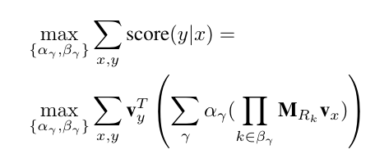
Matrix-based Reasoning
TensorLog
Given a head entity x, the score of each retrieved answer is:
learning parameters is difficult as each rule is associated with a parameter. Enumerating rules is an discrete task
The score of the query relation following different rules

Slide 27
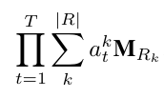
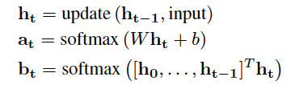
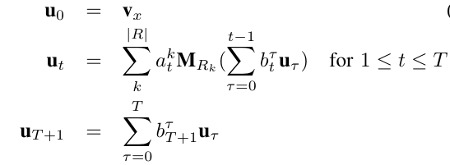
Matrix-based Reasoning (Cont.)
Neural LP
Interchanges the summation and the product
Change the weight of each rule into the weights of the predicates in the rule
Model the length dynamically
Softly combine next-hop relation
Learn attentions by RNN
Historical path
Fail to infer tree-like, conjunctions of rules
Weighted average of the paths with different lengths

Slide 28
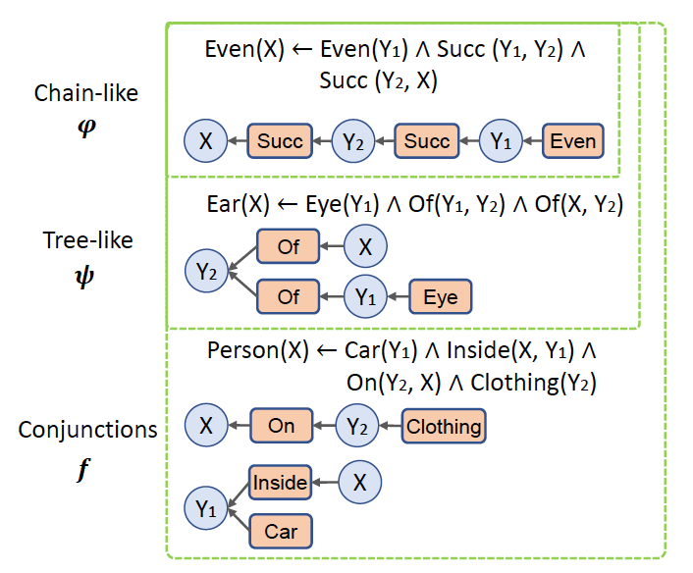


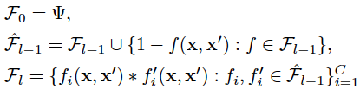
Matrix-based Reasoning (Cont.)
Neural Logic Inductive Learning
Replace v_{y} with another relation path. Thus it can represent the tree-like rules
Logic combination of primitive statements via
Three stacked transformers are to learn attentions

Slide 29

Matrix-based Reasoning (Cont.)
Neural-Num-LP
Extends Neural LP to learn the numerical rules
Support the comparison operator

Slide 30
Summary of KGC

Slide 31
Knowledge Graph Question Answering
KGQA
Neural Reasoning
Symbolic Reasoning
Neural-Symbolic Reasoning
Semantic Parsing
Template Parsing
Neural-enhanced symbolic reasoning
End-to-end reasoning
Single-relation
Multi-hop relation
Complex-logic
Constraints
Question types

Slide 32
Knowledge Graph Question Answering
KGQA
Neural Reasoning
Symbolic Reasoning
Neural-Symbolic Reasoning
Semantic Parsing
Template Parsing
Neural-enhanced symbolic reasoning
End-to-end reasoning
Single-relation
Multi-hop relation
Complex-logic
Constraints
Question types

Slide 33
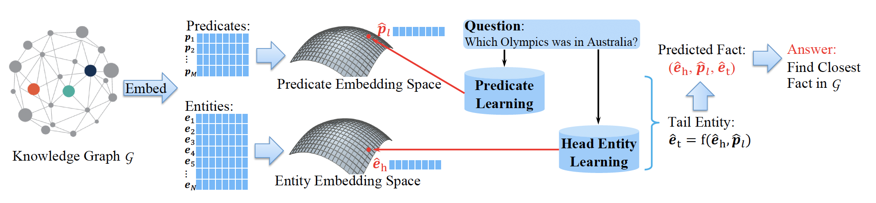
Neural Reasoning for Single-Relation
KEQA
Embed both the triplets and the question
Infer the predicate in the question
Find one-hop candidate answers from the head entity

Slide 34
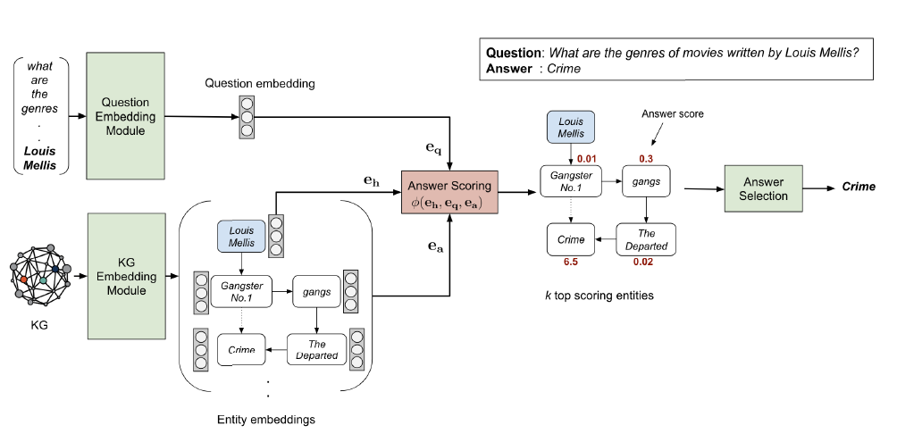
Neural Reasoning for Multi-hop Relation
EmbedKGQA
Candidate answers are all the entities in KGs.

Slide 35
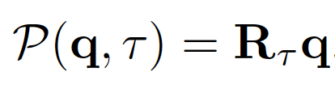
Neural Reasoning for Complex-logic Question
GQE
Start with the embeddings of the topic entities
Iteratively apply geometric operations to generate the query embedding.
Projection operator P
Forward
Intersection operator I
Conjunction
Embed a question (a set) into a single point

Slide 36
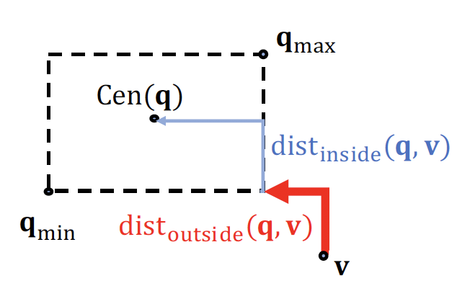
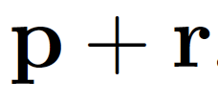
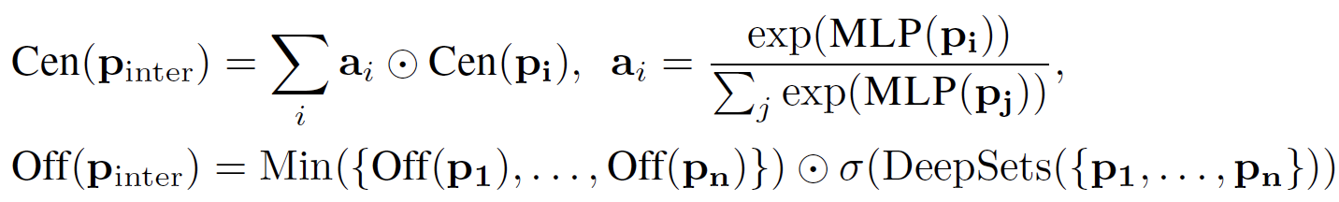
Neural Reasoning for Complex-logic Question
Query2Box
Embed a query as a box
An entity embedding v is represented as (v,0)
A relation embedding r is represented as (cen(r), off(p))
Projection operator
Intersection operator
Optimize the distance between v and the answer box.
Shrink the offset

Slide 37
Knowledge Graph Question Answering
KGQA
Neural Reasoning
Symbolic Reasoning
Neural-Symbolic Reasoning
Semantic Parsing
Template Parsing
Neural-enhanced symbolic reasoning
End-to-end reasoning
Single-relation
Multi-hop relation
Complex-logic
Constraints
Question types

Slide 38
Symbolic Reasoning
Parse structured queries for questions
Semantic parsing
Directly learn a mapping function
Template parsing
Generate templates before learning a mapping function

Slide 39
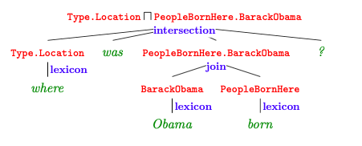
Semantic Parsing
Parse questions into logic expression, and use the logic expression to retrieve the answer
Kwiatkowksi et al.
Follow CCG to convert questions
E.g., x=“New York borders Vermont”, z=“next_to(ny,vt)”
Learn a function f from the training data {(x,z)} to map x to z.
Berant et al.
Follow 𝝺-DCS to convert questions
Ground truth of logic expressions (latent variables) are unobserved
No matter the edges are in KGs or not

Slide 40
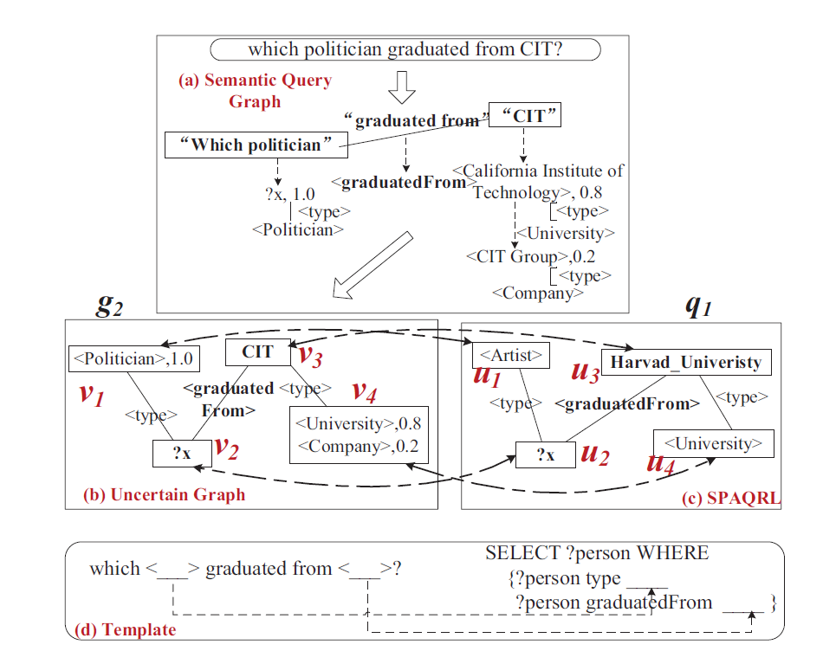
Template-based Parsing
Offline stage: generate a collection of templates
Online stage: align the new question to an existing template
UncertainTQA
A template = (g, q)
GED
Given a new question, its most similar SPARQL query graph will be found

Slide 41
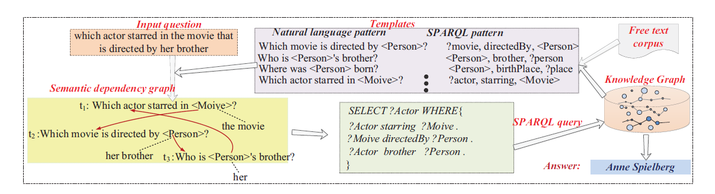
Template-based Parsing (Cont.)
TemplateQA
Replace entities with types
Map language patterns to relation types
Online
Offline
Jaccard similarity
Answer type
A template = (A natural language template, a SPARQL template)

Slide 42
Knowledge Graph Question Answering
KGQA
Neural Reasoning
Symbolic Reasoning
Neural-Symbolic Reasoning
Semantic Parsing
Template Parsing
Neural-enhanced symbolic reasoning
End-to-End reasoning
Single-relation
Multi-hop relation
Complex-logic
Constraints
Question types

Slide 43
Neural Symbolic Reasoning
Neural-enhanced symbolic reasoning
Target at parsing the questions
NN is to measure the similarity between the questions and the parsed graphs.
End-to-end reasoning
Parse the questions and retrieves the answers simultaneously
NN is to embed the inferred paths or graphs, based on which the answer can be determined.

Slide 44
Knowledge Graph Question Answering
KGQA
Neural Reasoning
Symbolic Reasoning
Neural-Symbolic Reasoning
Semantic Parsing
Template Parsing
Neural-enhanced symbolic reasoning
End-to-End reasoning
Single-relation
Multi-hop relation
Complex-logic
Constraints
Question types

Slide 45
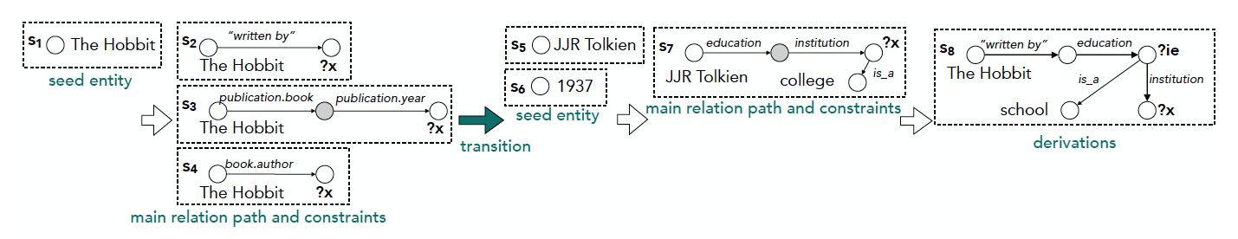
Neural-enhanced symbolic reasoning
Single-relation questions
Yih et al.
Determine (mention, entity) , (nlp pattern, relation)
Add a CNN model to determine the mapping
Multi-hop questions
MULTIQUE
Add an LSTM to encode and measure the similarity between the question and each current sub-query graph.

Slide 46
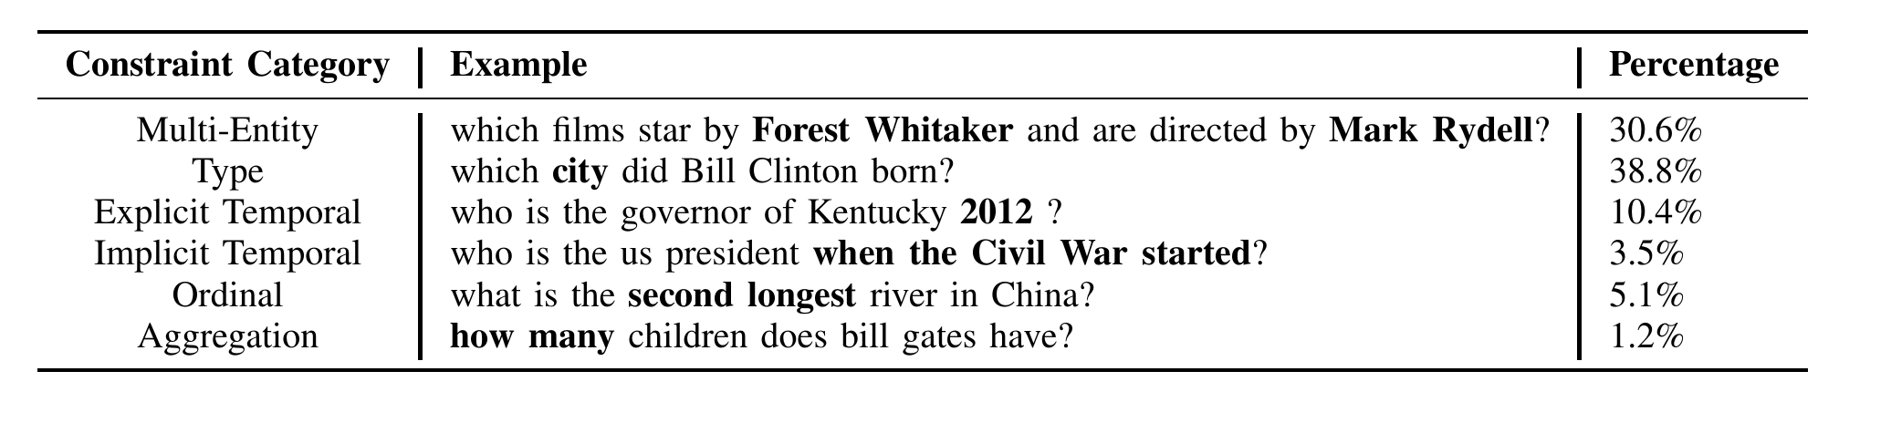
Neural-enhanced symbolic reasoning
Multi-constraint questions
Bao et al.
Multi-constraint query graph
Node: constant nodes such as entities or attribute values, variable nodes representing unknown entity/attribute value.
Edge: relation or function, e.g., “<2000,<,2001>”
First construct multi-hop query graph, then add constraints
Lan et al. incorporate constraints and extend relation simultaneously
A siamese CNN is to measure the similarity between the query graph and the question

Slide 47
Knowledge Graph Question Answering
KGQA
Neural Reasoning
Symbolic Reasoning
Neural-Symbolic Reasoning
Semantic Parsing
Template Parsing
Neural-enhanced symbolic reasoning
End-to-End reasoning
Single-relation
Multi-hop relation
Complex-logic
Constraints
Question types

Slide 48
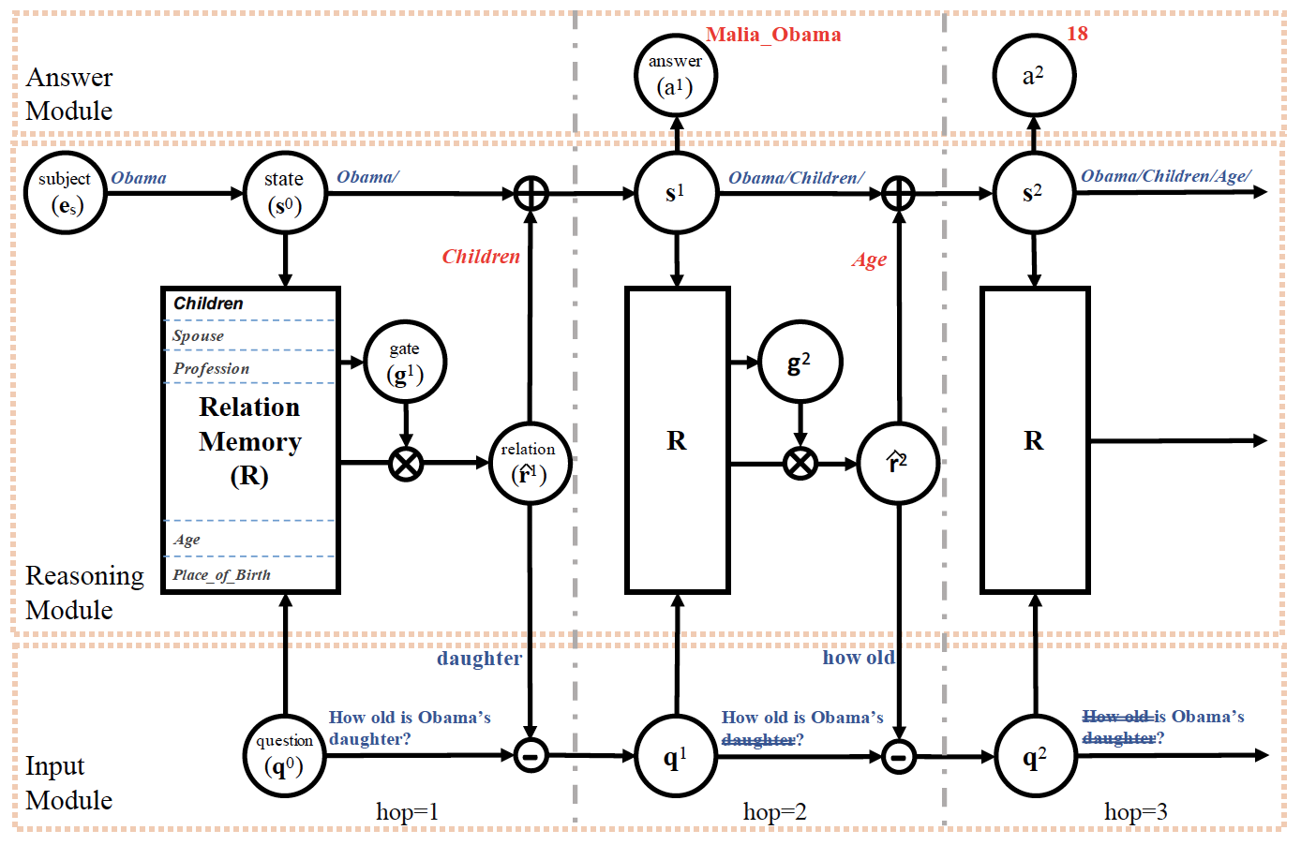
End-to-End Path-based Reasoning
IRN
The paths are observed
SRN
Paths are unobserved. RL
Input module: update the query embedding
Reasoning module: based on the question embedding and the historical path

Slide 49
End-to-end Graph-based Reasoning
Graft-Net
Extract subgraphs around the topic entity in the question by PPR (Ad-hoc)
Perform GNN to represent nodes
PullNet
RL
Weak supervision (shortest paths between topic entities and answer entities)
VRN
Topic entities are unknown (hidden variables)

Slide 50
Summary of KGQA

Slide 51
Future Directions
Knowledge graph Pre-training
Few-shot reasoning
Answering complex questions
Reasoning on Multi-sources
Dynamic Reasoning
Analogical Reasoning

Slide 52
Neural-Symbolic Reasoning on Knowledge Graphs
Thank you!
Jing Zhang, School of Information, Renmin University of China

