Slide 1
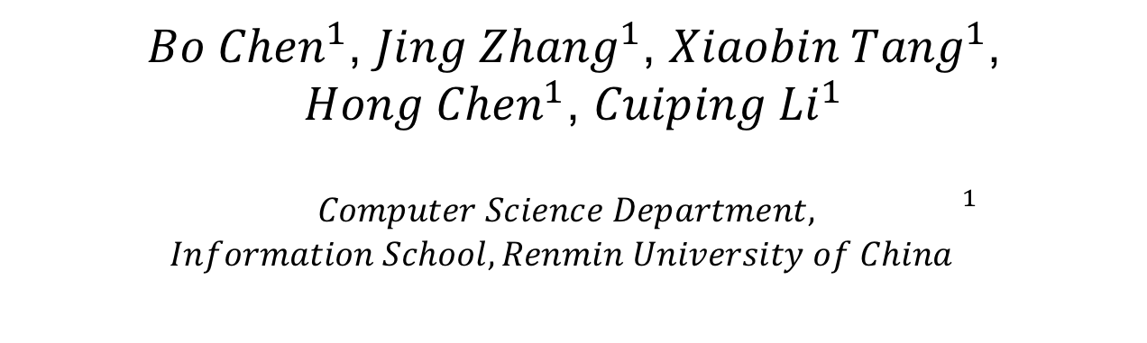
JarKA: Modeling Attribute Interactions for Cross-lingual Knowledge Alignment
${Bo Chen}^{1}$, ${Jing Zhang}^{1}$, ${Xiaobin Tang}^{1}$, ${Hong Chen}^{1}$, ${Cuiping Li}^{1}$
$${\begin{aligned}Computer Science Department, \\ Information School, Renmin University of China \end{aligned}}^{1}$$

Slide 2
Motivation
DBpedia, Freebase, YAGO and so on have been published as the well-known KGs.
Knowledge embedded in different languages is extremely unbalanced!
DBpedia: 2.6 billion triplets in English vs 278 million in Chinese.
Cross-lingual KGs alignment is essential to reduce the language gap for knowledge acquisition!
DBpedia: https://wiki.dbpedia.org/;
Freebase: http://freebase.com/;
YAGO: https://www.mpi-inf.mpg.de/departments/databases-and-information-systems/research/yago-naga/yago/

Slide 3
Challenges
The same entities “Audi RSQ” in two cross-lingual KGs from wiki.
Challenge 1: Heterogeneity of Attributes.
“Manufacturer” and “Body style” have corresponding attributes in Chinese.
“Designer” and “Engine” have no counterparts!
(We should not aggregate all the attributes to represent the entity! Modelling Attribute Interactions)
Challenge 2: Multi-view Combination.
Missing attributes or relationships triplets may cause error propagation to the combined pattern.
(Attribute and structure view should be distinguished.)

Slide 4
Interaction-based Attribute Model
Embed Cross-lingual Attribute Values.
Applying the neural machine translation(NMT) to embed the cross-lingual embedding space into the same feature space.
Comparing each attribute pairs via embedding cos-similatity.

Slide 5
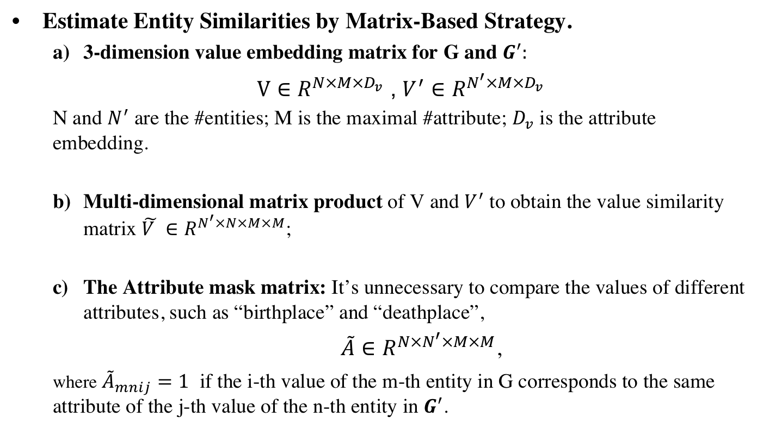
Interaction-based Attribute Model
Estimate Entity Similarities by Matrix-Based Strategy.
3-dimension value embedding matrix for G and $G^{′}:$
$V∈R^{N×M×D_{v}}$ , $V^{′}∈R^{N^{′}×M×D_{v}}$
N and $N^{′}$ are the #entities; M is the maximal #attribute; $D_{v}$ is the attribute embedding.
Multi-dimensional matrix product of V and $V^{′}$ to obtain the value similarity matrix $\tilde{V }∈R^{N^{′}×N×M×M}$;
The Attribute mask matrix: It’s unnecessary to compare the values of different attributes, such as “birthplace” and “deathplace”,
$\tilde{A}∈R^{N×N^{′}×M×M}$,
where ${\tilde{A}}_{mnij}=1$ if the i-th value of the m-th entity in G corresponds to the same attribute of the j-th value of the n-th entity in $G^{′}$.

Slide 6
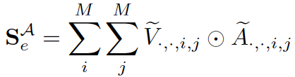
Interaction-based Attribute Model
Final entity similarity matrix:

Slide 7
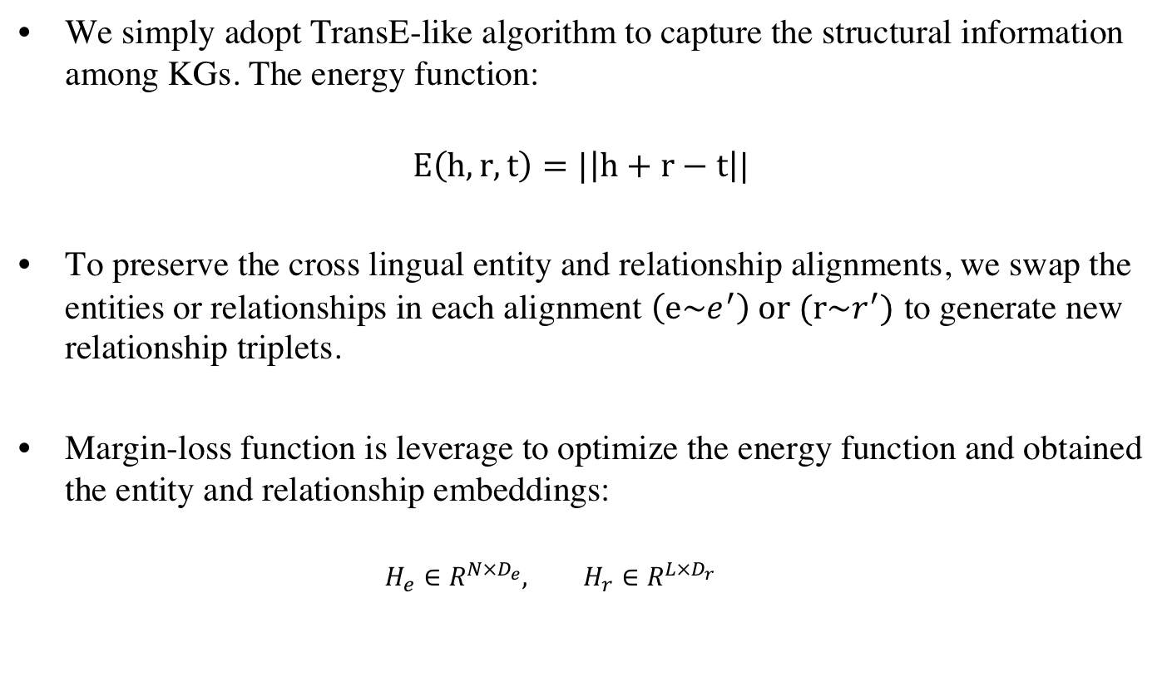
Embedding-Based Relationship Model
We simply adopt TransE-like algorithm to capture the structural information among KGs. The energy function:
$$E\left(h, r,t\right)=|\left|h+r−t\right||$$
To preserve the cross lingual entity and relationship alignments, we swap the entities or relationships in each alignment $\left(e\sim e^{′}\right) or (r\sim r^{′})$ to generate new relationship triplets.
Margin-loss function is leverage to optimize the energy function and obtained the entity and relationship embeddings:
$${H_{e}∈R^{N×D_{e}}, H}_{r}∈R^{L×D_{r}}$$

Slide 8


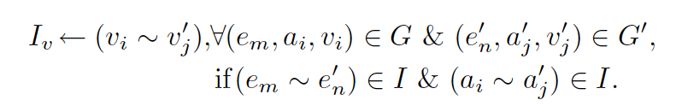
Seeds Inference
If we combine the learned attribute and relationship embeddings to represent the entity, this may cause noise due to the missing issue from both views.
Interaction via inferring confident seeds from both views
For attribute view:
Entity:
Attribute: (Depend on the aligned entities)
Value: (Depend on the aligned entities and attributes)
For relationship view:
Entity: same as attribute view
Relationship: same as the attribute inference in attribute view.

Slide 9

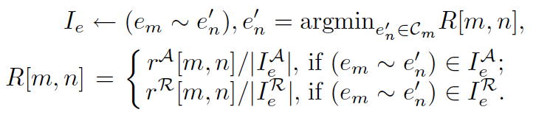
Merge Strategies
Standard Multi-view Merge Strategy. Following the standard co-training algorithm, we firstly infer seeds from attribute view, then infer seeds from the remaining candidates via structural view.
Score-Based Merge Strategy. we select the counterpart with the maximal score into the final new alignments.
Rank-Based Merge Strategy. Due to the effect of different score scales, we select the alignments with a higher rank index in the two views respectively.

Slide 10
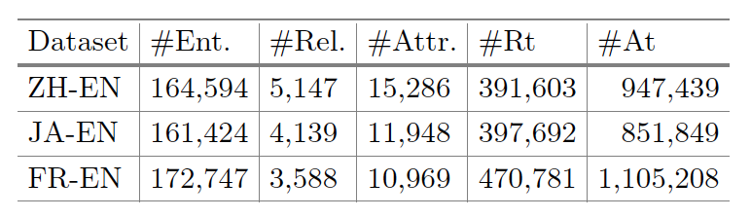
Experiments
Dataset. We evaluate our proposed model on DBP15K, a well-known public dataset for KG alignment contains 3 pairs of cross-lingual KGs. Each pair of cross-lingual KGs has 15,000 inter-lingual links (ILLs).

Slide 11
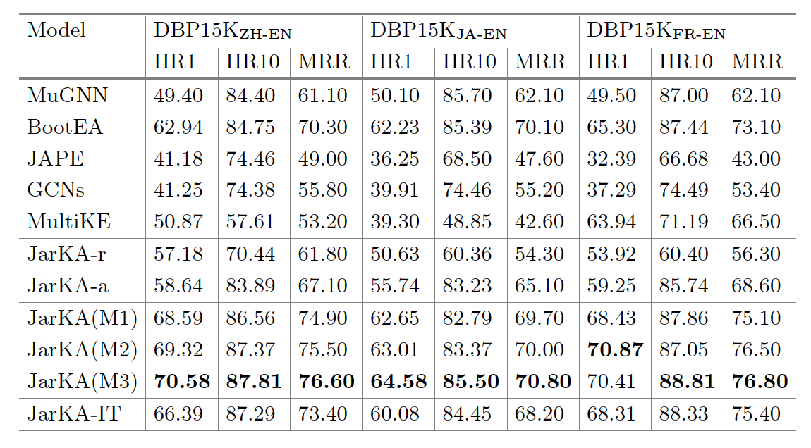
Experiments
Blue : the multi-view model is outperform either single view.
Red : the Rank-based Merge Strategy is the best cause it consider the relative rank index in each view.
Green: iteration step can bootstrap our model’s performance.

Slide 12
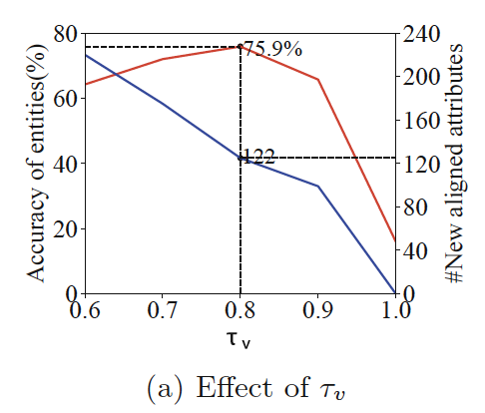
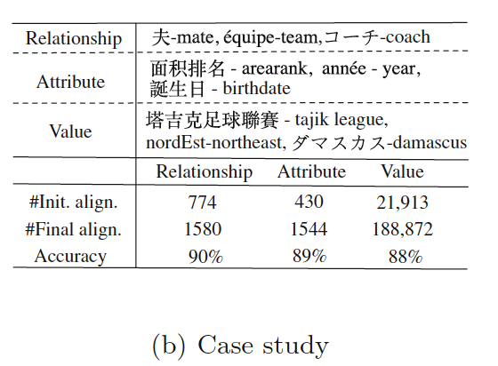
Experiments
A better threshold can balance both the quality and quantity of the new alignments.
Our proposed model do have the ability to accurately align the knowledge about Relationship, Attribute and Value.

Slide 13
Conclusion
We present the first attempt to formalize the problem of cross-lingual knowledge alignment as comprehensively linking entities, relationships, attributes and values;
An interaction-based attribute model is proposed to compare the aligned attributes of entities instead of globally embedding entities and A matrix-based strategy is adopted to accelerate the comparing process.
A joint framework together with three merge strategies to solve the conflicts of the alignments inferred from the attribute model and the relationship model.
https://github.com/BoChen-Daniel/PAKDD-20-JarKA.

Slide 14
Thank you！

