Slide 1
MEgo2Vec: Embedding Matched Ego Networks for User Alignment Across Social Networks
Jing Zhang⁺, Bo Chen⁺, Xianming Wang⁺, Fengmei Jin⁺, Hong Chen⁺, Cuiping Li⁺, Guojie Song*, Yutao Zhang#
⁺Information School, Renmin University of China
*MOE Key Laboratory of Machine Perception, PKU
#Computer Science Department, Tsinghua University

Slide 2
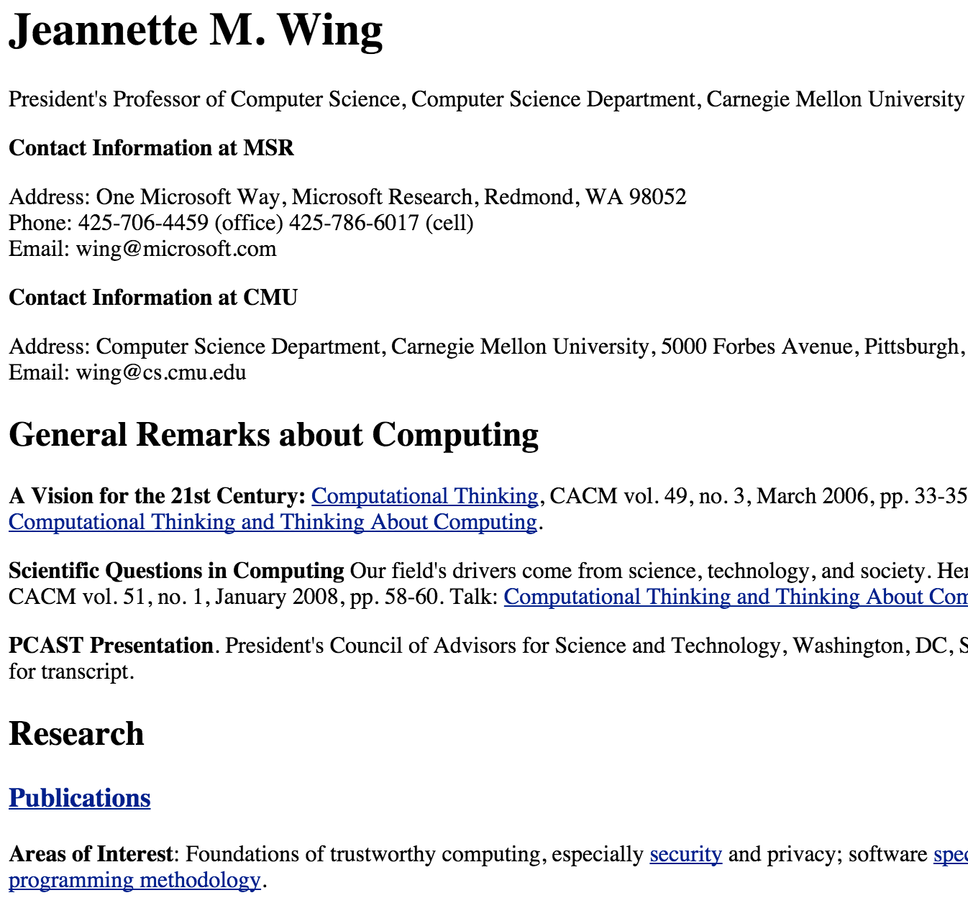
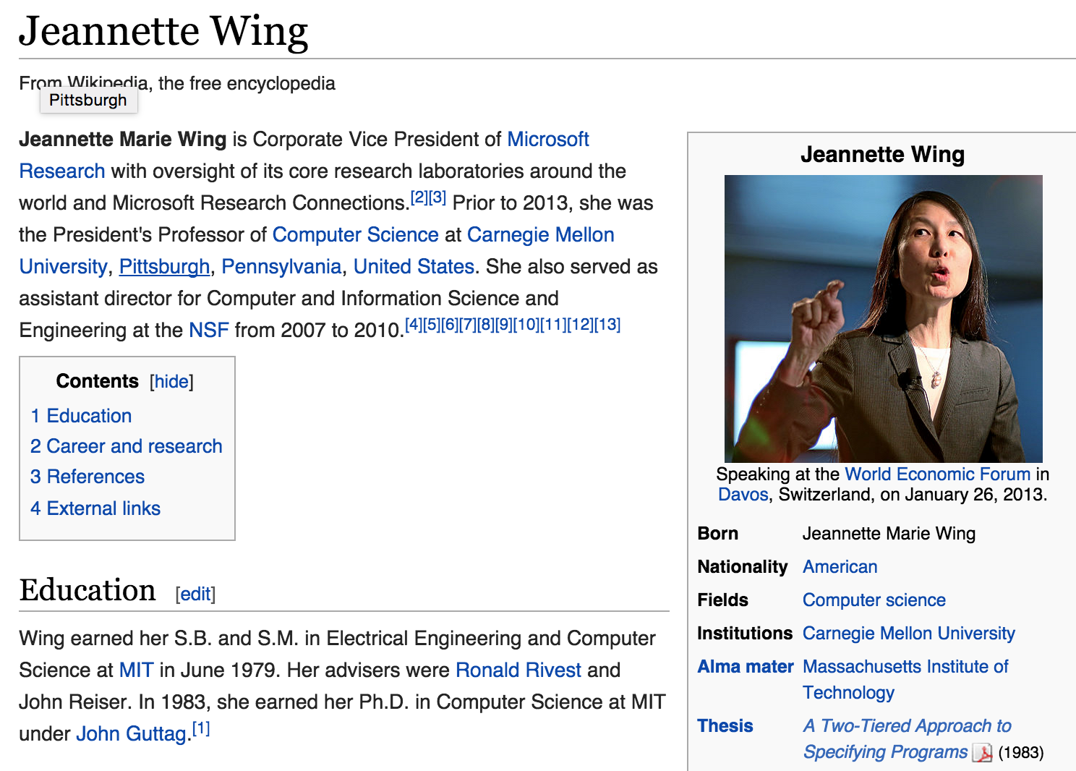
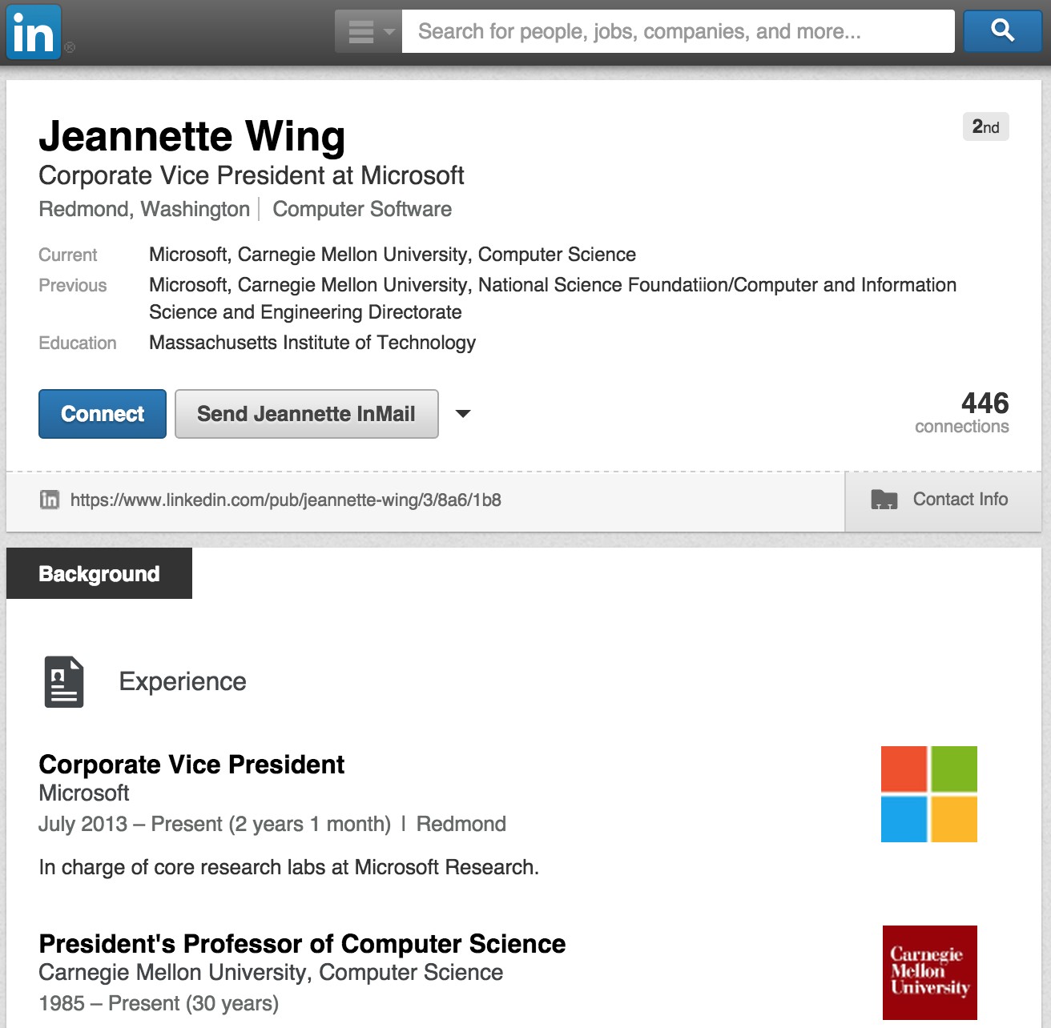
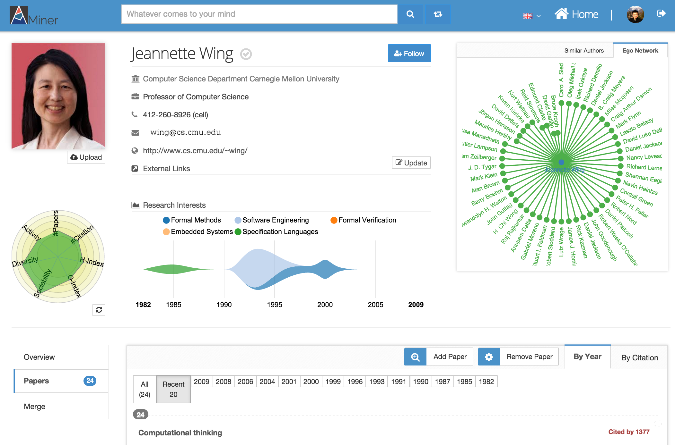
Motivation
User profiles are distributed…
We need to align users across different networks to benefit link prediction, social recommendation, information diffusion
Homepage
Wikipedia
LinkedIn
AMiner

Slide 3
Traditional Methods
General solution:
Compare profile attributes and neighbor pairs

Slide 4
Challenge 1
How to unitedly model profile similarity?
Name: Jaro-Winkler distance
Self-description: TF-IDF based cosine similarity
Cannot capture the semantics of different literal strings.
A unified way with little effort of feature engineering to better represent different profile attributes is worth studying.

Slide 5
Challenge 2
How to deal with diverse neighbors in different social networks?
Leveraging all neighbors’ information without distinction may contrarily bring in additional noise.

Slide 6
Challenge 3
How to incorporate the influence of network topologies?
s
s
The linkage between v₃ and v₄ and the linkage between u₃ and u₄ reduce the possibility that v₃ is wrongly matched to u₃, and v₄ is wrongly matched to u₄.

Slide 7













Problem Formulation
Compare the ego networks of two users
( and are the focal node to be aligned.)
Two input ego networks
Matching ego network
Objective: learn a predictive function

Slide 8
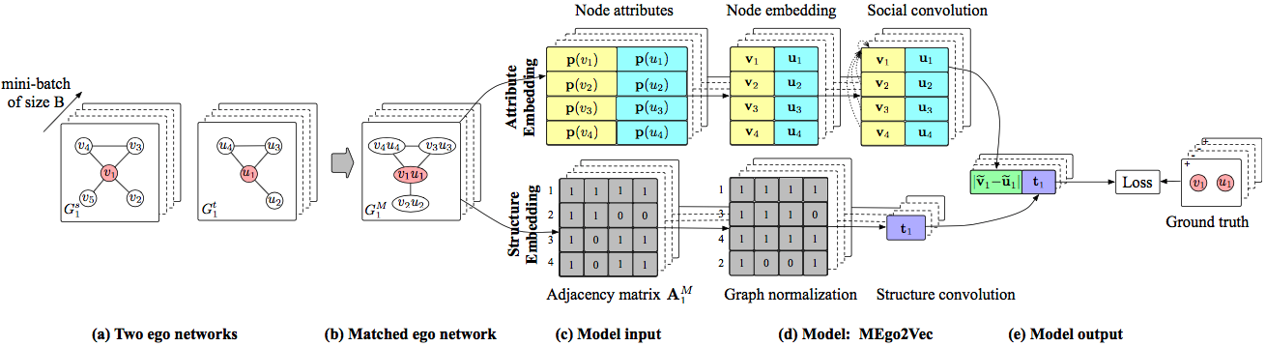
Methodology Overview
1
Candidate Generation
Select the user names with certain relatedness.
Wei Wang -> W. Wang, Wei. W
2
3
Matched Ego Network Construction
Matched Ego Network Embedding

Slide 9
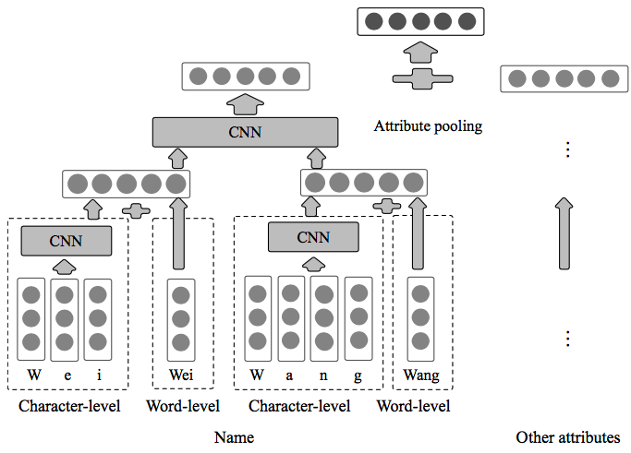
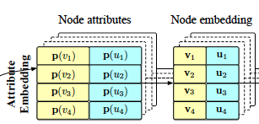
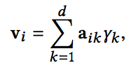
Attribute Embedding
Objective: model both the literal and semantic characteristics of the attributes unitedly
Input: node attributes
Output: node embeddings
Method: a multi-view hierarchical embedding model
Char-view: tony vs tony123; Word-view: long text.
Aggregation
s
2nd Layer
1st layer

Slide 10
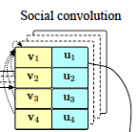
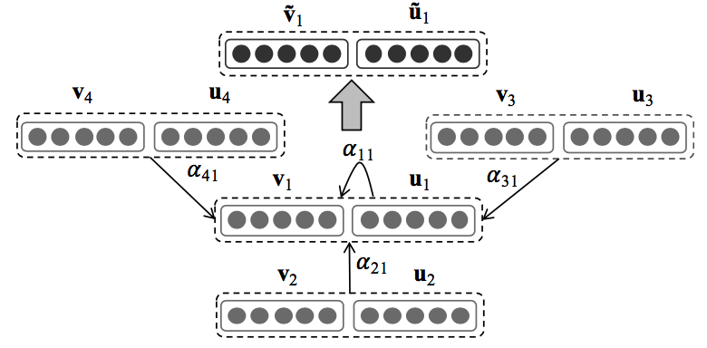

Social Convolution
Objective: leverage neighbor’s embeddings and distinguish the effects from different neighbor pairs
Input: nodes embeddings and neighbor embeddings
Output: convolved node embeddings
Method: a social convolutional model.

Slide 11

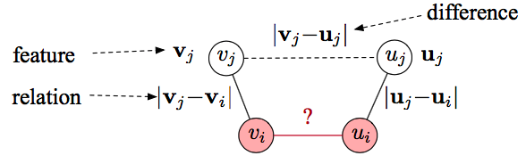

Three Attention Mechanisms
Feature Attention
A neighbor pair makes more contribution on inferring the label of the focal pair if the features of are more discriminative.
‘Jesper Wang’ vs ‘Wei Wang’

Slide 12

Three Attention Mechanisms
Difference Attention
A neighbor pair takes a more important role on predicting the label of if the two neighbors are more similar to each other.

Slide 13

Three Attention Mechanisms
Relation Attention
A neighbor pair takes more effects on determining the label of if the relationship between user and in G_{s} share the same semantics with the relationship between user and in G_{t} .
United attention

Slide 14
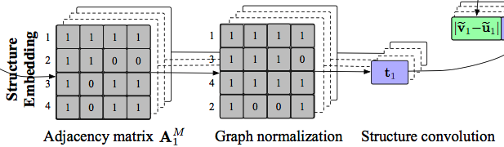
Structure Embedding
Objective: Make the neighbor pairs with similar structural roles in different matched ego networks being positioned similarly in the embedding vectors
Input: Adjacency matrix
Output: Structure embedding
Method: graph normalization + CNN model
Rank neighbor pairs according to their similarities to the focal pair.

Slide 15

Objective Function

Slide 16
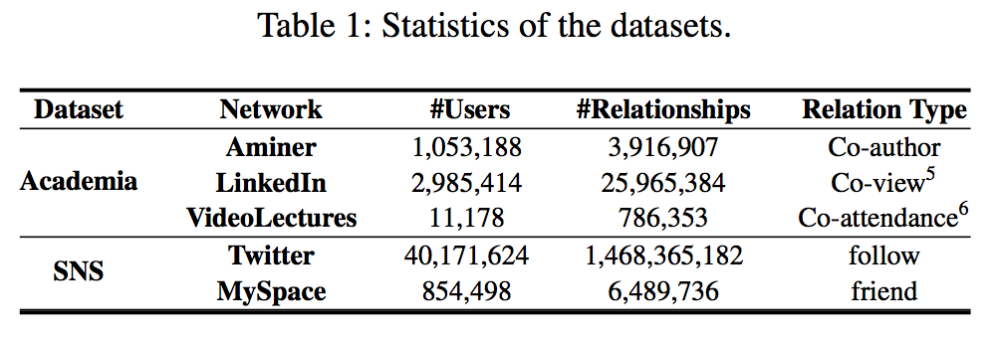
Datasets
Three Academia networks and two SNS networks.
Training Data. We keep the ratio between positive and negative in- stances as about 1:10 and collect 33,981, 34,060 and 35,080 instances for Aminer-LinkedIn, Aminer-VideoLectures and Twitter-MySpace respectively.

Slide 17
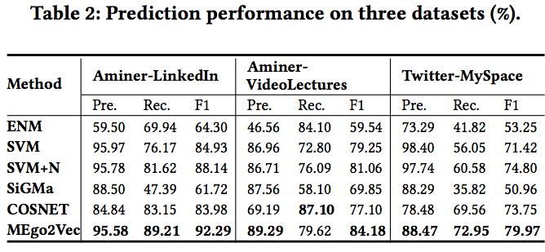
Alignment Performance
In terms of F1, MEgo2Vec achieve about +3.12-30.57% improvement over all the baseline methods.

Slide 18
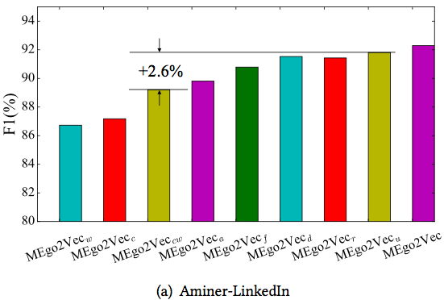
Performance of Model Variants
Multi-View Embedding
Multi
Char
Word

Slide 19
Performance of Model Variants
Neighbors Effect
Social Convolution
Average Feature Difference
Relation
United

Slide 20
Performance of Model Variants
Structure Embeddings
Final
Model

Slide 21
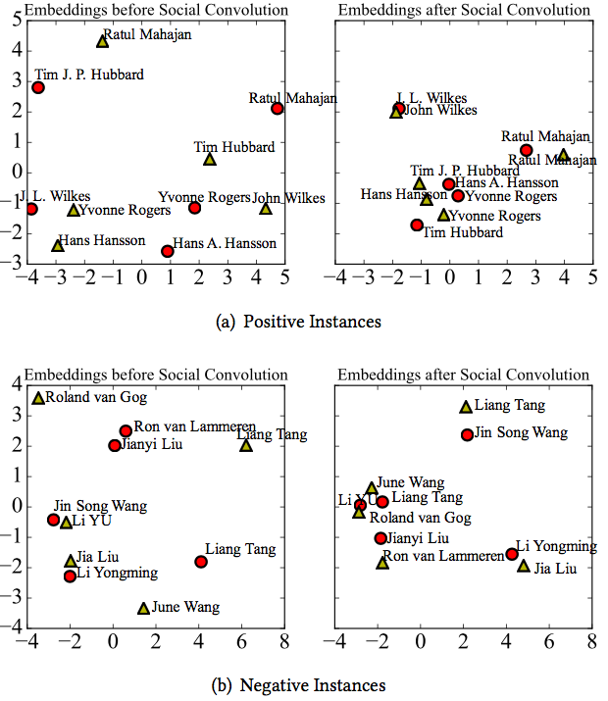
Case Study of Learned Embeddings

Slide 22
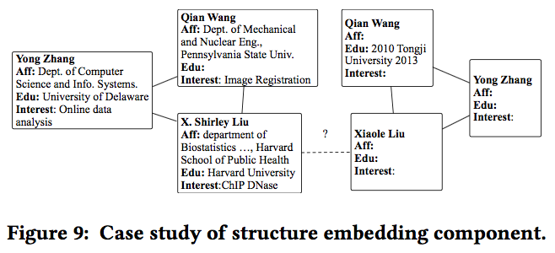
Case Study of Structure Embedding Component

Slide 23
Conclusion
We propose a novel graph neural network model, to formalize our problem as a united optimization framework.
The multi-view node embedding can model the literal and semantic characteristics of different attributes unitedly;
The attention mechanism can distinguish the effects of different neighbors to alleviate error propagations;
The structure embedding can capture the influence of different topologies.

Slide 24
Thank you！

