Slide 1

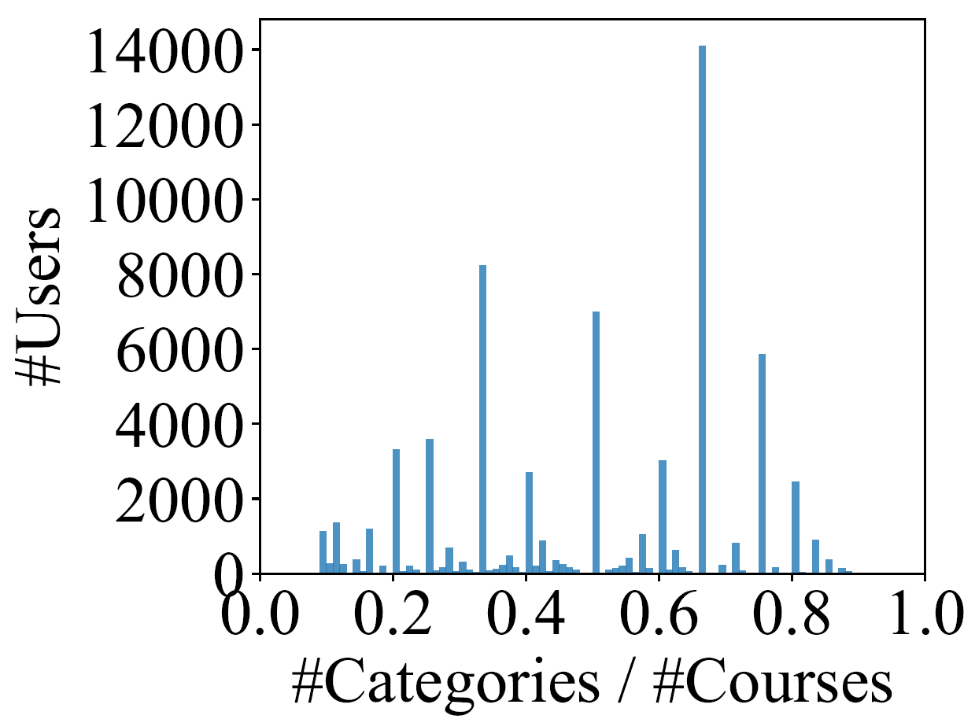
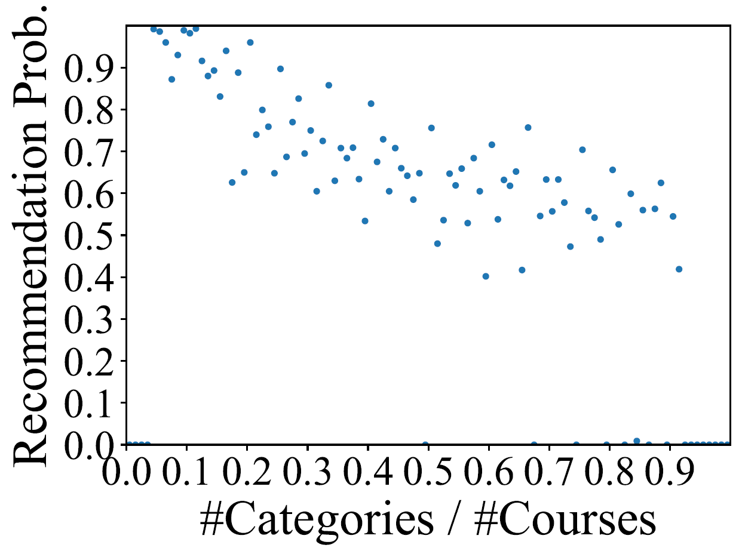
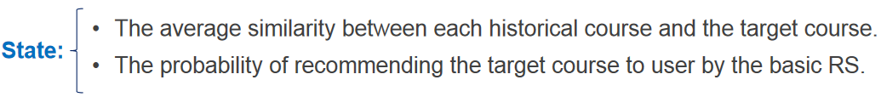
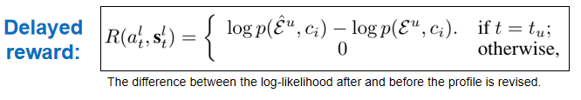

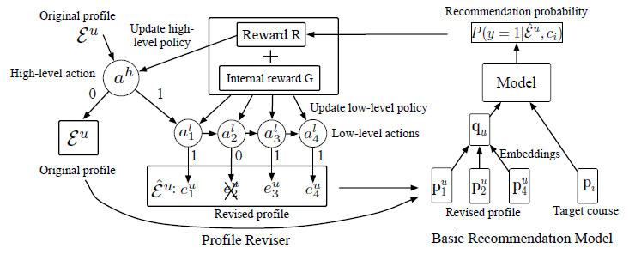



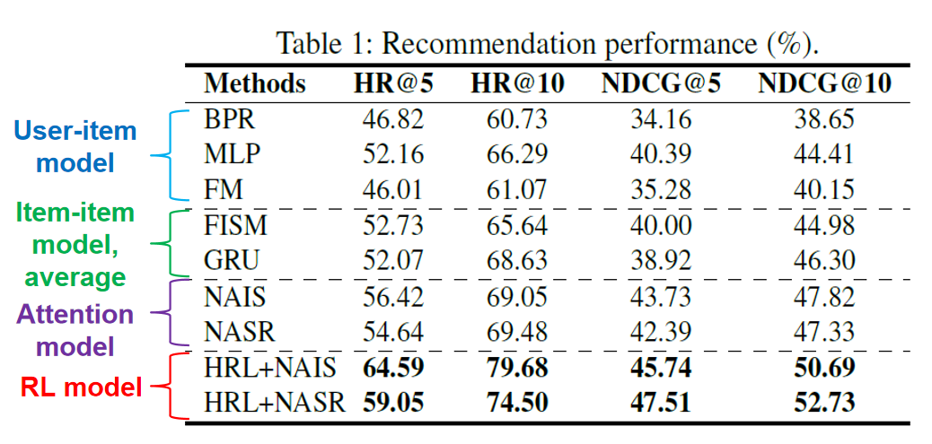
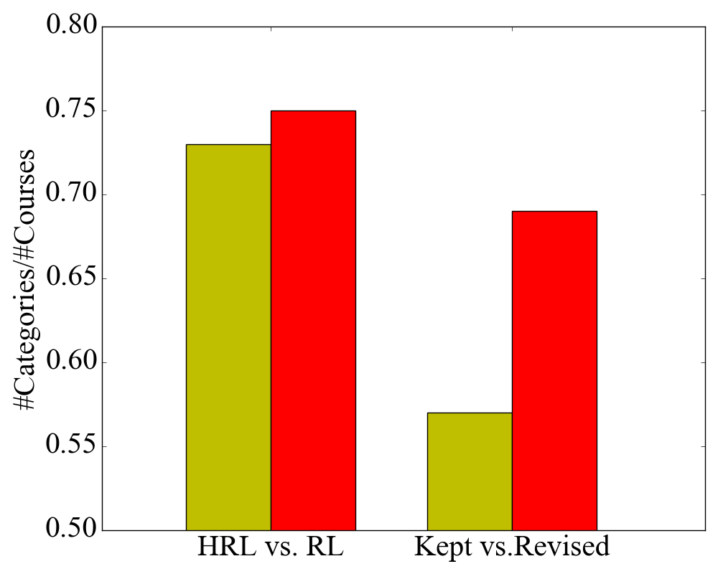
Hierarchical Reinforcement Learning
for Course Recommendation in MOOCs
AAAI 2019: Hawaii, USA
${\text{Jing} \text{Zhang}}^{†}$, ${\text{Bowen} \text{Hao}}^{†}$, ${\text{Bo} \text{Chen}}^{†}$, ${\text{Cuiping} \text{Li}}^{†}$, ${\text{Hong} \text{Chen}}^{†}$, ${\text{Jimeng} \text{Sun}}^{⋕}$
${ }^{†}$Renmin University of China$^{⋕}$Georgia Institute of Technology
Problem & Challenges
For each user u, given his/her historical enrolled courses $ℰ^{u}≔\left(e_{1}^{u},…,e_{t_{u}}^{u}\right)$ before time $t_{u}$, we aim at recommending the courses user u will enroll at next time $t_{u}+1.$
Limitations of Existing Attention-based Recommendation Model
Data Observation
The relevant courses may be diluted by the irrelevant courses.
Irrelevant courses are rigidly assigned attention coefficients.
Dataset: we select the users who enrolled at least three courses from 10/31/2016 - 3/31/2018 from XuetangX – the most popular MOOCs platform in China.
Contributing courses
Noisy courses
Contributing
courses
Positive
Instance
Negative instance
A large number of users enrolled diverse courses
The recommendation performance based on the diverse profiles is impacted
Solution: Reinforcement Learning
Objective: remove the irrelevant courses to the target course.
Challenge: do not have explicit/supervised information about which courses to be removed.
Solution: model the actions of revising/removing courses as a markov decision process and use the feedback to supervise the revise/remove process.
High-level: revise the whole profile $ε^{u}$ or not
Low-level: remove a historical course $e_{t}^{u} ∈ε^{u}$ or not
The difference between the average similarity between each historical course and the target course after and before the profile is revised.
Experimental Results
HRL+NAIS:
Crisis Negotiation
Social Civilization
Web Technology
C++ Program
Web Development
NAIS:
29.61
29.09
28.32
28.12
The target course
HRL+NAIS:
Modern Biology
Medical Mystery
Biomedical Imaging
R Program
Biology
NAIS:
37.79
37.96
37.62
37.84
The target course
HRL+NAIS:
Web
Technology
Art
Classics
National Unity Theory
Philosophy
Life Aesthetics
Kept: kept profiles by our approach
Revised: revised profiles by our approach
NAIS:
38.32
35.87
40.63
43.69
The target course
The greedy reviser performs worse (-2.27% in terms of HR@10 ) than our approach.
RL: one-level RL
HRL: our approach
The revised profiles by the proposed HRL are more consistent.
High-level task tends to keep more consistent profiles while revise more diverse profiles.

