Slide 1

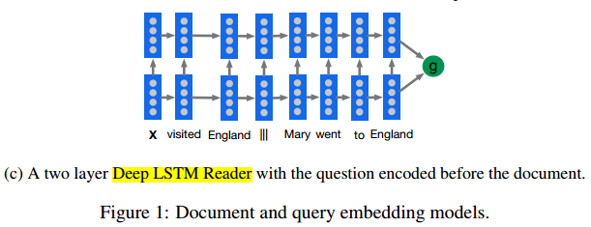

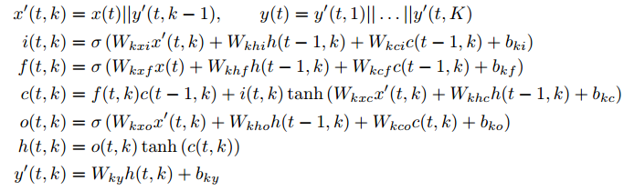
Deep LSTM Reader
估计此概率
Embedding
Feature extraction: LSTM
Context-query interaction: q在序列的前面后面接context
Answer prediction: softmax
网络模型用来求解此向量, 文与问题的相互作用向量
文章和问题的相互作用后的表示向量

Slide 2
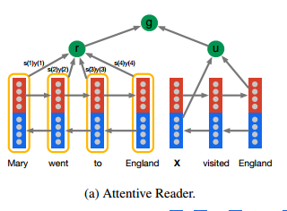


Attentive Reader
Encoder (FE): BiLSTM 不同的两个分别用于d和q
Interaction(attention):
Prediction

Slide 3
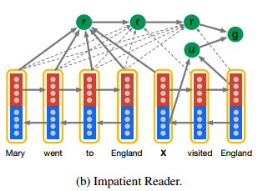

Impatient Attentive Reader
Encoder (FE): BiLSTM 不同的两个分别用于d和q
Interaction(attention):
针对询问词: 与文章相关联
然后将询问词前后进行信息传导
Prediction

Slide 4
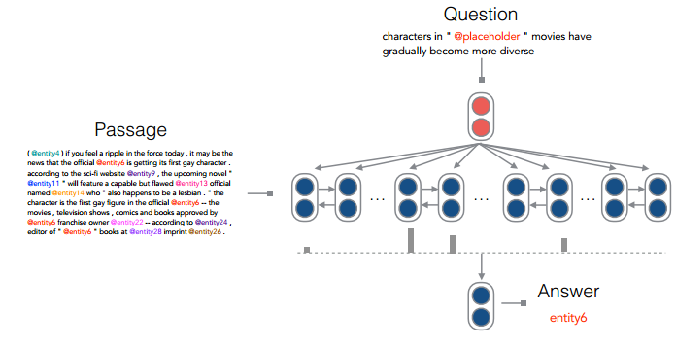



Chen attention reader(2016)
Encoder: biLSTM (两个)
Attention: general attention, a bilinear term
Prediction: softmax, negative likelihood 使用了文章中的词

Slide 5

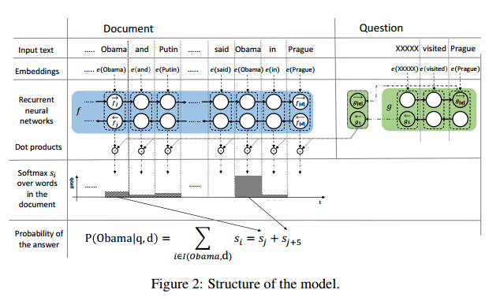

Attention sum reader
One word embedding function
Two encoder function f and g
Pointer sum attention
Pointer sum attention
这里的attention的不同,权重就是最后每个单词的概率
1.简单有效
2.适合于作答案为一个词且来自于文章当中
没有计算一个最终的输出向量，而是直接用attention权衡文章中每个单词的权重

Slide 6
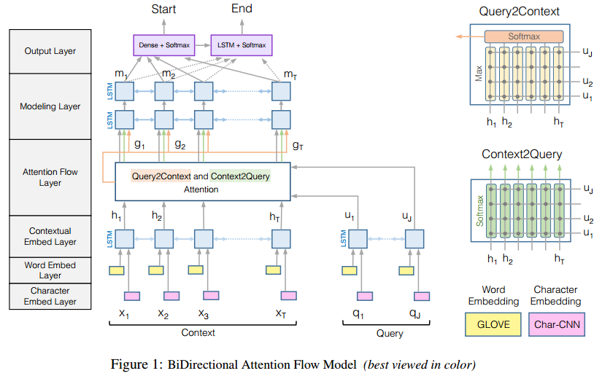
BiDAF (BiDirectional Attention Flow)
a hierarchical multi-stage process
6 layers
Attention in two direction
Context-to-query Attention

Slide 7
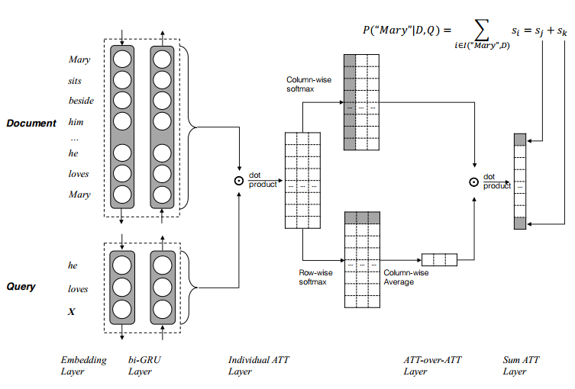
AoA Reader (BiDirectional Attention Flow)
a hierarchical multi-stage process
6 layers
Attention in two direction
Context-to-query Attention

Slide 8
One-hot
Multi-hot
Undirectional
Bidirectional

