Slide 1
modem协议基础

Slide 2
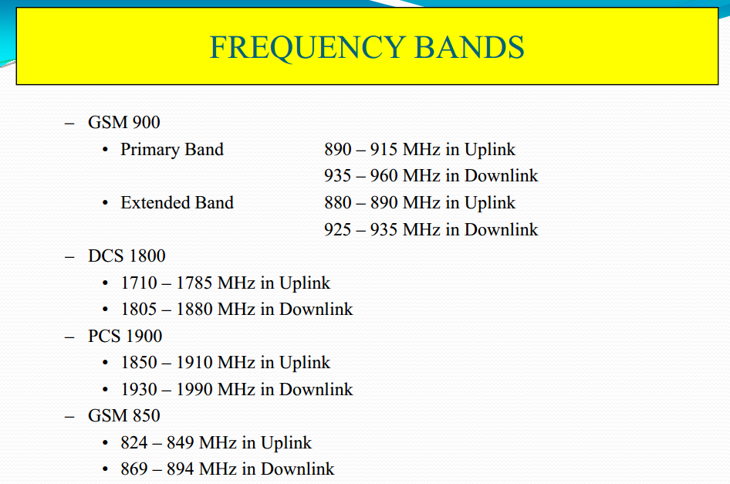
GSM :Global System for Mobile Communications

Slide 3
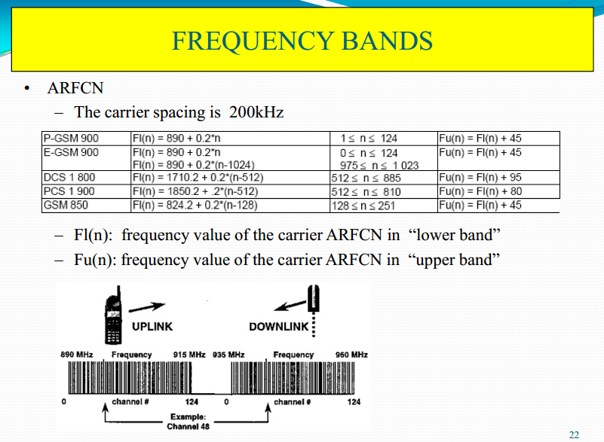

Slide 4
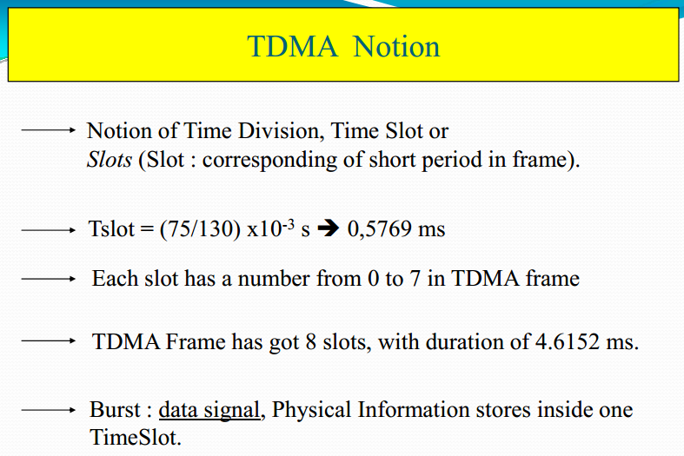

Slide 5
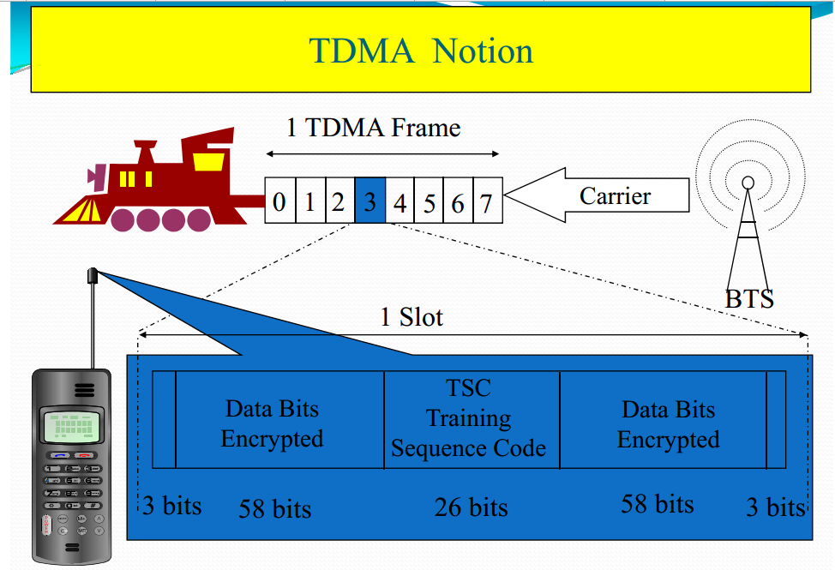

Slide 6
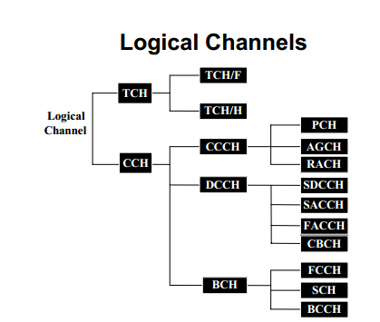

Slide 7
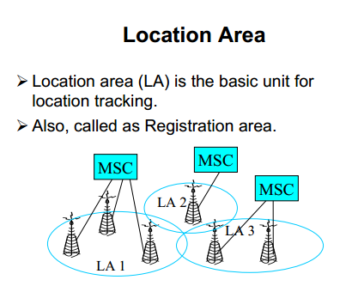

Slide 8
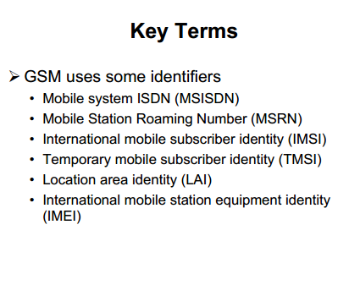

Slide 9
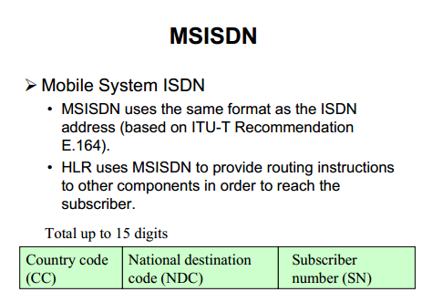

Slide 10
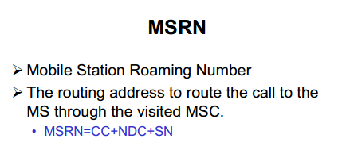

Slide 11
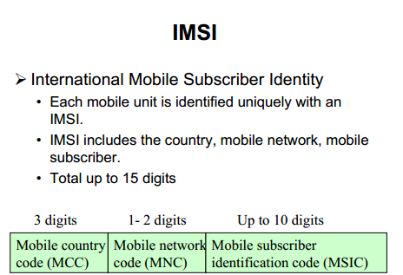

Slide 12
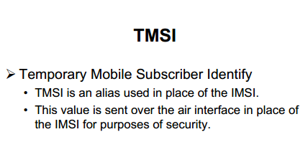

Slide 13
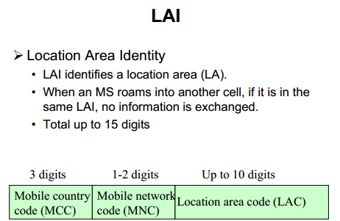

Slide 14
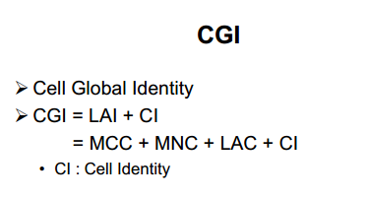

Slide 15
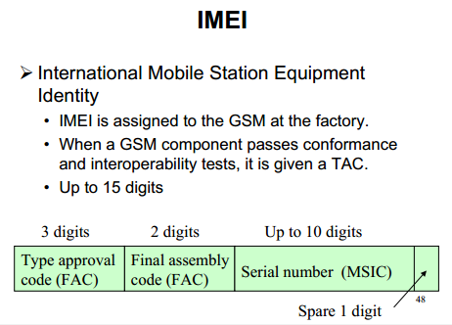

Slide 16
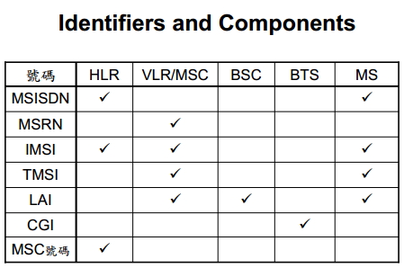

Slide 17
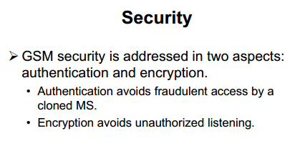
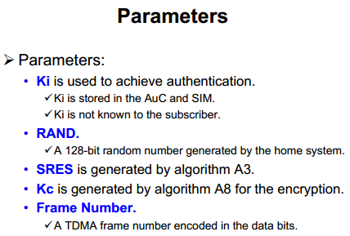
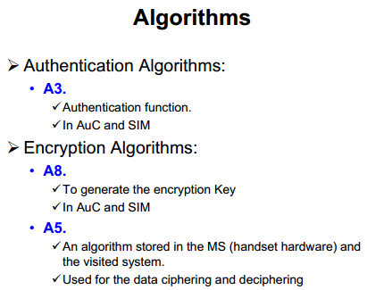
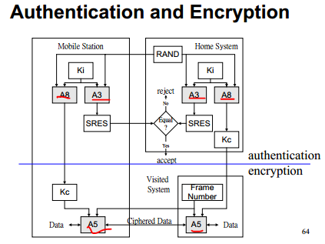

Slide 18
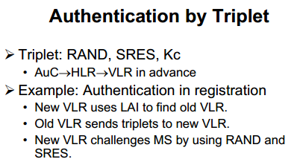
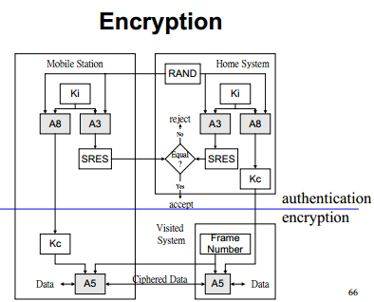

Slide 19
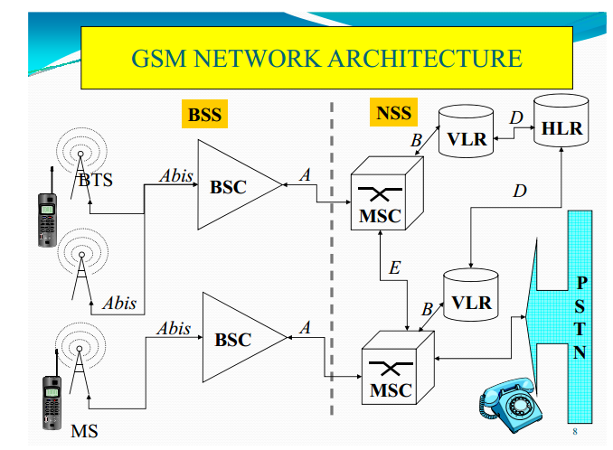
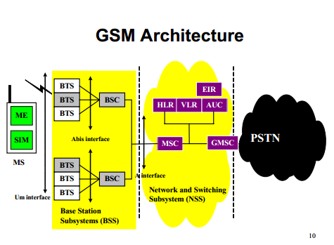

Slide 20
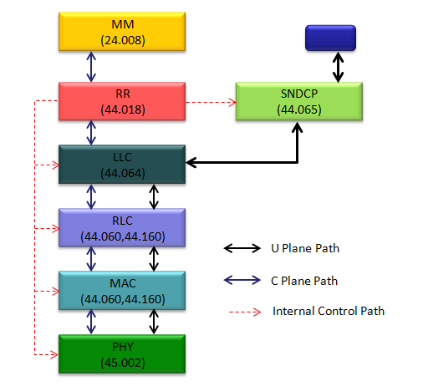

Slide 22
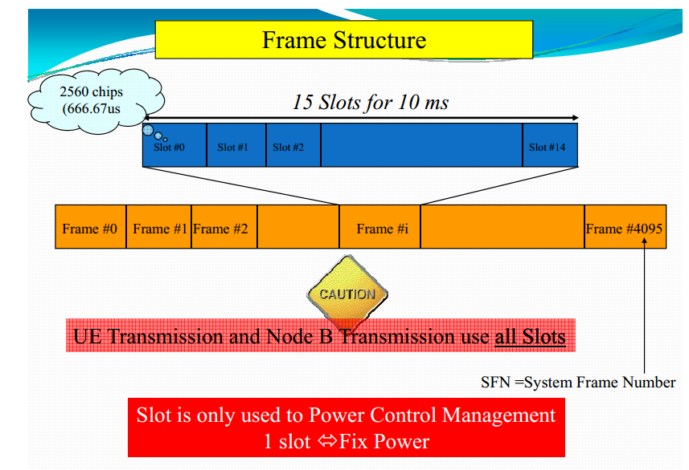
UMTS(Universal Mobile Telecommunications System)

Slide 23
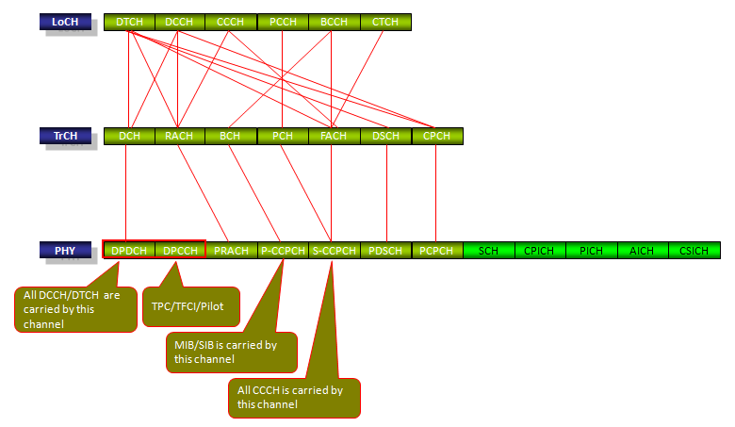
UMTS channel

Slide 24
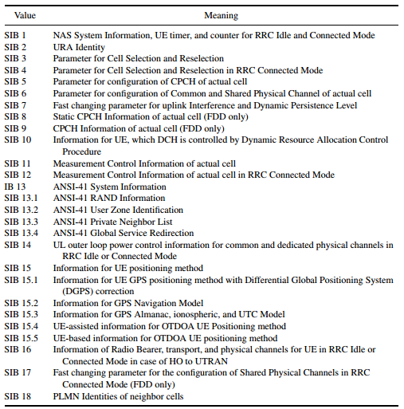

Slide 25
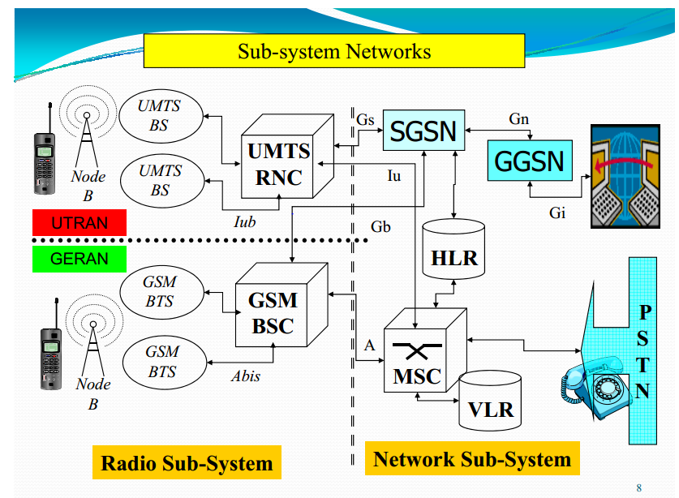
Network architecture

Slide 26
Scrambling in the Downlink
Scrambling in the Downlink In the downlink, the shift register arrangement
above allows 218 − 1 different scrambling codes to be generated. However, for ease of code
acquisition and cell search, not all of these are used. The scrambling codes are arranged
into 512 sets of primary scrambling codes, each with an associated 15 secondary codes.
The 512 primary codes are further divided into 64 code groups of 16 codes. Each code has
associated with it an alternative left and right associated scrambling code that can be used
in compressed mode , Each cell is allocated exactly one primary scrambling code; the code number of this
primary scrambling code is the cell’s Cell ID, and the primary scrambling code is used to
transmit the P-CCPCH, S-CCPCH, P-CPICH, PICH, AICH, AP-AICH, CD/CA-ICH and
the CSICH. The other physical channels can either be transmitted on the primary scrambling code or on one of the 15 secondary codesPHYSICAL CHANNELS 75 from the set associated with the primary code. The primary scrambling code is searched for
by the mobile terminal during cell search, The mobile terminal finds the primary scrambling code during the cell search procedure.
Detection of the S-SCH gives the scrambling code group to which the primary code belongs
and correlation of the CPICH with all of the codes in that group identifies the code.

Slide 27
Cell Search Procedure
Cell Search procecess in WCDMA would be described as follows (For the detailed understanding, I would recommend you to study each of the physical channels involved in the following description).
i) Every cell is tranmitting its scrambling code(Primary Scrambling Code) via CPICH.
ii) UE detect the cell power, primary scrambling code and some addition info for compensating demodulation process
iii) UE detect P-SCH (Primary Synchronization Code) and figure out slot boundary (start and end of each slot)
iv) UE detect S-SCH (Primary Synchronization Code) and figure out frame bounday (start and end of each frame)
v) UE detect P-CCPCH and decode MIB. Through this MIB, UE can figure out SFN.

Slide 28
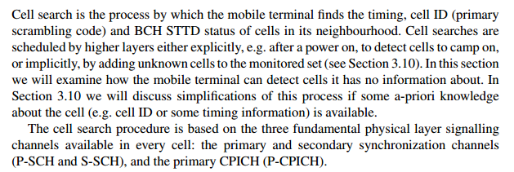
CELL SEARCH

Slide 29
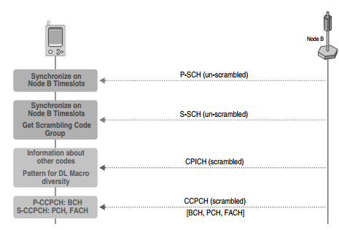

Slide 31
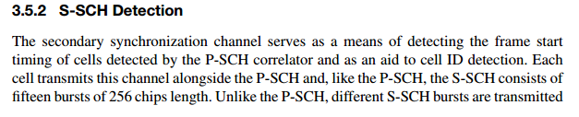

Slide 33
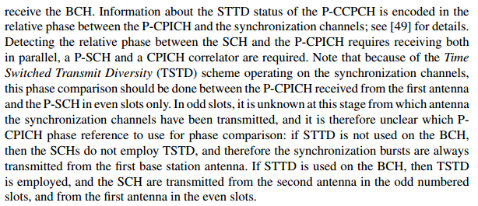

Slide 34
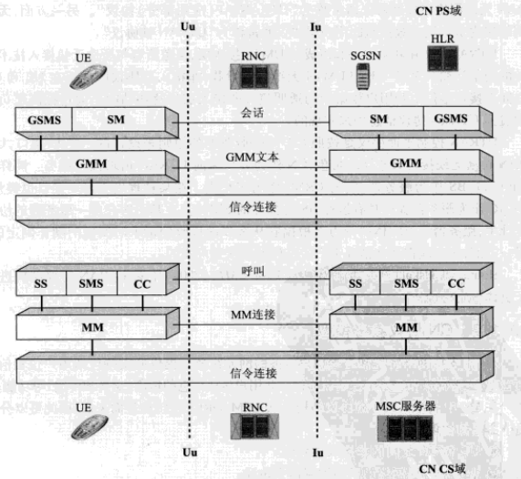
UMTS NAS层

Slide 35
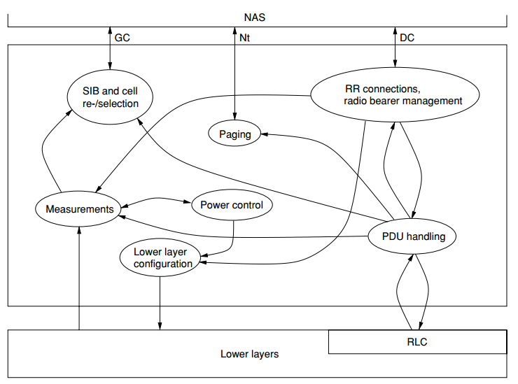

Slide 36
Sequence for mobile originated CS domain call.

Slide 37
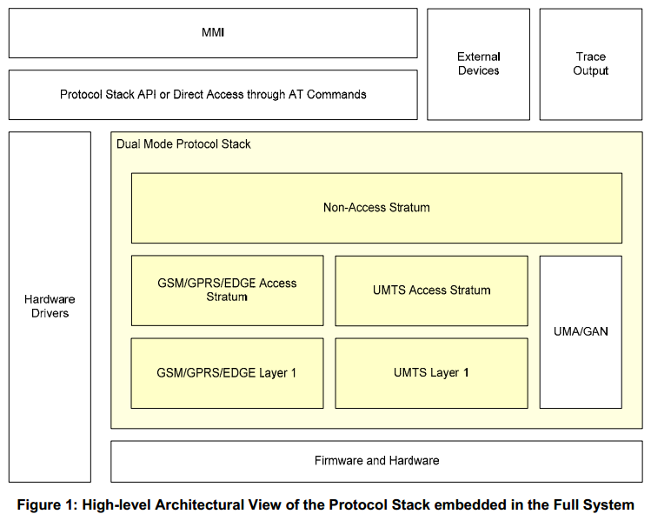
modem分层架构

Slide 38
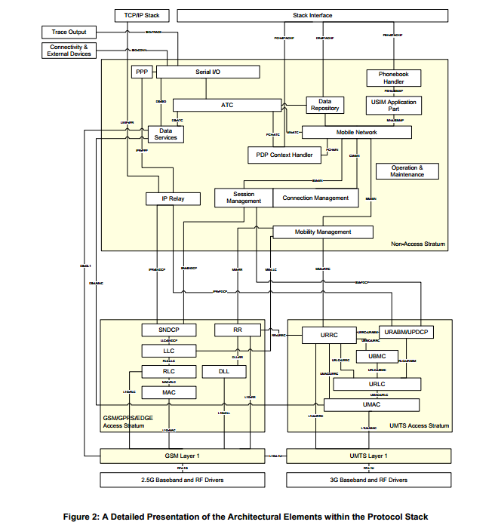

Slide 39
常用协议：
搜网策略：23122(正对GWL适用)
GSM,UMTS 的NAS层流程：24008(公共过程，专有过程)
LTE 的NAS层流程：24301(公共过程，专有过程)
层3信令消息：24007，
AT命令：27007，
USIM卡：21111，31102(IMSI, HHPLMN, LOC, RPLMN等)
短信：23040(RP-DATA,CP-DATA, CP-ACK)
WAP及彩信：29002，
GSM: 44018(RRC)，44060(MAC,RLC)，
UMTS: 25331(RRC)，25101(Frequency，band，arfcn)，25133，25304(RRC层idle和connected态，终端行为的描述)
LTE: 36331(RRC)，36101(Frequency，band，earfcn)，36133，36304(RRC层idle和connected态，终端行为的描述)
通信常见缩略语：21.905(从A到F的通信常见缩略语介绍)
GCF & PRCRB测试：51010(GSM) 34123(UMTS,LTE) 34124(卡)
VoLTE:
SRVCC: 23.216
RFC 3261 SIP
RFC 2327 SDP
协议下载网址：
www.etsi.org (pdf 版) www.3gpp.org(word版) www.3gpp2.org(CDMA, EVDO 协议) www.ietf.org(RFC协议)

Slide 40
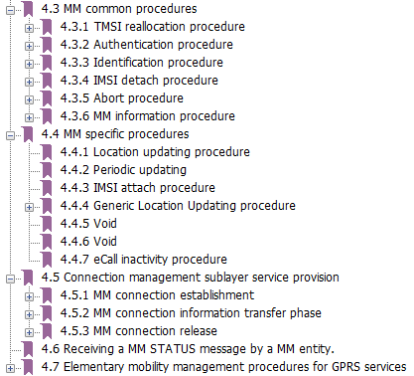
NAS层协议介绍： GSM UMTS部分（24008）：

Slide 41
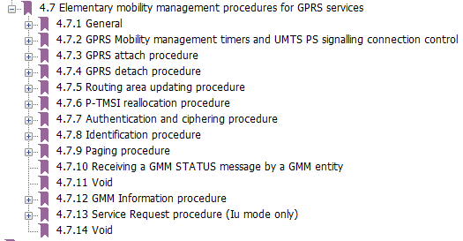

Slide 42
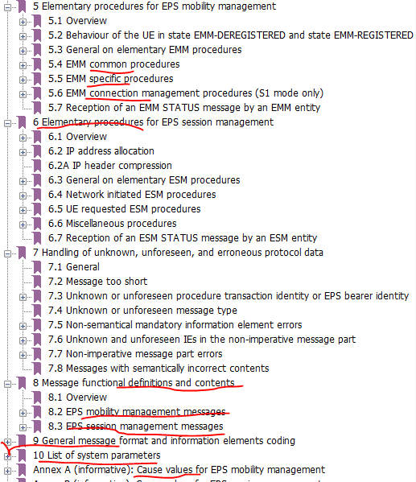

Slide 43
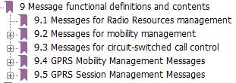
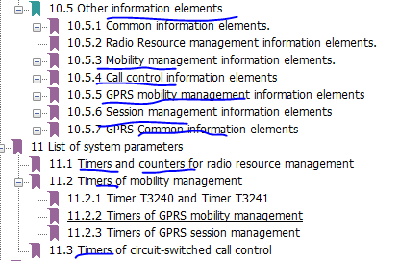

Slide 44
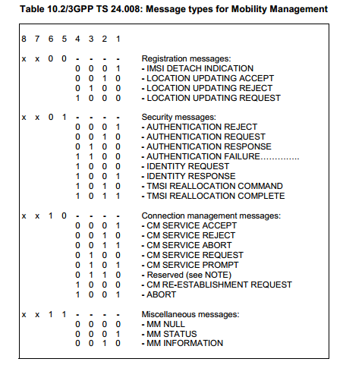
CS域消息移动性管理过程

Slide 45
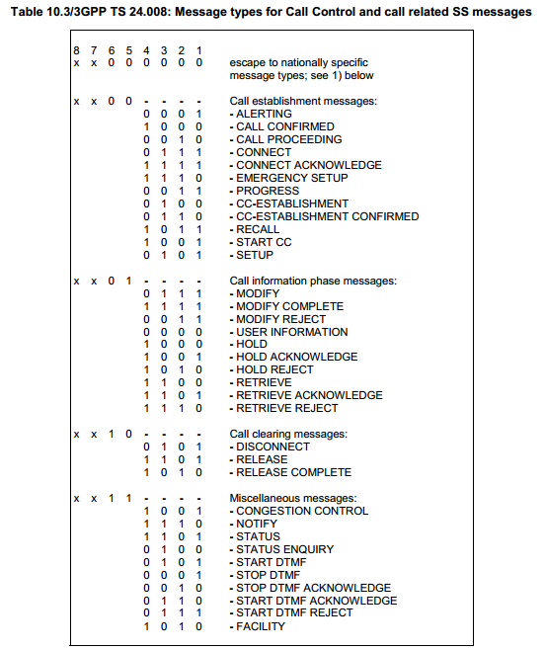
CS域业务管理过程

Slide 46
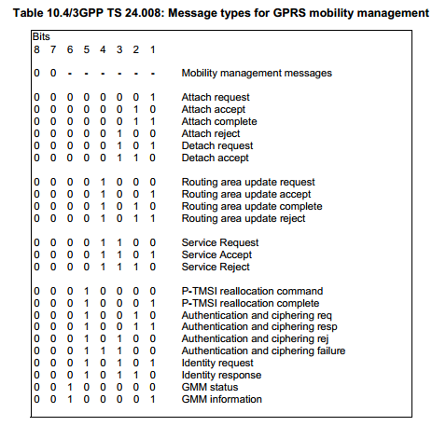
PS域消息移动性管理过程

Slide 47
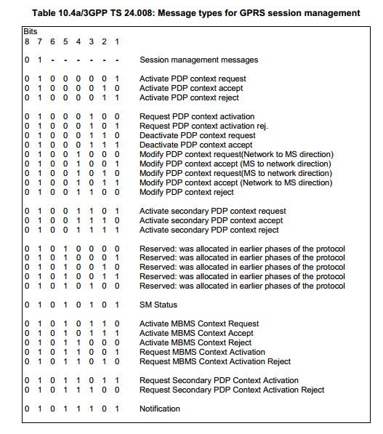
PS域业务管理过程

Slide 48
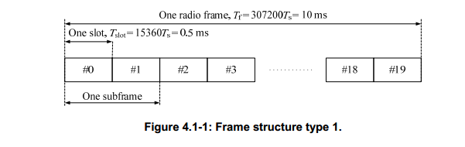
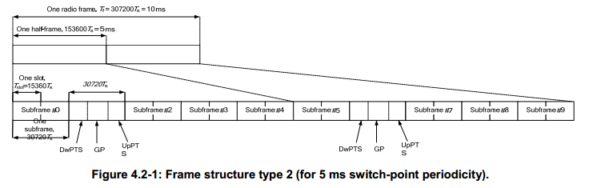
LTE(Long Term Evolution)

Slide 49
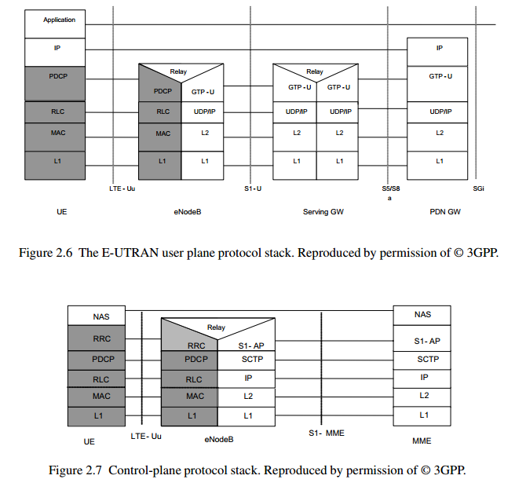

Slide 50
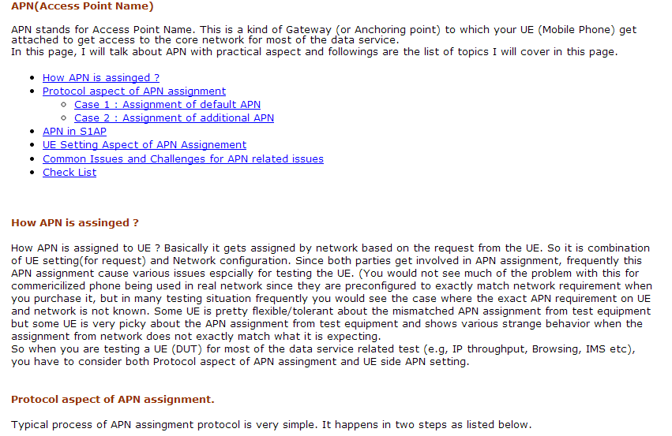

Slide 51
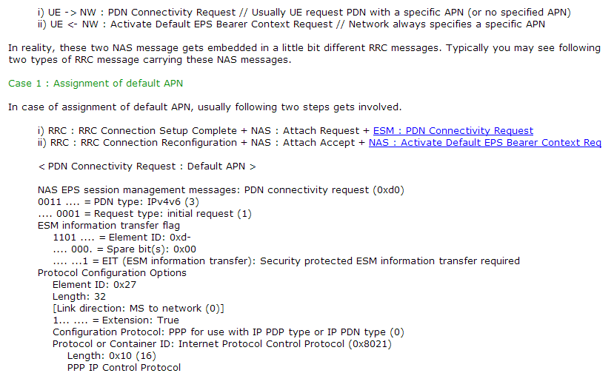

Slide 52


Slide 53


Slide 54


Slide 55


Slide 56


Slide 57


Slide 58


Slide 59


Slide 60


Slide 61


Slide 62


Slide 63


Slide 64


Slide 65



Slide 66

IRAT(Inter Radio Access Technology )

Slide 67

Architecture

Slide 68



Specialized message

Slide 69


