Slide 1
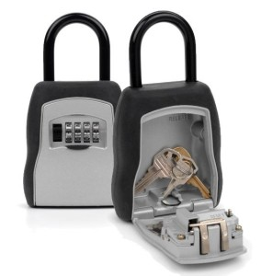
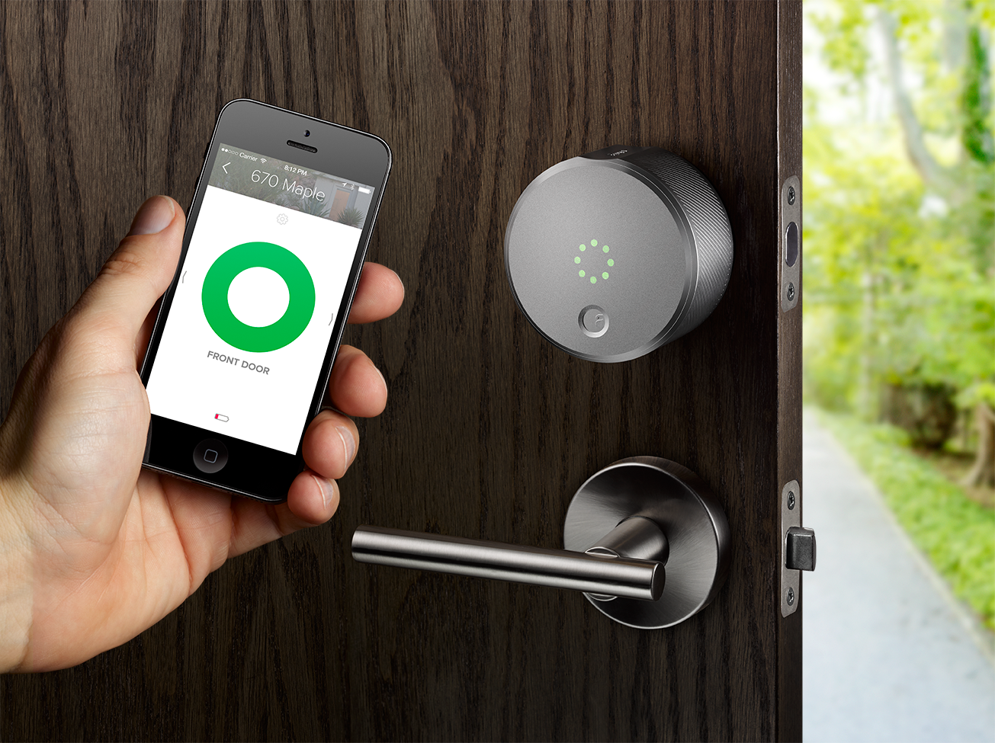
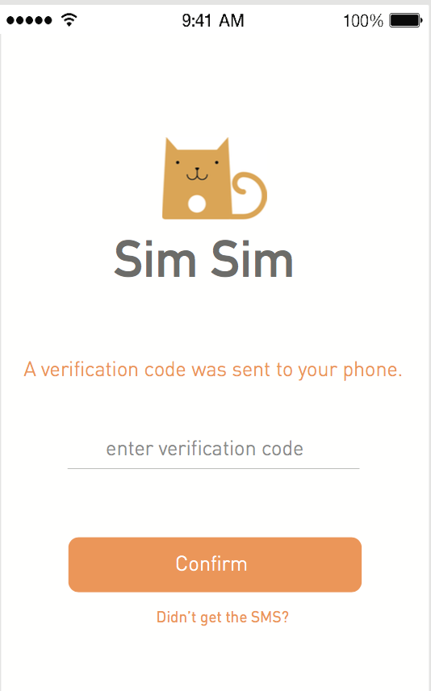
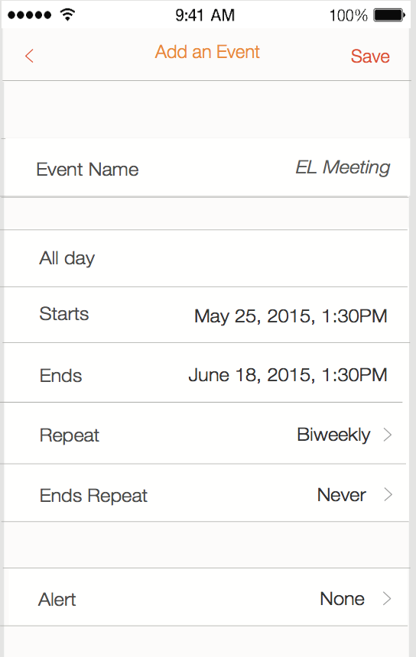
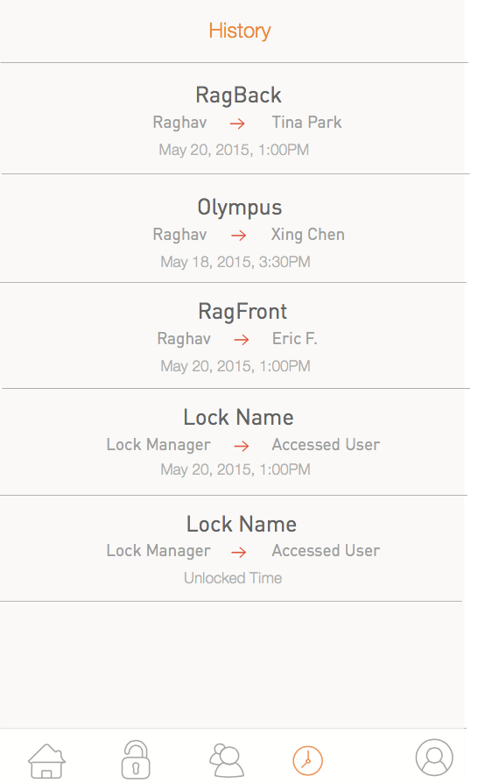
Smart Lock Android App Qiuge Zhang(qiugez) Shuaipeng Cao(shuaipec) Xiaokai Sun(xiaokais)
The idea
Michael went to San Francisco for travelling and live in an Airbnb. The host of the apartment was not at home and leave the key in the password lock box outside of the room. He called the host to ask the password to open the box. But he found it was very unsafe because the password of the lock box was not changed very often and somebody can get back sometime to get the key. This will threaten the safety of other’s Airbnb customers. And if the customer didn’t put the key back into the lock box, it will also cause a trouble for the host. So he was thinking if there is a better way to lock and unlock the door for the customer. Then he came out with an idea to use the mobile app to unlock the smart lock of the door. If the lock of the door is a smart lock and can get the signal of the mobile app by Bluetooth, and the access to the room can be granted to the user based the date, it would be a great idea. Accordingly, the host can buy a smart lock for his properties and register it through the mobile app using his phone number. Whenever a customer reserves the room, the host grants him the access of the lock. The access period is the same as the reservation period, which will expire when the reservation ends. Then the customer can’t come back after that. The safety now for both customers and hosts are better than before.
Traditional lock box
Smart lock & app
Challenges
When we hand the smart lock to the sales, it would be a challenge to convince the customers that the smart lock is safer. Customers may worry the lock would be hacked by somebody and get the access to their home.
There would be power issue. We the battery is not enough, the lock can’t be unlocked thoroughly which means it is still locked. A better way should be developed to watch the power of the battery and alert the users.
Hardware design would also be a challenge. How to make the lock box fix the actual door, how to customize it and how to install it would all be a problem for our real product.
If one property has more than one lock, it would be a trouble for our design because we assume one property has only one lock. In this case, we would need to change the database design from one-to-one to one-to-many relationship between property table and lock table.
Safety is the biggest problem of the lock. How to encode the password and maintain the server database securely would need to be concerned, since currently we keep everything in database without encryption.
Notable Features
Verification code concept is used.
After input primary phone number,
a verification code would be sent to the phone. Only if the input code matches the verification code, the user can be registered.
The most charming point of the smart lock app is the time period restriction. Only in the specified time period, the app can open the lock.
For every user, there is a history list which can show all of previous access history between host and guest.

