Slide 1
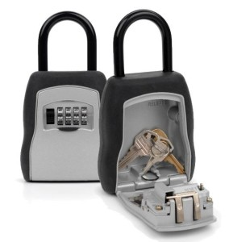
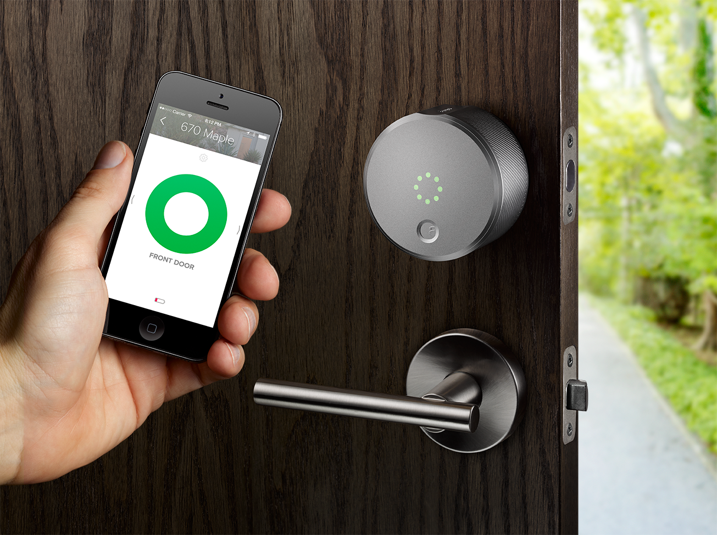
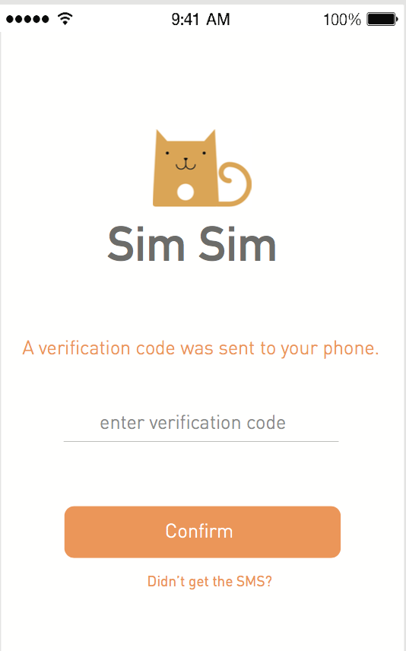
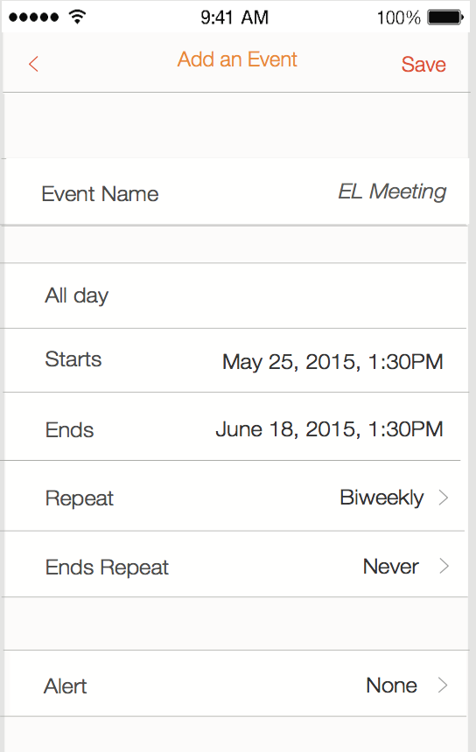
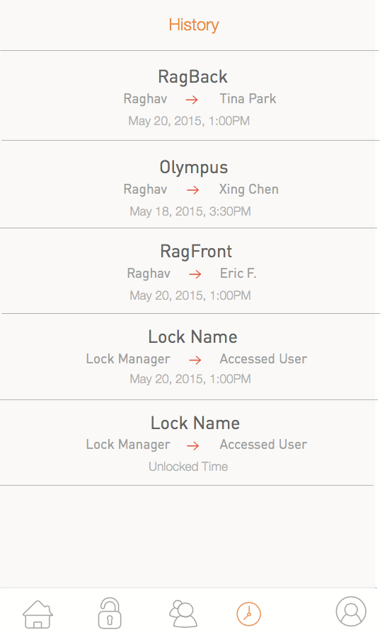
Smart Lock Android App Qiuge Zhang(qiugez) Shuaipeng Cao(shuaipec) Xiaokai Sun(xiaokais)
The idea
Michael went to San Francisco for travelling and live in an Airbnb. The host of the apartment was not at home and leave the key in the password lock box outside of the room. He called the host to ask the password to open the box. But he found it was very unsafe because the password of the lock box was not changed very often and somebody can get back sometime to get the key. This will threaten the safety of other’s Airbnb customers. And if the customer didn’t put the key back into the lock box, it will also cause a trouble for the host. So he was thinking if there is a better way to lock and unlock the door for the customer. Then he came out with an idea to use the mobile app to unlock the smart lock of the door. If the lock of the door is a smart lock and can get the signal of the mobile app by Bluetooth, and the access to the room can be granted to the user based the date, it would be a great idea. Accordingly, the host can buy a smart lock for his properties and register it through the mobile app using his phone number. Whenever a customer reserves the room, the host grants him the access of the lock. The access period is the same as the reservation period, which will expire when the reservation ends. Then the customer can’t come back after that. The safety now for both customers and hosts are better than before.
Traditional lock box
Smart lock & app
Challenges
1. UI design and Implementation. In order to achieve an user-friendly UI, we used many beautiful pictures, complex android widgets and so many adjustments of details of the UI. We also used relative layout in most cases to make sure that our app can be used in 2 different resolution device.
2. Implementations of OOD and OOP in our App. We applied the concepts of OOD and OOP into our project in purpose of making our project modularized. We divided the design of our project into different layers and used interfaces between different layers.
3. Designs of Database Schema and Server-Side Web project. There is a relatively much more complicated relationship between the entities. We have spent a lot of time on analyzing the relationships and processes of CRUD operations.
4. Since out team members are in different places and impossible to meet, it’s hard to us to unify our parts, especially at the beginning our design is very rough. Later we redesigned the whole project in much more detail,
then we can follow the design and unify the whole project together.
5. Our database uses one-to-one, one-to-many and many-to-many relationships. The design of the database is not polished until we got some problems as our development go further. This caused us to change some design.
Notable Features
Verification code concept is used.
After input primary phone number,
a verification code would be sent to the phone. Only if the input code matches the verification code, the user can be registered.
The most charming point of the smart lock app is the time period restriction. Only in the specified time period, the app can open the lock.
For every user, there is a history list which can show all of previous access history between host and guest.

