Slide 1
Week 3 Assignment
Xiaokuan Zhao

Slide 2
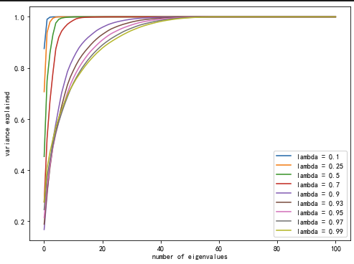
Problem 1
Step1: Calculate the covariance matrix using: covariance matrix = data.T@np.diag(Weight)@data
Step2: Using PCA to calculate the cumulative percentage of eigenvalue
Step3: Draw the graph

Slide 3
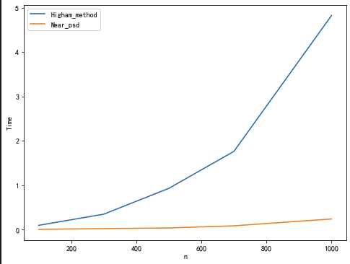
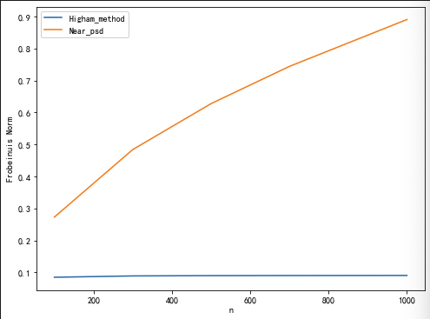
Problem 2
Computational Time Error term measured by Frobenious norm

Slide 4
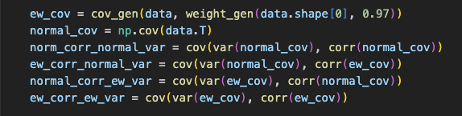
Problem 3 procedure
1. Generate exponentially weighted covariance matrix using the same way as in problem1
2. Using build-in function to generate four combinations:
3. Using PCA to filter eigenvalues and compute the result

Slide 5
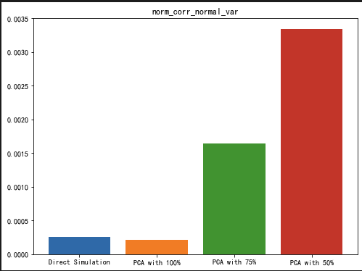
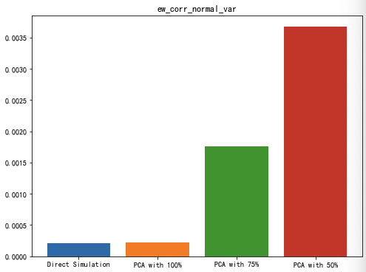

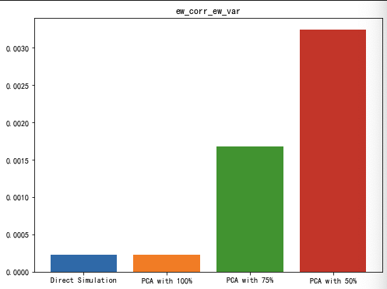
Problem 3 Distribution of Error Term

Slide 6
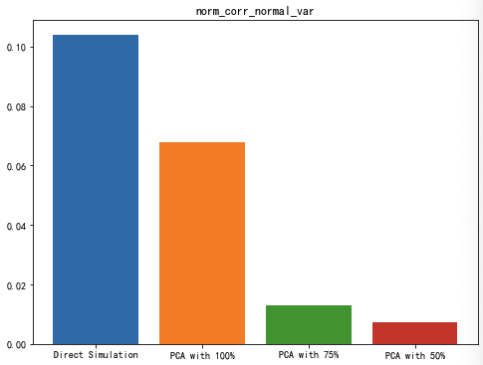
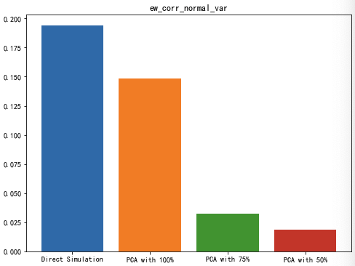
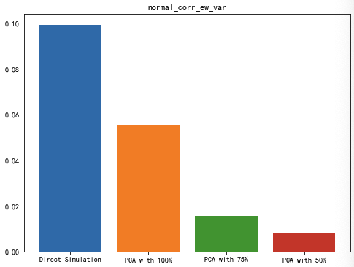
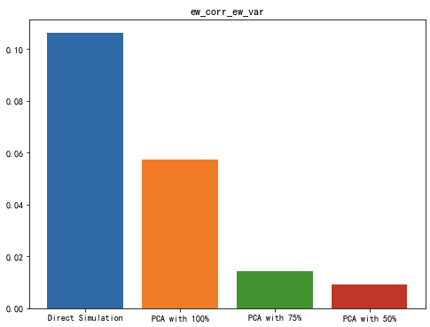
Problem 3 Distribution of Running Time

