Slide 1
Week 3 Assignment
Xiaokuan Zhao

Slide 2
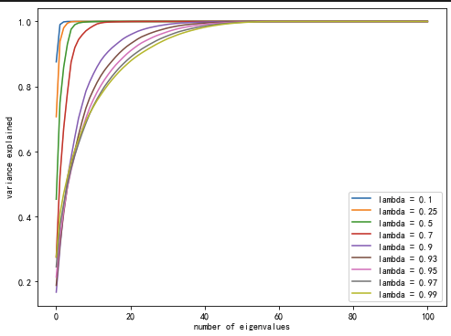
Problem 1
Step1: Calculate the covariance matrix using: covariance matrix = data.T@np.diag(Weight)@data
Step2: Using PCA to calculate the cumulative percentage of eigenvalue
Step3: Draw the graph

Slide 3
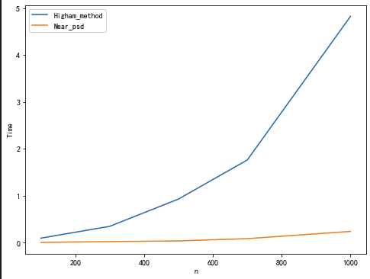
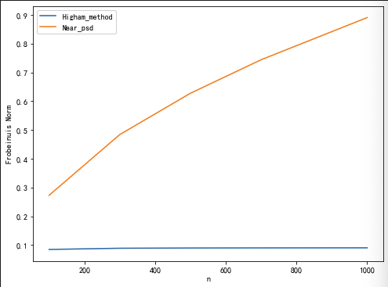
Problem 2
Computational Time Error term measured by Frobenious norm

Slide 4
Problem 3 procedure
Step 1. Generate exponentially weighted covariance matrix using the same way as in problem1
Step 2. Using build-in function to generate four combinations:
1) Generating exponentially weighted covariance metrix and normal covariance matrix
2) Then we use function var() and corr() to calculate covariance function
Step 3. Using PCA to filter eigenvalues and compute the result

Slide 5
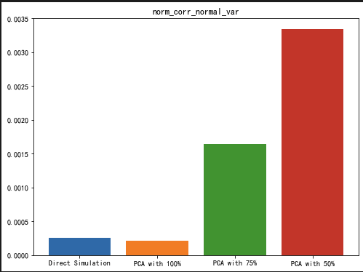
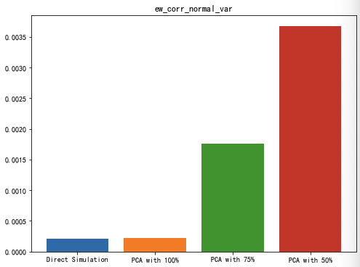

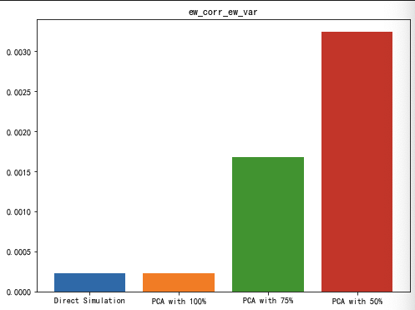
Problem 3 Distribution of Error Term

Slide 6
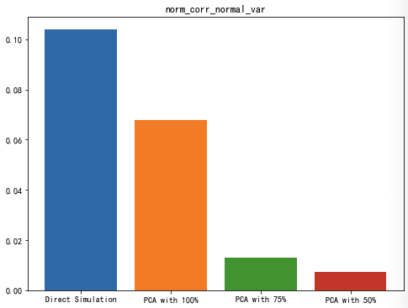
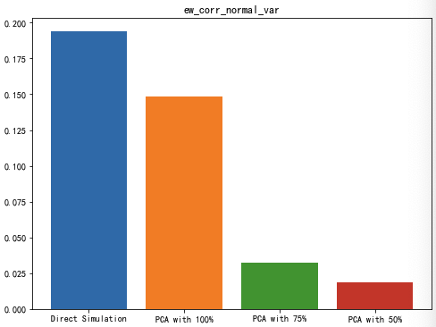
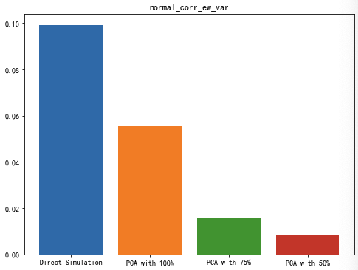
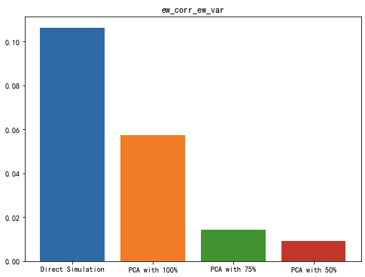
Problem 3 Distribution of Running Time

