Slide 1


Slide 2

15 Google地圖應用網站
15-1 認識Google API
15-2 在網頁上加入Google Maps

Slide 3
15-1 認識Google API
Google API就是Google提供給協力廠商或程式設計人員使用的函式或副程式，其種類繁多，大部分的Google服務都有對應的API可以呼叫，例如：
Google Maps API
Android
Google Calendar API
Google Toolbar API
YouTube API
Google Earth API
Google AJAX Search API

Slide 4
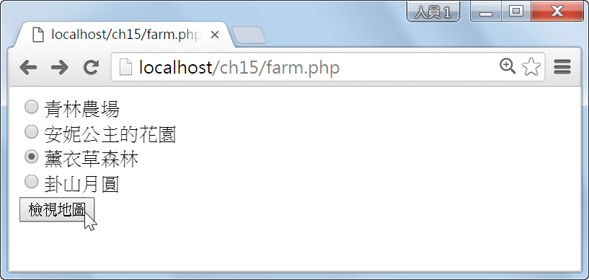
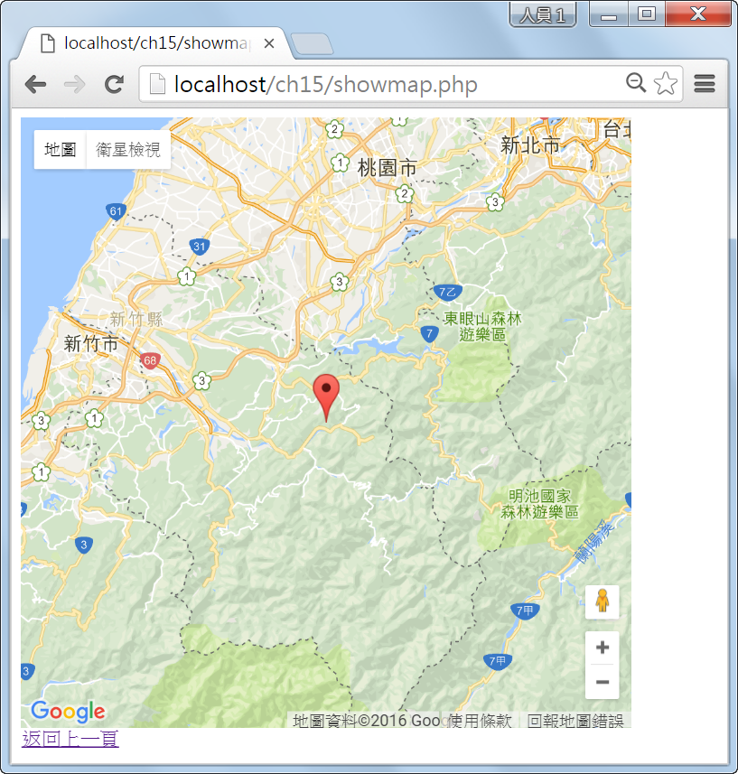
15-2 在網頁上加入Google Maps
在本節中，我們會以實際的例子說明如何使用Google Maps API將Google Maps加入網頁，其執行結果如下圖。

Slide 5
\ch15\farm.php
01:<!doctype html>
02:<html>
03: <head>
04: <meta charset="utf-8">
05: </head>
06: <body>
07: <?php
08: $farm_address=array('桃園縣觀音鄉大堀村大湖路二段131-1號',
09: '台中縣新社鄉中和村中興路233號',
10: '新竹縣尖石鄉嘉樂130號',
11: '彰化縣彰化市卦山路23號');
12: ?>
13: <form method="post" action="showmap.php">
14: <input type="radio" name="farm" value="<?php echo $farm_address[0]; ?>" checked> 青林農場<br>
15: <input type="radio" name="farm" value="<?php echo $farm_address[1]; ?>"> 安妮公主的花園<br>
16: <input type="radio" name="farm" value="<?php echo $farm_address[2]; ?>"> 薰衣草森林<br>
17: <input type="radio" name="farm" value="<?php echo $farm_address[3]; ?>"> 卦山月圓<br>
18: <input type="submit" value="檢視地圖">
19: </form>
20: </body>
21:</html>

Slide 6
\ch15\showmap.php (下頁續1/2)
01:<!doctype html>
02: <html>
03: <head>
04: <meta charset="utf-8">
05: <script type="text/javascript" src="http://maps.google.com/maps/api/js?sensor=false">
06: </script>
07: <script type="text/javascript">
08: var geocoder;
09: var map;
10:
11: function initialize()
12: {
13: geocoder = new google.maps.Geocoder();
14: var latlng = new google.maps.LatLng(0, 0);
15: var myOptions = {zoom:10, center:latlng, mapTypeId:google.maps.MapTypeId.ROADMAP};
16: map = new google.maps.Map(document.getElementById("map_canvas"), myOptions);
17: codeAddress();
18: }
19:
20: function codeAddress()
21: {
22: var address = document.getElementById("address").value;
23: if (geocoder)
24: {
25: geocoder.geocode({'address': address}, function(results, status)

Slide 7
\ch15\showmap.php (接上頁2/2)
26: {
27: if (status == google.maps.GeocoderStatus.OK)
28: {
29: map.setCenter(results[0].geometry.location);
30: var marker = new google.maps.Marker({map:map,position:results[0].geometry.location});
31: }
32: else
33: {
34: alert("檢視地圖失敗，原因在於：" + status);
35: }
36: });
37: }
38: }
39: </script>
40: </head>
41: <body onload="initialize()">
42: <input type="hidden" id="address" value="<?php echo $_POST["farm"]; ?>">
43: <div id="map_canvas" style="width:500px; height:500px;"></div>
44: <a href="farm.php">返回上一頁</a>
45: </body>
46:</html>

