Slide 1
php程式設計_HTTP Header處理
使用者認證

Slide 2
HTTP Authentication認證

Slide 3
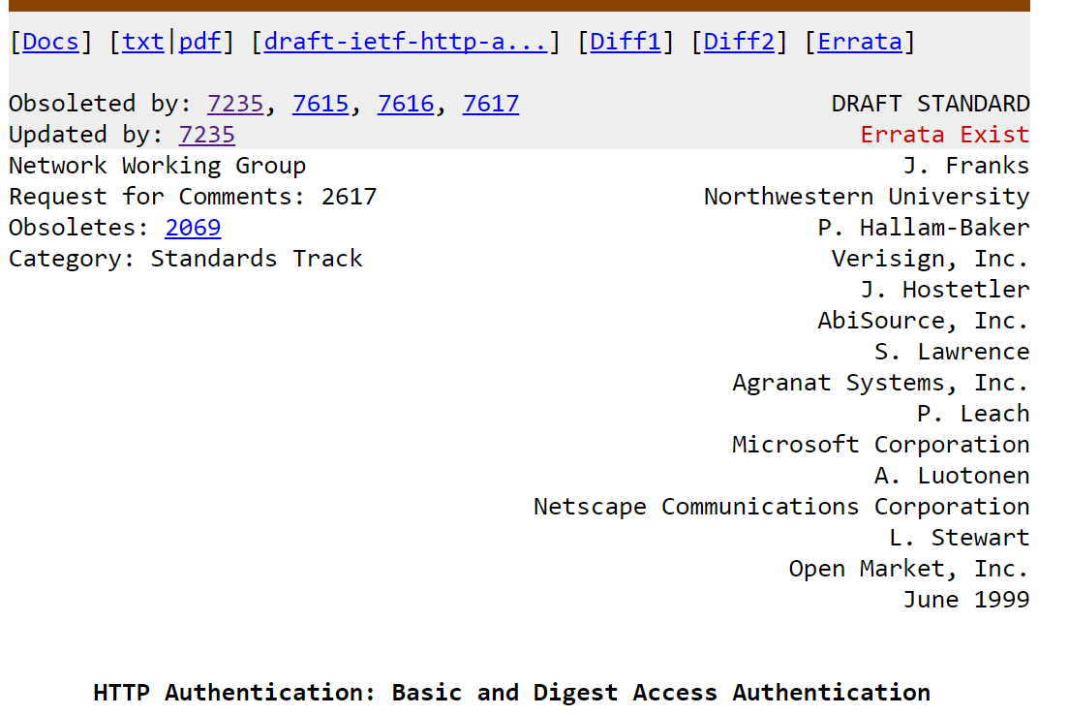
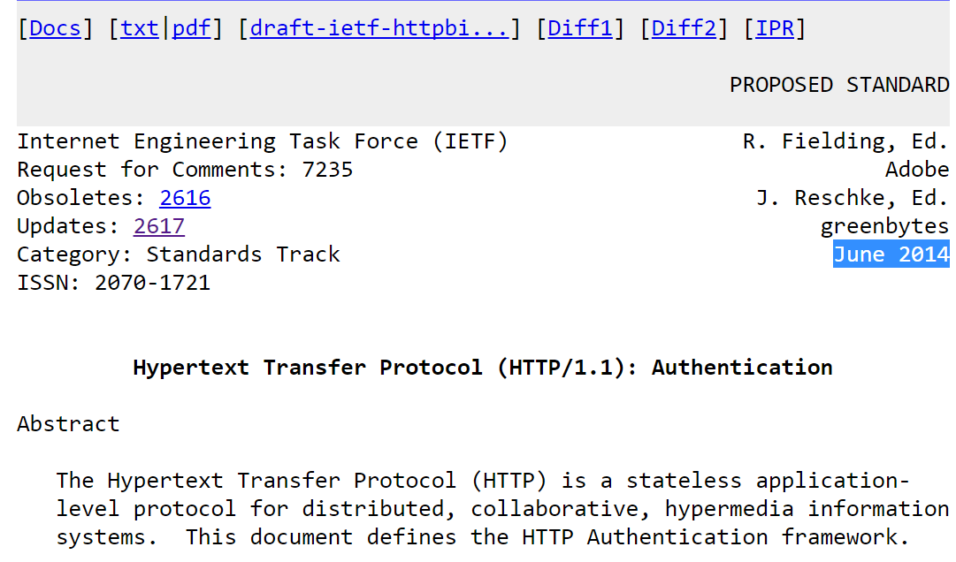
HTTP Authentication framework [RFC 2617|RFC7253]
Authentication is the process of identifying whether a client is eligible to access a resource.
RFC標準定義兩種認證機制: Basic Authentication vs Digest Access Authentication

Slide 4
除了標準的HTTP Authentication(黃底|本課程), WINDOWs還有自家的認證機制(淡綠底) https://docs.microsoft.com/en-us/dotnet/framework/wcf/feature-details/understanding-http-authentication
Authentication Scheme | Description
Anonymous | 匿名➔誰都可以存取 An anonymous request does not contain any authentication information. This is equivalent to granting everyone access to the resource.
Basic | Basic authentication sends a Base64-encoded string that contains a user name and password for the client. Base64 is not a form of encryption and should be considered the same as sending the user name and password in clear text. If a resource needs to be protected, strongly consider using an authentication scheme other than basic authentication.
Digest | Digest authentication is a challenge-response scheme that is intended to replace Basic authentication. The server sends a string of random data called a nonce to the client as a challenge. The client responds with a hash that includes the user name, password, and nonce, among additional information. The complexity this exchange introduces and the data hashing make it more difficult to steal and reuse the user's credentials with this authentication scheme. Digest authentication requires the use of Windows domain accounts. The digest realm is the Windows domain name. Therefore, you cannot use a server running on an operating system that does not support Windows domains, such as Windows XP Home Edition, with Digest authentication. Conversely, when the client runs on an operating system that does not support Windows domains, a domain account must be explicitly specified during the authentication.
NTLM | NT LAN Manager (NTLM) authentication is a challenge-response scheme that is a securer variation of Digest authentication. NTLM uses Windows credentials to transform the challenge data instead of the unencoded user name and password. NTLM authentication requires multiple exchanges between the client and server. The server and any intervening proxies must support persistent connections to successfully complete the authentication.
Negotiate | Negotiate authentication automatically selects between the Kerberos protocol and NTLM authentication, depending on availability. The Kerberos protocol is used if it is available; otherwise, NTLM is tried. Kerberos authentication significantly improves upon NTLM. Kerberos authentication is both faster than NTLM and allows the use of mutual authentication and delegation of credentials to remote machines.
Windows Live ID | The underlying Windows HTTP service includes authentication using federated protocols. However, the standard HTTP transports in WCF do not support the use of federated authentication schemes, such as Microsoft Windows Live ID. Support for this feature is currently available through the use of message security. For more information, see Federation and Issued Tokens.

Slide 5


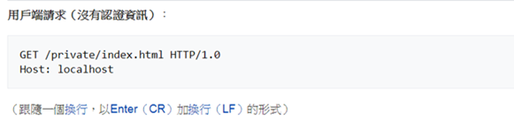

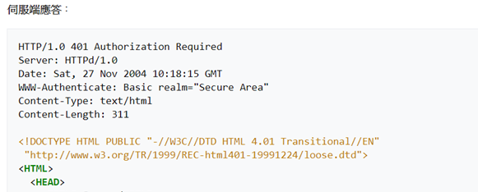
Basic access authentication https://zh.wikipedia.org/wiki/HTTP基本認證 中文版寫得比較好
客戶端程式(Client)
①
要有認證的
網站伺服器
Web Server
客戶端送出沒有認證資料的request
Client request (no authentication)
資料庫伺服器
Database Server
②
Server送出401回應➔ 告知客戶端沒有認證資料
使用WWW-Authenticate欄位
告知是Basic認證

Slide 6
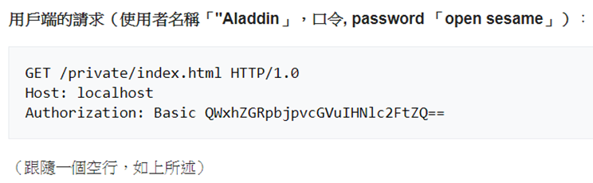
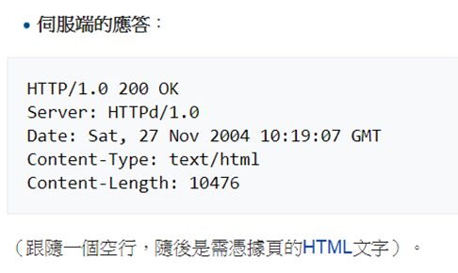
Basic access authentication https://zh.wikipedia.org/wiki/HTTP基本認證 中文版寫得比較好
客戶端程式(Client)
③
要有認證的
網站伺服器
Web Server
客戶端送出有認證資料的request
資料庫伺服器
Database Server
④
用戶端軟體會在原先的請求上增加認證訊息頭（值是base64encode(username+":"+password)）
你可以用python試試看
print "Aladdin:open sesame".encode("base64")
print "QWxhZGRpbjpvcGVuIHNlc2FtZQ==".decode("base64")

Slide 7
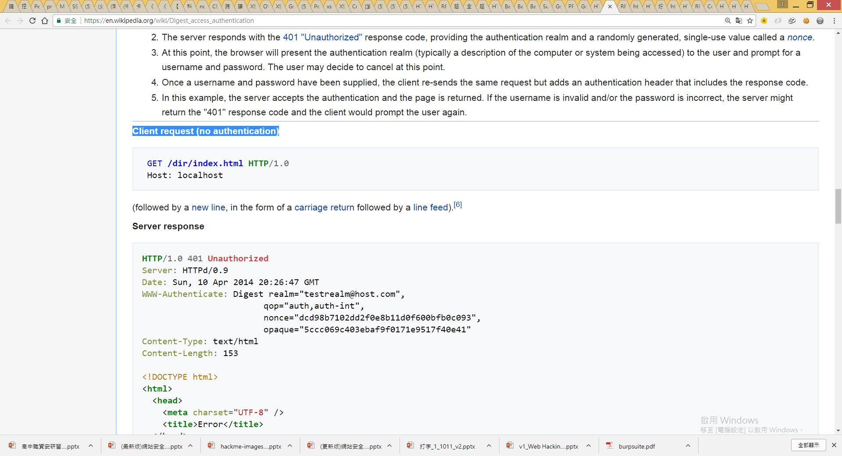
Digest access authentication https://en.wikipedia.org/wiki/Digest_access_authentication
客戶端程式(Client)
①
要有認證的
網站伺服器
Web Server
客戶端送出沒有認證資料的request
Client request (no authentication)
資料庫伺服器
Database Server
②
Server送出401回應➔ 告知客戶端沒有認證資料
使用WWW-Authenticate欄位
告知是Digest認證

Slide 8
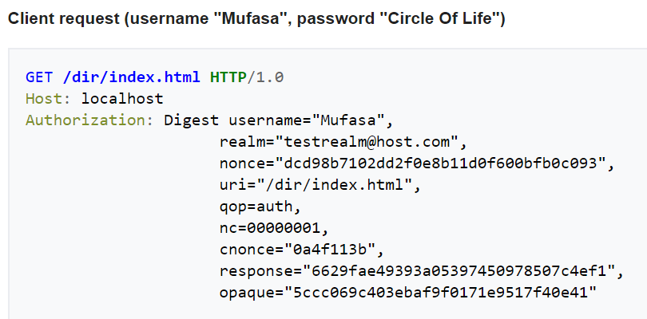
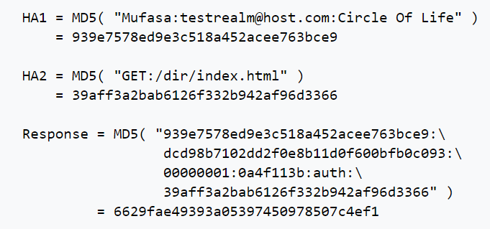
Digest access authentication https://en.wikipedia.org/wiki/Digest_access_authentication
③
客戶端送出有認證資料的request
客戶端程式(Client)
要有認證的
網站伺服器
Web Server
④
Digest===MD5
資料庫伺服器
Database Server
②
Server送出401回應➔
告知客戶端沒有認證資料

Slide 9
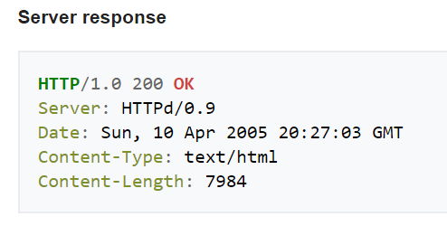
Digest access authentication https://en.wikipedia.org/wiki/Digest_access_authentication
③
客戶端送出有認證資料的request
客戶端程式(Client)
要有認證的
網站伺服器
Web Server
資料庫伺服器
Database Server
④

Slide 10
HTTP Authentication認證
使用header()

Slide 11
先講一下$_SERVER http://www.w3school.com.cn/php/php_superglobals.asp
超全域變數superglobals 在 PHP 4.1.0 中引入，是在全部作用域中始終可用的內置變數。
PHP 中的許多預定義變數[pre_define variable]都是“超全域的”
$_SERVER 這種超全域變數保存關於報頭、路徑和腳本位置的資訊
元素/代碼 | 描述
$_SERVER['PHP_SELF'] | 返回當前執行腳本的檔案名。
$_SERVER['SERVER_ADDR'] | 返回當前運行腳本所在的伺服器的 IP 地址。
$_SERVER['SERVER_NAME'] | 返回當前運行腳本所在的伺服器的主機名稱（比如 www.w3school.com.cn）。
$_SERVER['SERVER_SOFTWARE'] | 返回伺服器標識字串（比如 Apache/2.2.24）。
$_SERVER['SERVER_PROTOCOL'] | 返回請求頁面時通信協定的名稱和版本（例如，“HTTP/1.0”）。
$_SERVER['REQUEST_METHOD'] | 返回訪問頁面使用的請求方法（例如 POST）。
$_SERVER['REQUEST_TIME'] | 返回請求開始時的時間戳記（例如 1577687494）。
$_SERVER['QUERY_STRING'] | 返回查詢字串，如果是通過查詢字串訪問此頁面。
$_SERVER['HTTP_ACCEPT'] | 返回來自當前請求的請求頭。
$_SERVER['HTTP_ACCEPT_CHARSET'] | 返回來自當前請求的 Accept_Charset 頭（ 例如 utf-8,ISO-8859-1）
$_SERVER['HTTP_HOST'] | 返回來自當前請求的 Host 頭。
$_SERVER['HTTP_REFERER'] | 返回當前頁面的完整 URL（不可靠，因為不是所有使用者代理都支援）。

Slide 12
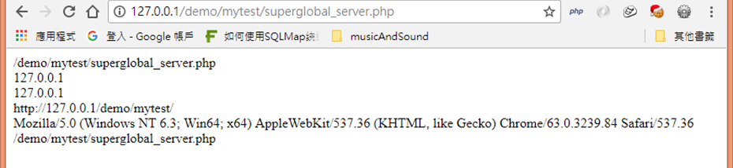
<?php
echo $_SERVER['PHP_SELF'];
echo "<br>";
echo $_SERVER['SERVER_NAME'];
echo "<br>";
echo $_SERVER['HTTP_HOST'];
echo "<br>";
echo $_SERVER['HTTP_REFERER'];
echo "<br>";
echo $_SERVER['HTTP_USER_AGENT'];
echo "<br>";
echo $_SERVER['SCRIPT_NAME'];
?>
superglobal_server.php

Slide 13
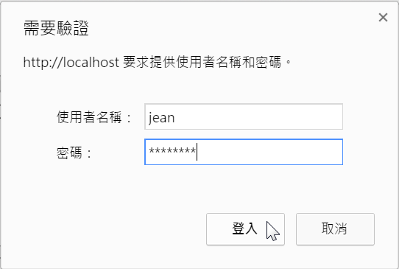
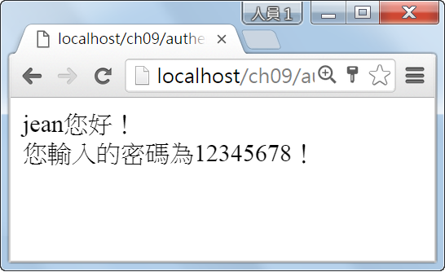
authen.php
01:<?php
02: header("Content-type: text/html; charset=utf-8");
03: if (!isset($_SERVER['PHP_AUTH_USER']))
04: {
05: header('WWW-Authenticate: Basic realm="快樂網站"');
06: echo "抱歉！您沒有輸入密碼！";
07: exit();
08: }
09: else
10: {
11: echo "{$_SERVER['PHP_AUTH_USER']}您好！<br>";
12: echo "您輸入的密碼為{$_SERVER['PHP_AUTH_PW']}！";
13: }
14:?>
$_SERVER['PHP_AUTH_USER'] #當 PHP 運行在 Apache 模塊方式下，並且正在使用 HTTP 認證功能，這個變量便是用戶輸入的用戶名。
$_SERVER['PHP_AUTH_PW'] #當 PHP 運行在 Apache 模塊方式下，並且正在使用 HTTP 認證功能，這個變量便是用戶輸入的密碼。
$_SERVER['AUTH_TYPE'] #當 PHP 運行在 Apache 模塊方式下，並且正在使用 HTTP 認證功能，這個變量便是認證的類型。

Slide 14
authen2.php
<?php
if (!isset($_SERVER['PHP_AUTH_USER'])) {
header('WWW-Authenticate: Basic realm="My Realm"');
header('HTTP/1.0 401 Unauthorized');
echo 'Text to send if user hits Cancel button';
exit;
} else {
echo "<p>Hello {$_SERVER['PHP_AUTH_USER']}.</p>";
echo "<p>You entered {$_SERVER['PHP_AUTH_PW']} as your password.</p>";
}
?>

