Slide 1
Linux常用指令
【網路】指令

Slide 2
Linux常用【網路】指令
ifconfig
指令 | 功能
hostname | {顯示|查看}本地主機名稱
ifconfig | {顯示|查看}本地ip地址
netstat | 顯示通訊協定統計資料和目前的TCP/IP網路連線
nslookup | 透過DNS查詢主機 Ip
dig | 透過DNS查詢主機 Ip
ping | 察看遠方主機是否暢通
traceroute | 追蹤連線路徑
wget | 以指定URL 地址下載文件．
ip | 強大的網路指令 iproute2
eth0: flags=4163<UP,BROADCAST,RUNNING,MULTICAST> mtu 1500
inet 192.168.2.113 netmask 255.255.255.0 broadcast 192.168.2.255
inet6 fe80::a00:27ff:feec:26e5 prefixlen 64 scopeid 0x20<link>
ether 08:00:27:ec:26:e5 txqueuelen 1000 (Ethernet)
RX packets 1535414 bytes 2103590819 (1.9 GiB)
RX errors 0 dropped 0 overruns 0 frame 0
TX packets 520786 bytes 154845019 (147.6 MiB)
TX errors 0 dropped 0 overruns 0 carrier 0 collisions 0
lo: flags=73<UP,LOOPBACK,RUNNING> mtu 65536
inet 127.0.0.1 netmask 255.0.0.0
inet6 ::1 prefixlen 128 scopeid 0x10<host>
loop txqueuelen 1 (Local Loopback)
RX packets 40391310 bytes 2029157274 (1.8 GiB)
RX errors 0 dropped 0 overruns 0 frame 0
TX packets 40391310 bytes 2029157274 (1.8 GiB)
TX errors 0 dropped 0 overruns 0 carrier 0 collisions 0
IP位址➔ inet 192.168.2.113
MAC位址(網路卡)➔ ether 08:00:27:ec:26:e5
Lo==localhost=127.0.0.1

Slide 3
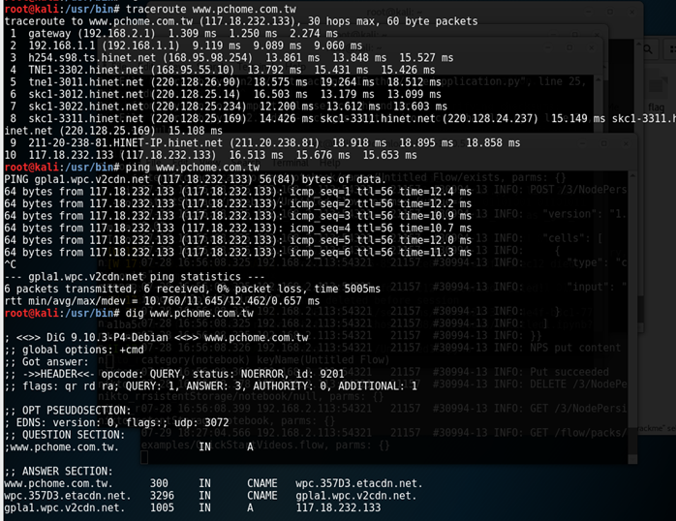
實作
練習
{ping|traceroute|dig} www.google.com
追蹤從你的機器到google要經過多少路由

Slide 4
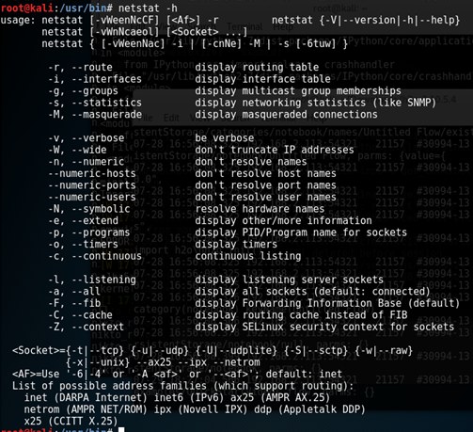
實作
練習
netstat -h
netstat -a
netstat -r
netstat -a | head

Slide 5
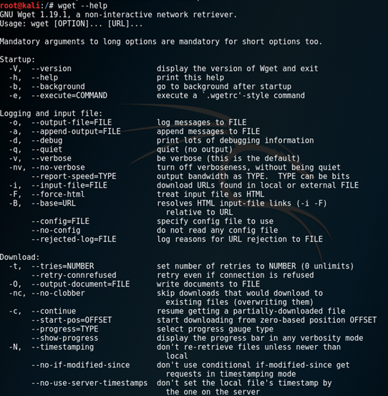
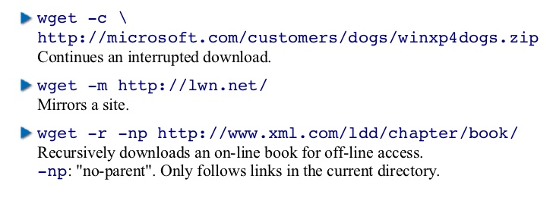
實作
練習
下載資料
wget天王

