Slide 1

Control Statements Loops
Copyright © 2020 Pearson Education Ltd. All Rights Reserved

Slide 2
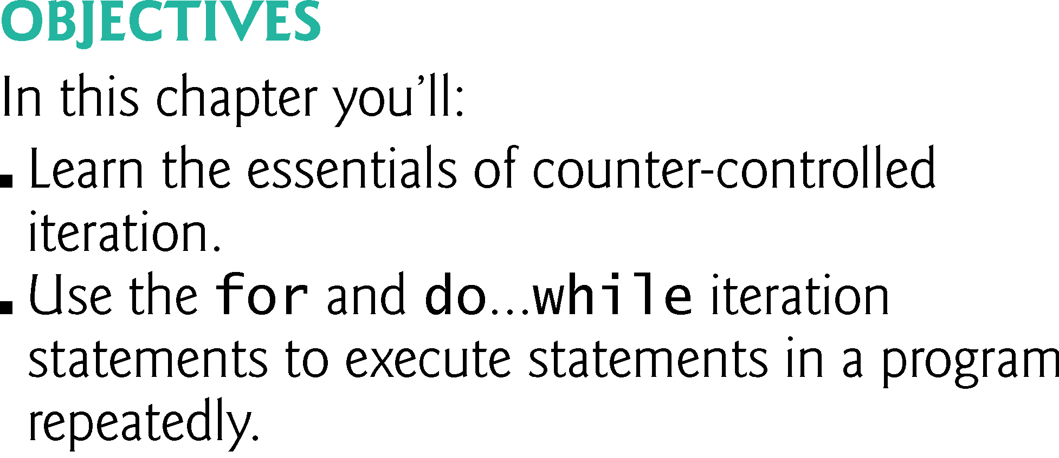
Copyright © 2020 Pearson Education Ltd. All Rights Reserved

Slide 3
41. Warm up java arrays
public class ArrayDemo {
public static void main(String[] args) {
int[] vorTabel = {5, 3, -2, 9, 0, -5, 10, 11, -7, 10};
for (int i = 0; i < vorTabel.length; i++) {
System.out.println(vorTabel[i]);
}
}
}

Slide 4
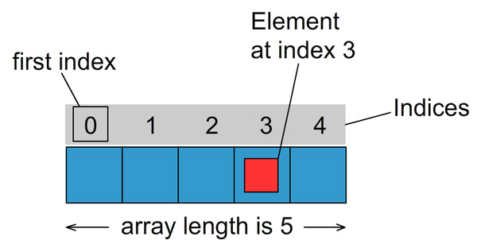
Arrays index and Array length

Slide 5
Counter-controlled iteration requires
  a control variable (or loop counter)
  the initial value of the control variable
  the increment by which the control variable is modified each time through the loop (also known as each iteration of the loop)
  the loop-continuation condition that determines if looping should continue.
Copyright © 2020 Pearson Education Ltd. All Rights Reserved

Slide 6
for iteration statement
  Specifies the counter-controlled-iteration details in a single line of code.
  Figure 4.2 reimplements the application of Fig. 4.1 using for.

Slide 7
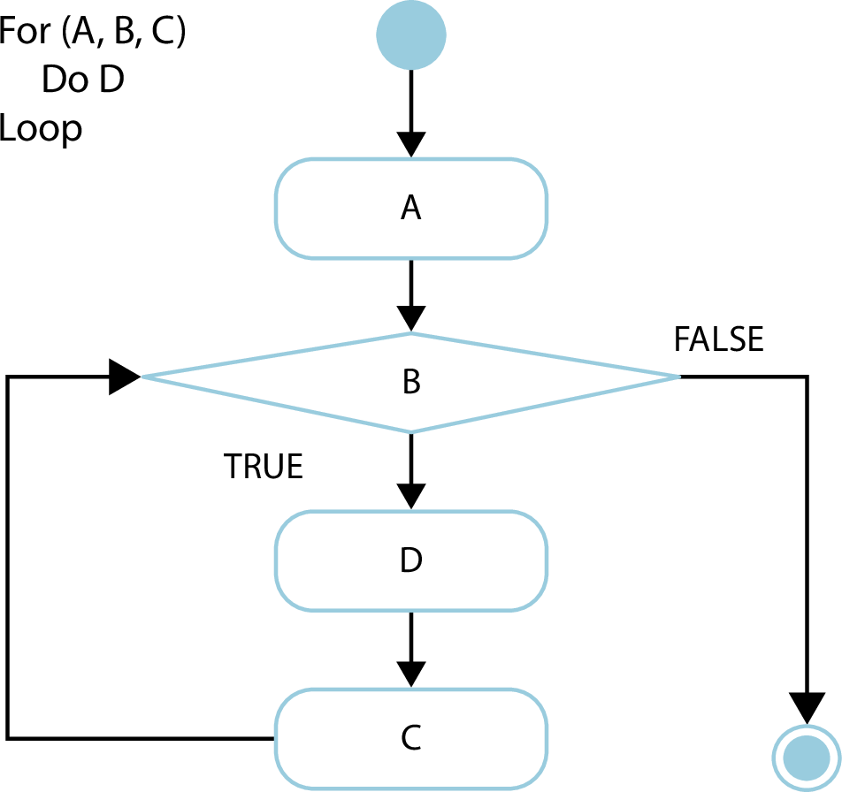

Slide 8
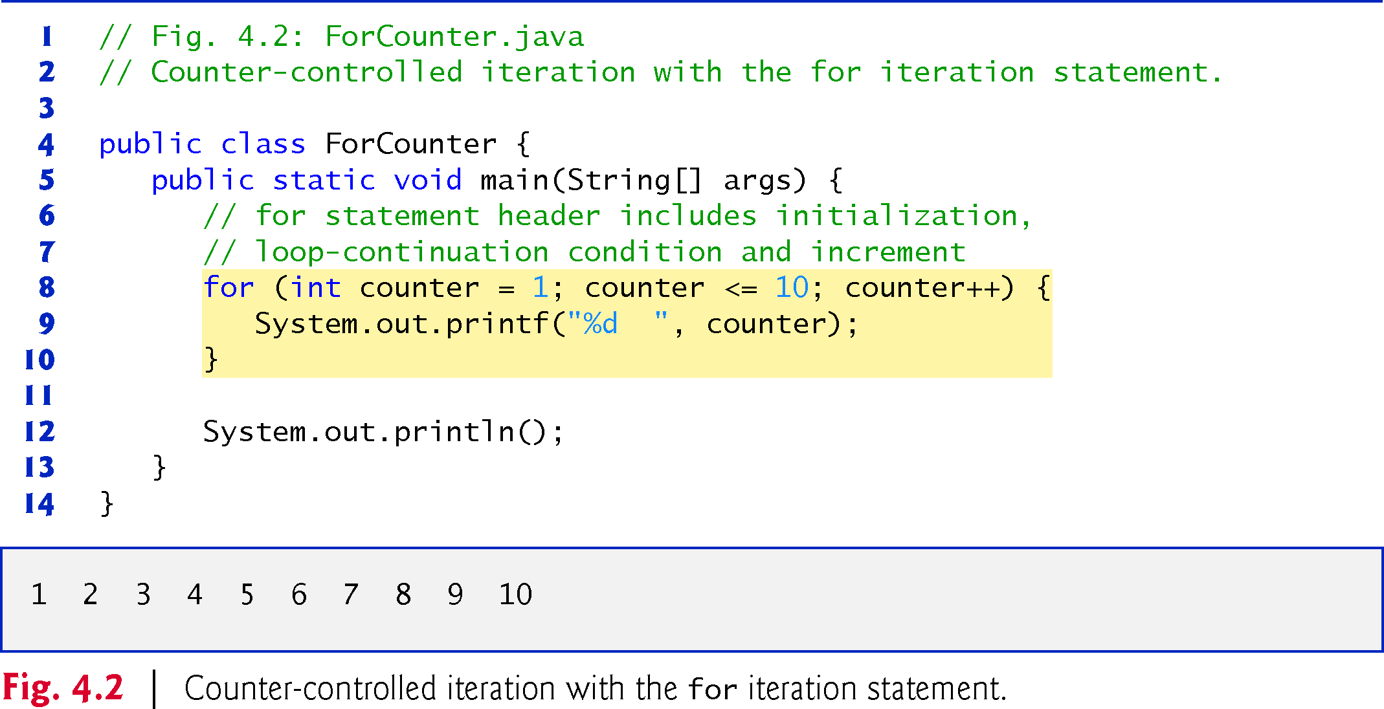
For1.java
Copyright © 2020 Pearson Education Ltd. All Rights Reserved

Slide 9
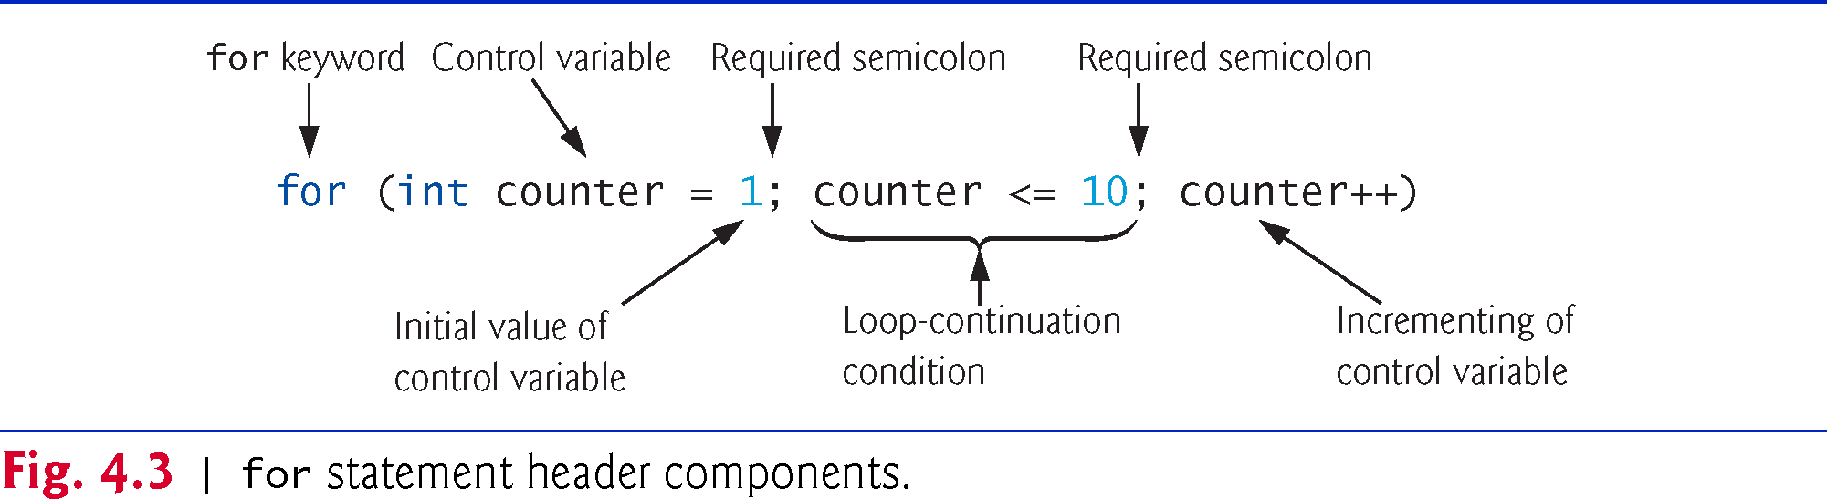
Copyright © 2020 Pearson Education Ltd. All Rights Reserved

Slide 10
The general format of the for statement is
for (initialization; loopContinuationCondition; increment) statement

The two semicolons in the for header are required.

Slide 11
a)Vary the control variable from 1 to 100 in increments of 1.
for (int i = 1; i <= 100; i++)
b)Vary the control variable from 100 to 1 in decrements of 1.
for (int i = 100; i >= 1; i--)
c)Vary the control variable from 7 to 77 in increments of 7.
for (int i = 7; i <= 77; i += 7)

Slide 12
d)Vary the control variable from 20 to 2 in decrements of 2.
for (int i = 20; i >= 2; i -= 2)
e)Vary the control variable over the values 2, 5, 8, 11, 14, 17, 20.
for (int i = 2; i <= 20; i += 3)
f)Vary the control variable over the values 99, 88, 77, 66, 55, 44, 33, 22, 11, 0.
for (int i = 99; i >= 0; i -= 11)

Slide 13
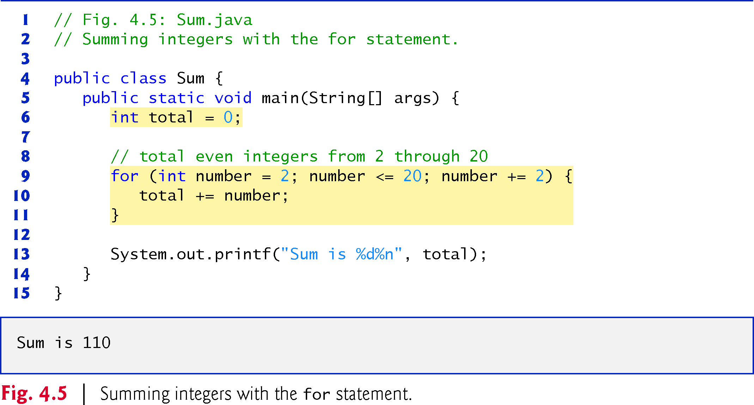
For2.java
Copyright © 2020 Pearson Education Ltd. All Rights Reserved

Slide 14
Compound interest application
A person invests $1,000 in a savings account yielding 5% interest. Assuming that all the interest is left on deposit, calculate and print the amount of money in the account at the end of each year for 10 years. Use the following formula to determine the amounts:
a = p (1 + r)^{n}
where
p is the original amount invested (i.e., the principal) r is the annual interest rate (e.g., use 0.05 for 5%)
n is the number of years
a is the amount on deposit at the end of the nth year.

Slide 15
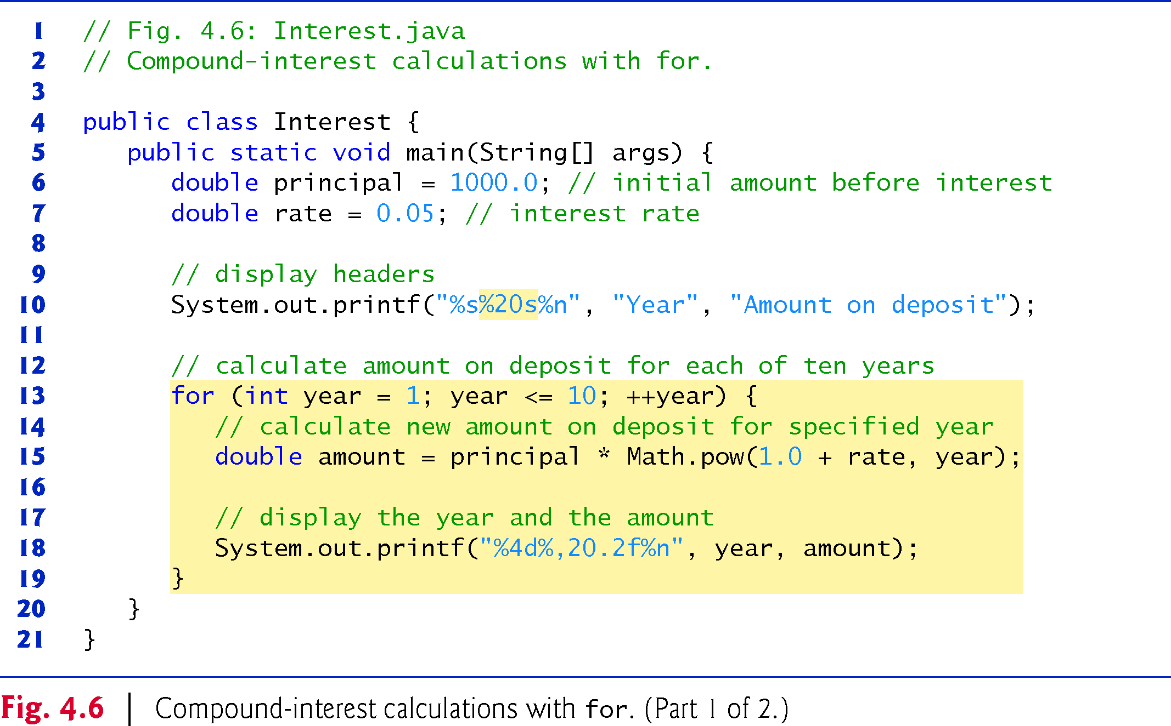
For3.java
Copyright © 2020 Pearson Education Ltd. All Rights Reserved

Slide 16
Exercise with For and break
Test with debug tools in Vscode
DocJava 5.1-5.4

Slide 17
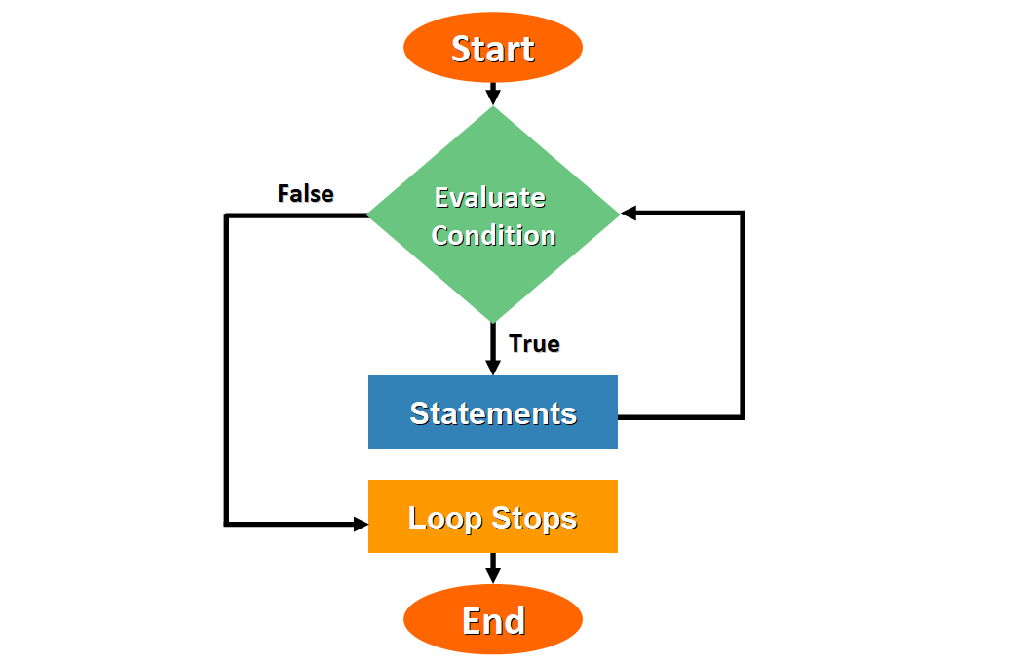
int tal;
while (true) {
System.out.println("Indtast tal:");
tal = Integer.parseInt(indlæser.readLine());
if (tal == 0) {
break;
}
System.out.println("Du indtastede: " + tal);
}

Slide 18
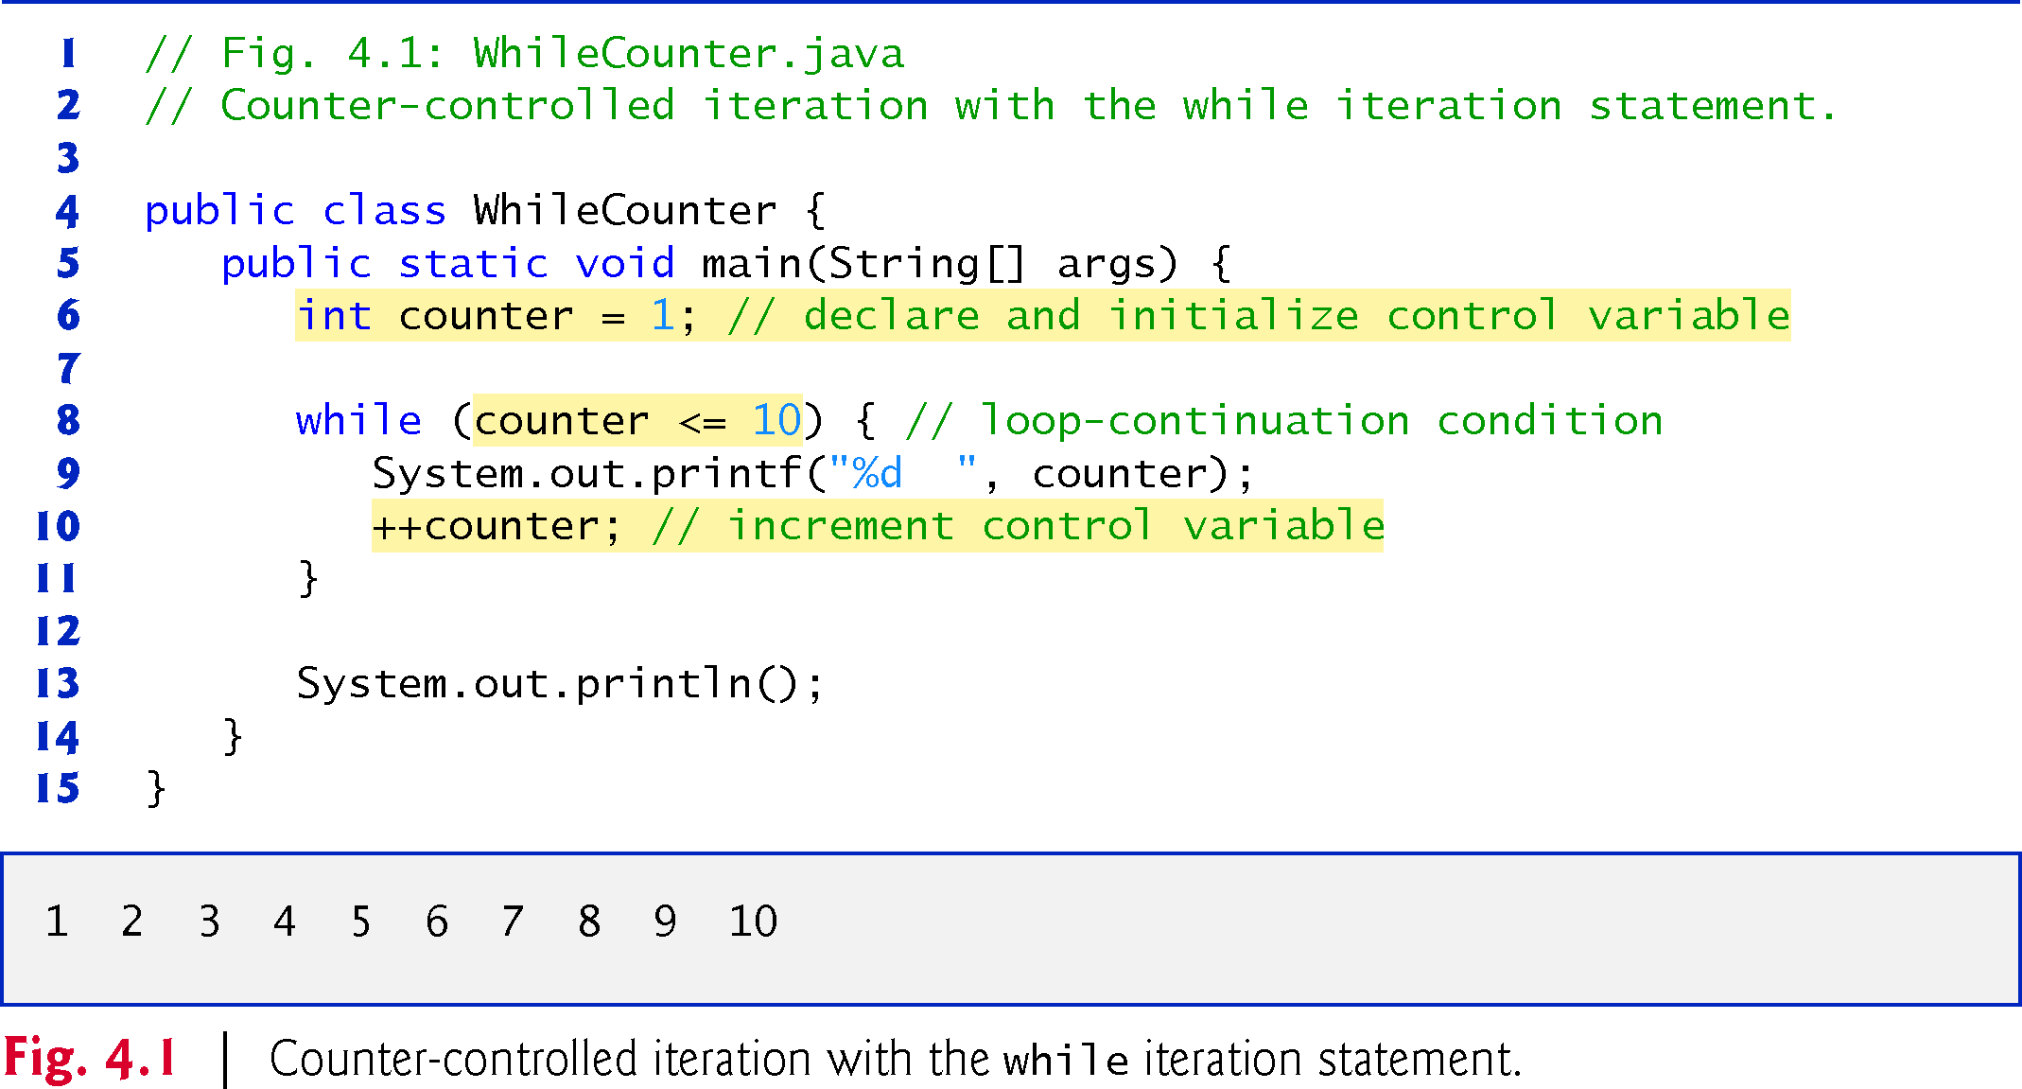
Copyright © 2020 Pearson Education Ltd. All Rights Reserved
Notes:
Try while couter in intelli J- refactor while (true) {
if (counter >= 10) break;
System.out.println(counter);
// update expression
counter++;
}

Slide 19
The do…while iteration statement is similar to the while statement.
In the while, the program tests the loop-continuation condition at the beginning of the loop,
before executing the loop’s body; if the condition is false, the body never executes.
The do…while statement tests the loop-continuation condition after executing the loop’s body;
therefore, the body always executes at least once.
Copyright © 2020 Pearson Education Ltd. All Rights Reserved

Slide 20
Thus, the do…while statement with one body statement is usually written as follows:
  do
{
statement
} while (condition);

Slide 21
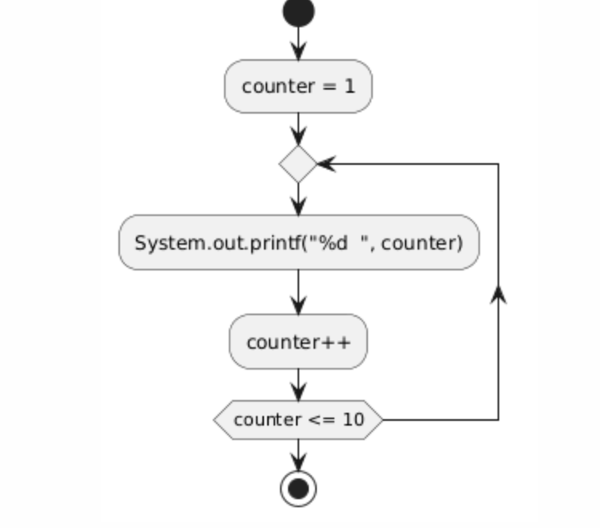
Copyright © 2020 Pearson Education Ltd. All Rights Reserved

Slide 22
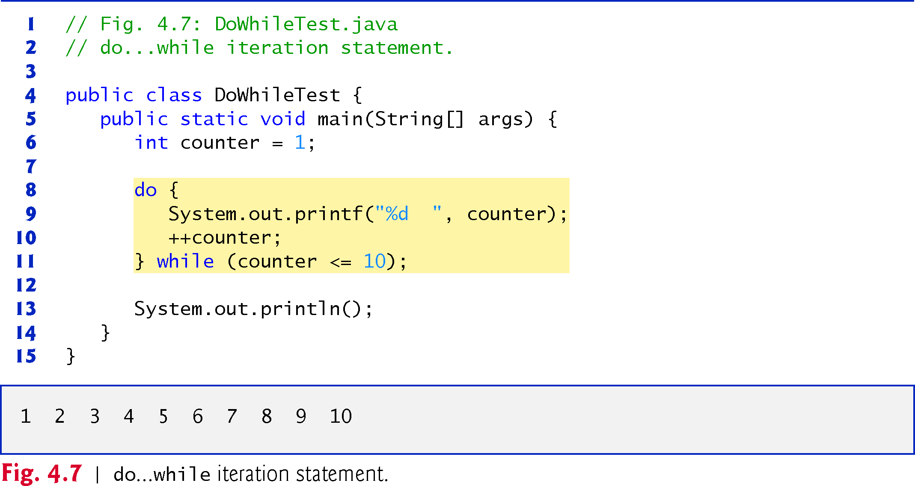
While4.java
Copyright © 2020 Pearson Education Ltd. All Rights Reserved
Notes:
In normal while System.out.printf("%d ", counter);
counter++;
while (counter <= 10) {
System.out.printf("%d ", counter);
counter++;
} // end do...while

Slide 23

Important distinction
A counter-controlled loop usually stops because a condition becomes false:
while (i < 10)
A sentinel-controlled loop stops when the user/program gives a special value:
while (number != -1)

Slide 24
import java.io.BufferedReader;
import java.io.InputStreamReader;
public class Sentinel {
public static void main(String[] args) throws Exception {
BufferedReader indlæser =
new BufferedReader(new InputStreamReader(System.in));
int sum = 0;
int tal;
do {
System.out.println("Indtast tal: ");
tal = Integer.parseInt(indlæser.readLine());
sum += tal;
} while (tal != 0);
System.out.println("Summen er " + sum);
}
}

