Slide 1

Control Statements Loops –part I
Copyright © 2020 Pearson Education Ltd. All Rights Reserved

Slide 2
AGENDA
Now we are in Part I
Three building blocks — in the order you'll use them.
1
2
3
Arrays
The for statement
The while statement
Declaring, indexing, and measuring the length of a table of data.
Counter-controlled iteration, written as one compact header.
The general-purpose loop that for is built on top of.
Part II will cover multi-dimensional arrays, ArrayList, do-while, break & continue.
2 / 14

Slide 3
4. 1 · ARRAYS
An array groups values of the same type into one table-like structure.
vorTabel[3] → 9
5
3
-2
9
0
-5
10
11
-7
10
Each slot is called an element.
0
1
2
3
4
5
6
7
8
9
Every element has a position, its index.
index
Indices run from 0 to length − 1.
length = 10 (largest index = 9)
The size is fixed once the array is created.
Danish courses often use "tabel" as a synonym for array.
3 / 14

Slide 4
Declaring and initializing an array
Allocating without values
int[] vorTabel = {
5, 3, -2, 9, 0, -5, 10, 11, -7, 10
};
int[] vorTabel = new int[10];
Creates 10 slots, each defaulting to 0 — then fill them one by one:
int[]
element type, followed by [ ]
vorTabel
the array's name
vorTabel[0] = 5;
vorTabel[1] = 3;
vorTabel[2] = -2;
// ... and so on
{ ... }
an initializer list — comma-separated values
An initializer list can only be used at the moment of declaration.
An array's size is fixed at allocation — this is its static property.
4 / 14

Slide 5
Reading the array's length
Never hard-code the size of an array. Ask the array itself with .length — then your loops still work if the array's size ever changes.
System.out.println(vorTabel.length);
OUTPUT
10
5 / 14

Slide 6
. Print java array
public class ArrayDemo {
public static void main(String[] args) {
int[] vorTabel = {5, 3, -2, 9, 0, -5, 10, 11, -7, 10};
for (int i = 0; i < vorTabel.length; i++) {
System.out.println(vorTabel[i]);
}
}
}

Slide 7
4. 2 For
Counter-controlled iteration
1
Control variable
2
Initial value
a variable that tracks progress through the loop
what the control variable starts at
3
Increment
Continuation condition
how much it changes on each iteration
6 / 14

Slide 8
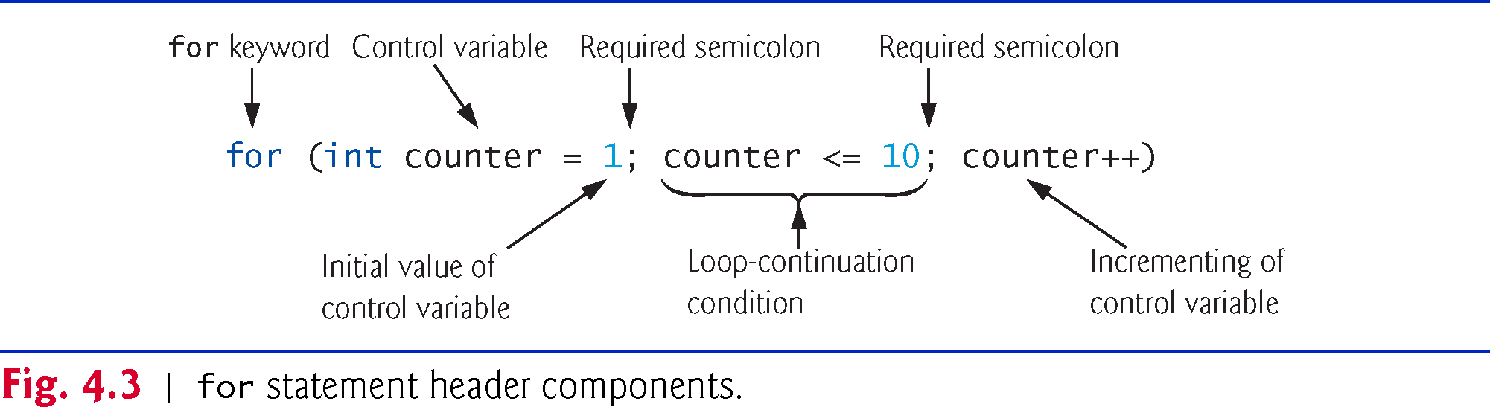
Copyright © 2020 Pearson Education Ltd. All Rights Reserved

Slide 9
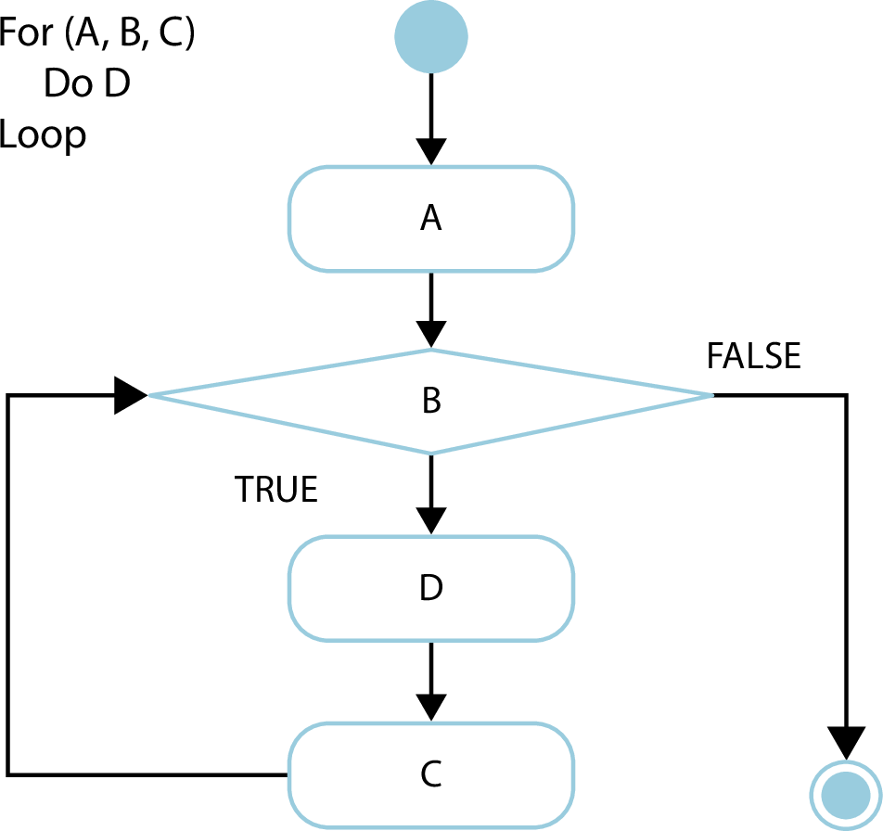

Slide 10
for (initialization;
loopContinuationCondition;
increment)
statement

Slide 11
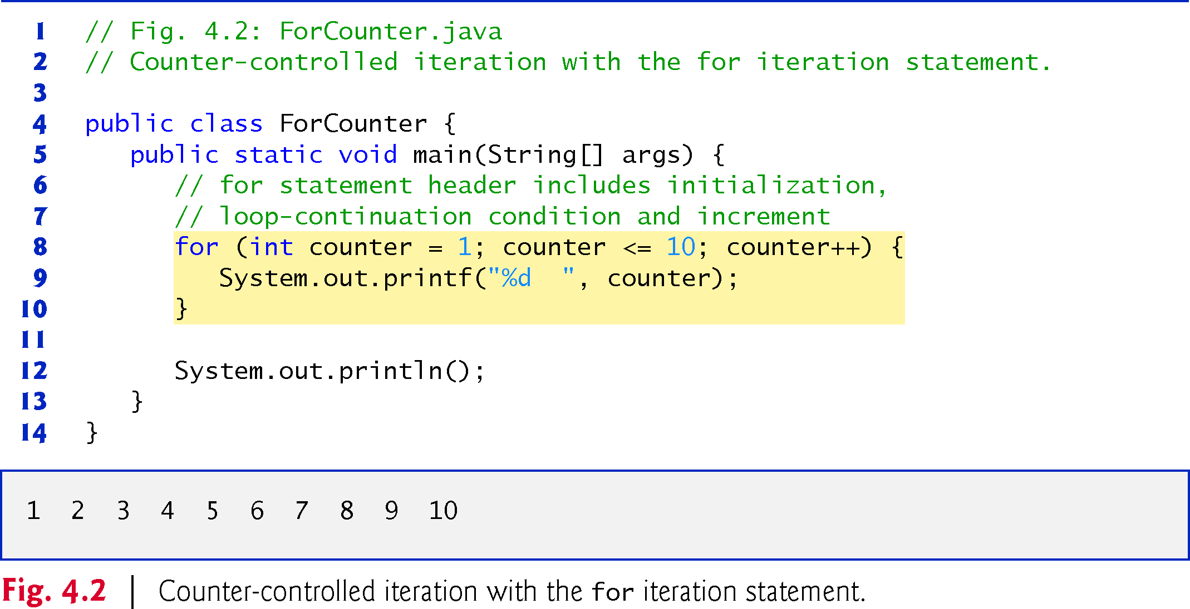
For1.java
Copyright © 2020 Pearson Education Ltd. All Rights Reserved
Notes:
%dInteger
%fFloating-point
%sString"Hello"
%cCharacter'A'
%bBooleantrue
%nNew line—

Slide 12
4. 3 Scope of the for-loop counter variable
for (int i = 0; i < 5; i++) {
System.out.println(i);
}
System.out.println(i); // ERROR

Slide 13
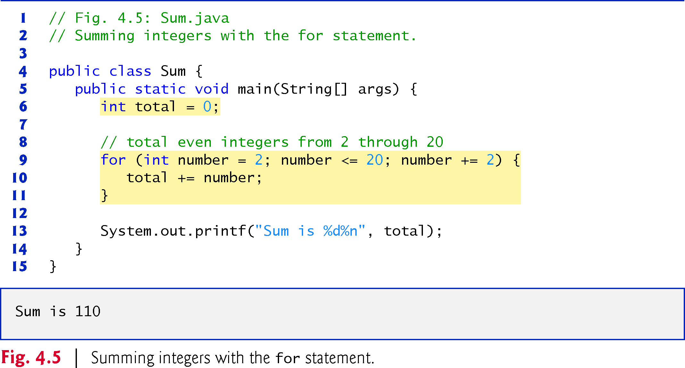
For2.java
Copyright © 2020 Pearson Education Ltd. All Rights Reserved

Slide 14
Compound interest application
Use the following formula to determine the amounts:
a = p (1 + r)^{n}
where
p is the original amount invested (i.e., the principal) r is the annual interest rate (e.g., use 0.05 for 5%)
n is the number of years
a is the amount on deposit at the end of the nth year.

Slide 15
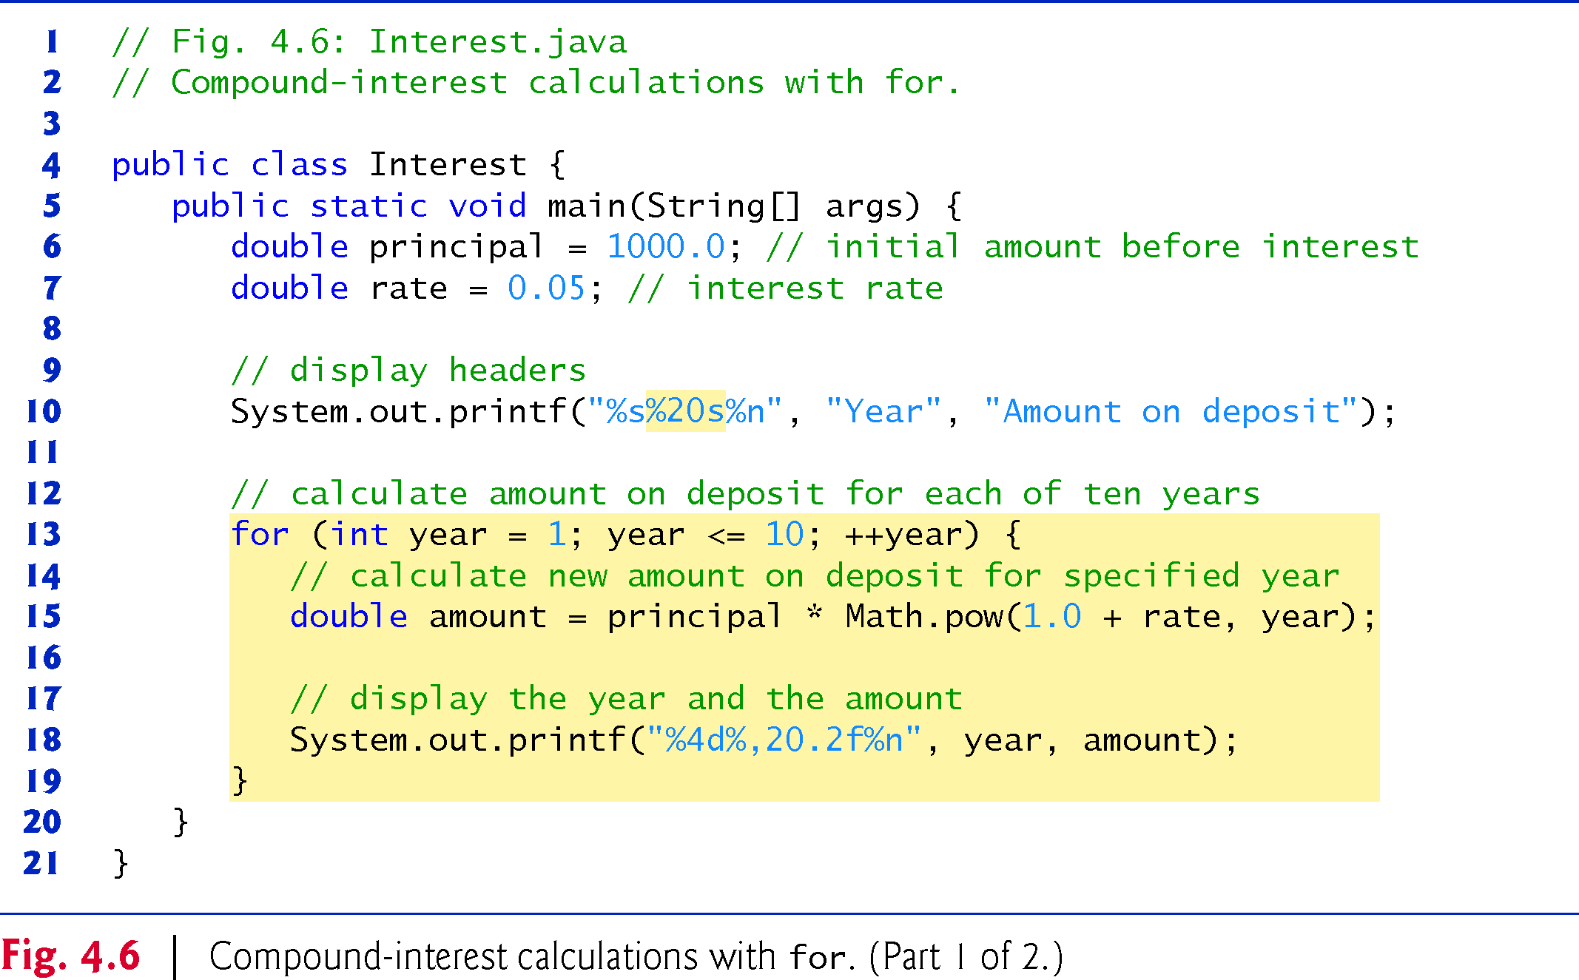
For3.java
Copyright © 2020 Pearson Education Ltd. All Rights Reserved

Slide 16
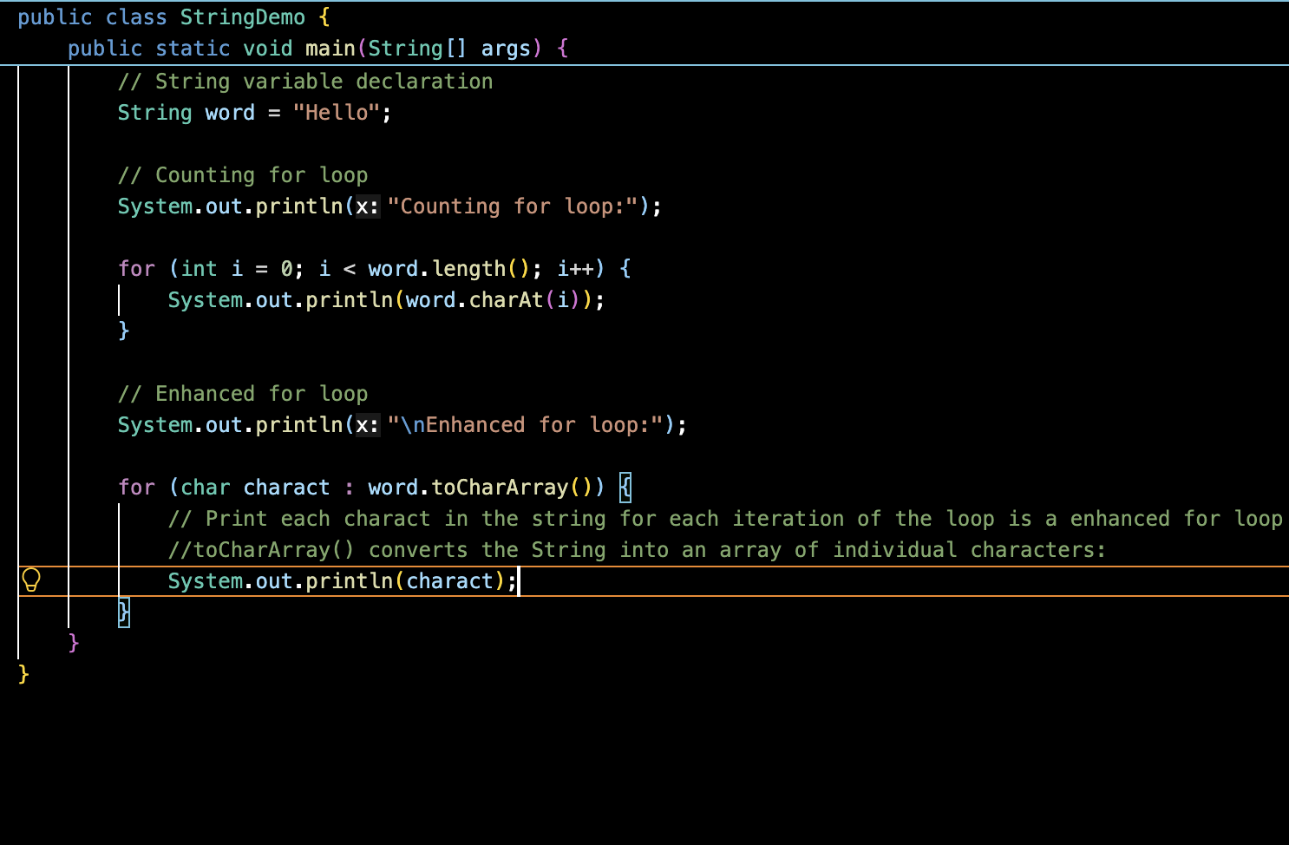
Enhanced for (foreach)

Slide 17
4. 5 While
The while statement
while (condition) {
statement
}
Syntactically, while looks just like if — parentheses around a condition, then a statement (or block) to control.
The one real difference
After the statement runs, while loops back and re-checks the condition
11 / 14

Slide 18
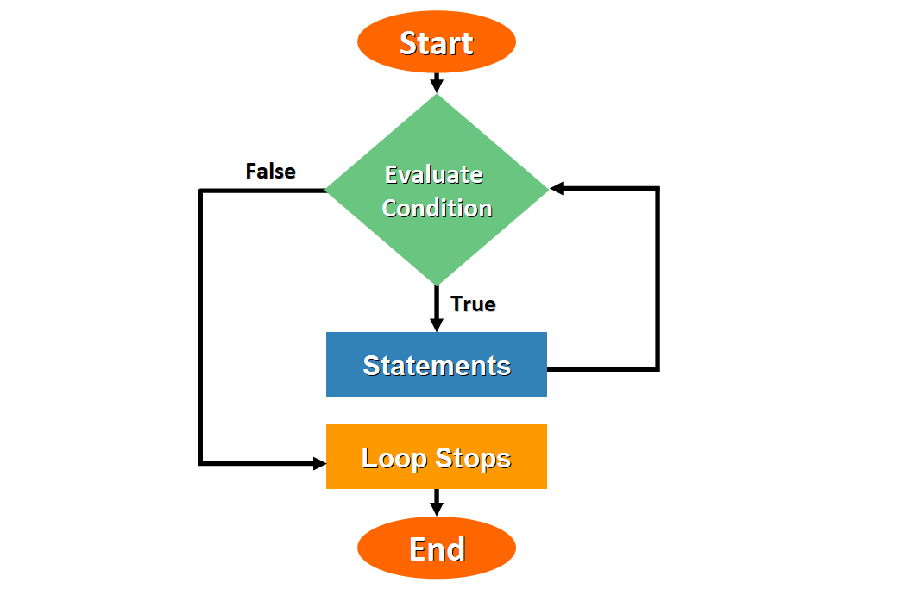
int tal;
while (true) {
System.out.println("Indtast tal:");
tal = Integer.parseInt(indlæser.readLine());
if (tal == 0) {
break;
}
System.out.println("Du indtastede: " + tal);
}
Notes:
Tal scope

Slide 19
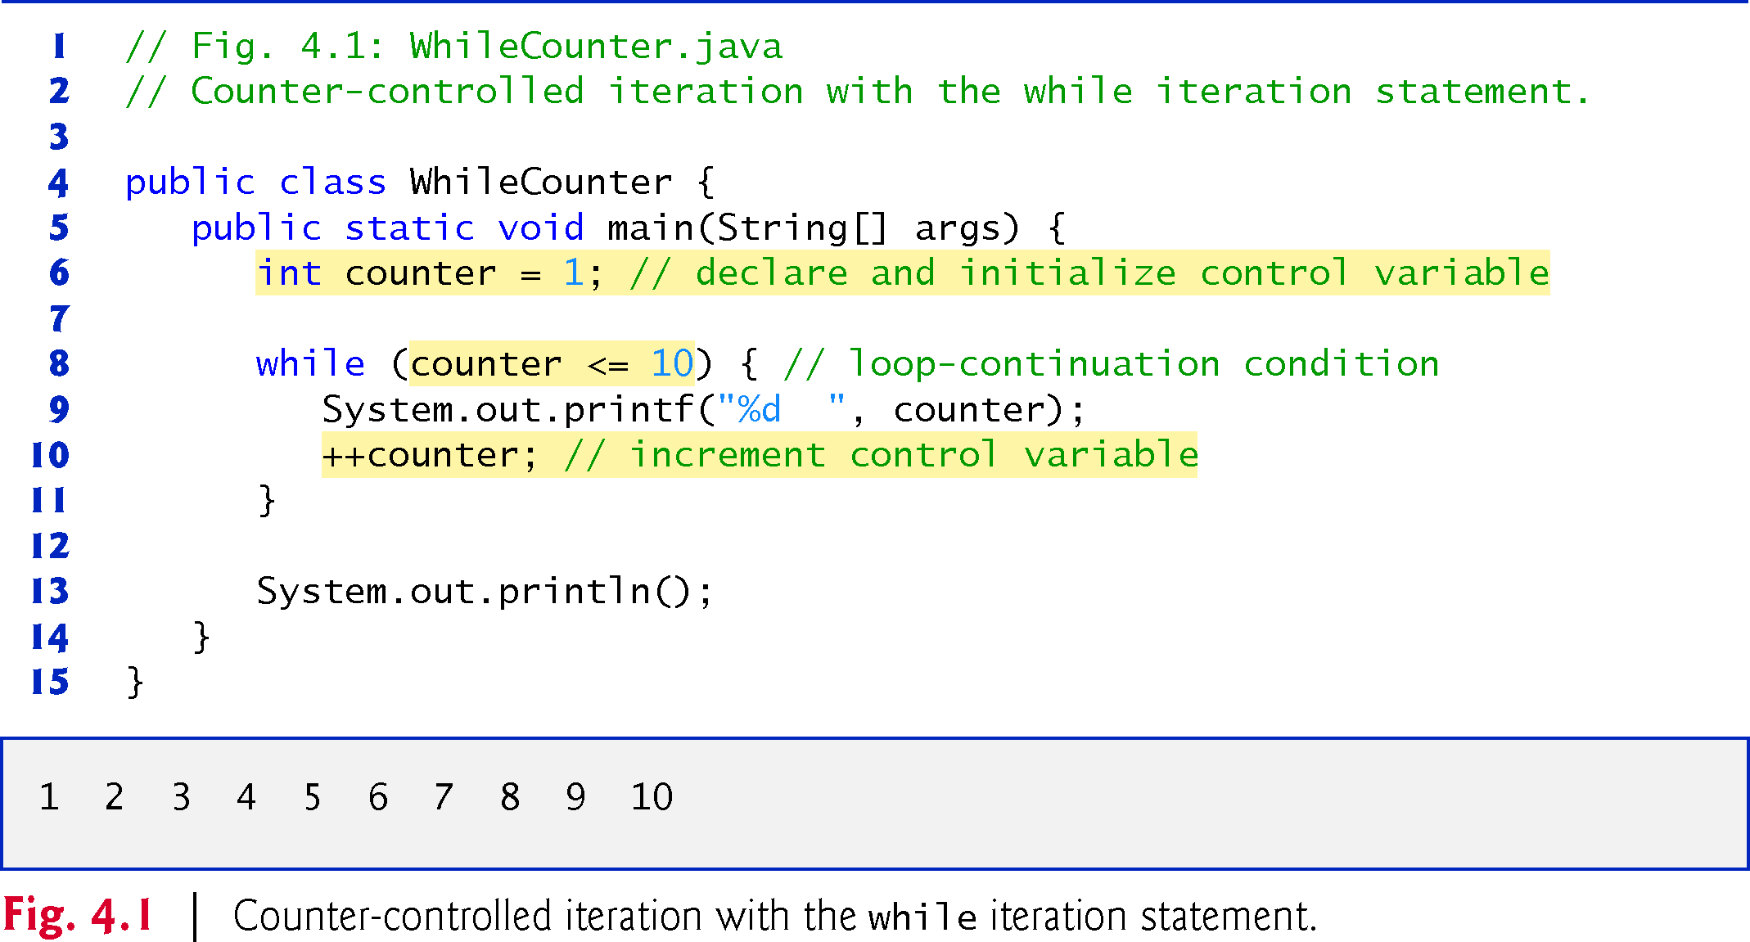
Copyright © 2020 Pearson Education Ltd. All Rights Reserved
Notes:
Try while couter in intelli J- refactor while (true) {
if (counter >= 10) break;
System.out.println(counter);
// update expression
counter++;
}

Slide 20
COMPARE
for vs. while
for
while
• Best when the iteration count is known up front
• Initialization, condition, increment sit in one header
• General purpose — works for any condition
• Natural fit for sentinel-controlled loops
13 / 14

Slide 21
Important distinction
A counter-controlled loop usually stops because a condition becomes false:
while (i < 10)
A sentinel-controlled loop stops when the user/program gives a special value:
while (number != -1)

Slide 22
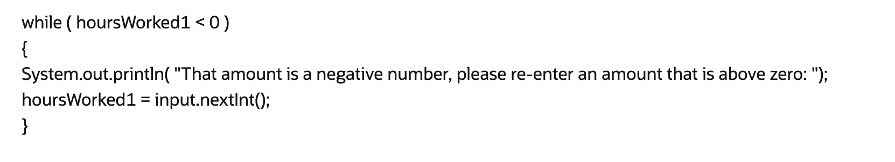
sentinel-controlled loop

Slide 23
import java.util.Scanner;
public class Sentinel {
public static void main(String[] args) {
Scanner indlæser = new Scanner(System.in);
int sum = 0;
int tal;
System.out.println("Indtast tal: ");
tal = indlæser.nextInt();
while (tal != 0) {
sum += tal;
System.out.println("Indtast tal: ");
tal = indlæser.nextInt();
}
System.out.println("Summen er " + sum);
indlæser.close();
}
}
sentinel- demo

Slide 24
Thus, the do…while statement with one body statement is usually written as follows:
  do
{
statement
} while (condition);

Slide 25
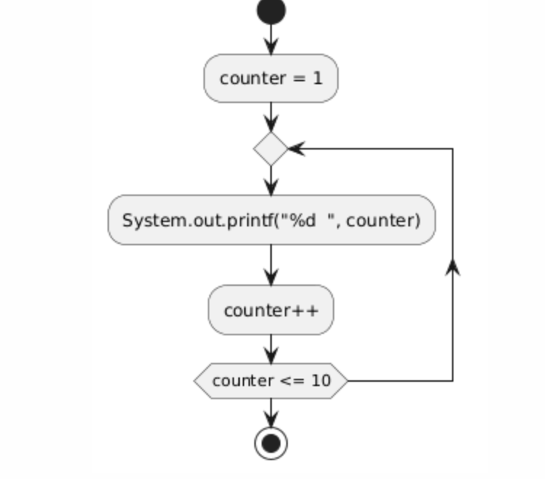
Copyright © 2020 Pearson Education Ltd. All Rights Reserved

Slide 26
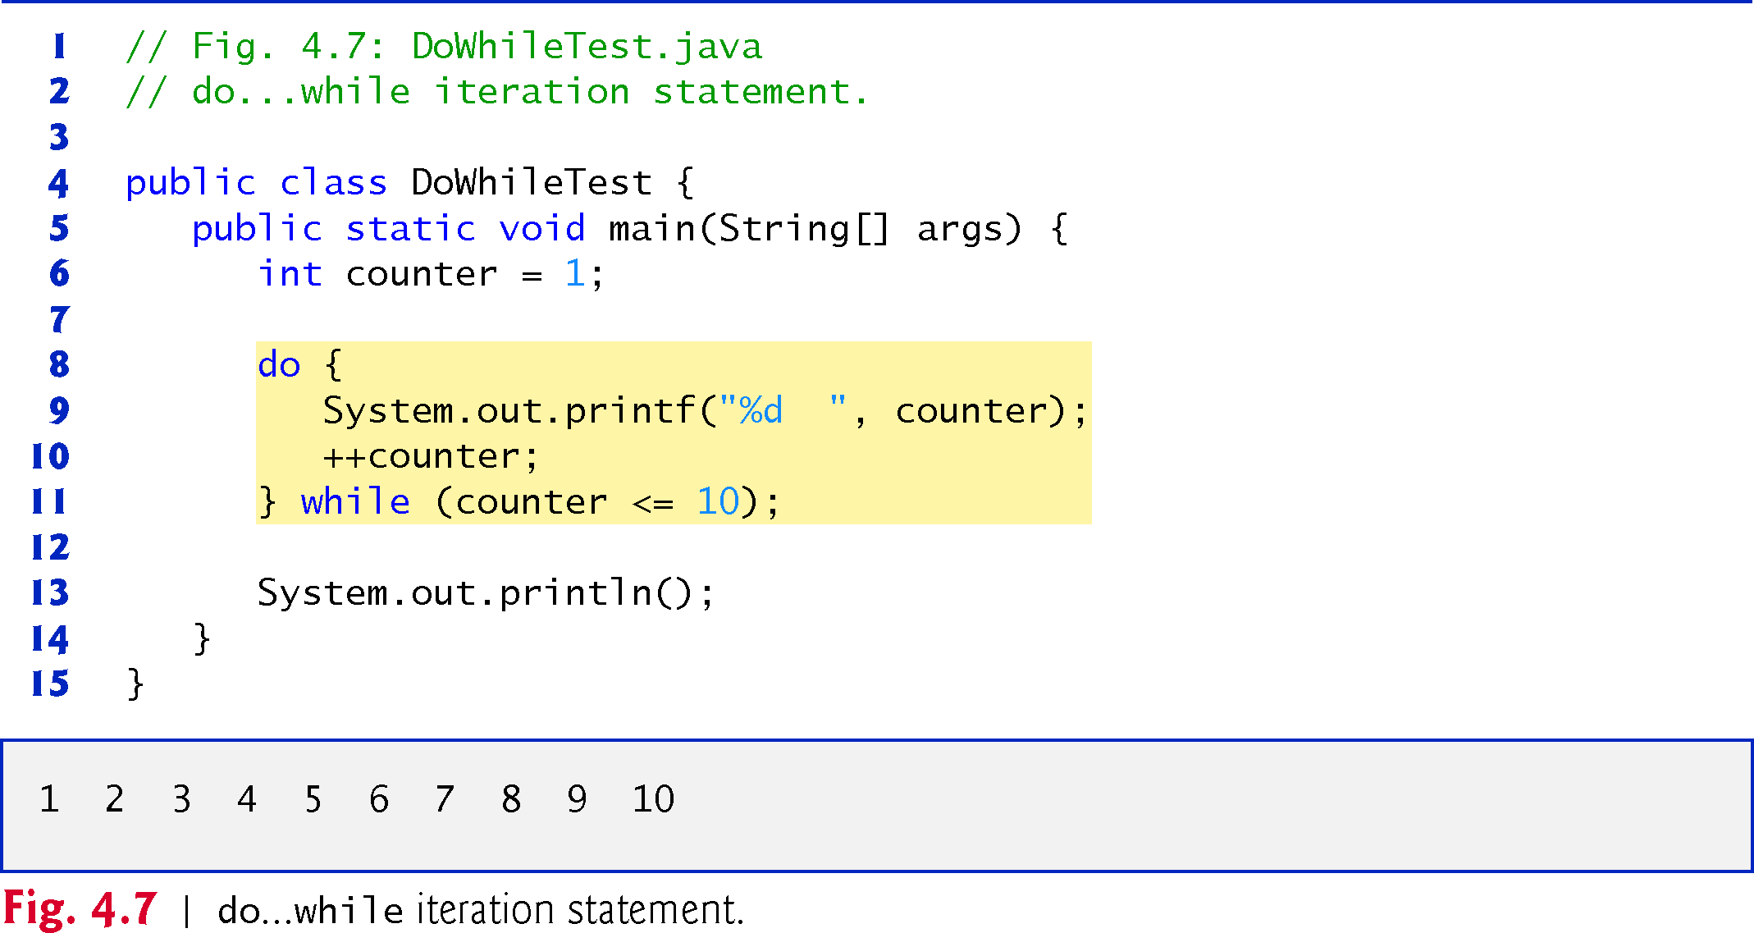
While4.java
Copyright © 2020 Pearson Education Ltd. All Rights Reserved
Notes:
In normal while System.out.printf("%d ", counter);
counter++;
while (counter <= 10) {
System.out.printf("%d ", counter);
counter++;
} // end do...while

Slide 27
Gruppe | Ansvar
1 | Array
2 | while
3 | For
4 | Scope of counter variable
5 | Sentinel
Notes:
Marco - String

