Slide 1

Control Statements Loops Multi-dimensional & asymmetric arrays · ArrayList · do-while · break & continue
Copyright © 2020 Pearson Education Ltd. All Rights Reserved

Slide 2
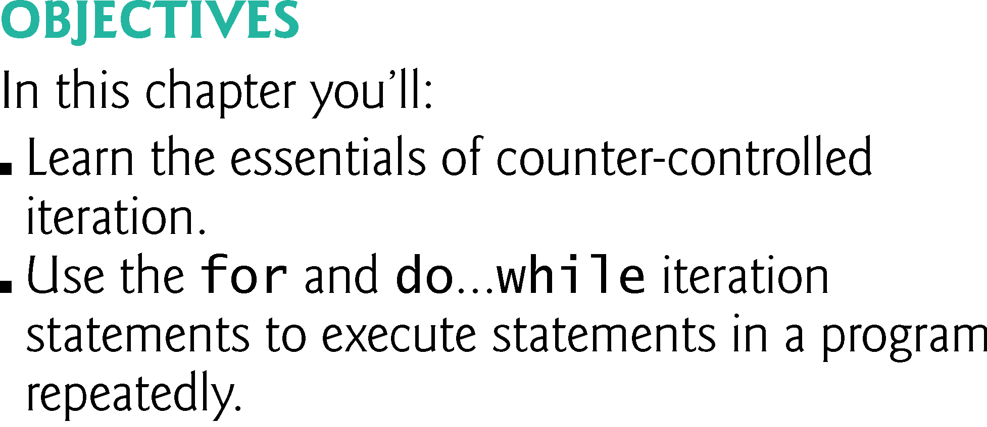
Copyright © 2020 Pearson Education Ltd. All Rights Reserved

Slide 3
Break and continue in doc java with 2 demos

Slide 4
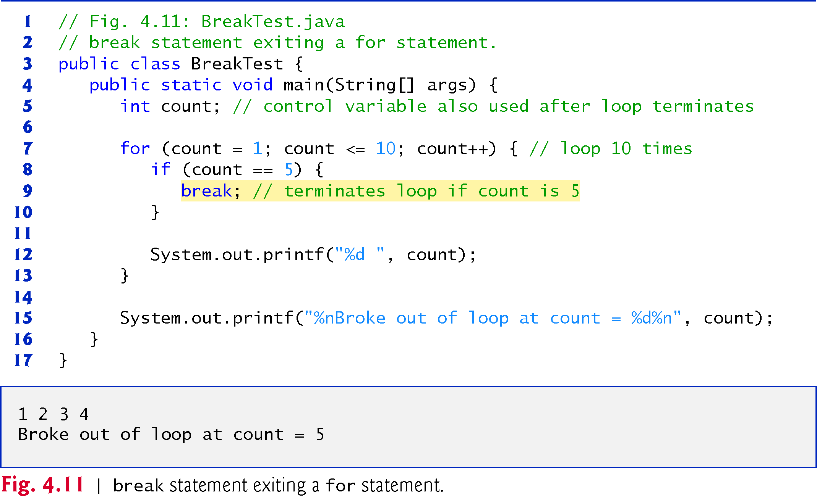
Copyright © 2020 Pearson Education Ltd. All Rights Reserved

Slide 5
The continue statement, when executed in a while, for or do…while, skips the remaining statements in the loop body and proceeds with the next iteration of the loop.
In while and do…while statements, the program evaluates the loop-continuation test immediately after the continue statement executes.
In a for statement, the increment expression executes, then the program evaluates the loop-
continuation test.
Copyright © 2020 Pearson Education Ltd. All Rights Reserved

Slide 6
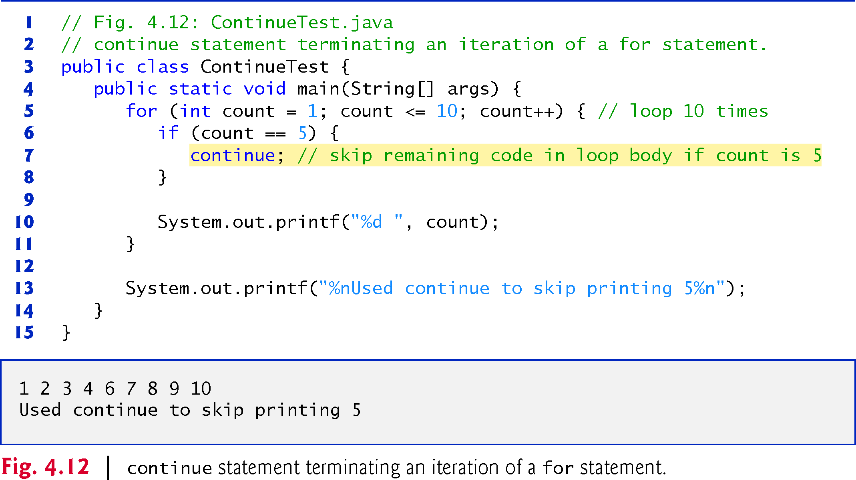
Copyright © 2020 Pearson Education Ltd. All Rights Reserved

Slide 7
The break statement, when executed in a while, for, do…while or switch, causes immediate exit from that statement.
Execution continues with the first statement after the control statement.
Common uses of the break statement are to escape early from a loop or to skip the remainder
of a switch.

