Slide 1


© 1992-2015 by Pearson Education, Inc. All Rights Reserved.

Slide 2
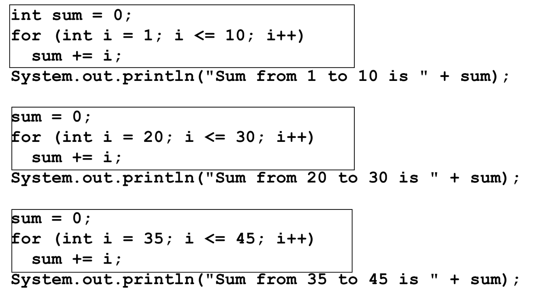
Problem
Notes:
for left parenthesis int i = 1 semi colon, i is less than or equal to 10 semi colon i ++ right parenthesis
sum + = i semi colon
system.out.prinln left parenthesis start double quotation marks Sum from 1 to 10 is end double quotation marks + sum right parenthesis semi colon
sum = 0 semi colon
for left parenthesis int i = 20 semi colon, i is less than or equal to 30 semi colon i ++ right parenthesis
sum + = i semi colon
system.out.prinln left parenthesis start double quotation marks Sum from 20 to 30 is end double quotation marks + sum right parenthesis semi colon
sum = 0 semi colon
for left parenthesis int i = 35 semi colon, i is less than or equal to 45 semi colon i ++ right parenthesis
sum + = i semi colon
system.out.prinln left parenthesis start double quotation marks Sum from 35 to 45 is end double quotation marks + sum right parenthesis semi colon

Slide 3
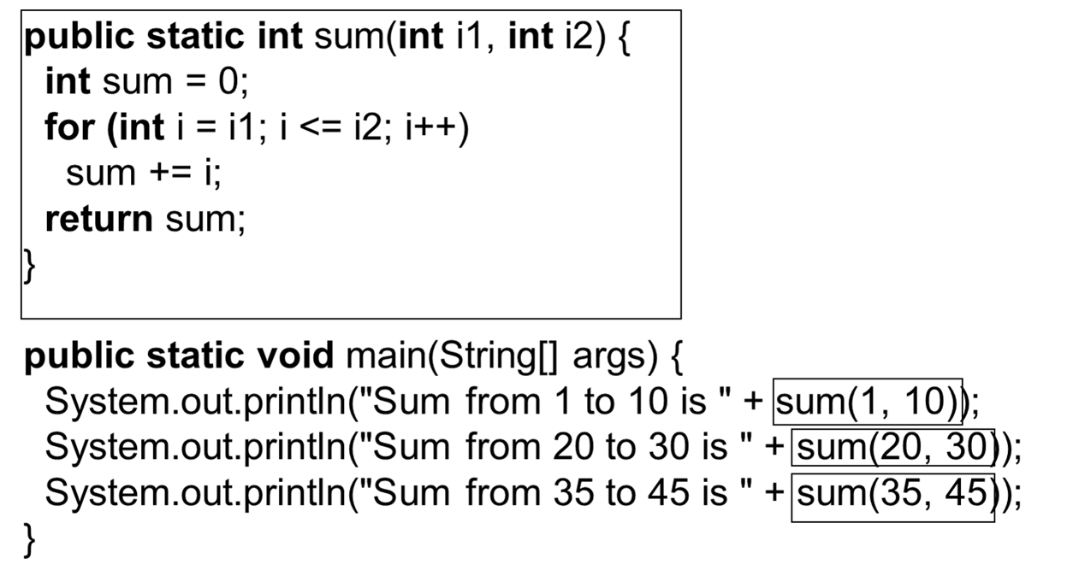
Solution
Notes:
int sum = 0 semi colon
for left parenthesis int i = i1 semi colon i is less than or equal to i2 semi colon i ++ right parenthesis
sum + = i semi colon
return sum semi colon
right brace
public static void main left parenthesis string left bracket right bracket args right parenthesis left brace
system.out.println left parenthesis start double quotation marks Sum from 1 to 10 is end double quotation marks + sum left parenthesis 1, 10 right parenthesis, right parenthesis semi colon (sum left parenthesis 1, 10 right parenthesis is highlighted)
system.out.println left parenthesis start double quotation marks Sum from 20 to 30 is end double quotation marks + sum left parenthesis 20, 30 right parenthesis, right parenthesis semi colon (sum left parenthesis 20, 30 right parenthesis is highlighted)
system.out.println left parenthesis start double quotation marks Sum from 35 to 45 is end double quotation marks + sum left parenthesis 35, 45 right parenthesis, right parenthesis semi colon (sum left parenthesis 35, 45 right parenthesis is highlighted)
right brace
MethodDemo: https://liveexample.pearsoncmg.com/html/MethodDemo.html

Slide 4
Copy-Paste Programming vs Methods
Copy-paste programming: the same piece of code is copied to every place it is needed
Methods : each piece of code should exist in exactly one place.

Slide 5
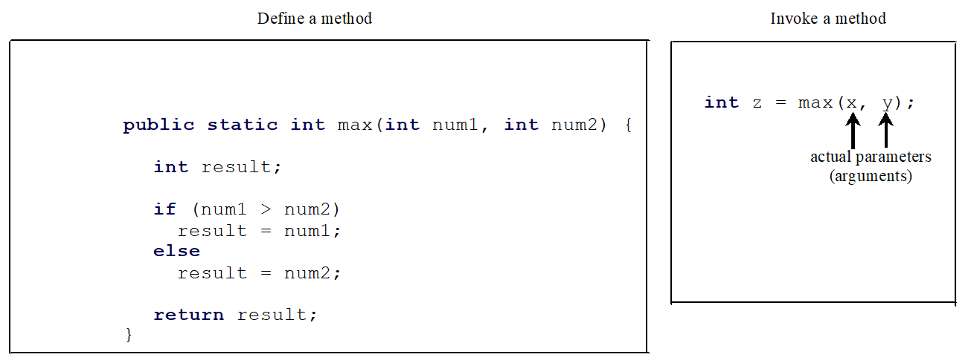
Defining Methods (1 of 2)
A method is a collection of statements that are grouped together to perform an operation.
Notes:
Define a method
public static int max open parenthesis int num 1, int num 2 close parenthesis open braces int result Semicolon
if open parenthesis num 1 greater than num 2 close parenthesis result = num 1 Semicolon
else
result = num 2 Semicolon
return result Semicolon close braces
Invoke a method.
int z = max open parenthesis x, y close parenthesis Semicolon
x and y are labeled as actual parameters, arguments

Slide 6
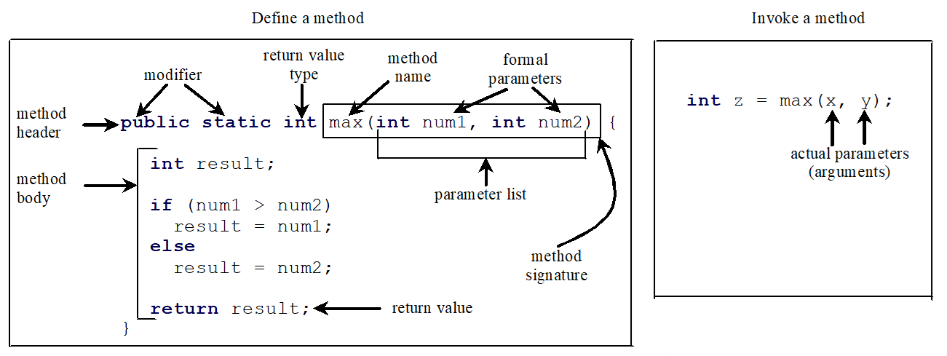
Defining Methods (2 of 2)
A method is a collection of statements that are grouped together to perform an operation.
Notes:
Define a method.
Public static int max open parenthesis num 1, int num 2 close parenthesis open braces int results Semicolon This line is labeled, method header. Public static are labeled, modifier. int is labeled return value type. max is labeled method name. num 1 and num 2 are labeled formal parameters. information within the parenthesis is labeled parameter list. max open parenthesis int num 1, int num 2 close parenthesis is labeled, method signature.
Below is the method body.
if open parenthesis num 1 greater than num 2 close parenthesis result = num 1 Semicolon
else
result = num 2
return result Semicolon It is labeled return value.
Invoke a method.
int z = max open parenthesis x, y close parenthesis Semicolon
x and y are labeled as actual parameters (arguments).

Slide 7
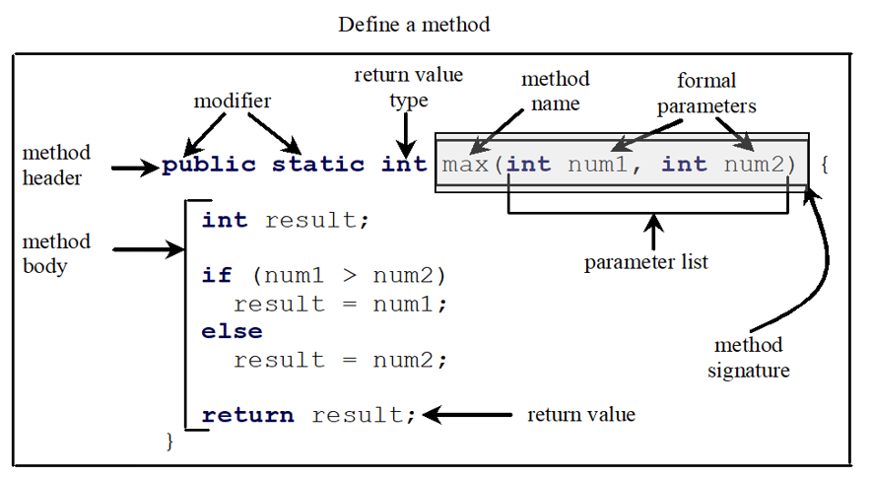
Method Signature
Method signature is the combination of the method name and the parameter list.
Notes:
Define a method.
Public static int max open parenthesis num 1, int num 2 close parenthesis open braces int results Semicolon This line is labeled, method header. Public static are labeled, modifier. int is labeled return value type. max is labeled method name. num 1 and num 2 are labeled formal parameters. information within the parenthesis is labeled parameter list. max open parenthesis int num 1, int num 2 close parenthesis is labeled, method signature.
Below is the method body.
if open parenthesis num 1 greater than num 2 close parenthesis result = num 1 Semicolon
else
result = num 2
return result Semicolon It is labeled return value.
Invoke a method.
int z = max open parenthesis x, y close parenthesis Semicolon
x and y are labeled as actual parameters, arguments.

Slide 8
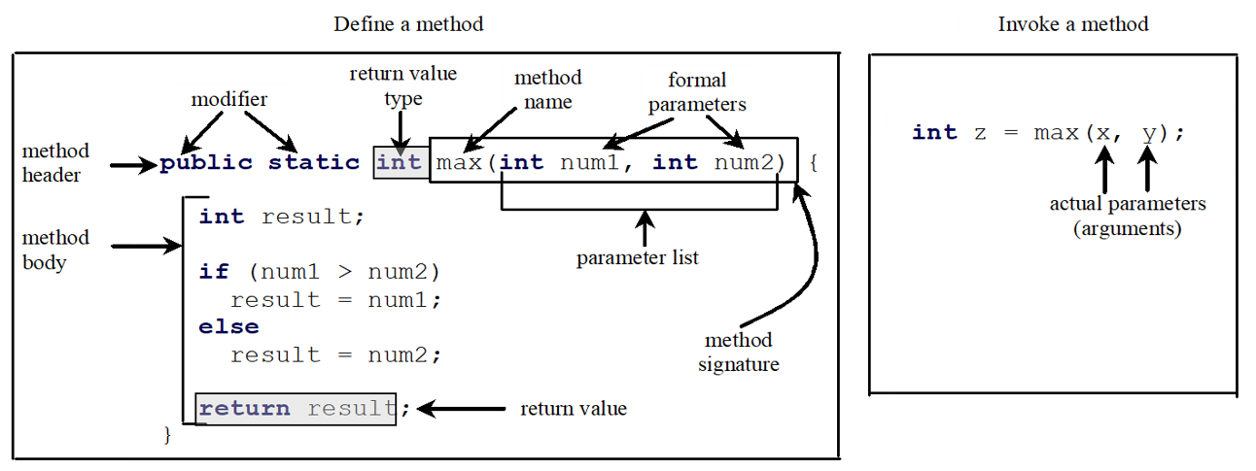
Return Value Type
A method may return a value. The returnValueType is the data type of the value the method returns. If the method does not return a value, the returnValueType is the keyword void. For example, the returnValueType in the main method is void.
Notes:
Define a method.
Public static int max open parenthesis num 1, int num 2 close parenthesis open braces int results Semicolon This line is labeled, method header. Public static are labeled, modifier. int is labeled return value type. max is labeled method name. num 1 and num 2 are labeled formal parameters. information within the parenthesis is labeled parameter list. max open parenthesis int num 1, int num 2 close parenthesis is labeled, method signature.
Below is the method body.
if open parenthesis num 1 greater than num 2 close parenthesis result = num 1 Semicolon
else
result = num 2
return result Semicolon It is labeled return value.
Invoke a method.
int z = max open parenthesis x, y close parenthesis Semicolon
x and y are labeled as actual parameters, arguments.

Slide 9








Return type
In some cases, methods that perform a task will not return any information
  Such methods use the return type void.
public class SayHello {
// Static void method
public static void sayHello(String name) {
System.out.println("Hello, " + name + "!");
}
public static void main(String[] args) {
// Call the static method directly without creating an object
sayHello("Victor");
}
}

Slide 10
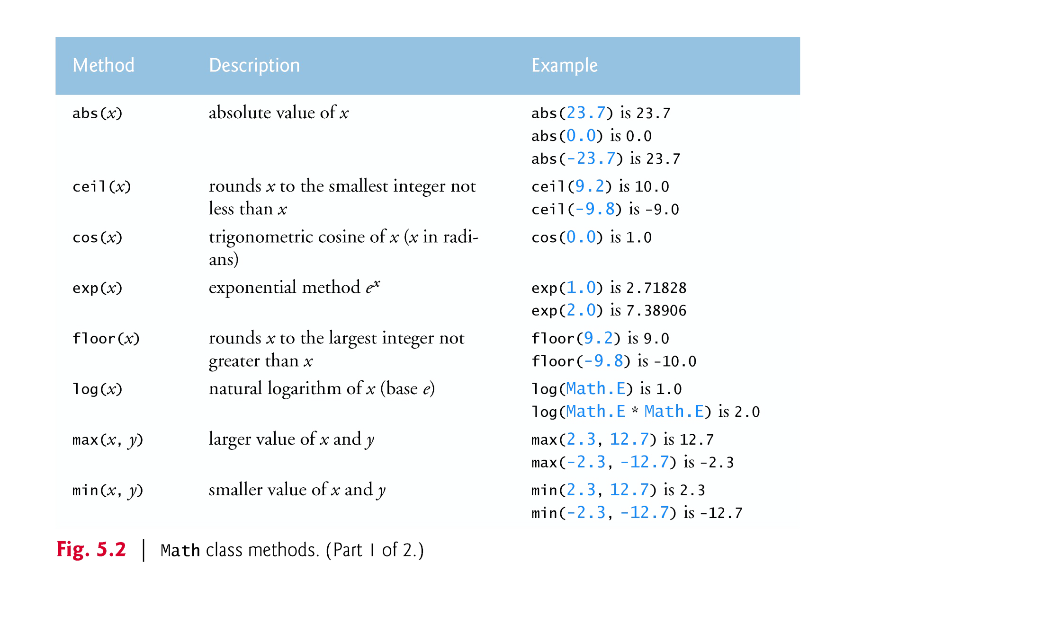
Math method

Slide 11
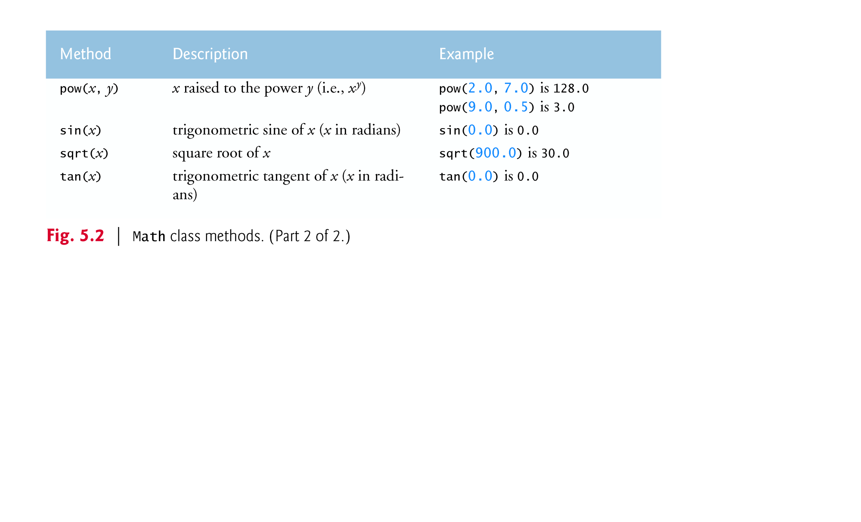


Slide 12
public class MaxExample {
public static void main(String[] args) {
double num1 = 5.7;
double num2 = 9.3;
// Use Math.max to find the larger number
double max = Math.max(num1, num2);
//choose to remove. and see all options
System.out.println("The larger number is: " + max);
}
}
Reference
https://docs.oracle.com/en/java/javase/25/docs/api/java.base/java/lang/Math.html

Slide 13
Instance method vs. static method
ArrayList<String> fruits = new ArrayList<>();
ArrayList<String> vegetables = new ArrayList<>();
fruits.add("Apple");
vegetables.add("Carrot");
Math.sqrt(25);
Math.max(10, 20);
Math.abs(-5);

Slide 14

Why Is Method main Declared static?
When you execute the Java Virtual Machine (JVM) with the java command, the JVM attempts to invoke the main method of the class you specify
Declaring main as static allows the JVM to invoke main without creating an object of the class

Slide 15
The maximum method (not from the math library) determines and
returns the largest of three double values
  You must call method maximum explicitly to tell it to perform its task

Slide 16
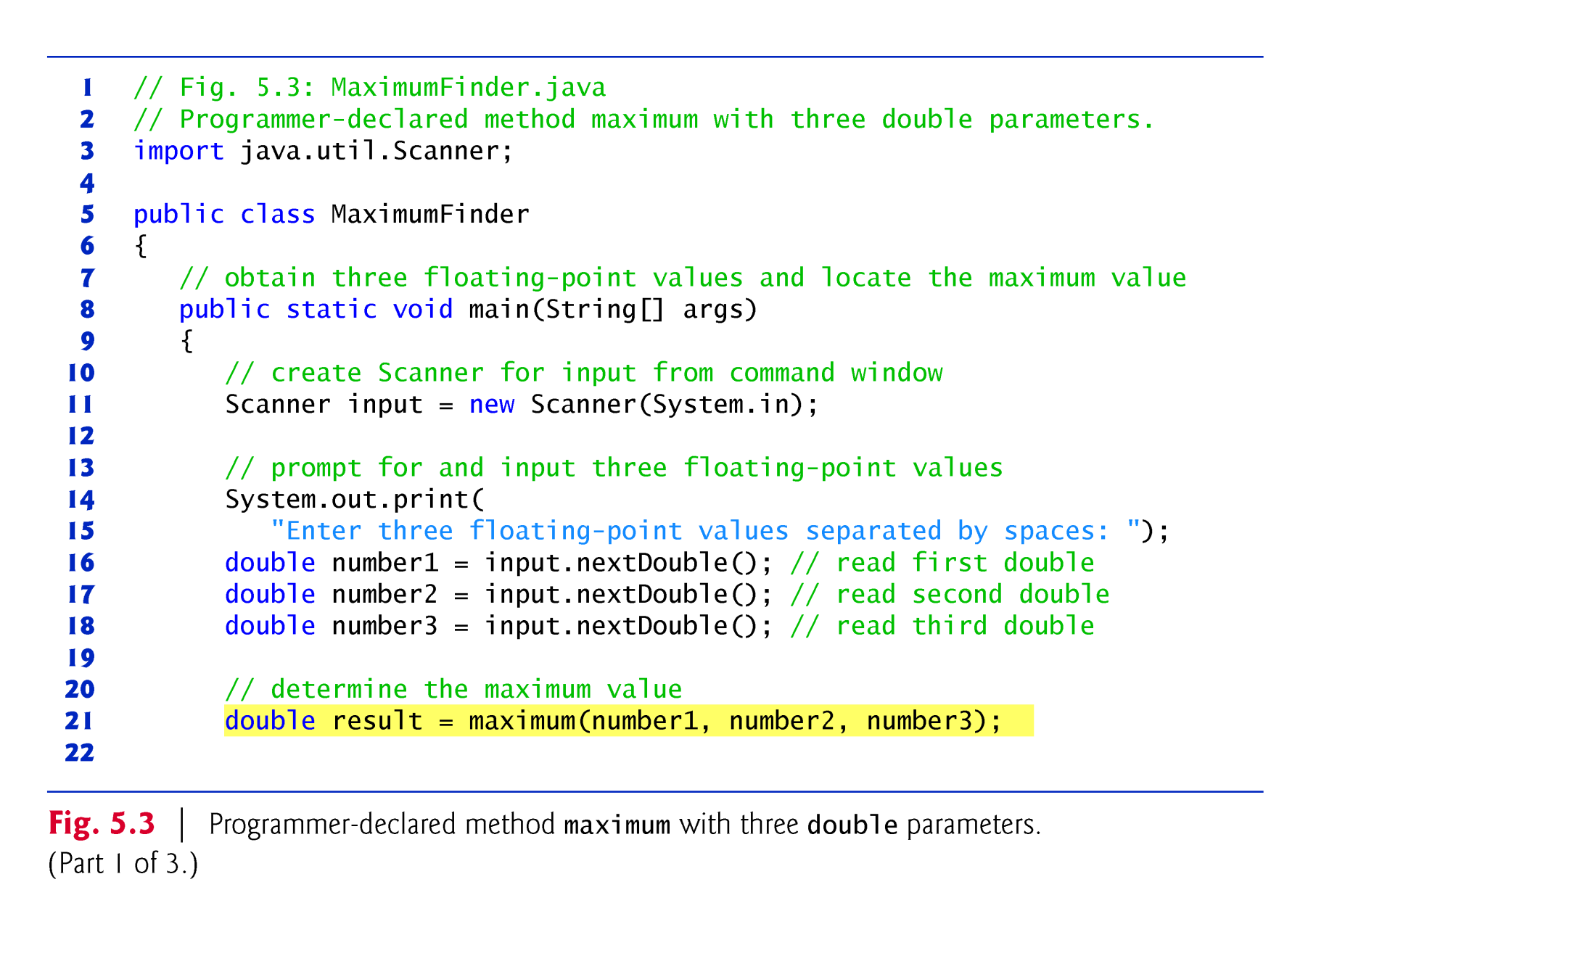
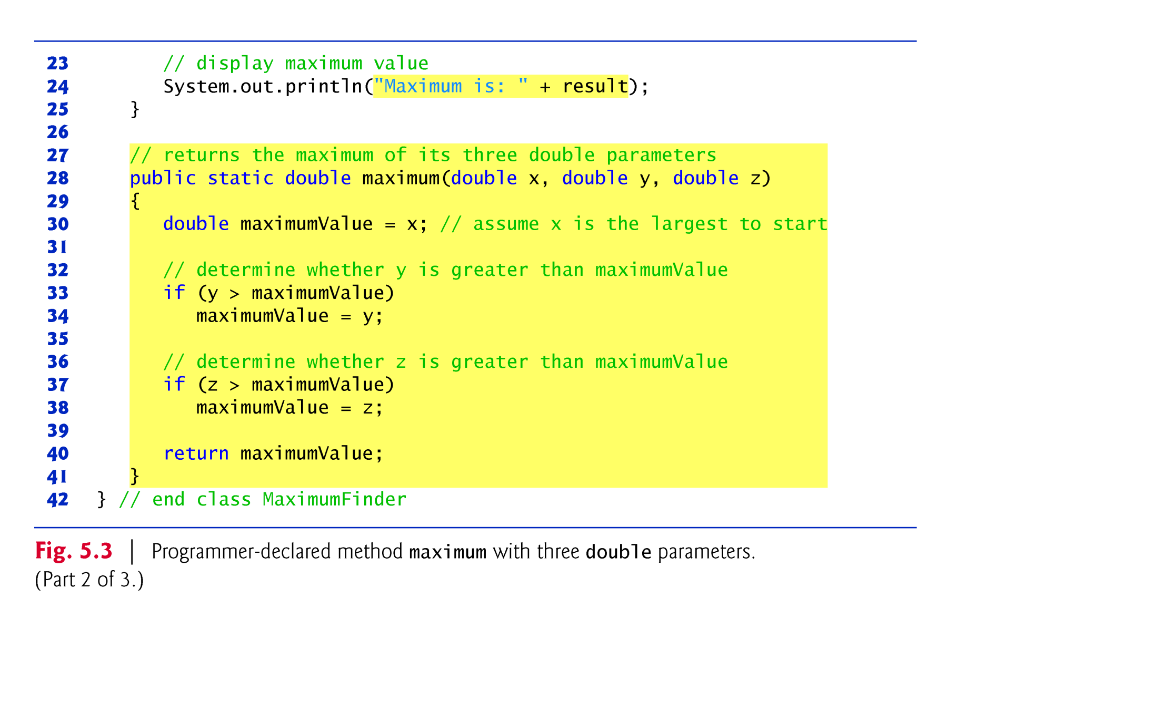

Slide 17
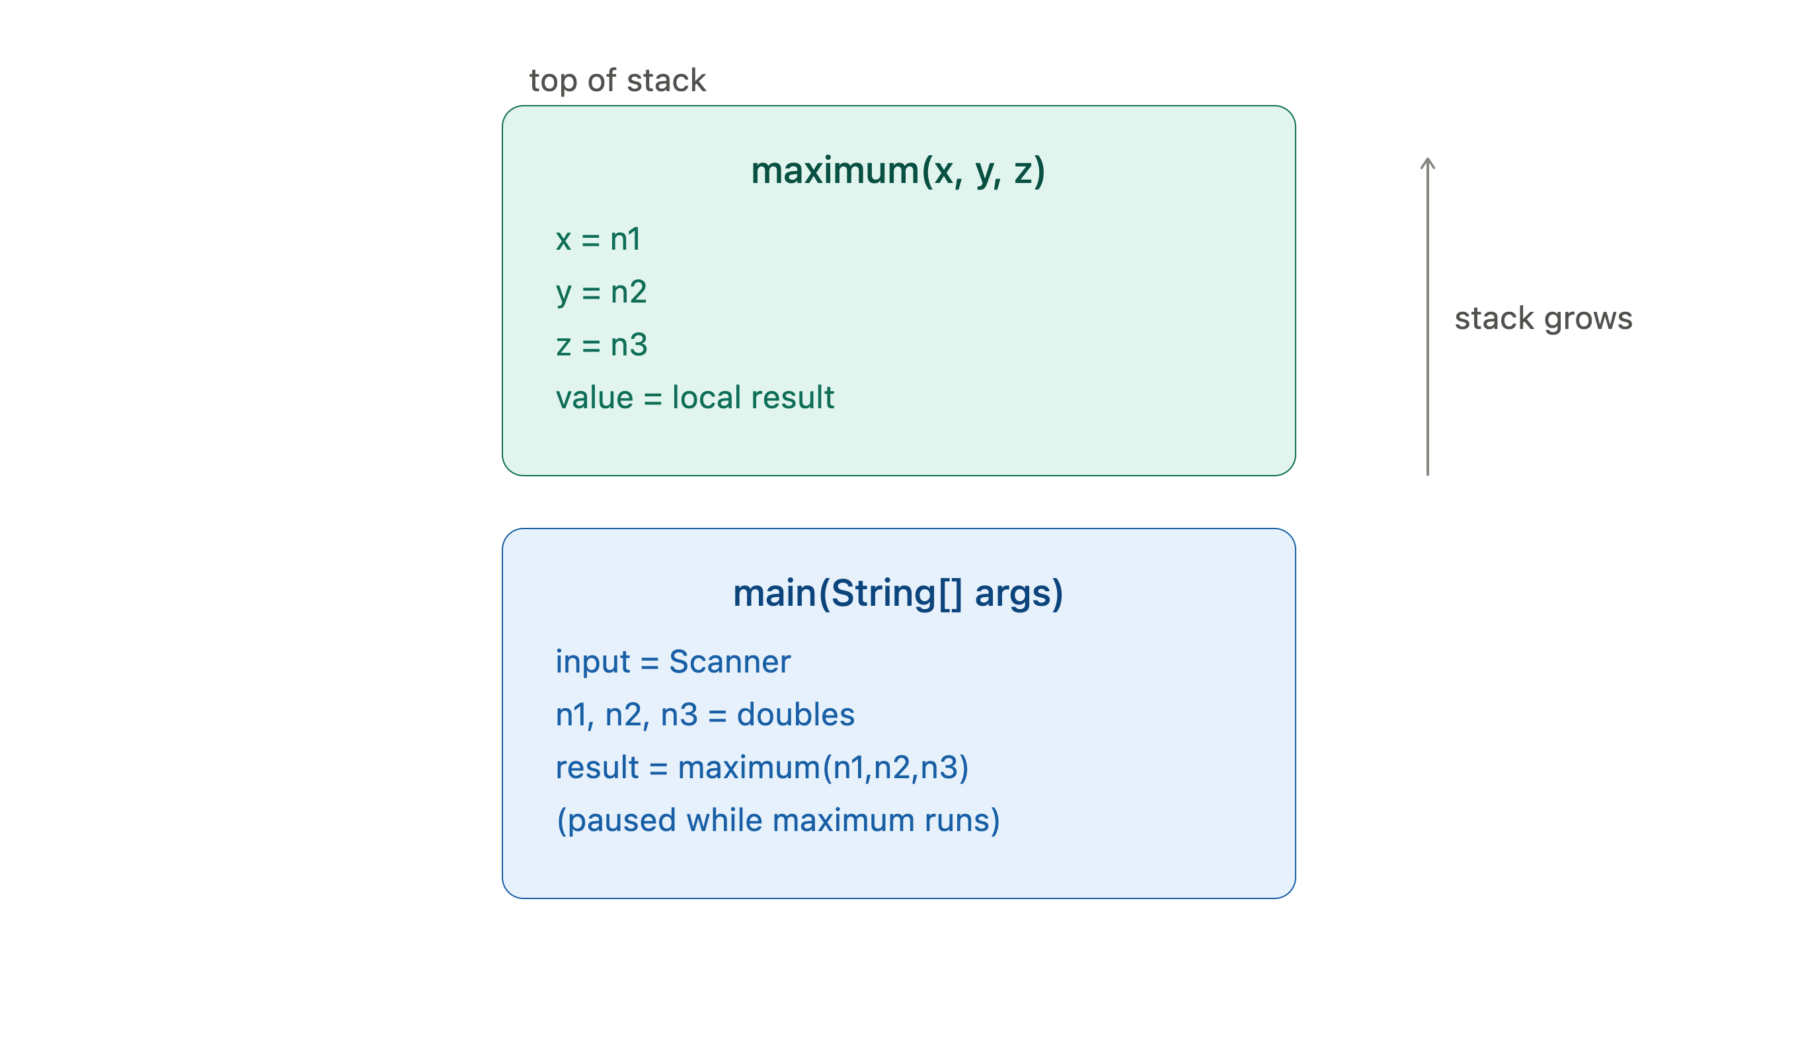
Call Stacks
A method call stack in Java is a memory structure that Java uses to keep track of which methods are currently running.
Notes:
Can sees in vs code

Slide 18
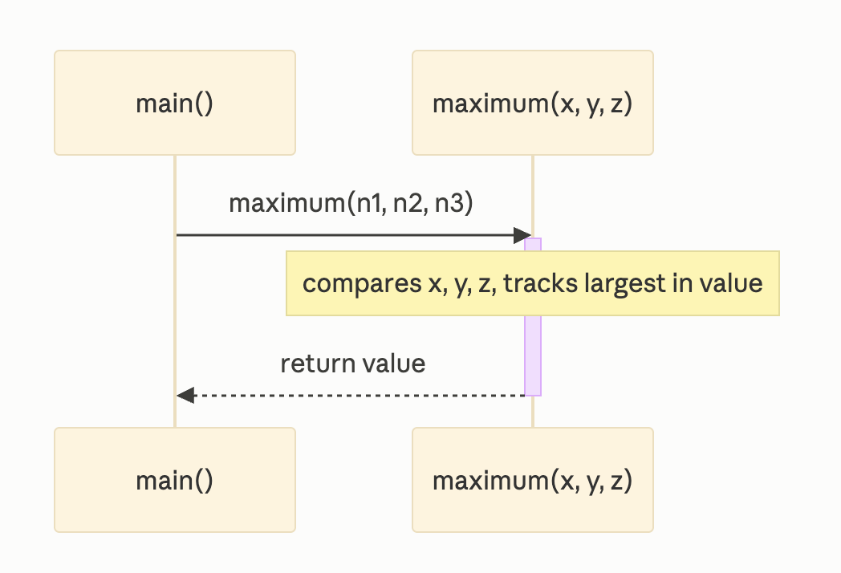
Sequence Diagram
(dies … …)

Slide 19
If truly random, then every value in the range should have an equal chance (or probability) of being chosen each time nextInt is called
Class Random provides another version of method nextInt that receives an int argument and returns a value from 0 up to, but not including, the argument’s value

Slide 20
SecureRandom class
Part of java.security.SecureRandom, so you must import
Generates cryptographically strong random numbers,
Used for security-sensitive applications, like:
  Password generation
  Tokens for authentication
  Encryption keys

Slide 21
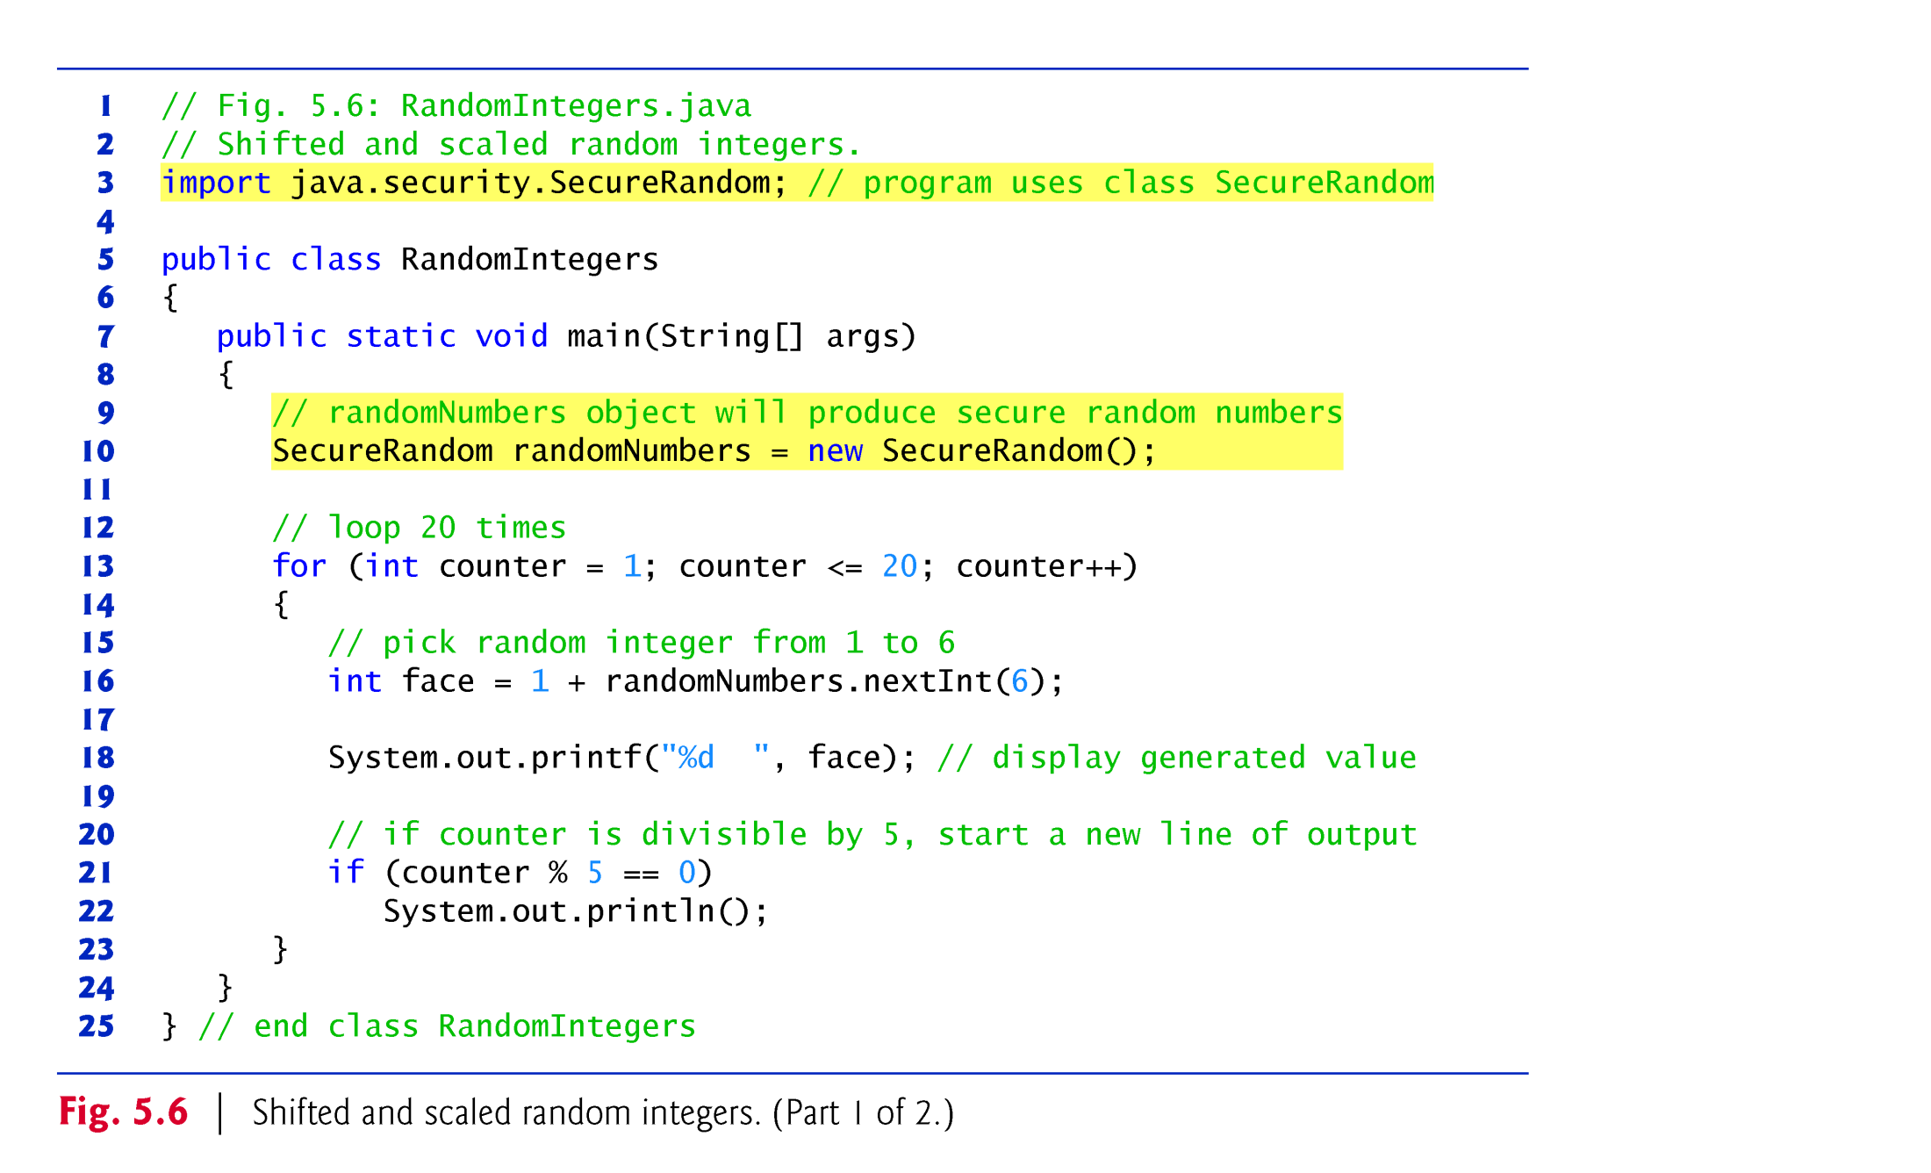

Slide 22
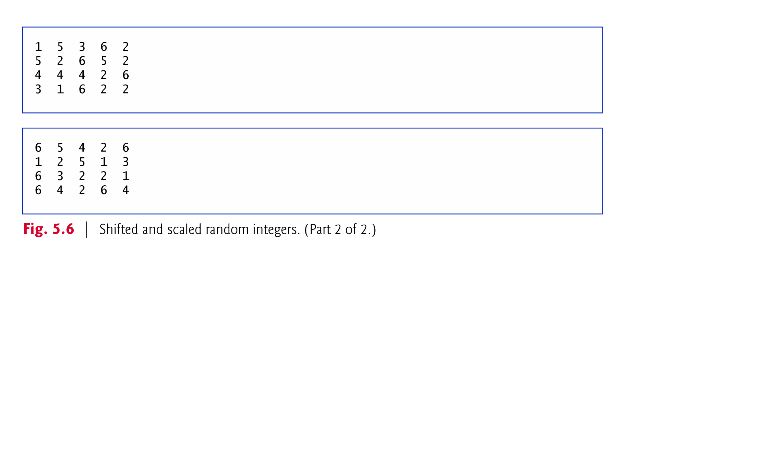

Slide 23
Declarations introduce names that can be used to refer to classes, methods, variables and parameters
The scope of a declaration is the portion of the program that can refer to the declared entity by its name
Such an entity is said to be “in scope” for that portion of the program

Slide 24
public class Main {
public static void main(String[] args) {
calculateSum();
// This would cause an error:
// System.out.println(sum);
}
public static void calculateSum() {
int number1 = 10;
int number2 = 20;
int sum = number1 + number2;
System.out.println("The sum is: " + sum);
}
}

Slide 25
Methods of the same name can be declared in the same class, as long as they have different sets of parameters
  Called method overloading
Math methods abs, min and max are overloaded with four versions each:
  One with two double parameters
  One with two float parameters
  One with two int parameters
  One with two long parameters

Slide 26
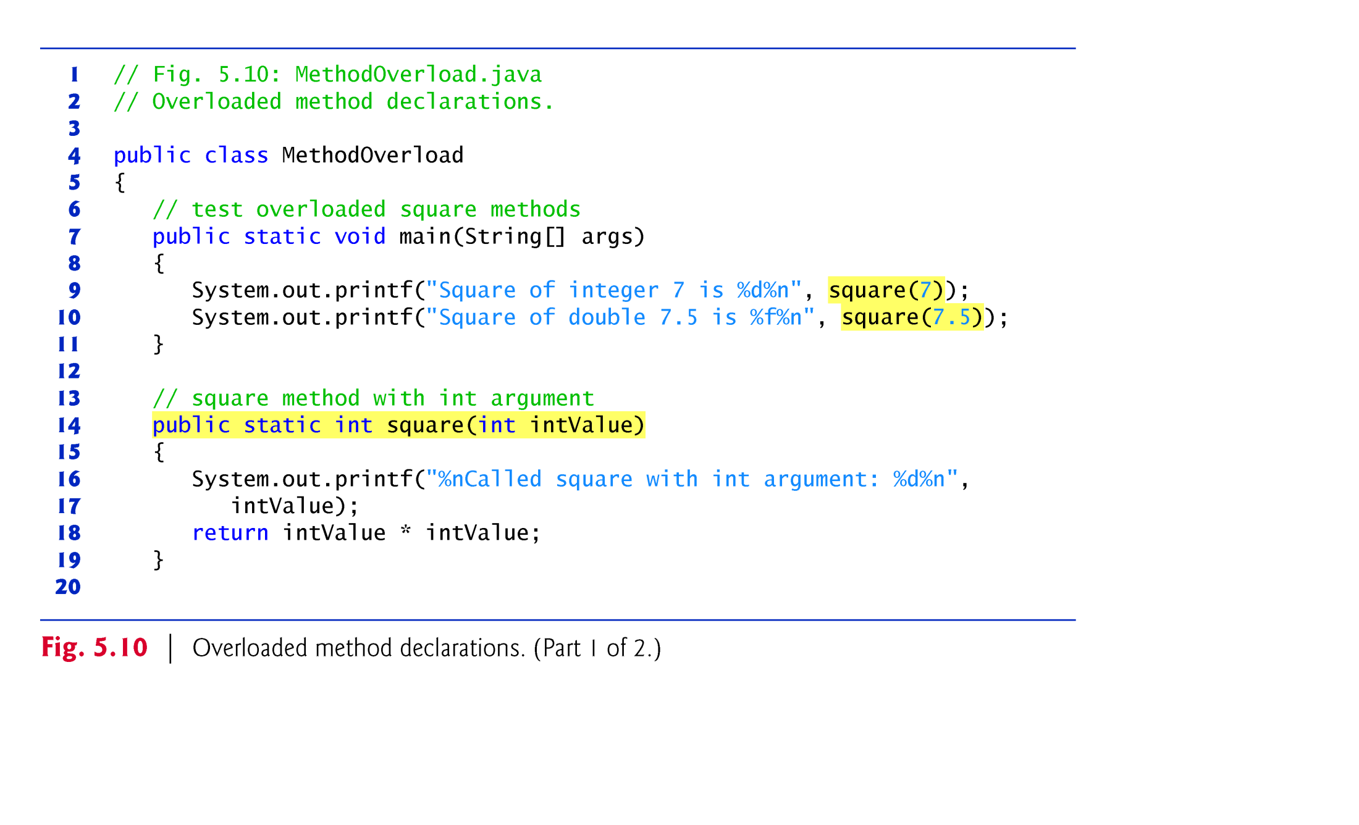

Slide 27
