Slide 1
12
FORMATTING TEXT

Slide 2
Font-related properties
Text line settings
Various text effects
List style properties
ID, class, and descendent selectors
Specificity

Slide 3
Web Typography
Styling text on the web is tricky because you don’t have control over how the text displays for the user:
  They may not have the font you specify.
  They may have their text set larger or smaller than you designed it.
Best practices allow for flexibility in text specification.

Slide 4
Typesetting Terminology
A typeface is a set of characters with a single design (example: Garamond).
A font is a particular variation of the typeface with a specific weight, slant, or ornamentation (example: Garamond Bold Italic).
In traditional metal type, each size was a separate font (example: 12-point Garamond Bold Italic).
On a computer, fonts are generally stored in individual font files.

Slide 5
CSS Basic Font Properties
CSS font properties deal with specifying the shapes of the characters themselves:
font-family
font-size
font-weight
font-style
font-variant
font (a shorthand that includes settings for all of the above)

Slide 6
Specifying the Font Family
font-family
Values: One or more font family names, separated by commas
Example:
body { font-family: Arial; }
var { font-family: Courier, monospace; }

Slide 7
Specifying the Font Family (cont’d)
Font names must be capitalized (except generic font families).
Use commas to separate multiple font names.
If the name has a character space, it must appear within quotation marks:
p { font-family: "Duru Sans", Verdana, sans-serif; }

Slide 8
Using Fonts on the Web
The font must be available on the user’s machine for it to display.
The best practice is to provide a list of options. The browser uses the first one that is available.
Start with the font you want and then provide backup options ending with a generic font family, as shown here:
p { font-family: "Duru Sans", Verdana, sans-serif; }
You can also download a web font with the page, but it adds to the download and display time.

Slide 9
Generic Font Families
Generic font families instruct the browser to use an available font from one of five stylistic categories:
serif, sans-serif, monospace, cursive, fantasy
Generic font families are often used as the last backup option.

Slide 10
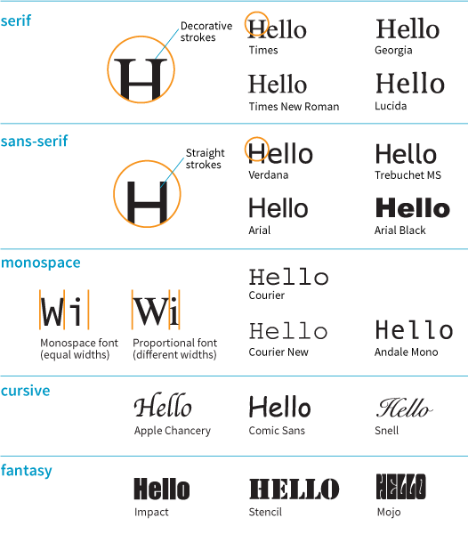
Generic Font Families (cont’d)

Slide 11
Specifying Font Size
font-size
Values:
  CSS length units
  Percentage value
  Absolute keywords (xx-small, x-small, small, medium, large, x-large, xx-large)
  Relative keywords (larger, smaller)
Example:
  h1 { font-size: 2.5rem; }

Slide 12
Specifying Font Size (cont’d)
Most common sizing methods:
  rem and em units
  percentages (based on the inherited font size for that element)
  pixels (px) can be used, but they’re not flexible

Slide 13
Font Size: rem Units
The rem (root em) is equal to the font size of the html (root) element.
In browsers, the default root size is 16 pixels, so:
1 rem = 16 pixels.
If the font size of the root is changed, rem measurements change too.
!!! Old browsers do not support rem units (IE8 and earlier).

Slide 14
Font Size: em Units
The em unit is based on the current font size of the element.
The default font size is 16 pixels. By default, 1em = 16 pixels.
But if you change the font size of the element, the size of its em unit changes too.
Ems may be different sizes in different parts of the document and may compound larger or smaller when elements are nested.

Slide 15
Font Weight (Boldness)
font-weight
Values: normal, bold, bolder, lighter, 100, 200, 300, 400, 500, 600, 700, 800, 900
Example:
  h1 { font-weight: normal; }
  span.new { font-weight: bold; }
Most common values are normal and bold.
Numerical values are useful when using a font with multiple weights.

Slide 16
Font Style (Italics)
font-style
Values: normal, italic, oblique
Example:
  cite { font-style: italic; }
Makes text italic, normal, or oblique (slanted, but generally the same as italics).

Slide 17
Small Caps
font-variant
Values (in CSS2.1): normal, small-caps
Example:
  abbr { font-variant: small-caps; }
Small caps are a separate font design that uses small uppercase characters in place of lowercase letters.
They help acronyms and other strings of capital letters blend in with the weight of the surrounding text.
CSS Fonts Module 3 has expanded the values available for font-variant

Slide 18
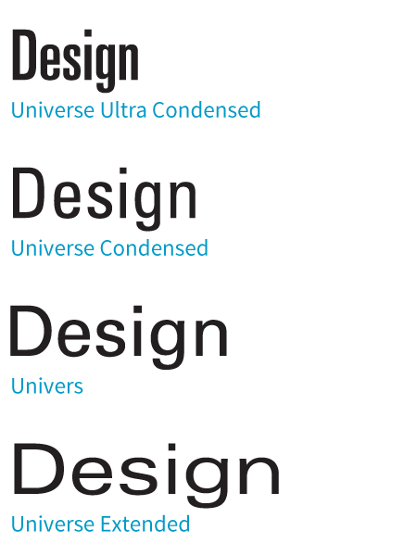
Condensed and Extended Text
font-stretch
Values (in CSS2.1): normal, ultra-condensed, extra-condensed, condensed,
semi-condensed, semi-expanded, expanded, extra-expanded, ultra-expanded
Example:
  abbr { font-variant: small-caps; }
Tells the browser to select a normal, condensed, or extended font variation from a typeface if it is available

Slide 19
The Shortcut font Property
font
Values (in CSS2.1): A list of values for all the individual properties, in this order:
{font: style weight stretch variant size/line-height font-family}
At minimum, it must contain font-size and font-family, in that order. Other values are optional and may appear in any order prior to font-size.
Example:
  p { font: 1em sans-serif; }
  h3 { font: oblique bold small-caps 1.5em Verdana, sans-serif; }

Slide 20
Advanced Typography
The CSS3 Font Module offers properties for fine-tuned typography control, including:
  Ligatures
  Superscript and subscript
  Alternate characters (such as a swash design for an S)
  Proportional font sizing using x-height
  Kerning
  OpenType font features

Slide 21
Text Line Treatments
Some properties control whole lines of text:
  Line height (line-height)
  Indents (text-indent)
  Horizontal alignment (text-align)

Slide 22
Line Height
line-height
Values: Number, length, percentage, normal
Example:
  p { line-height: 1.4em; }
Line height defines the minimum distance from baseline to baseline in text.

Slide 23
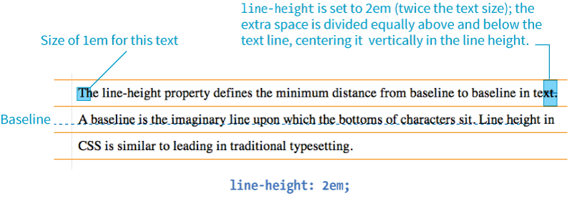
Line Height (cont’d.)
The baseline is the imaginary line upon which the bottoms of characters sit.
If a large character or image is on a line, the line height expands to accommodate it.

Slide 24
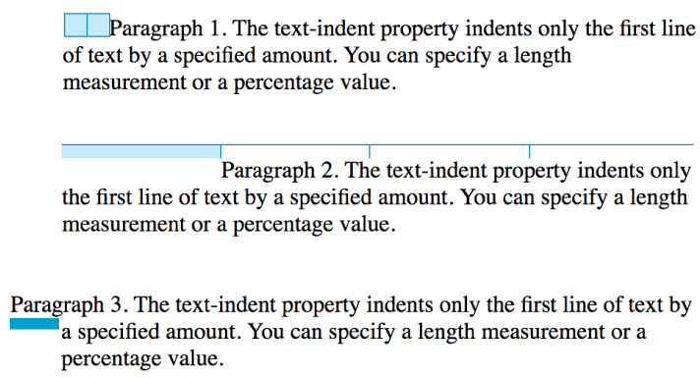
Indents
text-indent
Values: Length, percentage
Examples:
p {text-ident: 2em;}
p {text-ident: 25%;}
p {text-ident: -35px;}

Slide 25
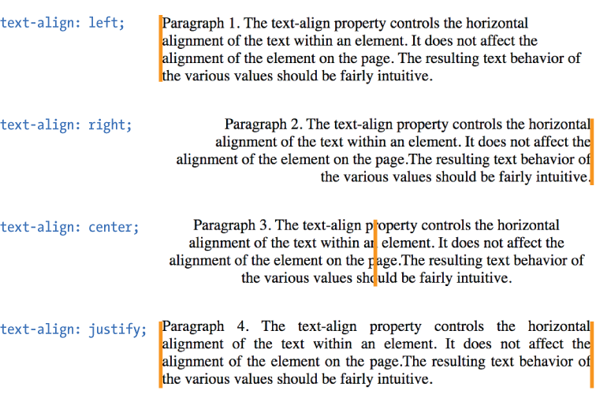
Horizontal Text Alignment
text-align
Values: left, right, center, justify, start, end
Examples:

Slide 26
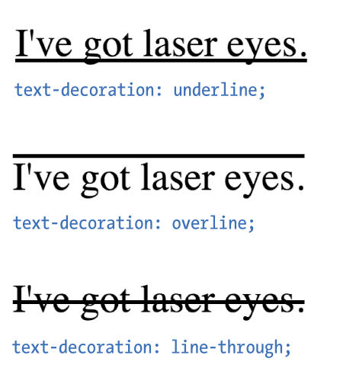
Underlines (Text Decoration)
text-decoration
Values: none, underline, overline, line-through, blink
Examples:
NOTE:
text-decoration is often used to turn off underlines under links:
a {
text-decoration: none;
}

Slide 27
Text Decoration Tips
If you turn off underlines under links, be sure there is another visual cue to compensate.
Underlining text that is not a link may be misleading. Consider italics instead.
Don’t use blink. Browsers don’t support it anyway.

Slide 28
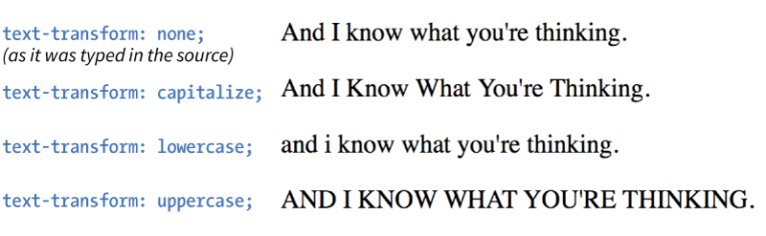
Capitalization
text-transform
Values:
none, capitalize, lowercase, uppercase, full-width
Examples:

Slide 29
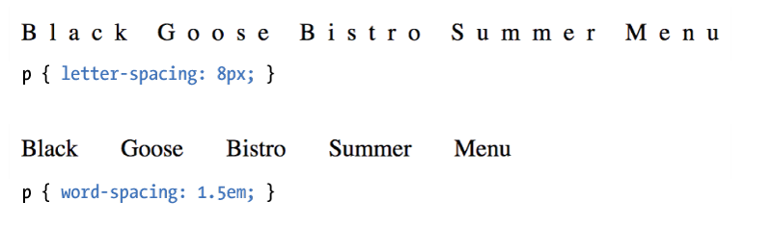
Spacing
letter-spacing
Values: length, normal
word-spacing
Values: length, normal
Examples:

Slide 30
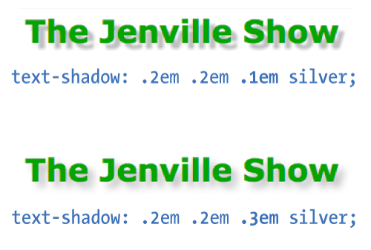
Text Shadow
text-shadow
Values: 'horizontal-offset' 'vertical-offset' 'blur-radius' 'color', none
The value is two offset measurements, an optional blur radius, and a color value (with no commas between).
Example:

Slide 31
List Style Properties
There are three properties for affecting the display of lists:
  list-style-type
  Chooses the type of list marker
  list-style-position
  Sets the position of the marker relative to the list element box
  list-style-image
  Allows you to specify your own image for use as a bullet

Slide 32
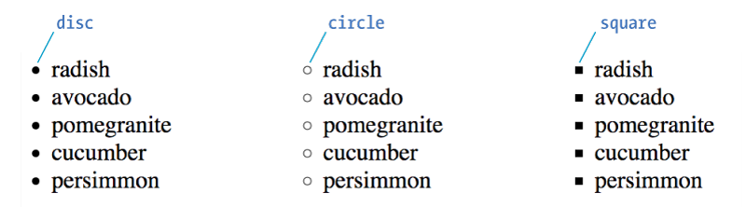
LIST STYLES
Choosing a Marker
list-style-type
Values:
none, disc, circle, square, decimal, decimal-leading-zero, lower-alpha, upper-alpha, lower-latin, upper-latin, lower-roman, upper-roman, lower-greek
Unordered lists: ul { list-style-type: keyword; }

Slide 33
LIST STYLES
Choosing a Marker (cont’d)
Ordered lists: ol { list-style-type: keyword; }
Keyword | System
decimal | 1, 2, 3, 4, 5…
decimal-leading-zero | 01, 02, 03, 04, 05…
lower-alpha | a, b, c, d, e…
upper-alpha | A, B, C, D, E…
lower-latin | a, b, c, d, e… (same as lower-alpha)
upper-latin | A, B, C, D, E… (same as upper-alpha)
lower-roman | i, ii, iii, iv, v…
upper-roman | I, II, III, IV, V…
lower-greek | α, β, γ, δ, ε…

Slide 34
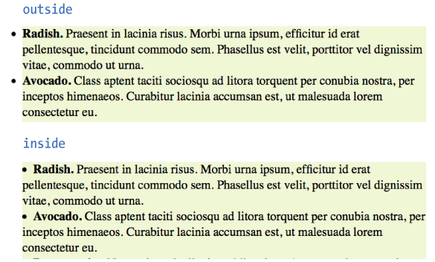
LIST STYLES
Marker Position
list-style-position
Values: inside, outside, hanging
Positions the marker relative to the content area:

Slide 35
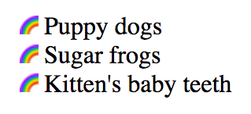
LIST STYLES
Custom Bullets
list-style-image
Values: url(location), none
Example:
    ul {
    list-style-type: disc;
    list-style-image: url(/images/rainbow.gif);
    list-style-position: outside;
    }

Slide 36
More Selector Types
Descendant selectors
ID selectors
Class selectors
Universal selector

Slide 37
Descendant Selectors
A descendant selector targets elements contained in another element.
It’s a kind of contextual selector (it selects based on relationship to another element).
It’s indicated in a list separated by a character space.
ol a {font-weight: bold;}
(only the links (a) in ordered lists (ol) would be bold)
h1 em {color: red;}
(only emphasized text in h1s would be red)

Slide 38
Descendant Selectors (cont’d)
They can appear as part of a grouped selector:
h1 em, h2 em, h3 em {color: red;}
(only emphasized text in h1, h2, and h3 elements)
They can be several layers deep:
ol a em {font-variant: small-caps;}
(only emphasized text in links in ordered lists)

Slide 39
ID Selectors
ID selectors (indicated by a # symbol) target elements based on the value of their ID attributes:
<li id="primary">Primary color t-shirt</li>
To target just that item:
li#primary {color: olive;}
To omit the element name:
#primary {color: olive;}
It can be used as part of a compound or contextual selector:
#intro a { text-decoration: none;}

Slide 40
Class Selectors
Class selectors (indicated by a . symbol) select elements based on the value of their class attributes:
p.special { color: orange;}
(All paragraphs with the class name "special" would be orange.)
To target all element types that share a class name, omit the element name in the selector:
.hilight { background-color: yellow;}
(All elements with the class “hilight” would have a yellow background.)

Slide 41
Universal Selector
The universal element selector (*) matches any element, like a wildcard in programming languages:
* {border: 1px solid gray;}
(puts a 1-pixel gray border around every element in the document)
Can be used as part of contextual selectors:
#intro * {border: 1px solid gray;}
(selects all elements contained within an element with the ID intro)

Slide 42
Specificity Basics
Specificity refers to a system for sorting out which selectors have more weight when resolving style rule conflicts.
More specific selectors have more weight.
In simplified terms, it works like this:
  Inline styles with the style attribute are more specific than (and will override…)
  ID selectors, which are more specific than (and will override…)
  Class selectors, which are more specific than (and will override…)
  Individual element selectors

Slide 43
Calculating Specificity
There is a system used to calculate specificity. Start by drawing three boxes:
[ ] [ ] [ ]
For each style rule:
Count the IDs in the selector and put that number in the first box.
Count the class and pseudo-class selectors and put the number in the second box.
Count the element names and put the number in the third box
[ ID ] [ class ] [ elements ]
The first box that is not a tie determines which selector wins.

Slide 44
Calculating Specificity (cont’d)
Example:
h1 { color: red;} [0] [0] [1]
h1.special { color: lime; } [0] [1] [1]
The second one has a class selector and the first one doesn’t, therefore the second one is more specific and has more weight.
The lime color applies to h1s when they have the class name “special.”

Slide 45
Using Specificity
Use specificity strategically to take advantage of overrides:
p { line-height: 1.2em; } [0] [0] [1]
(sets the line-height for all paragraphs)
blockquote p { line-height: 1em; } [0] [0] [2]
(more specific selector changes line-height when the paragraph is in a blockquote)
p.intro { line-height: 2em; } [0] [1] [1]
(paragraphs with the class “intro” have a line-height of 2em, even when they’re in a blockquote. A class name in the selector has more weight than two element names.)

