Slide 1
11
INTRODUCING CSS

Slide 2
The benefits of CSS
Understanding document structure
Writing style rules
Attaching styles to the HTML document
Inheritance
The cascade
The box model
CSS units of measurement
Developer tools

Slide 3
The Benefits of CSS
Precise type and layout control
Less work: Change look of the whole site with one edit
Accessibility: Markup stays semantic
Flexibility: The same HTML markup can be made to appear in dramatically different ways

Slide 4
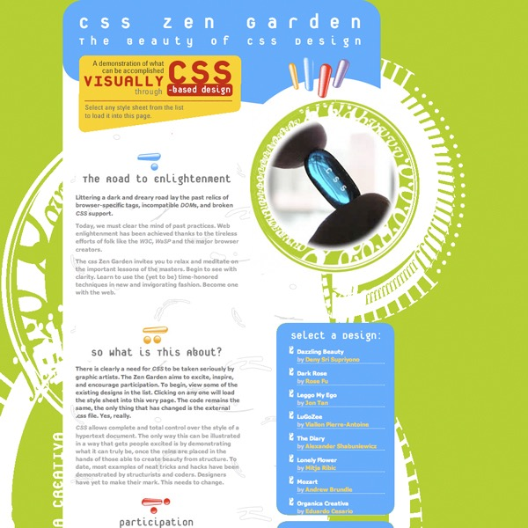
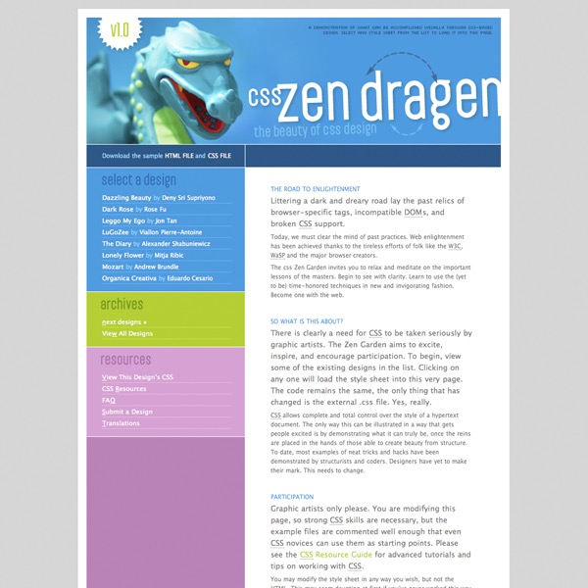
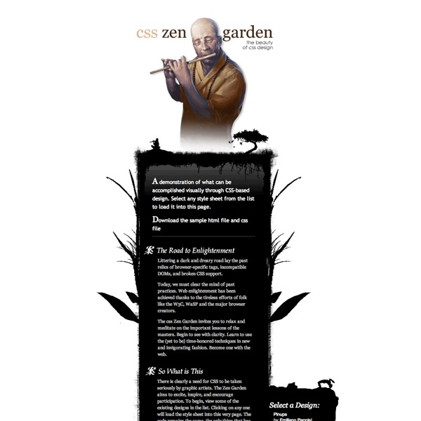
Style Separate from Structure
These pages have the exact same HTML source but different style sheets:
(csszengarden.com)

Slide 5
CSS rendering algorithm
HTML
↓
DOM (Document Object Model)
↓
CSS
↓
Style calculation
↓
Layout
↓
Paint
↓
Compositing
↓
Pixels on screen

Slide 6
Adding Styles to the Document
There are three ways to attach a style sheet to a document:
External style sheets
A separate, text-only .css file associated with the document with the link element or @import rule
Embedded style sheets
Styles are listed in the head of the HTML document in the style element.
Inline styles
Properties and values are added to an individual element with the style attribute.

Slide 7
External Style Sheets
The style rules are saved in a separate text-only .css file and attached via link or @import.
Via link element in HTML:
<head>
<title>Titles are require</title>
<link rel="stylesheet" href="/path/example.css">
</head>
Via @import rule in a style sheet:
<head>
<title>Titles are required</title>
<style>
@import url("/path/example.css");
p {font-face: Verdana;}
</style>
</head>

Slide 8
Embedded Style Sheets
Embedded style sheets are placed in the head of the document via the style element:
      <head>
      <title>Titles are required</title>
      <style>
      /* style rules go here */
      </style>
      </head>

Slide 9
Inline Styles
Apply a style declaration to a single element with the style attribute:
<p style="font-size: large;">Paragraph text...</p>
To add multiple properties, separate them with semicolons:
<h3 style="color: red; margin-top: 30px;">Intro</h3>

Slide 10
Style Rules
Each rule selects an element and declares how it should display.
h1 { color: green; }
This rule selects all h1 elements and declares that they should be green.
strong { color: red; font-style: italic; }
This rule selects all strong inline elements and declares that they should be red and in an italic font.

Slide 11
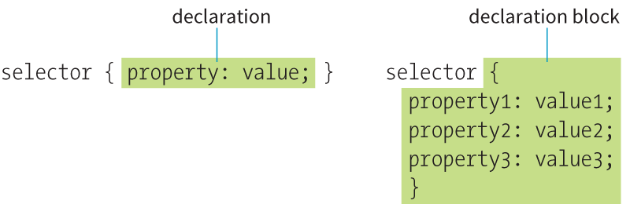
Style Rule Structure
  A style rule is made up of a selector a declaration.
  The declaration is one or more property / value pairs.

Slide 12
Selectors
There are many types of selectors. Here are just two examples:
p {property: value;}
Element type selector: Selects all elements of this type (p) in the document.
#intro {property: value}
ID selector (indicated by the # symbol) selects by ID value. In the example, an element with an id of “intro” would be selected.

Slide 13
Declarations
The declaration is made up of a property/value pair contained in curly brackets { }:
selector { property: value; }
Example
    h2 { color: red;
    font-size: 2em;
    margin-left: 30px;
    opacity: .5;
    }

Slide 14
Declarations (cont’d)
End each declaration with a semicolon to keep it separate from the next declaration.
White space is ignored, so you can stack declarations to make them easier to read.
Properties are defined in the CSS specifications.
Values are dependent on the type of property:
    Measurements
    Keywords
    Color values
    More

Slide 15
CSS Comments
/* comment goes here */
Content between /* and */ will be ignored by the browser.
Useful for leaving notes or section labels in the style sheet.
Can be used within rules to temporarily hide style declarations in the design process.

Slide 16
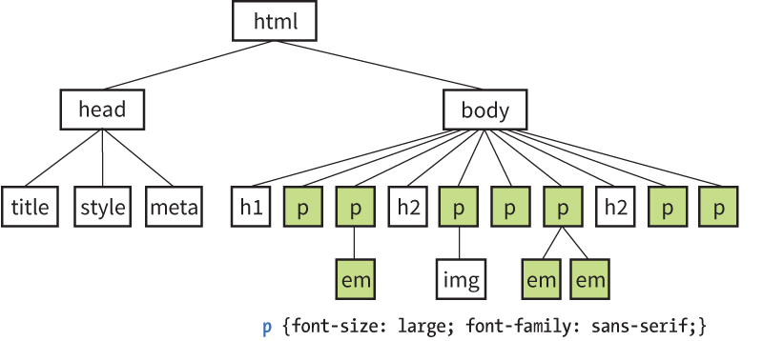
Iheritance
For example, applying a sans-serif font to a p element causes the em element it contains to be sans-serif as well:

Slide 17
The Cascade
The cascade refers to the system for resolving conflicts when several styles apply to the same element.
Style information is passed down (it “cascades” down) until overwritten by a style rule with more weight.
Weight is considered based on:
    Priority of style rule source
    Specificity of the selector
    Rule order

Slide 18
The Cascade: Priority
Style rules from sources higher in this list override rules from sources listed below them.
Any style marked as !important by the user (to accommodate potential accessibility settings)
Any style marked !important by the author (of the web page)
Author styles (style sheets created in web site production)
User styles (added by the reader)
User agent styles (browser defaults)

Slide 19
The Cascade: Specificity
When two rules in a single style sheet conflict, the type of selector is used to determine which rule has more weight.
For example, ID selectors are more specific than general element selectors.
NOTE: Specificity will be discussed once we have covered more selector types.

Slide 20
The Cascade: Rule Order
When two rules have equal weight, rule order is used. Whichever rule appears last “wins.”
      <style>
      p {color: red;}
      p {color: blue;}
      p {color: green;}
      </style>
      In this example, paragraphs would be green.
Styles may come in from external style sheets, embedded style rules, and inline styles. The style rule that gets parsed last (the one closest to the content) will apply.

Slide 21
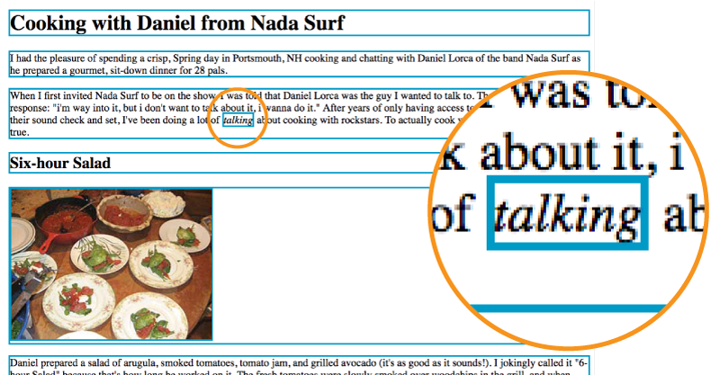
The Box Model
Browsers see every element on the page as being contained in a rectangular box. Block elements and inline elements participate in the box model.
In this example, a blue border is added to all elements.

Slide 22
The Box Model (cont’d)
The box model is the foundation of CSS page layout.
Apply properties such as borders, margins, padding, and backgrounds to element boxes.
Position, move, grow, and shrink boxes to create fixed or flexible page layouts.

Slide 23
CSS Units of Measurement
CSS provides a variety ways to specify measurements:
Absolute units
Have predefined meanings or real-world equivalents
Relative units
Based on the size of something else, such as the default text size or the size of the parent element
Percentages
Calculated relative to another value, such as the size of the parent element

Slide 24
Absolute Units
With the exception of pixels, absolute units are not appropriate for web design:
    px pixel
    in inches
    mm millimeters
    cm centimeters
    q 1/4 millimeter
    pt points (1/72 inch)
    pc pica (1 pica = 12 points = 1/6 inch)

Slide 25
Relative Units
Relative units are based on the size of something else:
    em a unit equal to the current font size
    ex x-height, equal to the height of a lowercase x
    rem root em, equal to the font size of the html element
    ch zero width, equal to the width of a zero (0)
    vw viewport width unit (equal to 1/100 of viewport width)
    vh viewport height unit (1/100 of viewport height)
    vmin viewport minimum unit (value of vh or vw, whichever is smaller)
    vmax viewport maximum unit (value of vh or vw, whichever is larger)

Slide 26
RELATIVE UNITS
The rem Unit
The rem (root em) unit is based on the font size of the html element, whatever that happens to be.
Default in modern browsers: Root font size is 16 pixels, so a rem = a 16-pixel unit.
If the root font size of the document changes, so does the size of a rem (and that’s good for keeping elements proportional).

Slide 27
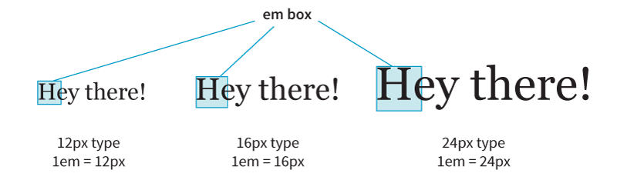
RELATIVE UNITS
The em Unit
The em unit is traditionally based on the width of a capital letter M in the font.
When the font size is 16 pixels,1em = 16 pixels, 2em = 32 pixels, and so on.
NOTE: Because they’re based on the font size of the current element, the size of an em may not be consistent across a page.

Slide 28
RELATIVE UNITS
Viewport Percentage Lengths (vw/vh)
Viewport width (vw) and viewport height (vh) units are relative to the size of the viewport (browser window):
    vh = 1/100th width of viewport
    vh = 1/100th height of viewport
They’re useful for making an element fill the viewport or a specified percentage of it. This image will be 50% the width and height of the viewport:
img { width: 50vw; height: 50vh; }

Slide 29
Browser Developer Tools
Major browsers have built-in tools that aid development:
  HTML, CSS, and JavaScript inspectors
  Network speed reports
  Animation tools
  Other helpful features

Slide 30
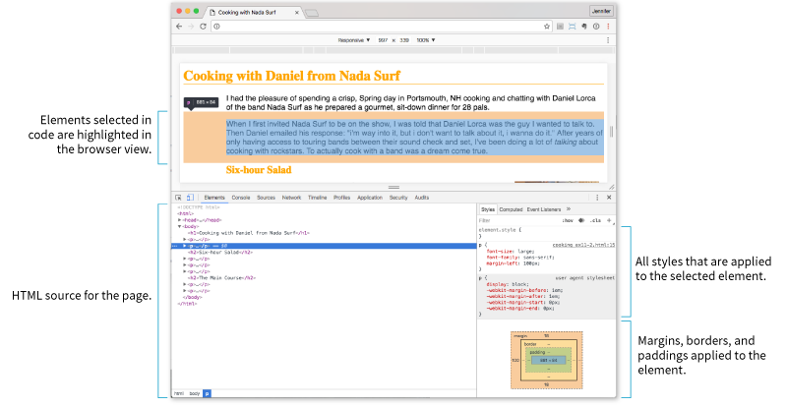
Browser Developer Tools (cont’d)
Chrome DevTools (View > Developer > Developer Tools)
Firefox, Safari, Opera, and Microsoft Edge also have developer tools.

