Slide 1

HTML basic

Slide 2
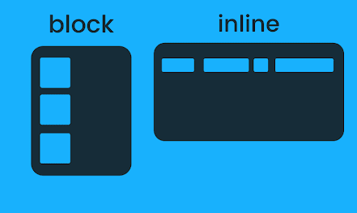
Block level html element
Block-level = defines a larger structure or section (big boxes).
Inline = pieces of text
Structural / grouping
<html>, <body>, <head>
<div>, <section>, <article>, <aside>, <main>, <header>, <footer>, <nav>
Headings & paragraphs
<h1>, <h2>, <h3>, <h4>, <h5>, <h6>
<p>, <div>

Slide 3
Kode til Web
Block
c404
Inline
c406

Slide 4
Web media
Web Image
The image formats most commonly used on websites are
JPG/JPEG: Any program that opens .jpg can also open .jpeg.
GIF: Graphics Interchange Format
PNG: Portable Network Graphic
SVG: Scalable Vector Graphic

Slide 5
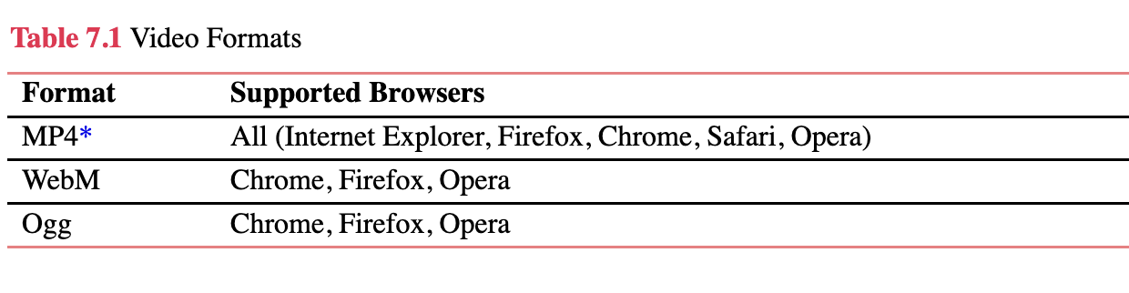
Video formats

Slide 6
Hands On Exercise:
Your startup project folder
Download from –MS teams->

